Slide 1
Anaerobic Wastewater Treatment
Ge Gao, Maithili Gokarn, Walker Grimshaw, Caitlin Rose McKinley, Liankun Zhu

Slide 2
Review
Anaerobic Wastewater Treatment
Absence of oxygen
Low cost
Energy Neutral or Energy Positive
Low production of waste biological sludge

Slide 3
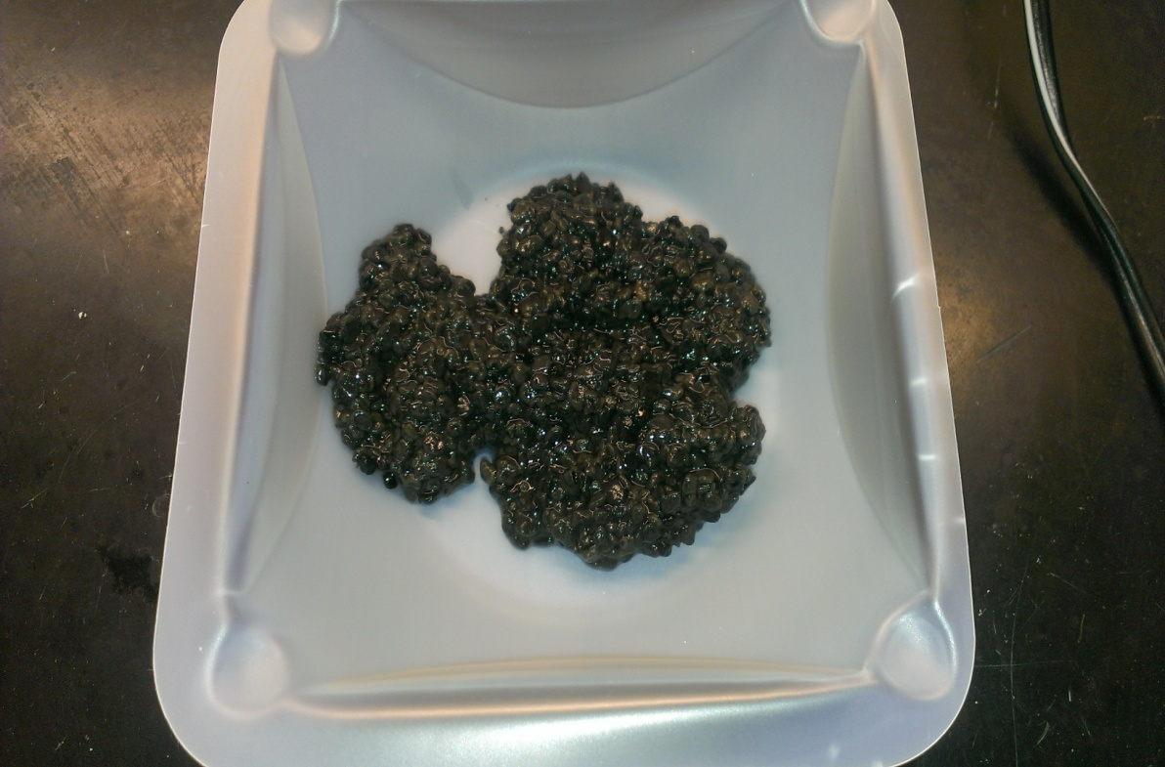
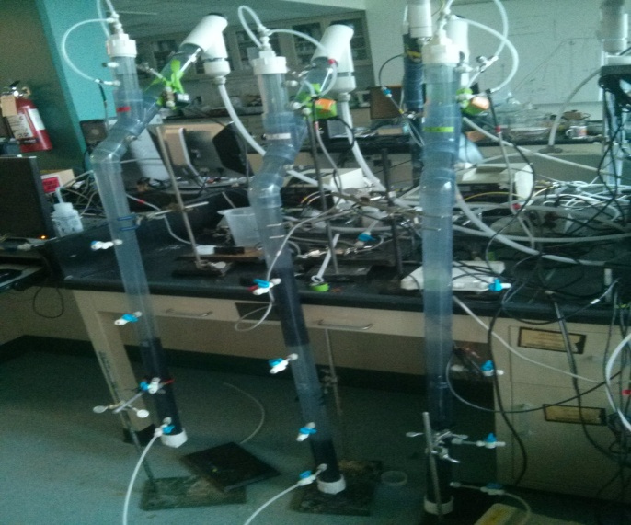
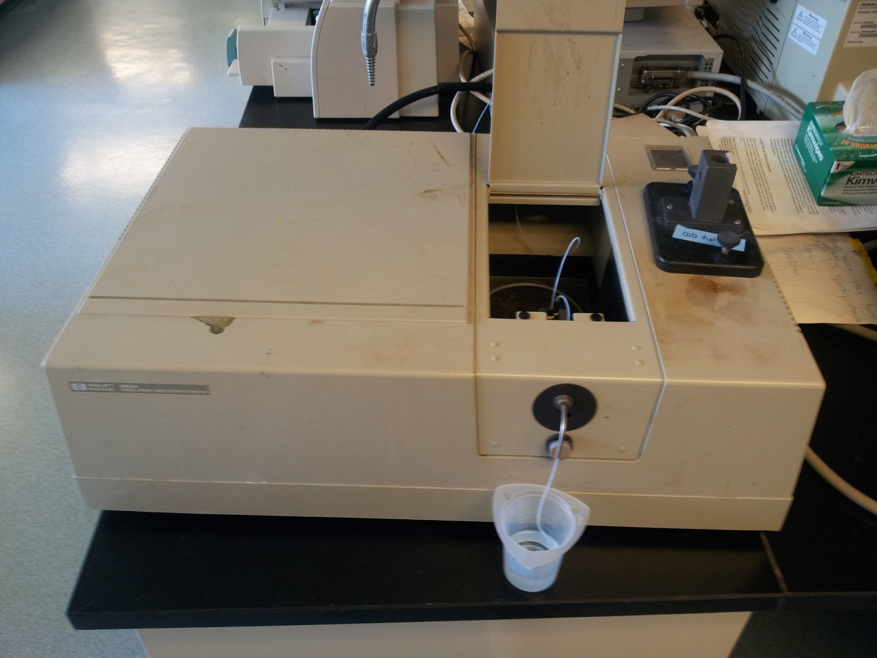
Review
Testing the model developed
Reactor Operation
Three reactors without media ( UASB)
Three reactors with media( AFBR).
Data Collection and Analysis

Slide 4
Data Analysis –Results from past two weeks
Reactor 2.4 ,2.5 and 2.6. (UASB)
Inoculated on November 22,2013
Reactor 2.1,2.2,2.3 (AFBR)
Inoculated on December 6,2013 –insufficient data to conduct analysis

Slide 5
Data Analysis –Results from past two weeks
COD Removal
Biogas Production
Methane Production
Sand Fluidization
Dissolved Methane
Microscopy

Slide 6
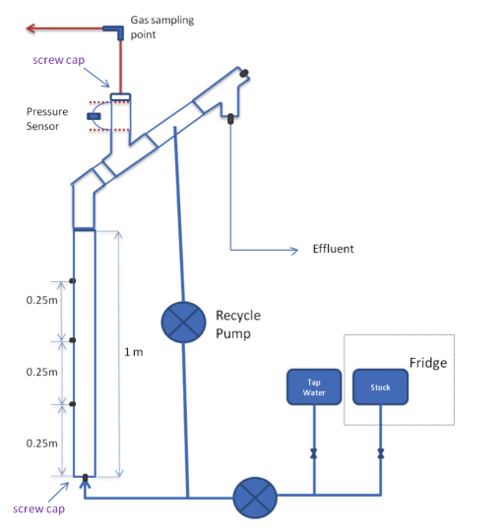
Biogas Production
Pressure sensor connected to process controller ,records pressure within gas chamber .
Pressure measured is recorded on Microsoft Excel every 30 seconds .
Pressure is recorded in terms of height of water (cm).

Slide 7
Biogas Production
Graph of the pressure data recorded for Reactor 2.4 on December 6,2013

Slide 8
Biogas Production
Reactor 2.4 Reactor 2.6
Reactor 2.4
Date | Pressure(cm) | Cross sectional area of gas chamber(cm²) | Volume of biogas collected(cm³)
11/22/2013 | - | 11.40
11/23/2013 | 4.18 |  | 47.63
11/26/2013 | 4.68 |  | 53.33
11/27/2013 | 16.9 |  | 192.58
11/28/2013 | 11.69 |  | 133.21
11/29/2013 | 5.32 |  | 60.62
11/30/2013 | 20.27 |  | 230.98
12/1/2013 | 2.37 |  | 27.01
12/2/2013 | 20.43 |  | 232.80
12/3/2013 | 25.56 |  | 291.26
12/4/2013 | 29.16 |  | 332.28
12/5/2013 | 38.84 |  | 442.59
12/6/2013 | 42.56 |  | 484.98
12/7/2013 | 15.95 |  | 181.75
12/8/2013 | 21.26 |  | 242.26
12/9/2013 | 13 |  | 148.14
12/10/2013 | 14.75 |  | 168.08
Total volume of biogas collected |  |  | 3269.49
Reactor 2.6
Date | Pressure (cm) | Cross sectional area of gas chamber(cm²) | Volume of gas collected(cm³)
11/22/2013 | 4.63 | 11.40 | 52.76
11/23/2013 | 1.82 |  | 20.74
11/26/2013 | 4.32 |  | 49.23
11/27/2013 | 18.69 |  | 212.98
11/28/2013 | 12 |  | 136.74
11/29/2013 | 6.67 |  | 76.01
11/30/2013 | 27.92 |  | 318.15
12/1/2013 | 3.58 |  | 40.79
12/2/2013 | 22.05 |  | 251.26
12/3/2013 | 31.93 |  | 363.85
12/4/2013 | 34.7 |  | 395.41
12/5/2013 | 52.04 |  | 593.00
12/6/2013 | 57.41 |  | 654.19
12/7/2013 | 25.77 |  | 293.65
12/8/2013 | 33.91 |  | 386.41
12/9/2013 | 12.11 |  | 138.00
12/10/2013 | 14.42 |  | 164.32
Total volume of biogas collected |  |  | 4147.49

Slide 9
Biogas Production

Slide 10
Biogas Production

Slide 11

Biogas Production
Reactor 2.5
Not air tight
Clogging of granules
Erratic data and graph
No conclusion from data

Slide 12
Biogas Production
Graph of the pressure data recorded for Reactor 2.5 on December 6,2013

Slide 13
Biogas Production
Conclusions
Reactor 2.6 has produced most amount of biogas
Similarity in the graphs of reactor 2.4 and 2.6 could be because they share same influent line .
More data required to reach solid conclusion and understand trend .

Slide 14
Results from the past two weeks
Methane Production data from UASB reactors (2.4, 2.5, and 2.6)
Inoculated on November 22
Standard Curve for methane

Slide 15
Methane Production

Slide 16
Methane Production Deliverables
Difficult to classify methane trends, but 2.4 and 2.6 (the most stable reactors) have negative trends
Instabilities may be due to outside influences
  Extraction methods
  Time of day of sampling

Slide 17
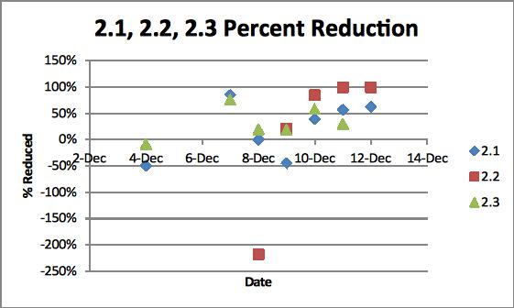
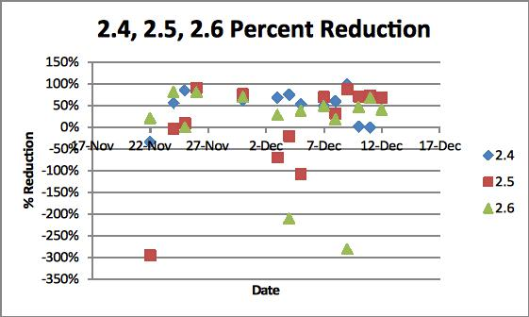
Results from the past two weeks
COD Removal

Slide 18
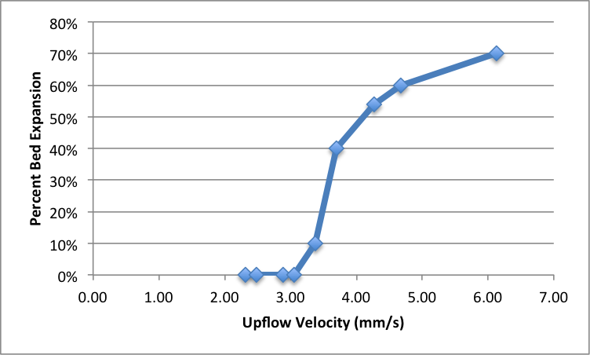
Results from the past two weeks
Fluidization Velocity Test 1----0.15 mm Sand

Slide 19
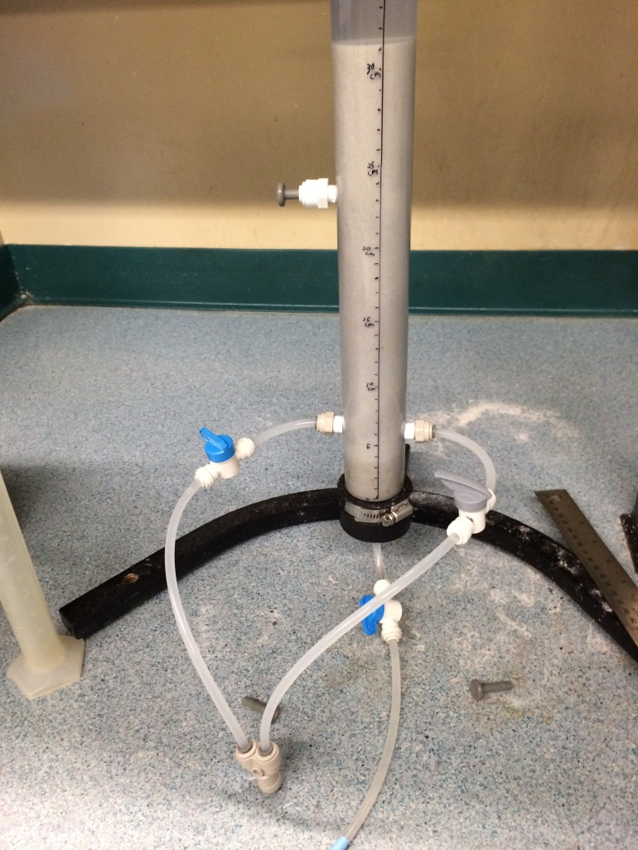
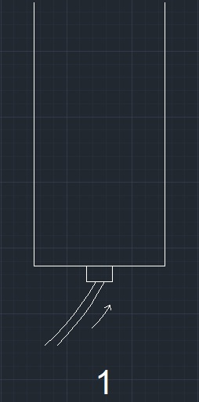
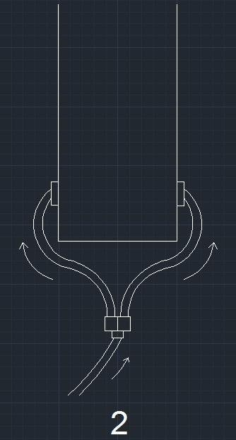
Results from the past two weeks
Fluidization Velocity Test 2----Quartz Powder
Two inlet geometries

Slide 20
Results from the past two weeks
Fluidization Velocity Test 2----Quartz Powder
Flow Rate (mL/min) | Upflow Velocity (mm/s) | Percent Bed Expansion (%)
20 | 0.292 | 2.40%
25 | 0.365 | 7.20%
30 | 0.439 | 10%
35 | 0.512 | 14%
40 | 0.585 | 16.80%
45 | 0.658 | 19.20%
50 | 0.731 | 20.40%
55 | 0.804 | 22.80%
60 | 0.877 | 25.20%
65 | 0.95 | 28%
70 | 1.023 | 30.40%
75 | 1.096 | 31.60%
80 | 1.169 | 32.80%

Slide 21
Results from the past two weeks
Fluidization Velocity Test 2----Quartz Powder
Flow Rate (mL/min) | Upflow Velocity (mm/s) | Percent Bed Expansion( %)
20 | 0.292 | 1.50%
25 | 0.365 | 6%
30 | 0.439 | 8%
35 | 0.512 | 9.50%
40 | 0.585 | 10%
45 | 0.658 | 10.50%
50 | 0.731 | 11.50%
55 | 0.804 | 13%
60 | 0.877 | 14%
65 | 0.95 | 14.50%
70 | 1.023 | 15%
75 | 1.096 | 15.50%
80 | 1.169 | 16%

Slide 22
Results from the past two weeks
Where is the methane going?
  Previous research has indicated high dissolved methane concentrations in effluent…

Slide 23
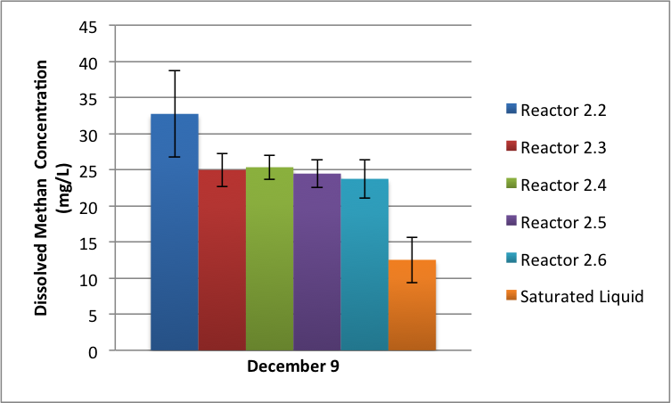
Dissolved Methane

Slide 24
Granule Characterization
Confocal Microscopy - The Biotechnology Resource Center Imaging Facility, Cornell University
  Layered microscopy

Slide 25
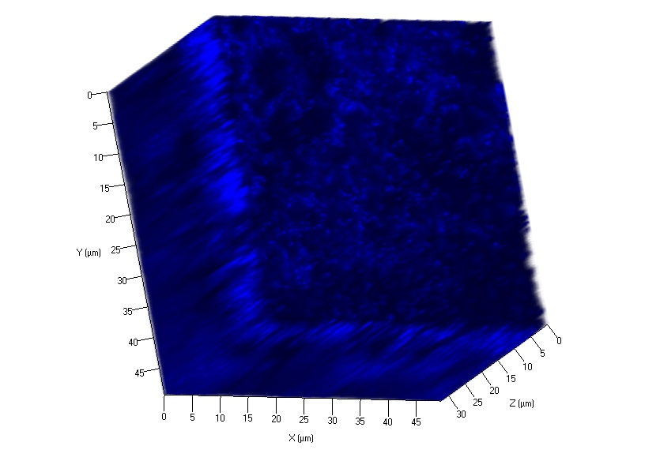
DAPI (DNA stain)

Slide 26
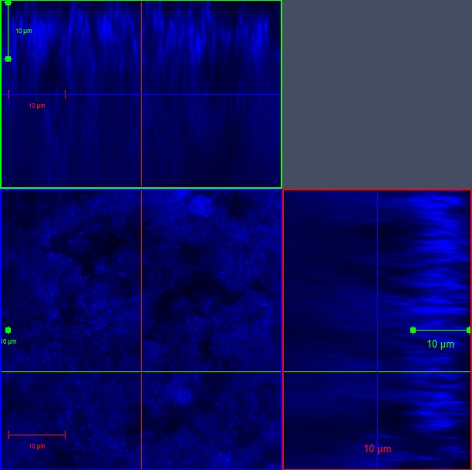
DAPI (DNA Stain)

Slide 27
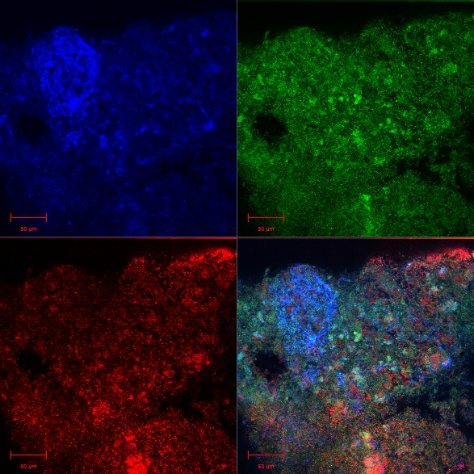
Acradine Orange (Nucleic Acid Stain) and Autofluorescence

Slide 28
Future Directions
Plans to keep anaerobes alive over the break
Moving to a temperature controlled room in January

Slide 29
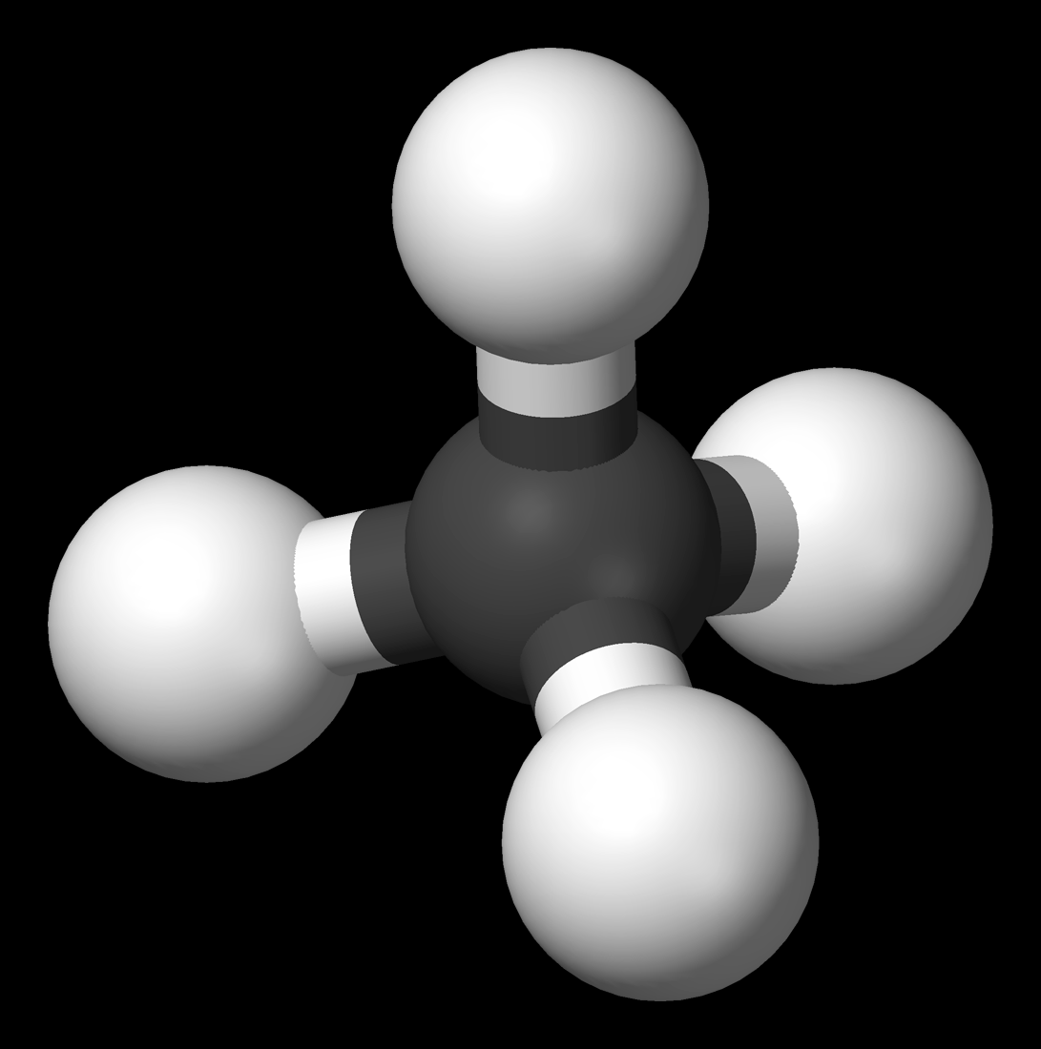
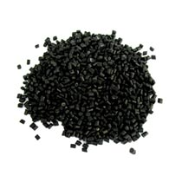
Future Directions
Get Methane from liquid to gas phase
Prevent Clogging in AFBRs
Prevent Granule Breakup in UASBs

Slide 30
Future Directions
Improve biomass adhesion to support material in AFBRs
  Want to wash out non-adhered biomass
Steady State Operation

