Slide 1
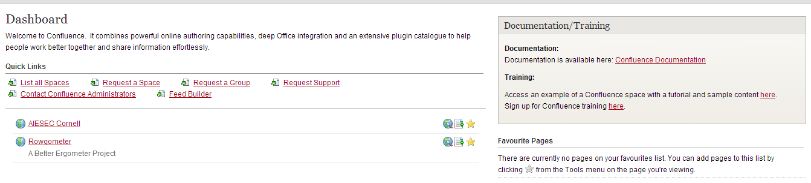
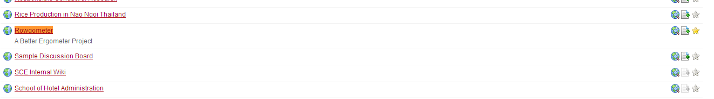
Adding Spaces to your Favorites for easier accessibility
After logging in, click “List all Spaces”
CTRL+F “Rowgometer”
Click on the star to add it to your favorites
After adding the space to your favorites, it will show up when you log into your dashboard. This way, you won’t have to search each time.

Slide 2
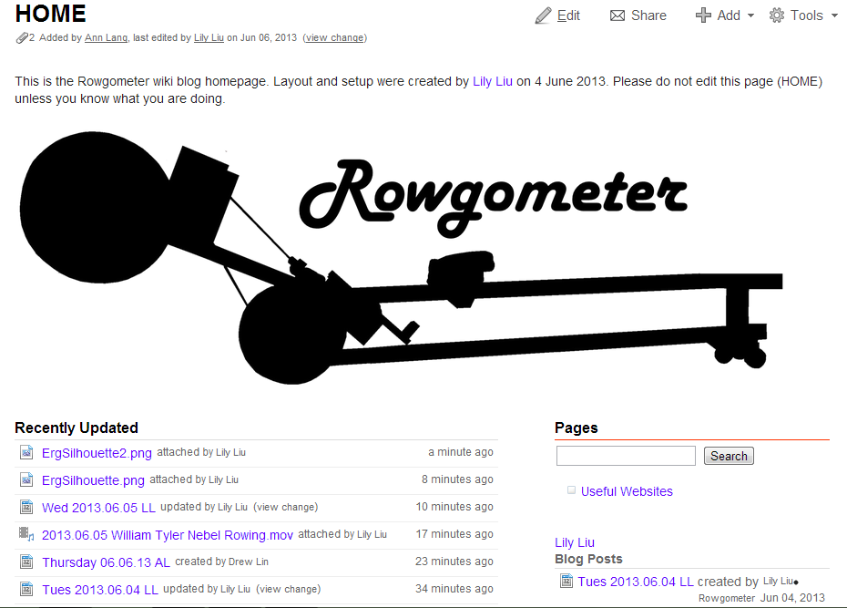
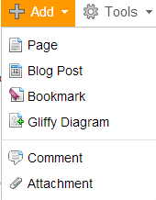
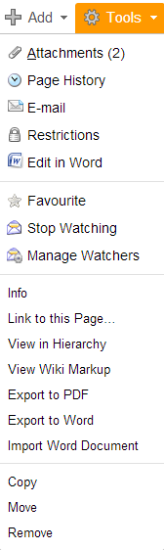
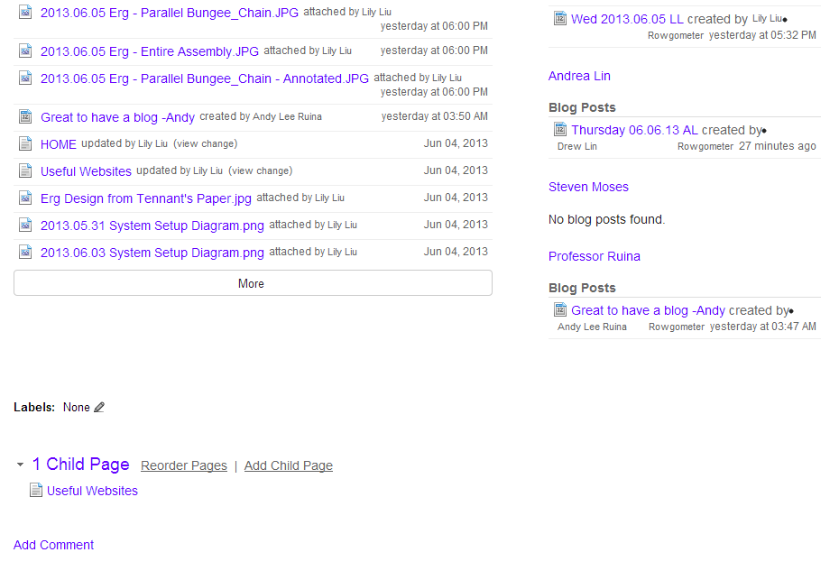
See all attachments on page
Page = general info for everyone
Blog post = individual account of day’s activities
Gliffy creates vector drawings and diagrams
Page properties
Search bar
See recent activity (like newsfeed)
A list of all pages created
List of blog posts by each person, separated by author
Labels = tags, to organize info by topic
A child page is a subpage, like bullets in an outline hierarchy.
Page
  Child Page
  Child Page
Page
Etc…
PARTS OF THE HOMEPAGE
https://confluence.cornell.edu/display/Rowgometer/HOME

Slide 3
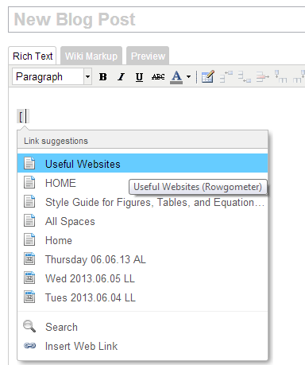
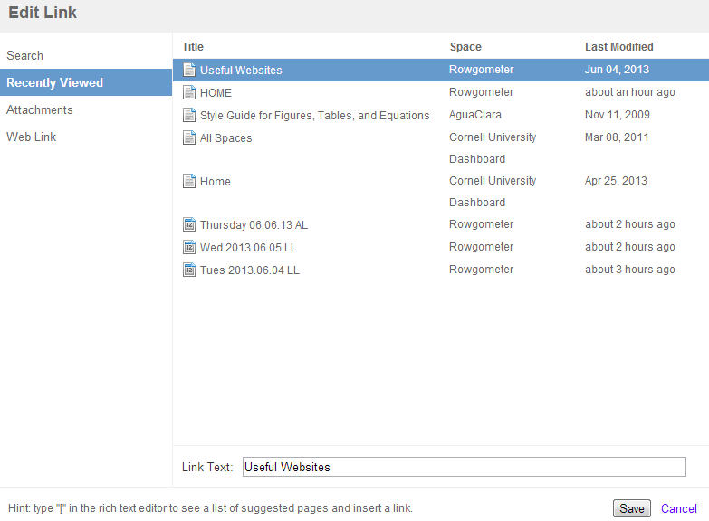

Type [ to begin to insert a link.
After clicking “edit link,” this pops up. Click through to find the link you want.
This is the text displayed on the page, associated with the link
Inserting Links
Also see http://www.it.cornell.edu/services/confluence/howto/link.cfm
After a link has already been formed, right click it and click “Edit Link Location” to change the displayed text on the post or where the link links to.

Slide 4
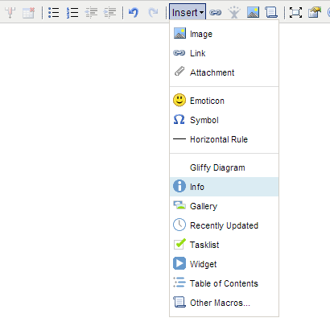
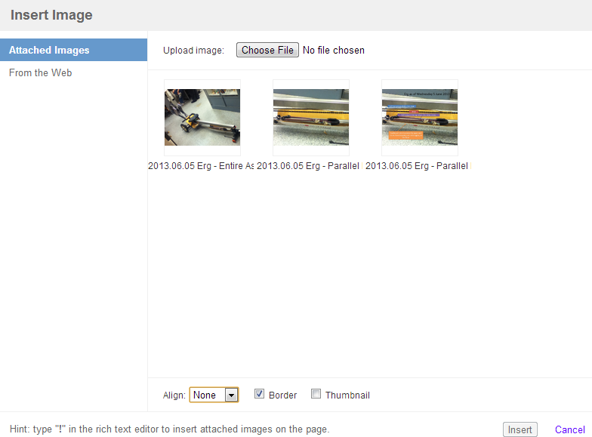
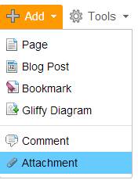
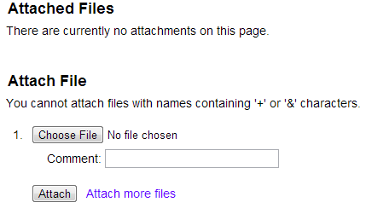
You can only link to an item (picture, document) after it’s already been attached. Items are attached after you publish a page or post (click save). Thus, you’ll can go back to edit the page after attaching the items, or first attach the item.
After items have been attached, all attachments associated with the page will be displayed for selection.
“Widget” is the macro used to insert web videos. For Youtube videos, you have to use the long url found on the top of the browser, rather than the short url listed under “share.”
On the page that you want to attach the item, click ADD > Attachment to upload the attachment. Then, choose the file from your computer.
Inserting Images and Attachment Items

Slide 5
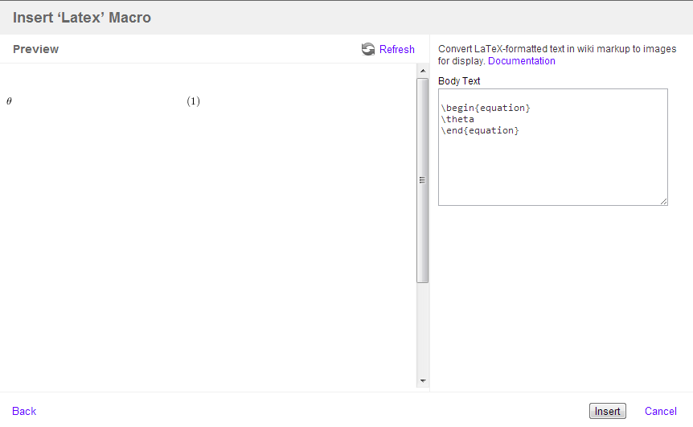
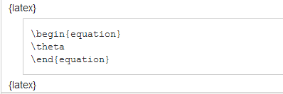

Type {latex and select the Latex module
This will pop up.
Use LaTeX syntax, with \begin and \end
Click Insert.
Something like this will be entered into the Rich Text Editor. Click the “Preview” tab to preview the results before publishing.
Inserting equations and math symbols
using LaTeX syntax and Latex macro

