Slide 1
Flocculator Design Detail
Spring 2013 AguaClara
Kelly Huang

Slide 2
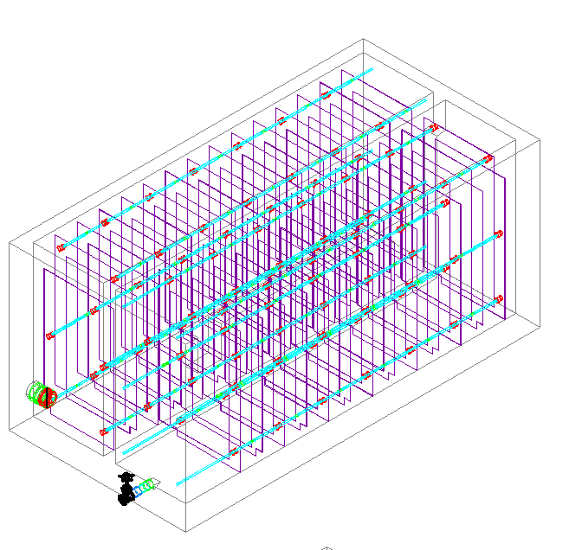
Flocculation Tank

Slide 3
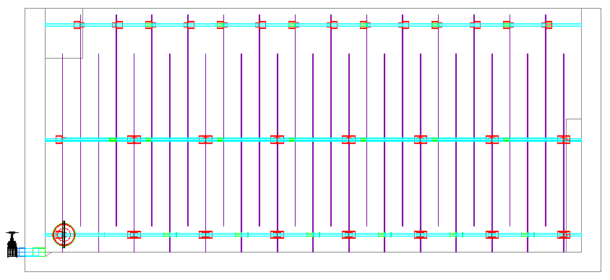
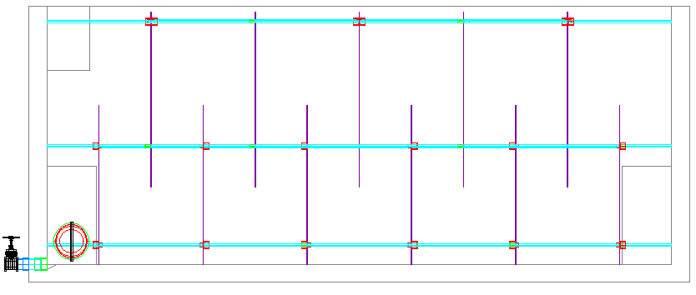
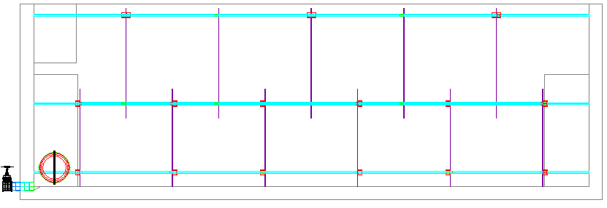
Side Views of Flocculation Tanks
6 Lps
25Lps
50Lps
Notes:
- Not neccesary at lower flowrates, but adding it to al of designs

Slide 4
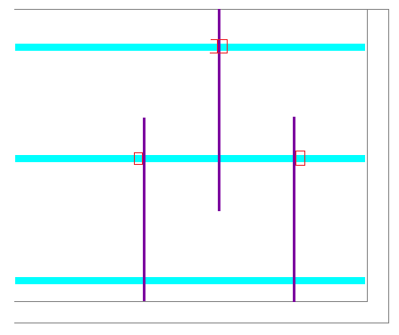
Pseudo Code

Slide 5
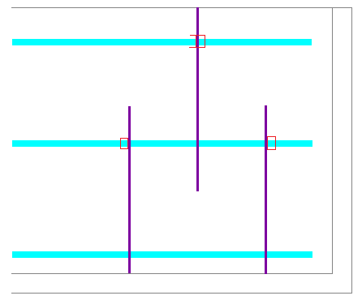

Slide 6
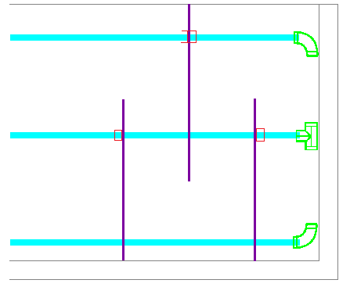

Slide 7
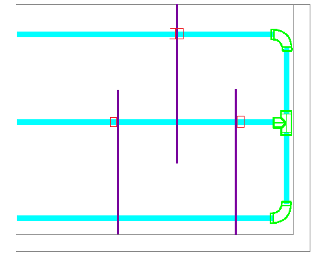

Slide 8
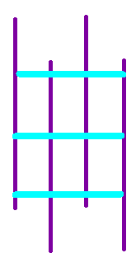
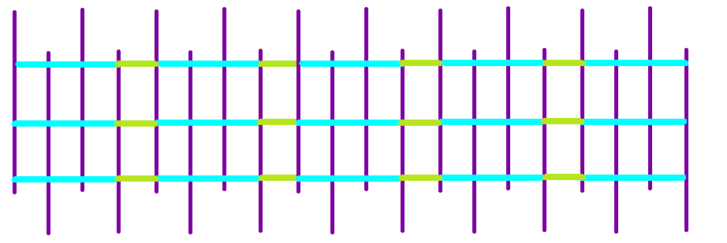
Placement of Code
Modules
Array of Modules in a channel

Slide 9
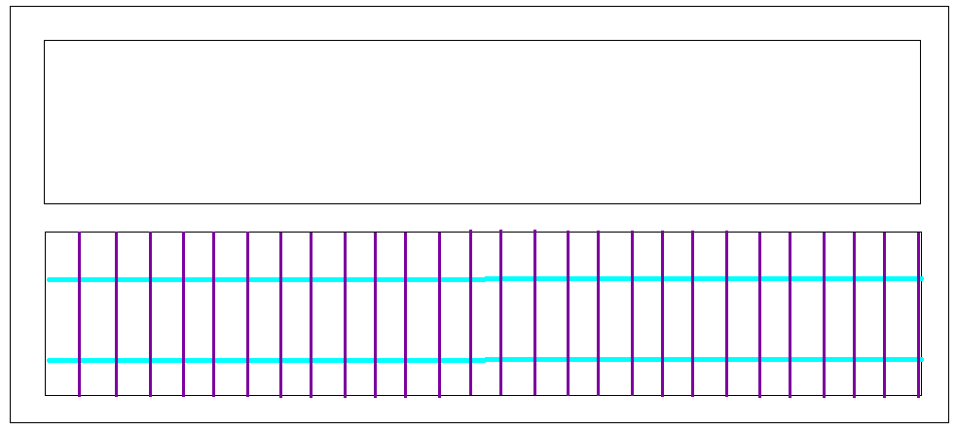
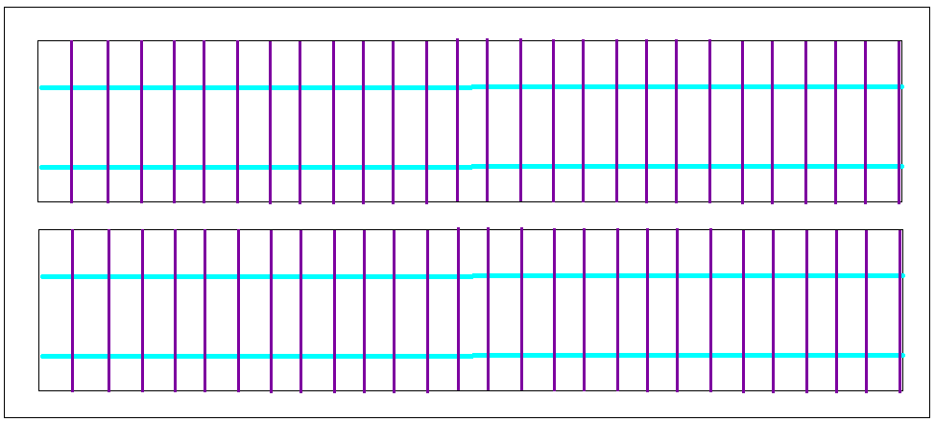
Array of channels

Slide 10
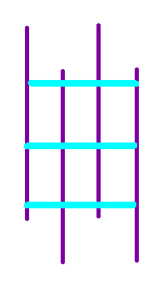
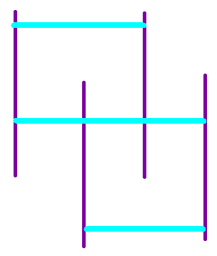
Considerations
Different Cases depending on flow rate
  Overlapping modules Non-Overlapping modules
Notes:
- *in code, both cases

Slide 11
Accomplishments
Become familiar with Mathcad and AutoCAD
Read flocculation tank report from spring 2011 that detailed module piping and caps/couplings
Waded through flocculation tank code
  Idea of origins, drawing order
  “Module Piping” which draws one column of pipes
Asked May to explain how modules work

