Slide 1

FREEDOM OF INFORMATION ACT
5 U.S.C. §552

Slide 2
WHAT’S AVAILABLE?
Executive Branch Materials
  Agencies
  Military
  Government Corporations i.e. - FDIC

Slide 3
EXEMPTIONS
5 U.S.C. §552 (b)
Classified documents
Internal agency personnel rules and practices
Personnel and medical files
Inter/Intra agency communications considered “privileged” for litigation purposes
Records compiled for law enforcement (in certain circumstances

Slide 4
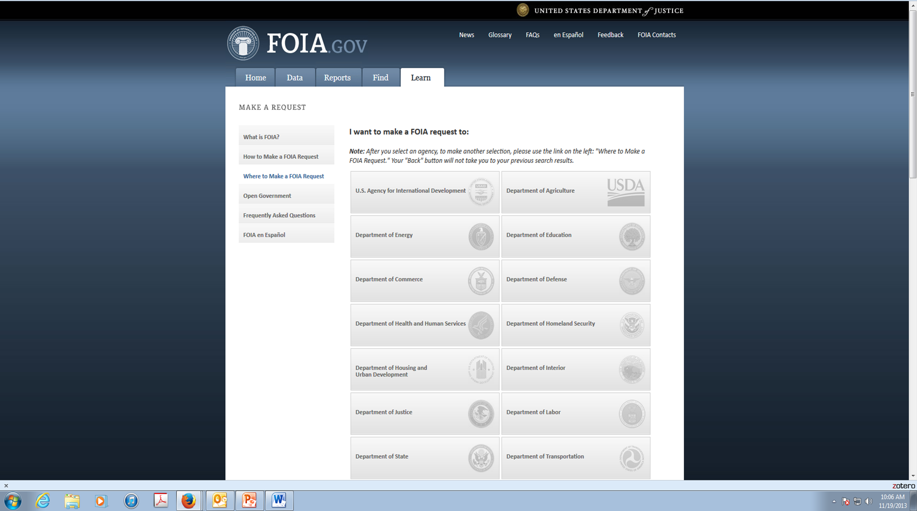
WHERE TO SUBMIT

Slide 5
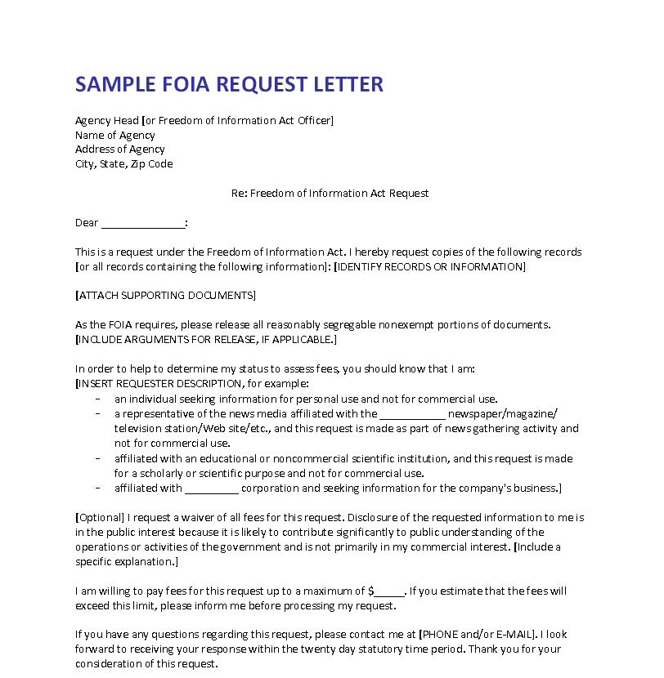
WHAT TO INCLUDE

Slide 6
AGENCY RESPONSE
20 working days
  Except for in “unusual circumstances”
Expedited review request
  10 days to grant or deny
If DENIED:
  Agency must tell the reason for denial and notify you the right to make an appeal

