Slide 1
Case Law Research

Slide 2
Three Branches of Government
Legislative
(Congress, Legislature)
Judicial
(Courts)
Executive
(President, Governor)
Statutes (Legislation)
Cases
(Opinions, Decisions)
Regulations (rules) and Administrative Decisions

Slide 3
What areas of law do statutes and cases cover?
Both statutes
and cases
Statutes
Cases

Slide 4
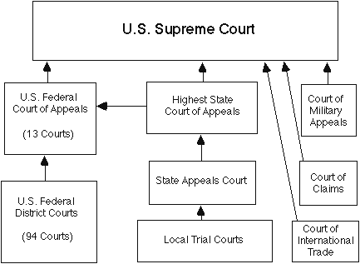
Court Structure

Slide 5
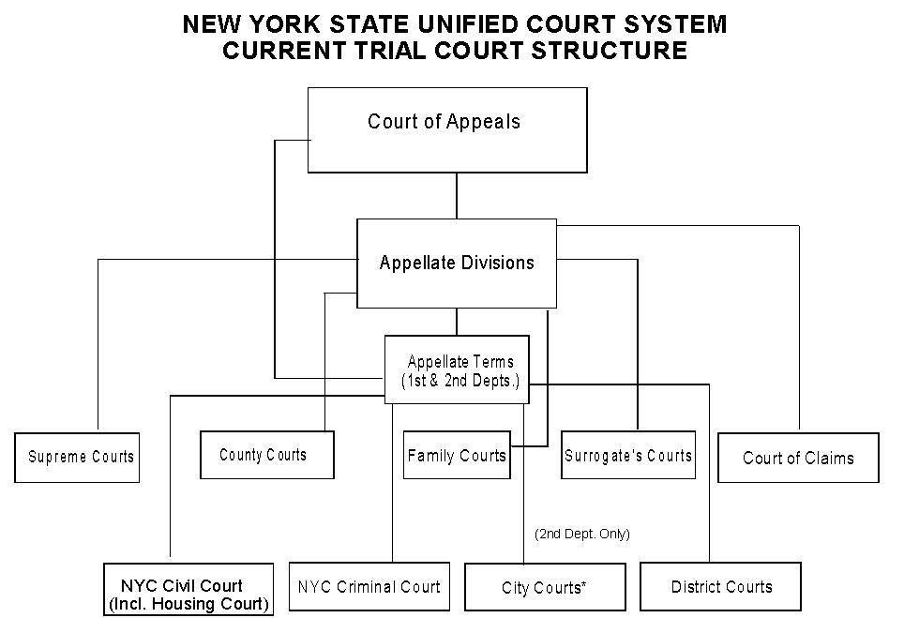
New York State Courts

Slide 6
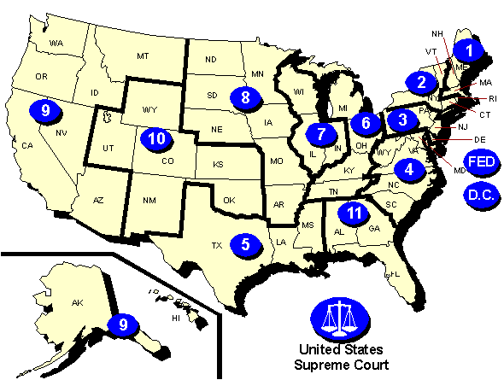
U.S. Circuit Court Regions
From http://www.justice.gov/usao/eousa/kidspage/circuit.html

Slide 7
Reading a case citation
Torrech-Hernandez v. General Elec. Co.,
519 F.3d 41 (1st Cir. 2008)
Case Name
Year of Decision
Volume
Page
Court
Reporter

Slide 8
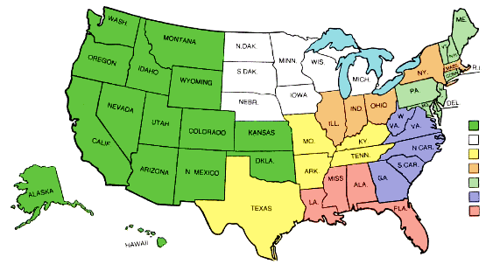
National Reporter System Map

Slide 9
Sample Citations
Marbury v. Madison, 5 U.S. (1 Cranch) 137 (1803)
Meritor Sav. Bank v. Vinson, 477 U.S. 57, 60, 106 S. Ct. 2399, 91 L. Ed. 2d 49 (1986)
Stambovsky v. Ackley, 169 A.D.2d 254, 572 N.Y.S.2d 672 (1990)
Smith v. State, 199 P.3d 1052 (Wyo. 2009)
Marsh v. Millward, 381 S.W.2d 110 (Tex. Civ. App. 1964)

Slide 10
Stare decisis and precedent
Stare decisis: “The doctrine of precedent, under which it is necessary for a court to follow earlier judicial decisions when the same points arise again in litigation.” – Black’s Law Dictionary 1414 (7th ed. 1999)
Precedent: “A decided case that furnishes a basis for determining later cases involving similar facts or issues.” -- Black’s Law Dictionary 1195 (7th ed. 1999)

Slide 11
Is it binding?
The rulings of a court are binding (or mandatory) only on courts under its jurisdiction and on itself.
US Supreme Court decisions are mandatory for all federal courts, and for all state courts on matters of federal law.

Slide 12
Unpublished Opinions
Generally, only opinions designated by the court as “for publication” are “published.” Published decisions are precedent.
Unpublished decisions are usually not precedent.
  Exceptions: Federal appellate court opinions issued on or after January 1, 2007, and as stated in court rules.
Unpublished decisions are nonetheless widely available online. Many are also published in the Federal Appendix.

Slide 13
Sample Case
Costanza v. Seinfeld, 279 A.D.2d 255, 719 N.Y.S.2d 29 (2001)

