Slide 1

MAE 3272: Computational Modeling of Bicycle Crank using ANSYS®
Rajesh Bhaskaran
Cornell University

Slide 2
My Co-ordinates
Dr. Rajesh Bhaskaran
Swanson Director of Engineering Simulation
Mechanical & Aerospace Engineering
E-mail: bhaskaran at cornell dot edu
Office: 102 Rhodes Hall
Office hours (held in Swanson Lab, 163 Rhodes):
  M 1-2 pm, T 1:30-2:30 pm, F 3:30-4:30 pm
  Come for help with ANSYS

Slide 3
Computer Labs with ANSYS
B7 Upson
318 Phillips
ACCEL lab (Carpenter Hall)
Swanson Lab (163 Rhodes)

Slide 4
Swanson Lab (163 Rhodes)
16 Dell T5500 workstations
  2 quad-core Intel Xeon processors
  30 GB of RAM
  Extensive software suite
Suitable for large finite-element models
(> ~200k elements)
All MAE3272 students should have access
  E-mail me if you are having access problems
Notes:
Resource available to MAE students for advanced FEA and CFD

Slide 5
Student Version of ANSYS (including Mechanical & FLUENT)
$25 for one-year license
Provides access to FEA, CFD and rigid-body dynamics capabilities
E-mail me for purchase instructions

Slide 6
ANSYS Node Limits
 | Node limit for ANSYS Mechanical
Student version | 32k
Version in computer labs | 256k
Research version | No limit
Get solution error when you exceed the node limit

Slide 7
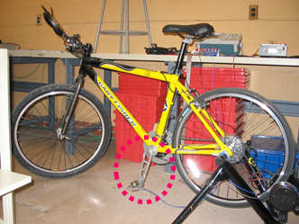
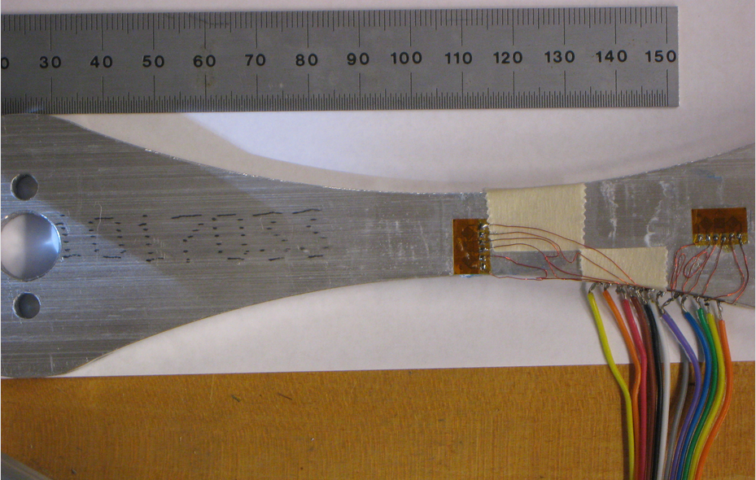
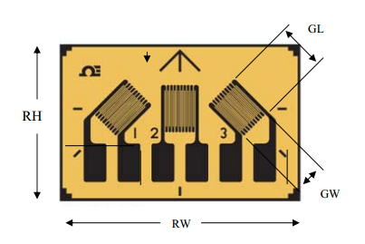
Crank Arm Experiment
Strain Gage Rosette

Slide 8
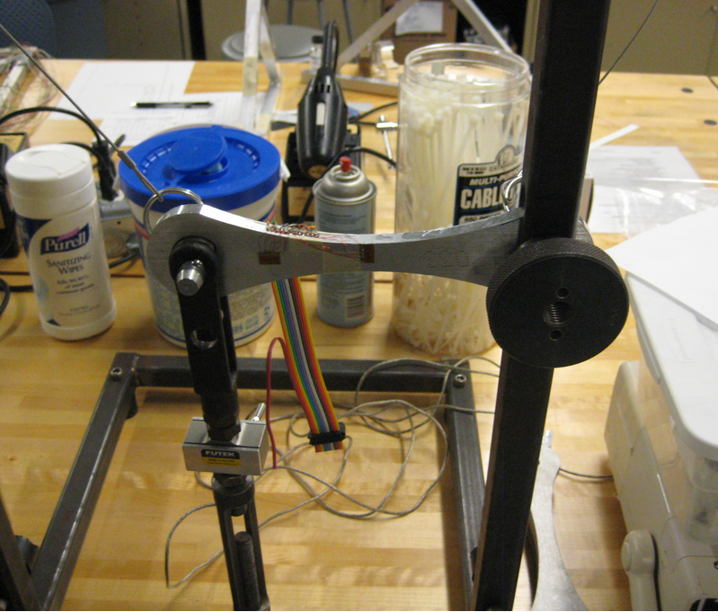

Testing Procedure
Static Test
Dynamic Test

Slide 9
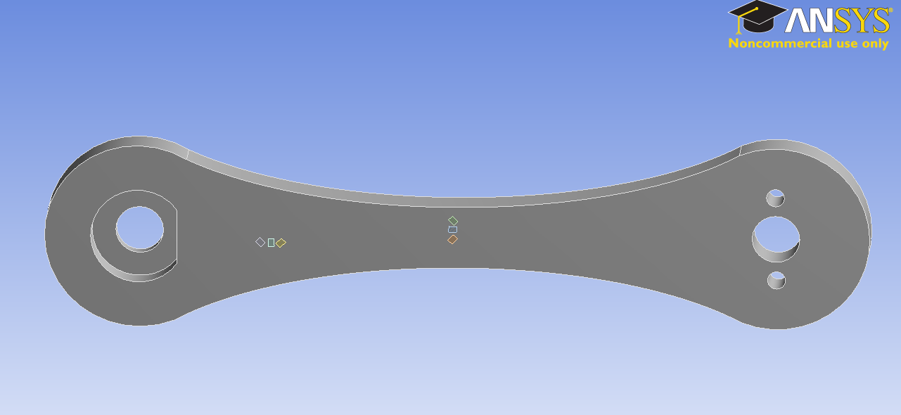
Static Test
Experimental Set-up
ANSYS Model
Strain Gage Rosette

Slide 10
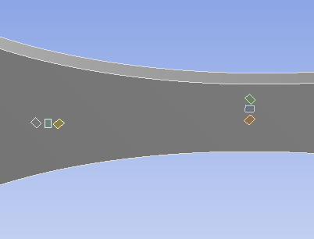
Close-Up View of Sample Rosette Locations
Physical Model
ANSYS Model

Slide 11
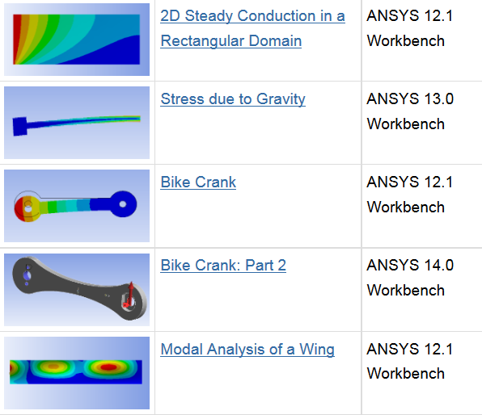
Tutorials on ANSYS Modeling Procedure
Google “cornell ansys”
URL: https://confluence.cornell.edu/x/uhPpB
Part 2 has resources related to adding strain gages to the crank model
  Will be updated to address questions that y’all have

Slide 12
ANSYS Modeling Procedure for Static Test Case
Back-of-the-envelope estimates using beam theory
Import CAD geometry
Mesh, Setup Physics and Solve
Check results
Add gauges to CAD geometry
Calculate strain values for gauges
Compare with measured values
Covered in MAE 3250

Slide 13
ANSYS Modeling Procedure for Static Test Case
Back-of-the-envelope estimates using beam theory
Import CAD geometry
Mesh, Setup Physics and Solve
Check results
Add gauges to CAD geometry
Calculate strain values for gauges
Compare with measured values

Slide 14
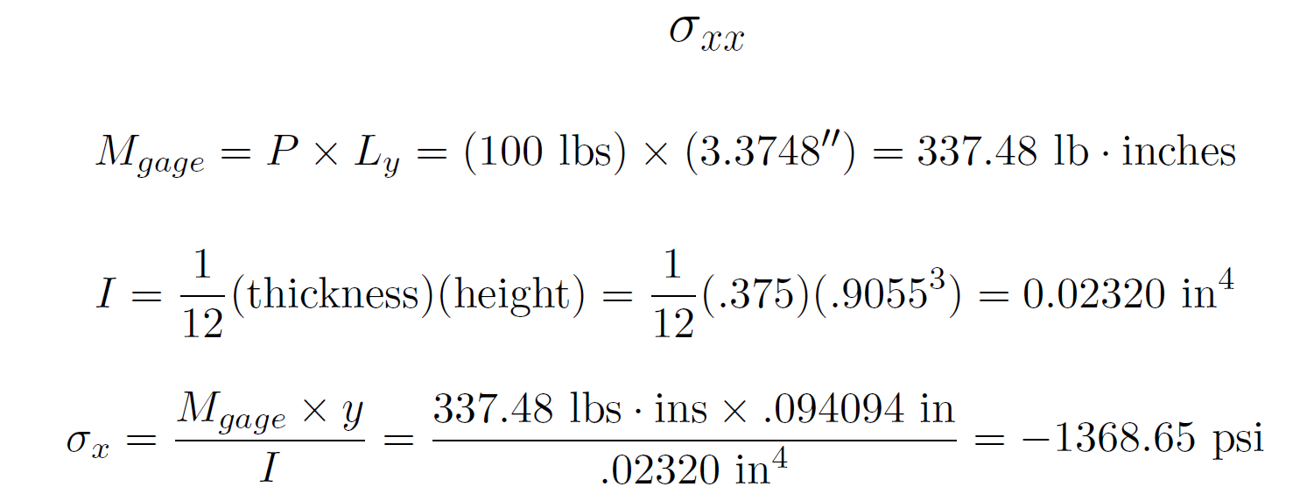
Back-of-the-Envelope Estimates
Use Euler-Bernoulli beam theory
  See Pre-Analysis step in the tutorial

Slide 15
ANSYS Modeling Procedure for Static Test Case
Back-of-the-envelope estimates using beam theory
Import CAD geometry
Mesh, Setup Physics and Solve
Check results
Add gauges to CAD geometry
Calculate strain values for gauges
Compare with measured values
Will focus on these steps

Slide 16
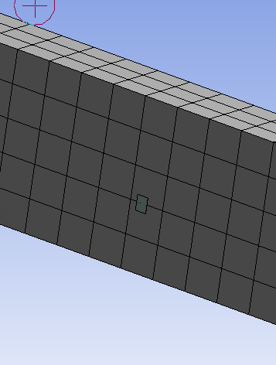
Strain Gage Modeling in ANSYS
Extract average strain over the area covered by strain gage
Create a surface element for each strain gage
  Shell element: shell181
  Use for strain/stress evaluation only
    Gage nodal displacements are calculated from underlying crank displacements
      Not from stiffness matrix inversion
      Stiffness of gage is ignored

Slide 17
Strain Gage Modeling: Procedure
Create surface on crank face
  Plane > Sketch > Surface from sketch
Bond surface to crank face
Mesh surface with one shell181 element
  Insert Commands
  Use for strain/stress evaluation only
Solve and view results
  Use local element coordinate system to get strain component along gage length

Slide 18
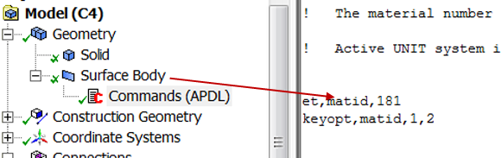
Strain Gage Modeling: Commands
See help for shell181 for more info
et: set “element type”
et, matid, 181: set element type to 181 (i.e. shell181)
keyopt: set “keyoption” to control element behavior
keyopt, matid, 1, 2: set keyoption #1 to 2 (strain/stress evaluation only)

Slide 19
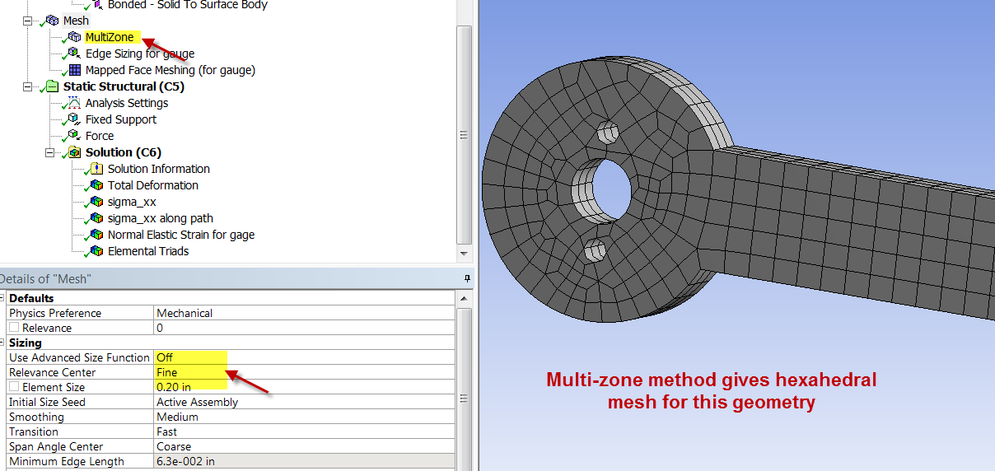
Strain Gage Modeling: Mesh

Slide 20
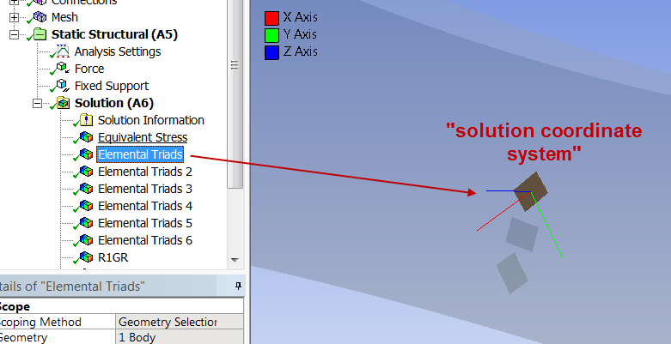
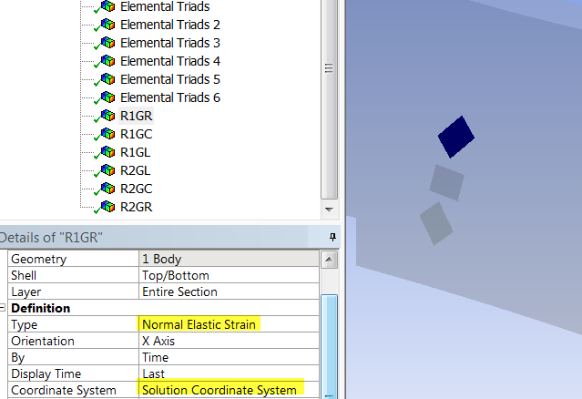
Results: Solution Coordinate System
Local coordinate system for element

Slide 21
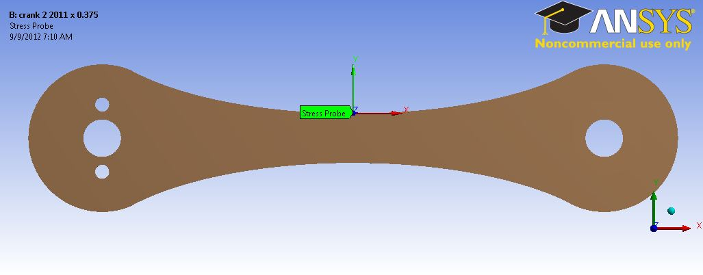
Mesh Refinement
Need to check dependence of results on the mesh
 | ANSYS (0.05” edge sizing) | ANSYS (0.075” edge sizing) | ANSYS (0.1” edge sizing) | Beam Bending Theory
Strain xx (micro-strain) | -1239.9 | -1239.4 | -1239 | -1227.9

Slide 22
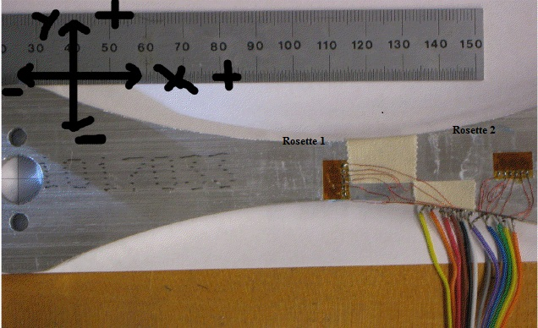
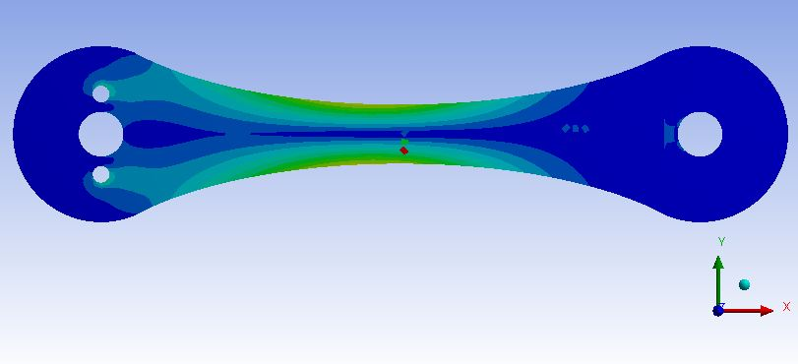
Sample Results: ANSYS vs. Experiment vs. Theory
Strain gauge | Beam theory | ANSYS | Experiment | % difference
Rosette 1 Right | 12 | -6 | -10 ± 4 | 40
Rosette 1 Center | 317 | 311 | 351 ± 6 | 11
Rosette 1 Left | 172 | 206 | 274.5 ± 4. | 25
Rosette 2 Right | -29 | -42 | -47.75 ± 4 | 12
Rosette 2 Center | 6 | 6 | 7.75 ± 2 | 22
Rosette 2 Left | 15 | 30 | 35.5 ± 2 | 15

Slide 23

Sensitivity to Gage Locations
FEA results are very sensitive to gage location
Two independent measurements of gage location by the same person
 | Gage location #1 | Gage location #2
Rosette 1 center (microstrains) | 312 | 486

Slide 24
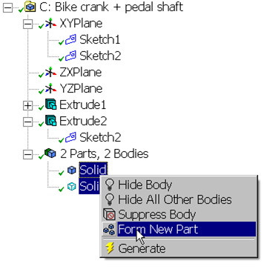
Dynamic Test
Model as quasi-static
  Use loads at any instant and analyze as static
Creates bonded contacts at interfaces between parts

Slide 25
Conclusion
Resources available:
  Tutorials
  This ppt
  My ANSYS model
  Yours truly and TA’s
Static test: Can get good comparison between ANSYS, experiment & beam theory in regions of high strain
Dynamic test: Might not get good comparison
  Think about possible reasons
Enjoy!

