Slide 1
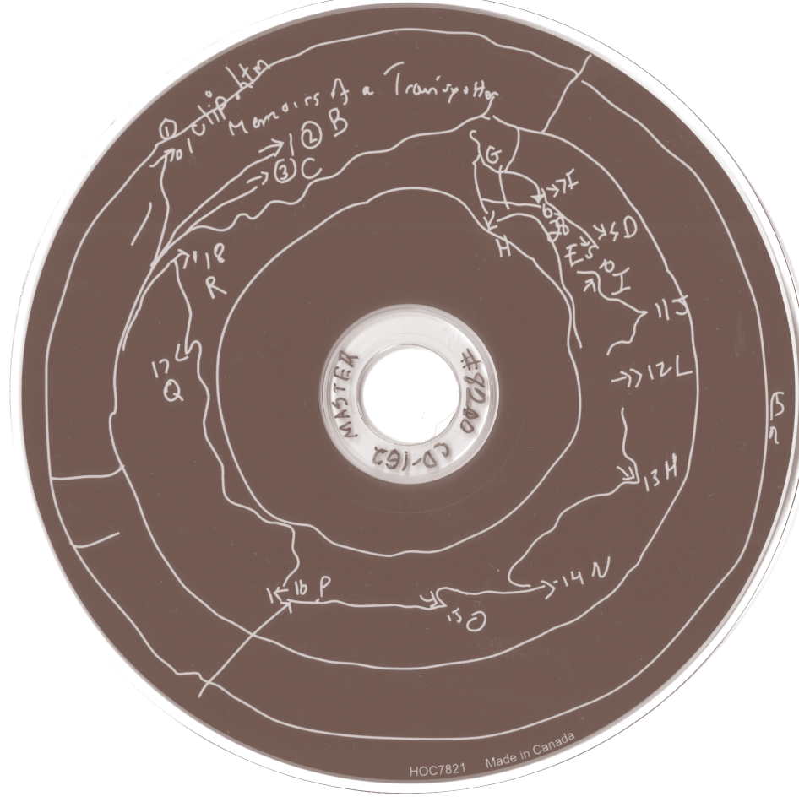
Community Notes
Add your thoughts throughout the session!
http://bit.ly/1DEoD8j
- OR -
Sign into Google Drive
Find 2014 DLF Forum Community Notes folder
Look for the document titled after this session (Forum hosts will also tweet the direct link shortly before session.)
Accessing Digital Art: Emulation and Preservation of Complex Digital Art Objects
http://www.diglib.org/forums/2014forum/program/35z/

Slide 2
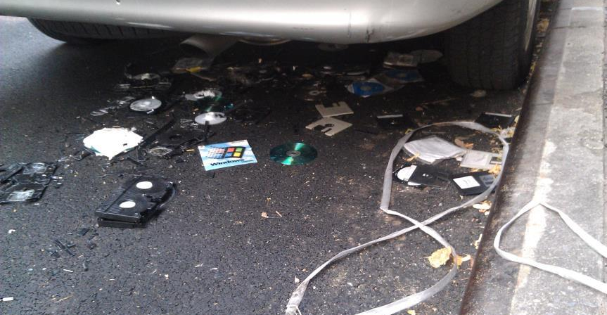
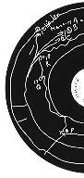


Accessing Digital Art:
Emulation and Preservation of Complex Digital Art Objects
Dianne Dietrich, Jason Kovari and Michelle Paolillo
Digital Library Federation 2014 October 29

Slide 3
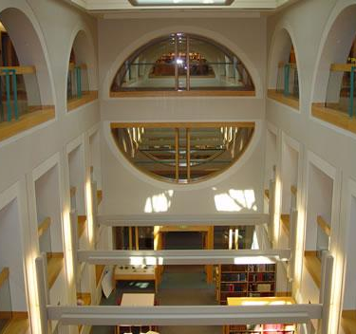


Rose Goldsen Archive of New Media Art
Founded in 2002
Research Repository
Notes:
Rose Goldsen Archive of New Media Art based in Division of Rare and Manuscript Collections at Cornell University Library
Rooted in the research mission of CUL
Not a museum
Access is central- affects preservation decisions

Slide 4
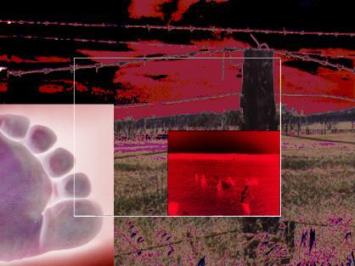
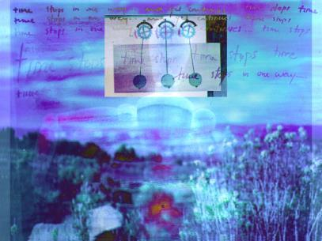
Complexity of Works
Interactivity
Non-linear form
Visual, aural and textual interplay
Storage strategy of media
Notes:
New Media Art, as included in this project
are from mid-1990s to mid-2000s.
CD-ROM-based
Contemporaneous conception of artistic expression & medium that is considerably different than art as conceived before
Inherently complex
interactive/non-linear/multimedia-reliant
Complex technical underpinning (file systems, file types, etc. that interact)
Application dependencies (Apps and plugins sometimes included on disks, and sometimes not)
Hardware dependencies
Multiple-File Systems, and Operating System dependencies
Every artwork therefore has a very specific “stack” of dependencies.
Complex preservation challenge for its curators - especially at scale
scale required for level-of-access to meet research mission

Slide 5
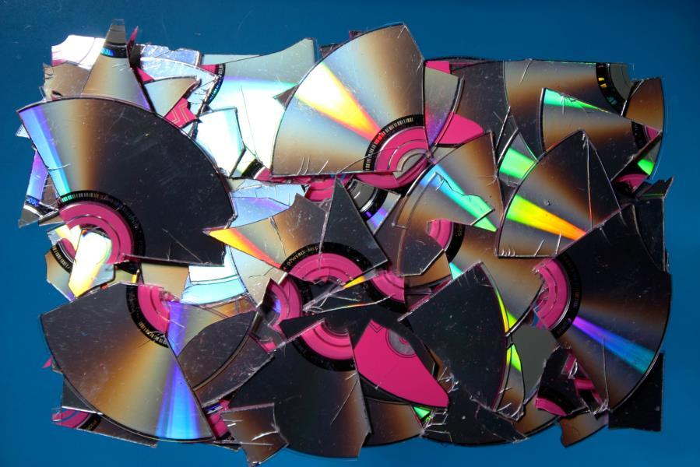
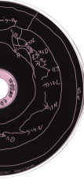
Preservation & Access Framework
Develop methodology for analysis of works
Define significant properties
Develop metadata requirements
https://confluence.cornell.edu/display/pafdao/Home
Notes:
Preserve these works
as software and digital files
as experiential, interactive works
late-2012/early-2013 National Endowment for the Humanities funded PAFDAO (Preservation and Access Framework of Digital Art Objects) with the goals of:
unpacking the complexities of the preservation tasks,
creating a framework and workflow for preservation of this collection and those like it.
Preservation is bound with access:
at-scale: not trying for exhibition-level completely faithful representation of the artwork as experienced by a circa 1993 user
goal: generalizable access that is scalable and sustainable

Slide 6
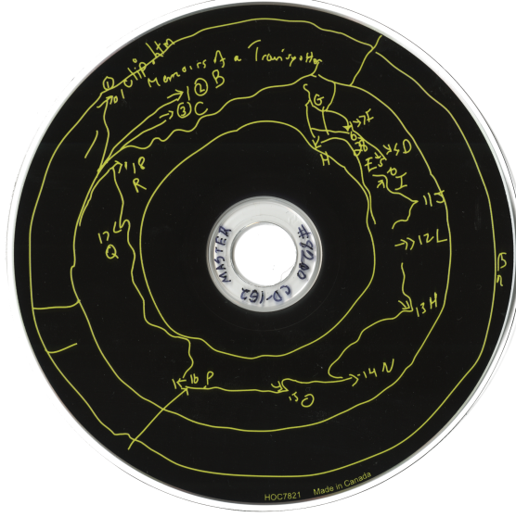
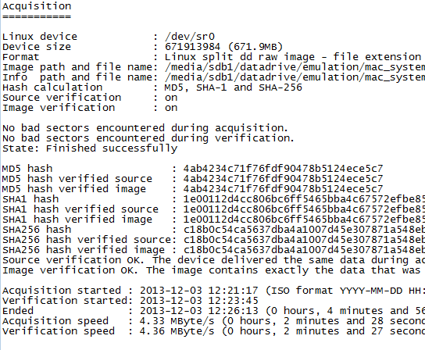
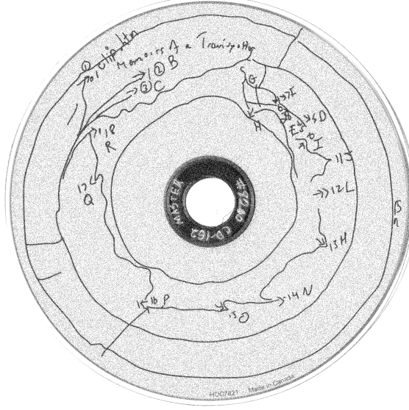
Creating Disk Images
Sector-by-sector copy of CD-ROM
Retain disk structure and contents; separate from fragile media
Derive Guymager output
01000011 01101111 01110010 01101110 01100101 01101100 01101100 00100000 01010101 01101110 01101001 01110110 01100101 01110010 01110011 01101001 01110100 01111001
Notes:
Obvious beginning - separate the works from their media because:
Physical fragility of media (lots of research on how long CDs actually last; assumption that they will last 100 years but find that they last dramatically less)
The specter of obsolescence
Method:
BitCurator Environment
Use Guymager
explicit feedback on sector health for both the media and the newly produced image.
We don’t particularly like that it comes in a text file.
Other tools are available
ISOBuster - Windows
Recommended to us by our advisory group, originally used - BUT -
does not go log bad sectors - only prompts during process.
FTK Imager - Windows
Strength - to provide a method for browsing contents of disk image (not a concern of ours)
did not seem to do explicit logging during disk image creation
part of multi $$ forensic toolkit
Might use ISOBuster or FTK Imager for audio & data discs (hybrid) - perhaps more powerful tool for imaging the hybrid discs
But what about fixity?

Slide 7
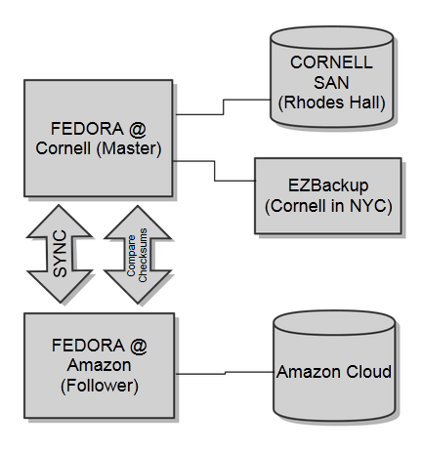

Preservation
Dark Archive
NDSA Level 1
Fedora storage:
3 types of objects:
Resource
Aggregate
Metadata
Notes:
Once we image, what about fixity?
Cornell University Library Archival Repository
Dark Archive - no public access, for stewards only
Level 1 - http://www.digitalpreservation.gov/ndsa/activities/levels.html not quite there, but getting there.
Our Archival repository,
Deposit into Master
Describe sync with Follower after deposit
3rd instance on tape
Building blocks, like tinker toys:
Resource - Assets, disk images
Aggregate - Groupings and relationships, relatedness.
Metadata - descriptors, both curatorial, technical, preservation - can be indexed, can be searched.
With a few fundamental object types, you can create a lot of structure!

Slide 8
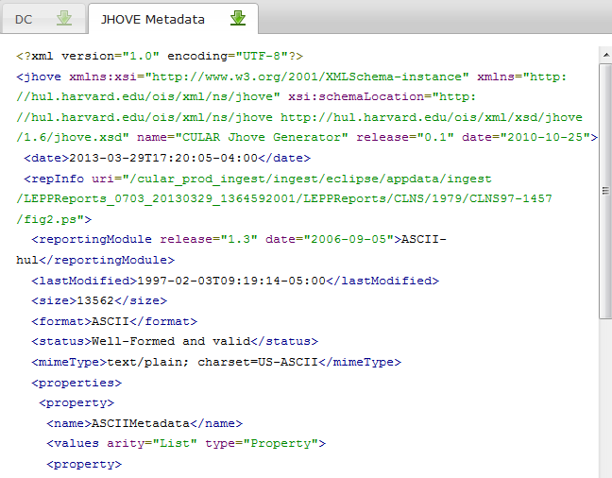
Metadata
Collection-level dmd
Technical description & checksums
Valid XML accepted
Notes:
CULAR Metadata (not PAFDAO-specific):
Policy requirement of collection level descriptive metadata (EAD XML)
At deposit, use JHOVE to create technical metadata - checksums used for continuous monitoring for unwanted changes between master and follower
Can accept XML (any schema) metadata and associate as needed
Lots of flexibility for where metadata lives and the role it plays within the system.

Slide 9
Structuring Deposit : the obvious
Individual
Work
MARCXML
Structure predictably ordered & extensible
Metadata indexing
Resource
Aggregate
Metadata
Disk Image
Disk image 1
Disk image 2…
Guymager txt file
Derivatives
(as needed)
Disk image 1
Disk image 2…
Documentation...
Related
Image files of cases, booklets, flyers, inserts, etc. associated with work
Notes:
So what structure are we building for the PAFDAO disk images?
Four aggregates
Uber aggregate for Individual work
named after the BibID
Disk Image
Aggregate of disk images and documentation (text readmes) relating to the specifics of deriving those particular information
Derivative - will be optional in the vast majority of the cases
Holding as a “what-if”; not yet have case where it has happened
Digital conservation where two disks have different bad sectors
HFS -> HFS+ conversion
Related
Documentation images of physical pieces (discs, cases, booklets, flyers, inserts, etc.) that comprise the physical original work.
DISCUSSION FOR METADATA OF THE CONCEPTUAL WORK
MARC XML derived from our catalog data
Can mimic the access points of the catalog within CULAR.
Structure predictably ordered, reasonably extensible, iterated for every work

Slide 10
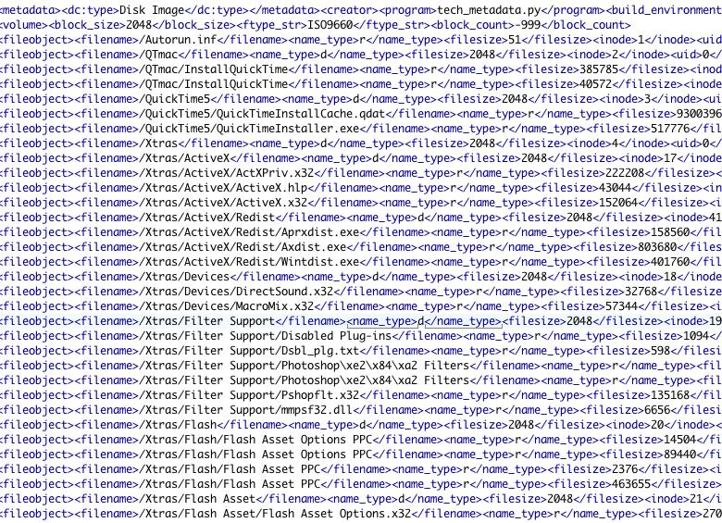
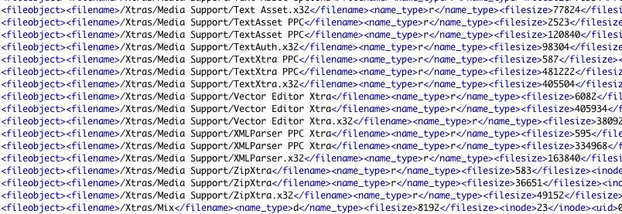
Metadata
DFXML & additional
Utility outputs
Issues:
HFS information
non-automatically derivable
over-description
Notes:
MARCXML for conceptual work level
Disk Images:
To provision for long-term preservation, we must capture metadata
Preservation metadata: PREMIS: (e.g.: digital lifecycle event metadata / non-auto derivable)
Technical metadata (auto-derivable): DFXML
Derived from various utilities/outputs, notably Guymager & Linux utility FILE: libmagic
Major question: File-level metadata?
*REMEMBER: we are preserving at the disk image level
FILE/libmagic = file identification
NOT file validation or extracting embedded metadata
What is the point of the metadata?
Indexed in CULAR? – if not, then why capture it?
concerned with over-description (creation of static)
SURVEY
artists, librarians, curators, scholars, etc.
survey did NOT raise use cases warranting this metadata
not missed opportunity - can capture later if use cases warrant

Slide 11
Structuring Deposit : file information
Individual
Work
MARCXML
Disk Image
Metadata indexed
access points
attributes & dependencies
Resource
Aggregate
Metadata
Disk image 1
Disk image 2…
Guymager txt file
DFXML
PREMIS
Derivatives
(as needed)
Disk image 1
Disk image 2…
Documentation...
DFXML
PREMIS
Related
Image files of cases, booklets, flyers, inserts, etc. associated with work
Notes:
Revisit CULAR structure
Note: DFXML and PREMIS at the Disk Image level
relate to the image itself -> placed at this level in the structure
Why capture file-level identification? Allows indexing for additional access points :
e.g.: Find all disk images that contain macromedia executables
e.g.: Find all disk images that contain VRML (virtual reality mark-up lang)
e.g.: Search for which has an HFS partition or ISO9660 partition
File-level identification matters / these queries matter for emulation

Slide 12
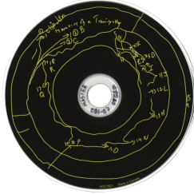
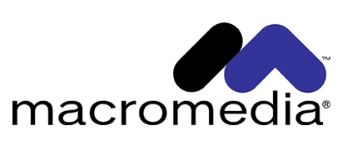
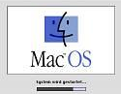
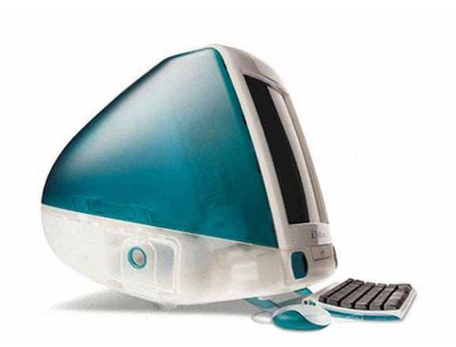
Emulation
Interaction to fulfill research needs
Layers of the Stack
“Depth” of emulation
Mac vs. Windows
WINE compatibility layer
Notes:
Stack (Emulation)
Work depends on successful interaction of layers.
Application -> Operating System -> Hardware/Firmware
Taking the pragmatic approach - emulating only to the depth required.
Allow interaction with the work to further research.
Try to make playback natural, but 100% fidelity to original not required.
Document any deviations from original in playback
Use various contemporary emulators
Exciting to see works on contemporary systems
Mac emulators
Two types
Basilisk: Older works - Motorola processor (7.5.5 to 8.1)
SheepShaver: Newer works - PowerPC processor (8.0 to 9.0.4)
Give us plenty of flexibility
VERY IMPORTANT: Apple made specific hardware -
we have to emulate firmware. Include ROMs!
Are re-creating a generic “Mac”; not any specific Mac environment
Experience of hardware original is lost.
Windows
Many run without emulation
Market decisions by Microsoft in favor of backwards compatibility
Haven't needed to explore Windows emulation as much
Some cases have required WINE as an environment for Windows executables/application.
General thoughts about emulation
We think pragmatic approach is OK, given our focus on research as opposed to display
Acknowledge our pragmatism leaves some holes:
Have not built as much, nor documented as much, on the Windows side
Our Windows documentation provides little guidance should Microsoft make different marketing decisions.
Pivot to Classification:
Strategies for emulation in the future will be different
In addition to metadata - classification document

Slide 13
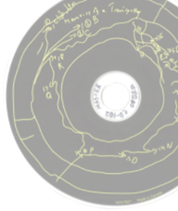

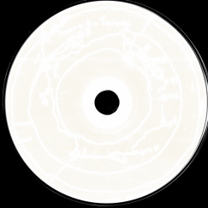
Classification fallacies
Compiled code & executables
Web files,
markup languages
Emulation-dependent
Difficult to provide access
Browser-based
Easy to provide access
Notes:
Classification documentation intends to capture salient features and place works in categories
Attempt to simplify building new emulators, take some of the trial and error out of the process.
Easy to assume simplistic things (as above);
reality teaches us differently

Slide 14
Classification realities
HTML/Browser
Applications
VRML
Plugins
Notes:
We think emulation looks more like this diagram
The real world dependencies are much more complex - interdependent layers
Experience is teaching us what types of things “behave alike”
Technical metadata alone will not be enough to automatically classify these works
Human judgment to make sense of technical requirements/classifications
This is where we are putting a lot of time currently.
BitCurator has a utility called Sorter - we will put more effort here...
address a disk image to determine contents
98% HTML and 2% JPG - this is a browser based work
“99% EXE and 1 MOV” - macromedia
Will be experimenting with that further.

Slide 15
Structuring Deposit
Documentation
Compiled
Emulators
Artworks
Clarity for stewards
Facilitate future research
Assist in future emulation strategies
Images
Individual
Work
Executables
Disk image
ROMs
Derivative
Related
Notes:
Return to take a macro-look at the structure
Previous structure for works noted at right
Ringed in red
Red ringed item (individual work) will be iterated, one for each conceptual work
Documentation aggregate
documentation re: deposit itself (req. by CULAR)
the value of the assets as expressed by the depositor (steward)
documentation of structure
classification documents and basic emulator notes
Compiled Emulators aggregate (center)
Images - compiled images of emulators needed to play works
Executables - as compiled, readmes and source files
ROMS - Zips of ROMs (firmware for simulated hardware), readmes
Important: emulation strategy will change over-time; readmes allow for this more iterative approach to be documented
Keeping an eye on emulation-as-service projects but approaching our process with assumption we need to preserve emulators
Readmes serve as unstructured metadata - iterative and updated as emulators (e.g.) update

Slide 16


Project Team
Cornell Team:
Desiree Alexander, Madeleine Casad, Dianne Dietrich,
Jason Kovari, Danielle Mericle, Liz Muller, Michelle Paolillo
Grant PIs: Oya Rieger, Timothy Murray
Consultants:
AVPreserve: Alex Duryee, Chris Lacinak, Kara VanMalssen
Advisory Board:
Ben Fino-Radin, Jean Gagnon, Rebecca Guenther, Matthew Kirschenbaum, Jon Ippolito, Norie Neumark, Christiane Paul,
Richard Rinehart, Simeon Warner
Supported by a grant from the National Endowment for the Humanities
Any views, findings, conclusions, or recommendations expressed in this presentation do not necessarily represent those of the National Endowment for the Humanities.
Notes:
https://confluence.cornell.edu/display/pafdao/Home

Slide 17
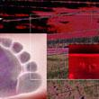
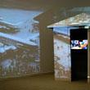
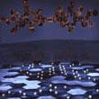

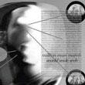
Discussion

Slide 18
Image credits (in order of appearance)
The mid-90s is under this car. Picture taken by Dianne Dietrich.
Physical CD – David Thomas; The Encoded Eye, The Archive, and its Engine House
Rare and Manuscript Collections (interior) – http://rmc.library.cornell.edu/presidents/view_image.php?img=97
Norie Neumark; Shock in the Ear – Screenshot from Contact Zones webpage: https://contactzones.cit.cornell.edu/artists/neumark.html/)
CULAR Logo – Carla DeMello
Shattered CDs – photo by lydyth; http://www.pxleyes.com/photography-picture/4b58e0e25d4d1/Dreaded-Broken--amp--Damaged-CD-s.html/
Yassine Bouhlel; A Nostalgic Rummage Through the History of Flash http://code.tutsplus.com/articles/a-nostalgic-rummage-through-the-history-of-flash--active-6733

Slide 19
Image credits (in order of appearance)
Operating System Documention Project; Mac System Software, http://www.operating-system.org/betriebssystem/_english/bs-macos.htm
The Telegraph. Apple Mac computers through the ages, http://www.telegraph.co.uk/technology/apple/4315904/Apple-Mac-computers-through-the-ages.html?image=3
Selected screen captures – Norie Neumark, Shock in the Ear; Renate Ferro, Panic Hits Home; Yao Jui Chung, The Soul Is But One Instant; Mark Hansen, Ben Rubin, Listening Post; Reginald Woolery, Million Man March/World Wide Web (From Rose Goldsen Archive of New Media Art homepage, http://goldsen.library.cornell.edu/)

