Slide 1
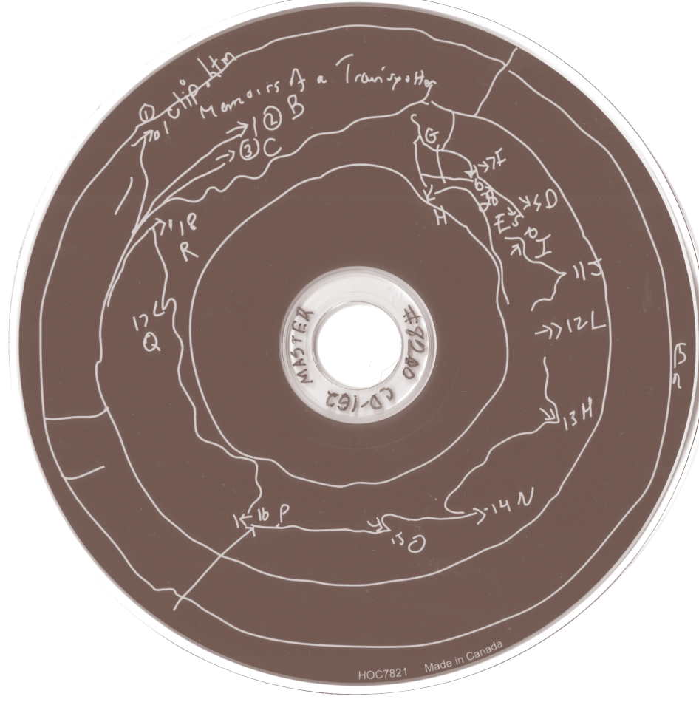
New Media Art : Preservation, Technical
and Descriptive Metadata
Jason Kovari | Head of Metadata Services | jak473@cornell.edu
Cornell University Library

Slide 2


(very brief) Background : PAFDAO
NEH funded project (2013-2015)
interactive new media art preservation
CD-ROM focus
overall project :
          disk imaging
          user survey
          metadata
          emulation & more…
https://confluence.cornell.edu/display/pafdao/
Notes:
Goldsen archive of new media art, based in RMC
background of what is New Media art
relied on both master and access copies
Project steps: (artist survey, imaging, emulation, ingest, etc.) -- focusing today on metadata
Major question: level of description?
file identification only
concerned with over-description (creation of static)
Survey for use cases
artists, librarians, curators, scholars, etc.
survey did NOT raise use cases warranting this metadata
not missed opportunity - can capture later if use cases warrant

Slide 3
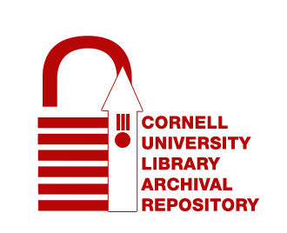
PAFDAO Deposit Structure
RMC
Archival Collection
Artworks
Disk Images
Disk Images
Documentation
Deriv
Disk
Derivat
Disk Image
Disk Images
Related
Derivative
Disk Image
Compiled Emulators
Related
Related
*Simplified diagram for demonstration*
https://confluence.cornell.edu/display/pafdao/
Notes:
Different Metadata live at different levels of CULAR
CULAR as agnostic in terms of schema, file formats, structure of deposit

Slide 4
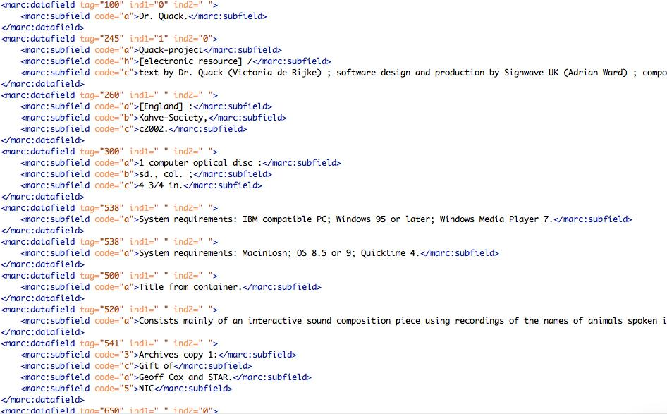
Descriptive Metadata
MARCXML
legacy catalog records
first-pass technical & artistic understanding
https://confluence.cornell.edu/display/pafdao/
Notes:
Metadata for the conceptual work
most straightforward part of metadata - MARC XML derived from our catalog data
Can mimic the access points of the catalog within CULAR.
provides first pass understanding (technical and artistic)
contains basic system requirements
(greyed-out image: e.g.: “Mac OS 8.5 or 9; Windows 95 or later; Windows Media Player 7 | Quicktime 4”)
while this is not the end-all (and at times incorrect based on testing), provides foundation

Slide 5
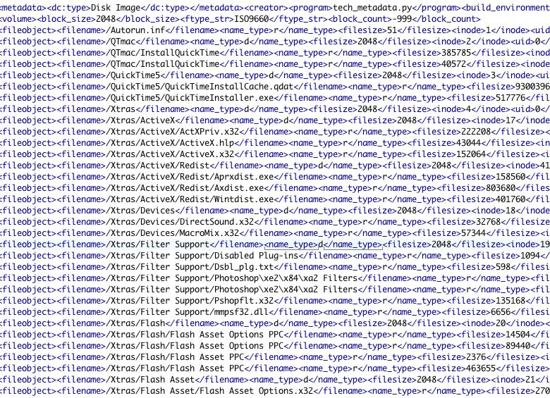
Technical Metadata
DFXML
derived from command line utilities
concern: HFS-specific information
https://confluence.cornell.edu/display/pafdao/
Notes:
Using DFXML to store technical metadata
DFXML does not handle HFS-specific information
used MODS note with uncontrolled type attribute
e.g.: entry type, creator code, resource fork size
SleuthKit utilities do not handle HFS file systems
lots of HFS in the test bed
used various command-line utilities (e.g.: FLS, unix utlility: file, hfsutils)
cobbled together via various Python scripts
remember, not concerned about file-level validation or embedded metadata extraction
where user survey helped inform metadata

Slide 6
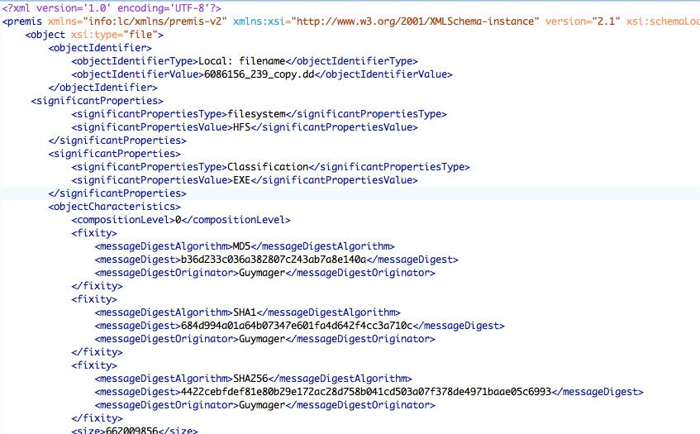
Preservation Metadata
PREMIS
Script pull from Guymager Info file
References to classifications
https://confluence.cornell.edu/display/pafdao/
Notes:
Used Guymager for disk imaging, chosen in part for the great INFO file it produces
includes details on creation environment, 3 checksums, unreadable sectors, etc.
formed the core of the PREMIS metadata, extracted by Python script
In addition to auto-derived / Guymager supplied metadata, also contains:
significant properties (artwork classes)
rendering environments
Finally, contains information about conservation treatments (for derivative img creation) and other lifecycle events

Slide 7
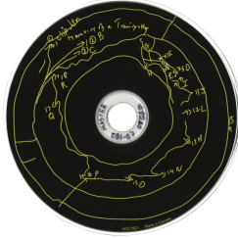
Artwork Classifications
HTML/Browser
Applications
VRML
Plugins
https://confluence.cornell.edu/display/pafdao/
Notes:
Technically driven
Classifications’ properties
Implications /strategies for rendering
- (e.g., recommendations and caveats about running works in various emulators)
Restoration potential.
Initial classification : file systems and file types present on the disc & stated system requirements of the work.
PREMIS files include references to these classifications.
Salient features to categorize
Interdependent layers
Technical metadata alone will not be enough to automatically classify these works
Human judgment to make sense of technical requirements/classifications

Slide 8
Unstructured Metadata
Emulator Documentation
Sector Notes Documentation
https://confluence.cornell.edu/display/pafdao/
Notes:
Emulator Documentation
E.g.: Basilisk II, SheepShaver, and QEMU
Since open source / community-driven
prudent to fully understand the capabilities and limitations of the proposed access and emulation strategy. Documented:
configuration and setup used, including configuration flags for compiling Basilisk II and SheepShaver from source
any issues that surfaced while testing the software.
Sector Notes Documentation
CDs burned over decade ago
2 rounds of disk image testing (IsoBuster & Guymager) & multiple hardware set-ups (internal CD-ROM drive and one connected via USB)
When unreadable sectors appeared, technical lead (DD) analyzed disk image to determine most faithful copy
all steps/decisions taken were documented

Slide 9
New Media Art : Preservation, Technical
and Descriptive Metadata
Jason Kovari | Head of Metadata Services | jak473@cornell.edu
Cornell University Library

