Slide 1
Small Scale Plant Model
Jenny Yin
Ed Cheng
Spring 2015

Slide 2
Goals
Finish a travel friendly model by the end of the semester
Purpose of Model:
  Professional
  Easy to Understand
  Visualization Tool
  Education/Awareness

Slide 3
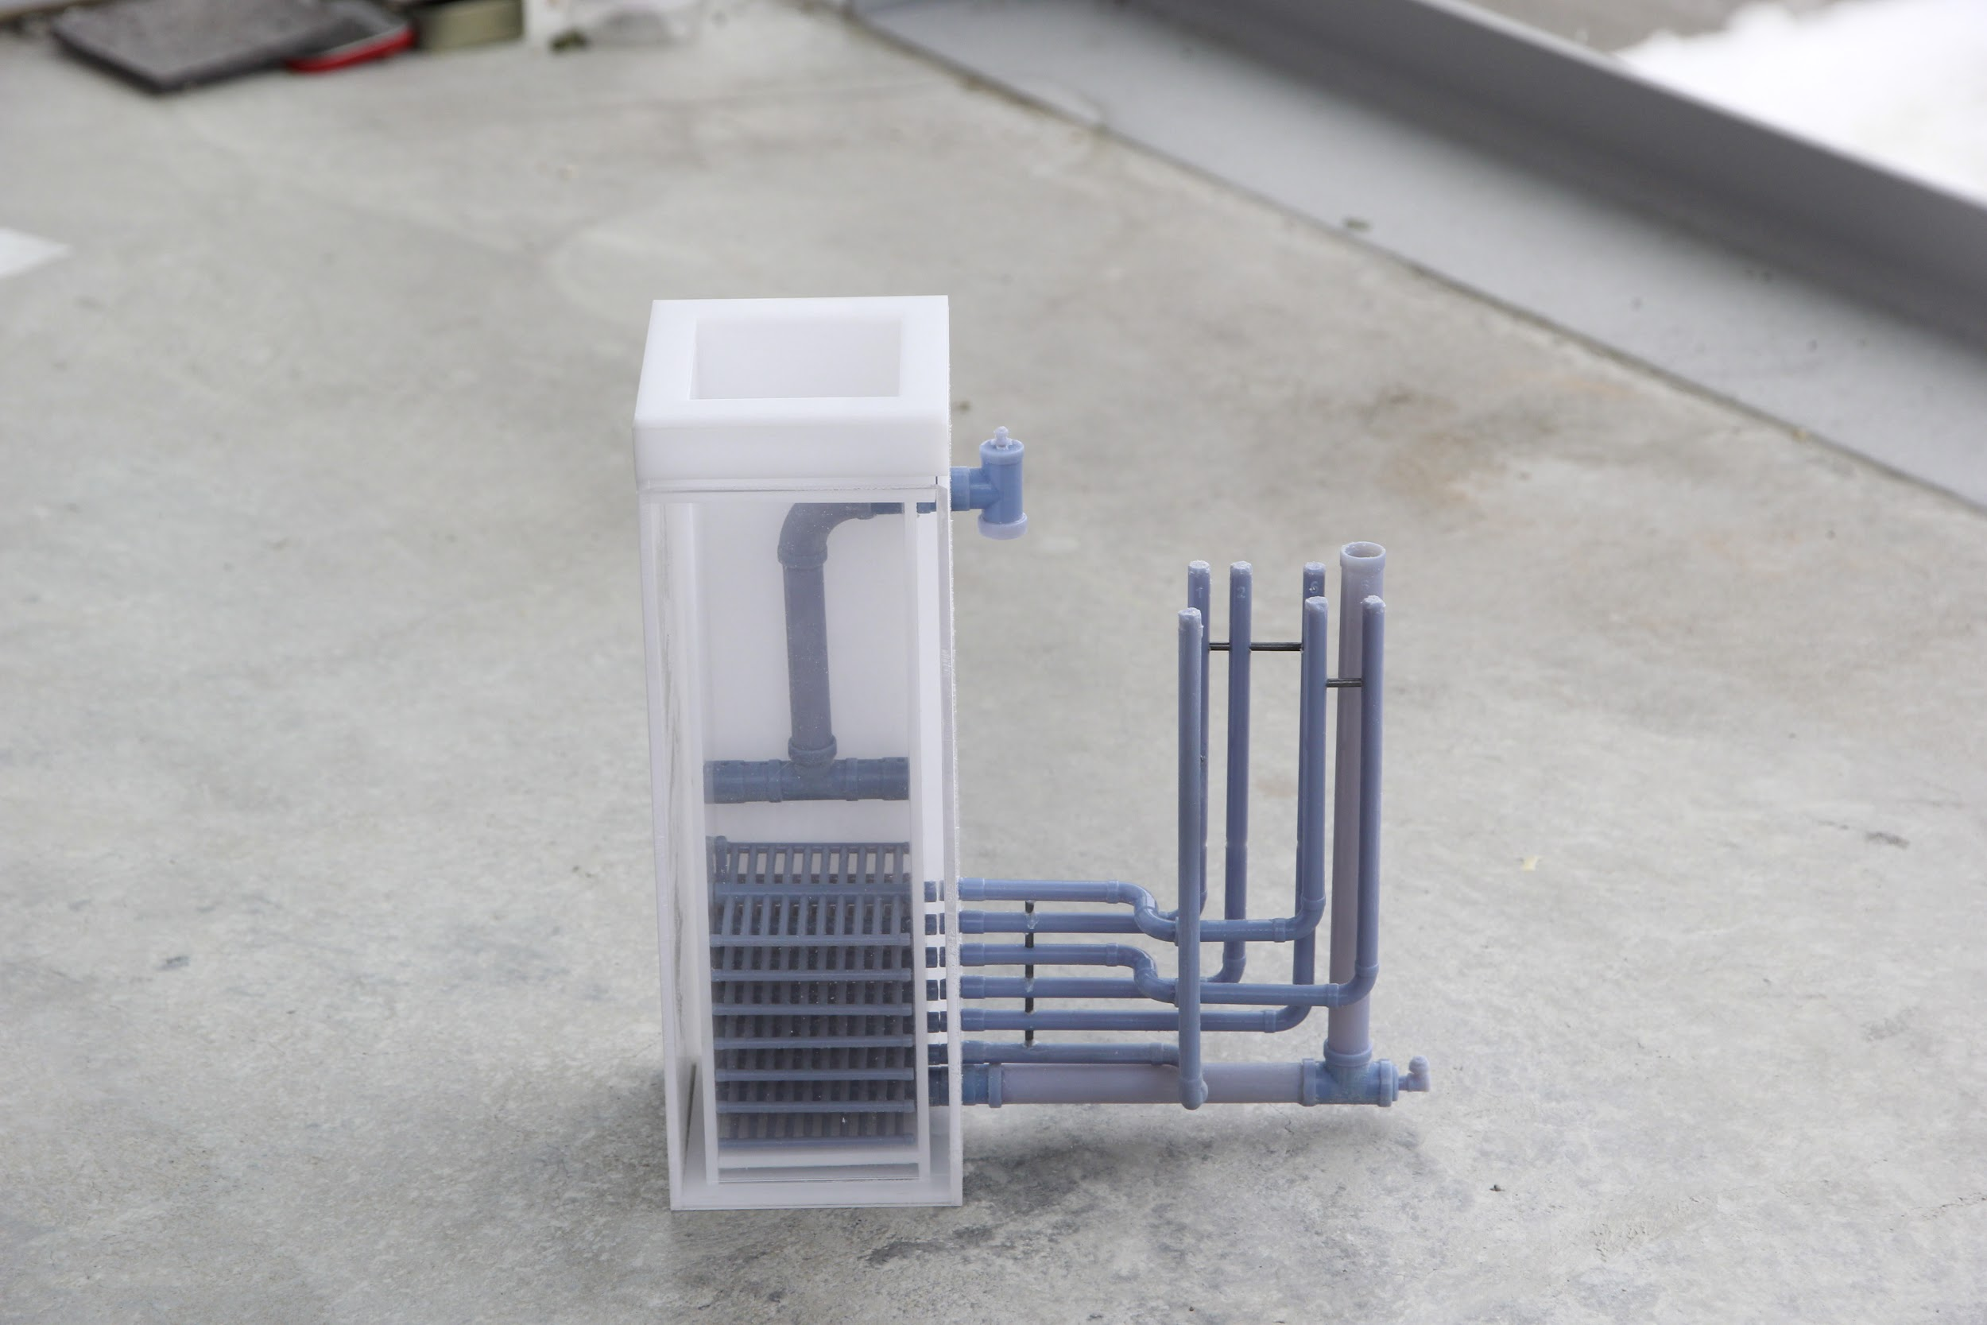
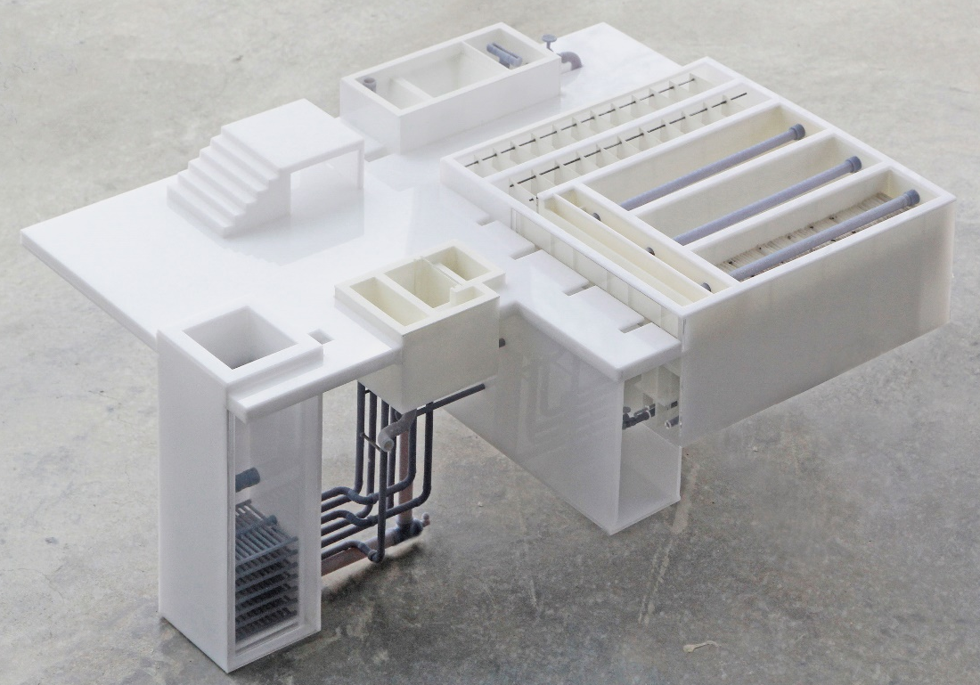
What We Completed
Repairing Old Model
  Pipes damaged due to air travel
  Replaced and stabilized damaged parts
  Included Styrofoam for extra support and protection
  Emergency repair kit

Slide 4
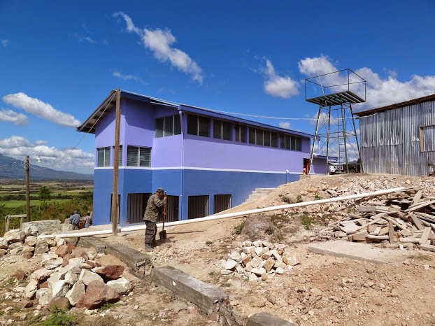
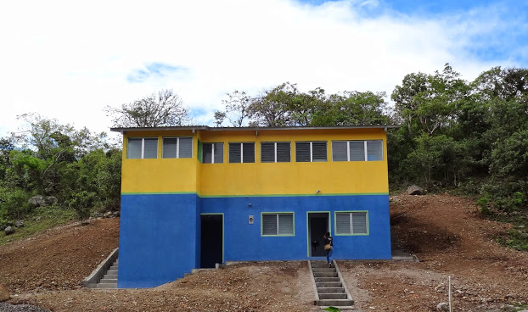
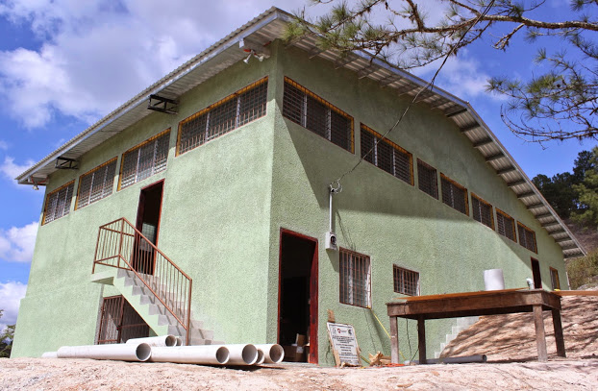
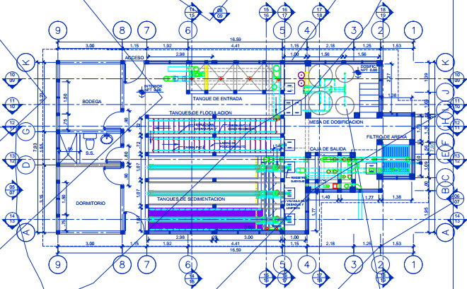
Analyzing the Plant

Slide 5
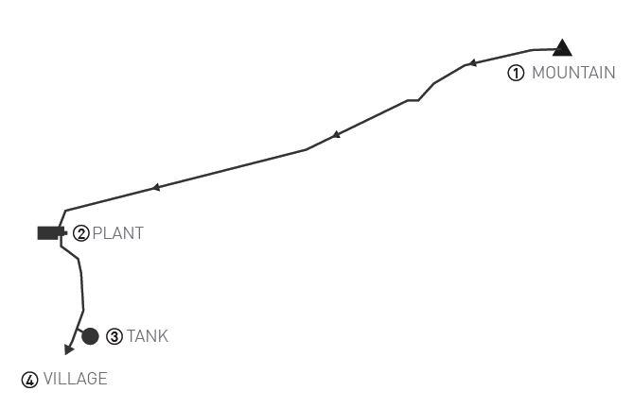
Analyzing the Plant

Slide 6
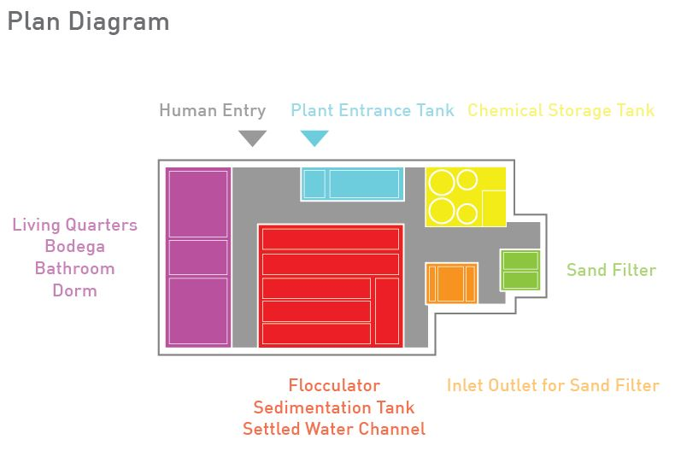
Analyzing the Plant

Slide 7
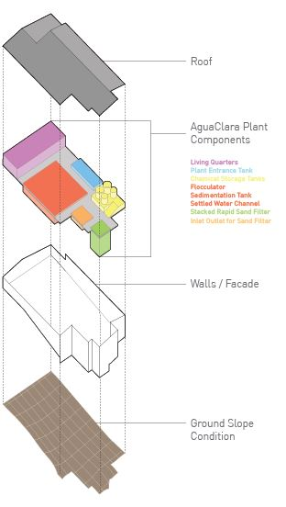
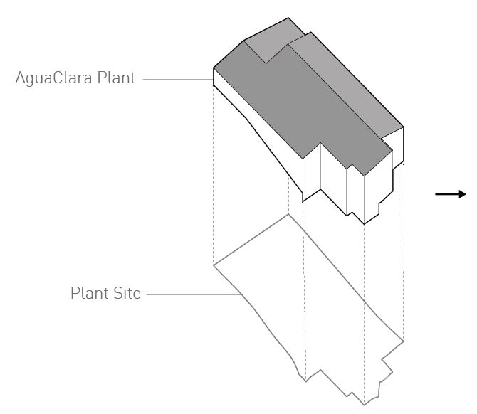
Analyzing the Plant

Slide 8
Possible Methods
Soap Model
  Cast parts of plant in clear soap to show flow of water
  Removable
  Building like case
AutoCAD → 3D Printing
Cardboard/Paper Model
Finished Wood Model

Slide 9
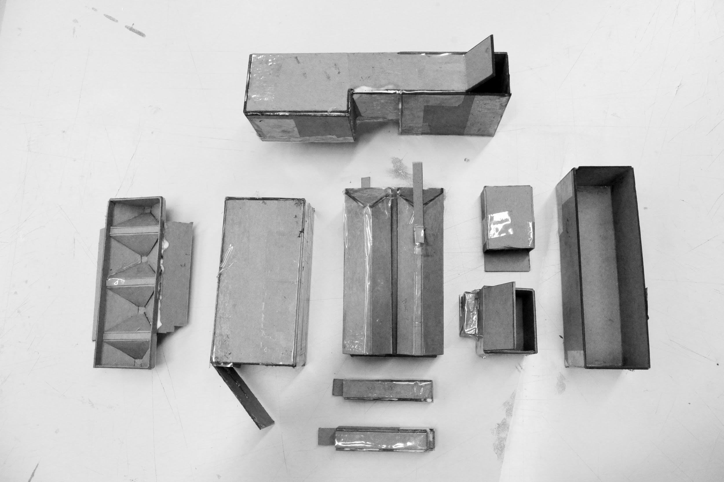
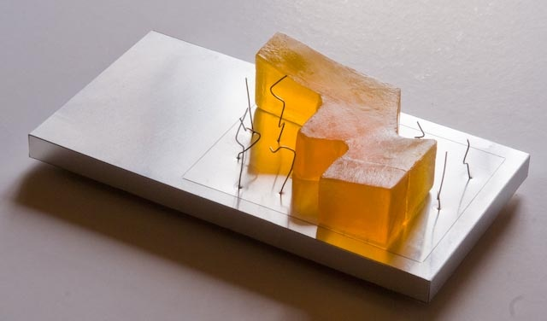
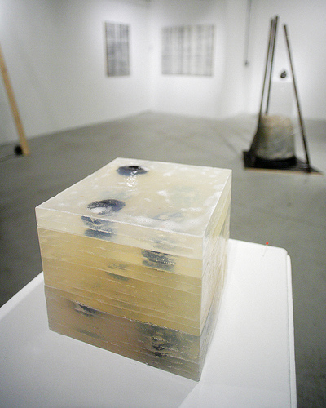
Soap Model

Slide 10
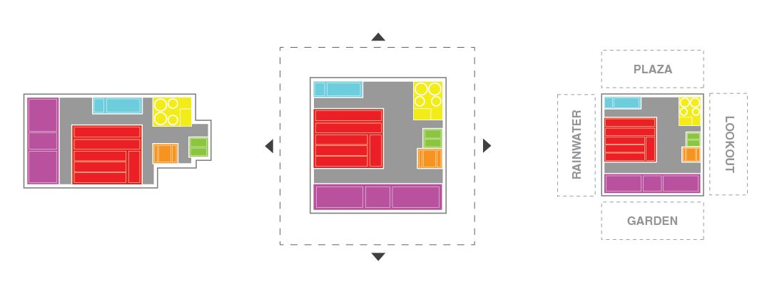
Reimagining the Plant

Slide 11
Next Steps
Simplify plant
Figure out optimal size and material
Try Building More
QUESTIONS & SUGGESTIONS???

