Slide 1
Small Scale Plant Model
Serena and Nick
Notes:
Purpose:

Slide 2
Small Scale Plant Model
Purpose:
  Teaching
    At Cornell or Honduras
  Motivational Purposes
Notes:
Purpose:
Teaching:
AguaClara members, Prospective AguaClara members, Engineers outside of Cornell, prospective Cornellians, or anyone interested in learning about AguaClara technologies
We can also bring it to Honduras and teach communities served by AguaClara plants, as well as the waterboards/municipal government
Motivational Purposes:
Cornell administration, awards programs, waterboards/municipal governments, conferences, organizations who support sustainable research, donors wishing to support plant construction, philanthropic organizations interested in improving technology

Slide 3
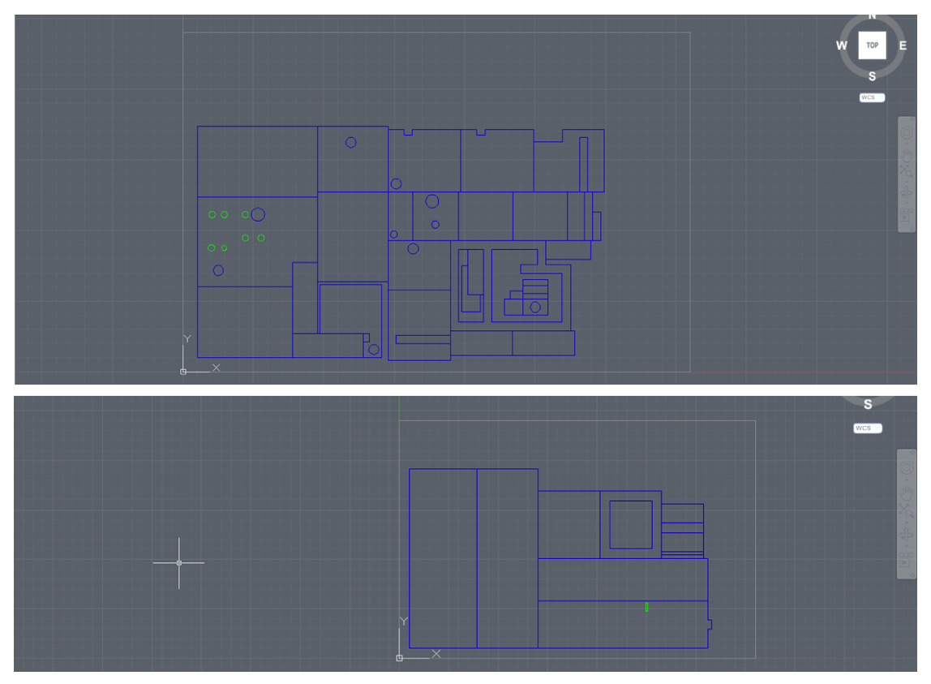
Small Scale Plant Model

Slide 4
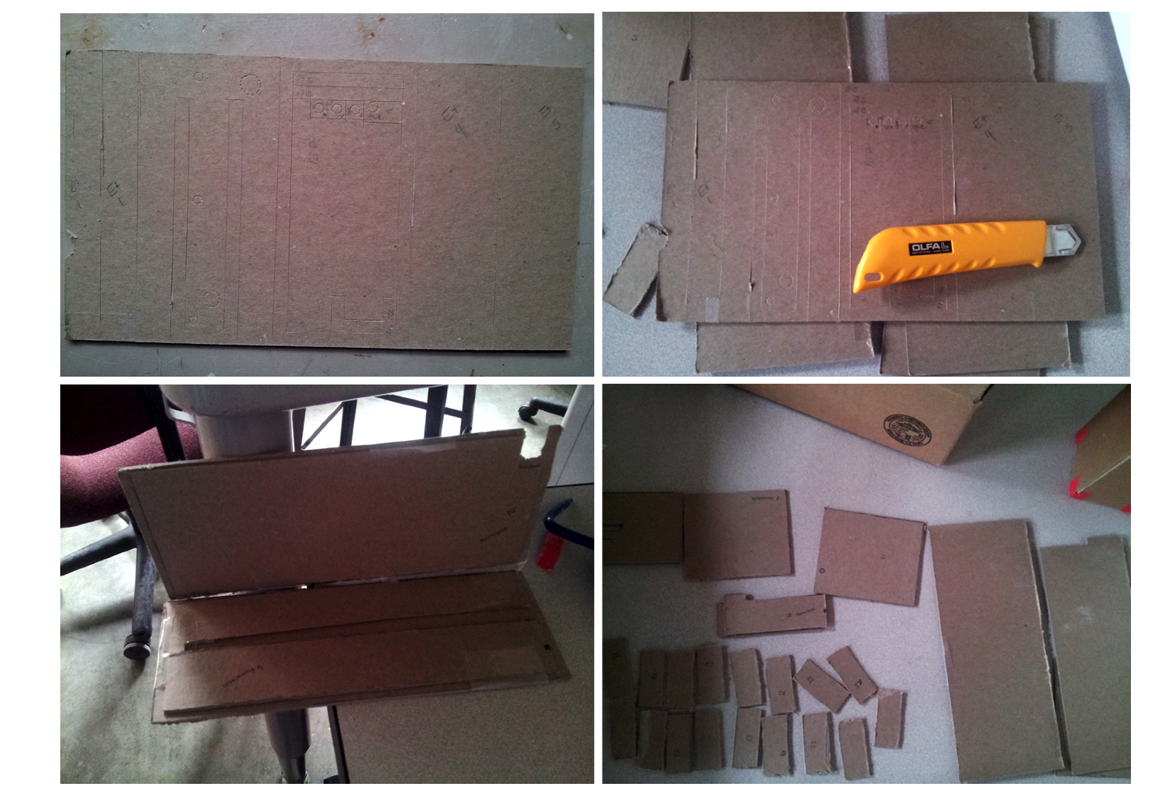
Small Scale Plant Model

Slide 5
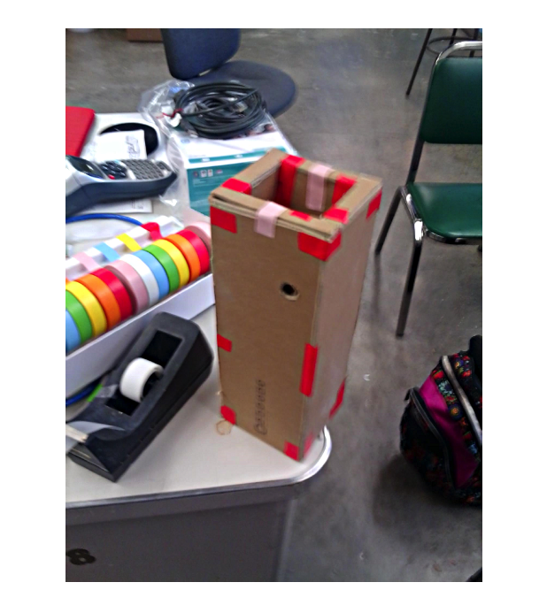
Small Scale Plant Model

Slide 6
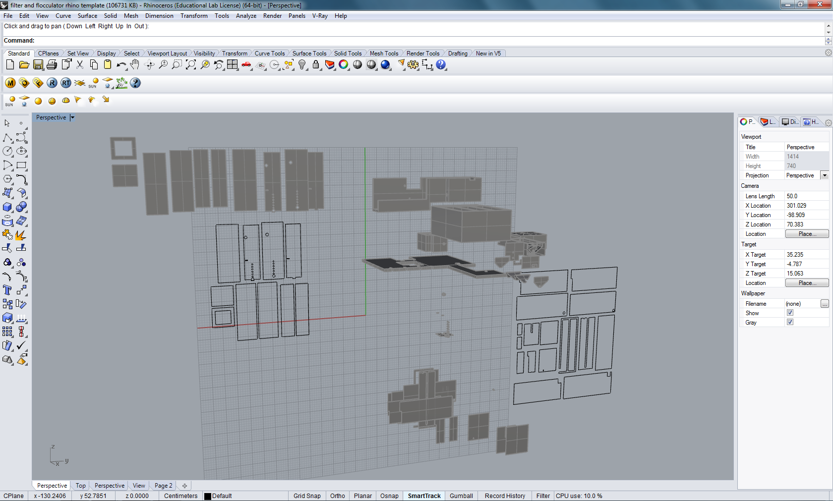
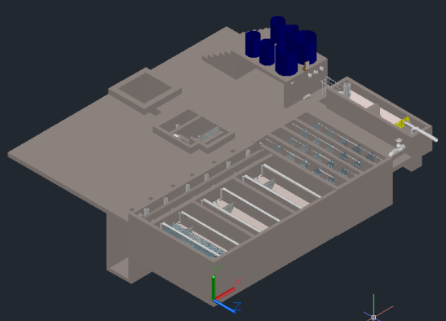
Small Scale Plant Model
Challenge:
  Repair old model
  Formatting AutoCAD drawings to be 3D printable
    Avoid Rhinoceros 5
    Mesh
    Scale Down
Notes:
Challenge:
Formatting AutoCAD drawings to be 3D printable
We used to use a design software called Rhinoceros 5 that was used by AAP students to 3D print. After talking to Monroe about how tedious the process of converting AutoCAD drawings to Rhinoceros Drawings were, we decided that it would be better to eliminate the tedious step. In order to print a design, the design it self cannot be solid block, it needs to be meshed.

Slide 7
Small Scale Plant Model
Plan for the Semester
  Re-Print broken pieces in old model
  Meshing in AutoCAD
    Steven Curtis
  Try printing
  Update MathCAD to AutoCAD (MtA) Code
Notes:
Plan For Semester:
Meshing in AutoCAD
There is a Plug-in that will download that should be able to mesh solids
Steven Curtis knows a lot about AutoCAD
Try Printing to make sure its possible with an AutoCAD file
Update MtA to include meshing and scaling

Slide 8
Small Scale Plant Model
Ultimate Goal:
  We want to be able to print small scale plant models of the most up to date design at the click of a button.

Slide 9



Small Scale Plant Model
Questions?

