Slide 1
Small Scale Plant Model
Serena Takada and Nick Cassab-Gheta
Notes:
Purpose:

Slide 2
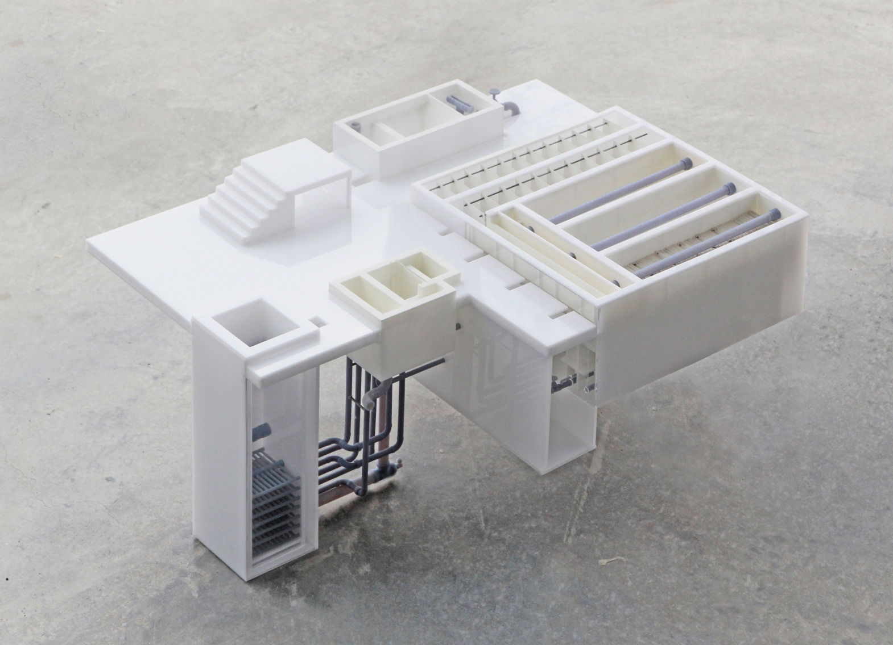
Purpose
Teaching:
  Cornell
  Honduras
  Events
  Motivational
  Purposes

Slide 3
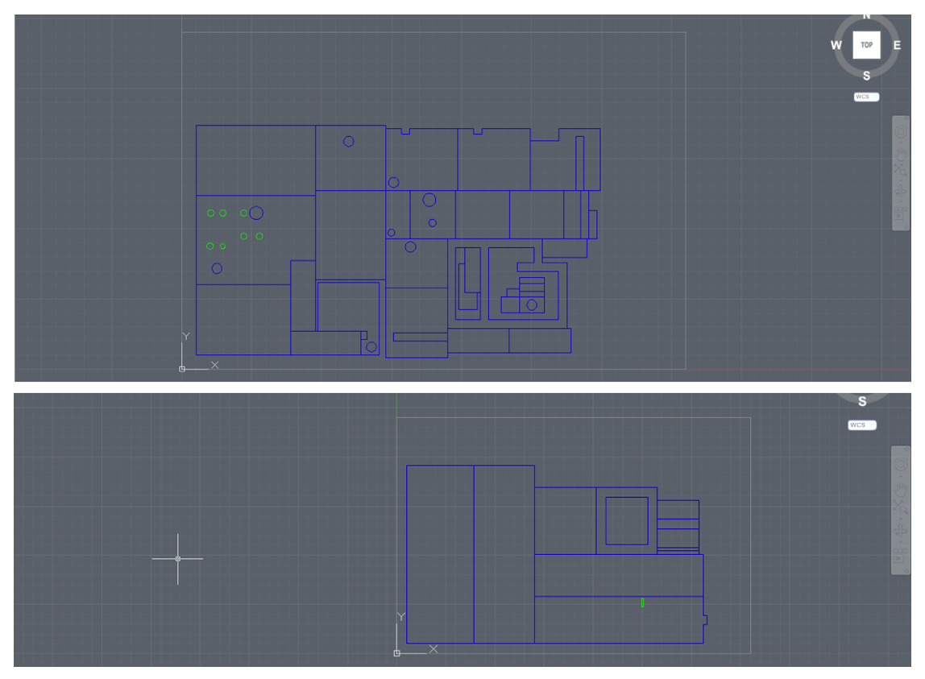
Past

Slide 4
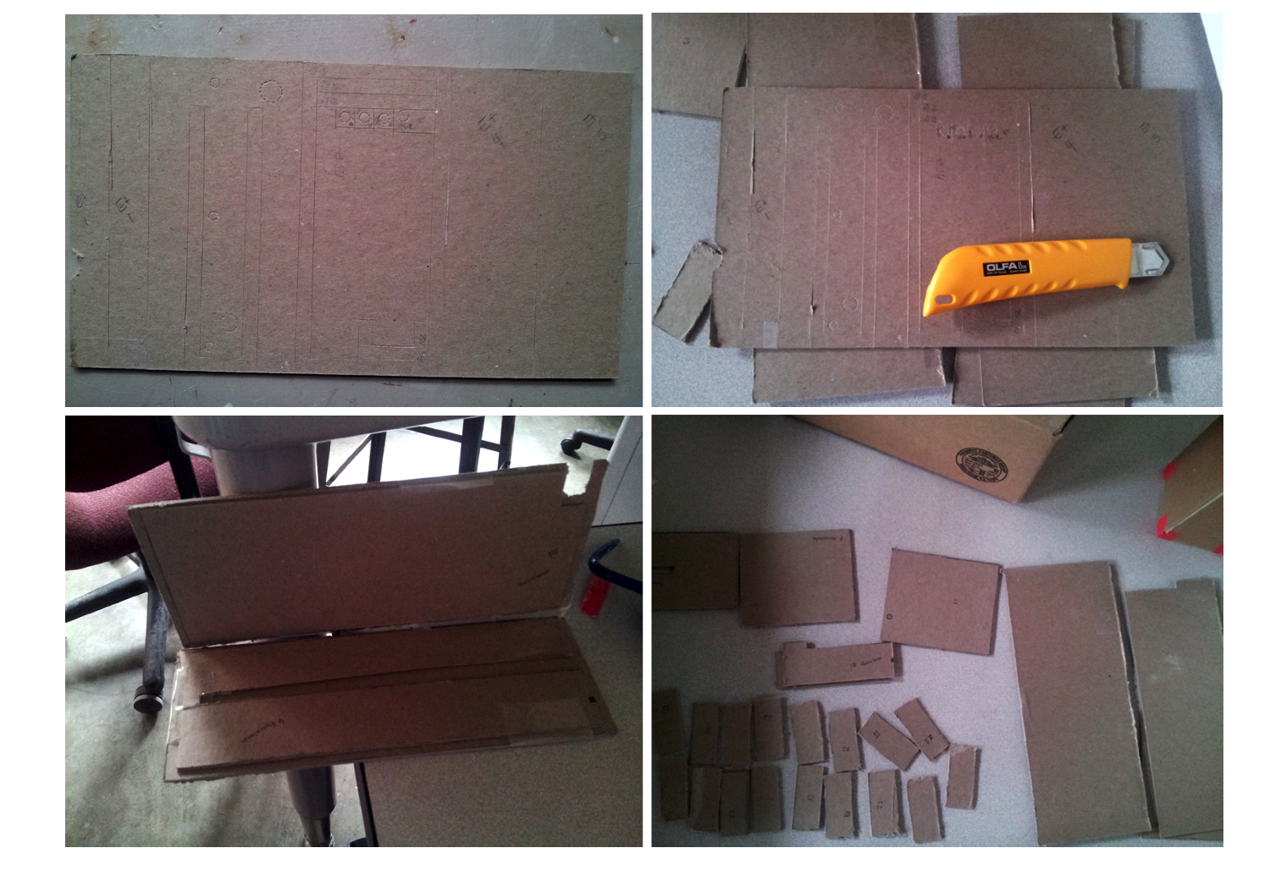
Past

Slide 5
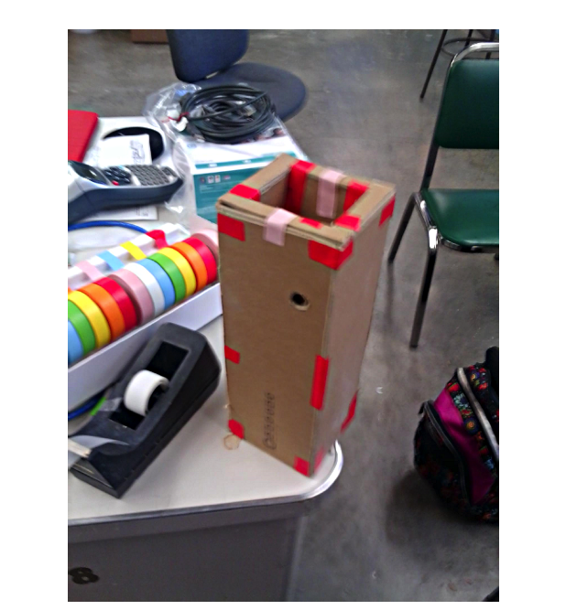
Past

Slide 6
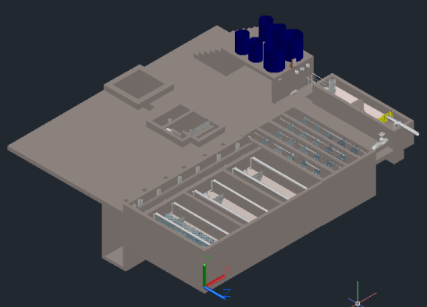
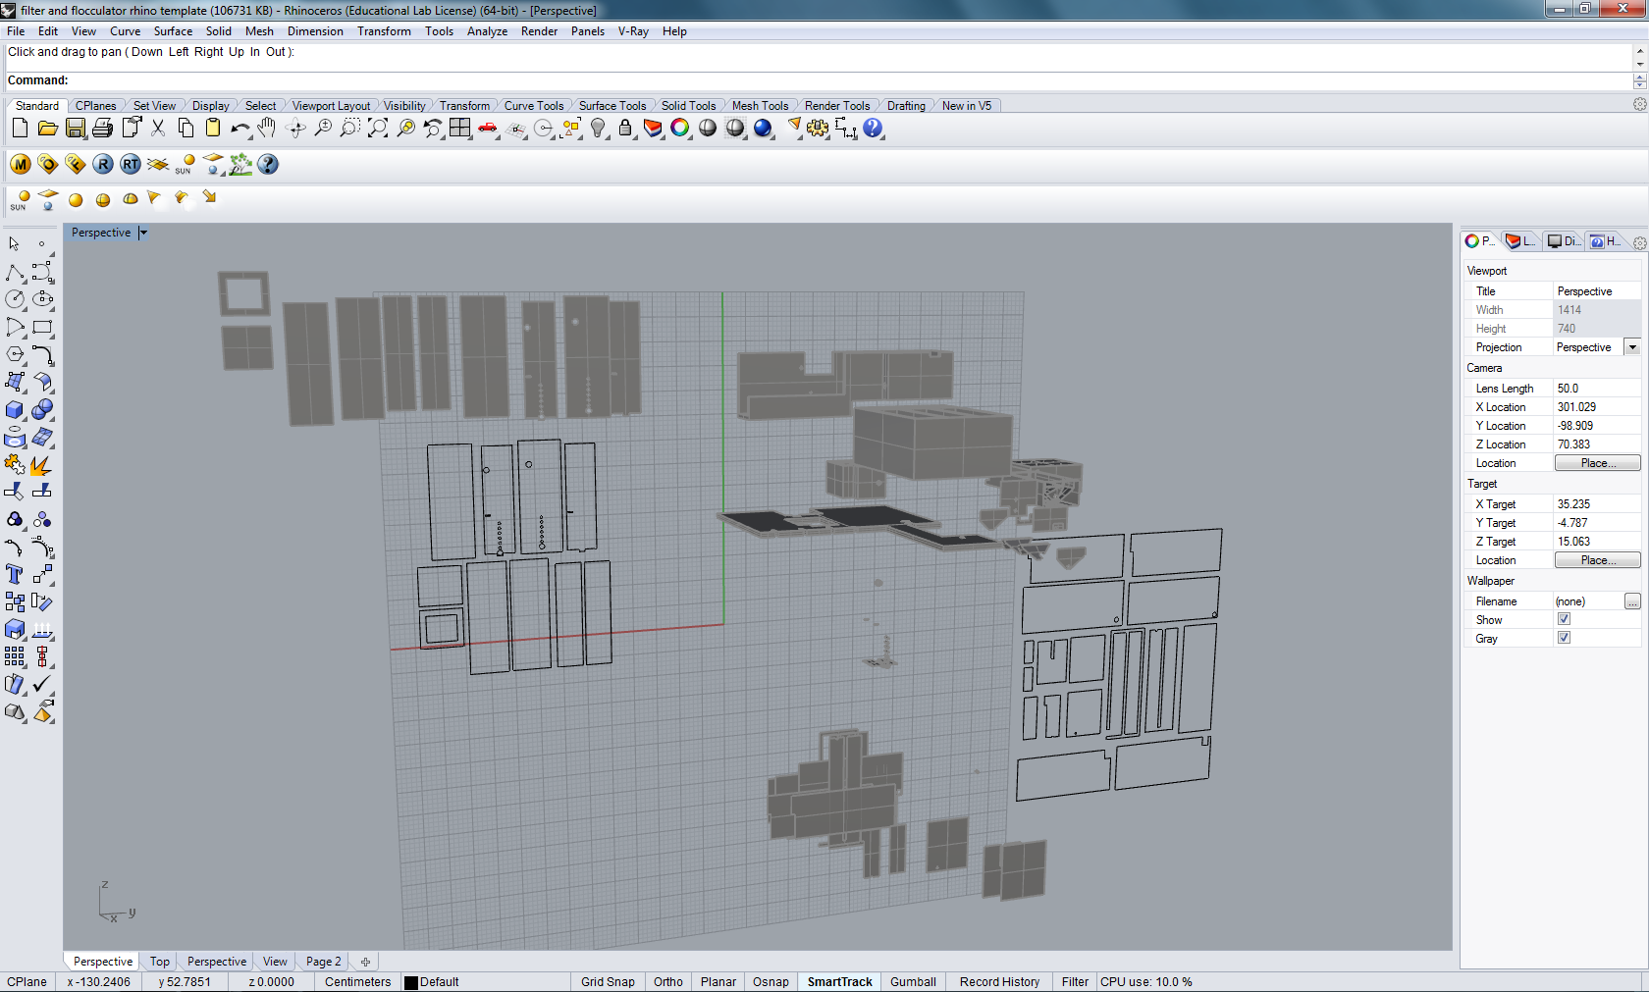
Achievements
  Repair old model
  Formatting AutoCAD drawings to be 3D printable

Slide 7
Repairing Old Model
Re-print Broken pieces
  With The help of
  Daniel Saloman

Slide 8
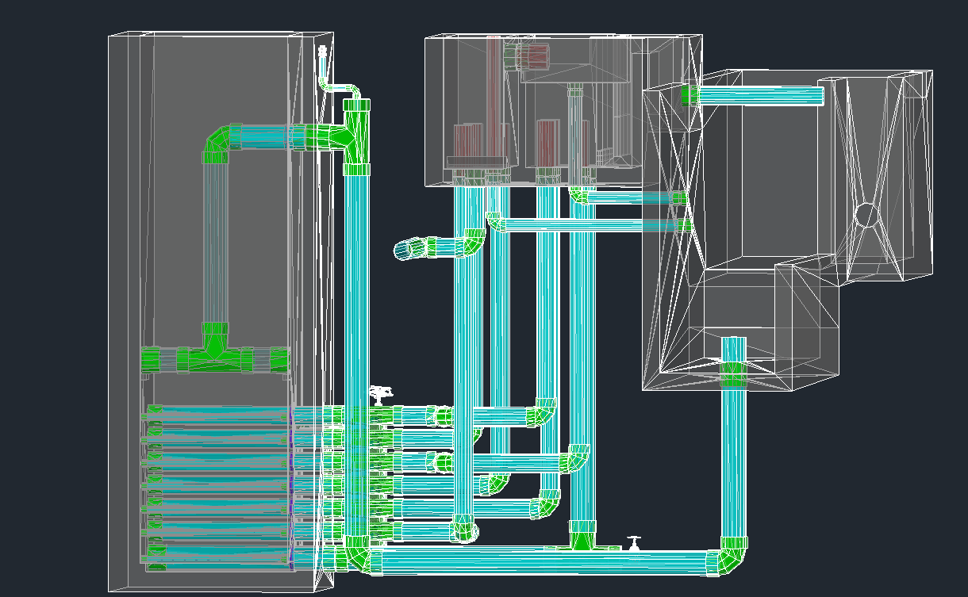
AutoCAD Meshing
Mesh in AutoCAD
  Daniel Saloman
  Meshing Commands in AutoCAD
    Failed to print Tanks
  Using Solid to Mesh Plug-in
    Pop-up interrupts command line

Slide 9
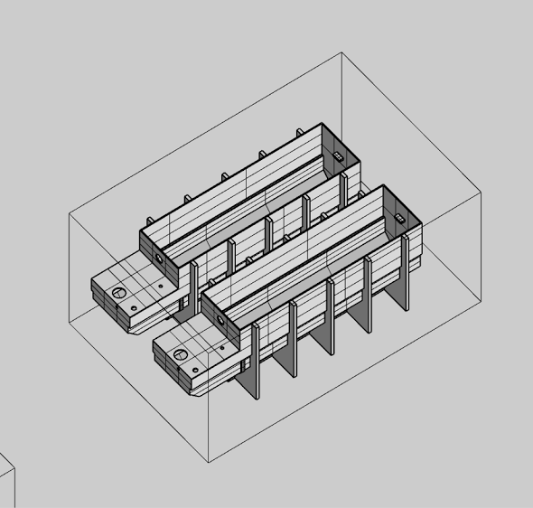
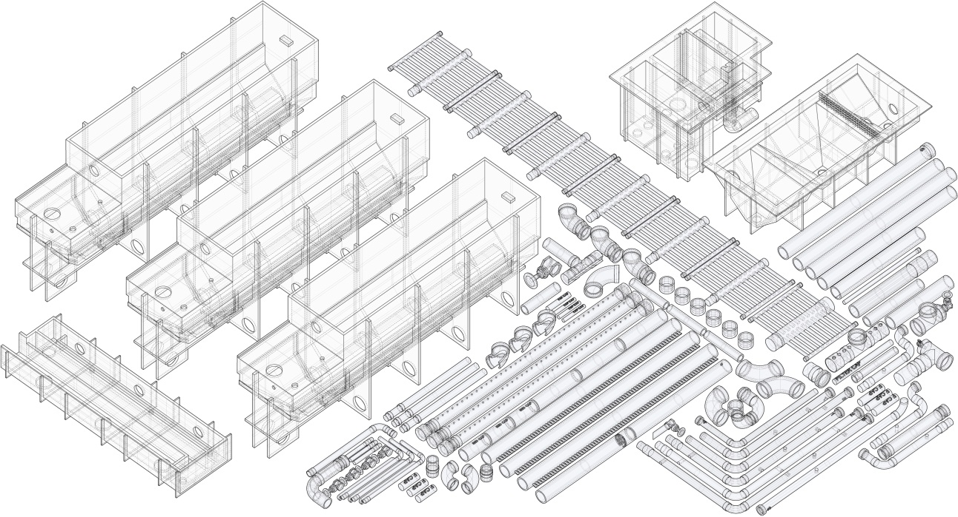
New Printer
  Update MathCAD to AutoCAD (MtA) Code
  Scaling

Slide 10
Future Goals
Ultimate Goal:
  We want to be able to print small scale plant models of the most up to date design at the click of a button.

Slide 11



Questions
Questions?

