Slide 1

Small Scale Plant Model
Theresa Chu
Amanda Rodriguez
Sarah Sinclair

Slide 2
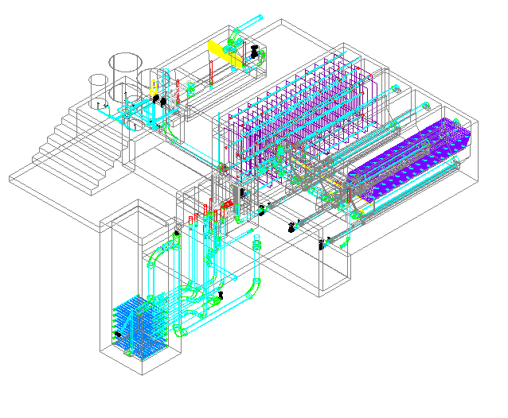
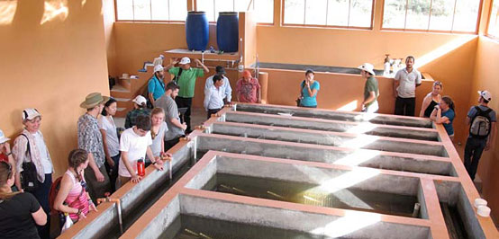

Slide 3
Purpose
In Honduras, team members realized how useful a visual representation was for understanding treatment process
Understanding process comprehensively key to the creation of future innovations

Slide 4
Abstract
Tangibility
Educational outreach efforts
Encourage sponsorship
Portable, durable
Clarify confusing features

Slide 5
Features to Highlight
Water flow through the plant
Hydraulics of sedimentation tank, flocculator, filter
Geometries of tanks
AguaClara-specific innovations

Slide 6
Educational Purpose
Team members who have not
been to Honduras
Cornell Engineers interested in joining our team
Engineers outside of Cornell
Prospective Cornellians
Outreach and Elementary education
Waterboards/Municipal governments
Community members served by the plant

Slide 7
Motivational Purposes
Cornell Administration
Awards Programs (Katerva, PC3, etc)
Waterboards/Municipal Governments
Ideas Festivals/Conferences
Organizations who support sustainable research
Donors wishing to support plant construction
Philanthropic Organizations (e.g. Rotary) interested in improving technology

Slide 8
Investigating Materials
Chipboard
Museumboard
Plexiglas

Slide 9
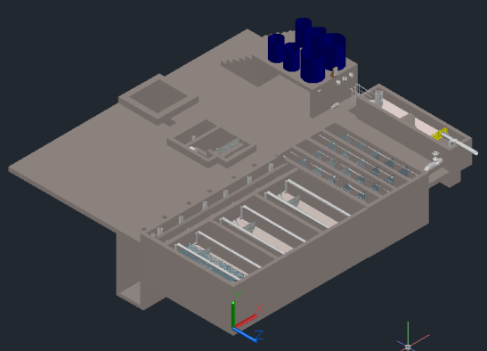
AutoCAD drawings
Challenge: convert CAD drawing to usable templates
Extract surfaces to use to manufacture components

Slide 10

Scaling
Based on carry-on suitcase dimensions
1:20 vs. 1:30

Slide 11
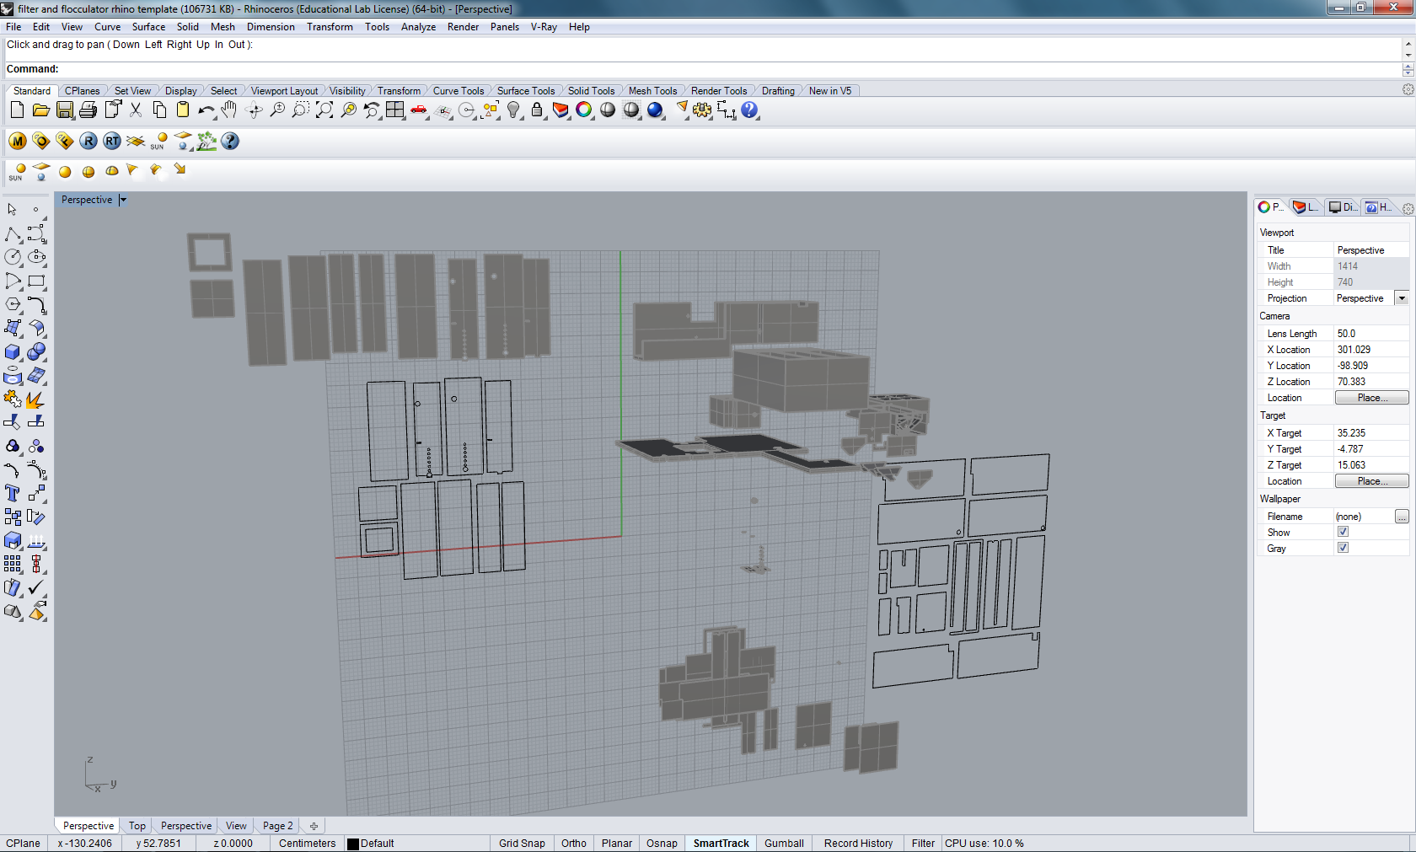
Rhino

Slide 12
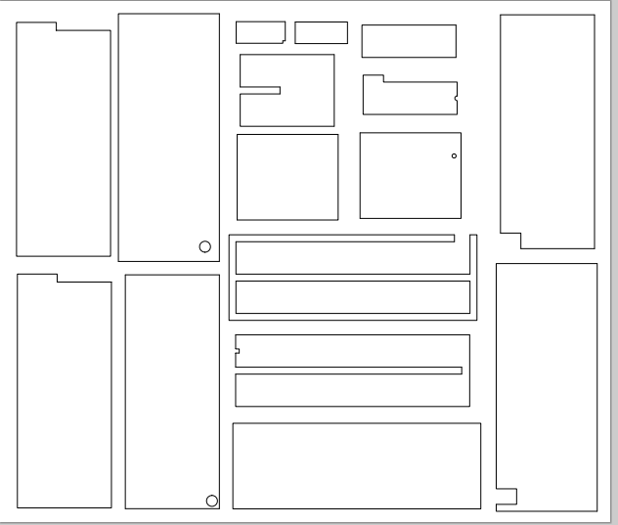
Flocculator Template

Slide 13

Laser Cutting
Technology available through AAP

Slide 14
Future Work
Budget
Mock-up
Purchase final materials
Final model

