Slide 1
Small Scale Plant Model
Jenny Yin
Ed Cheng
Spring 2015

Slide 2
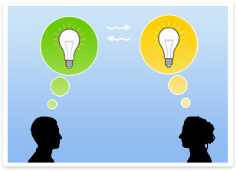
Purpose of the Model
Professional
Easy to Understand
Visualization Tool
Education
Awareness

Slide 3
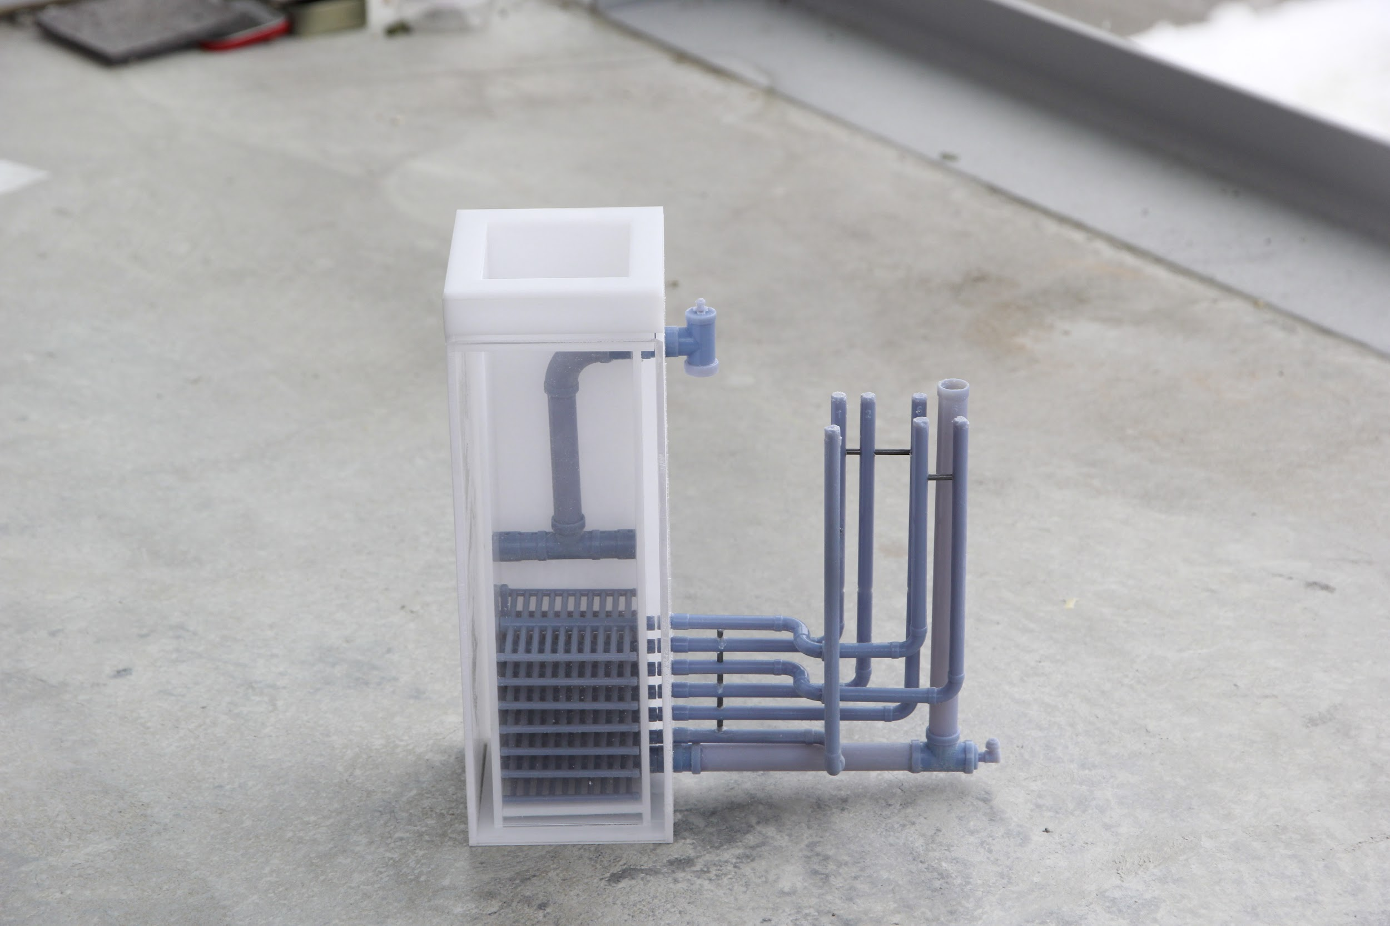
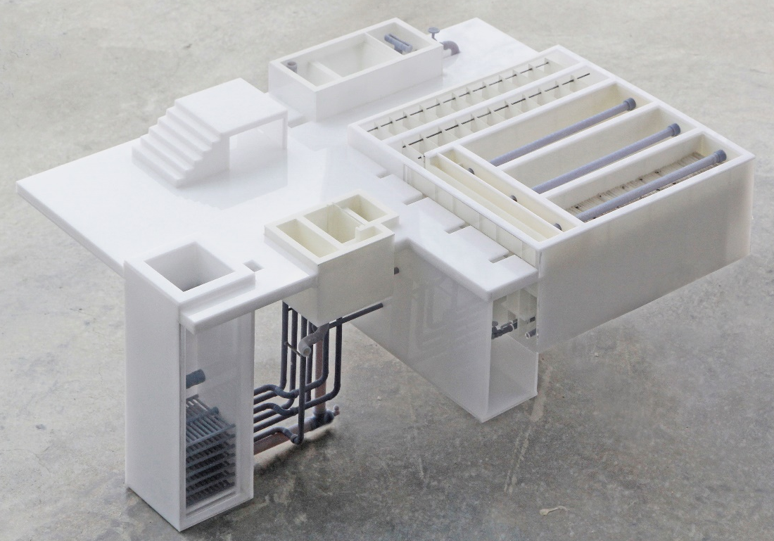
What We Completed
Repairing Old Model:
  Pipes damaged due to air travel
  Replaced and stabilized damaged parts
  Included Styrofoam for extra support and protection
  Emergency repair kit

Slide 4
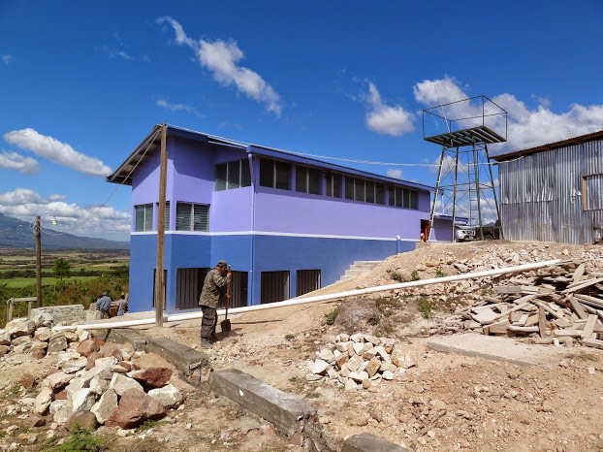
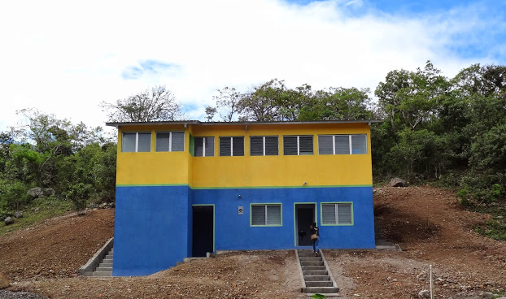
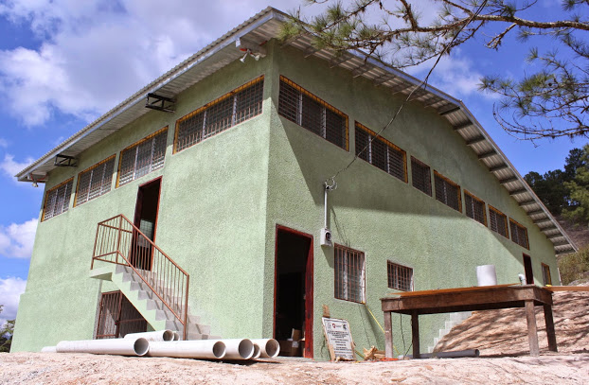
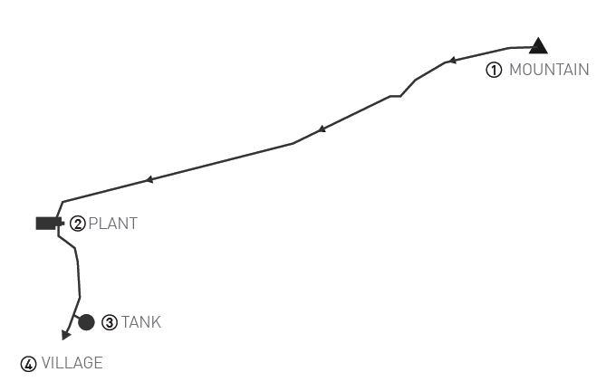
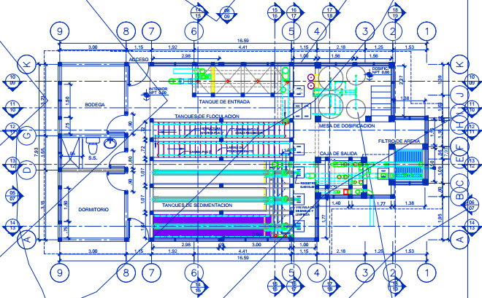
Analyzing the Plant

Slide 5
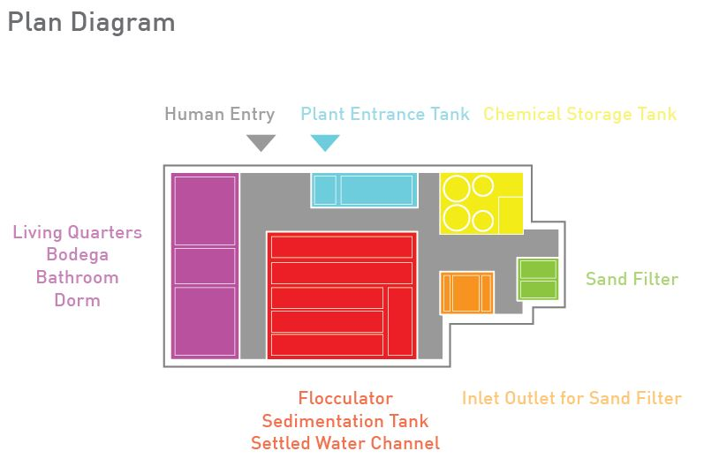
Analyzing the Plant

Slide 6
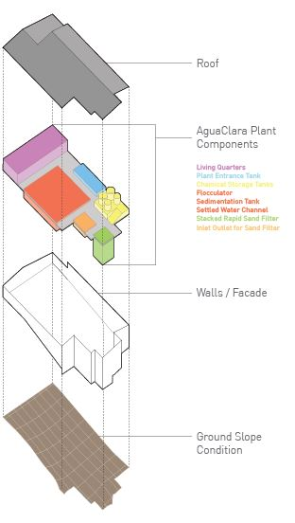
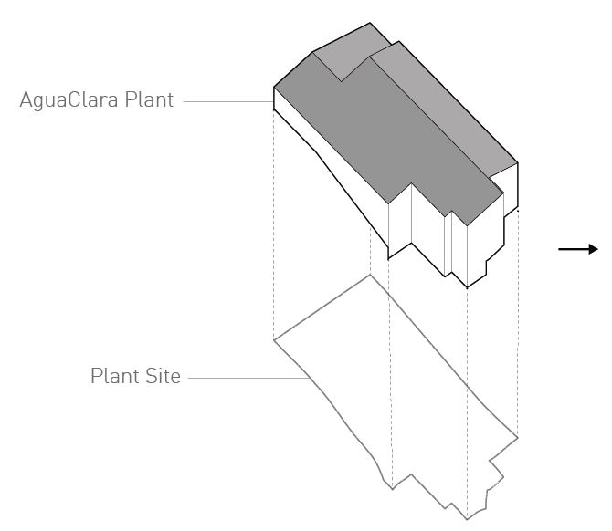
Analyzing the Plant

Slide 7
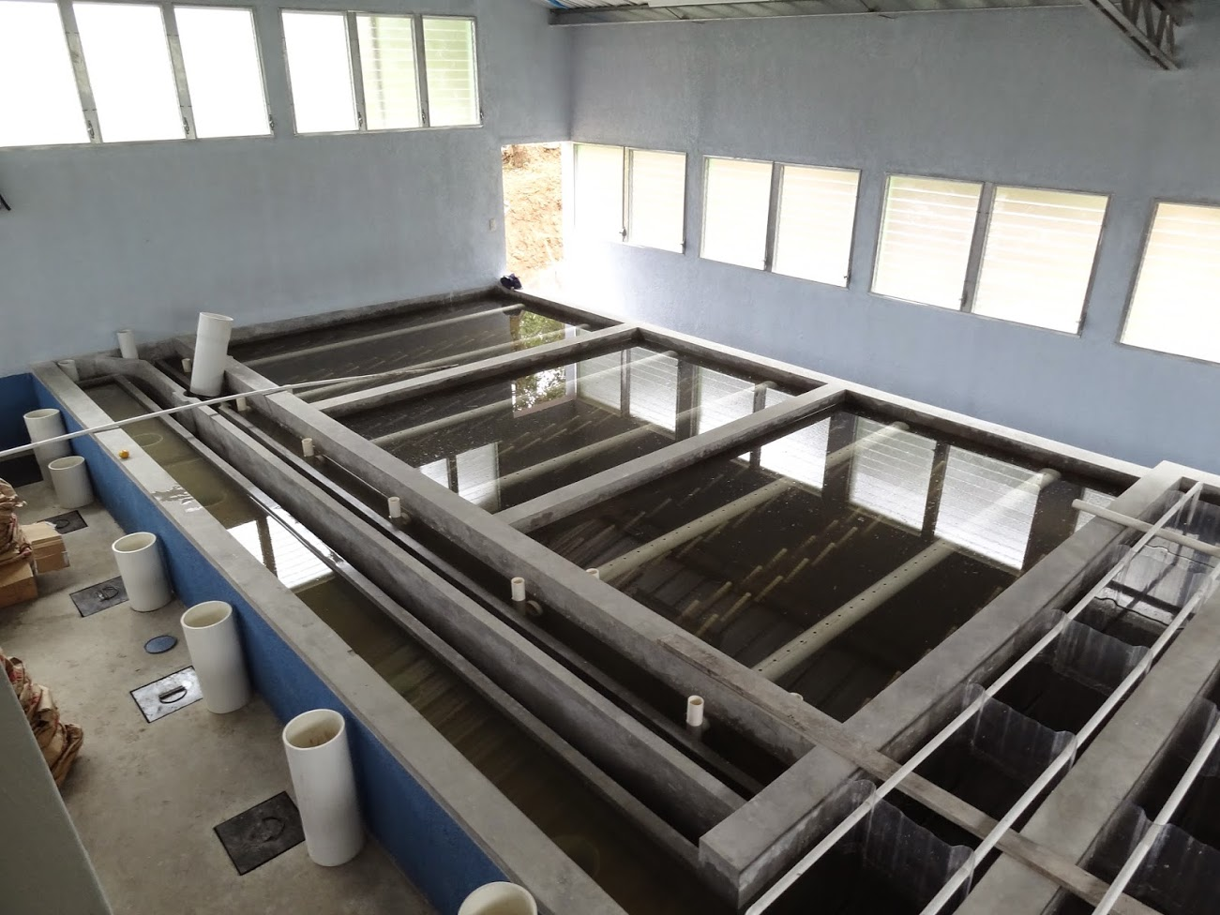
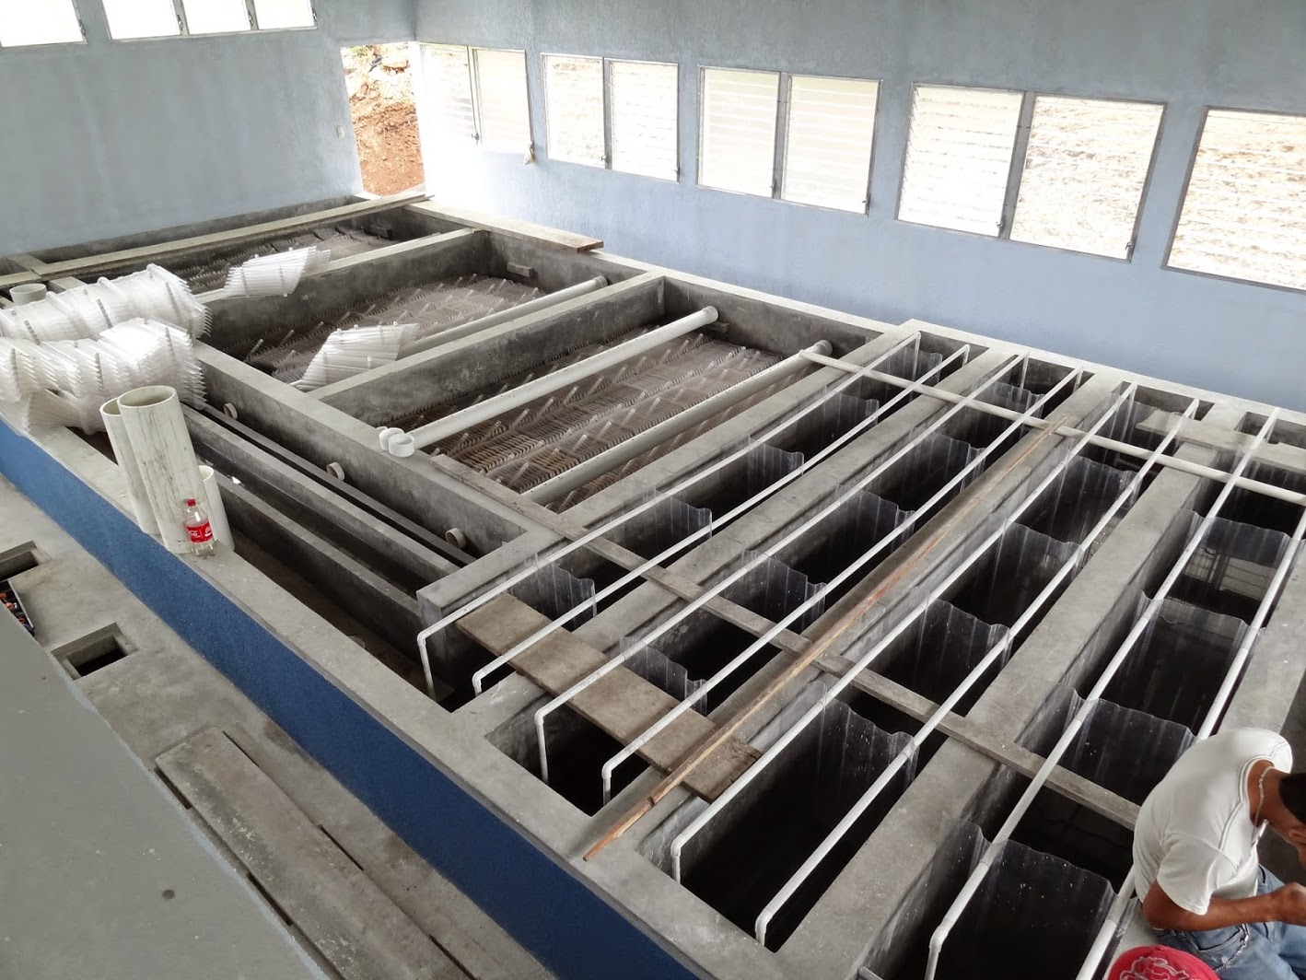
Possible Methods
Use transparent material to cast water in the plant
    Glycerin soap
    Shows water levels
    Removable
    Building like case
AutoCAD → 3D Printing
Cardboard/Paper Model
Final Model

Slide 8
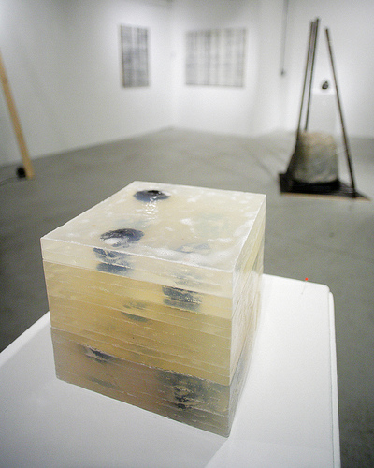
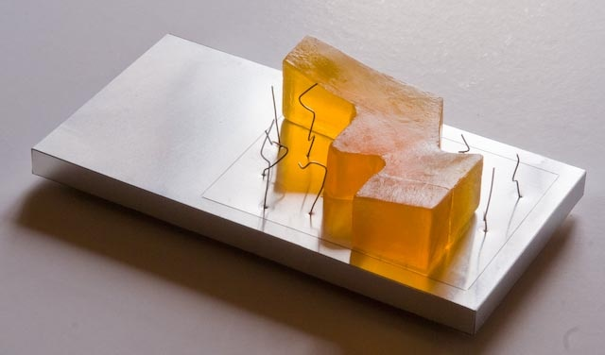
Soap Model
Glycerin soap Properties:
Low transparencies
Heavy
malleable surfaces
Difficult to clean up

Slide 9
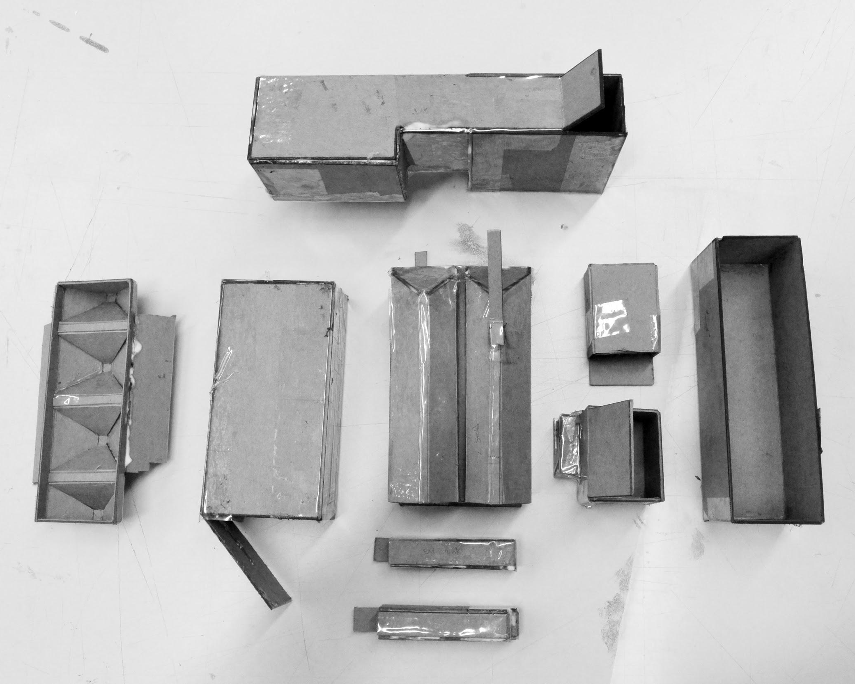
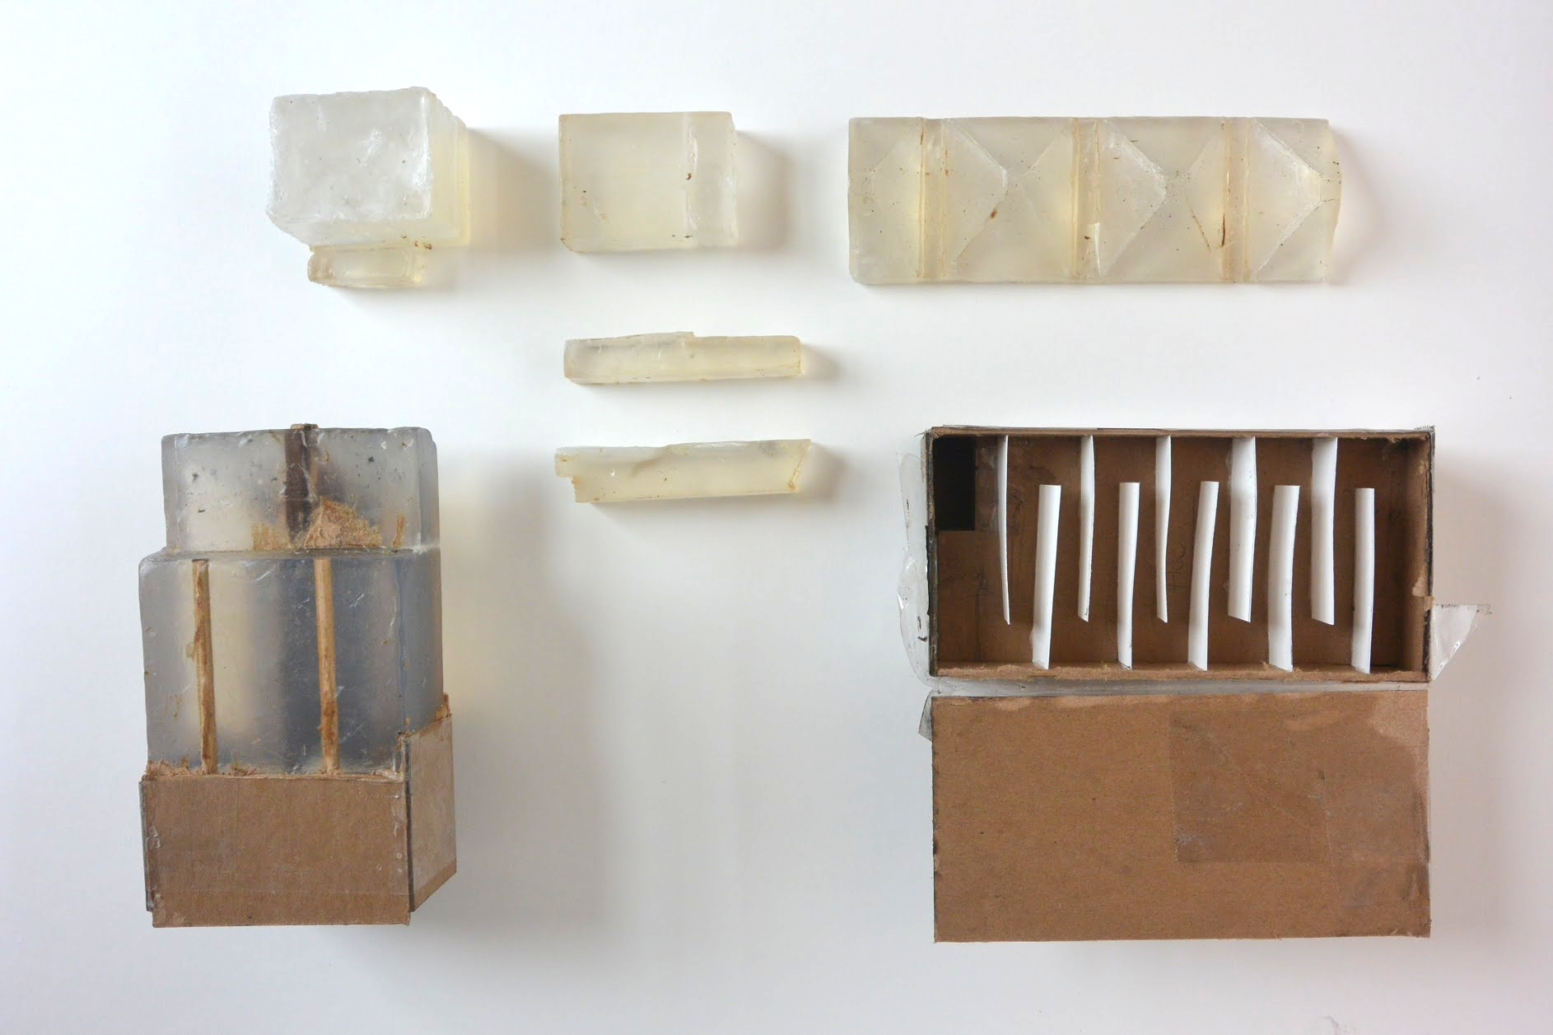
Soap Model
Trial Glycerin Soap Model Molds
Trial Glycerin Soap Model Components

Slide 10
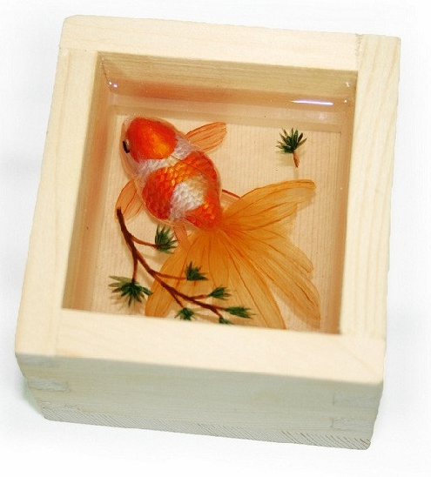
Epoxy Resin Model
Epoxy Resin Properties:
Plastic used to cast objects
  Advantages:
      Higher transparency level
      Smoother finish
  Disadvantage:
      Reacts with molds
      Toxic

Slide 11
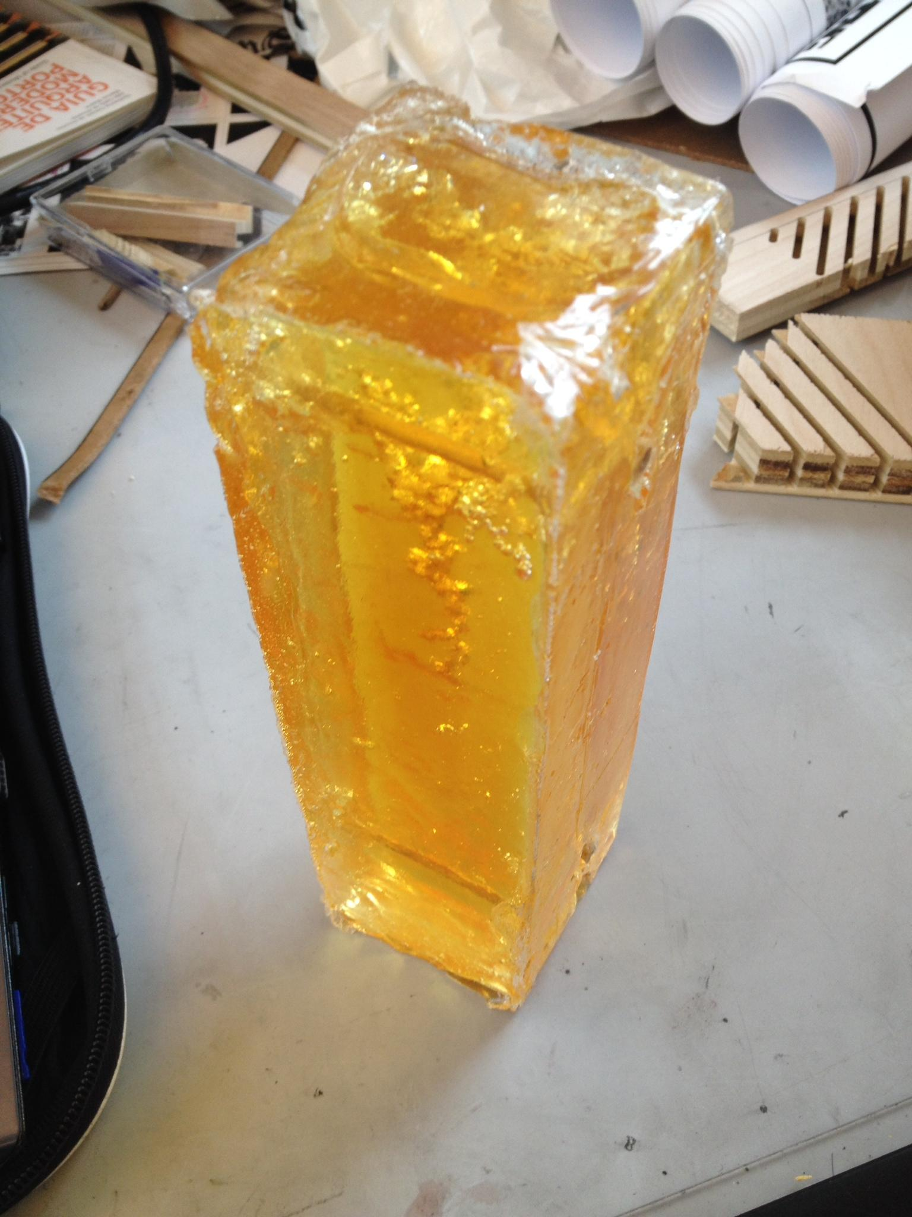
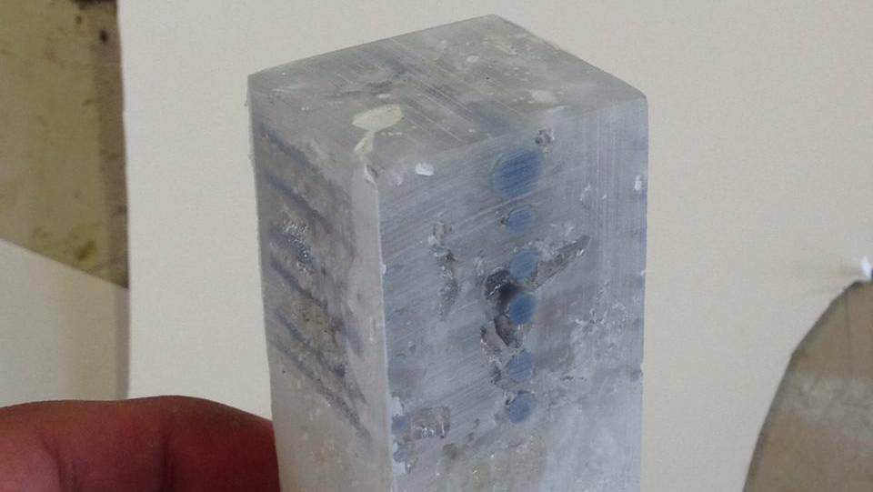
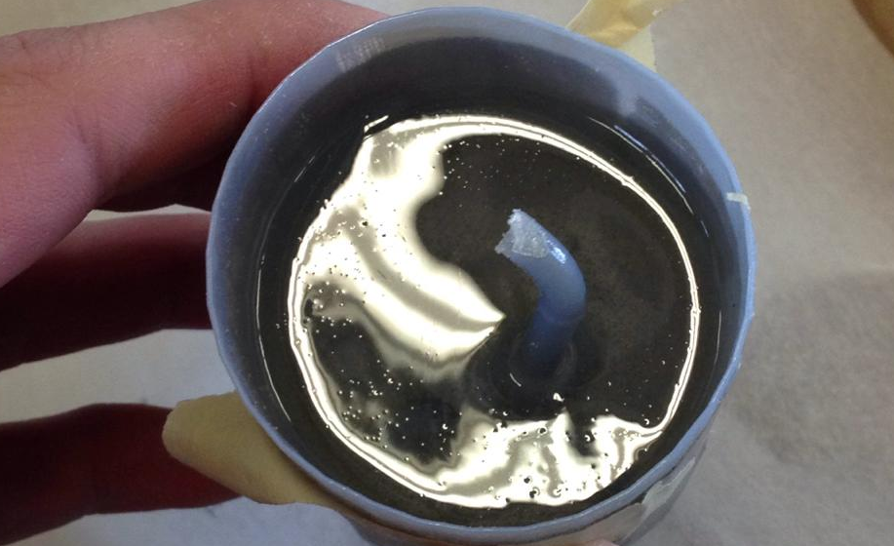
Epoxy Resin Model
Epoxy Cast Smooth-On 690 with Foam Board Mold
Epoxy Cast Smooth-On 650 with Cardboard Mold
Epoxy Cast Stuck Inside 3D Printed Mold

Slide 12
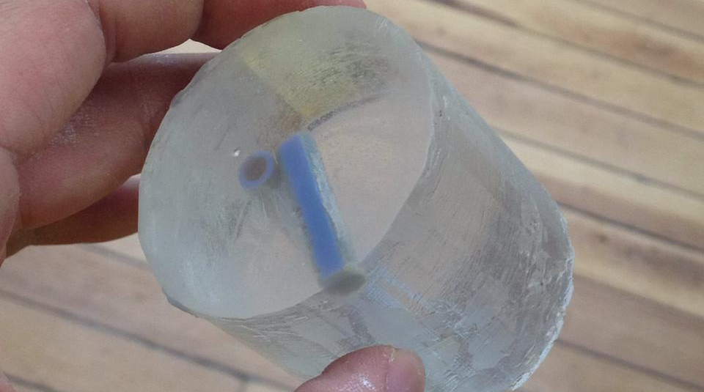
Epoxy Resin Model
3D printed mold
Vaseline used as release agent
Epoxy Poured into 3D Printed Mold with Vaseline Release

Slide 13
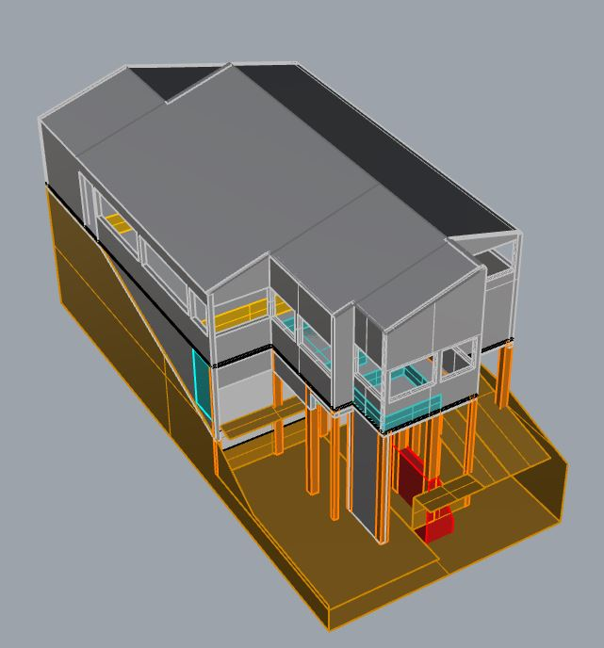
3D Modeling
Based on the Moroceli plant
3D model extracted from CAD plans of the plant
Minute details were neglected
3D Model Plan Created Using Rhinoceros

Slide 14
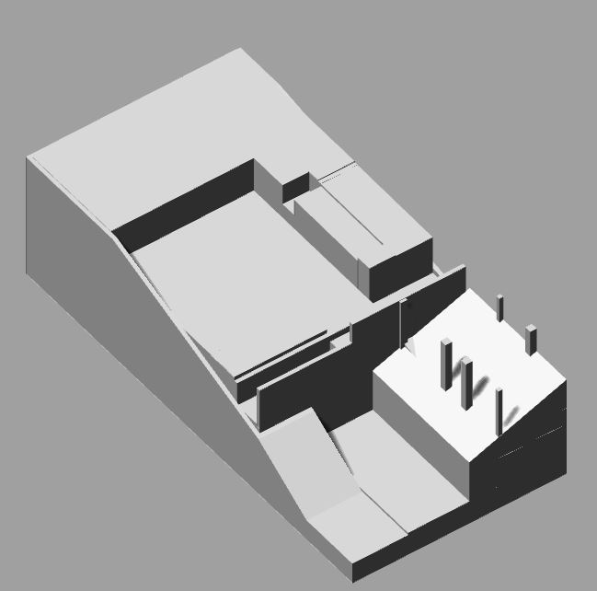
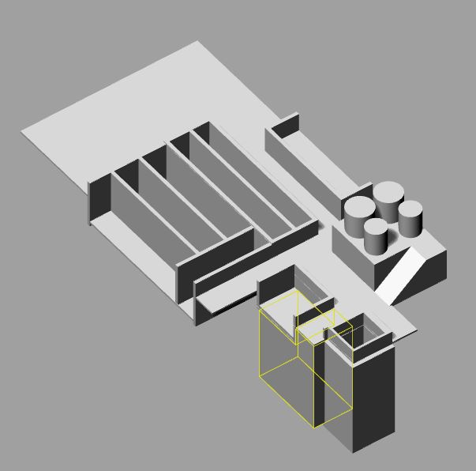
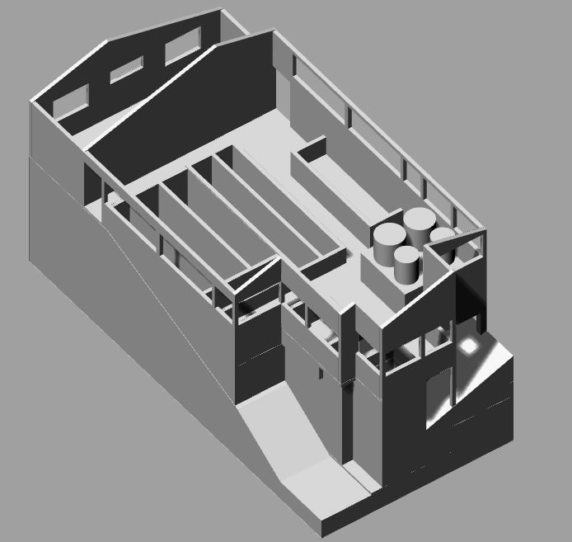
Model Components
1 Site and Foundation
2 Main Plate and Tanks
3 Walls + Enclosure

Slide 15
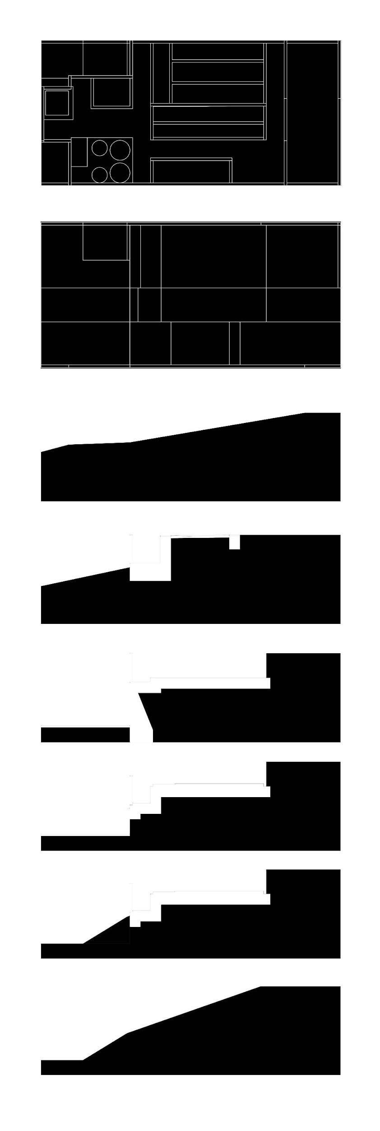
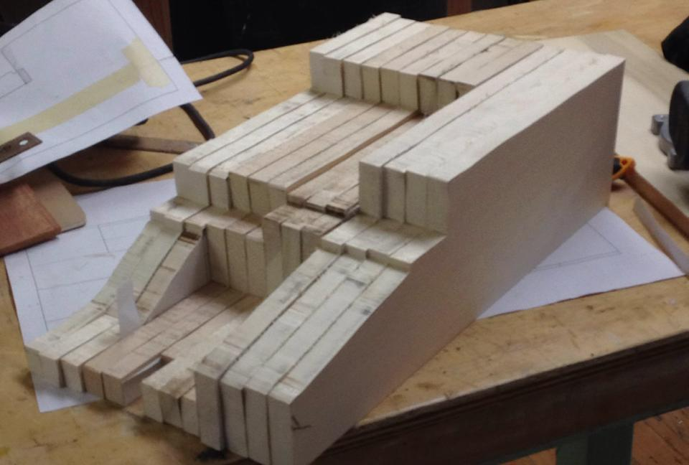
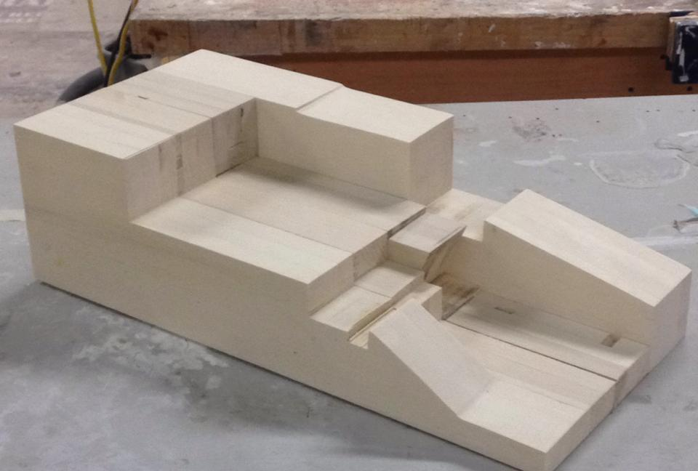
3D Modeling
Site Model Progress
Polished Site Model
Section Drawings of Site

Slide 16
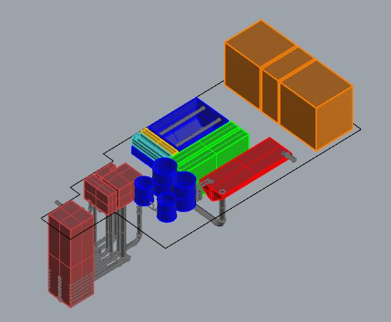
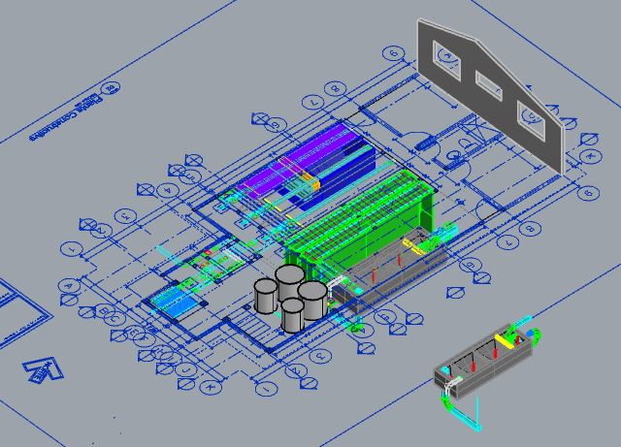
Model Progress
Essential components of plant
Scaling components for final model

Slide 17
AutoCAD to 3D Printing
Different surface meshing procedures
Extrude pipe from donut surface

Slide 18
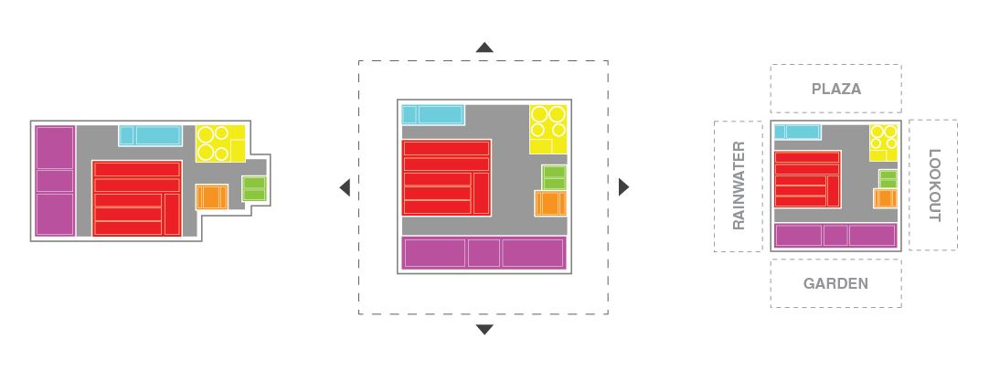
Reimagining the Plant
AguaClara building could be more than just a water treatment system
Potential community icon for village

Slide 19
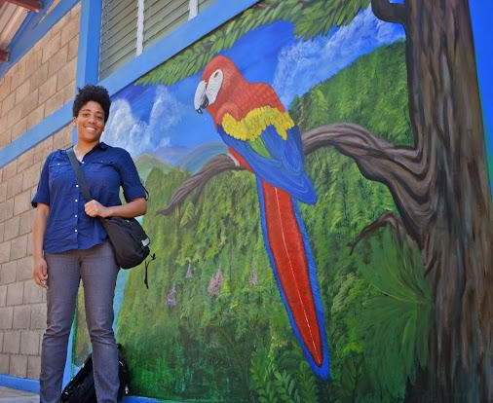
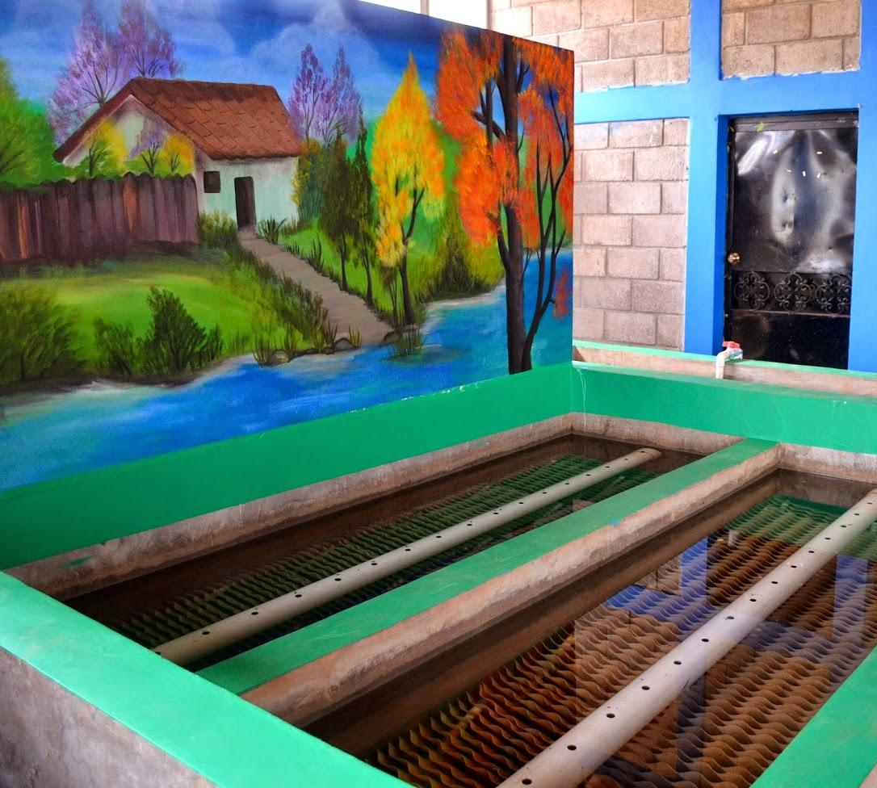
Reimagining the Plant
Mural paintings in Atima, Honduras

Slide 20
Conclusion
Worked on creating a smaller model of the AguaClara plant
Simplified understanding process by casting water
Experimented with different meshing processes

Slide 21
Future Works
Finish current model
Continue experiment with meshing in AutoCAD
Link AutoCAD with 3D Printing
Modify model composition to include future AguaClara changes

Slide 22
Questions
and/or
Comments?

