Slide 1

Small Scale Plant Model
Final Presentation Spring 2013

Slide 2
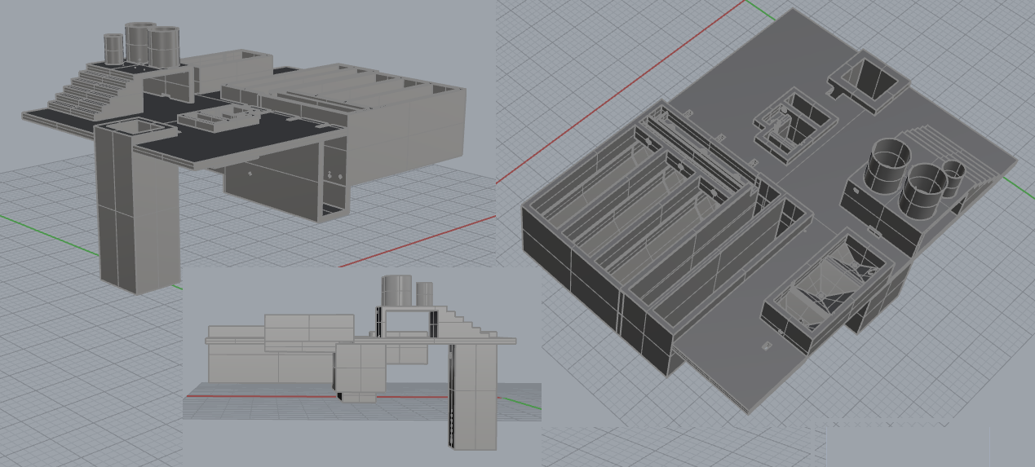
AutoCAD model

Slide 3
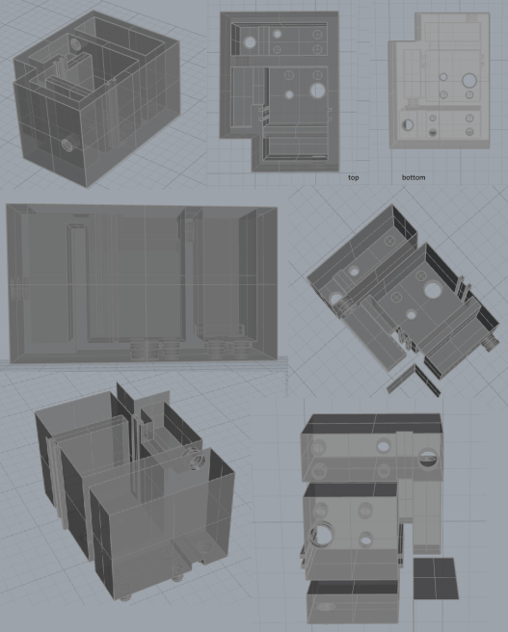
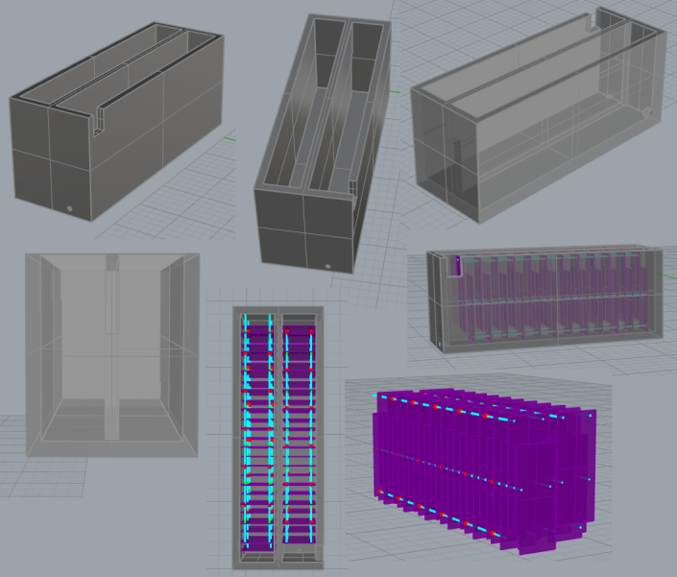
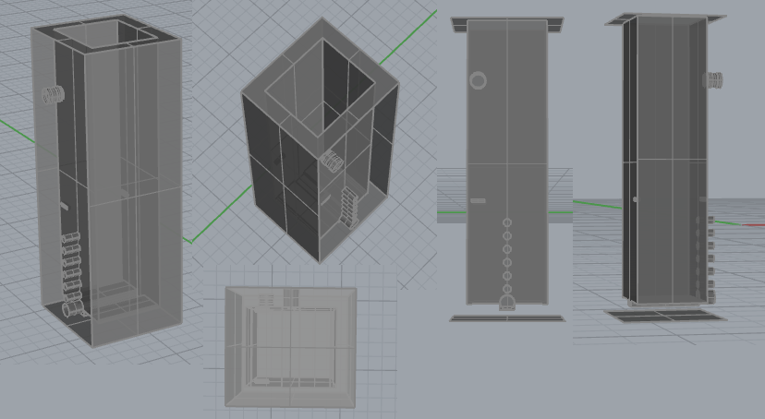
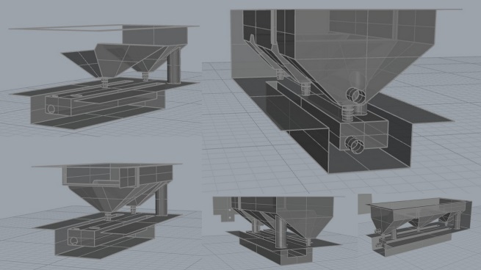
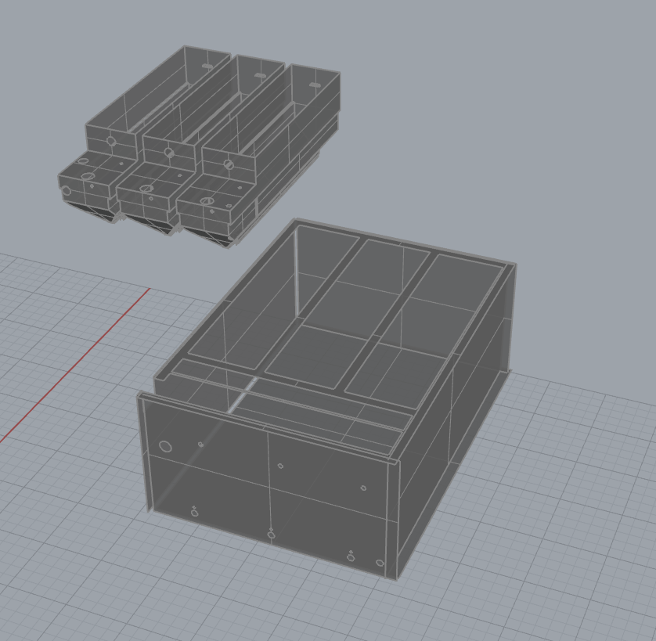
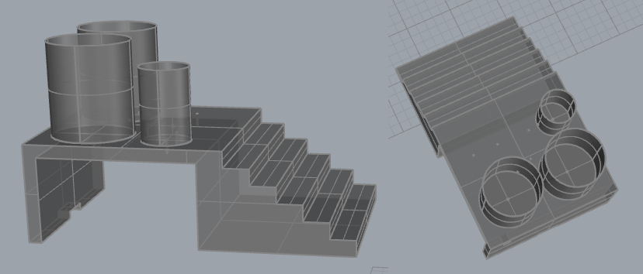
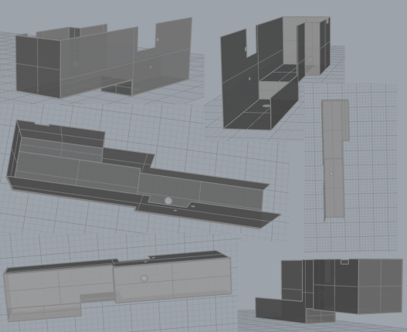
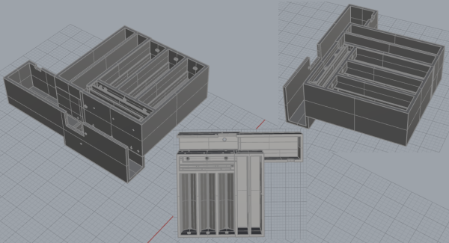

3-Dimensional Composite Shots

Slide 4
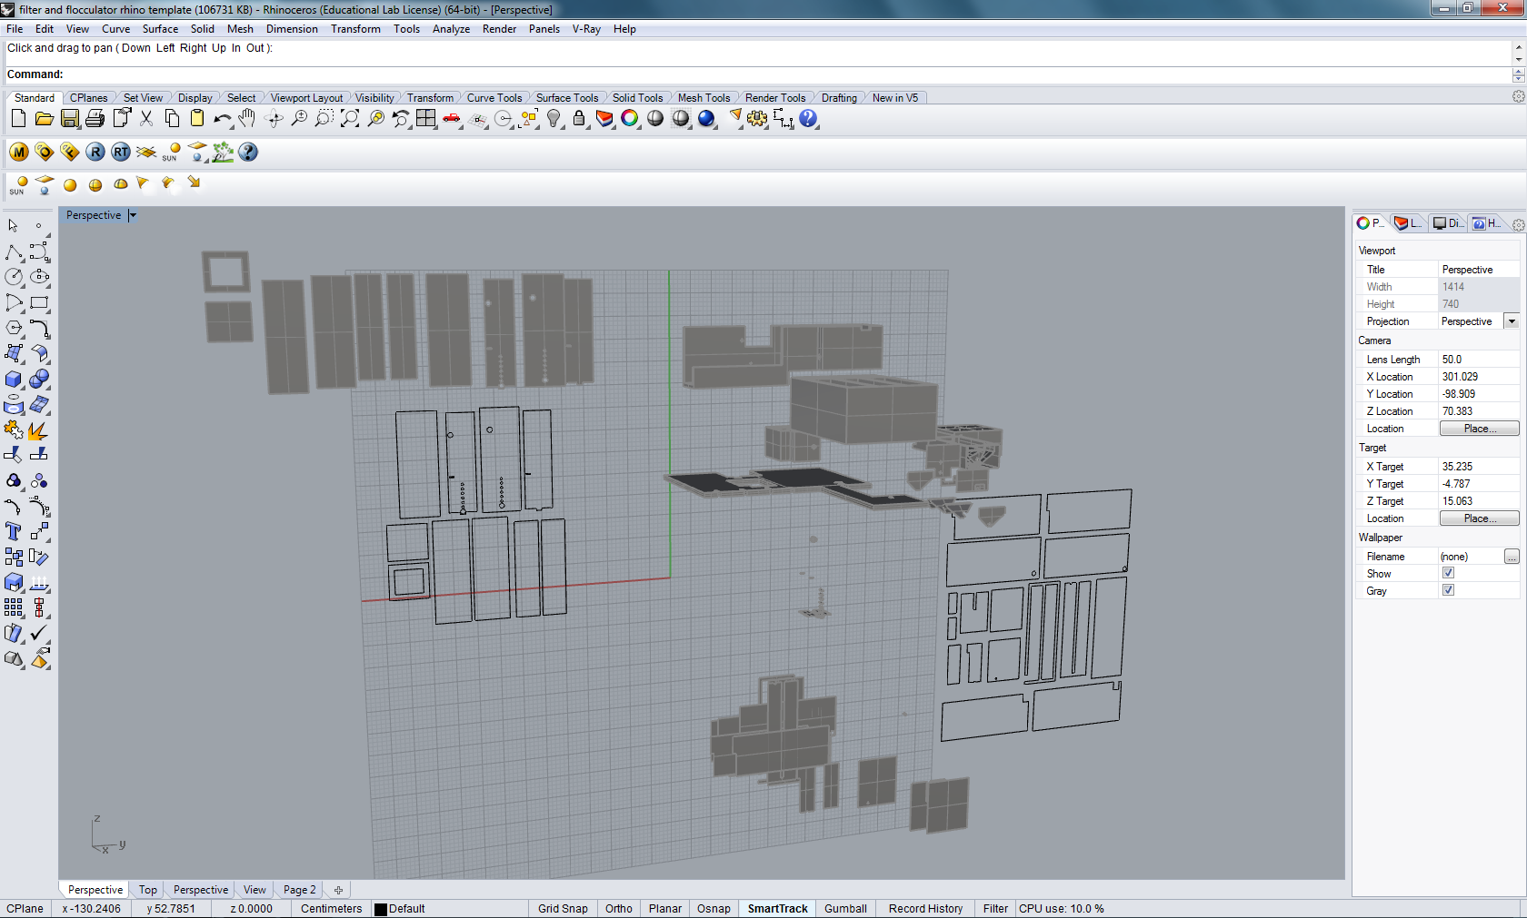
Creating Templates in Rhino

Slide 5
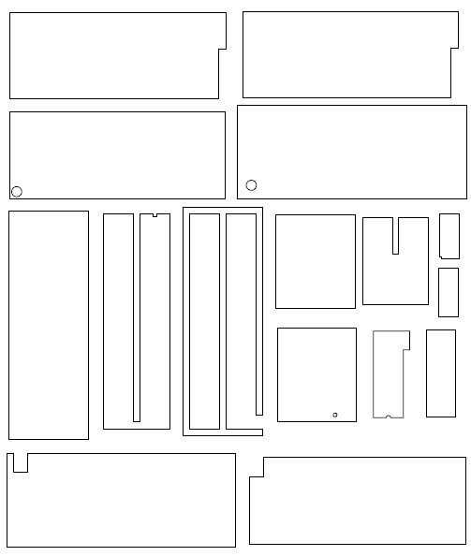
Exploded PDFs

Slide 6
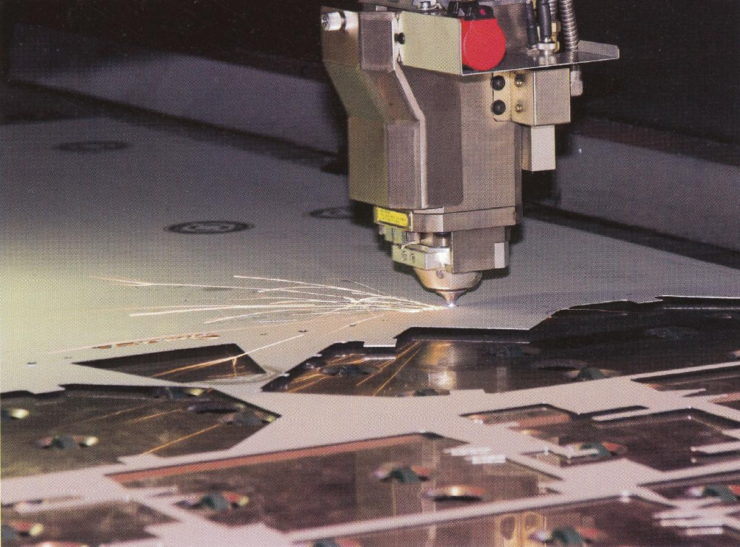
Optimized for Laser Cutting?

Slide 7
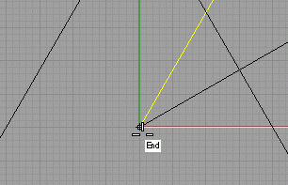
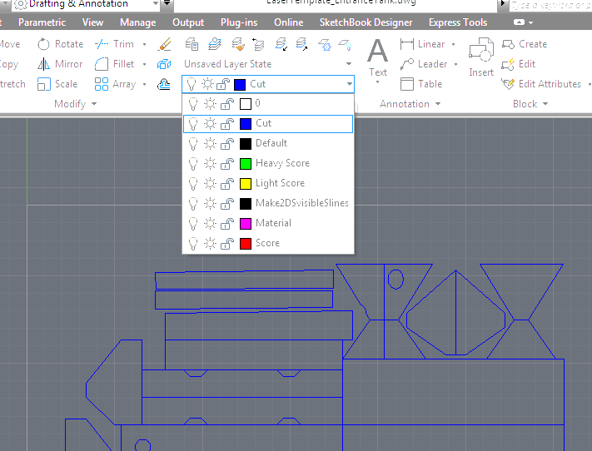
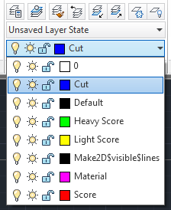

Frank Parish: Optimizing Templates

Slide 8
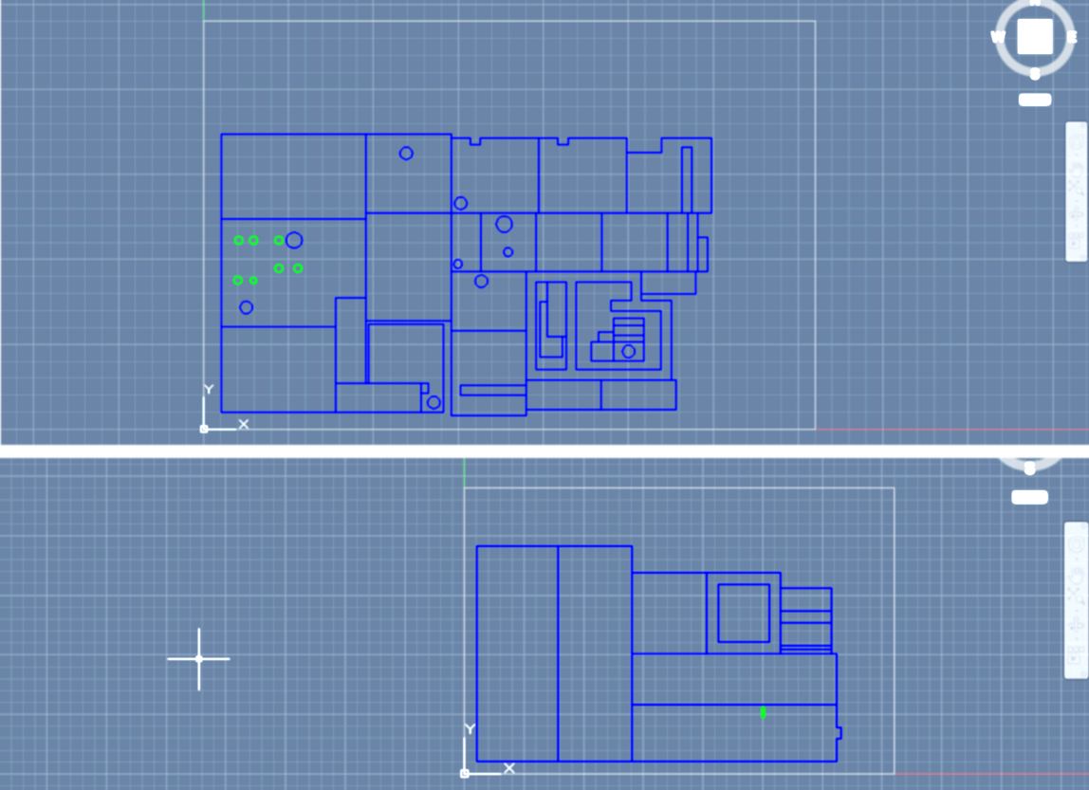
Filter Inlet and Filter

Slide 9
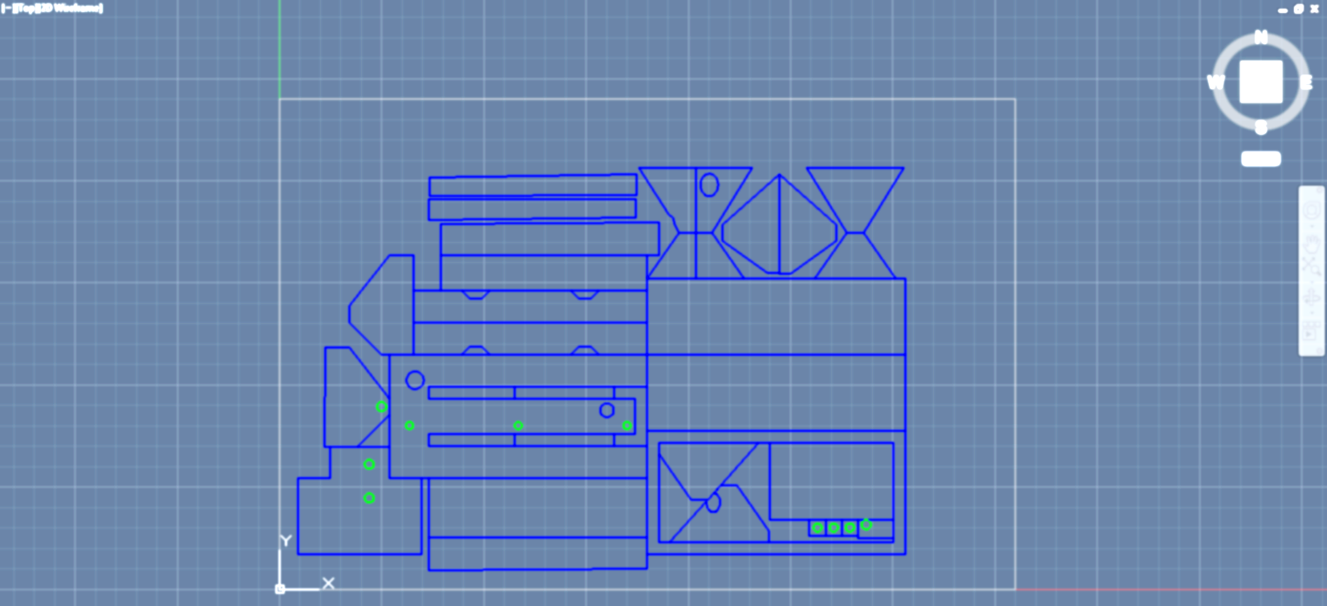
Entrance Tank

Slide 10
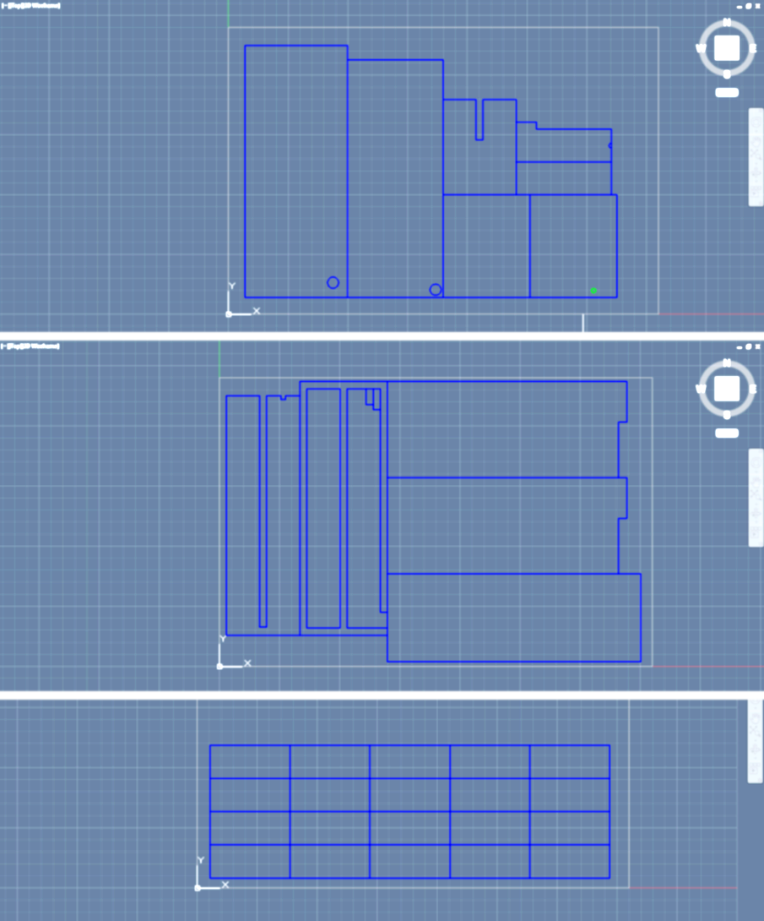
Flocculator

Slide 11
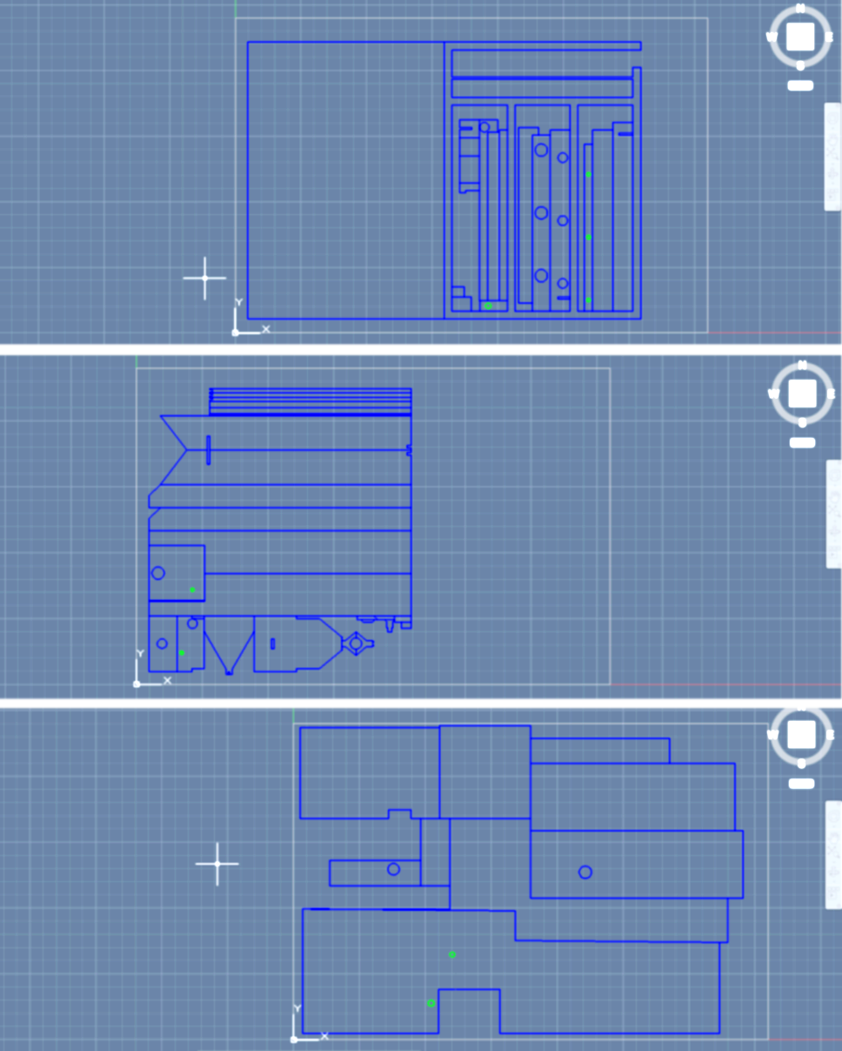
Sedimentation Tank

Slide 12
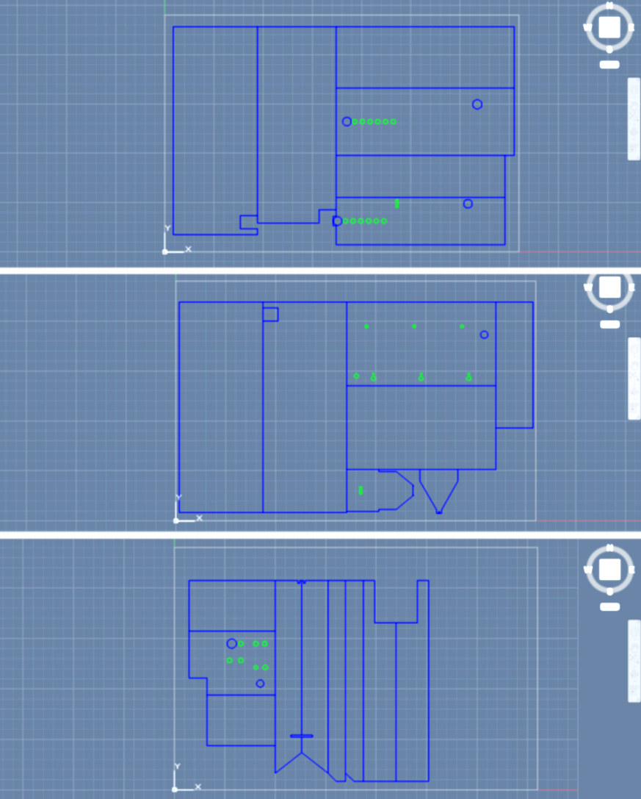
Transparent Pieces

Slide 13
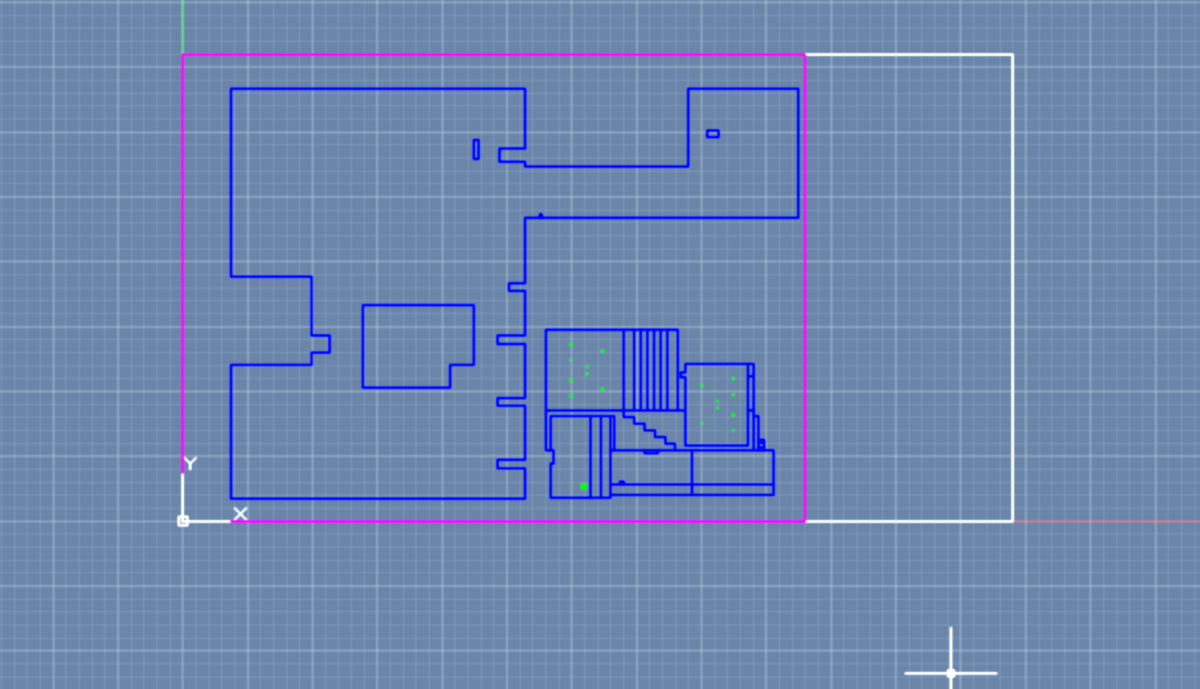
Main Base/Staircase

Slide 14
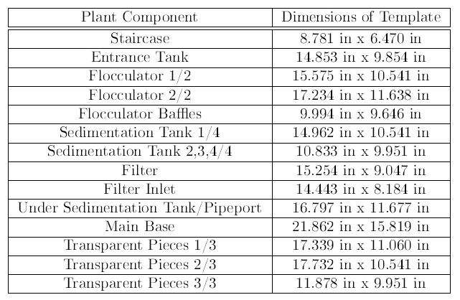
Final Template Dimensions

Slide 15
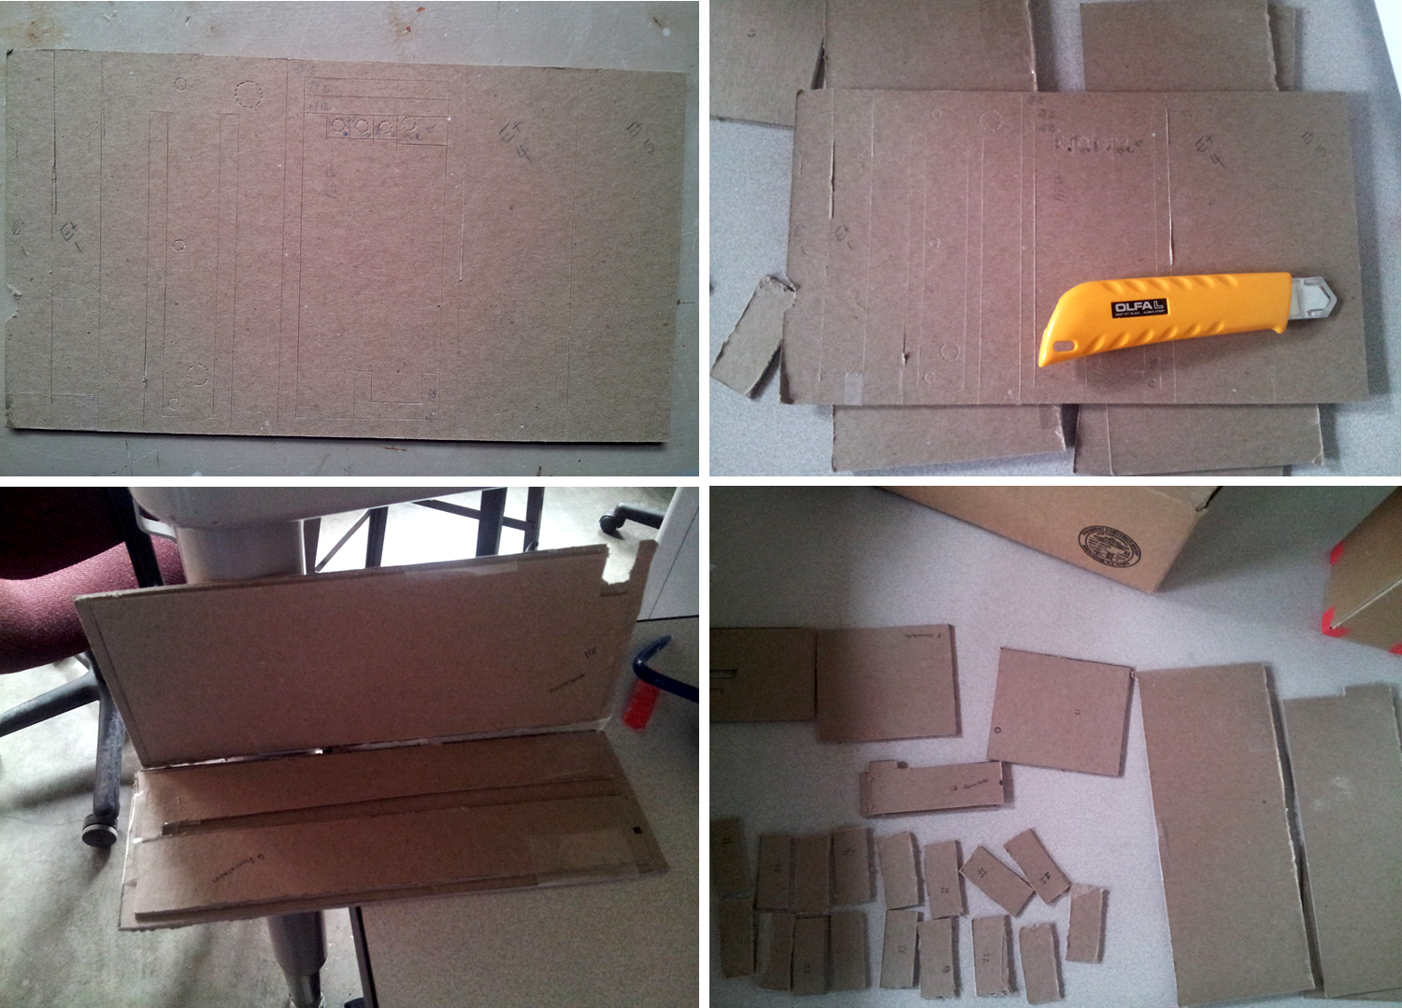
Mock-Up Construction

Slide 16
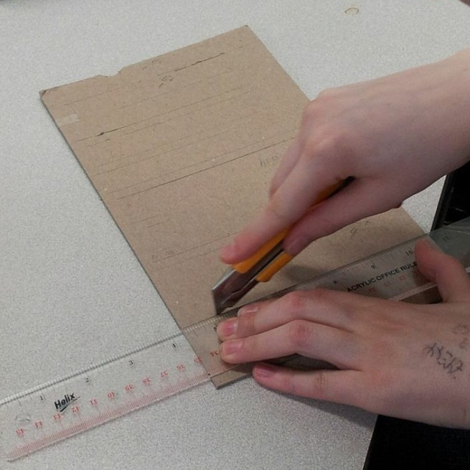
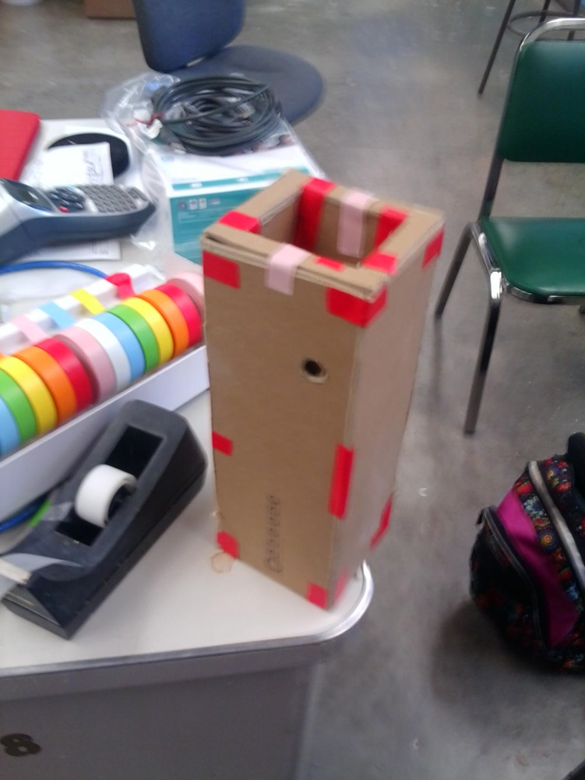
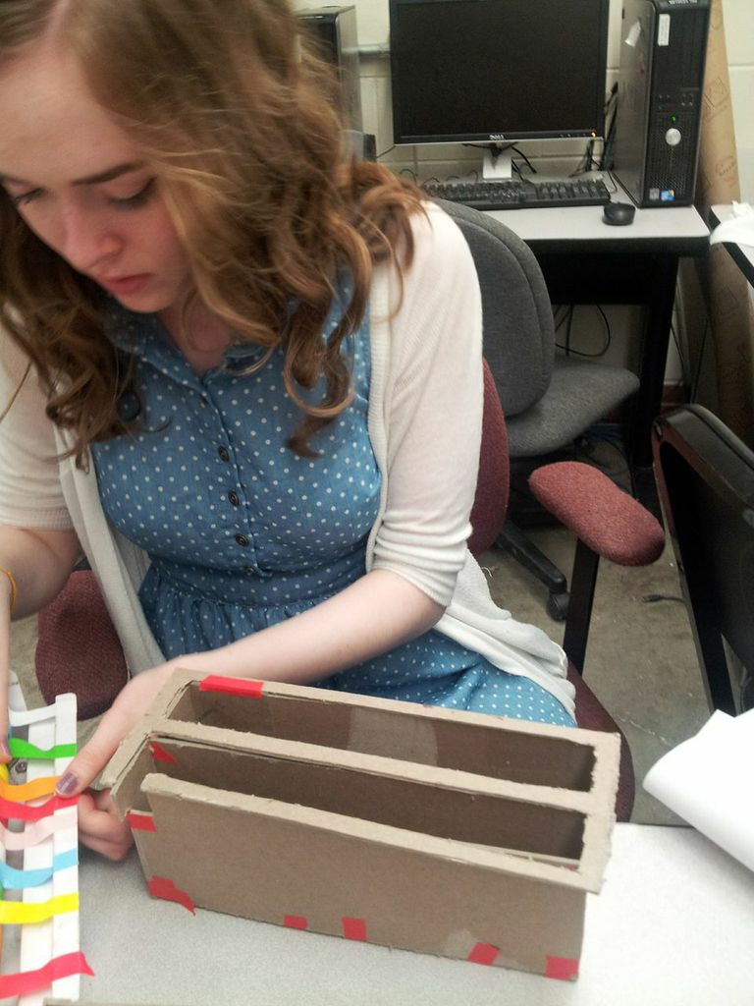
Mock-Up Construction

Slide 17
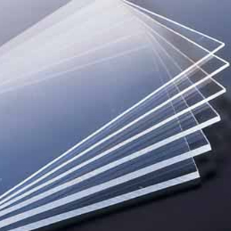
Plexiglas
3 sheets 18” x 12” transparent
6 sheets 24” x 24” white (to be cut down to 18” x 24”)
1 sheet 12” x 12” blue

Slide 18
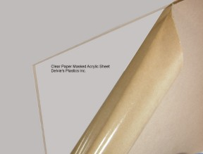
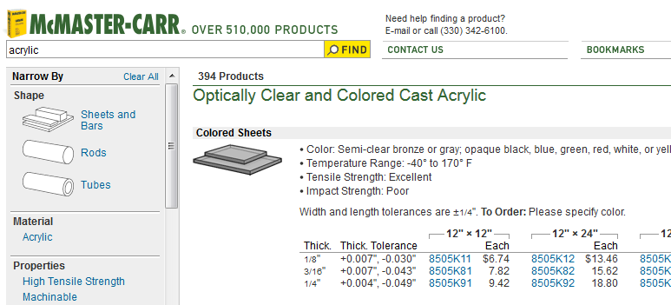
Final Materials
McMaster-Carr
Delvie’s Plastics, Inc.

Slide 19
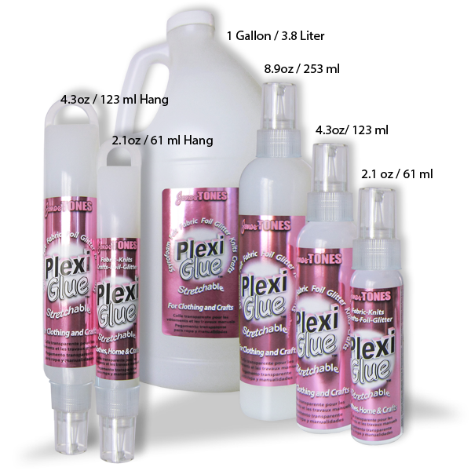
Plexiglue

Slide 20
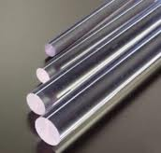
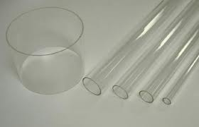

Plexiglas Tubing and Rod
Ithaca Plastics
  Tubing – $1/8$” inner, $1/4$” outer
  Rod – $1/8$”
Other suppliers?

Slide 21
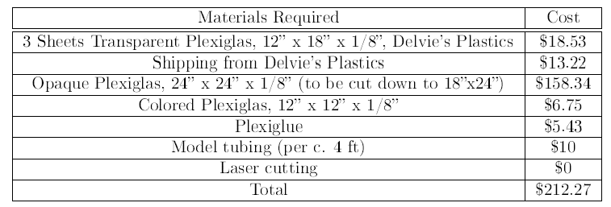
Budget

Slide 22
What’s Transparent and Why?
Filter sides
Flocculator sides
Sedimentation tank sides
Entrance tank sides
Filter inlet sides

Slide 23
Future Work
Complete mock- up
Finalize Laser Templates
  Consider thickness of Plexiglas
Cut Plexiglas (it’s been delivered!)
Use mock-up to idealize non-Plexiglas pieces

Slide 24
Non-Laser Cut Pieces
Piping
Linear Flow Orifice Meter (LFOM)
Plate settlers
Diffusers
Sand in filter
Floc blanket

Slide 25
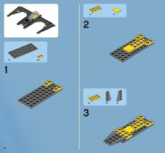
Future Work
Document Construction
  Think Lego manual!
Complete final model!!

