Slide 1
Design Team
Spring 2015

Slide 2
Goal
Update the Design Tool
What is the Design Tool?
AutoCAD Drawing
Report of Plant
Materials List
Section Cuts
User Input:
Plant Flow Rate

Slide 3
Server
Interface
Data and design flow rate input
Mathcad
General functions and inputs
User Email
Delivery of design materials
Mathcad
Design algorithms
LabVIEW
Program execution and communication between components
Mathcad
AutoCAD drawing algorithms
Microsoft Word
Design documentation
AutoCAD
3D plant model

Slide 4
Challenges
Sedimentation Tank Updates: Dave
Materials List: Stephanie and Ewa
Chemical Dose Controller: Michelle

Slide 5
Sedimentation Tank
Updates
David Gold

Slide 6
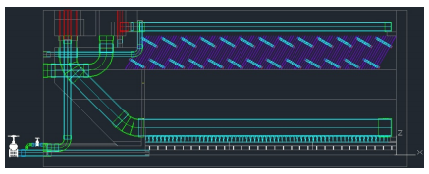
Code Organization
Design code has been incrementally updated over the past several years
Pieces of outdated code still exist in the current code

Slide 7
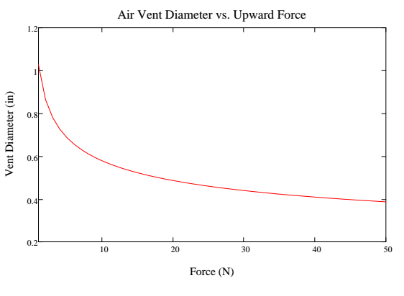
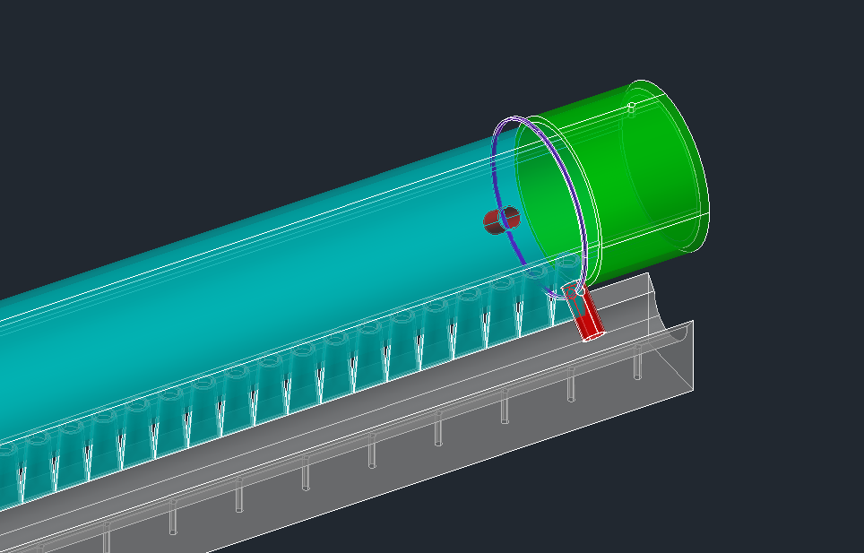

Manifold Air Vent

Slide 8
Sedimentation Tank
Questions?

Slide 9
Materials List
Stephanie Sun
& Ewa Przybylko

Slide 10
Materials List
Goals for Spring 2015:
  Create MathCAD code to draw plant pipes and accessories as blocks in AutoCAD
  Extract a materials list from AutoCAD that counts the instances of each block in the drawing
Purpose:
  Make it easier for engineers in Honduras to extract hydraulic materials lists from the AutoCAD drawings

Slide 11
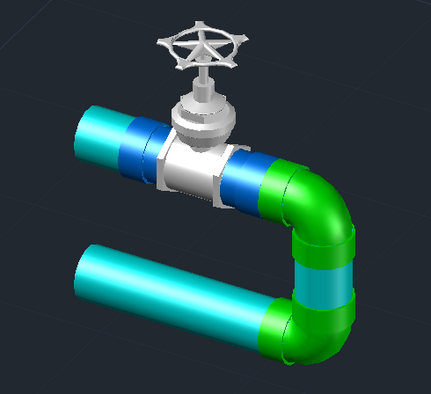
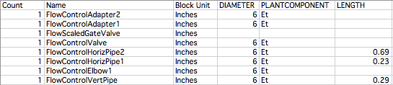
Materials List
Entrance Tank Flow Control Drain Grit
AutoCAD drawing (converted to blocks)
Sample Excel data output:

Slide 12

Materials List
So far:
  Successfully converted Entrance Tank drawing code to blocks and extracted Excel Materials Lists
Future:
  Apply this concept to other plant components
  Explore automating data extraction process
Entrance Tank
Hopper Drains

Slide 13
Materials List
Questions?

Slide 14
Chemical Dose Controller
Michelle Lee

Slide 15
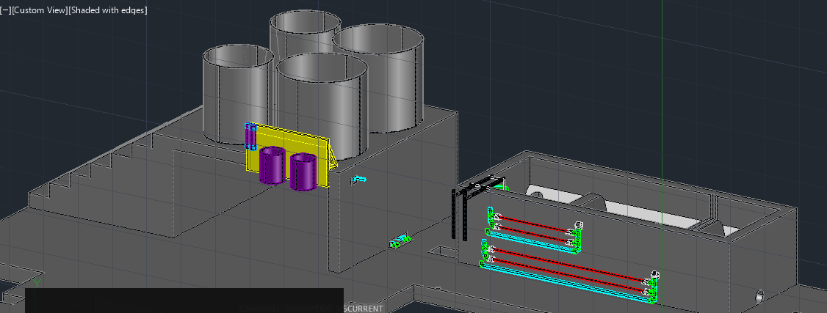
CDC
Importance
To update the design drawing of the CDC such it reflects to our clients of how the CDC is incorporated in the plant

Slide 16
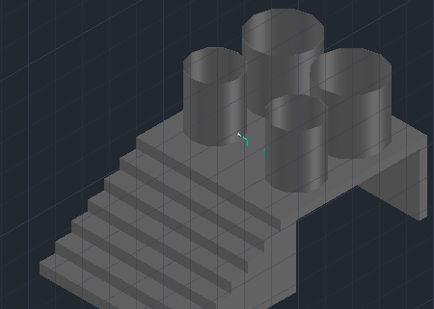
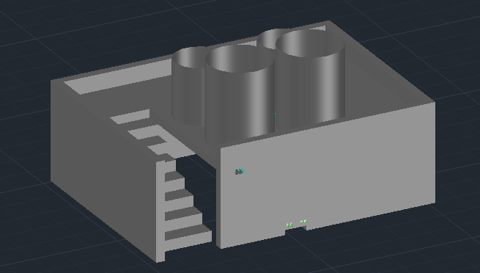
CDC
Progress
Modified the platform design in the plant drawing to improve its aesthetic appeal
Before
After

Slide 17
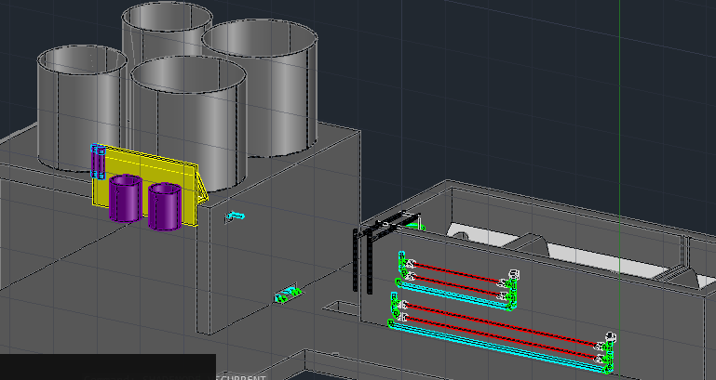
CDC
Future Plan
Continue to implement codes that draw pipes, tubes and other parts that are used in the Chemical Dose Controller.

Slide 18
CDC
Questions?

