Slide 1
Full Scale Floc Breakup
David Buck and Meg Fitzgerald

Slide 2

Flocculation – Quick Review
Coagulation
Flocculation
Floc Blanket
Sedimentation
Filtration
Collisions
More Collisions
Gravity!
Last chance!
Notes:
Here are the five stages of colloid or particle removal in hydraulic drinking water treatment plants. The first stage, coagulation, involves the addition of a chemical coagulant to destabilize a suspension of particles. The coagulant precipitates and attaches to the particle surface. Then in flocculation, velocity gradients in the water cause the particles (now coated in precipitated coagulant) to collide and stick to one another forming aggregates. In floc blankets there are many more opportunities for collisions. In sedimentation, fluid flow is very slow and the aggregates settle to the bottom of the tank. Filtration is often used to remove any remaining particles but is not included in the bench-scale setup.

Slide 3

Concept of Floc Breakup
“Big Flocs are Useless” Theory
Large Diameter Flocs and Shear Forces
  TO THE WHITE BOARD!!!

Slide 4
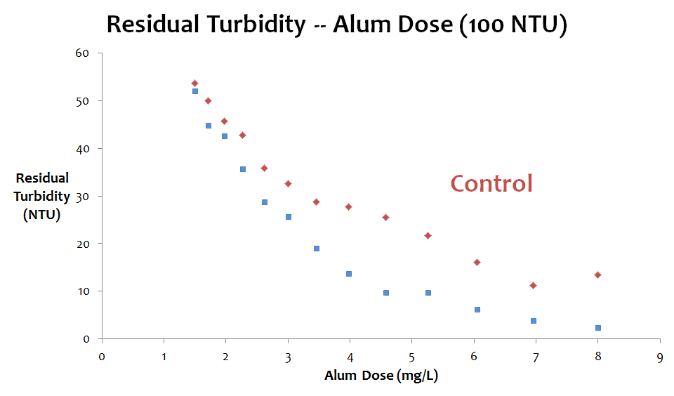
Why?
Evidence of Improved Performance
Notes:
Patience’s research indicates that adding break up points in flocculation improves performance by reducing effluent turbidity. This experiment was carried out in a laminar flow tube flocculator, but we believe the same principles apply and will be effective in a full scale turbulent flocculator.

Slide 5
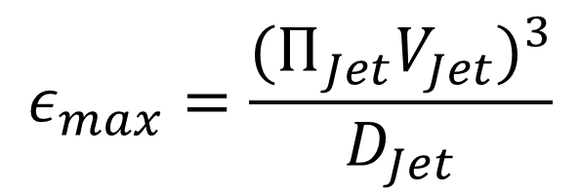
How?
Energy Dissipation Rate and Mixing
Flow expansions create jets
$$ε_{max}=\frac{{{(Π}_{Jet}V_{Jet})}^{3}}{D_{Jet}}$$
Notes:
build floc breakup device that will break large flocs into small flocs
small flocs will aggregate better
fewer colloids left at the end of flocculation
The mesh will create small orifices which will act as jets, create a flow constriction and expansion and dissipate energy as it breaks up large flocs

Slide 6
Our Goals
Design a device
Build a device
Send said device to Honduras for testing
Notes:
build floc breakup device that will break large flocs into small flocs
small flocs will aggregate better
fewer colloids left at the end of flocculation

Slide 7
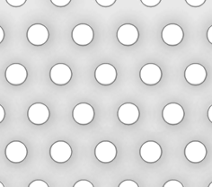
Basic Design Idea
Plate with holes in it

Slide 8
Constraints – What are the design considerations?
Head Loss through flocculator
Clogging
Floc Roll up
Specifications of the plant at Atima
%Open Area
Minimum Pore Size
Broken Particle Size
Q_{plant}, Cross Sectional Flow Area
Notes:
Questions to Group

Slide 9
Math
Assumptions:
  Q_{plant}= 16 L/s
  V_{captureSed}=0.36 mm/s
  A_{cross}=0.045m²
Steps:
  Determine target floc size
  Find energy dissipation rate
  Calculate possible solution set
  Compare to Available Materials

Slide 10
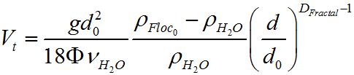
Target Floc Size
Floc Terminal Velocity as a function of diameter:
Relationship between Floc diameter and energy dissipation:
Rearrange, plug in what we know and what do we get?
D_{FlocMax}=0.113mm
ε_{Floc}=294 mW/kg

Slide 11
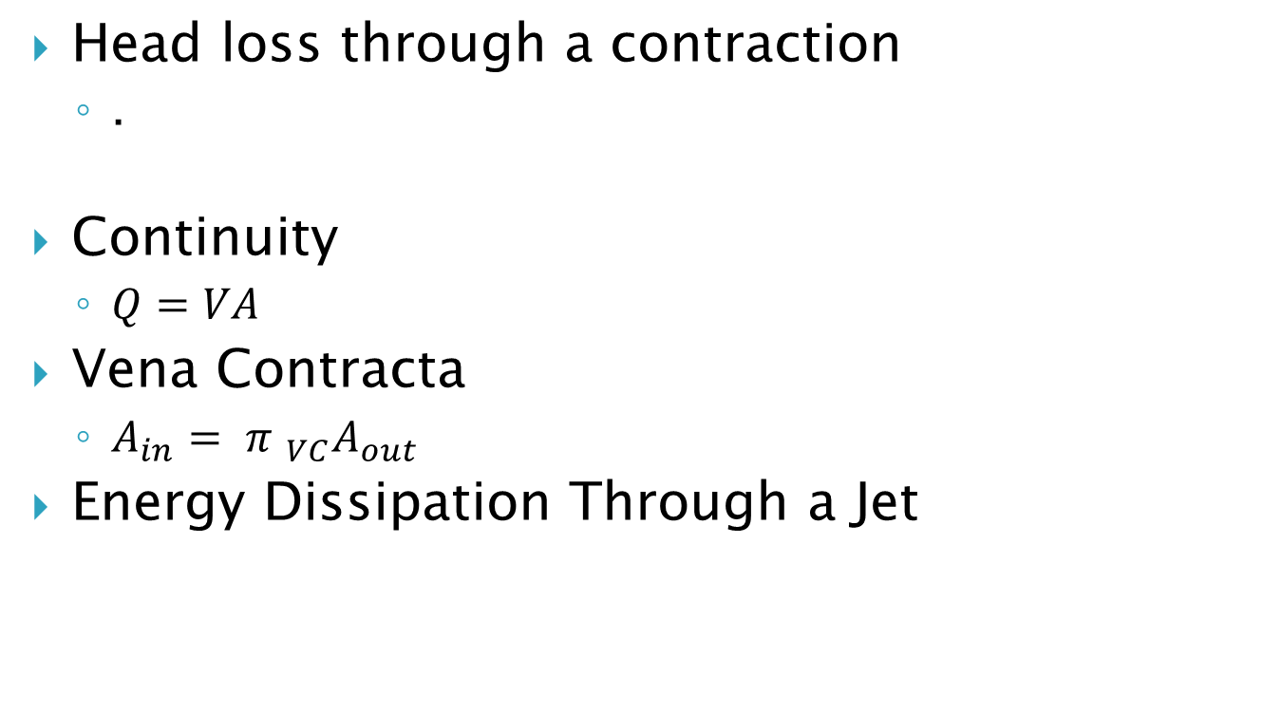
Major Concepts Behind Design
Head loss through a contraction
  .
Continuity
  $Q=VA$
Vena Contracta
  $A_{in}= {π }_{VC}A_{out}$
Energy Dissipation Through a Jet

Slide 12
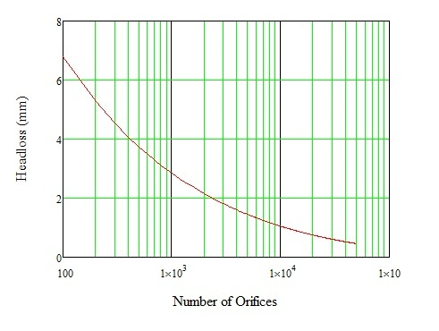
Head Loss as a Function of N_{orifices}

Slide 13
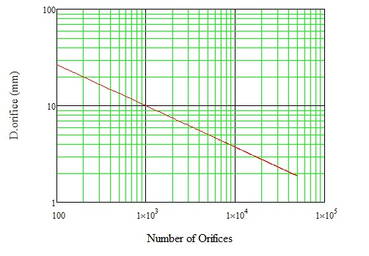
Orifice Diameter as a Function of N_{orifices}

Slide 14
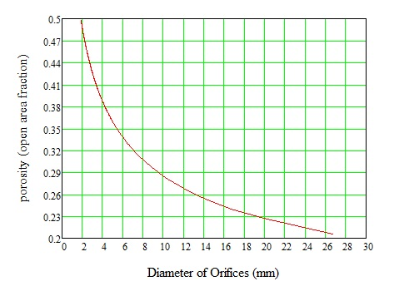
Porosity as a Function of Orifice Diameter

Slide 15
Material Selection
Compared available Material to solution set
Perforated Sheet Specifications:
  D_{orifice}=0.318mm = 0.125”
  Porosity = 40%
  N_{orifice}=14,000
Materials: steel, stainless corrosion resistant steel, polypropylene

Slide 16
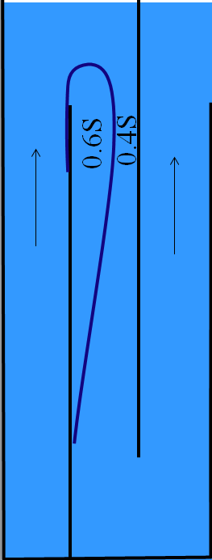
Placement
Where do you think it should go?

Slide 17

Brainstorm
How should we attach it to the Flocculator?

Slide 18

What’s Next?
Send it to Drew
See if it Works!

