Slide 1

Full Scale Floc Breakup
Team Members: David Buck and Meg Fitzgerald

Slide 2
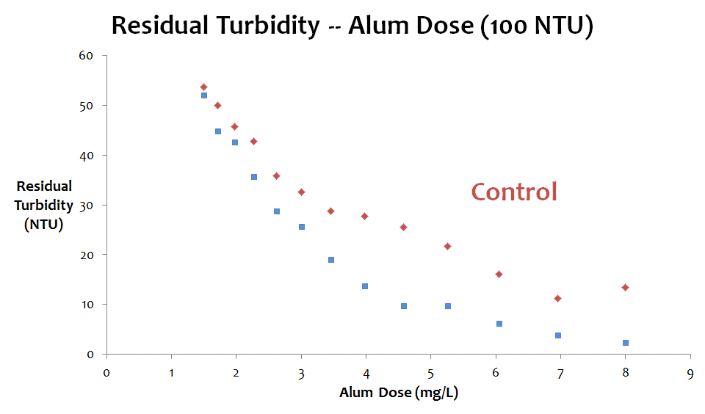

The Goal
Big Flocs are useless

Slide 3
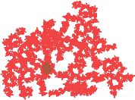
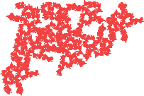
The Concept
Notes:
Velocity Gradients cause shear

Slide 4
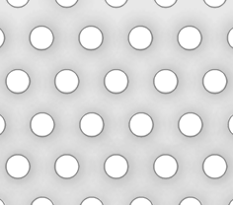
Basic Design

Slide 5
Design Procedure
Set Constraints
Target Floc Size and Energy Dissipation Rate
Optimal Number of Devices
Orifice Size and Porosity Design

Slide 6
Constraints: What are the failure modes?
  Energy dissipation
  Head Loss
  Porosity
Break up Flocs
Overtops the baffles
Streamlines bend as a jet
Notes:
Make one by one

Slide 7
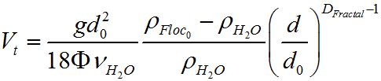
Target Floc Size and Energy Dissipation Rate
Broken Floc size function of Capture Sed Velocity
Energy Dissipation as a function of Floc Size
D_{FlocMax}=0.113mm
ε_{Floc}=300 mW/kg
Notes:
Add Top Function and target floc size and energy dissipation rate

Slide 8
Optimal Number of Devices
Time from broken to full floc size
Maximum Possible Devices = 75
Head loss is main constraint
Design Number of Device =5
Notes:
What number leads to a feasible solution

Slide 9
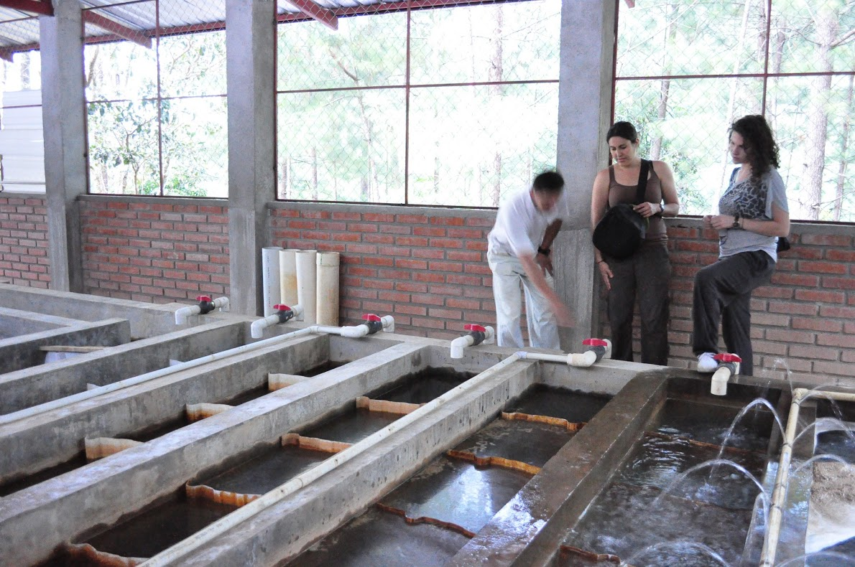
Orifice Size and Porosity – Head Loss

Slide 10
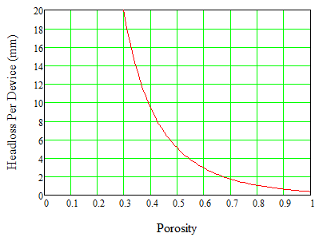
Head Loss
Notes:
Maximum headloss through entire flocculator = 5cm (only 10 cm of freeboard)
With 5 breakup devices we have a minumum of 0.39 porosity
If we increase number of devices, we decrease the headloss per device, which means we need a higher porosity, but we run into trouble with a high porosity because our streamlines don’t form a jet

Slide 11
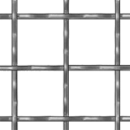
What do the streamlines look like?

Slide 12
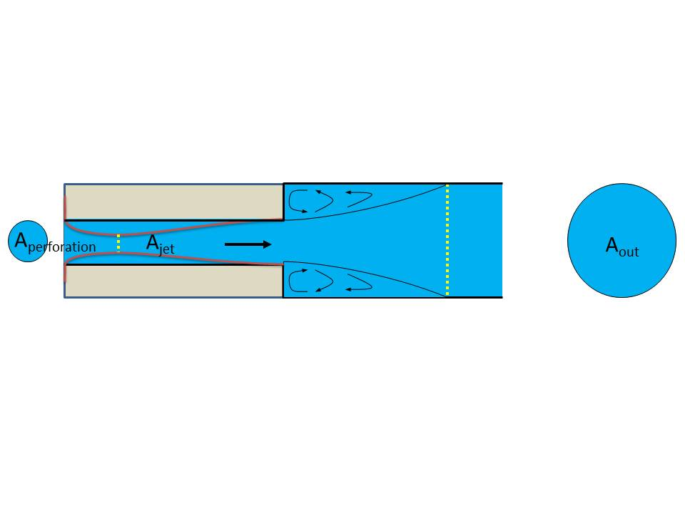
Energy Dissipation
  Flow Expansion creates energy dissipation, jets and mixing

Slide 13
Orifice Size and Porosity Design
Case 1: Orifice Diameter 1 cm; 11,887 orifices
Case 2: Orifice Diameter 5 cm; 475 orifices
Question: Does case 1 have more, less, or the same head loss as case 2? Why?
Notes:
Add Tricky Question Slide Porosity

Slide 14
Orifice Size and Porosity Design
Case 1: Orifice Diameter 9.4 cm; 5 orifices
Case 2: Orifice Diameter 2.6 cm; 100 orifices
Question: Does case 1 have a higher, lower, or the same energy dissipation rate as case 2? Why?
Notes:
Add Tricky Question Slide Energy Dissipation Rate

Slide 15

Final Design
Number of Orifices: 21
Orifice Size: 5.1 cm (2”)
Porosity: 39%
Materials
  Plastic sheets, drill holes
  Foam blocks for support
What’s Next?
  HAVE DREW TEST IT!
Notes:
Include Materials Selection and Optimal Placement

Slide 16

¿Preguntas?

