Slide 1
Case Studies in Food Safety
Martin Wiedmann
Department of Food Science
Cornell University
mw16@cornell.edu

Slide 2
Overview
Introductions
Class format and logistics
Course goals
An intro to case-based teaching
  Strategies for independent learning
  Strategies to solve problems
Food safety basics

Slide 3
Overview
Introductions
Class format and logistics
Course goals
An intro to case-based teaching
  Strategies to solve problems
  Strategies for independent learning
Food safety basics

Slide 4
Class format and logistics
Not a traditional course by any means
  Multi-institutional; with a variety of potential technical and other challenges
  Case-based rather than lecture based
The goal is for instructors for teach, but for everyone to learn (together)
  Independence and initiative is expected
Two types of evaluations: (i) graded and (ii) learning outcome assessments (not graded)
Logistics:
  Need to get Blackboard access (for readings, etc.)

Slide 5
Overview
Introductions
Class format and logistics
Course goals
An intro to case-based teaching
  Strategies for independent learning
  Strategies to solve problems
Food safety basics

Slide 6
Course goals
At the end of this course participants should be able to
  Understand (i) the biology and transmission characteristics of different foodborne pathogens (including typical sources and transmission routes) and (ii) the characteristics of the associated foodborne diseases.
  Evaluate the primary methods used to detect and subtype foodborne pathogens.
  Describe the causes and mechanisms of food contamination in various food-associated environments, and apply this knowledge to solving problems related to contamination of food.
  Integrate and apply core competencies in epidemiology and microbiology to solve/explain practical food safety problems.
  Apply critical thinking, problem solving and systems analysis skills to new situations.

Slide 7
Overview
Introductions
Class format and logistics
Course goals
An intro to case-based teaching
  Strategies for independent learning
  Strategies to solve problems
Food safety basics

Slide 8
An introduction to case studies and case-based learning
“Cases are factually-based, complex problems written to stimulate classroom discussion and collaborative analysis. Case teaching involves the interactive, student-centered exploration of realistic and specific situations. As students consider problems from a perspective which requires analysis, they strive to resolve questions that have no single right answer.”
Taken from: http://edutechwiki.unige.ch/en/Case-based_learning

Slide 9
Case-based format used here
May differ somewhat from case–to-case
Typically descriptive, narrative cases, parts of which are given successively
The goal is not as much to “correctly” solve the case, but develop strategies for solving cases
  Team work
  Setting learning goals and objectives (“to solve this case we need to know more about PFGE/epidemiological methods/norovirus biology etc.

Slide 10
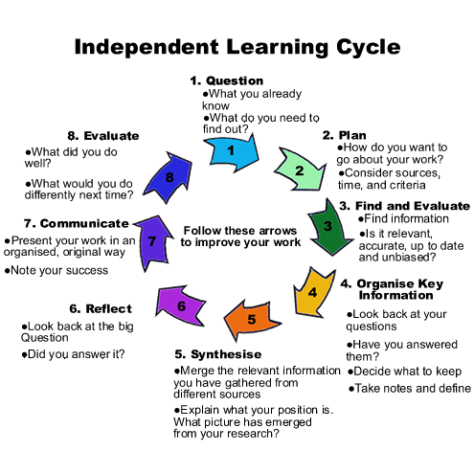
Taken from http://library.bishopluffa.org.uk/HTML_FILES/ilc.html

Slide 11
One problem solving strategy – “Differential diagnostic procedure”
Predominantly used in medical field
Key steps:
  Gather information
  Develop a list of possible causes for “the patient’s symptoms” or for us for “the problem to be addressed”.
    More effective if it uses a logical system, e.g., go through an experiment step-by-step to determine what may have gone wrong
    Need to find multiple possible causes (not just jump on one cause; “must be the hot dogs”)
Prioritization of the list of possible causes; possible prioritization methods are:
  Possibilistic – consider all causes equally likely
  Probabilistic – consider the most likely causes first
  Prognostic – consider the most serious causes first
  Pragmatic – consider the causes most responsive to treatment first
http://510medic.com/2010/07/07/differential-diagnosis-the-basics/

Slide 12
Problem solving – one possible framework
Define the problem
Identify (i) what relevant knowledge do I already have and (ii) what relevant knowledge do I not yet have
Develop learning goals
Find additional necessary, relevant, and reliable information (“information gathering”)
Develop a list of potential causes for the problem
Prioritize/rank potential causes
If needed collect additional information to refine the ranking of causes
Identify solutions/remedies for each potential cause
Implement remedies
Determine whether problem is solved
If problems persists, re-peat, focus on identifying alternative causes, alternative remedies, and implementing remedies for causes that had previously not made the priority list

Slide 13
Problem solving – how not do it
Hear about or see a problem (e.g., “yesterday’s experiment did not work”)
Identify a “cause” and a “solution” (e.g., “must be the undergrad that started working in the lab the day before; he/she prepared the media”)
Implement “solution” (“I guess I just have to do everything myself”)

Slide 14
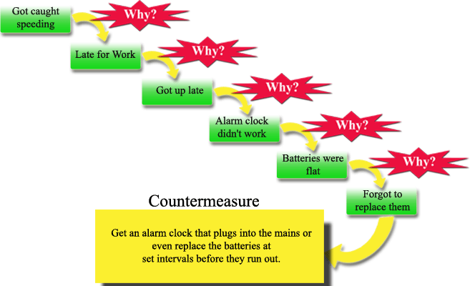
Root cause analysis – how to make sure the same problem does not happen again
From: http://www.educational-business-articles.com/5-whys.html

Slide 15
5 Whys Analysis
5 Whys is a simple and effective tool used to get to the root cause of a problem.
Subjective in its approach, it relies on the group analysing the problem, to come to their agreed conclusions as to what the root causes are to the problem at hand. It also relies on technical experts being present to drill down through the symptoms to get to the root cause.
The 5 Whys are set around asking ‘why’ to a problem, getting the answer and then asking why again and again, until you come up with the real root cause of a problem.
Adapted from: http://www.educational-business-articles.com/5-whys.html

Slide 16
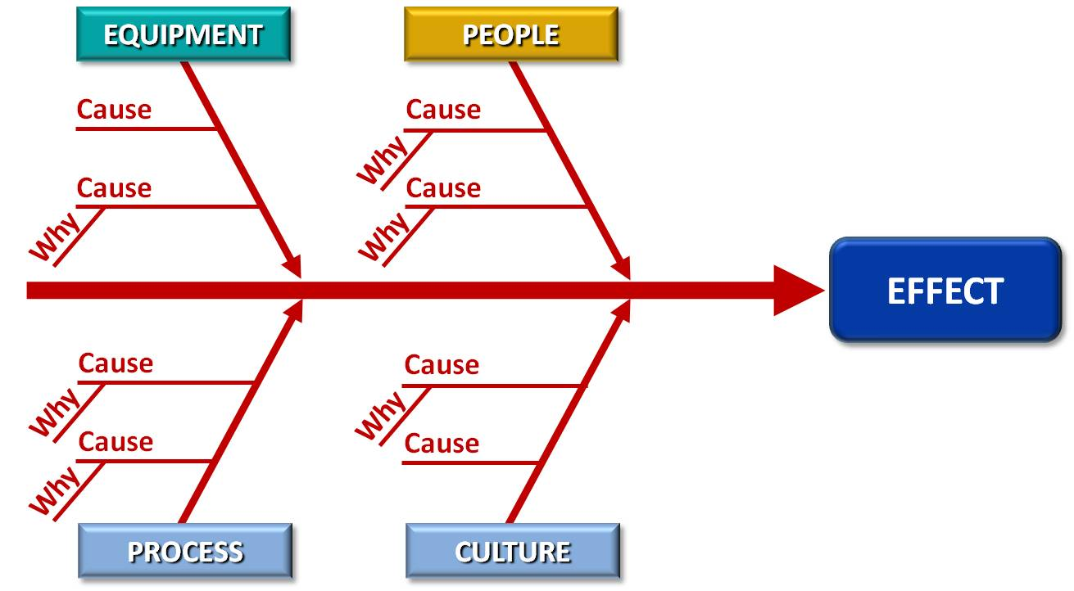
Fishbone diagram
From http://www.blog-bizedge.biz/2011/10/getting-to-root-of-problems-part-1.html

Slide 17
RCA-based Corrective Action
Define the problem or describe the event factually. Include the qualitative and quantitative attributes of the harmful outcomes. This usually includes specifying the natures, the magnitudes, the locations, and the timing of events.
Gather data and evidence, classifying it along a timeline of events to the final failure or crisis. For every behavior, condition, action, and inaction specify in the "timeline" what should have been done if it differs from what was done.
Ask "why" and identify the causes associated with each step in the sequence towards the defined problem or event. "Why" is taken to mean "What were the factors that directly resulted in the effect?"
Classify causes into causal factors that relate to an event in the sequence and root causes, that if eliminated, can be agreed to have interrupted that step of the sequence chain.
Identify all other harmful factors that have equal or better claim to be called "root causes." If there are multiple root causes, which is often the case, reveal those clearly for later optimum selection.

Slide 18
Identify corrective action(s) that will with certainty prevent recurrence of each harmful effect, including outcomes and factors. Check that each corrective action would, if pre-implemented before the event, have reduced or prevented specific harmful effects.
Identify solutions that, when effective, and with consensus agreement of the group, prevent recurrence with reasonable certainty , are within the institution's control, meet its goals and objectives and do not cause or introduce other new, unforeseen problems.
Implement the recommended root cause correction(s).
Ensure effectiveness by observing the implemented recommendation solutions.
Identify other methodologies for problem solving and problem avoidance that may be useful.
Identify and address the other instances of each harmful outcome and harmful factor
Taken form: http://en.wikipedia.org/wiki/Root_cause_analysis

Slide 19
A small case study… (informed by and based on a real event)
In a small town (2,000 inhabitants) in rural middle of nowhere, US, 5 children, aged 2 to 6, reported to a local hospital with symptoms of HUS.
E. coli O157:H7 was isolated from 4 of the 5 patients
One child died within 4 days of onset of the symptoms
Presume you are the team from the county health department that was assigned this case….

Slide 20
Overview
Introductions
Class format and logistics
Course goals
An intro to case-based teaching
  Strategies for independent learning
  Strategies to solve problems
Food safety basics

Slide 21
Strategies for staying up to date on food safety issues
Reading papers
  Sign up for TOC alerts for key journal (e.g.,. EID; Foodborne Pathogens and Disease)
Reading trade journals
  Food Safety Magazine etc.
E-mail mailing lists, twitter feeds (??), LinkedIn stuff (??)
  ProMed; Doug Powell’s bites listserv

Slide 22
Food safety
Chemical hazards
Physical hazards
Biological hazards

Slide 23
Food Safety Basics
The bugs and the diseases they cause (e.g., Salmonella, salmonellosis, and Reiter's Syndrome)
Environmental and food factors and their effects on foodborne pathogens
The tools (detection methods, subtyping methods, epidemiological tools)
The food system and transmission pathways
The regulatory and political environment

Slide 24
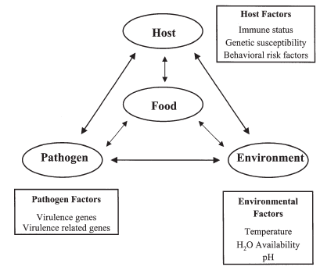
Roberts et al. Cell. Mol. Life Sci. 60: 904 – 918

Slide 25
Food Safety Basics
The bugs and the diseases they cause (e.g., Salmonella, salmonellosis, and Reiter's Syndrome)
Environmental and food factors and their effects on foodborne pathogens
The tools (detection methods, subtyping methods, epidemiological tools)
The food system and transmission pathways
The regulatory and political environment

Slide 26
Microbial foodborne diseases in the US (2011)
47.8 million cases of gastrointestinal illnesses ; 9.4 million due to known and 38.4 million due to unknown pathogens)
127,000 serious illnesses resulting in hospitalizations; 56,000 due to known and 71,000 due to unknown pathogens
3,037 deaths (range: 1,492–4,983) ; 1,351 due to known and 1,686 due to unknown pathogens

Slide 27
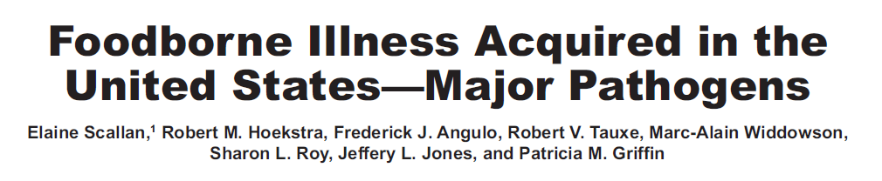

Slide 28
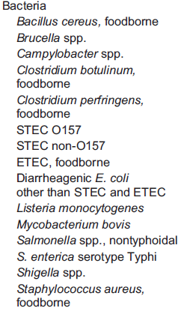
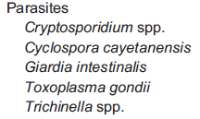
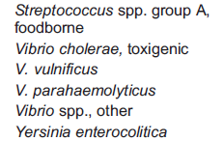
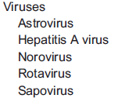

Slide 29
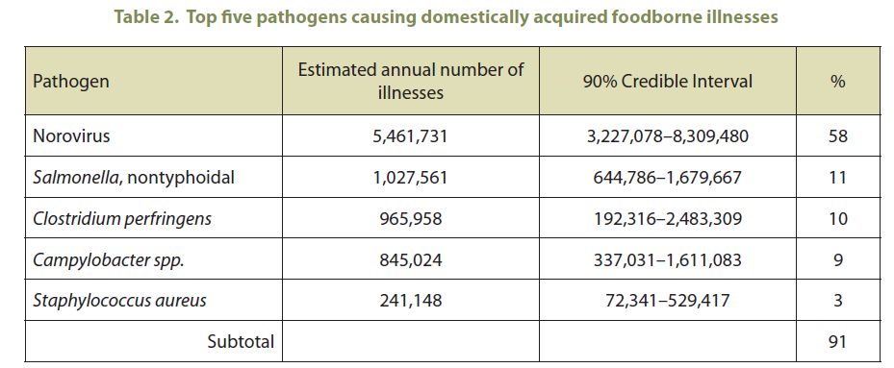
Notes:
Bacteria
Viruses
Protozoan
Parasites & worms

Slide 30
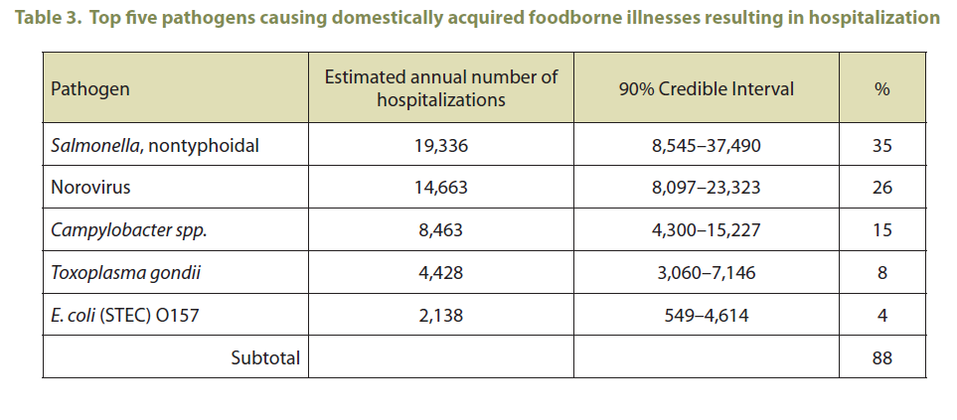

Slide 31
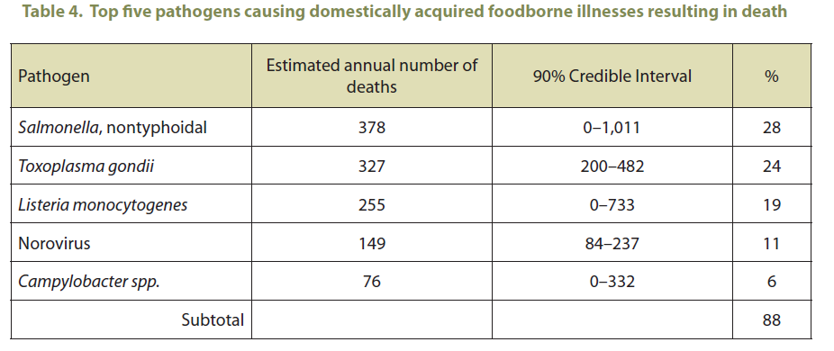

Slide 32
Food Safety Basics
The bugs and the diseases they cause (e.g., Salmonella, salmonellosis, and Reiter's Syndrome)
Environmental and food factors and their effects on foodborne pathogens
The tools (detection methods, subtyping methods, epidemiological tools)
The food system and transmission pathways
The regulatory and political environment

Slide 33
Nutrient Requirements and presence
Available Water (water activity; aw)
Acidity or pH
P/A of Oxygen
Presence of Inhibitors (chemical inhibitors, competitive microflora, etc.)
Temperature
Critical for prevention of botulism; see
http://www.fda.gov/Food/GuidanceComplianceRegulatoryInformation/
GuidanceDocuments/Seafood/FishandFisheriesProductsHazardsandControlsGuide/ucm092180.htm

Slide 34
Food Safety Basics
The bugs and the diseases they cause (e.g., Salmonella, salmonellosis, and Reiter's Syndrome)
Environmental and food factors and their effects on foodborne pathogens
The tools (detection methods, subtyping methods, epidemiological tools)
The food system and transmission pathways
The regulatory and political environment

Slide 35
Who regulates Food Safety in the US – the feds
USDA, Food Safety Inspection Service (FSIS): meat and poultry (and cat fish!)
  Standard methods are detailed in MLG
Food and Drug Administration (FDA), Department of Health and Human Services (DHHS): other foods, including dairy, seafoods, eggs
  Standard methods are detailed in BAM
Minor roles for EPA, National Marine and Fisheries Service (NMFS), USDA-Animal and Plant Health Inspection Service (APHIS).

Slide 36
Strain differentiation
(subtyping/fingerprinting)
Tools which allow sensitive differentiation of bacterial subtypes
  Detection of contamination sources
Strain differentiation methods commonly applied include serotyping, ribotyping, Pulsed Field Gel Electrophoresis (PFGE)

Slide 37
Examples of L. monocytogenes ribotypes

Slide 38
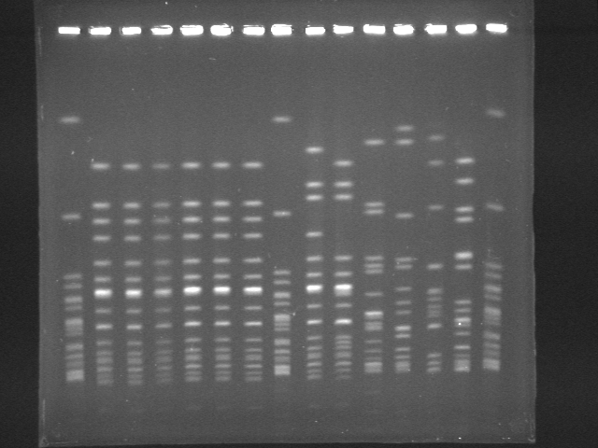
Examples of different PFGE patterns
M
M
M

Slide 39
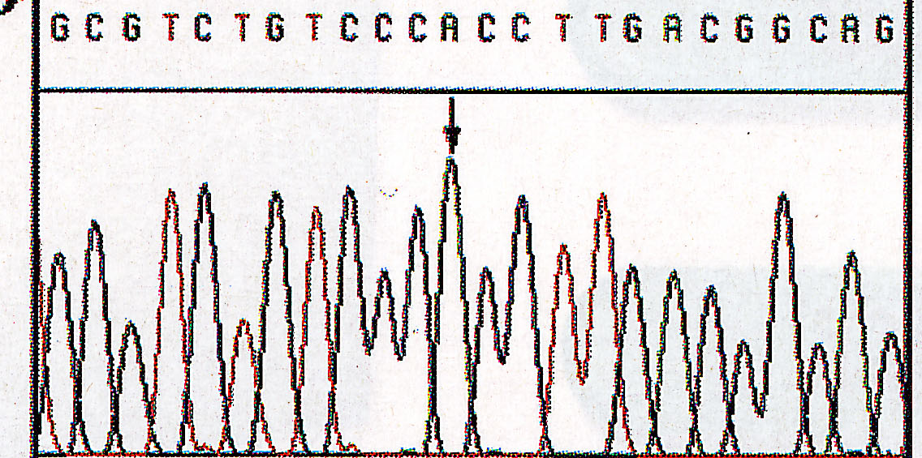
DNA sequencing-based subtyping
Isolate 1 AACATGCAGACTGACGATTCGACGTAGGCTAGACGTTGACTG
Isolate 2 AACATGCAGACTGACGATTCGTCGTAGGCTAGACGTTGACTG
Isolate 3 AACATGCAGACTGACGATTCGACGTAGGCTAGACGTTGACTG
Isolate 4 AACATGCATACTGACGATTCGACGAAGGCTAGACGTTGACTG

Slide 40
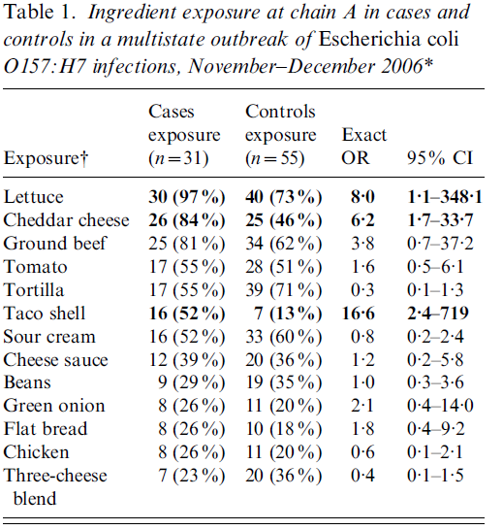
Sodha et al. 2011. Epidemiol. Infect. 139, 309–316.

Slide 41
Food Safety Basics
The bugs and the diseases they cause (e.g., Salmonella, salmonellosis, and Reiter's Syndrome)
Environmental and food factors and their effects on foodborne pathogens
The tools (detection methods, subtyping methods, epidemiological tools)
The food system and transmission pathways
The regulatory and political environment

Slide 42
Transmission of foodborne zoonotic diseases
Animal feed/environment/protozoans
Food animals
Manure
Water
Animal derived food products
Plant derived raw products
Food Processing Plants
RTE Foods
Humans

Slide 43

Global Food Supply
Chocolate- Belgium
Cocoa Powder- Switzerland
Roasted Espresso Beans-Columbia
Kahlua- Mexico
Mascarpone Cheese and Ladyfingers- Italy
Mint Leaf – United States
Vanilla Beans- Madagascar
Cream-
United States
Copyright © Yiannas
43

Slide 44
Examples of outbreaks
Salmonella outbreak linked to cereal (2008, 28 reported cases)
Botulism cases linked to carrot juice (2006, 4 patients)
Listeriosis outbreak linked to cantaloupe (2011, >140 cases and >35 deaths)
Salmonella Enteritidis linked to eggs (May 1 to November 30, 2010; approx. 1,939 illnesses)
E. coli O145 outbreak linked to Shredded Romaine Lettuce from a Single Processing Facility (2010; 26 confirmed and 7 probable cases).

Slide 45
Food Safety Basics
The bugs and the diseases they cause (e.g., Salmonella, salmonellosis, and Reiter's Syndrome)
Environmental and food factors and their effects on foodborne pathogens
The tools (detection methods, subtyping methods, epidemiological tools)
The food system and transmission pathways
The regulatory and political environment

Slide 46
Summary
Focus of this class will be on independent learning
  Everybody is expected to learn the Food safety basics themselves
For the case studies, “correct” answers are much less important than an appropriate approach

