Slide 1

Arsenic Removal
Imtiaz Karim, Tsz Him Lo, Katie Linscott, Carrie Smith

Slide 2


Introduction
Background
  WHO standard
  Health effects
    20-50% in Bangladesh
Motivation
  Get lab arsenic ready
Notes:
Carrie

Slide 3
Introduction
Tasks
  Safety
  Water type
  Detection and Data Collection methods
  Non-coagulant removal systems
  Coagulants
  Experimental design
    Mathcad file
  Conclusions and Future Work
Notes:
Carrie

Slide 4


Research: Lab Use
Obtaining arsenic
Dangers of arsenic
Minimizing the risks
Disposing arsenic waste
Notes:
Imtiaz

Slide 5
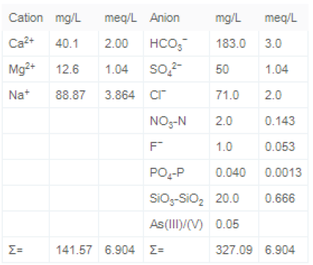
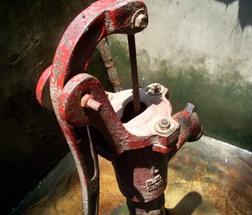
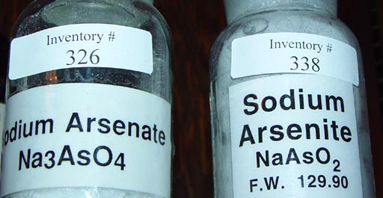
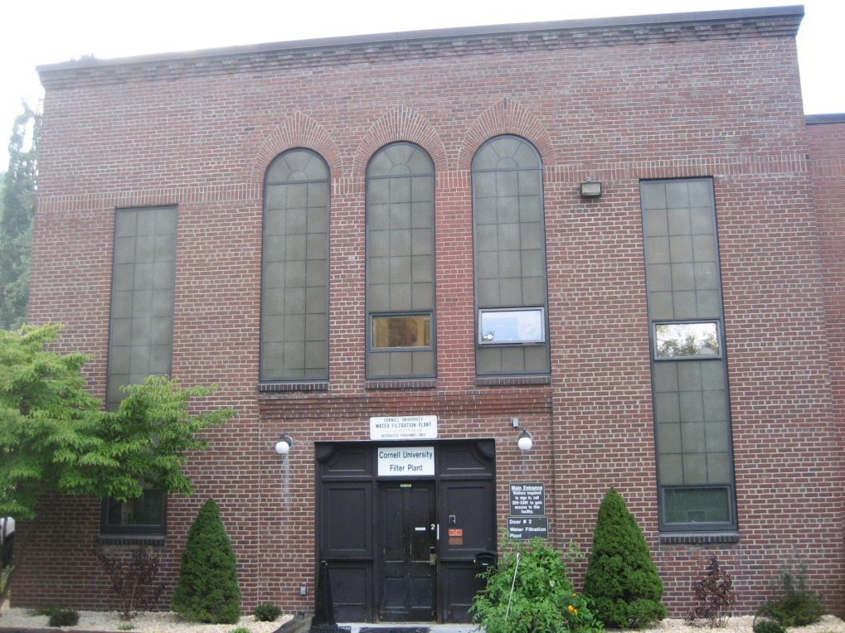
Research: Water Types and Interactions
Arsenic’s interaction with
  Clay and metal oxides
  Organic matter
(Lakshmanan, Clifford, and Samanta, 2010)
http://www.chemistryland.com/CHM130W/18-Final/OralExam/ArsenateArsenite.jpg
http://1.bp.blogspot.com/_odr6vqxoV5s/SgZUqOfoKLI/AAAAAAAAAA8/etGbTg9PSS0/s400/LCG+meeting+011.jpg
Notes:
Himmy

Slide 6
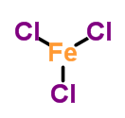
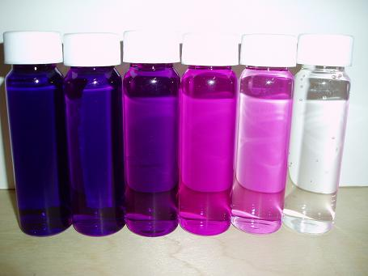
  Research: Coagulants and Pretreatment
Flocculation/sedimentation
  Ferric Chloride
  Ferric Sulfate
  PACl
  Alum
Pretreatment
  Potassium Permanganate
  Sodium hypochlorite
Notes:
Katie

Slide 7
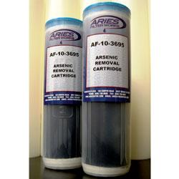
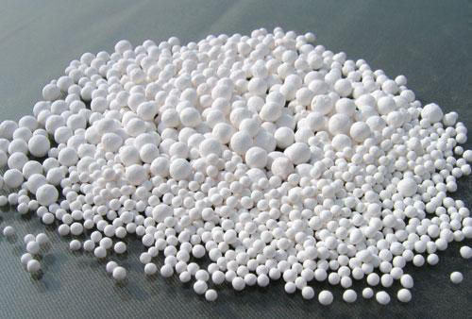
  Research: Non-coagulant removal systems
Ion Exchange Resin
Activated alumina
Iron Oxide Coated Sand
Coagulation plus filtration
  Flocs may be small
Notes:
Katie

Slide 8



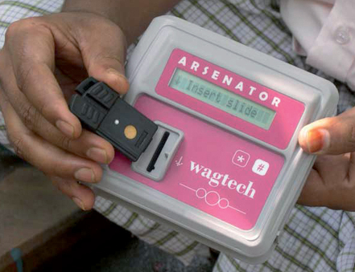
  Research: Detection and Data Collection methods
http://www.crimescene.com/rose/arsenic/Image6.gif
http://www.crimescene.com/rose/arsenic/Image7.gif
http://www.crimescene.com/rose/arsenic/Image9.gif
I’ll be back...
Hg⁺
Hg
Colorimetric
  Color of test strips indicates As concentration
  Problems
    Color blindness
    Arsine gas
AsH₂
Br
Br–
AsH₂
Br–
Br
H
H⁺
AsH₂
AsH₂–
AsH₂–
acid
reductant
arsenic-
contaminated
water sample
http://www.wagtech.co.uk/system/uploads/attachments/0000/3764/wagtech-digital-arsenic-detection-kit-arsenator-in-use_product_page_lightbox.jpg
Notes:
Himmy

Slide 9

  Research: Detection and Data Collection methods
Electrochemical
  Stripping voltammetry
  Determines ion species
  Low detection limits
  Sensitive, minimal sample preparation, low cost
  Interference of other metals
Notes:
Carrie

Slide 10
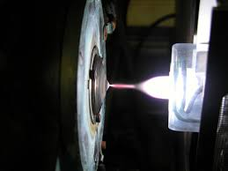
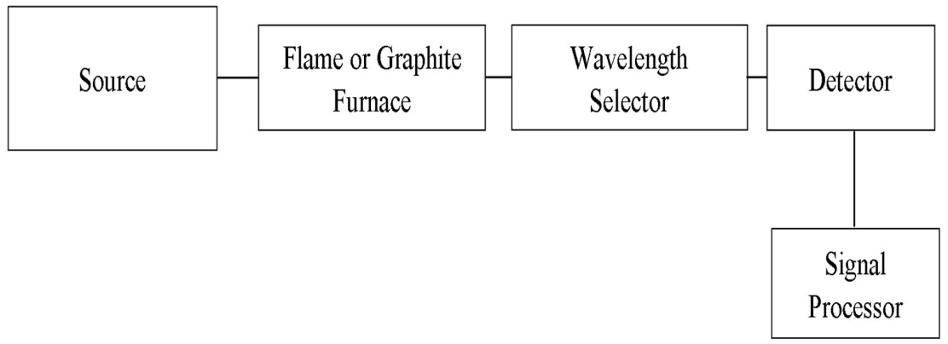
  Research: Detection and Data Collection methods
ICP-MS (on campus)
GFAAS (on campus)
  These are both expensive
Commercially available systems
  ArsenicGuard (TraceDetect)
  OVA5000
  PSA10.255
Process Controller
GFAAS
Notes:
Imtiaz

Slide 11
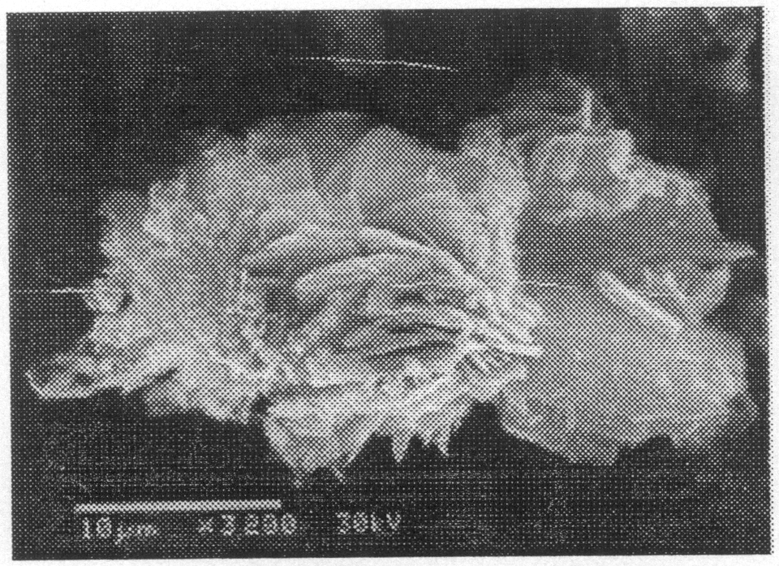
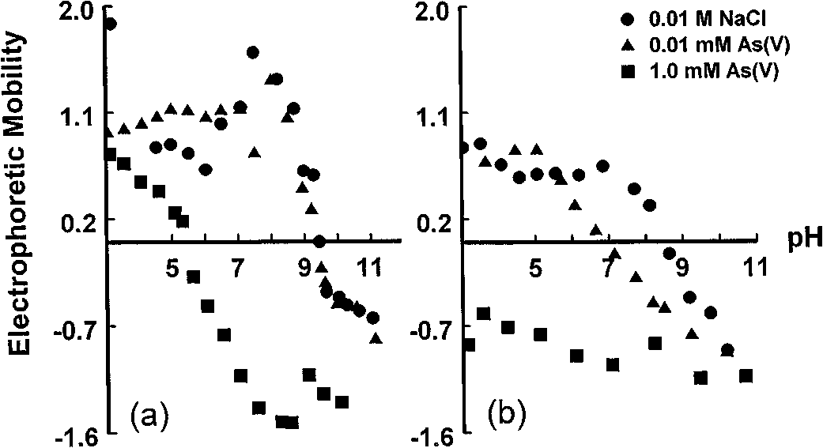
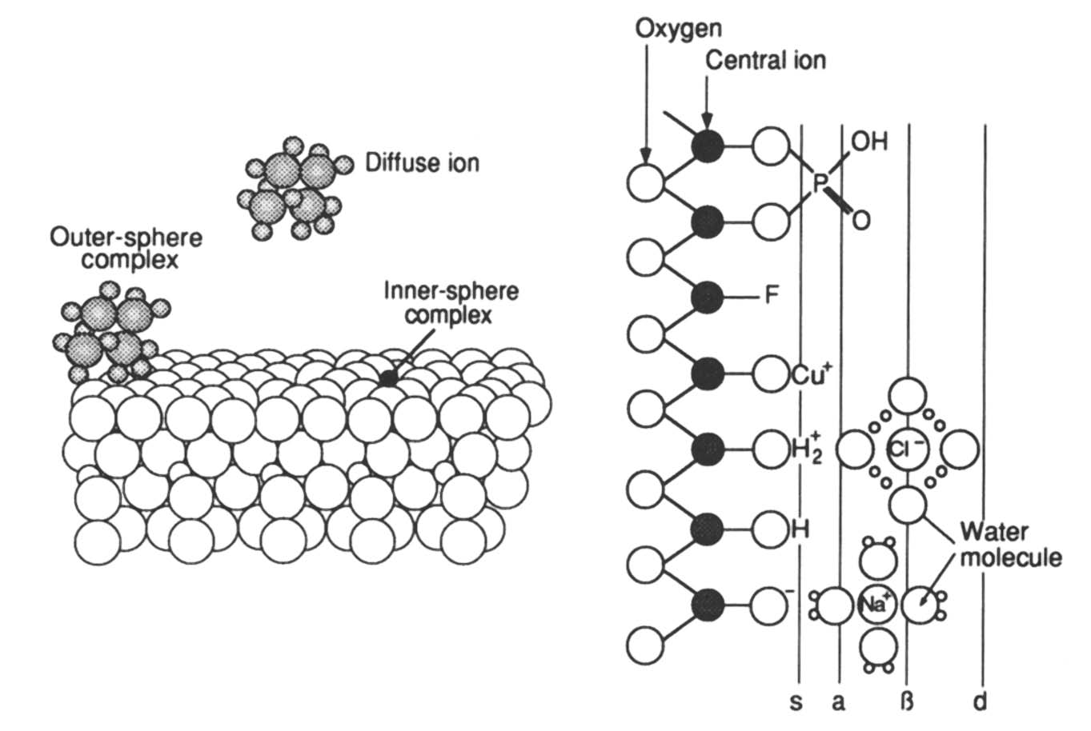
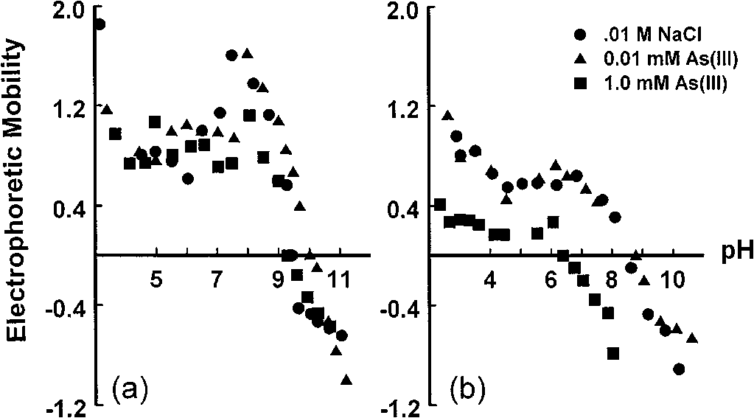
  Research: Arsenic/Coagulant Interactions
(Goldberg and Johnston, 2001)
(Lackovic, Nikolaidis, and Dobbs, 2000)
(Stumm, 1995)
Notes:
Himmy

Slide 12
  Research: Experimental design
Mathcad file
  Based on Flocculation/Sedimentation Optimization team
Changes to equations
  Energy Dissipation
  Floc Geometry
  Floc Volume Fraction
  Collision Potential
Notes:
Katie

Slide 13
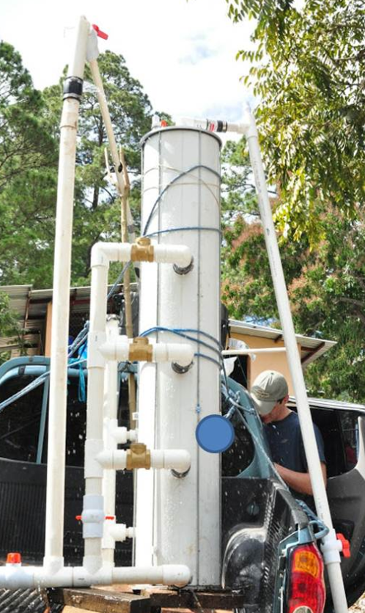
Conclusions
Starting point for lab-based studies
Covered safety, ground water composition, interactions, flocculation
Due to flocs likely being small, may want to just do direct filtration
Notes:
Carrie

Slide 14
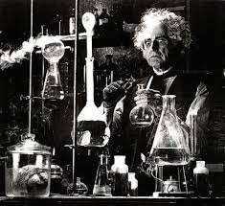
Future Work
Determine Appropriate testing location.
Create waste storage area.
Design the benchtop model.
Notes:
Imtiaz

Slide 15
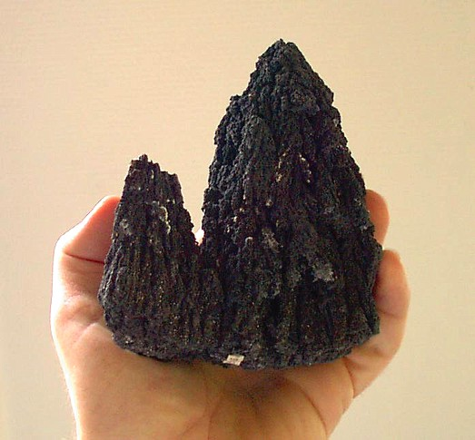
Questions?
I’m back!!!
http://www.summagallicana.it/lessico/a/arsenico.htm

