Slide 1
Arsenic Team
Tanapong Jiarathanakul, Jason Koutoudis, Mingze Niu
Faculty Advisors: Professors Lion and Weber-Shirk
Student Advisors: Casey Garland and Will Pennock

Slide 2

Why Study Arsenic?
Common global groundwater contaminant

Slide 3
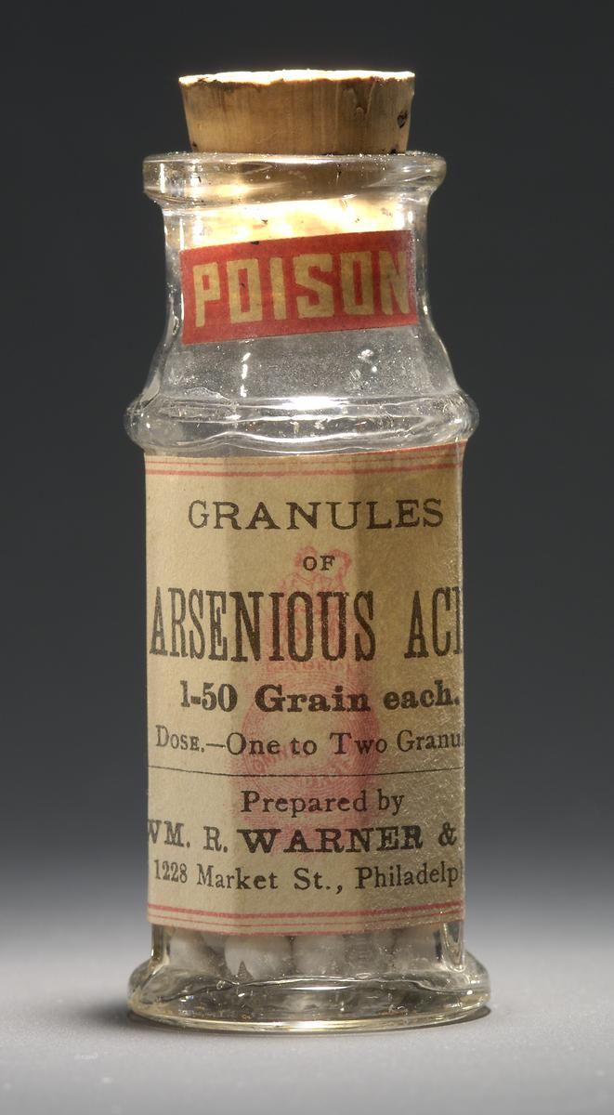
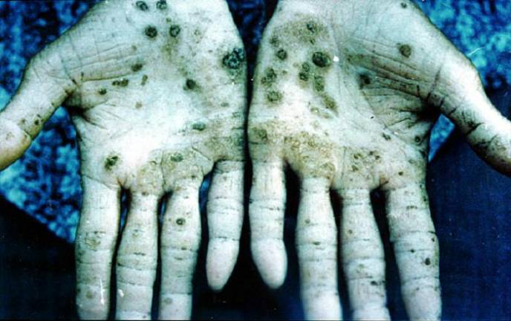
Why Study Arsenic?
High toxicity
  Lung and lymphatic cancer
  Nervous, circulatory, digestive and respiratory system damage
  Effects on skin, liver, kidneys and eyes

Slide 4

Why Study Arsenic?
International Agency for Research on Cancer (IARC) recognizes arsenic and arsenic compounds as Group 1 Carcinogen
EPA and FDA set maximum arsenic concentration in drinking water at 10 ppb

Slide 5
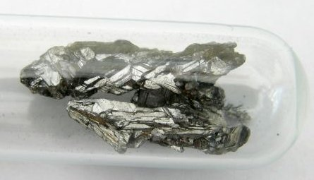
Our Goals
Determine the effectiveness of arsenic removal through filtration/coagulation
Implement full-scale experiment using sand column with continuous flow
Factors:
  Coagulant type
  Coagulant concentration
  Turbidity
  Bed depth
  Residence time

Slide 6
GFAAS
Graphite Furnace Atomic Absorption Spectrometer

Slide 7
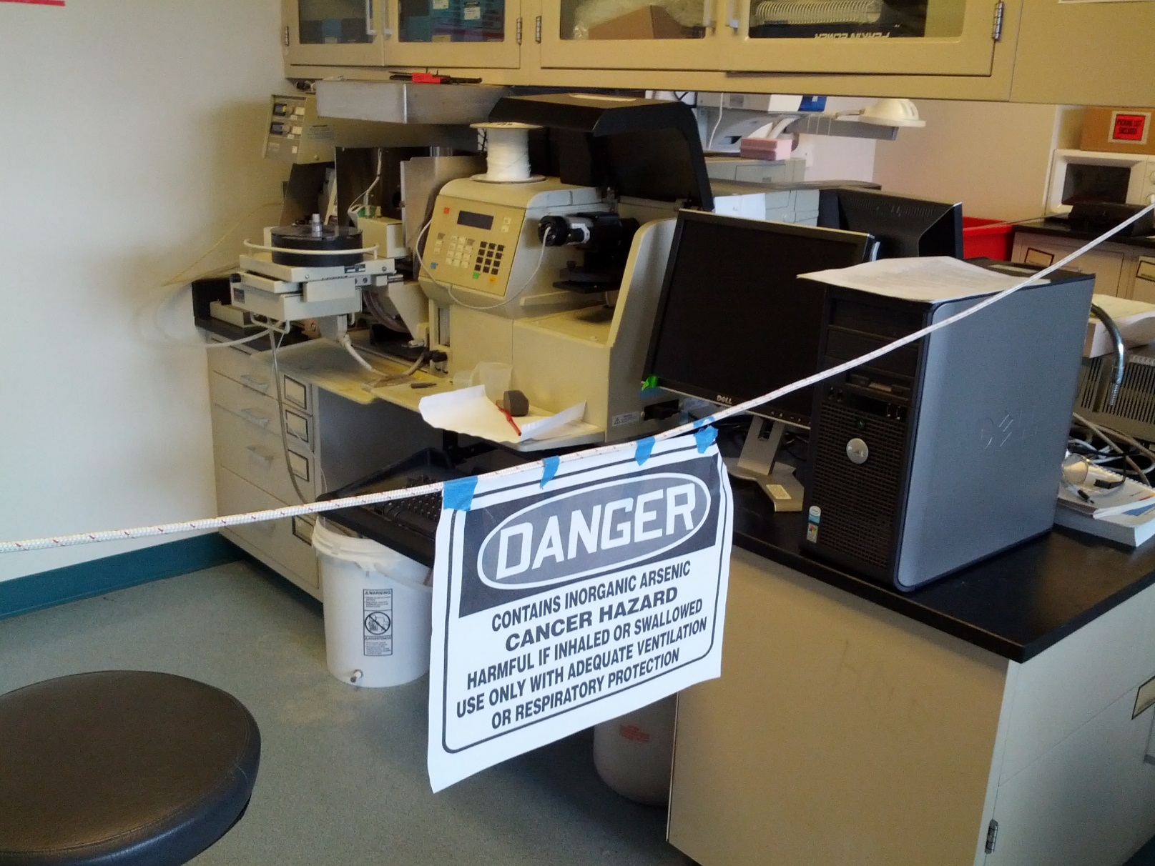
GFAAS

Slide 8
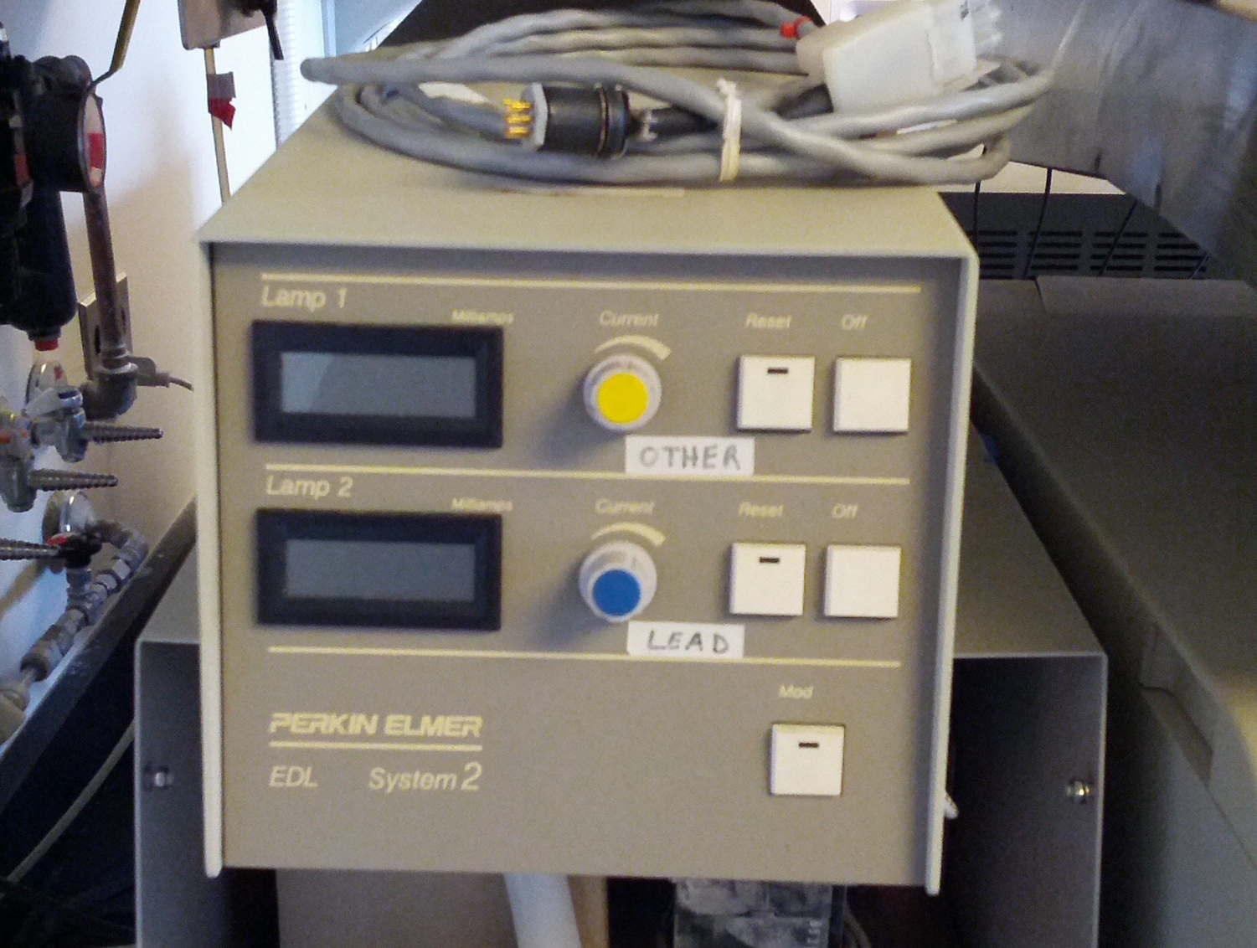
GFAAS

Slide 9
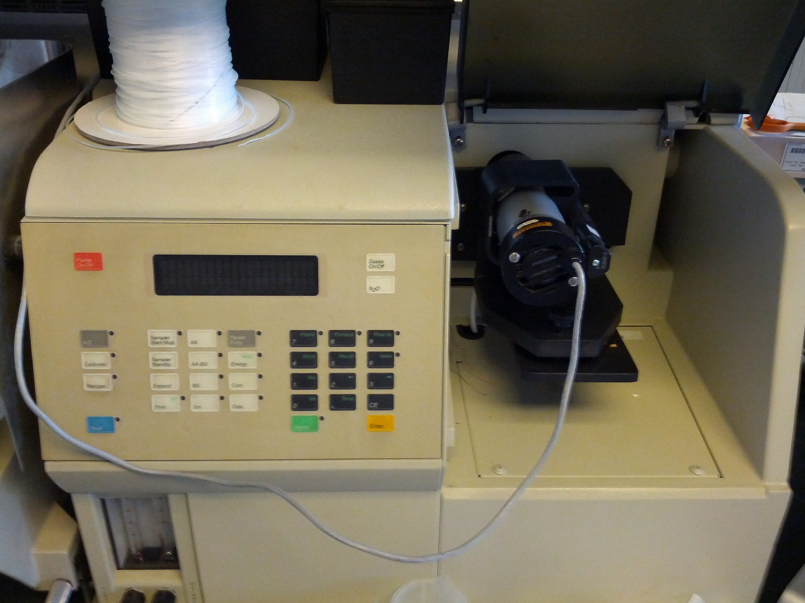
GFAAS

Slide 10
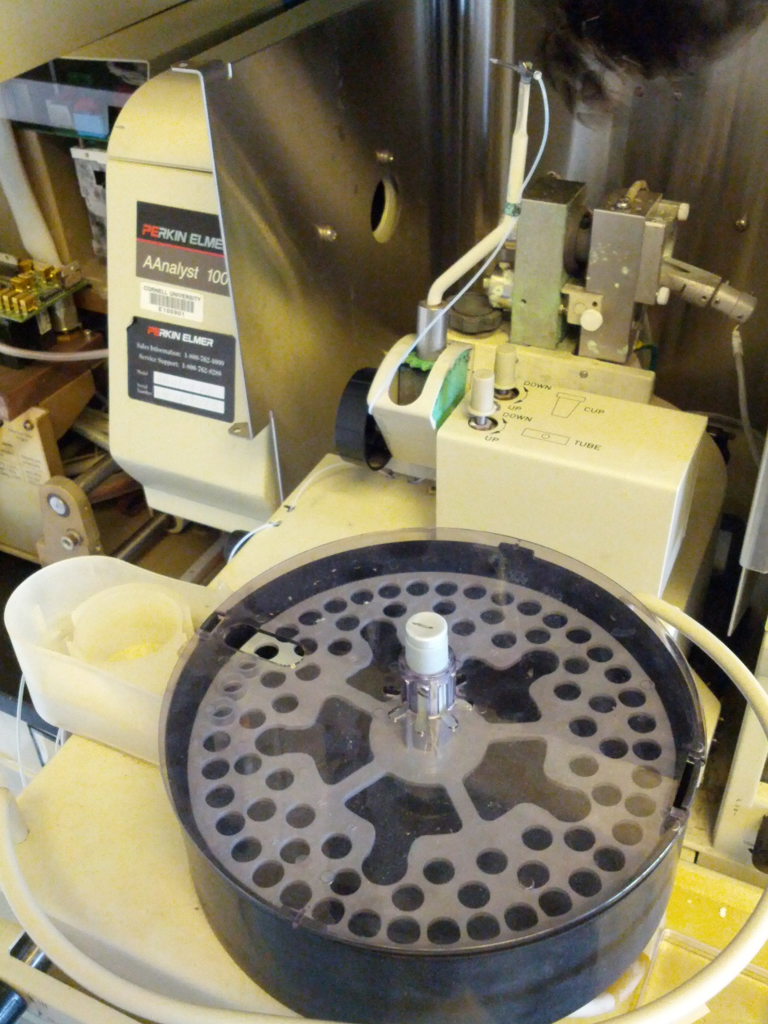
GFAAS

Slide 11

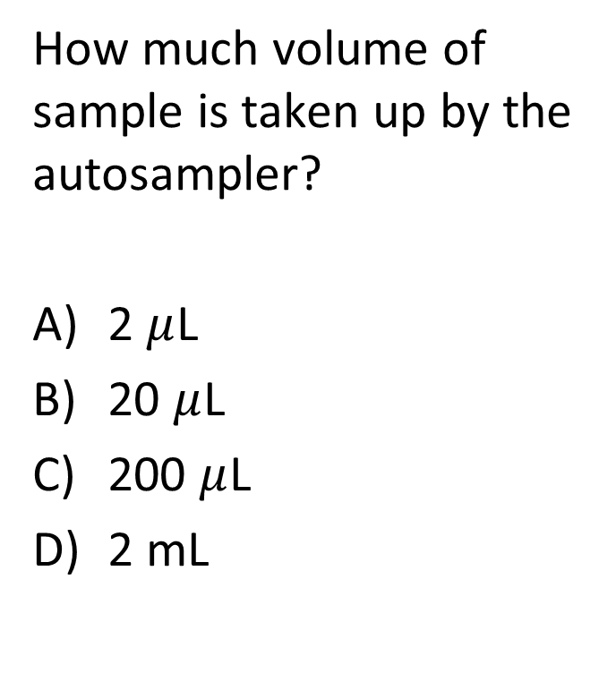
GFAAS
How much volume of sample is taken up by the autosampler?
2 $μ$L
20 $μ$L
200 $μ$L
2 mL

Slide 12
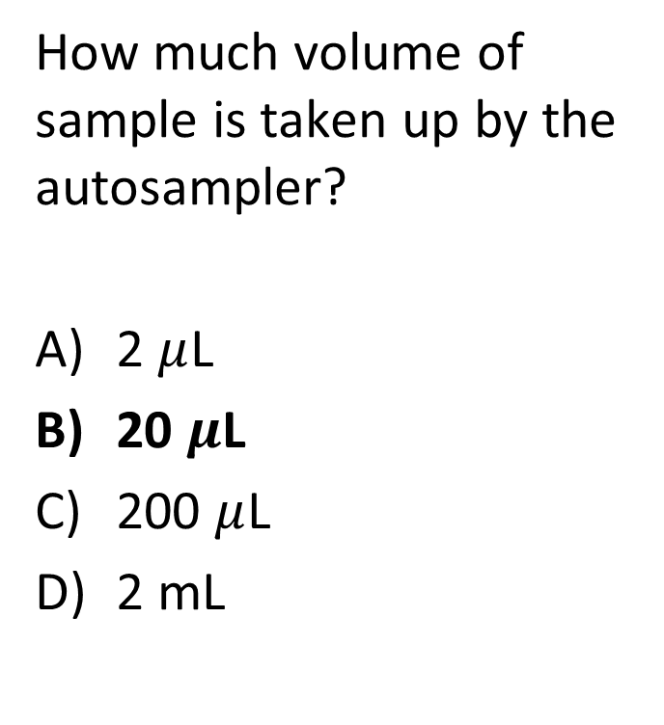
GFAAS
How much volume of sample is taken up by the autosampler?
2 $μ$L
20 $μ$L
200 $μ$L
2 mL

Slide 13
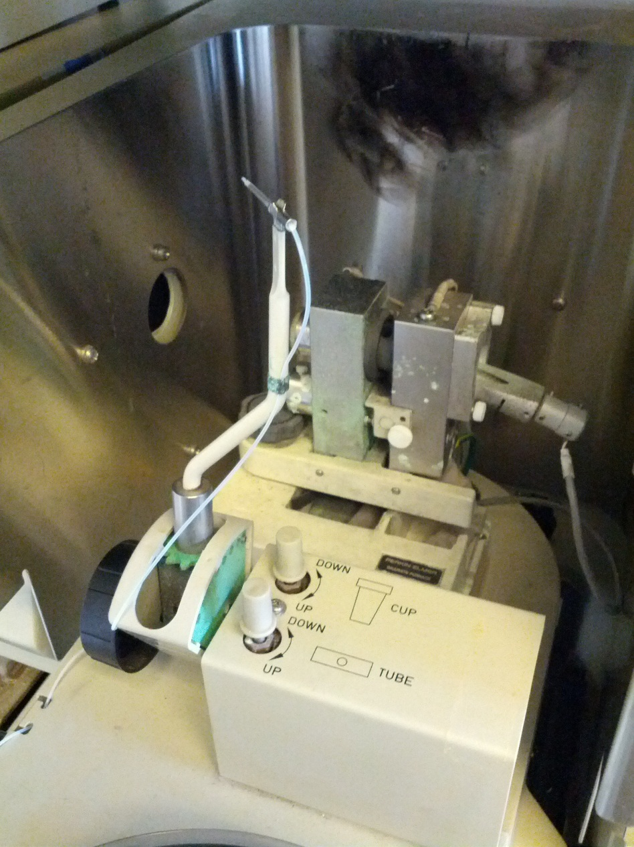
GFAAS

Slide 14
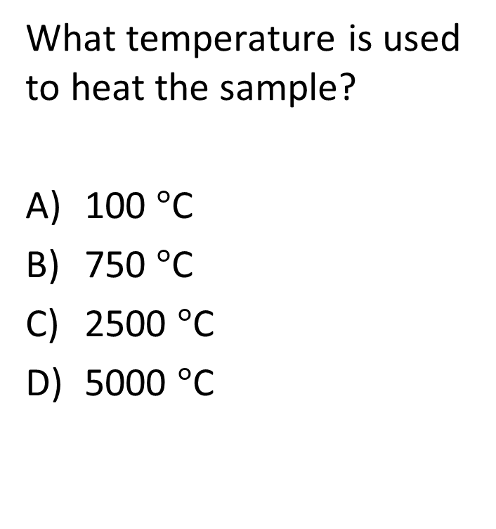
GFAAS
What temperature is used to heat the sample?
100 $°$C
750 $°$C
2500 $°$C
5000 $°$C

Slide 15

GFAAS
What temperature is used to heat the sample?
C) 2500 $°$C
To put things in perspective:
Earth’s mantle temperature range from 500 $°$C
to 4000 $°$C .

Slide 16
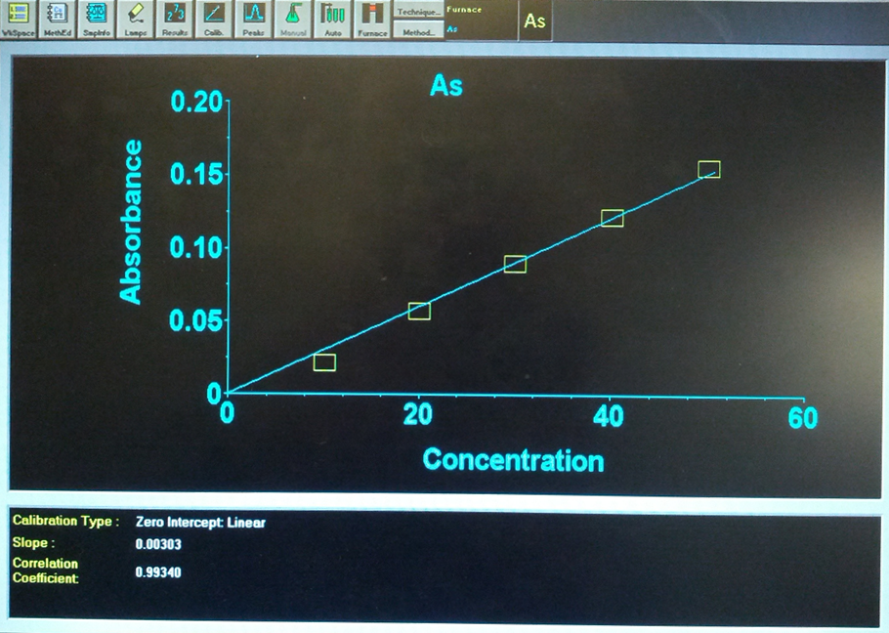
Calibration Curve

Slide 17
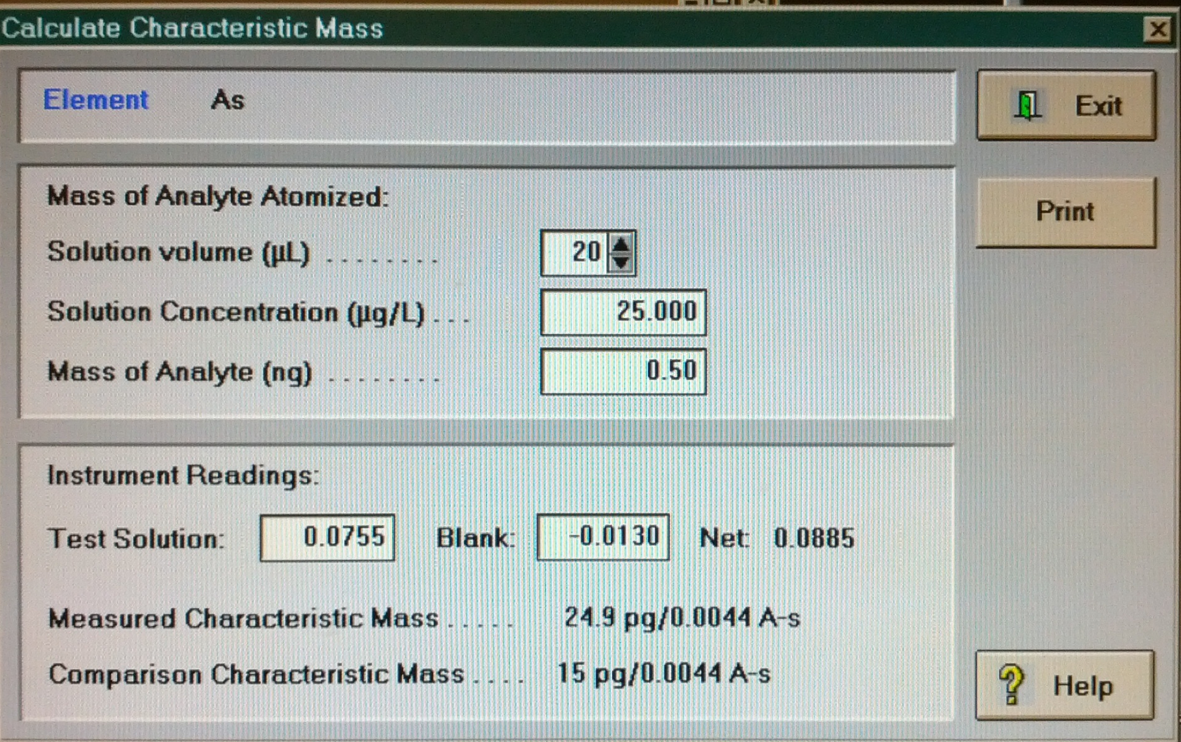
Characteristic Mass

Slide 18
Design of Filter Column

Slide 19
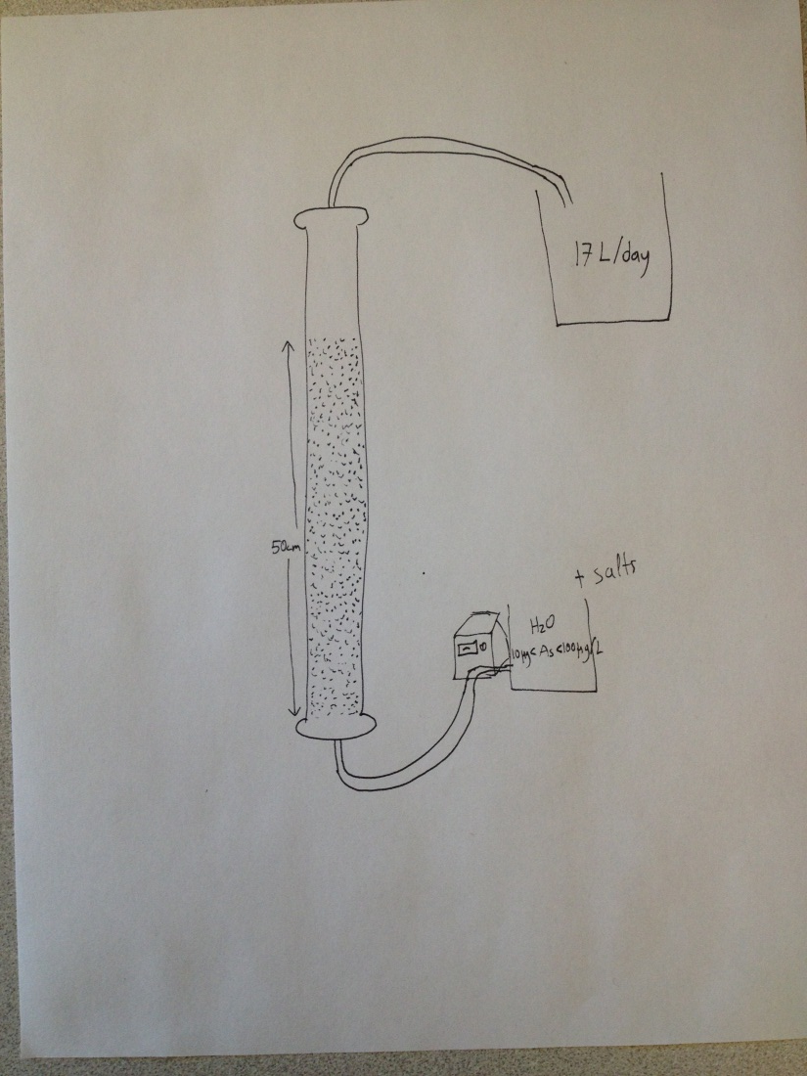
Filter Column Design
A 1.5 cm (inner) diameter column will be used at a height of approximately 0.75cm to minimize effluent volume and allow high residence time.
The influent groundwater will be sent in upflow stream

Slide 20
Filter Column Design
Approach velocity
  V= 1mm/s
Residence time
  t = 500s
Effluent volume after 1 day
  Q = 17 L/day
Min upflow fluidization velocity
  Vf= 2.4mm/s

Slide 21
Filter Column Design
Problems to Address:
Unwanted fluidization due to clogging by coagulant
Preferred height to operate smoothly
Backwashing concerns

Slide 22
Experimental Procedure

Slide 23
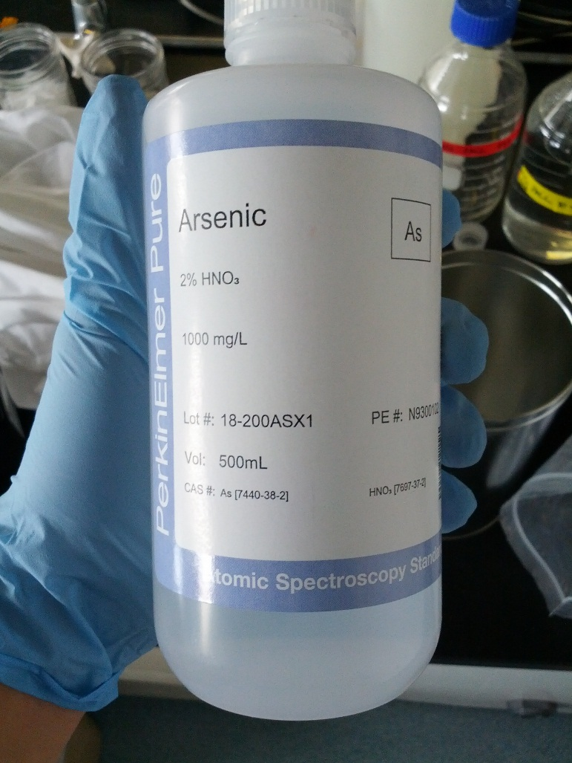
Experimental Procedure
Arsenic stock solution has a concentration of 1,000 mg/L with 2% nitric acid
Prepare ground water (pH about 8)
  1. Sodium nitrate (5.289 mg/L)
  2. Sodium bicarbonate (252 mg/L)
  3. Sodium phosphate monohydrate (0.00699 mg/L)
  4. Sodium fluoride (2.22 mg/L)
  5. Disodium metasillicate nona-hydrate (35.32 mg/L)
  6. Magnesium sulfate heptahydrate (62.6 mg/L)
  7. Calcium chloride dehydrate (111.1 mg/L)

Slide 24
Experimental Procedure
Design experimental procedure before testing arsenic
Ensure cycles run as expected, coagulant is well distributed
Coagulant distribution at different upflow velocities, use dyed color

Slide 25
Experimental Procedure
Used predetermined procedures to test the different factors on arsenic removal efficiency
  Types of coagulant
  Coagulant pretreatment vs. co-treatment
  pH level
  Upflow velocity
  Arsenic influent concentration

Slide 26
Experimental Procedure
  Types of coagulant
    Sand media can be coated with various types of coagulant to find the best removal
    From literature review, Iron oxide-coated has a high arsenic removal efficiency
    AguaClara uses aluminum-based coagulant

Slide 27
Experimental Procedure
  Coagulant pre-treatment
    Pre-treating the media with coagulant
  Coagulant co-treatment
    Adding coagulant concurrently to the influent while filter runs at the normal upflow velocity for arsenic removal

Slide 28
Experimental Procedure
Interactive Question
What pH level do you think has the highest arsenic removal efficiency?

Slide 29
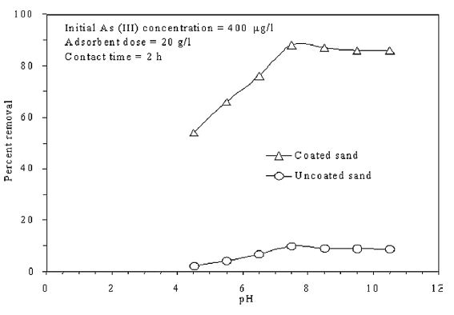
Experimental Procedure
pH level
  At pH below 7.5, the removal percent increases with increasing of pH
  At pH above 7.5, removal decreases slightly, but remains high constant efficiency
Gupta, V.K., Saini, V.K., Jain, N. Adsorption of As(III) from aqueous solutions by iron oxide-coated sand, Journal of Colloid and Interface Science 288 (2005) 55–60

Slide 30
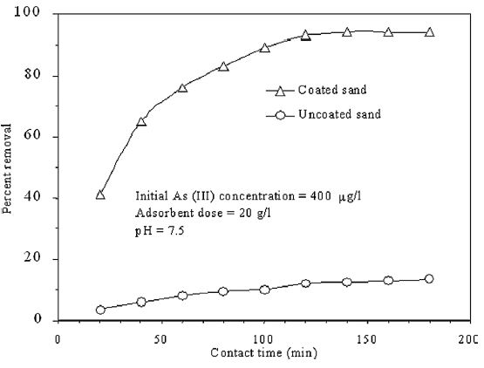
Experimental Procedure
  Upflow velocity (contact time)
    The effect of contact time is also important
    The removal percent goes up with contact time up to 97% removal at longer residence times
Gupta, V.K., Saini, V.K., Jain, N. Adsorption of As(III) from aqueous solutions by iron oxide-coated sand, Journal of Colloid and Interface Science 288 (2005) 55–60

Slide 31
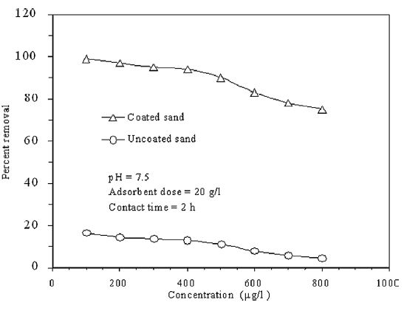
Experimental Procedure
Arsenic influent concentration
  At low concentration(100 ug/L), removal percent is high (99%)
  When the concentration increases, percent decreases to 75% at initial conc 800 ug/L
Gupta, V.K., Saini, V.K., Jain, N. Adsorption of As(III) from aqueous solutions by iron oxide-coated sand, Journal of Colloid and Interface Science 288 (2005) 55–60

Slide 32
Experimental Procedure
Clean the column and examine the reversibility of arsenic precipitation by backwash
If still has time remaining, will test the other two factors:
  Temperature
  Arsenic oxidation state

Slide 33
Future Tasks
Fabricate the sand column
Create calibration curve with lower concentration range
Test the effect of nitric acid
Develop further the experimental procedure

Slide 34
Thank you!
Team Arsenic : “Working Harder to Keep Arsenic out of Your Water”

