Slide 1
Arsenic Team
Tanapong Jiarathanakul
Jason Koutoudis
Mingze Niu
Faculty Advisor: Professor Weber-Shirk
Student Advisor: Casey Garland

Slide 2
Goal
Overall goal
  Design and improve AguaClara filtration unit to remove arsenic from influent
  Evaluate feasibility of implementation
This semester’s goal
  Fabricate a sand filtration unit
  Establish experimental procedure
  Improve arsenic detection method
  Measure arsenic removal

Slide 3
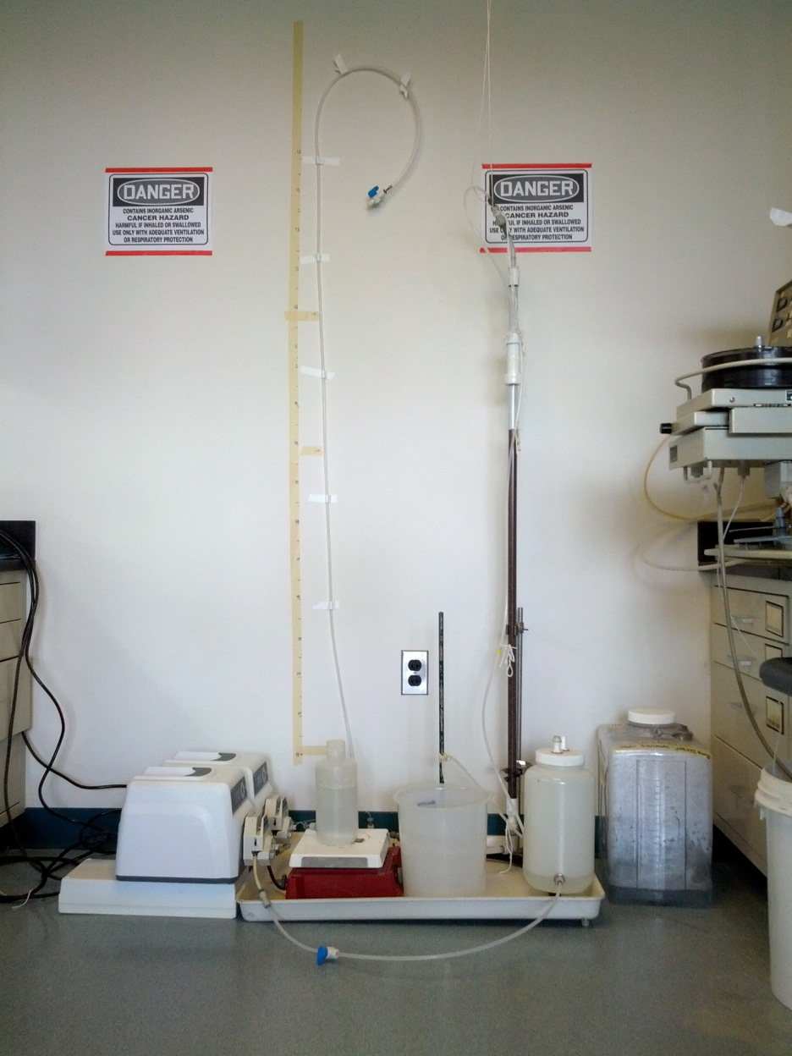
Filter Design
Upflow sand filtration column
  Height of sand = 87 cm
Groundwater pump
  16 size tube
PACl pump
  13 size tube
Manometer to monitor head loss
Magnetic stirrer plate to mix PACl
Notes:
Small quarter inch tube to bring the reference point down

Slide 4
Experimental Procedure

Slide 5
Preparation
Arsenic dilution in Groundwater
  Influent arsenic concentration is 100 ppb
PACl stock solution preparation
  100 mg/L PACl stock
  Equation for dilution factor
  Q_{total}*C_{in}=Q_{PACl}*C_{stock}

Slide 6
Preparation
Calibration of pumps
  Two pumps:
    PACl: size 13 tube,
    Groundwater: size 16 tube
  Evaluate flow rate of each pump at various rpm
  Calibration equations:
    PACl pump: rpm = 0.0717Q - 0.0417
    Groundwater pump: rpm = 1.2Q

Slide 7
Experimental Steps
Initial Backwash
  Tap water
  Maximum flow rate of 100 rpm or 7.1 mm/s
  122% fluidization
  5 – 10 minutes

Slide 8
Experimental Steps
Pre-treatment with PACl
  Pre-treated with 30 mg/L PACl in groundwater solution
  Total flow rate is 2.015 mm/s
  pH is between 6 – 7
  Stop pre-treatment when headloss increases to half of total height of the sand column (40 cm), from 80 to 120 cm, in 10 minutes
  Total mass injected is 2 mg

Slide 9
Experimental Steps
Continuous Flow Experiment
  Samples are collected every 10 minutes
  Arsenic concentration in groundwater = 100 ppb
  PACl influent concentration = 1 mg/L
  Approach velocity= 1 mm/s
  Total flow rate= 11.76 mL/min
  Groundwater pump= 14 rpm = 11.642 mL/min
  PACl pump= 2.2 rpm= 0.118 mL/min

Slide 10
Experimental Steps
Final backwash
  10 minutes at 100 rpm (7 mm/s) with groundwater
  Samples are collected every 1 minute for the first 5 minutes, then one more at 10 minutes

Slide 11
Experimental Steps
Sample analysis
  GFAAS (Graphite Furnace Atomic Absorption Spectrometer) is calibrated prior to experiment
  Samples are analyzed during experiment for direct feedback
Notes:
We want direct feedback to see if we are removing anything at all and changes over time.

Slide 12
GFAAS Analysis

Slide 13
Calibration Curve: 0 – 100 ppb
Notes:
Set intercept at 0

Slide 14
Arsenic Effluent Concentration
Co-treatment
No additional PACl
Notes:
Direct feedback, decide to alter method when we saw no increasing trend
When changed, maintain superficial velocity

Slide 15
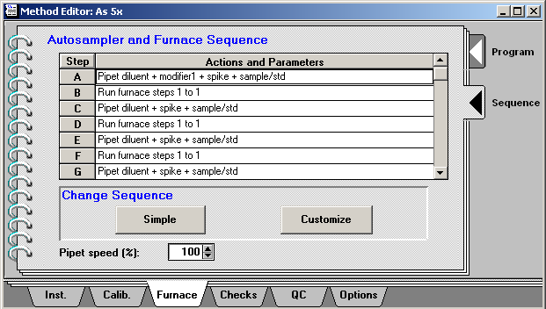
Multiple Injection Method
Program Furnace Sequence

Slide 16
Multiple Injection:
Calibration Curve 0 – 10 ppb

Slide 17
As Effluent Concentration: Multiple Injection Method
Co-treatment
No additional PACl

Slide 18
Calibration Curve: 0 – 50 ppb for Backwash Samples

Slide 19
As Effluent Concentration During Backwash

Slide 20
Data Analysis

Slide 21
pC*
Co-treatment
No additional PACl

Slide 22
Is that so?
Co-treatment
No additional PACl

Slide 23
Backwash

Slide 24
Future Work

Slide 25
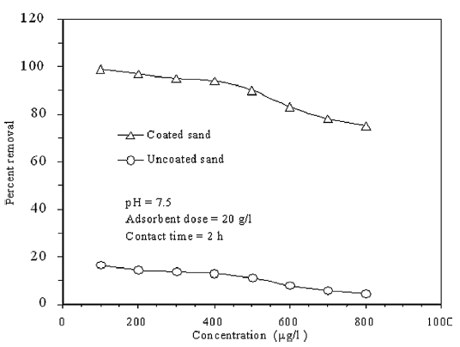
Establishing Base Line
Example

Slide 26
Calibration Curve:
Groundwater vs. HNO₃
Arsenic standard
  0.2% nitric acid
    Prevent As from sticking to walls of container
Samples
  No nitric acid
  Groundwater ions

Slide 27
Pre-treatment and
Co-treatment
Compare the effectiveness of each method separately
  And derive insight into removal mechanism
Test different pretreatment methods
  Derive optimal method
  Evaluate method that could apply to stacked rapid sand filters, eg. treat at the end of the backwash cycle
Evaluate the effective dosage of co-treatment for 100 ppb As groundwater

Slide 28
Removal efficiency rate in continuous flow
Better understand removal mechanism
Establish a stoichiometric relationship between coagulant dosage and effective Arsenic removal
  Run continuous flow experiment
  Observe the decrease in removal efficiency over time
Evaluate effect of pH

Slide 29

Questions?

Slide 30
Acknowledgements
Thank you:
Professor Lion
Professor Weber-Shirk
William Pennock
Casey Garland
Working harder to keep arsenic out of your water!

