Slide 1

Arsenic Removal from Drinking Water
By: Tanapong Jiarathanakul, Imtiaz Karim, Michelle Wagner
Faculty Advisors: Professor Lion and Professor Weber-Shirk
Student Advisors: Casey Garland and Will Pennock

Slide 2
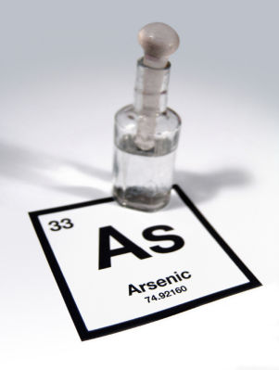
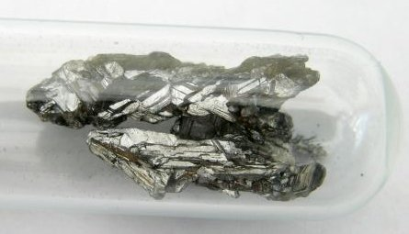
What is Arsenic?
Metallic grey element
Make up 0.00015% of the Earth’s crust
Common species
  Arsenate - As(V):
  Arsenite - As(III)

Slide 3
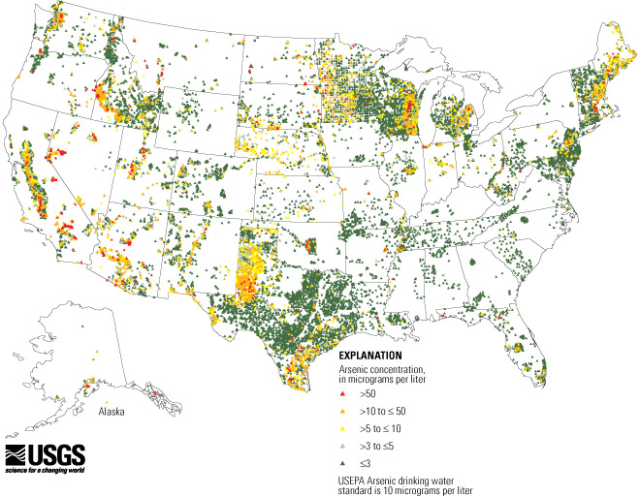
Why Study Arsenic?
Common global groundwater contaminant

Slide 4
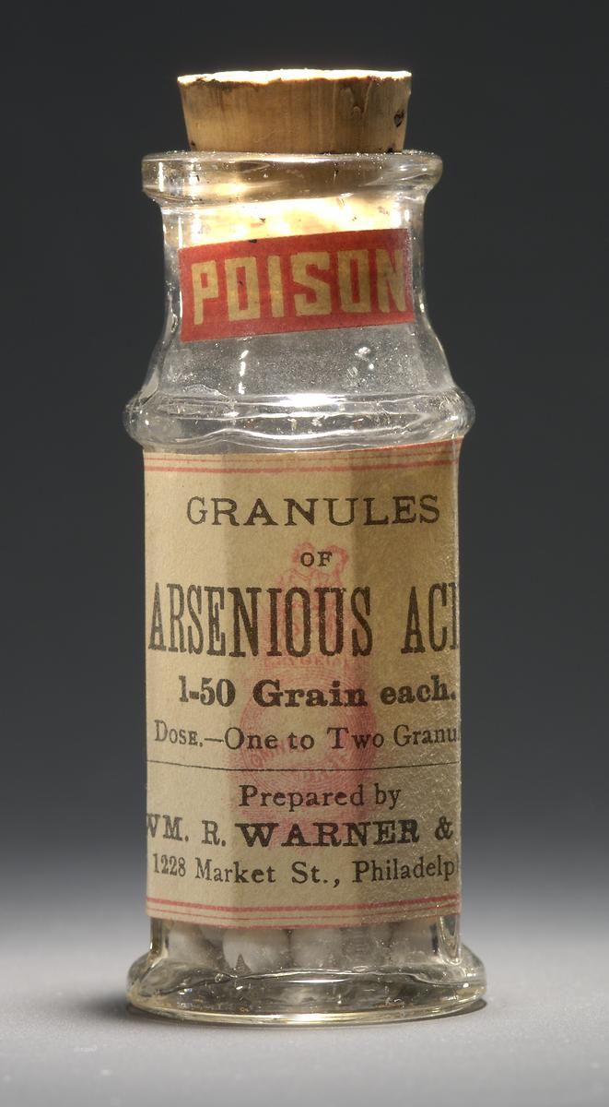
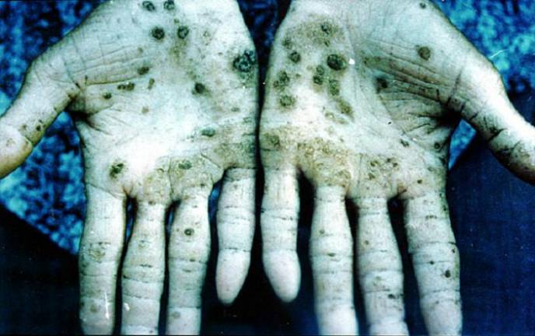
Why Study Arsenic?
High toxicity
  Lung and lymphatic cancer
  Nervous, circulatory, digestive and respiratory system damage
  Effects on skin, liver, kidneys and eyes

Slide 5
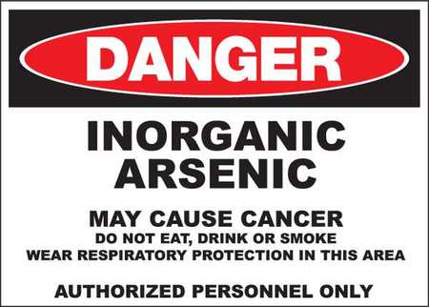
Why Study Arsenic?
International Agency for Research on Cancer (IARC) recognizes arsenic and arsenic compounds as Group 1 Carcinogen
EPA and FDA set maximum arsenic concentration in drinking water at 10 ppb

Slide 6
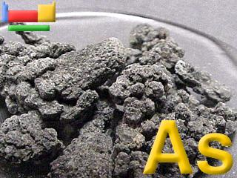
Our Goals
Determine the most efficient arsenic removal technique
Determine arsenic detection methods at low concentration
Explore the possibility of full-scale implementation
Factors:
  Coagulant type
  Coagulant concentration
  Turbidity
  pH
  Oxidation level
  Feasibility

Slide 7

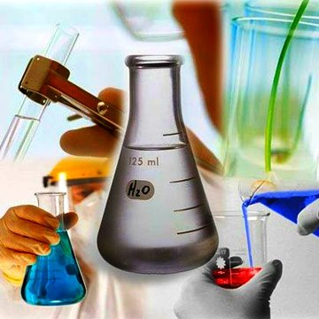
Arsenic Team
What have we done so far?
Sources: www.proprofs.com; sachabiochem0001.wordpress.com

Slide 8

A lot of research
Removal of arsenic from contaminated water sources by sorption onto iron-oxide-coated polymeric materials
Ioannis A. Katsoyiannis, Anastasios I. Zouboulis*
Removal of arsenates from contaminated water by coagulation- direct filtration
Ioannis A. Katsoyiannis, Anastasios I. Zouboulis*
Comparisons of Polymeric and Conventional Coagulants in Arsenic (V) Removal”, written by Maohong Fan, et. al (2002)
…
Source: arda.org

Slide 9
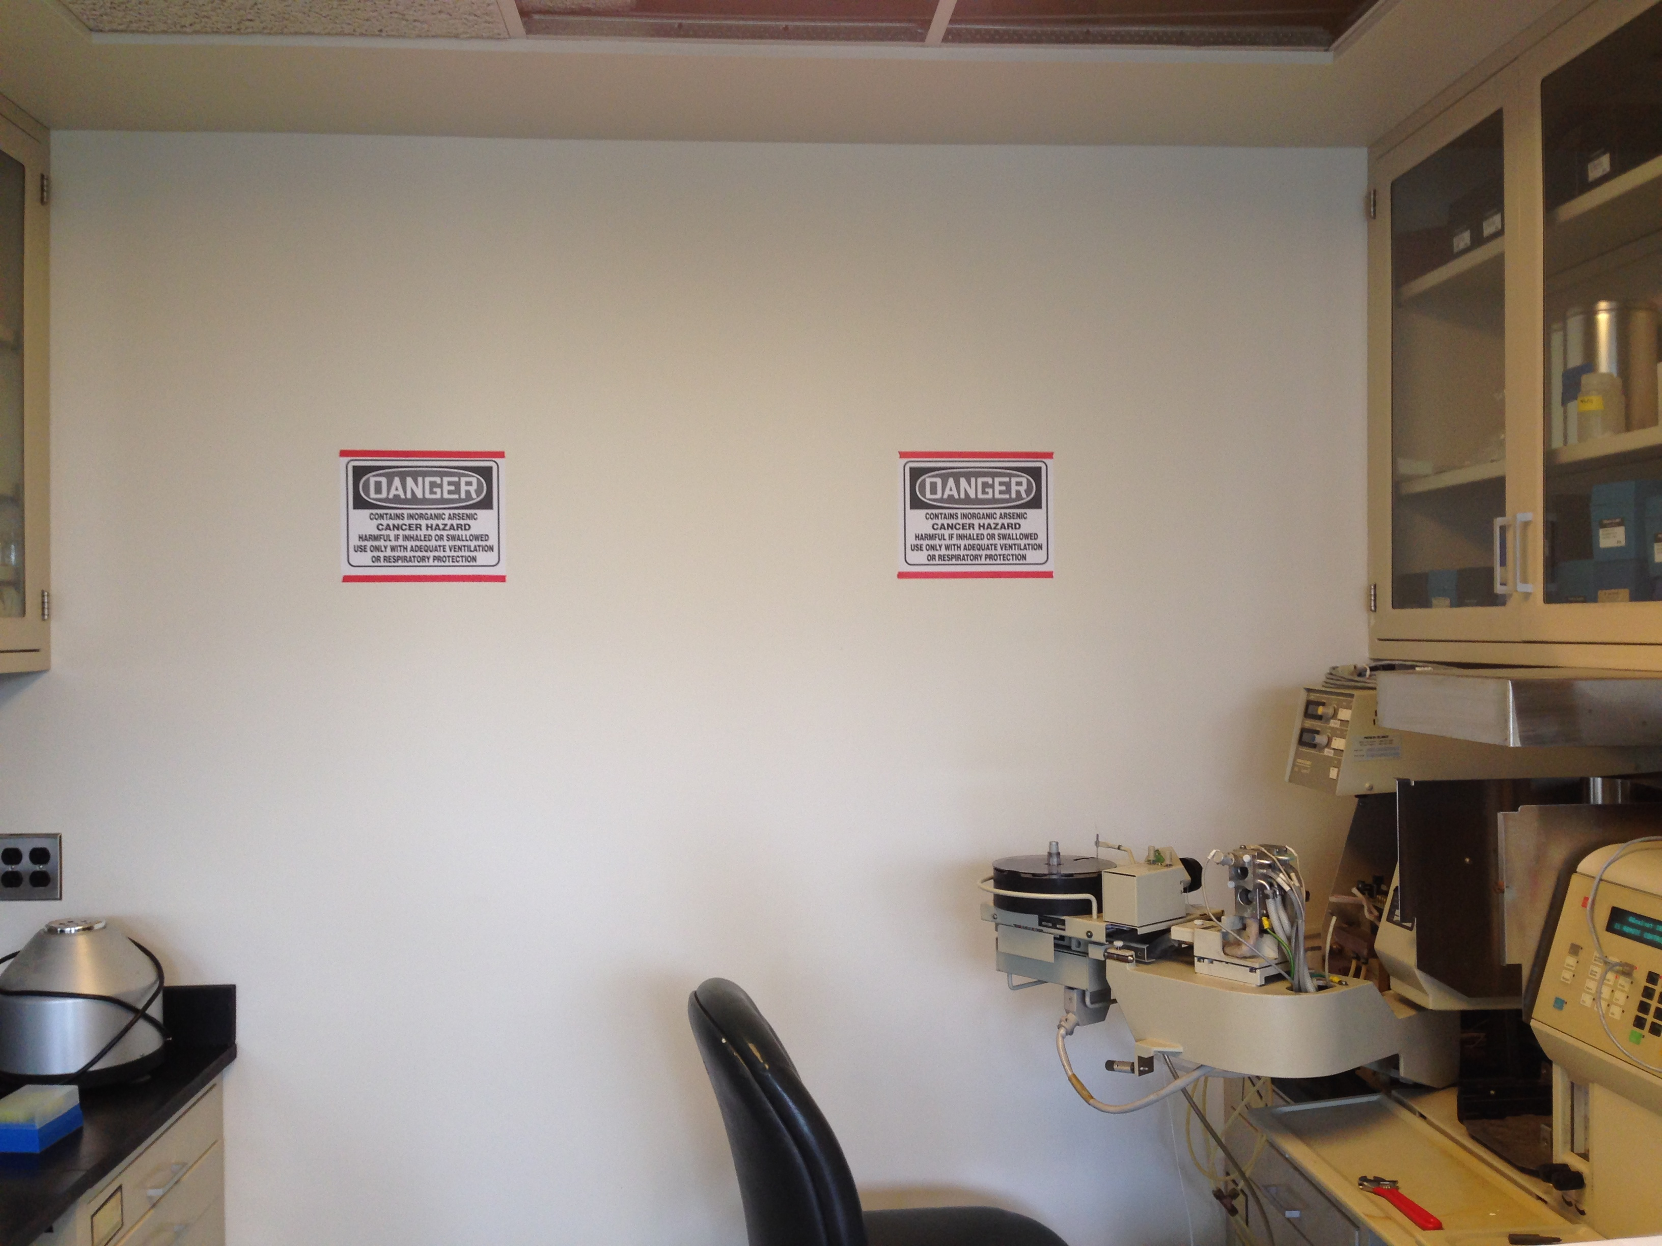
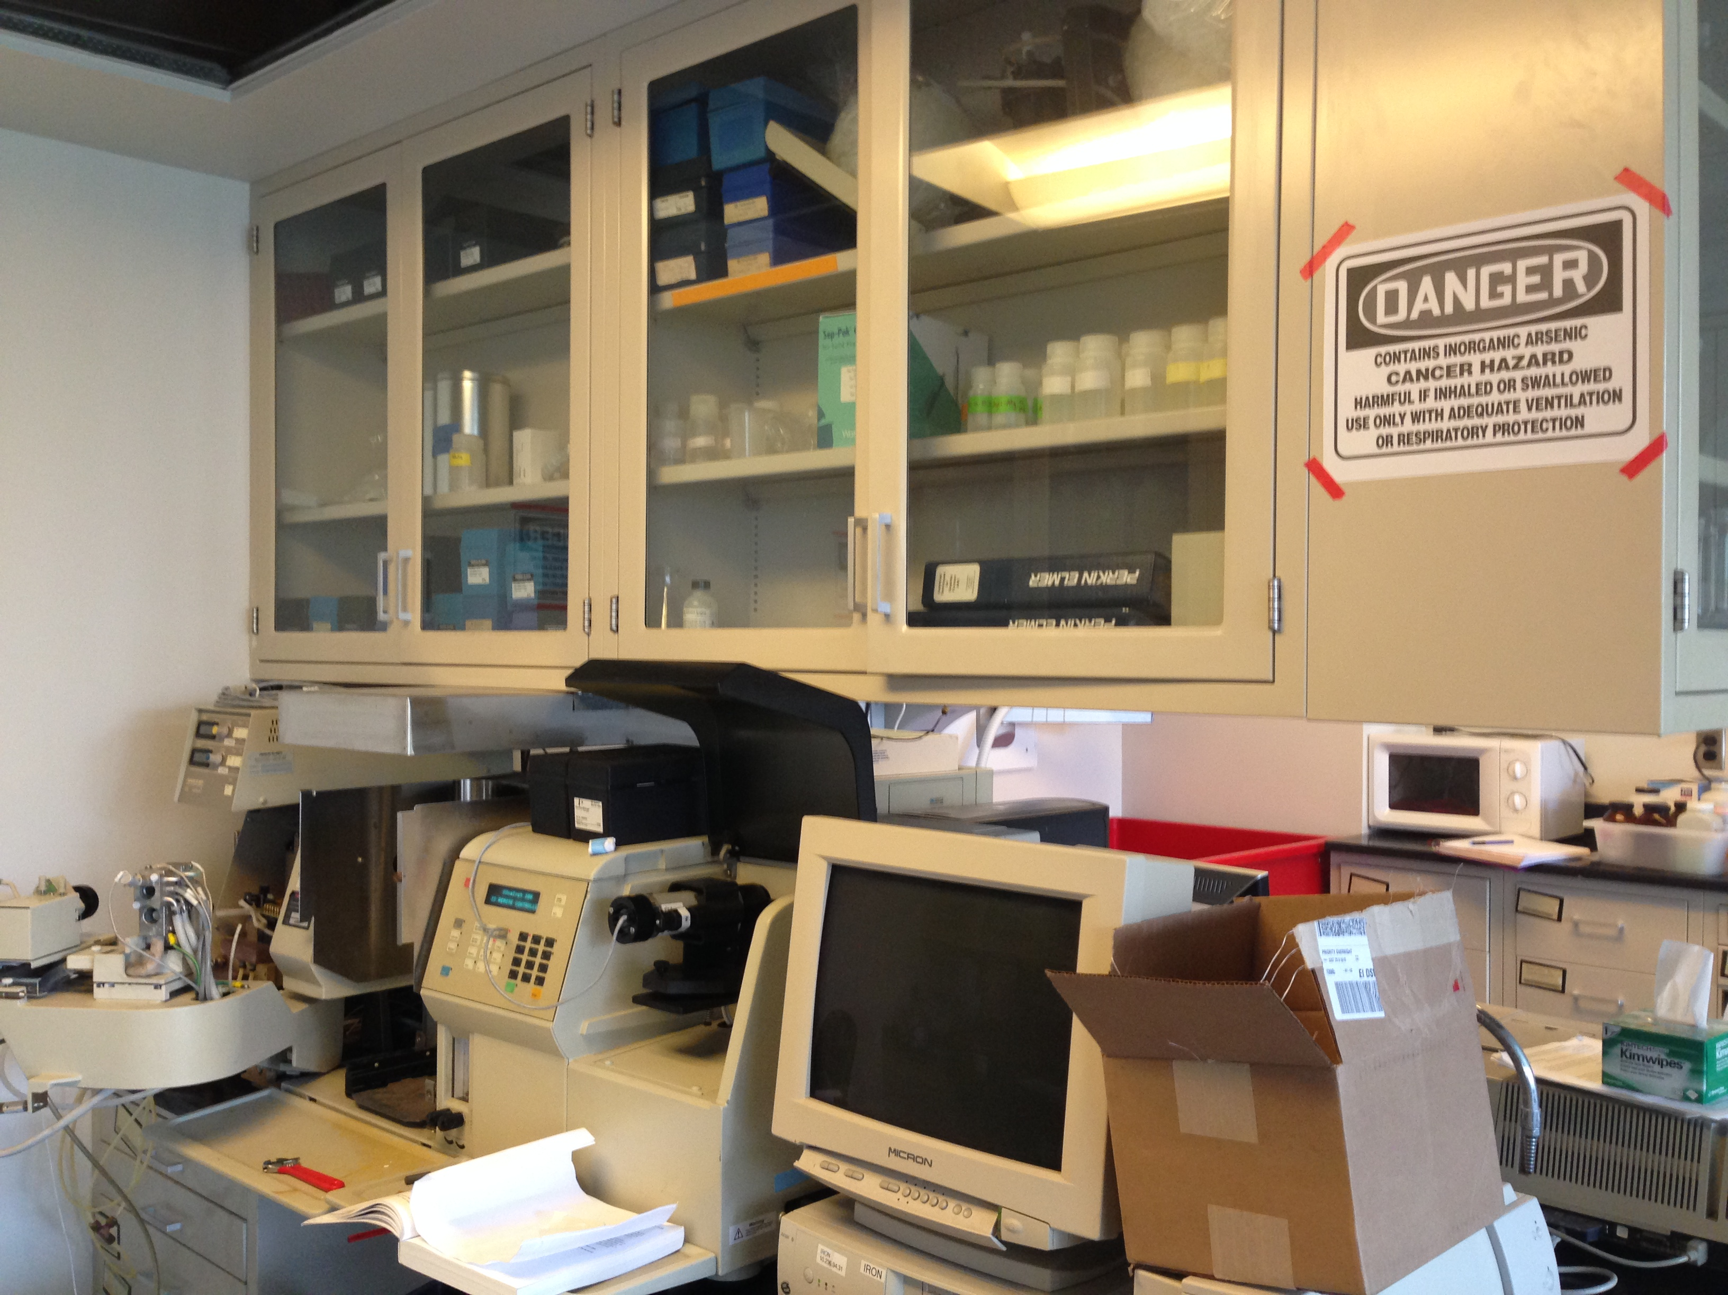
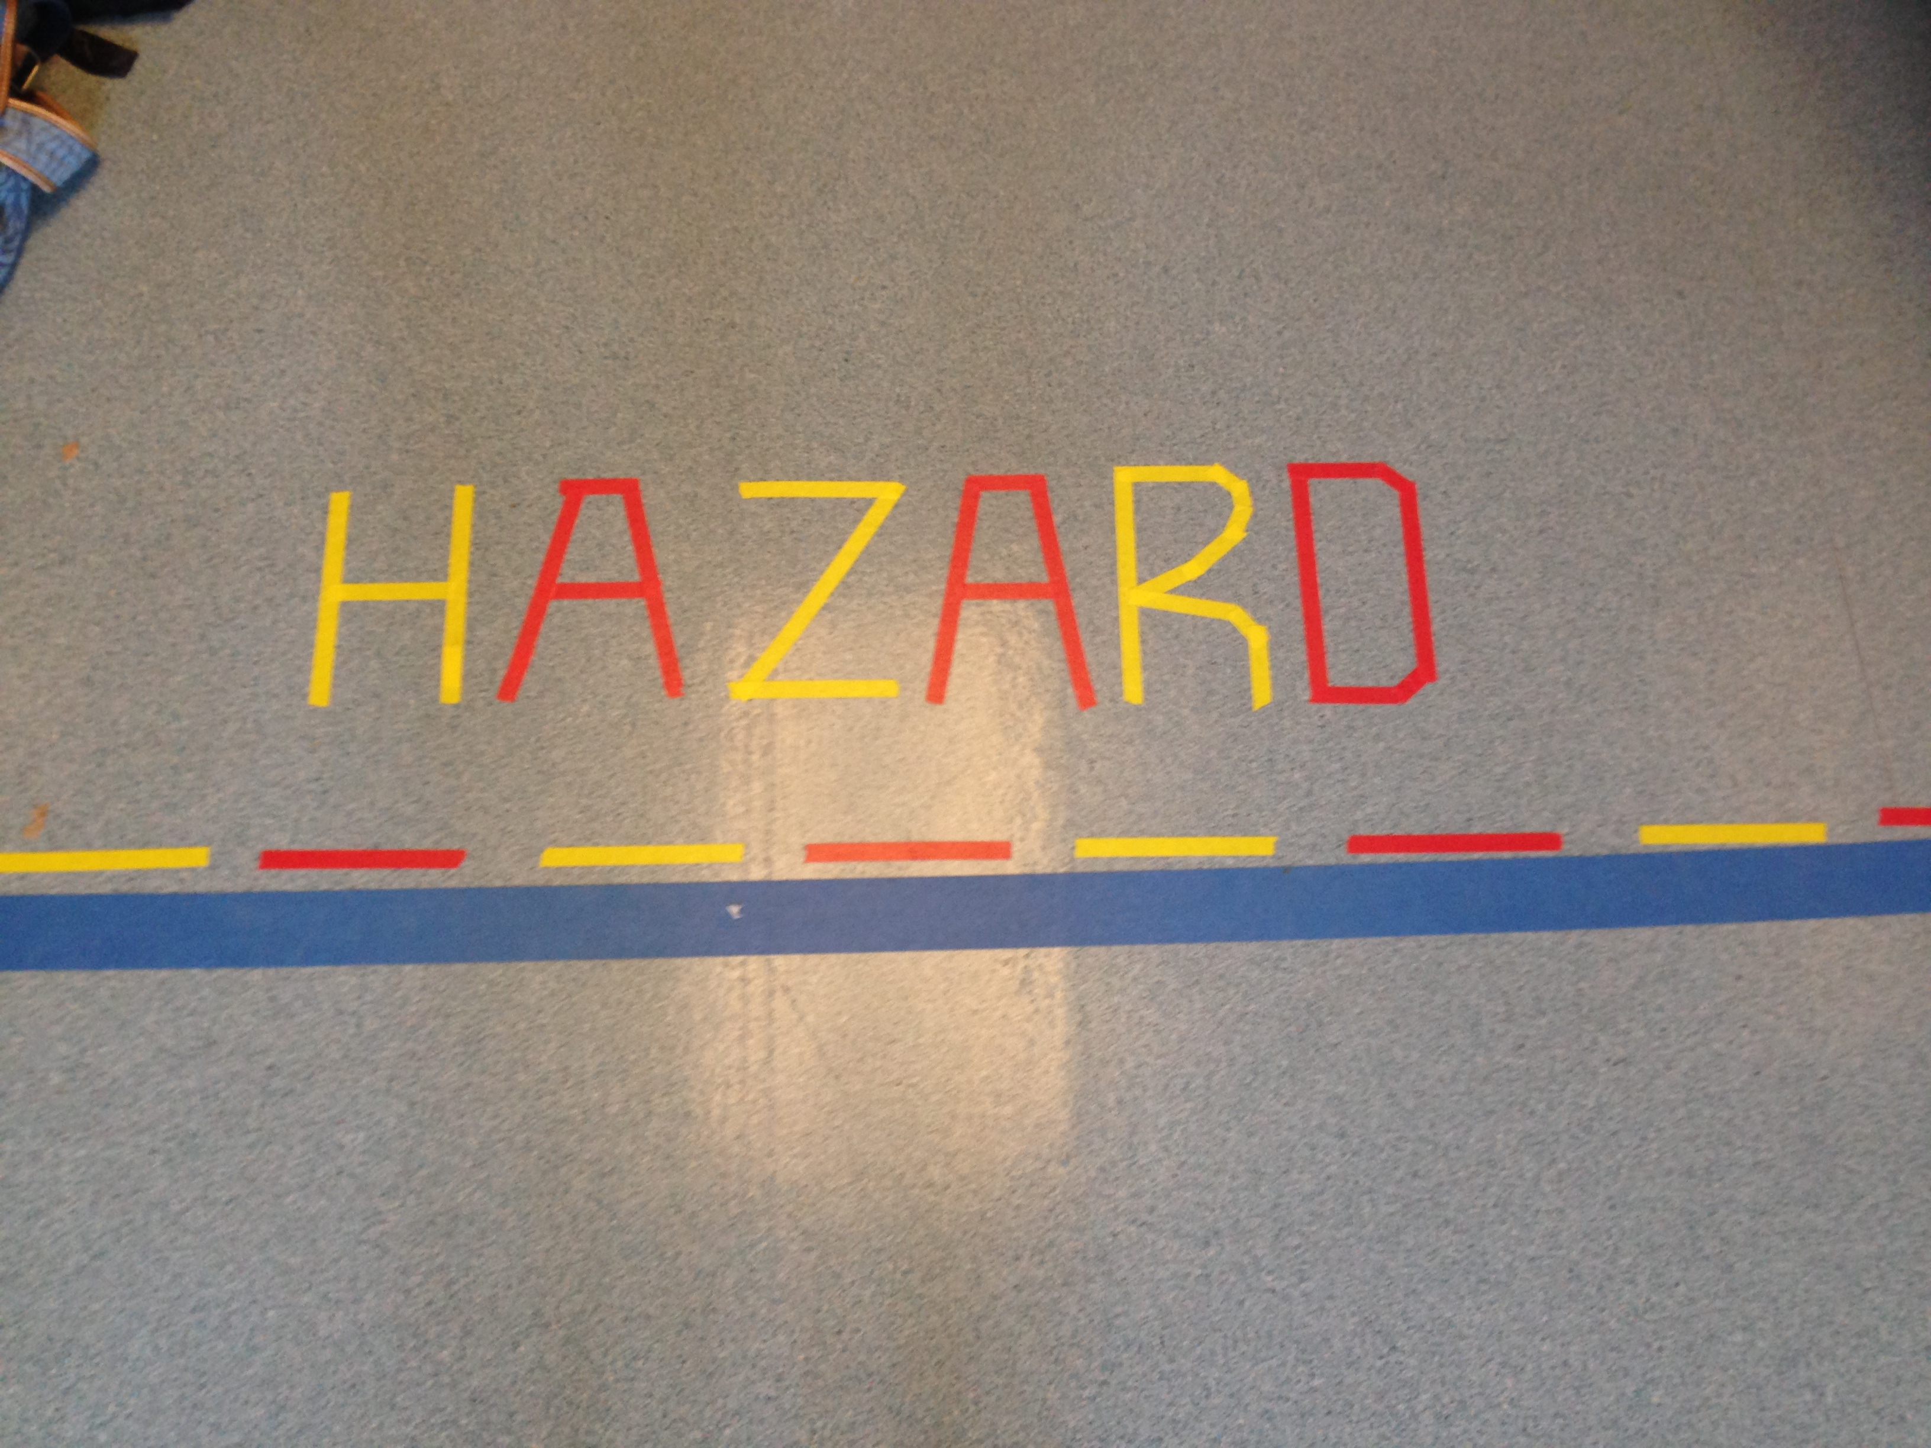
Safety Procedures

Slide 10
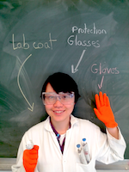

Lab Safety Equipment
Sources: http://2013.igem.org/Team:INSA_Toulouse/contenu/safety/safety_in_the_lab; mysafetysign.com

Slide 11
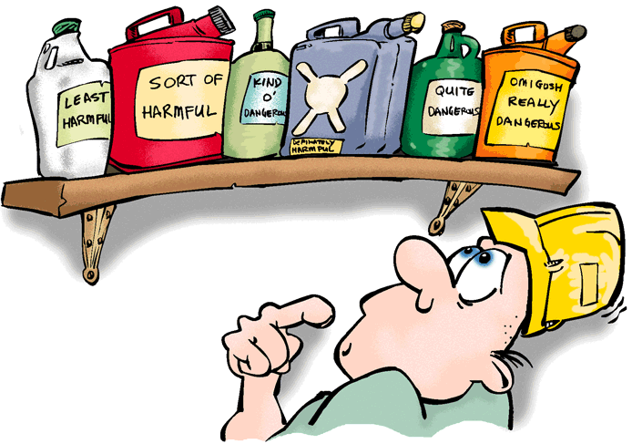
Obtaining materials and equipment
1. Centrifuge
2. Tumbler
3. Centrifuge tubes
4. Micropipettes
5. Coagulant (PACl, Alum, FeCl3)
6. Acid solution
7. Arsenic standard
8. Groundwater test solution
Source: thechroniclefast.com

Slide 12
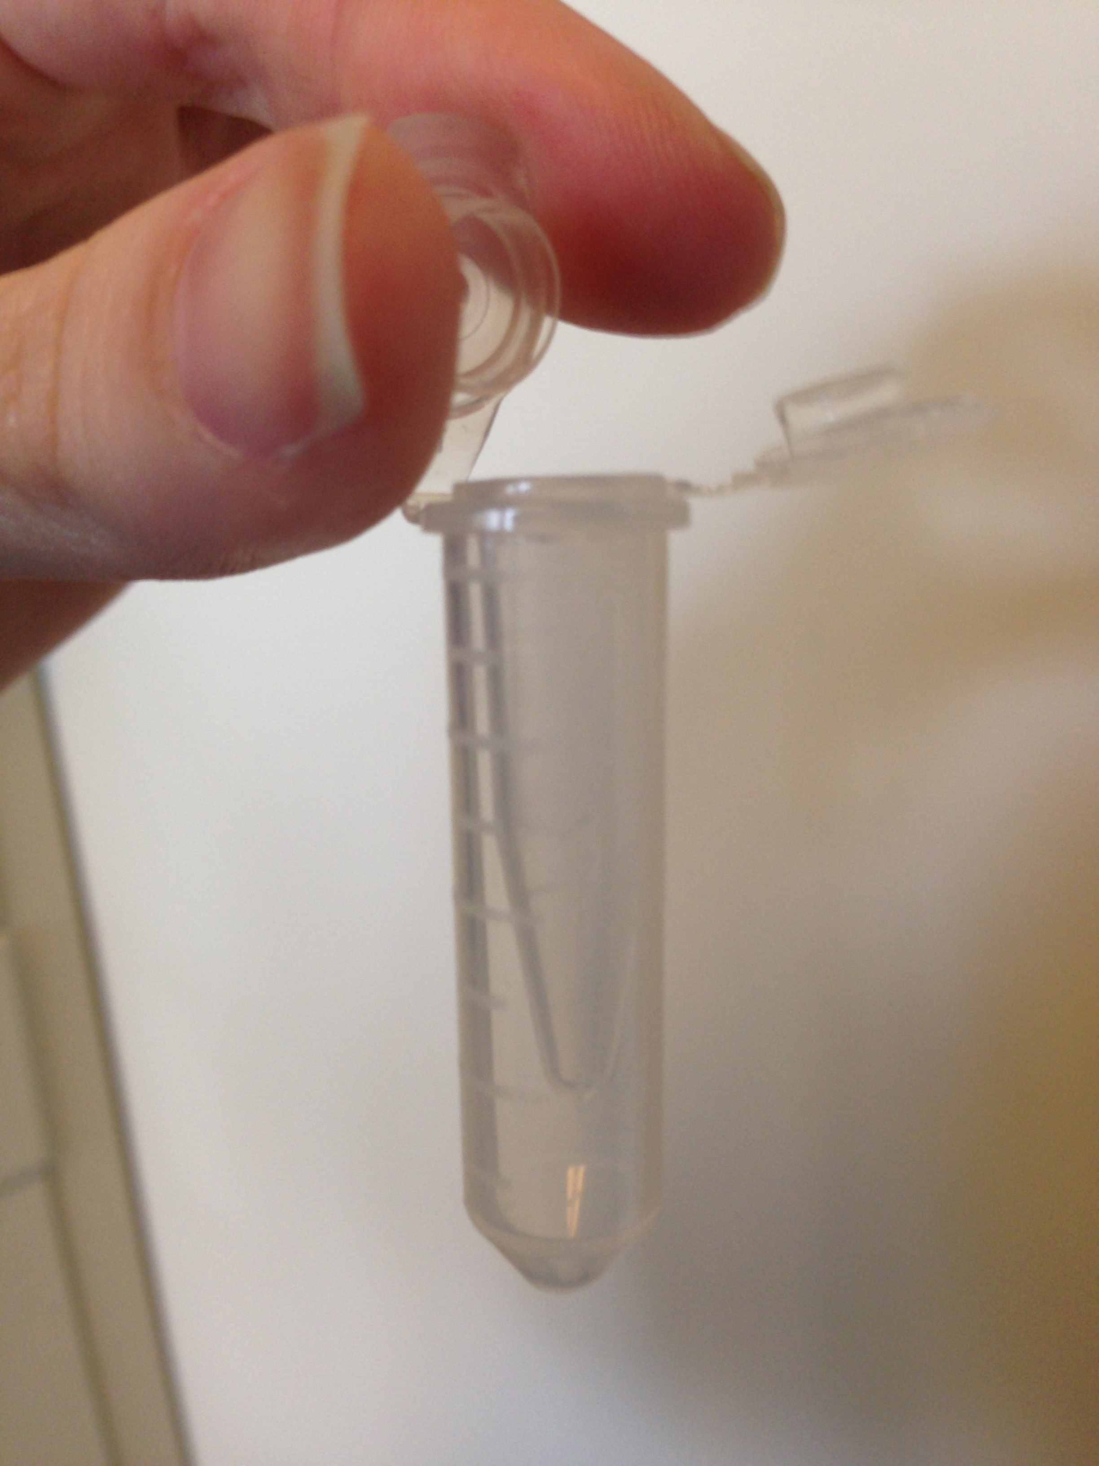
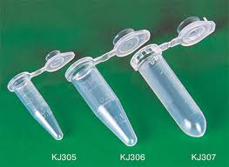
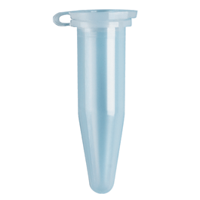
Tests of centrifuge tubes
+
=
Souce: made-in-china.com; www.spectrumchemical.com

Slide 13
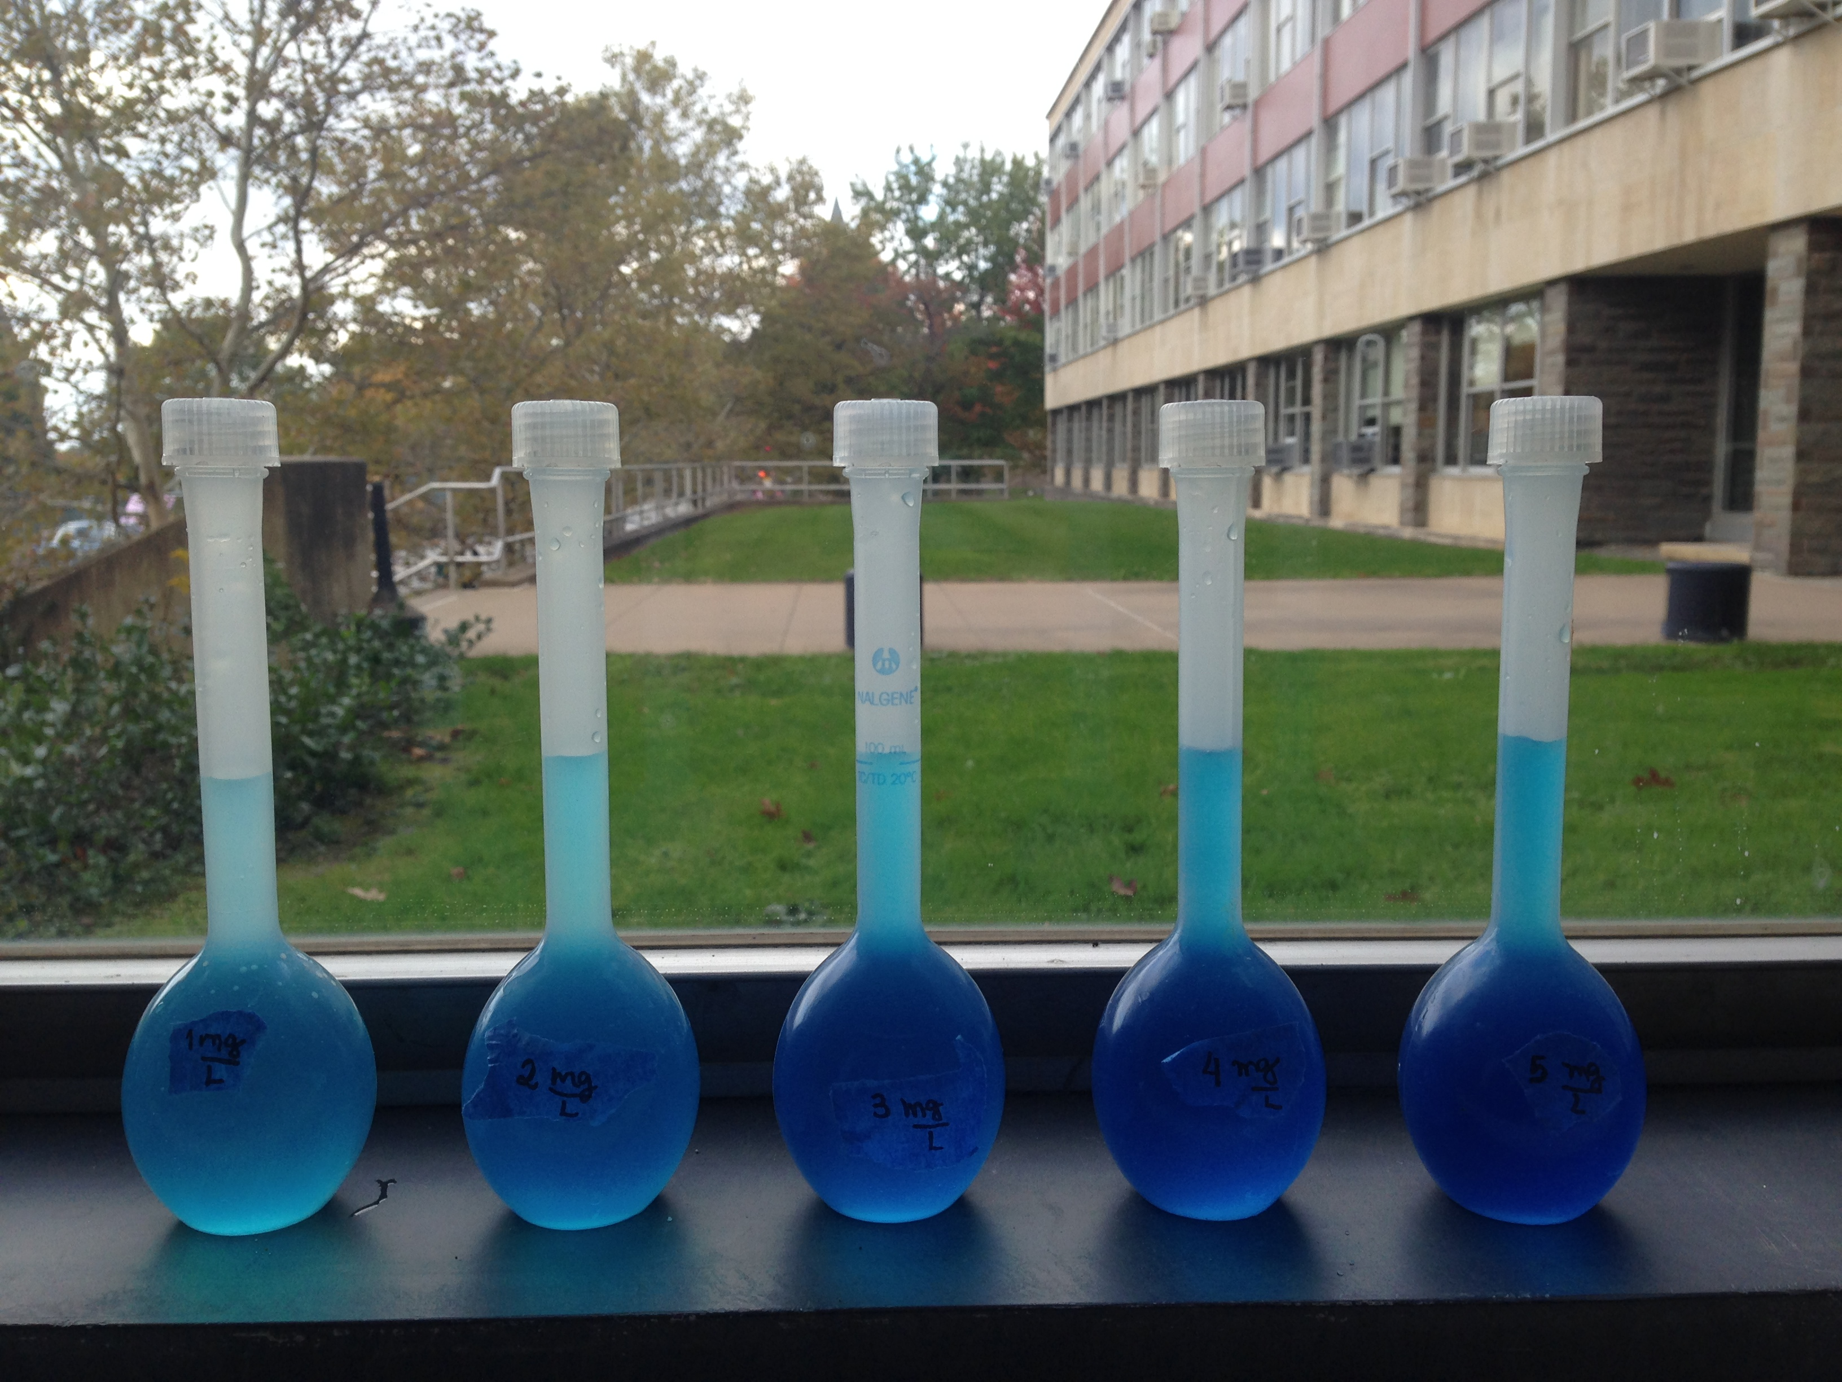
Calibration Curve

Slide 14
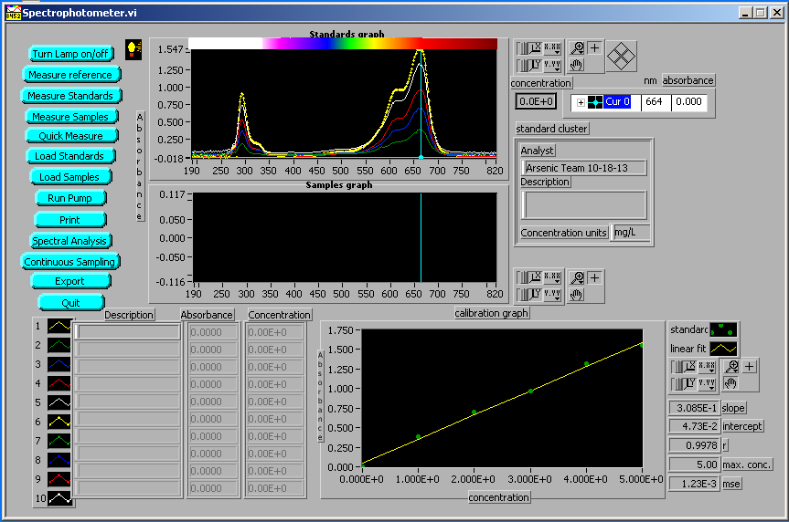

Slide 15
Learning how to use the GFAAS

Slide 16
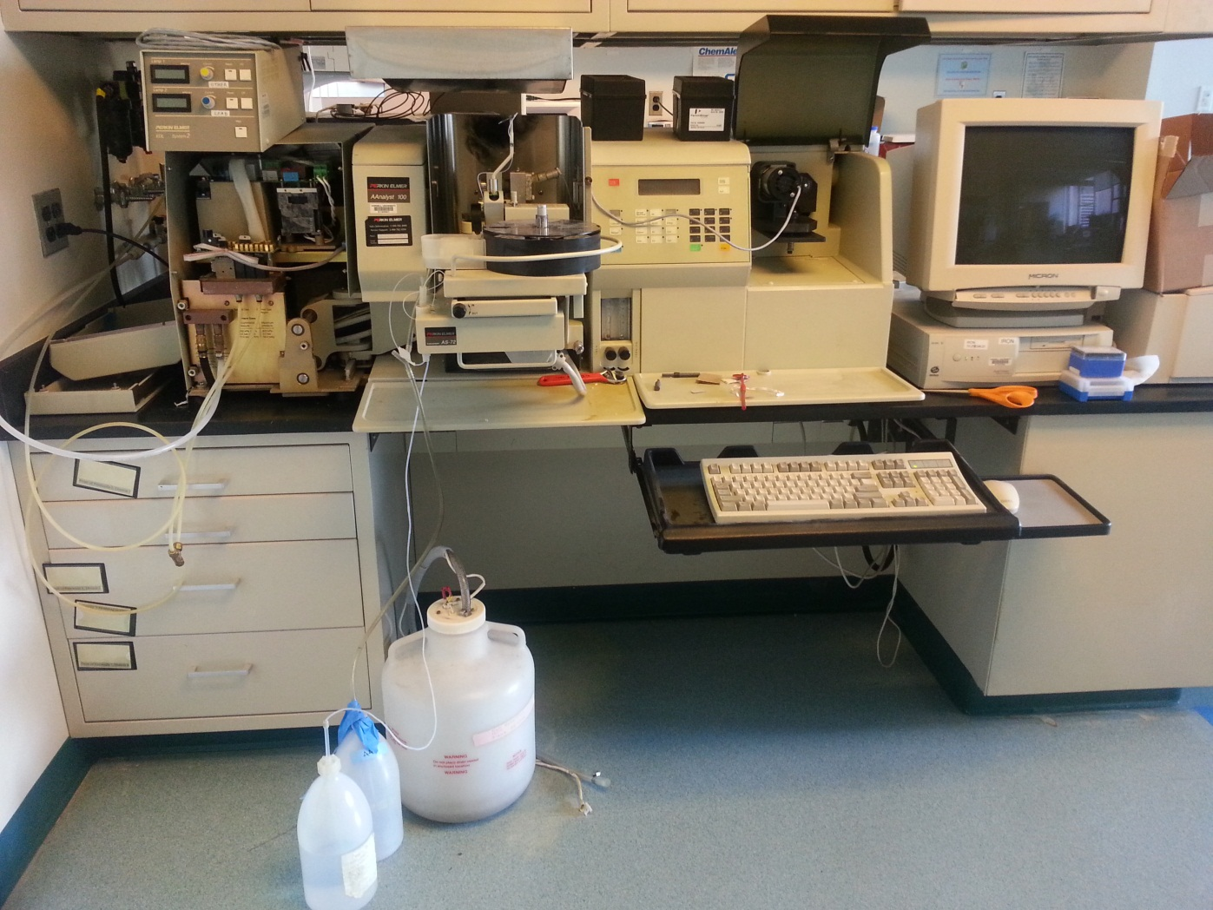
Meet Our Friend: GFAAS

Slide 17
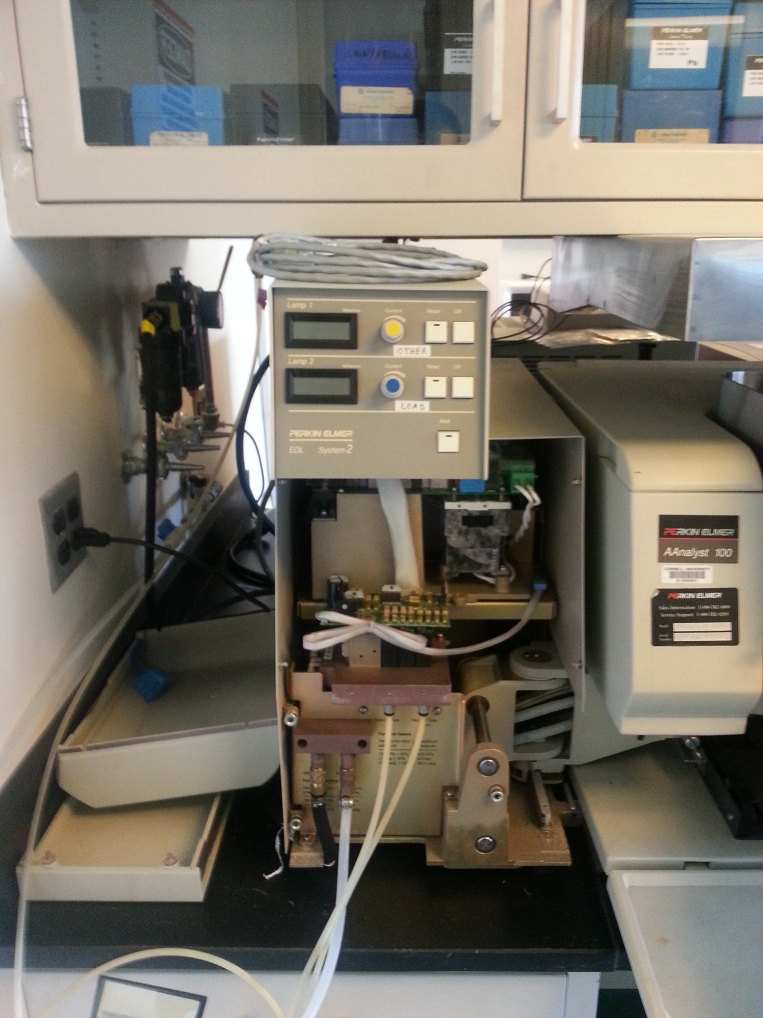

Slide 18
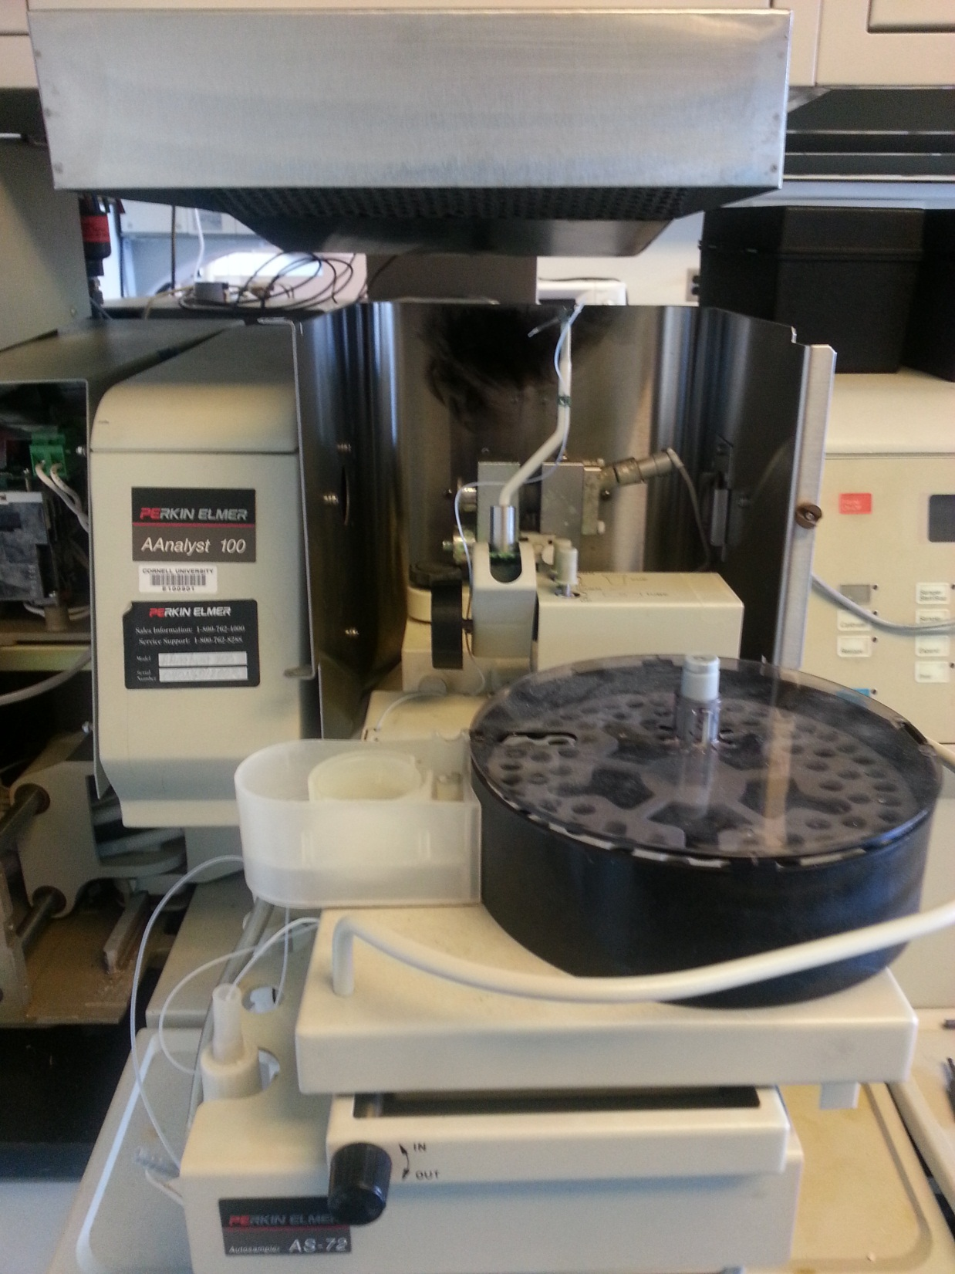

Slide 19
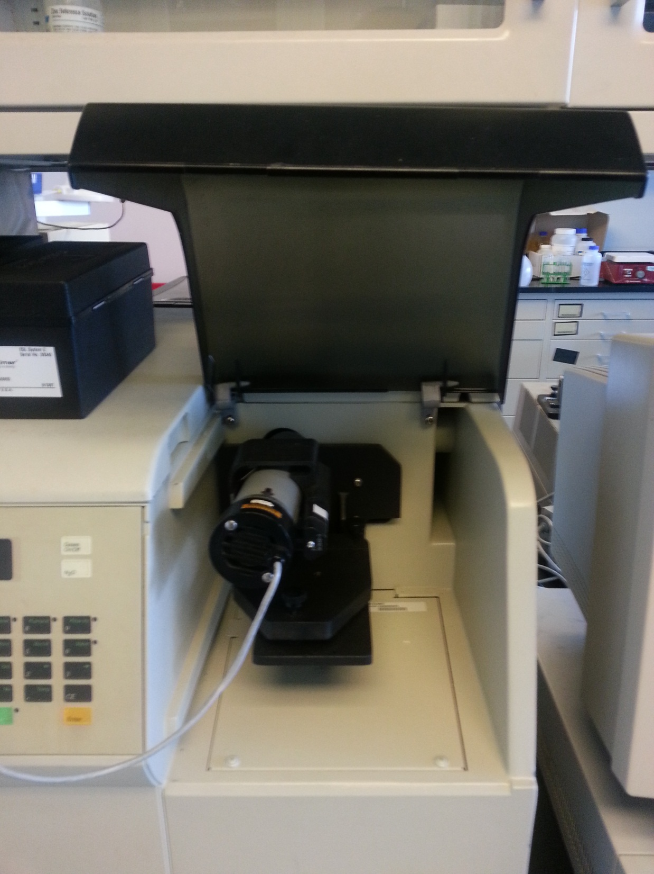

Slide 20
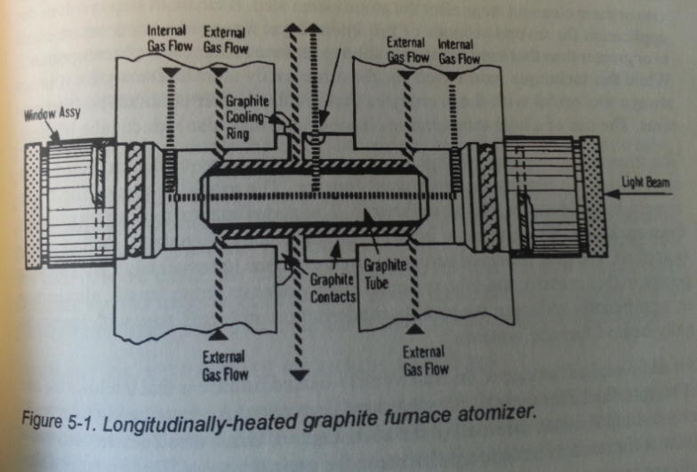

Slide 21
Upcoming Work
Tests with water
Clay may be included to create an initial turbidity
Create an arsenic calibration curve for the GFAAS
Determine the best method in order to measure low concentrations of arsenic and to optimize treatment processes for an efficient arsenic removal from contaminated waters

Slide 22
Thank you!
Team Arsenic : “Working Harder to Keep Arsenic out of Your Water”

