Slide 1



Arsenic Team
Tanapong Jiarathanakul, Imtiaz Karim, Michelle Wagner

Slide 2
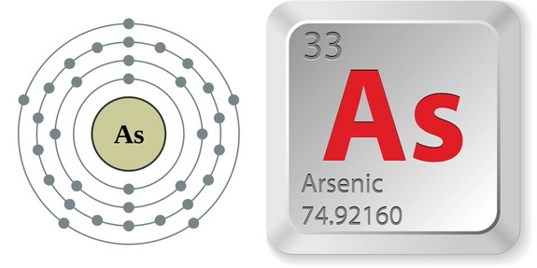
Outline
Goals
Accomplishment
  Experiment with Testing Procedures
Obstacles
  GFAAS
Future Plans
  Address this semester’s problems
  Begin testing with Arsenic

Slide 3
Goals
Devise methods to conduct research safely
Determine the best way to prepare and measure very low concentrations of arsenic
Design a small scale reactor system
Prepare test groundwater

Slide 4
What we have done so far
Preparation of lab space
Gathering of materials
Making groundwater solution
Practicing with dilution series and calibration curves
Experiment with testing procedures

Slide 5
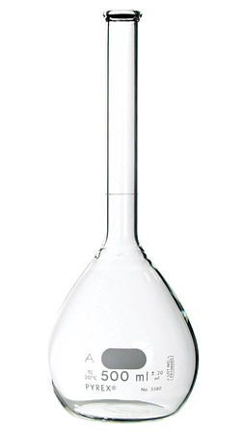
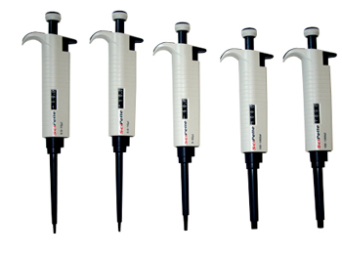
Standard Testing Procedure Experiment

Slide 6
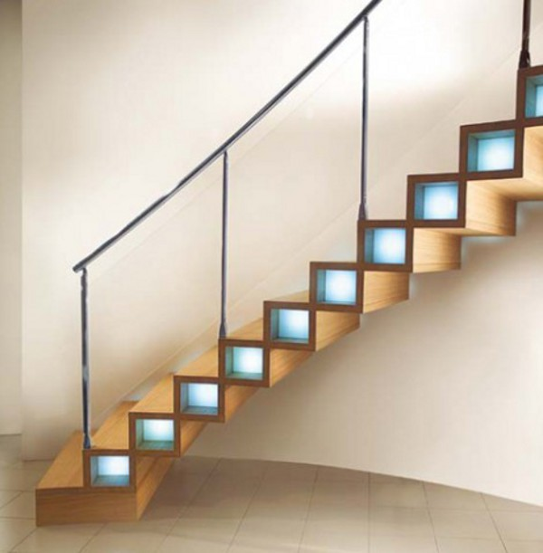
Goals
Design a standard reactor system using available lab equipment
Determine the ability for the tumbler and centrifuge to emulate flocculation, sedimentation and filtration

Slide 7
Methods
Four types of testing procedure
  Regular centrifuge tube (sedimentation)
  Tube with filter basket (filtration)
  Tube with coated filter basket without coagulant dose (coated-media filtration)
  Tube with coated filter basket with coagulant dose (coated-media filtration)
Notes:
Explain how you coat the filter

Slide 8
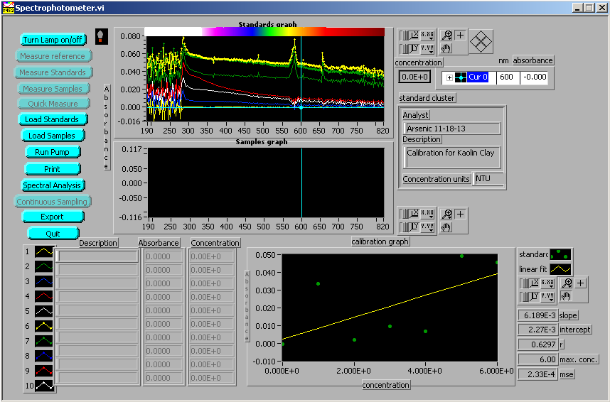
Calibration Curve
Dilution series of 1, 2, 3, 4, 5 and 6 NTU
Notes:
Note** 600 nm range

Slide 9
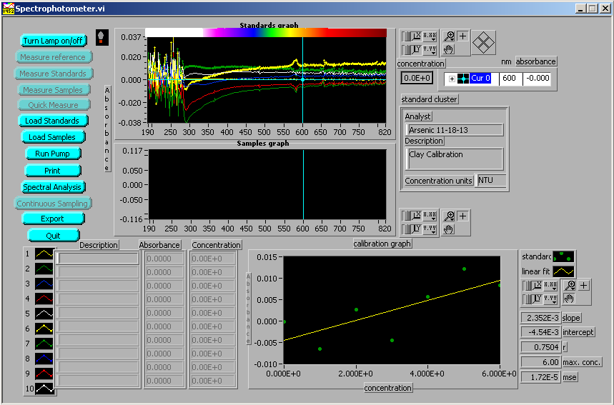
Calibration Curve
Dilution series of 1, 2, 3, 4, 5 and 6 NTU

Slide 10
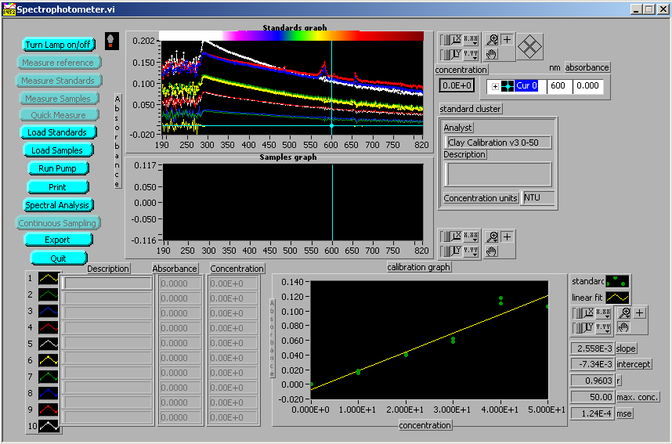
Calibration Curve
Dilution series of 10, 20, 30, 40, and 50 NTU

Slide 11
Calibration Curve

Slide 12
Sample Preparation
Turbidity = 5 NTU
PACl concentration = 2, 20 and 200 mg/L
Tumbler: Time = 5 minutes
Centrifuge: Time = 10 minutes, Power = 1

Slide 13
Results
Notes:
Spectrometer requires at least 0.6 mL of sample
Transfer of solution may cause resuspension

Slide 14
Results
Notes:
Sedimentation is not a reliable method

Slide 15
Conclusion
Sedimentation is not a reliable method
Filtration and coated filtration successfully removed turbidity
We will have to rerun this experiment with arsenic
We also need to adjust the time and power for the tumbler and centrifuge

Slide 16

Obstacles

Slide 17

GFAAS Issues
Changing the type of matrix modifier we are using
Replace old tubing

Slide 18
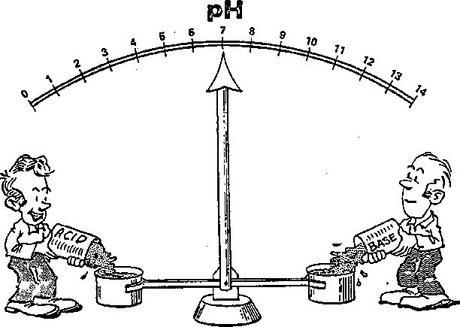
pH Problems
We did not considered the effect of pH in our samples
  PACL has low pH
  Groundwater solution has pH of 7.98
Notes:
Mention ideal pH = 7 for PACl to work properly

Slide 19
Testing Procedures
Problems with coating filter basket

Slide 20

Future Works

Slide 21
Future Works
Use GFAAS to test Arsenic
Test for different factors:
  Type of coagulant
  Oxidation state
  Clay or not clay/turbidity
  pH

Slide 22
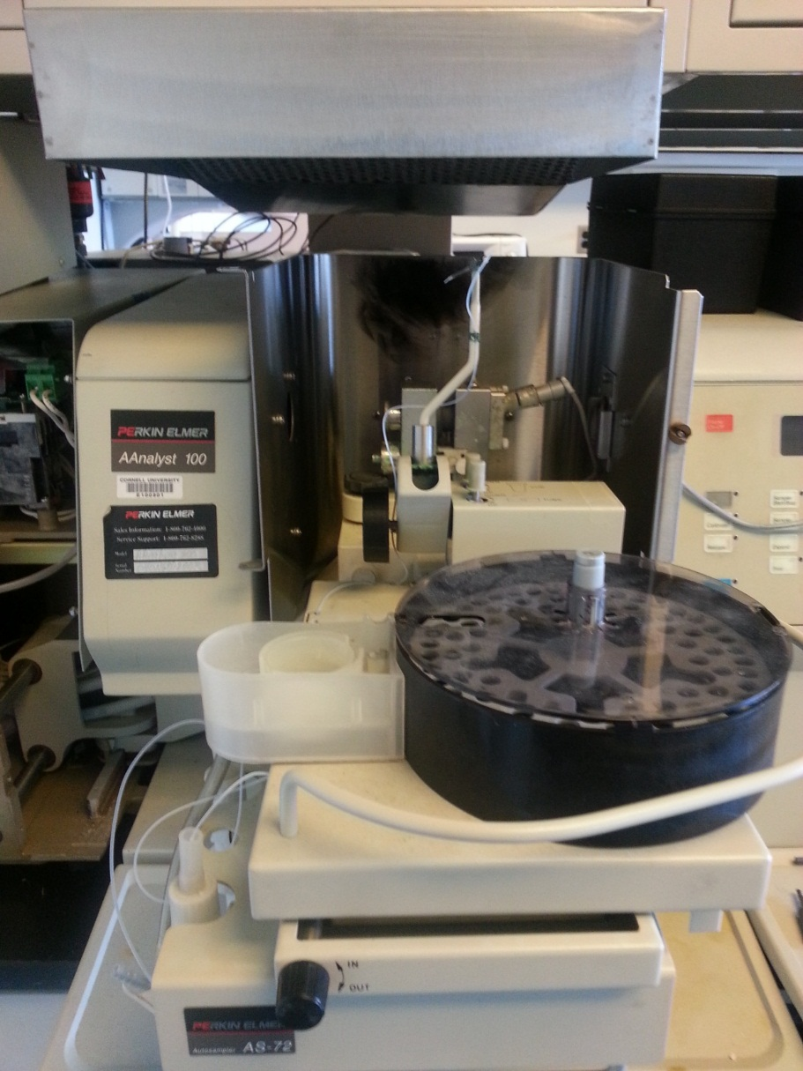
GFAAS
Align the sample platform with the light beam
Adjust the sampling arm
Create calibration curve

Slide 23
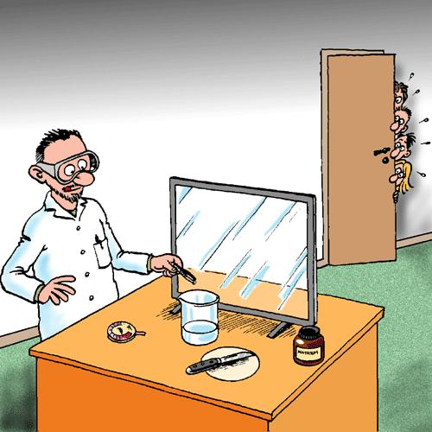
Experiment with Arsenic
Test the effects of these factors on arsenic removal
  Types of coagulant
  Oxidation state
  Turbidity
  pH

Slide 24

Questions?

Slide 25
Acknowledgements
Thank you:
Professor Lion
Professor Weber-Shirk,
William Pennock
Casey Garland
Working harder to keep arsenic out of your water!

