Slide 1
Stacked Rapid Sand Filter Theory (SRSF)
Spring 2014
Tanya Peifer
Valerie Shao

Slide 2

What is SRSF?
Stacked Rapid Sand Filter/Filtration
Invented by AguaClara and is currently used in the newer plants
Subsurface Water Injection

Slide 3
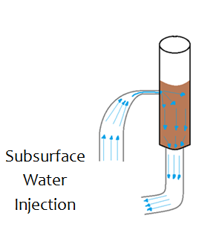
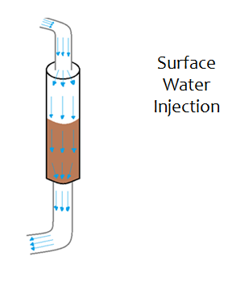
Subsurface
  Particles are captured throughout entire sand bed
  Flocs cannot continue to accumulate with high shear
  Water passes easily through sand bed
Surface
  Particles trapped on top of sand bed
  Flocs build up between pores and form a thick layer
  Pores clog

Slide 4
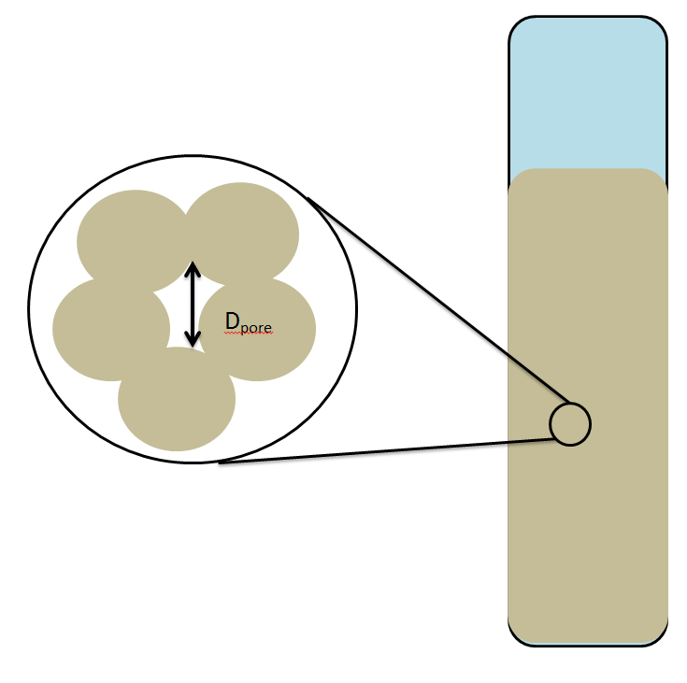
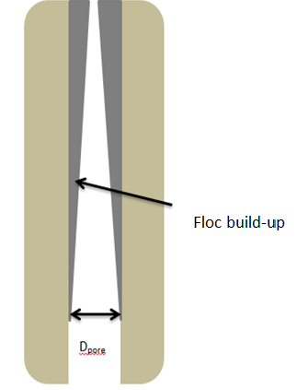
Why Are We Here?
Flocs build-up in sand pores, causing:
  An increase in
    Head loss
    Shear force
    Water velocity
  A decrease in
    Pore diameter
Notes:
We want to develop a model that given a known influent turbidity and PACl dosage can predict when the filter is no longer efficient. A simplified view of what’s going on in the filter: flocs attach to pores between sand grains. As the diameter of the pore becomes smaller and smaller the velocity of the water and the shear force increase until the strength of the stickiness of the coagulant is no longer enough for the flocs to attach and run through the column unfiltered.

Slide 5
Our Mission
Determining the relationship between mass added into system and its effects on head loss and effluent turbidity
Creating a mathematical model defining this relationship
Determining the minimum Dpore at each concentration of PACl

Slide 6
Experimental Procedure
Running several experiments at various PACl concentration dosages (0.2, 0.65,1.10,1.55, 2.0 mg/L)
Recording necessary values every 5 seconds:
  Influent turbidity
  Effluent turbidity
  Head loss

Slide 7
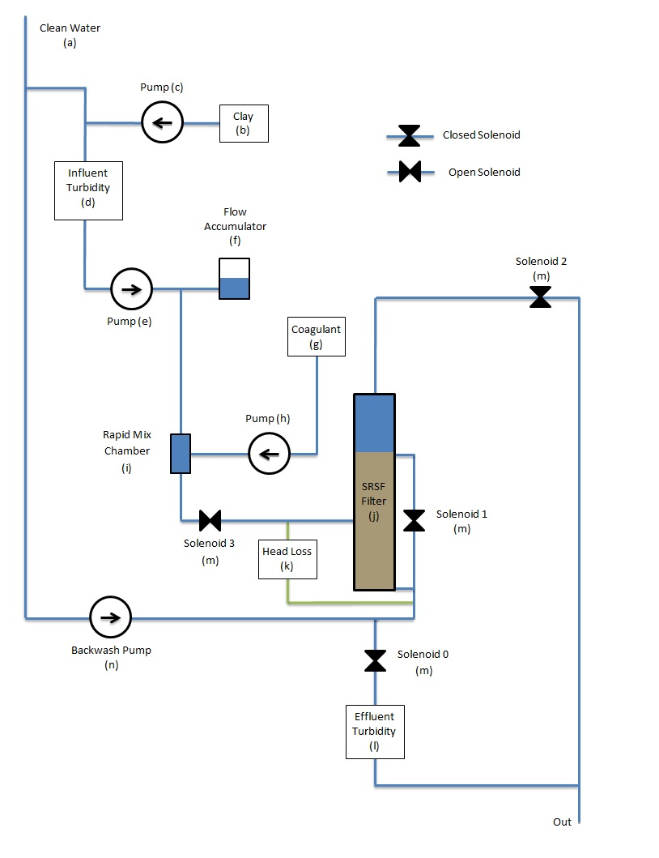
Experimental Set-up
Notes:
1. Clean water is stored at 20 C and aerated. 2. Water is continuously mixed with clay in the stock tank using an electric mixer. 3. The clay/water mixture from the stock tank is mixed into the influent water. The speed at which the clay pump runs is determined using Process Controller and PID to guarantee an influent turbidity of 5 NTU. 4. A turbidimater measures the turbidity of the water before coagulant is added. 5. Water passes through a peristaltic pump and the flow accumulator which decreases irregularities of the flow into the column. 6. PACl is stored in its own stock tank and is pumped into a rapid mix chamber where it combines with the influent water to form flocs. 7. The flocs flow up or down through one of the two sand beds and then exit the filter. 8. A pressure sensor measures the difference in head between influent and effluent water. 9. A turbidimeter measures the effluent turbidity

Slide 8
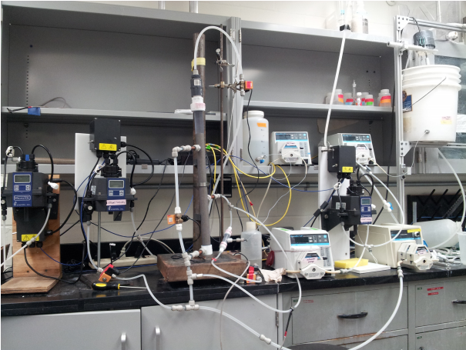
Experimental Set-Up

Slide 9
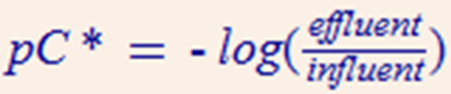
Performance Curves
Higher values denote higher efficiency
Plots at different PACl dosages all show distinct drop in efficiency followed by slight increase
Correspond to flocs being knocked out of filter due to high shear stress
Notes:
When analyzing the data we graphed performance curves for each of the PACl dosages. We run three trials of each PACl dosage.

Slide 10
Performance Curves II

Slide 11
Head loss
Traditional filters demonstrate exponentially increasing head loss when clogged due to accumulation of flocs on surface
SRSF is not affected by accumulation of flocs on surface because of subsurface injection
Theoretically head loss should increase linearly and level off
Initial tests suggest this trend occurs

Slide 12
Head loss II

Slide 13
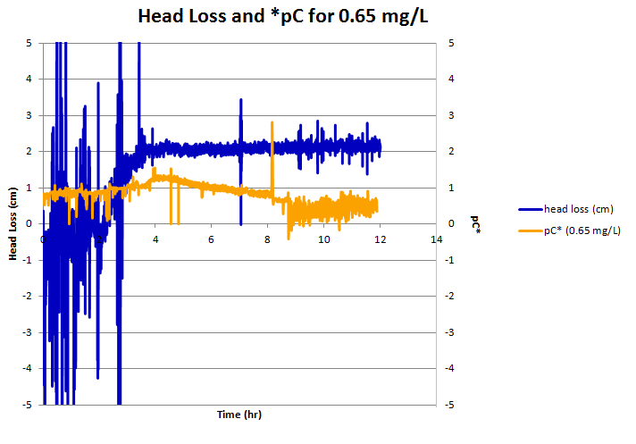
Head loss III
Notes:
The time that the head loss levels off and the pC curve begins decreasing occur at approximately the same time which adheres to our simplified model of the pores being filled.

Slide 14
Head loss IV
Converted influent turbidity measurements to mg
Plotted the head loss versus accumulated mass
Initial tests suggest that the increase in head loss is proportional to the amount of accumulated mass

Slide 15
Head loss V

Slide 16
Current Issues
Strange head loss readings
Even if we account for negative readings of our pressure sensor, some data still does not make sense

Slide 17
Future Work
Want to determine a model for filter performance at any given PACl dosage
Kozeny’s Equation
Can determine V_{pore} from known porosity, 0.4
μ = dynamic viscosity, ρ = density of sand
Determine value where head loss levels off at each PACl dosage
Solve equation for d_{pore}
Relate d_{pore} to amount of clay that can enter the filter before it clogs

Slide 18
Questions/Comments?

