Slide 1

SRSF Theory
Theresa Chu
Tanya Peifer
Michelle Bowen

Slide 2

What is SRSF?
Stacked Rapid Sand Filter/Filtration
Invented by AguaClara and used in newer plants
How is it different?
  Water enters the filter through embedded tubes
  Allows for entirely gravity-powered water filtration

Slide 3
Why are we here?
Create a theoretical understanding of SRSF
Why?
This understanding can be used to optimize SRSF performance
How?
By conducting experiments while varying certain inputs and monitoring important outputs

Slide 4

Challenges
Redesign the laboratory apparatus
Test and improve the turbidity feed system
Design a new system for coagulant dosing
Design and run experiments, varying important parameters
Begin developing a model for filter performance

Slide 5
Designing the Apparatus
Construction parameters
  Number of layers required
    2 layer filter was the simplest option that modeled SRSF
  Height of filter
  Inlet and outlet tube dimensions and materials

Slide 6
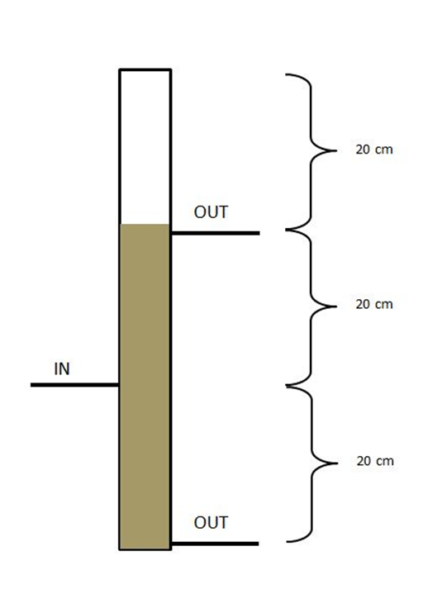
Redesigned Apparatus
One filter column
Models two layers of an SRSF, with one inlet and two outlets
Size considerations:
  Each filter layer is 20 cm
  Backwash expansion is approximately 30 %
Backwash space > .3*(40 cm)
Backwash space > 12 cm

Slide 7
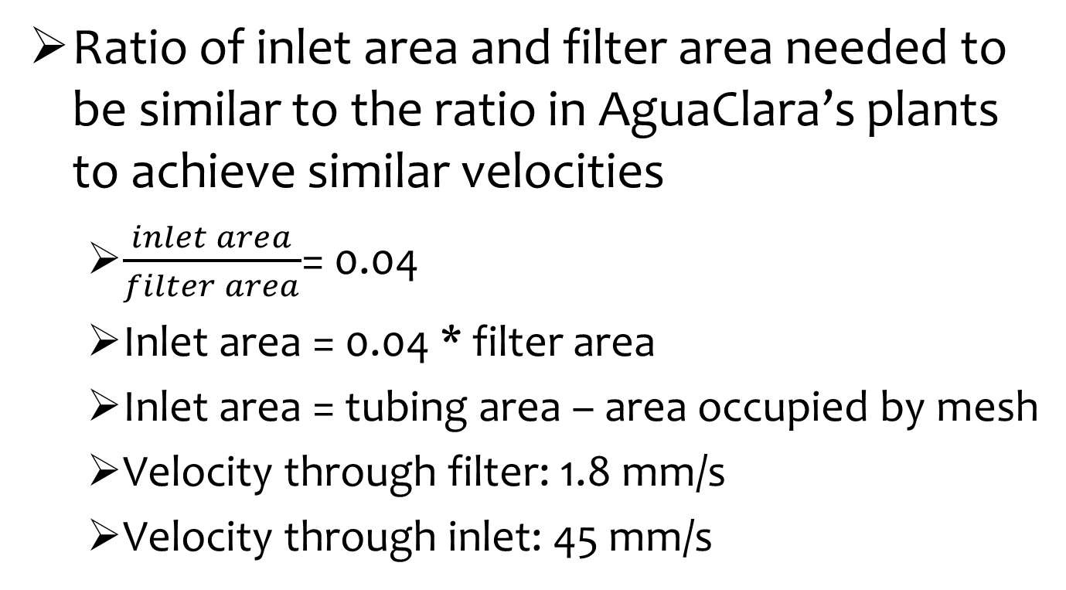
Inlet and Outlet Design
Ratio of inlet area and filter area needed to be similar to the ratio in AguaClara’s plants to achieve similar velocities
  $\frac{inlet area}{filter area}$= 0.04
  Inlet area = 0.04 * filter area
  Inlet area = tubing area – area occupied by mesh
  Velocity through filter: 1.8 mm/s
  Velocity through inlet: 45 mm/s

Slide 8
Materials
Clear PVC
  Length: 60 cm.
  ID: 1 in.
Sand
  Diameter of 1 grain: 0.02 in.
Multipurpose copper tubing
  ID: 0.37 in.
Copper mesh
  Opening size: 0.009 in.
  Porosity: 30%

Slide 9
Construction
Sealed end of filter
Drilled holes for inlet and outlet tubes
Threaded push-to-connect fittings were used to put the copper tubing inside the filter
  Fittings were drilled out to accommodate copper tubing
Copper tubing inserted halfway through column
Copper mesh welded on ends of copper tubing

Slide 10
Testing the Apparatus
Is the apparatus water tight?
Filled with water
Connected in system
Is the influent turbidity constant?
Ran trials to measure turbidity
Must be within 10% of target value to be acceptable

Slide 11
Current Issues
Influent turbidity varies
Coagulant loss on tubing
Old method: rapid mix chamber
  Clay settling out before reaching filter
  Coagulant coating the tubing and not the clay
Notes:
Varying influent turbidity
-- while varying naturally in Honduras, in order to collect consistent data that tells us something, we need a constant influent turbidity
---also, by the time the turbid water gets to the filter, it is usually about 5 NTU

Slide 12
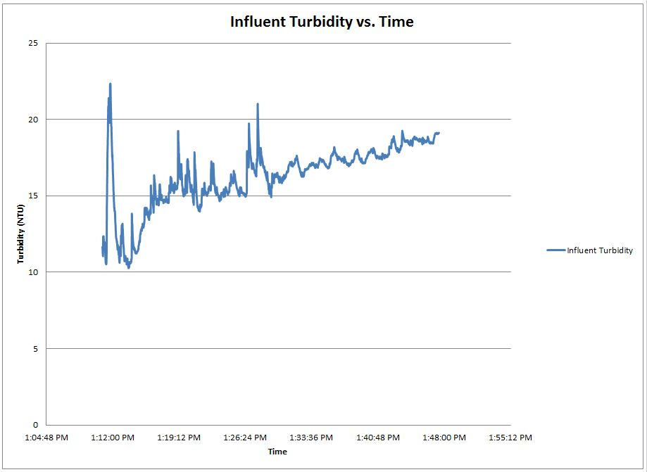
Influent Turbidity: Sample Results

Slide 13
Possible Solutions
For turbidity:
  PID system (uses Process Controller to measure levels of turbidity and add more or less clay stock depending on readings)
For coagulant loss:
  Direct injections (changed location)
  Larger contact chamber

Slide 14
Turbidity with PID

Slide 15
Future Work
Achieve constant influent turbidity
Continue running pilot experiments testing turbidity and addition of coagulant
Decide parameters for new experiments
Run experiments
Collect and analyze data
Develop model

Slide 16
Experiment Parameters
Given:
  Constant Influent Turbidity (5 ± 0.5 NTU)
  Constant Flow Rate (0.929 mL/s)
Independent Variable:
  Coagulant Dosage
Dependent Variables:
  Effluent Turbidity
  Head Loss

Slide 17
Developing A Model
Collect a group of performance curves using pC* and head loss
  pC* compares influent and effluent turbidities
Model filter performance
  Find pore storage volume as a function of coagulant dosage
  Predict head loss as a function of coagulant dose and mass of solids accumulated
Notes:
$${pC}^{∗} =−log{\frac{effluent}{influent}}$$

Slide 18

Questions?

