Slide 1

Surface vs. Subsurface Injection for Sand Filter
Summer 2013
Theresa Chu
Kelly Huang
Vikram Kejariwal
Tanya Peifer

Slide 2
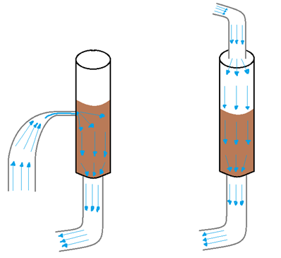
Background
Subsurface injection – represents stacked rapid sand filter (SRSF)
Surface injection – represents conventional downflow rapid sand filter
Subsurface
Water
Injection
Surface
Water
Injection

Slide 3
Goals for Summer 2013
Determine clogging conditions
Whether backwash is sufficient in unclogging the filter

Slide 4

Definitions
Head Loss
Clogging
  Surface: head loss increases exponentially
  Subsurface: head loss is 1.4 to 1.6 times sand depth (or greater than 40 cm = ineffective)

Slide 5
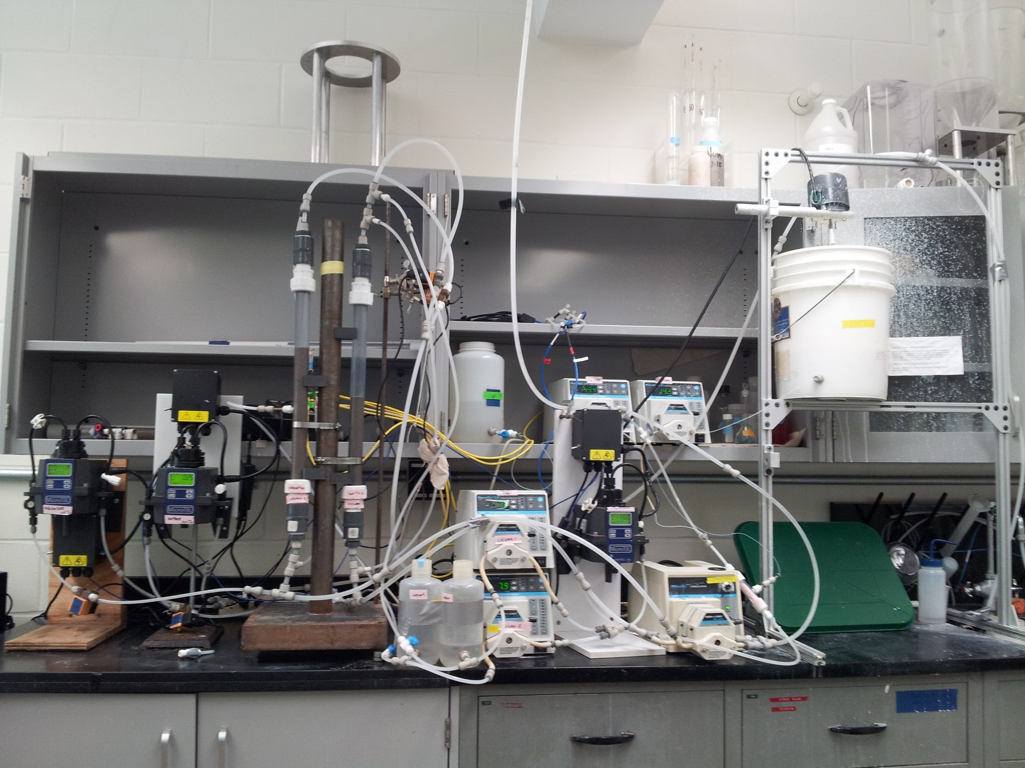
Apparatus

Slide 6
Variables
Independent
  PAC dosage
  Filter Velocity
  Influent Turbidity
Dependent
  Head Loss
  Effluent Turbidity
Qualitative observations
  Backwash (videos)
  Clay build-up

Slide 7
Hypothesis
Clogging will most likely occur at
  low filter velocity
  high PAC dosage
Backwashing will require more effort at higher PAC dosages

Slide 8
First 50 experiments

Slide 9
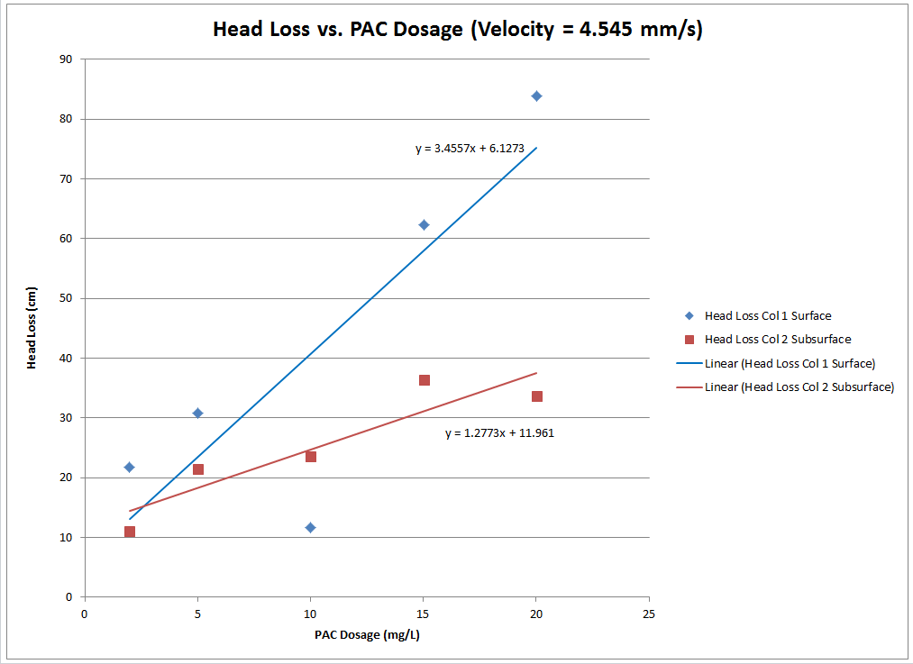
Head Loss vs. PAC Dosage

Slide 10
Head Loss vs. Velocity

Slide 11
Head Loss Over Time

Slide 12
Problems & Solutions
Only ran for 2 hours; no clogging occurred
Technical difficulties
  Pressure sensors
  Turbidimeter condensation
  Pump calibrations

Slide 13
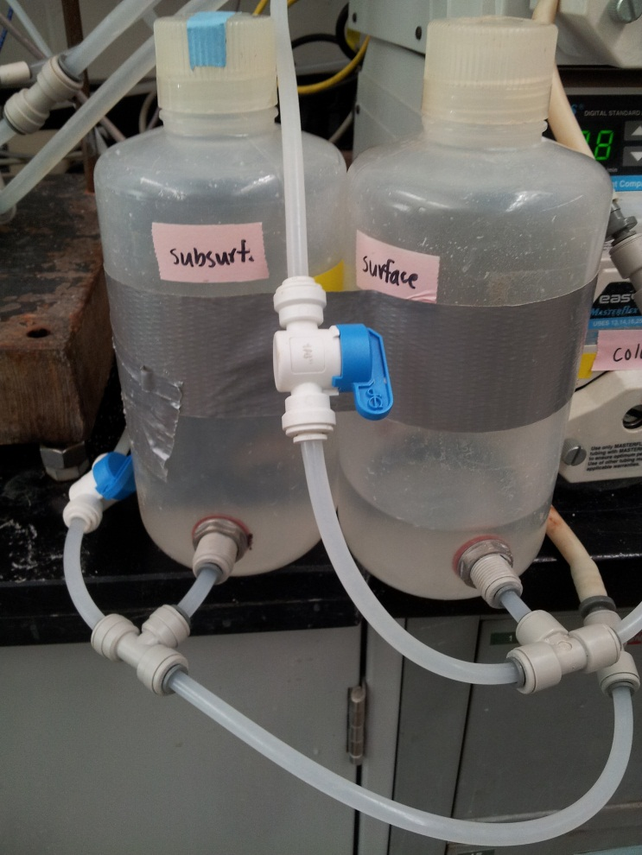
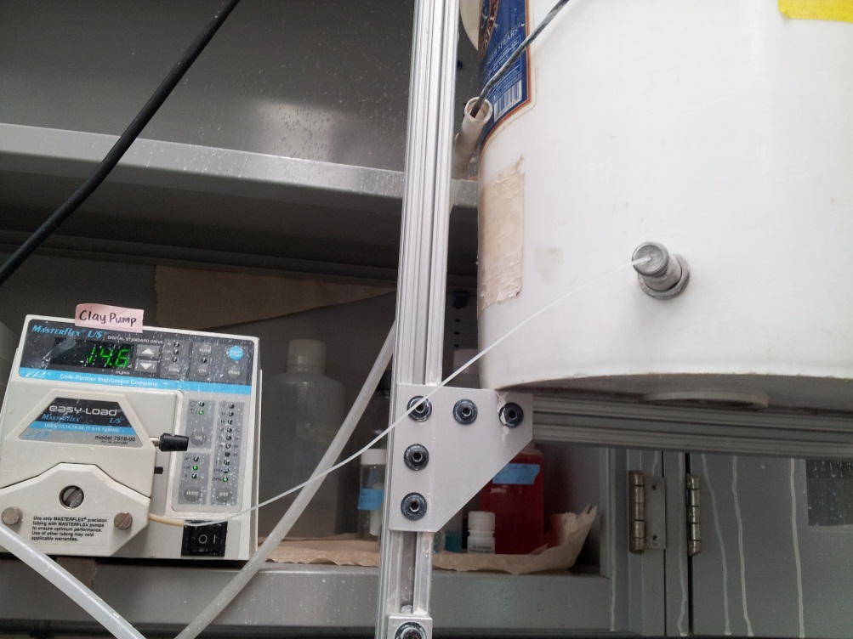
Problems & Solutions
  Inconsistent influent NTU (caused by settling clay in flow accumulators)
  Clay buildup in dosing tube

Slide 14
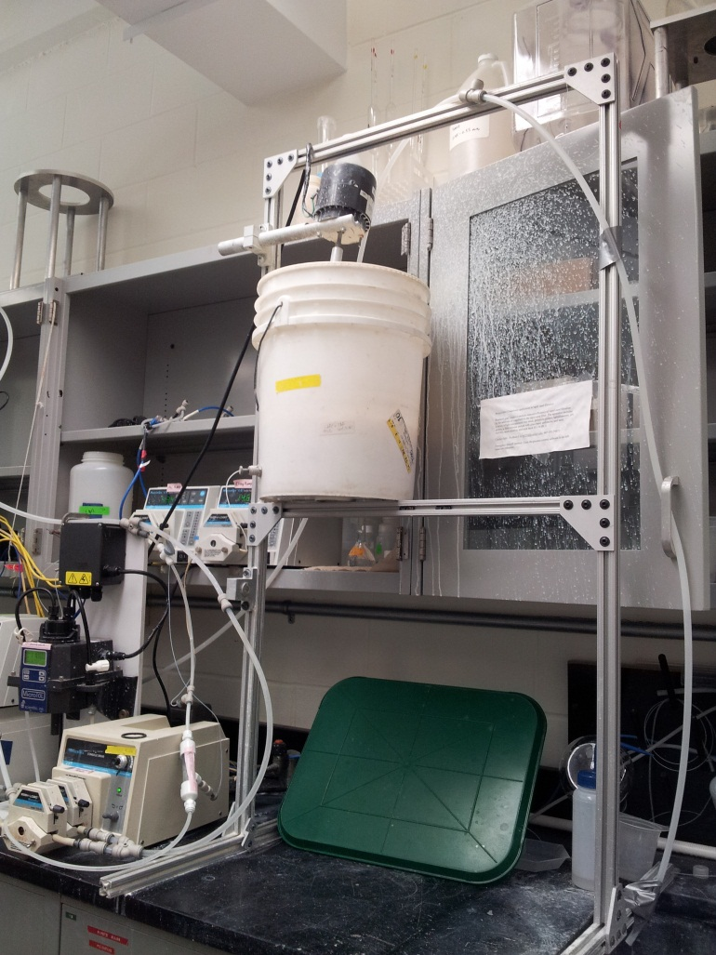
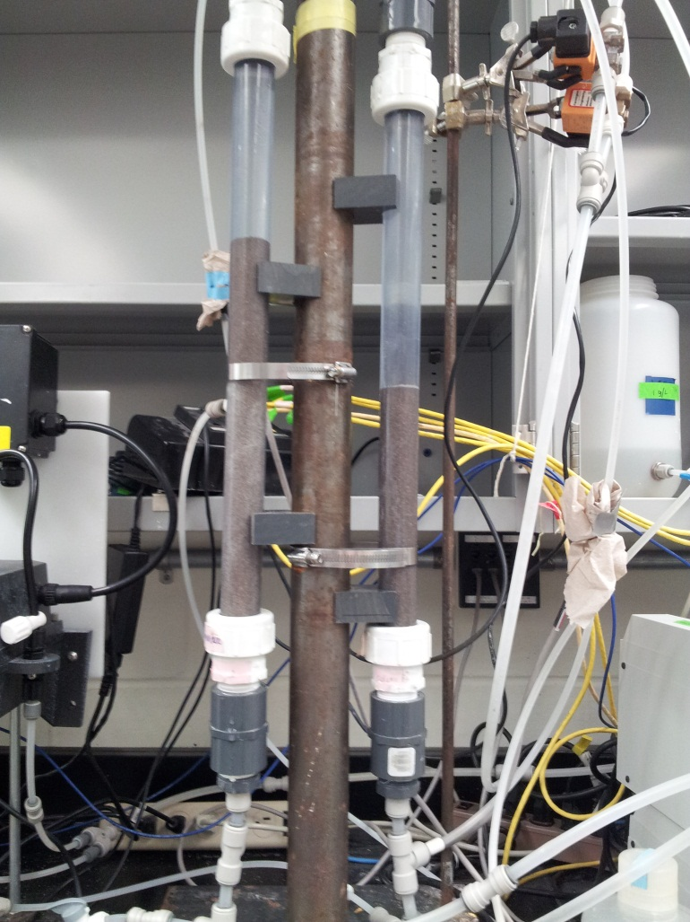
Problems & Solutions
  Column leaking, sand escaping during backwash
air in columns

Slide 15
Redesigned Experiments

Slide 16
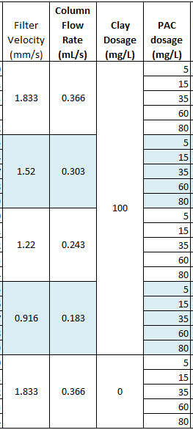
Current Research
Clay dosage (influent NTU)
  Constant at 100 mg/L
  Also testing no clay/just PAC
Filter Velocity
  0.916 mm/s – 1.833mm/s
PAC dosage
  5 mg/L – 80 mg/L
Run Time
  Indefinite
Notes:
Filter velocity = backwash velocity /6 (backwash velocity is typically 11 mm/s)

Slide 17
1.52 mm/s 15mg/L PAC
Head Loss

Slide 18
1.52 mm/s 15mg/L PAC
Turbidity

Slide 19
Future Work
Finish all proposed experiments
Find solution if backwashing isn’t sufficient
Analyze all data
Compile backwashing videos/ determine duration

