Slide 1

Surface vs. Subsurface Injection for Sand Filter
Summer 2013
Theresa Chu
Kelly Huang
Vikram Kejariwal
Tanya Peifer

Slide 2
Goals for Summer 2013
Determine clogging conditions
Whether backwash is sufficient in unclogging the filter

Slide 3
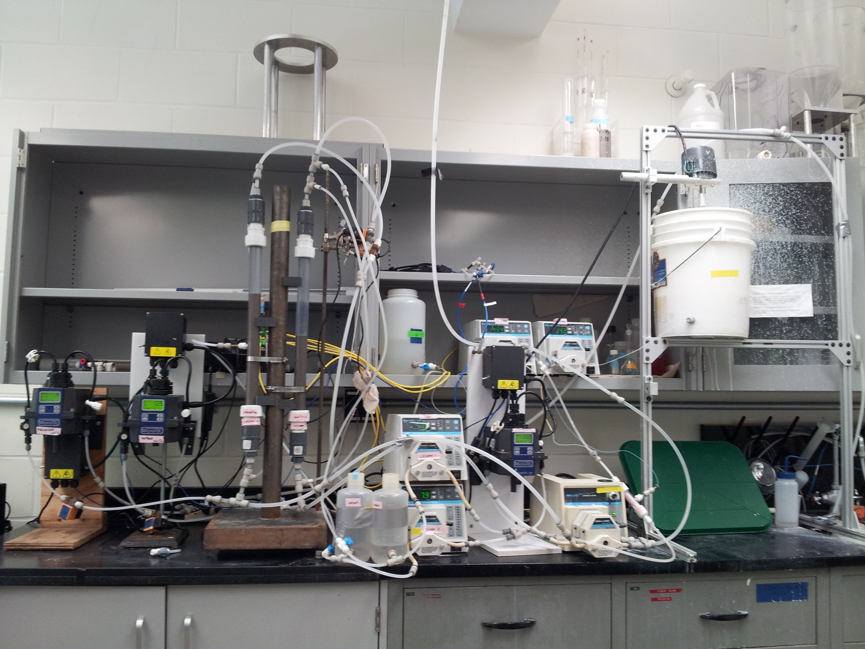
Apparatus

Slide 4
Hypothesis
Clogging will most likely occur at
  low filter velocity
  high PAC dosage
Backwashing will require more effort at higher PAC dosages

Slide 5
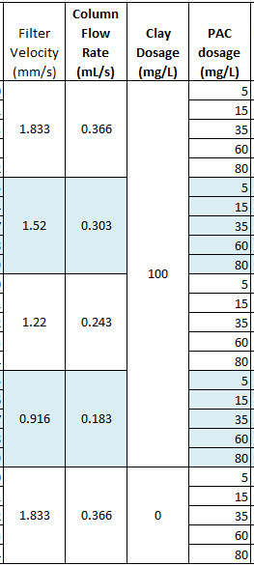
Current Research
Clay dosage (influent NTU)
  Constant at 100 mg/L
  Also testing no clay/just PAC
Filter Velocity
  0.916 mm/s – 1.833mm/s
  Recalculated (.48-.722 mm/s)
PAC dosage
  5 mg/L – 80 mg/L
Run Time
  Indefinite
Notes:
Filter velocity = backwash velocity /6 (backwash velocity is typically 11 mm/s)

Slide 6
Head Loss Analysis

Slide 7
Head loss Analysis

Slide 8
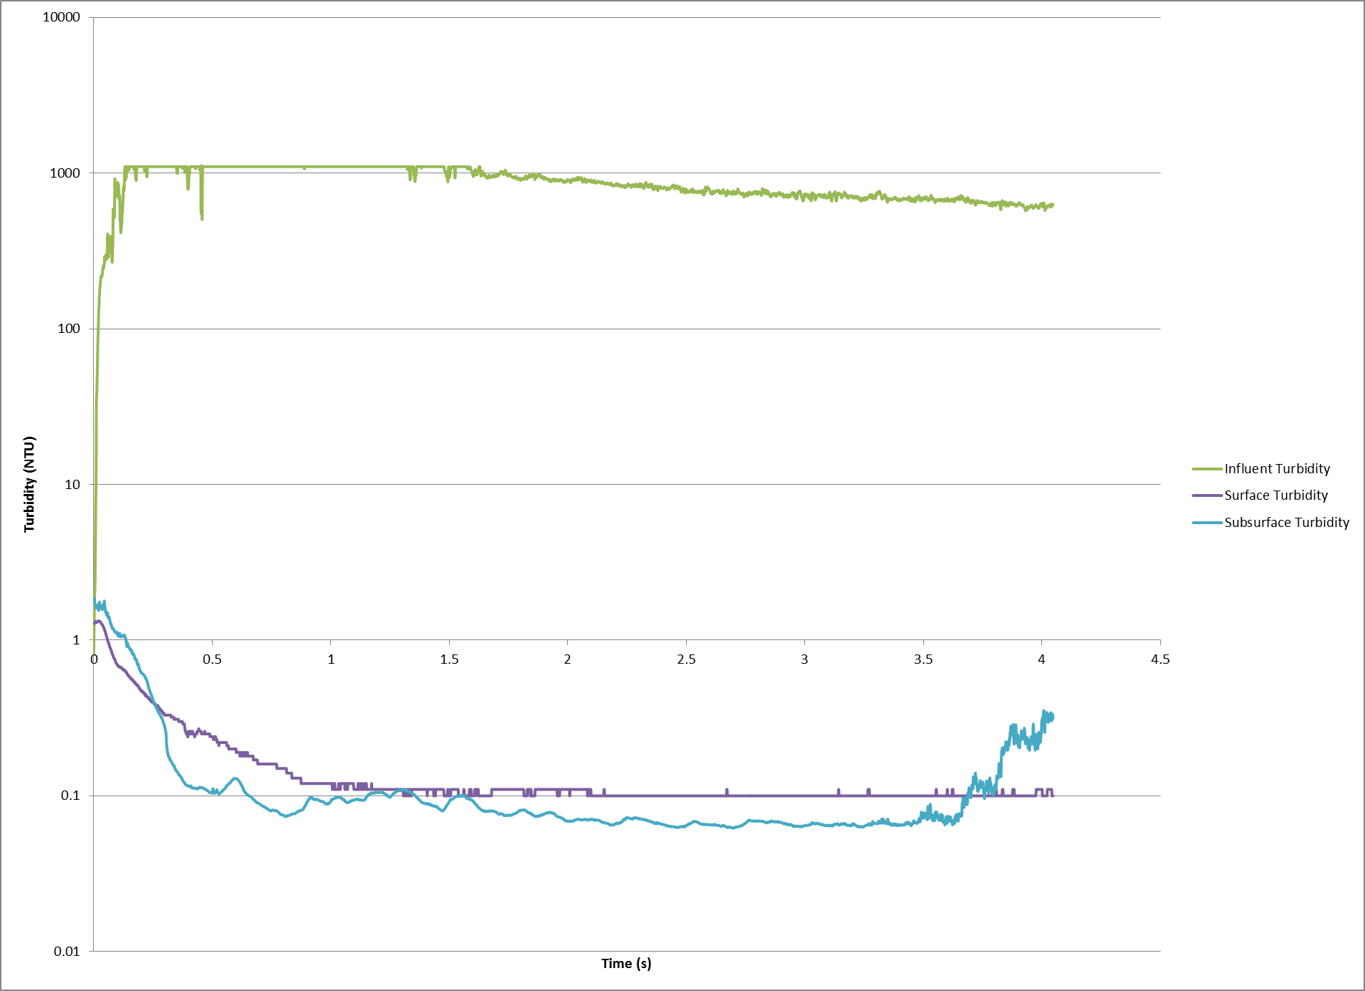
Turbidity over Time PAC 60 1.83mm/s

Slide 9
Conclusions
PAC dosage directly effects Head loss but a clear trend has yet to be determined
Subsurface clogs faster than Surface
Subsurface is easier to backwash than Surface
Before subsurface clogs it has lower effluent turbidity than surface

Slide 10
Future Work
Complete range of experiments to determine when clogging occurs
Construct a model to predict if clogging will occur

