Slide 1
StaRS Filter Theory
A mathematical model is under development to explain the physics of filtration.
Find more information at StaRS Filter Theory’s wiki.
StaRS Filter Theory | Research | Symposium Fall 2016

Slide 2
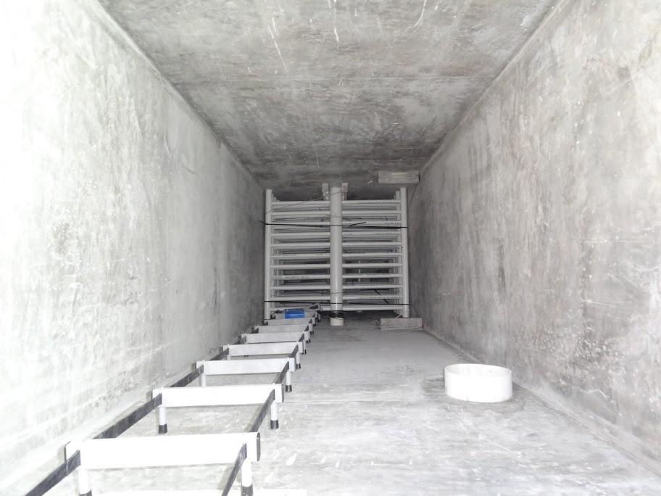
Optimize filter performance for cleaner water
StaRS Filter Theory | Research | Symposium Fall 2016
Notes:
Jonathan
AguaClara plant filter picture
Lab filter picture

Slide 3
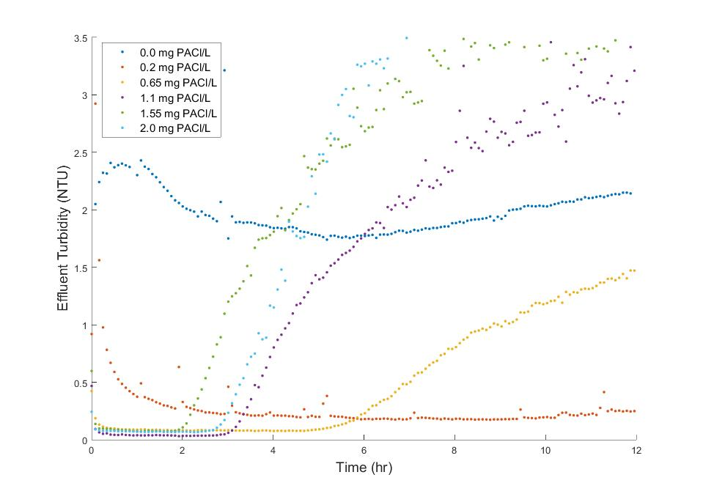
Previous data shows coagulant affects filter performance
0 mg PACl/L
0.65 mg PACl/L
0.2 mg PACl/L
Time (hr)
StaRS Filter Theory | Research | Symposium Fall 2016
Notes:
Jonathan
Head loss
Effluent turbidity
Defining failure time
2 graphs? 2 slides?

Slide 4
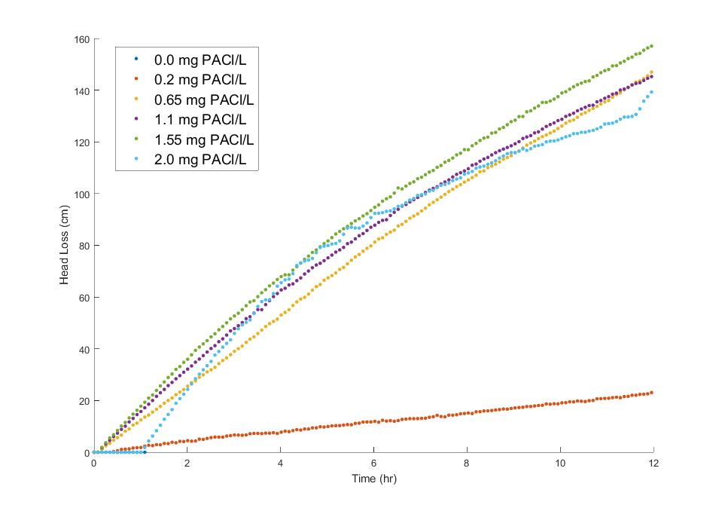
Failure time for various dosages have no correlation to head loss
Filter Failure
Head Loss (cm)
StaRS Filter Theory | Research | Symposium Fall 2016
Time (hr)

Slide 5

Modeling filter performance will help future design
Without model:
?
Model
Predict failure time
Characterize performance
Figure out which variables matter:
Media size? Bed depth? Relationship to head loss?
StaRS Filter Theory | Research | Symposium Fall 2016
Notes:
Jonathan

Slide 6
Creating a mathematical model is complex
“…modeling efforts to date have been a failure…”
Capillary model
Constriction model
Washer model
StaRS Filter Theory | Research | Symposium Fall 2016
Notes:
Theresa
Clean bed filter models
Dynamic modeling hasn’t been comprehensive
Hasn’t been very effective
http://www.eolss.net/sample-chapters/c07/e6-144-08.pdf
If one believes that the purpose of modeling is to be able to predict a priori the full behavior of filters, then the modeling efforts to date have been a failure. However, if the purpose of modeling is viewed as providing insight into filter behavior that might be useful for design and operation, then the modeling has been quite successful, even if incomplete.
Benjamin, M. M, & Lawler, D. F. (2013). Water quality engineering: physical/chemical treatment processes analysis. Hoboken, N.J.: John Wiley & Sons.
Questions we are trying to answer:
How much volume of flocs can the pores hold?
How much head loss will there be as a result of coagulant dose?
How much shear is there on the flocs attached to the filter sand?

Slide 7
Pores are modeled as small capillary tubes
StaRS Filter Theory | Research | Symposium Fall 2016
Notes:
Theresa
The individual pore spaces have been aggregated as small capillary tubes throughout the filter media

Slide 8
Pores are modeled as small capillary tubes
StaRS Filter Theory | Research | Symposium Fall 2016
Notes:
Theresa
The capillary tubes fill up over time

Slide 9
StaRS Filter Theory | Research | Symposium Fall 2016

Slide 10
StaRS Filter Theory | Research | Symposium Fall 2016

Slide 11
Estimated floc size is too large
StaRS Filter Theory | Research | Symposium Fall 2016
Notes:
Theresa
Estimated floc size is about 100 times the size of the capillary tube
With a capillary diameter of 0.4 mm, we obtain a floc size of 39 mm, which is larger than our entire filter diameter

Slide 12
Modeled floc volume is too large
Expected
Model
StaRS Filter Theory | Research | Symposium Fall 2016
Notes:
Theresa
Expected floc volume: around 2% of total pore space
Capillary model floc volume: around 80% of total pore space

Slide 13

Constriction model represents the pores as empty chambers
Constrictions
Expansions
StaRS Filter Theory | Research | Symposium Fall 2016
Notes:
Given the limitations of the capillary model, we modified the capillary model to better depict the distribution of pore volume in the filter. when sand particles are closely packed into a volume, there are spaces between the sand particles where they are the closest to one another and there are volumes between tangent sand particles that are much larger. We transferred this idea to our filter and created a new model, the constriction model. Similar to the capillary model, this model depicts the filter as a collection of capillaries with lengths of the height of the filter. However, unlike the capillary model the capillaries are a series of constrictions and chambers. Constrictions are, as we defined them, the spaces where the sand particles are the closest to one another and the chambers are the volumes of larger pore spaces between tangent sand particles. The blue space in this picture is the pore volume in one single capillary tube for the constriction model. This model helps us better understand the physics behind water flow and particle attachment in the StaRS filters.

Slide 14
Streamline convergence theory validates the constriction model
StaRS Filter Theory | Research | Symposium Fall 2016
Notes:
When water flows through the capillary, streamlines converge at the constrictions. At the site of convergence, there is a greater number of particles, increasing particle collisions and particle attachment to the constriction wall. Imagine people running. As the flow continues past the constriction, the streamlines diverge and particle collisions and attachment to the chamber wall are decreased. This theory suggests that there is a very small surface area to which particles can attach to in the filter because significant accumulation occurs mostly at the constrictions, which have a volume significantly smaller than the expansions. Therefore, this model aligns with the calculations we did in mathcad which demonstrated that the expected volume of accumulated particles is much smaller than total pore volume.

Slide 15
There are restrictions to the constriction model
black area: volume of particles accumulated at constriction
Zoomed in top-down view of filter
StaRS Filter Theory | Research | Symposium Fall 2016
Notes:
While we believe the capillary model is feasible, there is still a lot of work to be done. When the filter fails, the pores of the sand filter are clogged with flocs. The clogged flocs can be modeled as a mass of flocs at each constriction, represented by the black area in this top-down view of our filter. Currently, our immediate goal is to find the geometry of the mass of accumulated particles at each constriction. Doing so will give us an insight of how accurate the constriction model is.

Slide 16
The current hypothesis is that the single mass of flocs is in the shape of a washer
StaRS Filter Theory | Research | Symposium Fall 2016
Notes:
We currently believe that the flocs form as a washer at each constriction. This means that the volume of flocs at each constriction is very small in comparison to the total volume of pores. If the constriction model proves to be an accurate model, we hope to run experiments and see if the model applies to experiments with different parameters: coagulant dosage, influent turbidity, and sand filter depth.

Slide 17
Questions and
Recommendations
Theresa Chu
Masters of Engineering
tyc29@cornell.edu
Lucinda Li
B.S Environmental Engineering
ll555@cornell.edu
Jonathan Harris
B.S. Environmental Engineering
jdh345@cornell.edu
StaRS Filter Theory | Research | Symposium Fall 2016

Slide 18
Appendix
Slides
StaRS Filter Theory | Research | Symposium Fall 2016

Slide 19
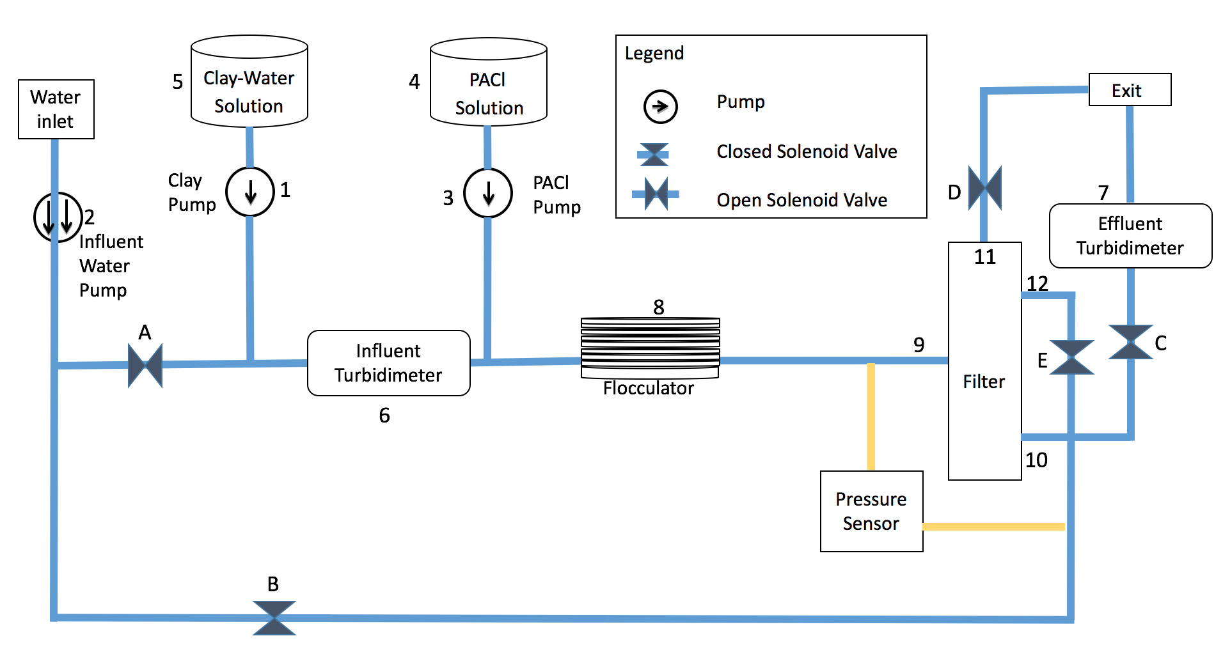
Filter Schematic

Slide 20
Conditions used to test the filter
PACl Dosage (mg/L): 0.2, 0.65, 1.1, 1.55, 2
Influent Turbidity: 5 NTU
  Variable controlled by PID
Flow Rate: 118 mL/minute
Sand Size: Sieved at 30-35
Procedure
  Run Time: 12 hours
  Backwash
Notes:
Procedure and experimental conditions
PID

