Slide 1
Stacked Rapid Sand (StaRS) Filter Theory
Isha Chaknalwar
Theresa Chu
Michelle Lee

Slide 2

Stacked Rapid Sand Filters
Stacked Rapid Sand (StaRS) Filter/Filtration
Invented by AguaClara
Used in newer plants
Water enters the filter through orifices in the pipes
Sand captures colloids
Allows for entirely gravity-powered water filtration
Notes:
Theresa

Slide 3
Purpose
StaRS Filter Theory
  Mathematical model
Fall 2014
  Head loss across copper mesh
Spring 2015
  Head loss across slotted pipes
Fall 2015
  Head loss across sand filter

Slide 4
Purpose
Fall 2015
Assess filter performance
Measure head loss across sand
Measure influent and effluent turbidity
Achieve turbidity breakthrough

Slide 5
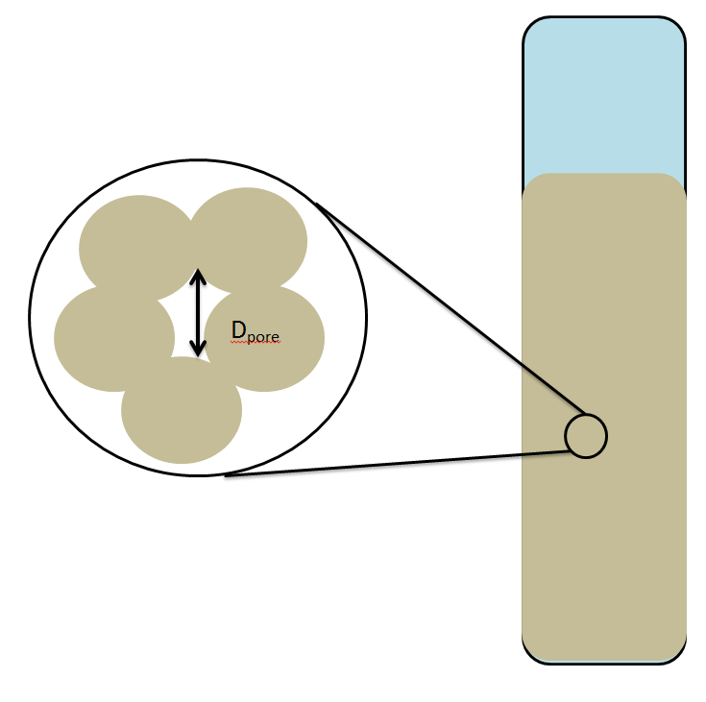
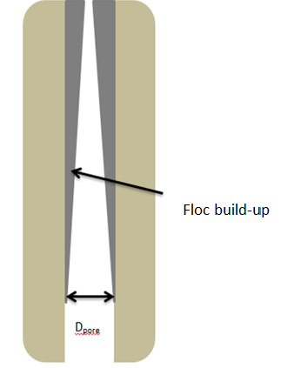
Theory
Flocs build-up in sand pores, causing:
Increase
  Head loss
  Shear force
  Water velocity
Decrease
  Pore diameter

Slide 6
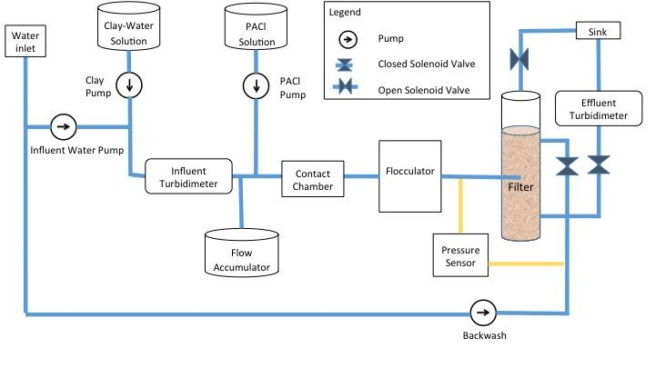
Experimental Apparatus
Notes:
Isha

Slide 7
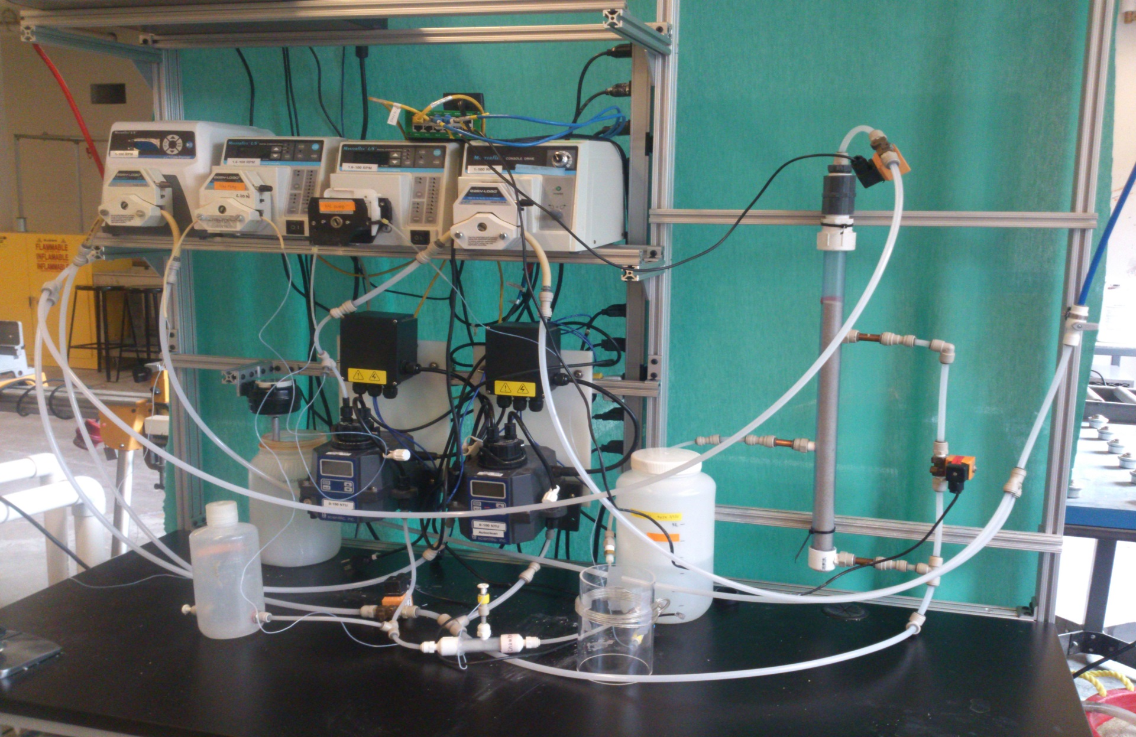
Experimental Apparatus

Slide 8
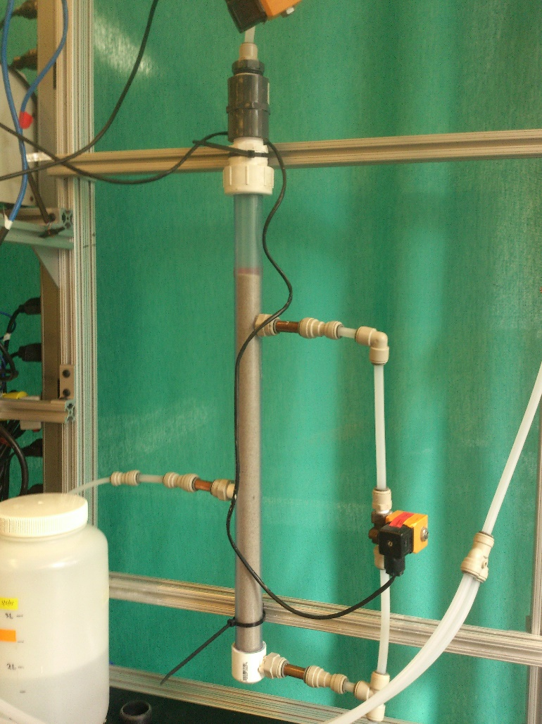
Filter Design
Two Sand Layers: 20 cm each
Velocity: 1.833 mm/s
Flow Rate: 0.984 mL/s
Remove slotted pipes → orifice
Create small flocs → flocculator

Slide 9
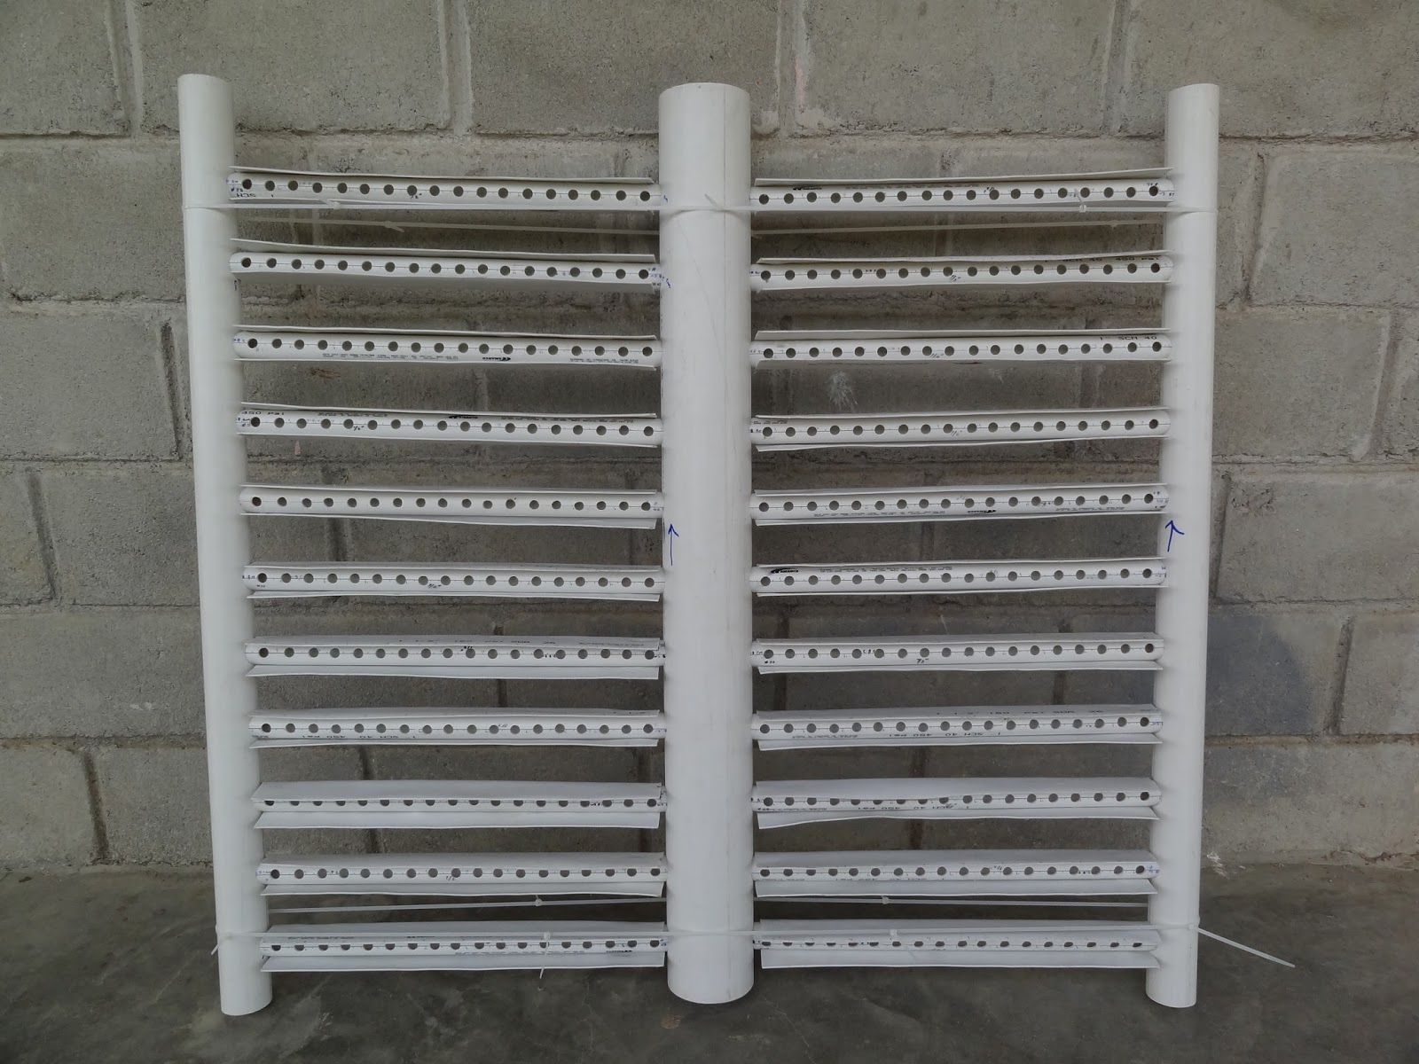

Inlet System
$$\frac{A_{orifice}}{A_{Filter}}=\frac{{OD}_{pipe}}{10 cm}$$

Slide 10
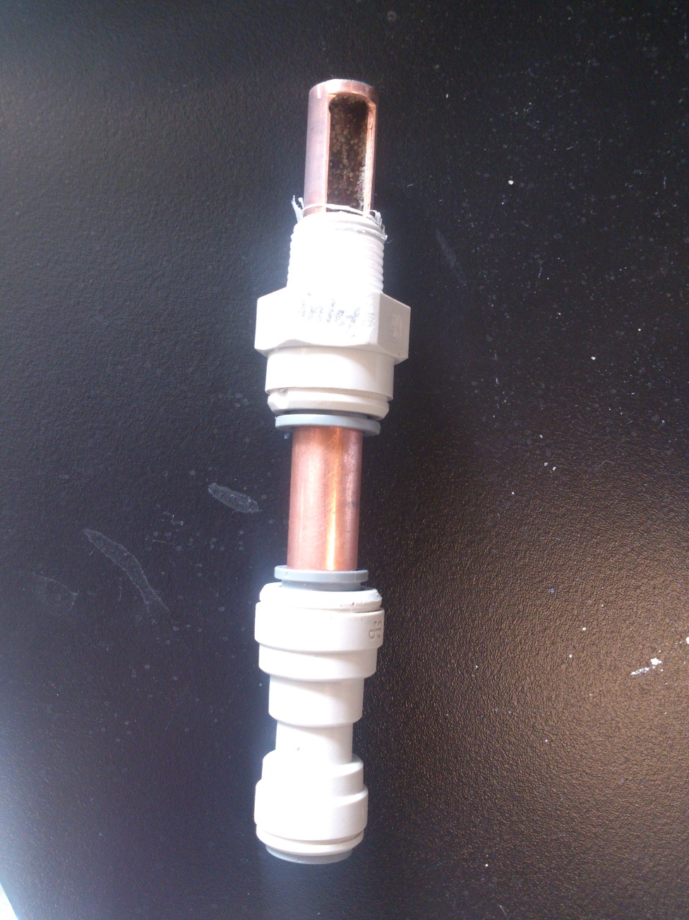
Inlet System
Orifice facing downward
New design avoids clogging of the inlet system
Notes:
Isha

Slide 11
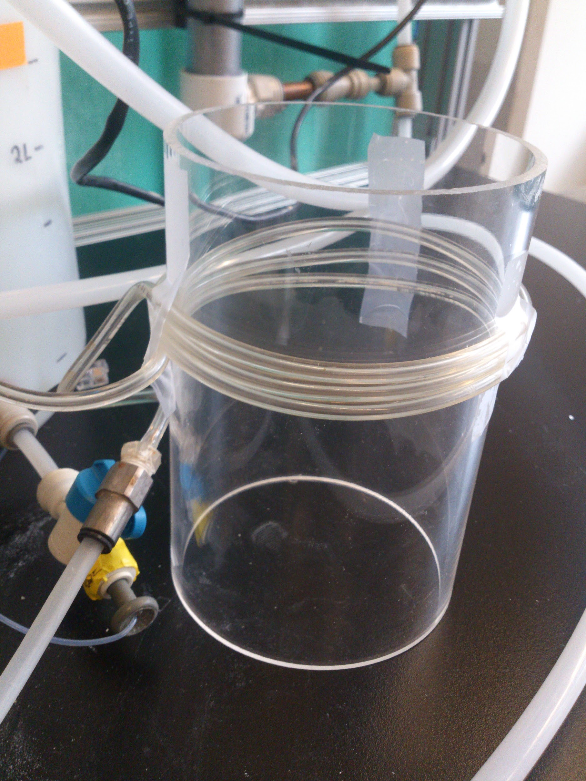
Flocculator
Model influent water in actual plants – small flocs
High energy dissipation rate: 3.5 W/kg
Small flocculator tube radius
Notes:
Michelle

Slide 12
Experimental Conditions
Influent Turbidity (NTU): 5
PACl doses (mg/L):
0.2, 0.65, 1.55, 2
Runtime (hr): 12
Notes:
Michelle
PACl -- dosage of 0.2 mg, 0.65 mg, 1.55 mg, and 2 mg PACl/L will be used

Slide 13
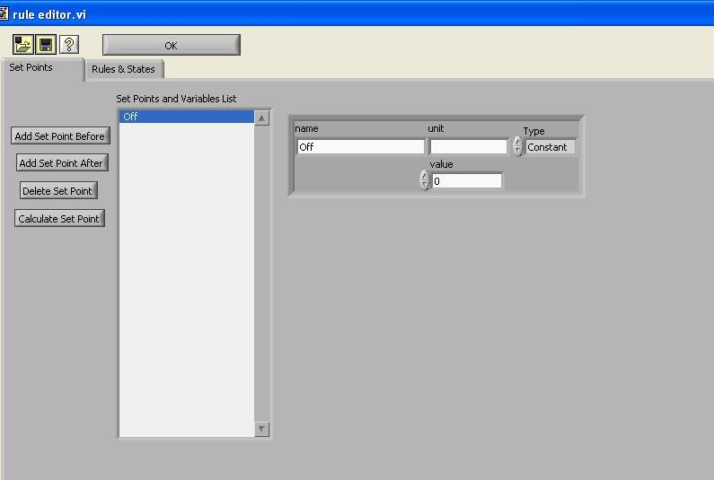
Future Work
Finish building
Set up ProCoDa
Run experiments
Create mathematical model
Notes:
We will connect everything to stampbox, pressure sensor.
We will write a new ProCoDA file to control all of the pumps and solenoid valves and collect pressure sensor and turbidimeter data.
We will run experiments to measure head loss and effluent turbidity over time. A collection of pC* curves based off of the effluent turbidity results will describe filter performance. Head loss over time will be analyzed for trends based on coagulant dosage and influent turbidity. We will use these trends to develop our mathematical model of head loss due to coagulant dosage. Based on those data, we will reevaluate the optimal filter depth for the sand filter layer depth

Slide 14
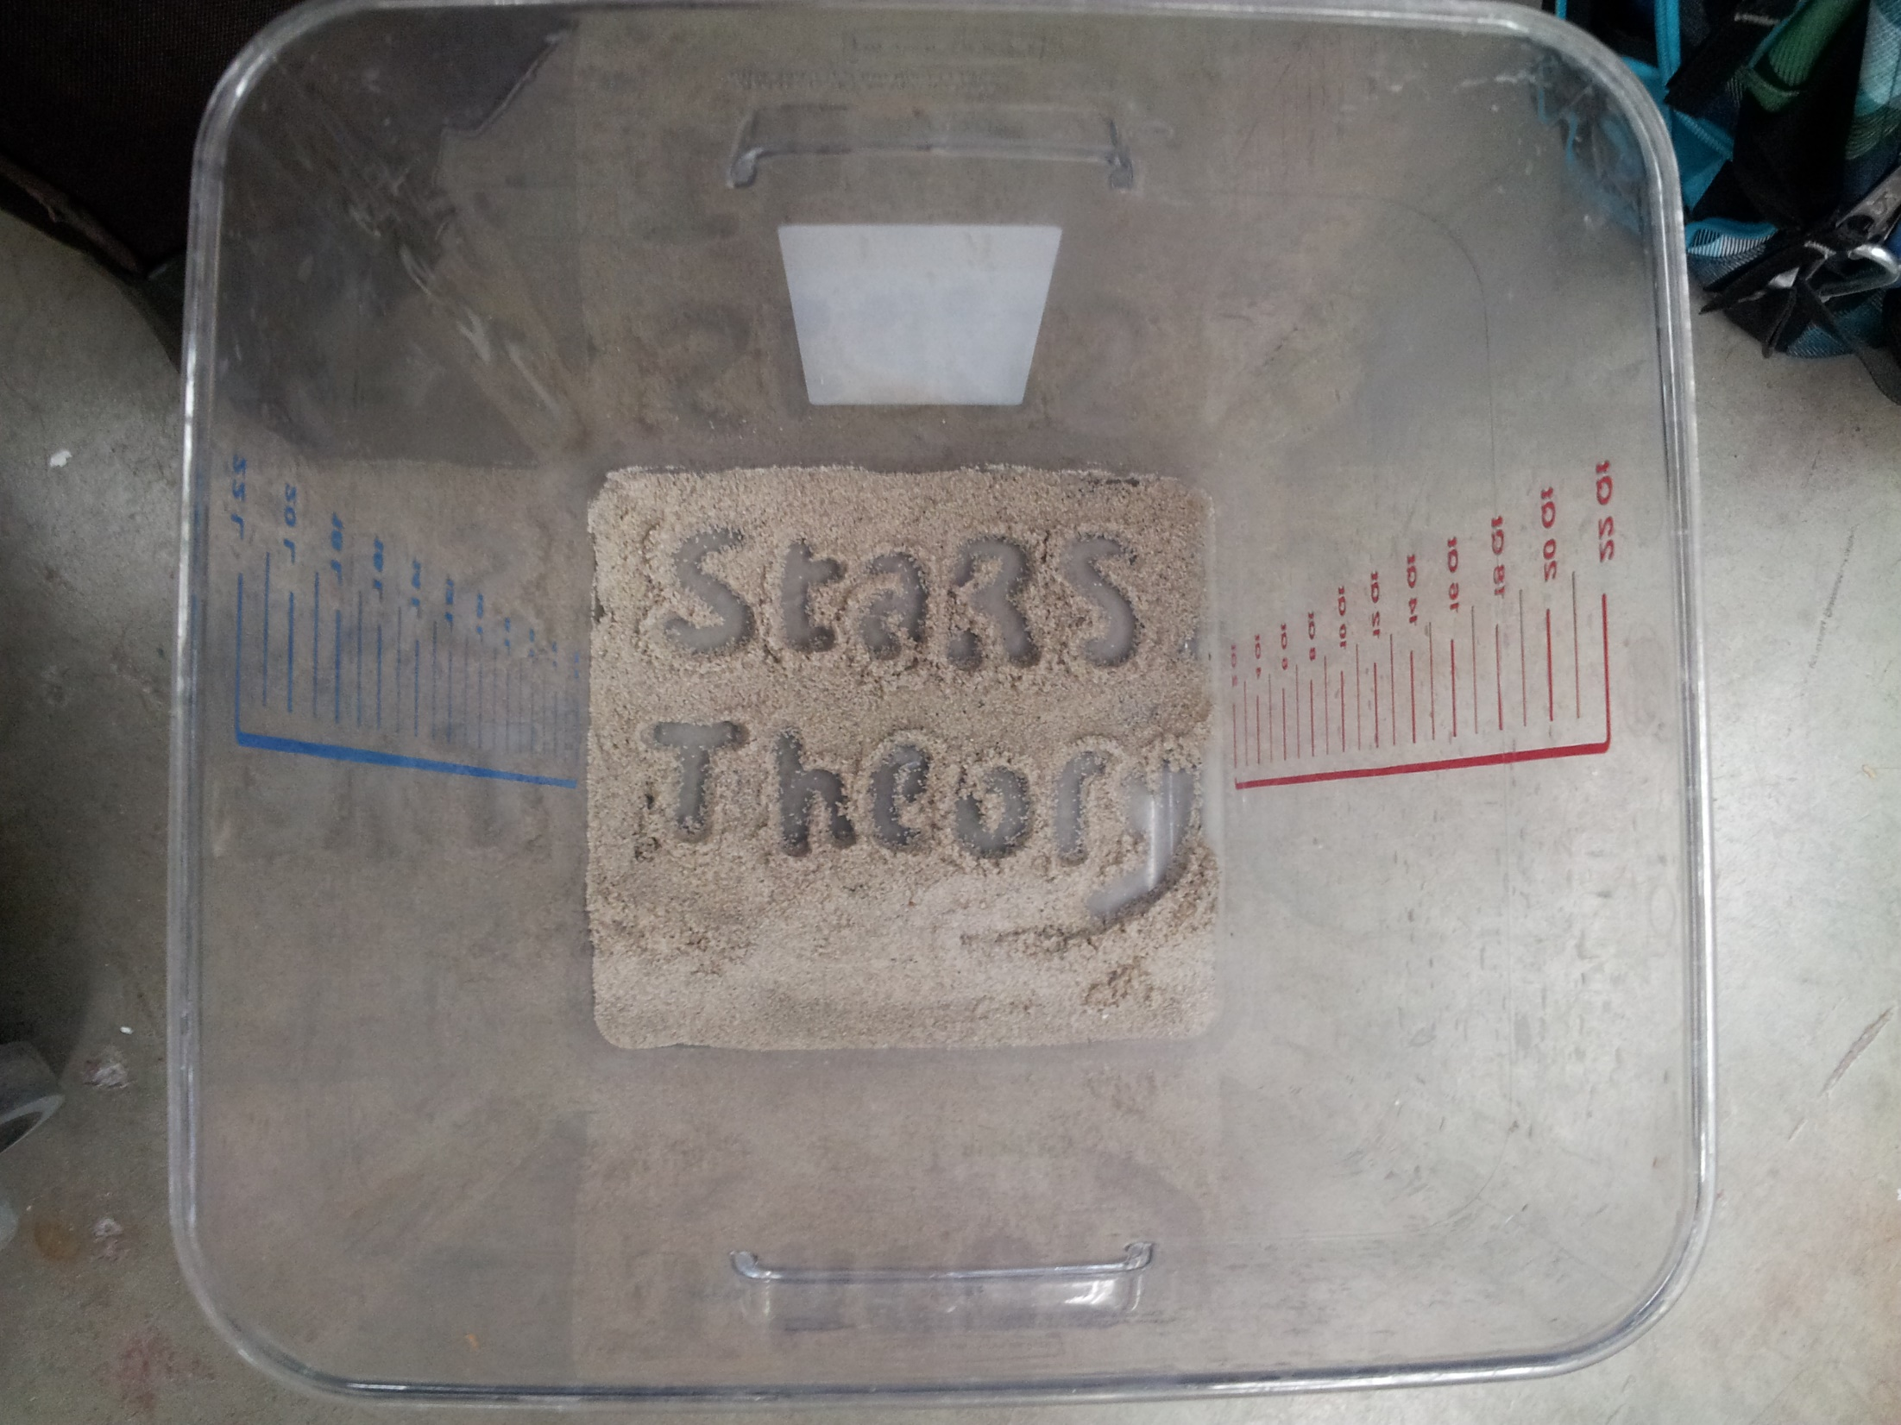
Questions?

