Slide 1
Stacked Rapid Sand (StaRS) Filter Theory
Experiments testing the effects of varying coagulant dosages on filter performance showed the impact of coagulant on head loss and effluent turbidity. Find more information at StaRS Filter Theory’s wiki.

Slide 2
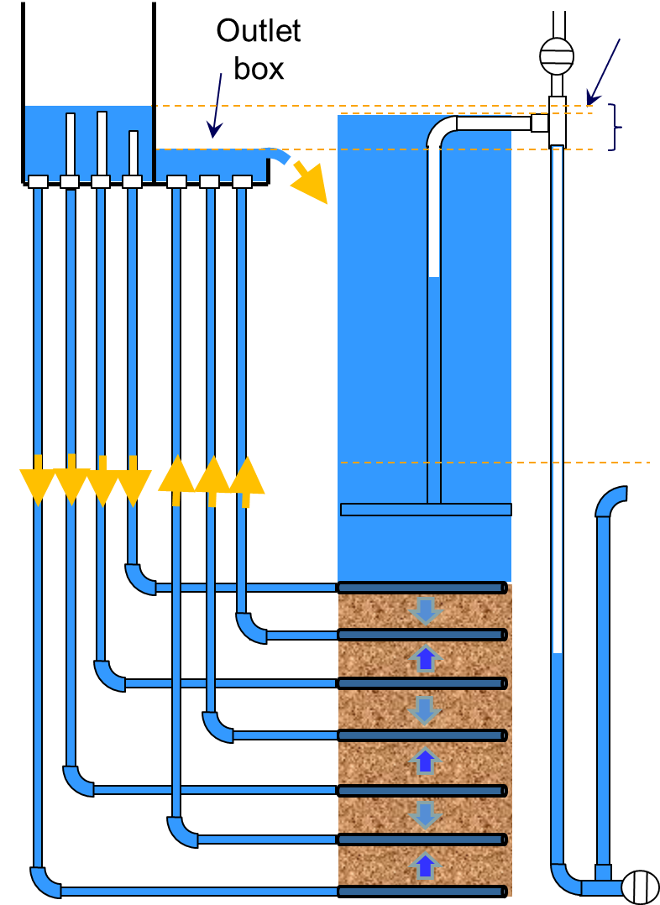
StaRS Filters clean settled water
Notes:
Stacked rapid sand filters clean settled water after sedimentation and removes fine particles that were not removed in previous processes. Settled water enters through four inlet pipes and clean water exists through three outlet pipes.

Slide 3
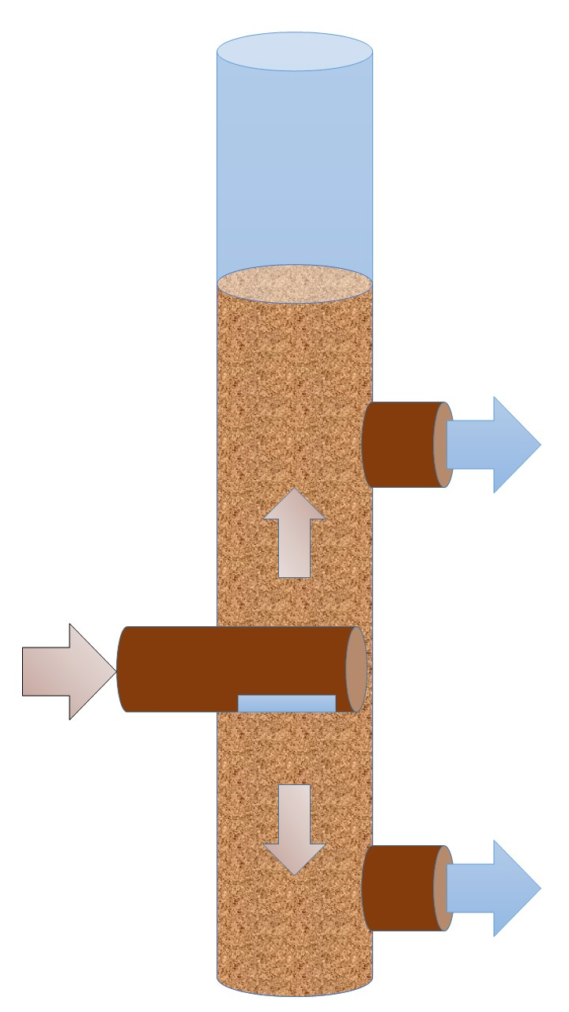
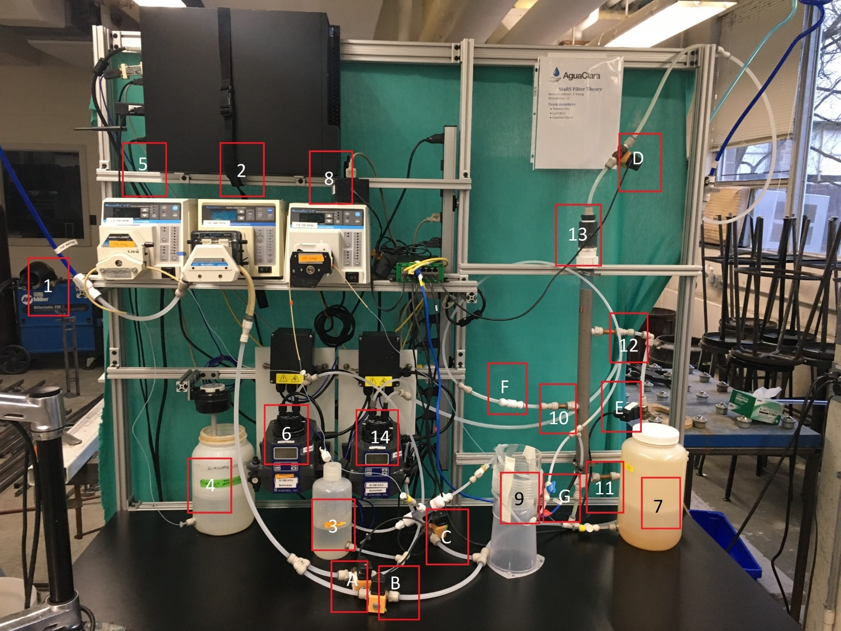
Raw water flows through two layers of sand in the filter
Notes:
The goal of the subteam is to create a mathematical model that demonstrates a relationship between PACl dosage and headloss. In the lab, the apparatus was built to model a sand column with two layers. This allows us to model the behavior in full-size stacked rapid sand filters. The water enters the filter and flows up and down at an equal flow rate for a more evenly distributed filter, maximizing the sand area used. When pore space is filled up with particles, head loss increases until filter failure. For our purposes, we define failure to be the moment when rate of change of effluent turbidity is greater than 0. A more detailed representation of our experimental schematic can be found in appendix slide Filter Schematic.
Goal
Apparatus
Up and down-distributed filter
Pore space clog-> head loss
Define failure
Appendix

Slide 4
Water travels in both directions through the filter
Notes:
Jonathan
Link to filter video: https://youtu.be/DzYxWDEED8M

Slide 5
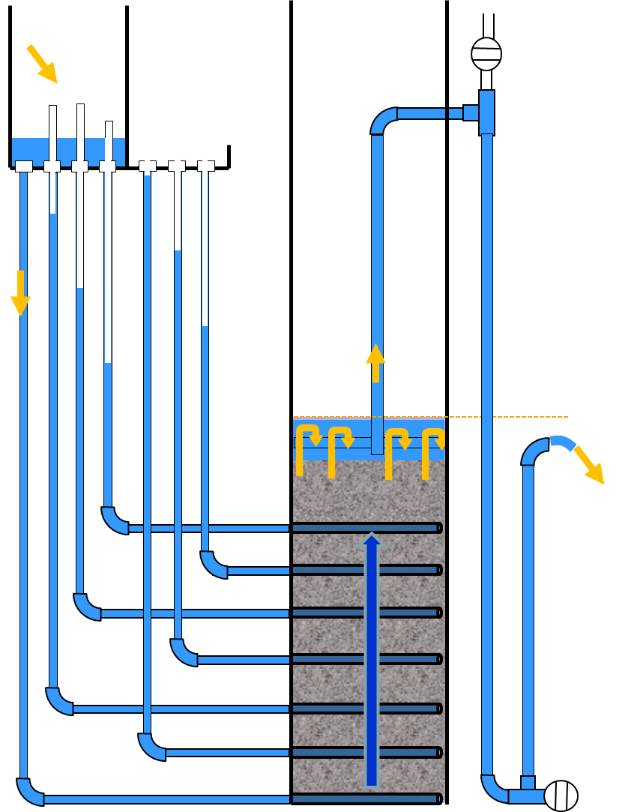
Backwash cleans the filter
Notes:
Jonathan (keep in final)
a process called backwash cleans the filter, relies on the difference in altitude to increase velocity for backwash

Slide 6
Backwash cleans the filter
Notes:
Jonathan
Link to backwash video: https://youtu.be/bWEkB_z0ZjY

Slide 7
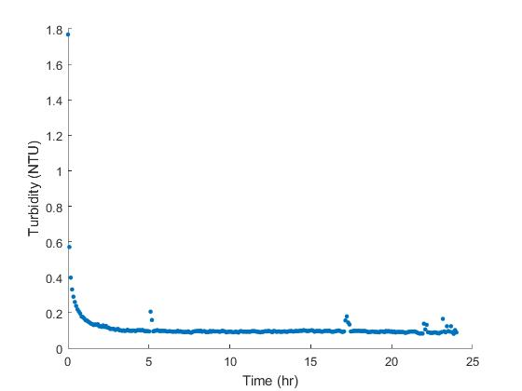
Clay alone never causes filter failure
Notes:
Theresa
First control experiment: only clay, 0 PACl
Filter never fails
Hypothesize that the filter will fail at a low enough PACl dosage, our goal was to find the threshold dosage
These Results show that clay only experimental condition can not help us, altered raw water mixture

Slide 8
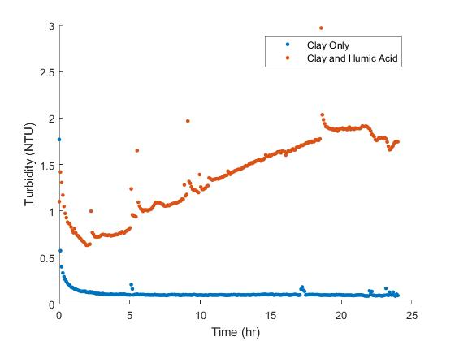
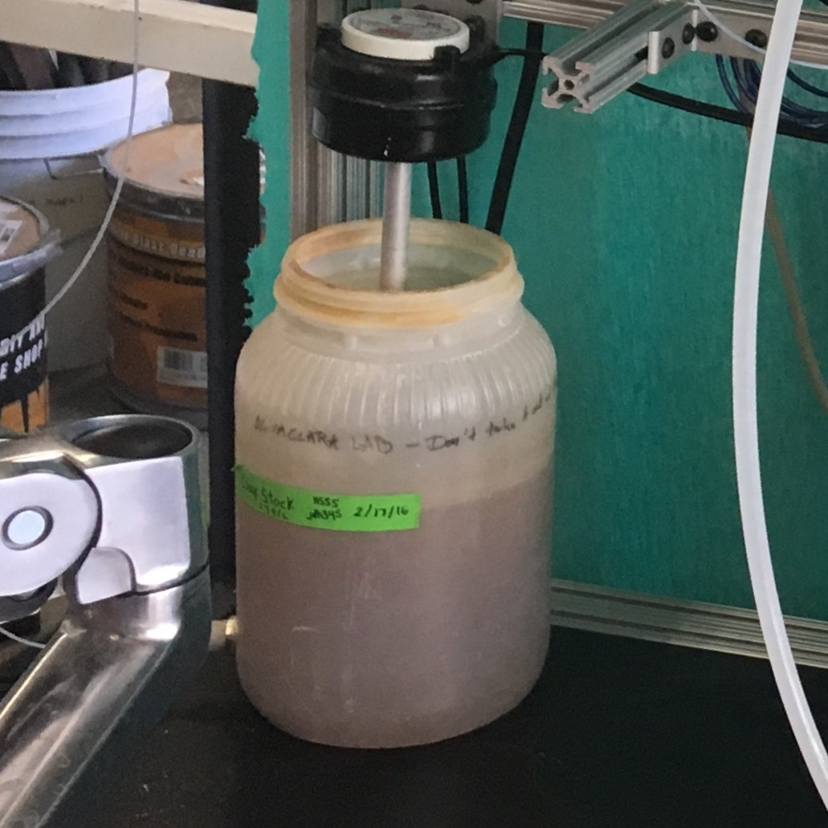
Humic acid and clay causes filter failure
Notes:
Theresa
Experimental conditions
24 hours, 0 to 2 mg/L PACl
Clay and humic acid fails on no coagulant, which is what we want, so that we can test the effect of coagulant
Appendix slide – conditions used to test the filter

Slide 9
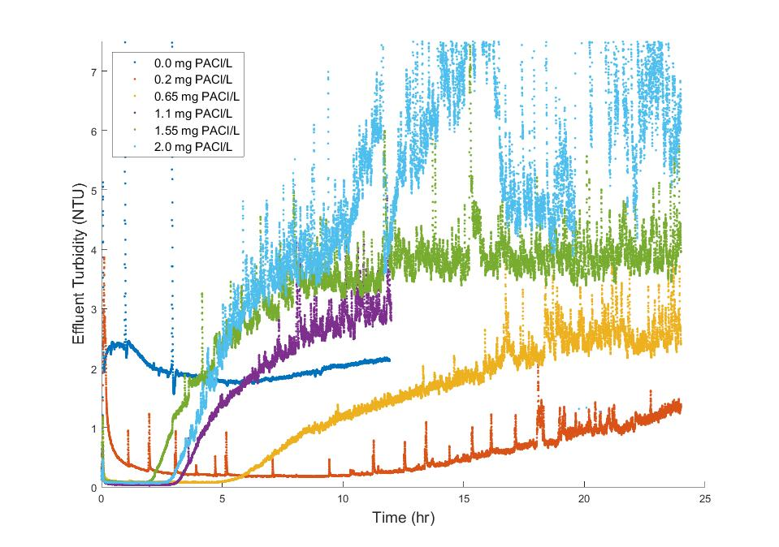
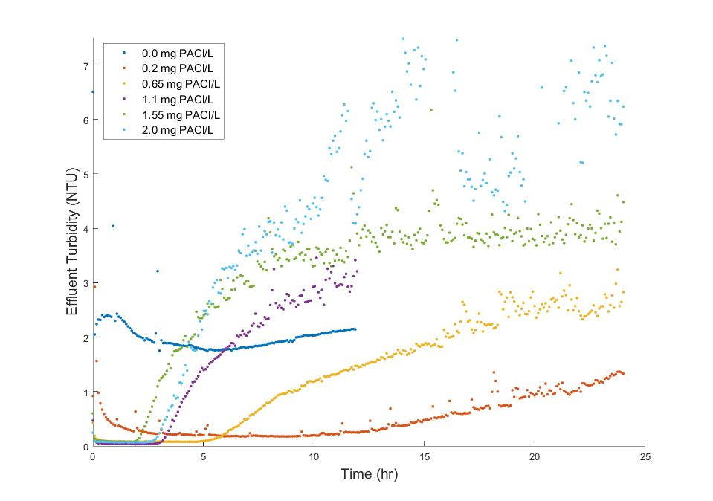
Smoothing data shows trends clearly
Notes:
Theresa
MATLAB code was written to smooth the data in blocks, remove large jumps in head loss

Slide 10
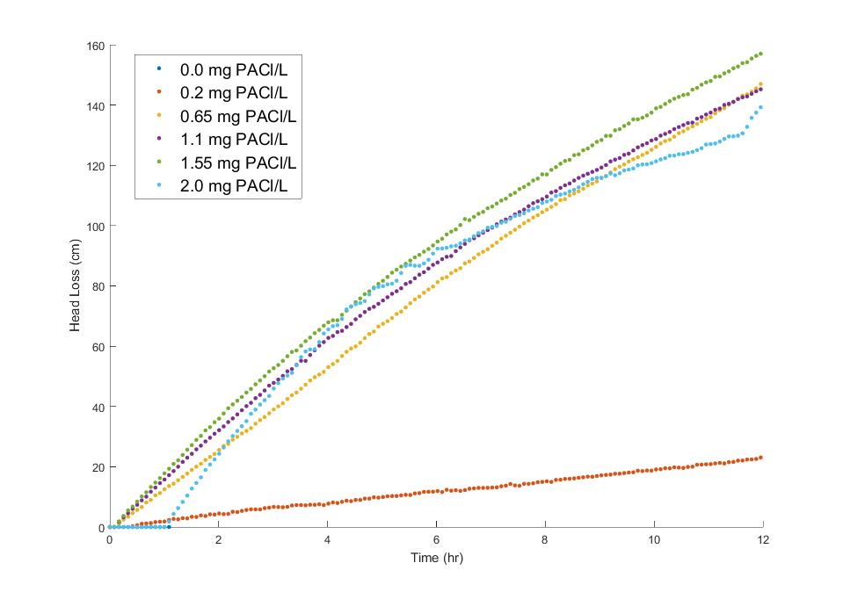
Increasing PACl dosage increases head loss
Head Loss vs Time (zoomed into the first 12 hours)
Filter Failure
Notes:
Analyzing the data for experiments conducted at PACl dosages 0 to 2.0, we conclude that increasing PACl dosage increases head loss. As PACl enters the system, flocs are created. They then enter the filter and clog the pores between the sand thus increasing head loss. In the experiments conducted, data suggests that there is a linear increase in head loss until failure. This is demonstrated in the beginning of the experiments for higher dosages (slide with head loss zoomed in).

Slide 11
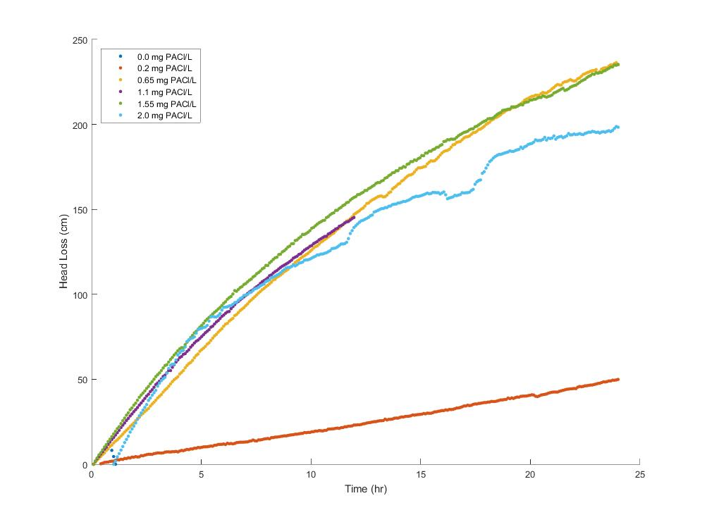
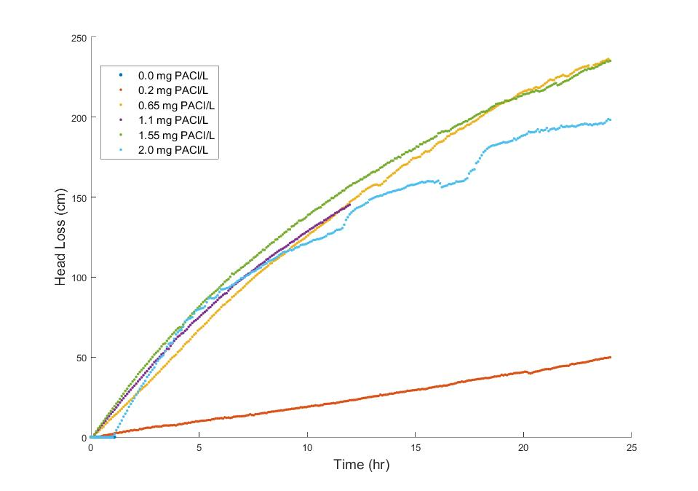
Increasing PACl dosage increases head loss
Head Loss vs Time
Filter Failure
Notes:
This graph compiles the curves for head loss in the same six experiments over its total 24 hour experiment time. For the experiments that did fail, the head loss curves converge on the same trend after failure. A theory we are considering is that there is an equilibrium floc size at which the rate of change in head loss after failure is no longer dependent on floc size and PACl dosage. Before failure, flocs are either broken up in the filter and flushed out the effluent or are trapped in the pores of the sand. However, after failure the size of flocs that are capable of going through the filter is eventually limited by shear forces in the sand column and pore size at which point there is an equilibrium floc size. Therefore experiments with PACl dosages greater than the PACl dosage associated with the equilibrium floc size will have various sizes of floc sizes, but will have the same effect on head loss so long as they are larger than the equilibrium floc size. We hypothesize that the flocs created in the 0.65 to 2.0 experiments are larger than the hypothetical equilibrium floc size thus head loss is affected very similarly in these experiments after failure and the curves converge on the same trend.

Slide 12
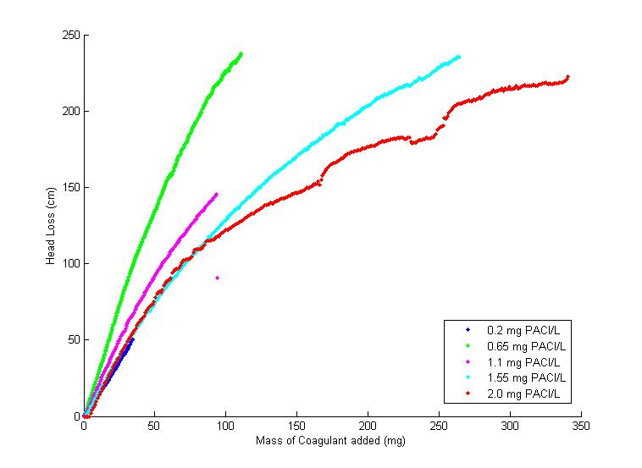
Mass of coagulant dosage affects head loss
Head Loss vs PACl
Notes:
Further analyzing the head loss data, we graphed head loss vs mass of PACl added. Interestingly enough these curves do not converge. While we are still exploring for an explanation, these results may suggest that head loss is heavily affected by the rate of PACl going into the filter as opposed to the total mass of PACl entering the filter.

Slide 13
Increasing PACl dosage changes effluent turbidity level
Notes:
Jonathan

Slide 14
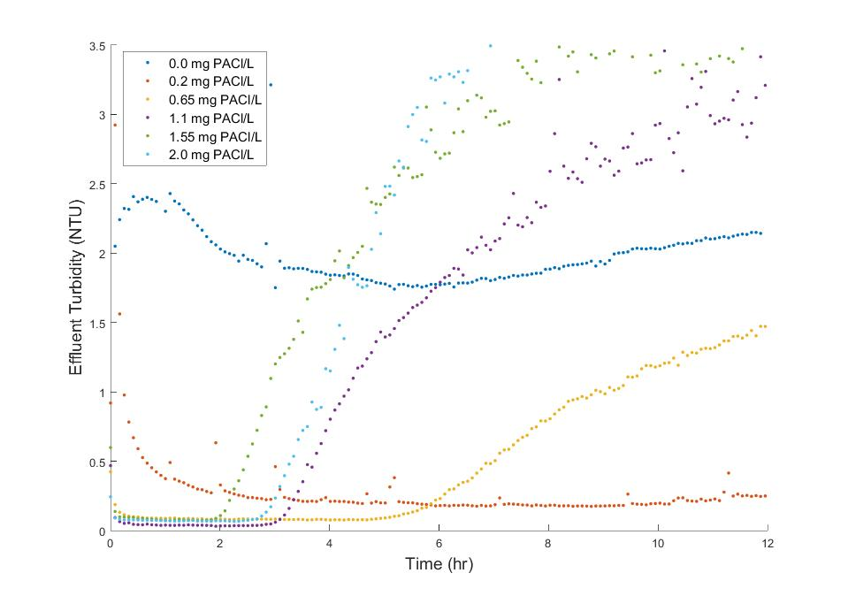
Increasing PACl dosage changes effluent turbidity level
0 mg PACl/L
0.65 mg PACl/L
0.2 mg PACl/L
Notes:
Jonathan
Here is a zoomed in look at the effluent turbidity that looks at the first 12 hours of filtration
-0 was a control experiment
Without PACl, the filter immediately failed.
As PACl was added, it decreased the effluent turbidity
As more PACl is added, the filter began to fail quicker
After 24 hours of filtration, the 0.2 mg PACl/L failed after 10 hours
After about 6 hours of filtration, the 0.65 mg PACl/L failed
1.1, 1.55, 2.0 mg PACl/L all failed in under 4 hours

Slide 15
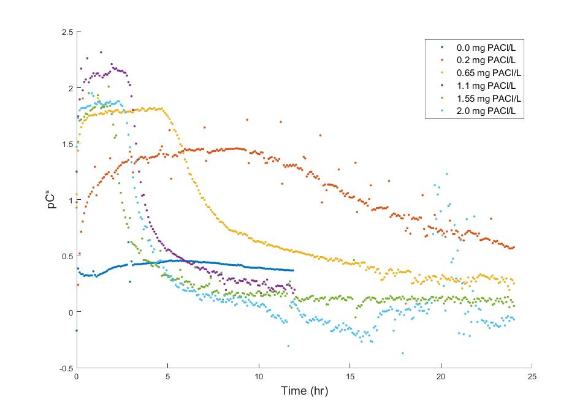
Increasing PACl dosage changes the performance of the filter
Notes:
Jonathan

Slide 16
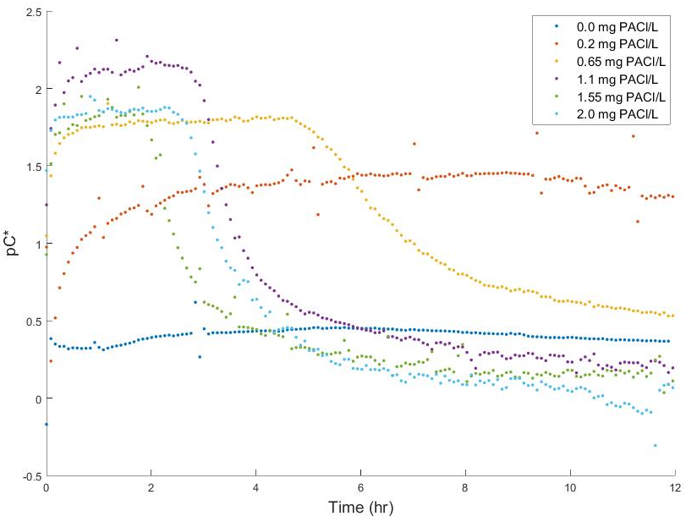
1.1 mg PACl/L
0.65 mg PACl/L
1.1 mg of PACl/L produced the cleanest water
0.2 mg PACl/L
0 mg PACl/L
Notes:
Jonathan
pC* shows the performance of our filter
pC* = -log(Effluent Turbidity/Influent Turbidity)
1.1 mg PACl/L produced the cleanest water
Even though the 0.2 mg PACl/L took the longest to fail, the quality of water was not as good as the higher PACl dosages
1.55 and 2.0 mg PACl/L both produced similar quality water, however the 1.55 failed in our experiments before 2.0
The 0.65 mg PACl/L produced water that is very close to both 1.55 and 2.0 mg PACl/L

Slide 17
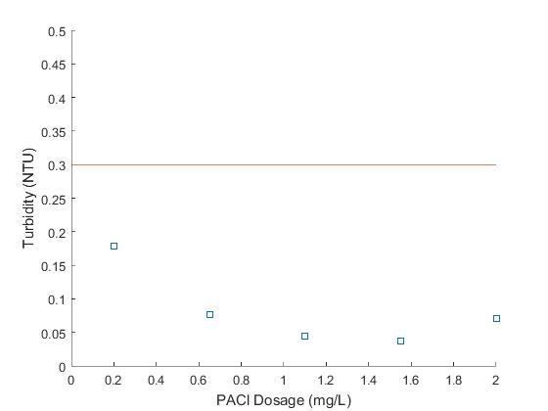
Increasing PACl dosage results in varying effluent turbidities
Notes:
Theresa
Plot of cleanest effluent turbidity before the filter failed (not just a peak, but representative of average effluent turbidity)
Everything is below US EPA standard, so the filter is doing well
Trade off between filter run time, coagulant dosage, and effluent turbidity
More coagulant doesn’t result in lower turbidity

Slide 18
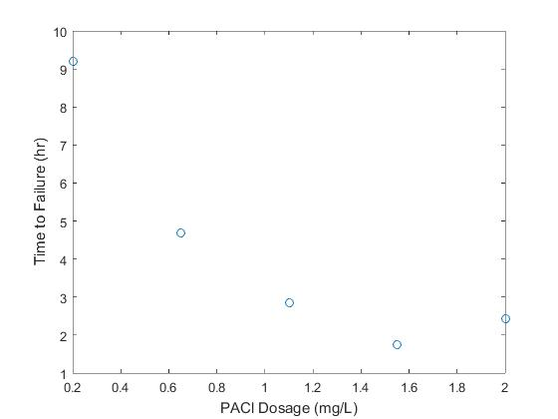
Increasing PACl dosage causes faster failure
Notes:
Theresa
Failure times

Slide 19
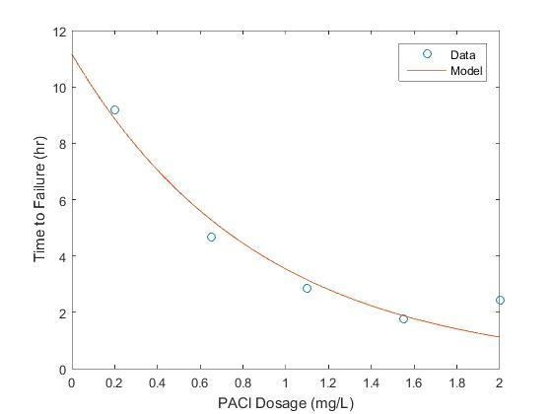
Increasing PACl dosage causes faster failure
Notes:
Theresa
Fitted an exponential model to failure times
Decrease in time to failure with increased coagulant dosage
Why? Mass increase in filter leads to higher head loss, pores clogging, fractal flocs

Slide 20
Explore the effect of different influent conditions
Influent Turbidity
2.5 NTU
5 NTU
PACl Dosage
0.1 mg/L
2.5 mg/L
7.5 NTU
Filter Layer Depth
10 cm
40 cm
30 cm
Notes:
Theresa
Coagulant sticks to walls of filter, making backwash difficult
Flocs settles in cuvette of turbidimeter measuring influent water
2.5, 5, 7.5 NTU
Lower and higher PACl dosages
Data analysis

Slide 21
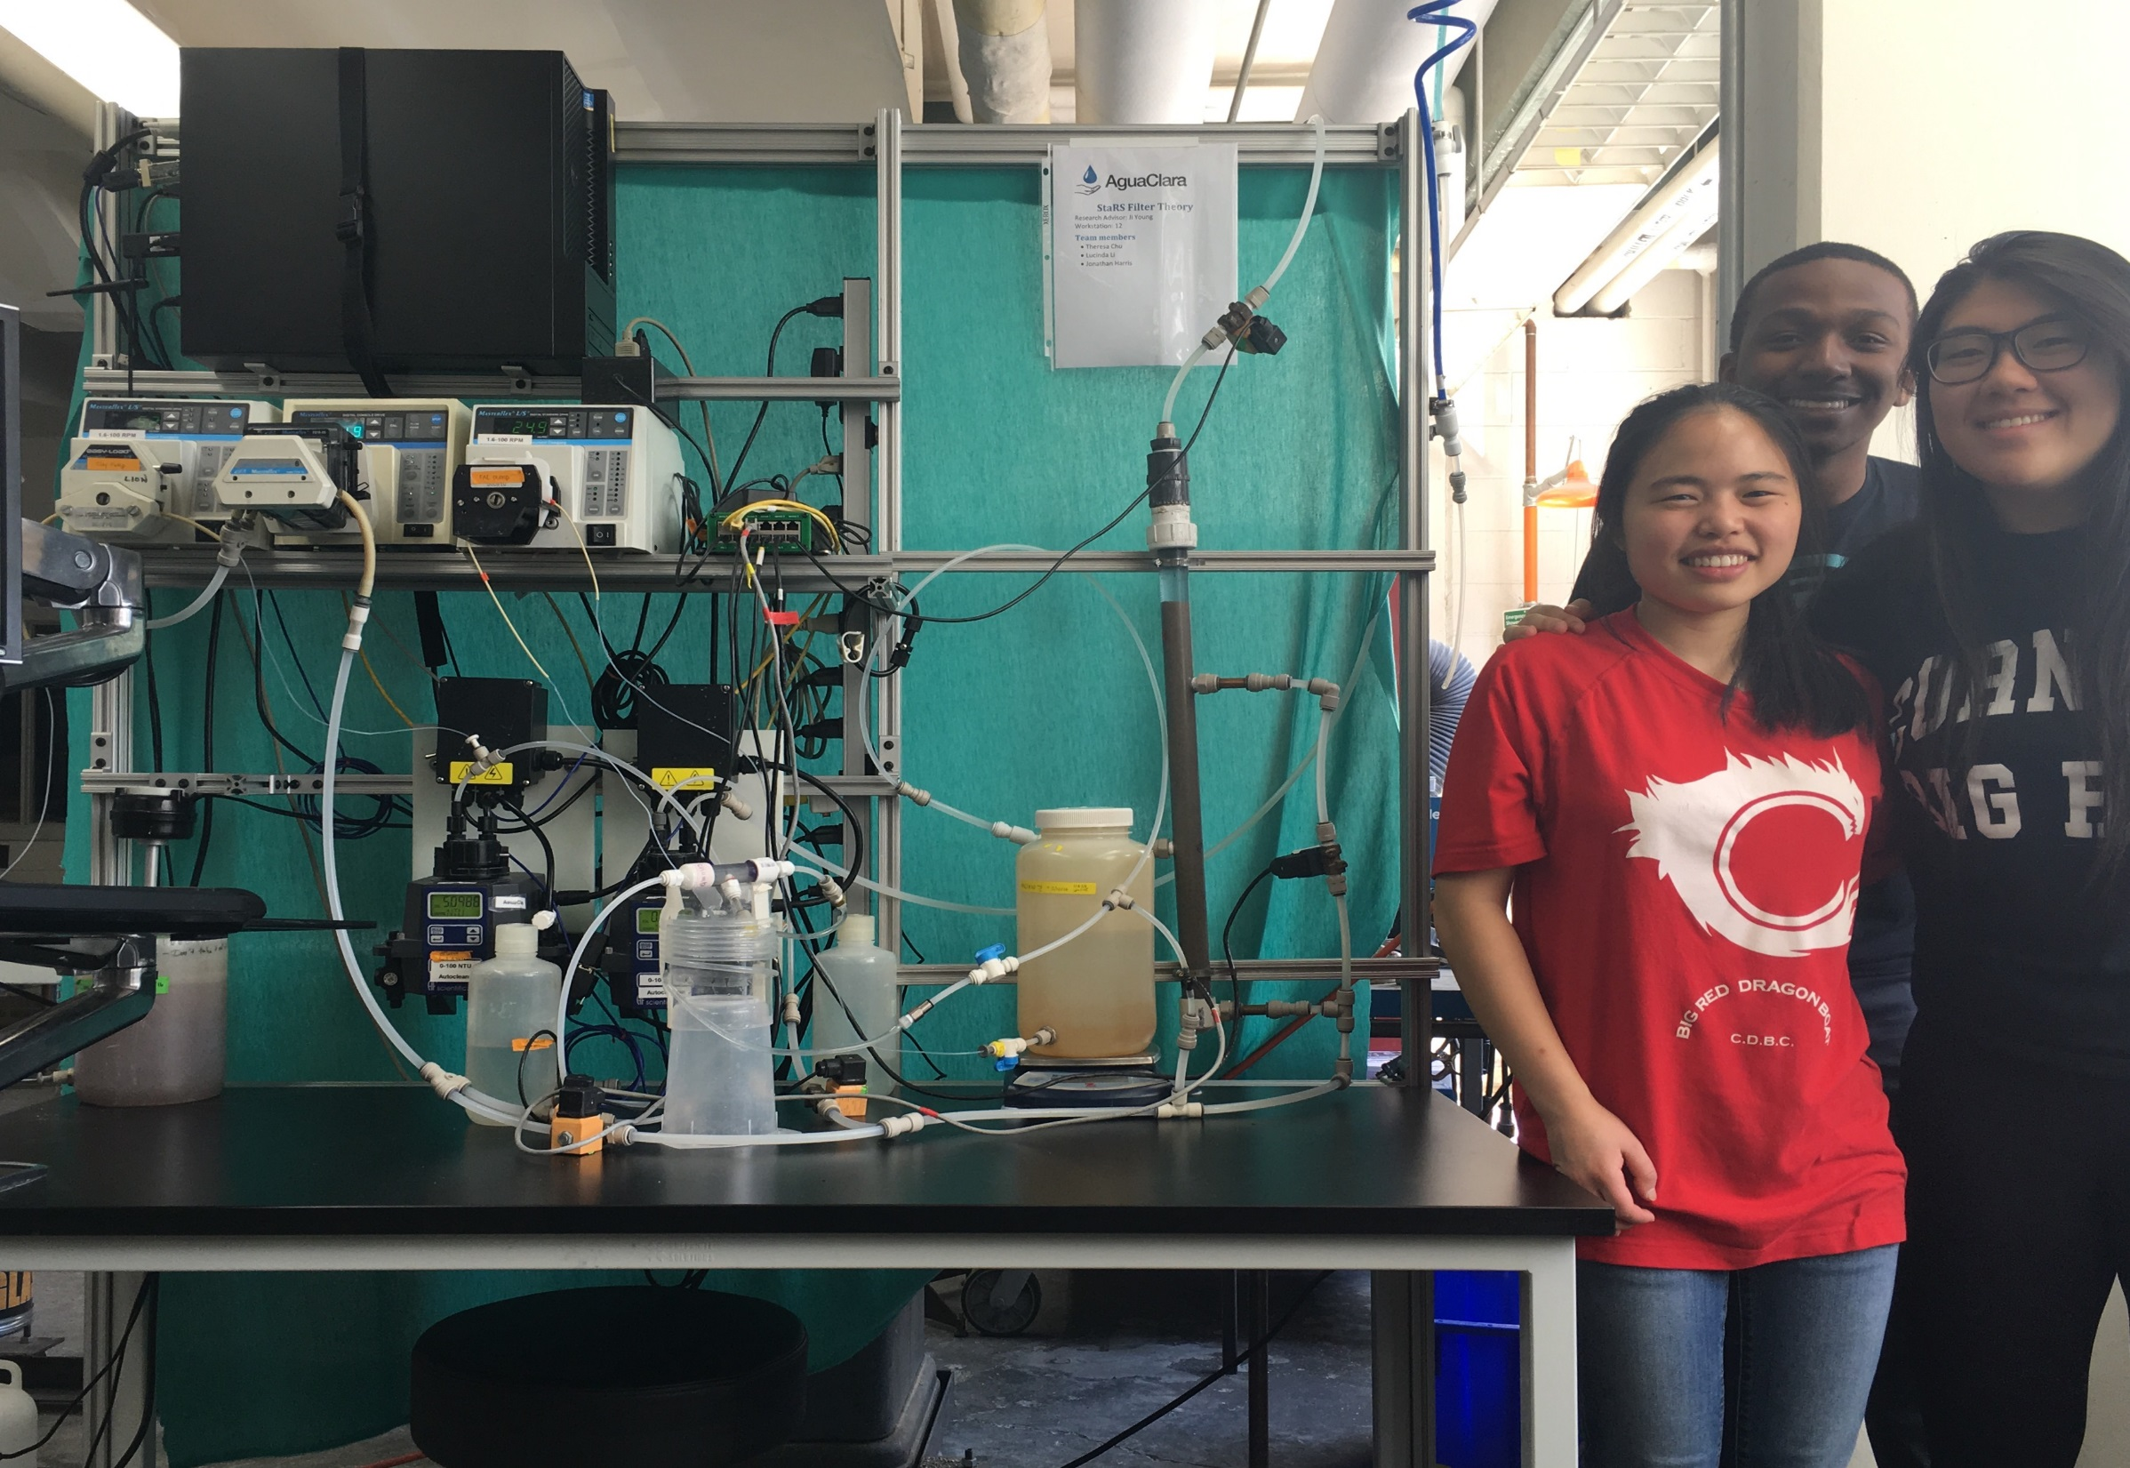
Questions and
Recommendations
Theresa Chu
Environmental Engineering
tyc29@cornell.edu
Lucinda Li
Environmental Engineering
ll555@cornell.edu
Jonathan Harris
Environmental Engineering
jdh345@cornell.edu
Notes:
Theresa | Environmental Engineering ‘16 | tyc29@cornell.edu
Lucinda | Environmental Engineering ‘18 | ll555@cornell.edu
Jonathan | Environmental Engineering ‘19 | jdh345@cornell.edu

Slide 22
Appendix
Slides

Slide 23
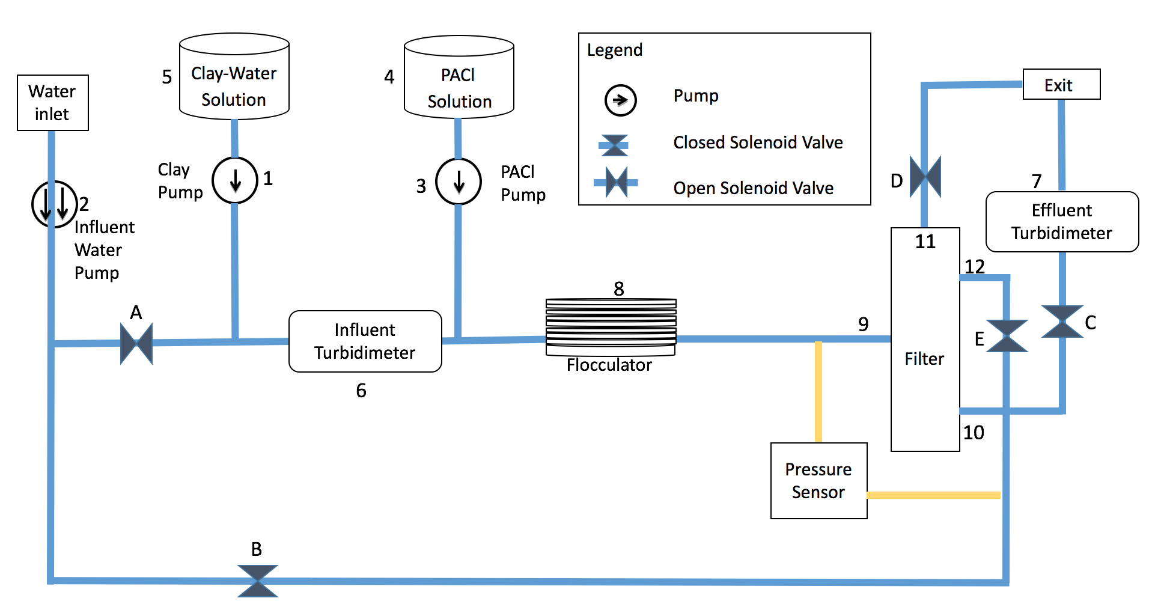
Filter Schematic

Slide 24
Conditions used to test the filter
PACl Dosage (mg/L): 0.2, 0.65, 1.1, 1.55, 2
Influent Turbidity: 5 NTU
  Variable controlled by PID
Flow Rate: 118 mL/minute
Sand Size: Sieved at 30-35
Procedure
  Run Time: 12 hours
  Backwash
Notes:
Procedure and experimental conditions
PID

