Slide 1
Stacked Rapid Sand (StaRS) Filter Theory
A mathematical model is under development to explain the physics of filtration.
Find more information at StaRS Filter Theory’s wiki.
StaRS Filter Theory | Research | Final Presentations Fall 2016
Notes:
Jonathan

Slide 2
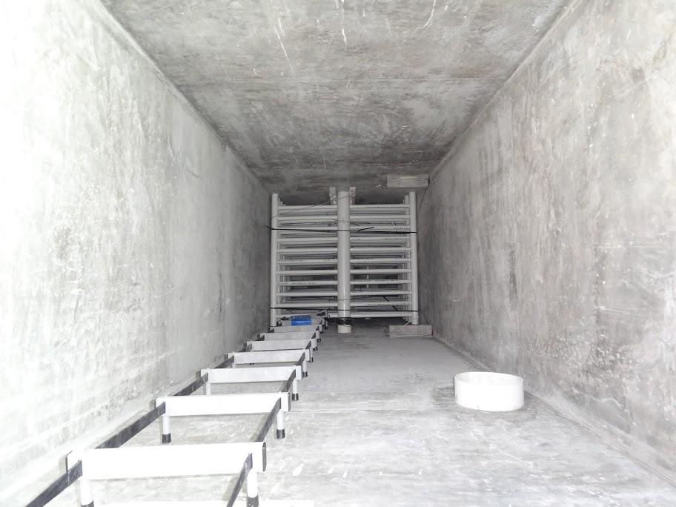
Optimize filter performance for cleaner water
StaRS Filter Theory | Research | Final Presentations Fall 2016
Notes:
Jonathan
AguaClara plant filter picture
Lab filter picture
The purpose of the StaRS Filter Theory team is understand what is happening in the Stacked Rapid Sand filters
Here is a photo of the AguaClara Filter
Each depth is 20cm, which was arbitrarily chosen
It is not know if this is the optimal depth for a filter

Slide 3

Modeling filter performance will help future design
Without model:
?
Model
Predict failure time
Characterize performance
Figure out which variables matter:
Media size? Bed depth? Relationship to head loss?
StaRS Filter Theory | Research | Final Presentations Fall 2016
Notes:
Jonathan
Most models do not explain filtration dynamics, they are called “clean bed” models because they only work when the filter is clean, aka the first few minutes of filter run, after that the models do not work.
Without the models, the filter is just a black box and we do not understand what is happening inside. We hoped with our model to better understand our filter.

Slide 4
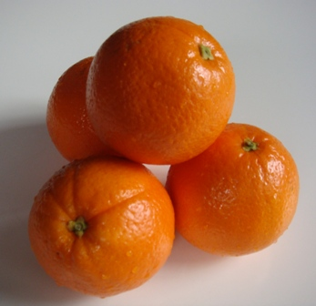
Particles collide with sand grains at constrictions
StaRS Filter Theory | Research | Final Presentations Fall 2016
Notes:
Jonathan
Sand grains are too small to see, so first we looked at a set of marbles. However, marbles are also pretty small, therefore a set of oranges shown above are used to understand the how a collection of sand grains have extensions and constrictions.
This led to the “constriction model.” We believe that water travels down the filter through a capillary, and that capillary has a number of these constriction. There are a number of capillaries in the filter. As the particles in the water travel down the capillary, as the fluid constrictions, the particles collide and stick to the sand grains.
Particles collide with sand grains
http://www.daviddarling.info/encyclopedia/S/sphere_packing.html
Particles collide with sand grains
http://www.daviddarling.info/encyclopedia/S/sphere_packing.html

Slide 5

Particles build up to create “washers”
StaRS Filter Theory | Research | Final Presentations Fall 2016
Notes:
Lucinda
Zoomed in top down, plan view area of the region between sand particles.
Particles attach at the walls of the sand particles forming a washer. As more particles attach and the effective diameter decreases, the washers reach a minimum effective diameter. This is a result of excessive shear and prevents further particle attachment.

Slide 6
Washers at the constrictions have a small thickness
StaRS Filter Theory | Research | Final Presentations Fall 2016
Notes:
If the sand particles were move farther apart, we would be able to see the washer that forms between the three tangent sand particles. In this figure, we can also see that the washers are thin as we expect them to have a very small thickness. In previous assessment of possible models, a very small value was determined for the ratio of captured particle volume to available pore volume. Out of the total available pore volume, only approximately 10^-3 of the volume is occupied with flocs. The washer model reasonably depicts this as the particles accumulate in thin, small washers.

Slide 7
Streamline convergence theory validates the washer model
StaRS Filter Theory | Research | Final Presentations Fall 2016
Notes:
Lucinda
This diagram is a vertical, cross sectional area of a constriction and expansion. That is if you cut the sand bed down its length. Point out constriction and expansion. Particle capture occurs through the mechanism of interception, where particles collide with the filter media along their paths of travel. When water flows through the capillary, streamlines converge at the constrictions increasing interception opportunities. Moreover, at the site of convergence, there is a greater number of particles, increasing particle collisions and particle attachment to the constriction wall. Imagine people running. As the flow continues past the constriction, the streamlines diverge and particle collisions and attachment to the chamber wall are decreased. This theory suggests that there is a very small surface area to which particles can attach to in the filter because significant accumulation occurs mostly at the constrictions, which have a volume significantly smaller than the expansions. Therefore, this model aligns with the calculations we did in mathcad which demonstrated that the expected volume of accumulated particles is much smaller than total pore volume.

Slide 8

Particles are removed in the active filter zone
Dirty Bed
Clean Bed
Active Zone
StaRS Filter Theory | Research | Final Presentations Fall 2016
Notes:
Lucinda
Zoom out of the individual constriction
Look at one capillary tube, for the sake of simplicity, we will only look at a sand filter layer that has top-down flow and we can imagine flocs entering from the top
Three zones we want to look at: dirty bed, clean bed, and active zone. When flocs enter the filter, the active zone starts out at the top of the filter.
Assume active zone is the same length (linear head loss, uniform particle attachment) and dirty and clean bed lengths are changing. Looking at effluent turbidity data, there is slight increase in performance throughout a filtration run and since the only parameters changing during a filtration run is the change in dirty and clean bed lengths, the data suggests that the increase in filter performance is due to the increased length of dirty bed and decreased length in clean bed.

Slide 9
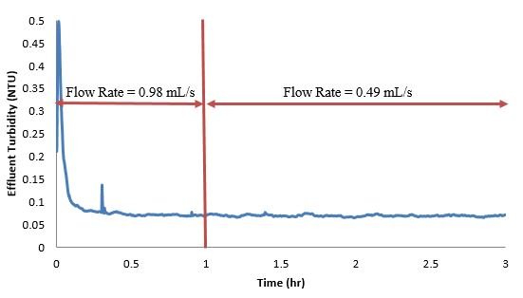
Changing flow rate has no effect on effluent turbidity
StaRS Filter Theory | Research | Final Presentations Fall 2016
Notes:
Theresa
Experiment ran with influent at 5 NTU and 2 mg/L PACl (eventually PID control did not work and influent turbidity changed, but influent turbidity was consistent at 5 NTU for the first 3 hours)
Ran flow rate at full flow rate for 1 hour, then half flow rate
We thought that effluent turbidity would decrease because the lower flow rate meant that there was less shear on the granular media walls (which are also coated with incoming particles), allowing smaller particles to be captured
This hypothesis was not true because effluent turbidity did not change – so particle size doesn’t seem to affect the amount that is captured

Slide 10
Only major head loss affects clean bed head loss
StaRS Filter Theory | Research | Final Presentations Fall 2016
Notes:
Theresa
Ran filter at incremental flow rates up to full flow rate (0.98 mL/s)
Head loss is linear with velocity
Follows Carman-Kozeny clean bed head loss which has head loss proportionally linear to velocity
Solved for D60, the effective sand grain size, and got 0.484 mm, which is very close to the sieved estimate of 0.500 m

Slide 11
Minor losses contribute to dirty bed head loss
StaRS Filter Theory | Research | Final Presentations Fall 2016
Notes:
Theresa
Clogged filter at normal flow rate, 5 NTU, 2 mg/L PACl
“Stepped down” flow rate at half the speed and collected head loss readings
Fit the values to a parabolic function, which would follow a head loss based on major losses and minor losses
Squared term is minor losses, single term is major losses
Solved for K = 4579 with # pores = 400
There are a lot of minor losses
Note change in scale for head loss – there’s a lot more head loss

Slide 12
Washer model is feasible
Notes:
Theresa
Minor head loss shows that there are contractions and expansions due to pore restrictions resulting from particles sticking to sand grains and collecting in a washer
These washers of flocs have led to minor losses
Future questions for washer model
How deep is the active layer in the washer model?
What is the height of the washer?
What is the shear force on the washer?

Slide 13
Questions and
Recommendations
Theresa Chu
Masters of Engineering
tyc29@cornell.edu
Lucinda Li
B.S Environmental Engineering
ll555@cornell.edu
Jonathan Harris
B.S. Environmental Engineering
jdh345@cornell.edu
StaRS Filter Theory | Research | Final Presentations Fall 2016

Slide 14
Appendix
Slides

Slide 15
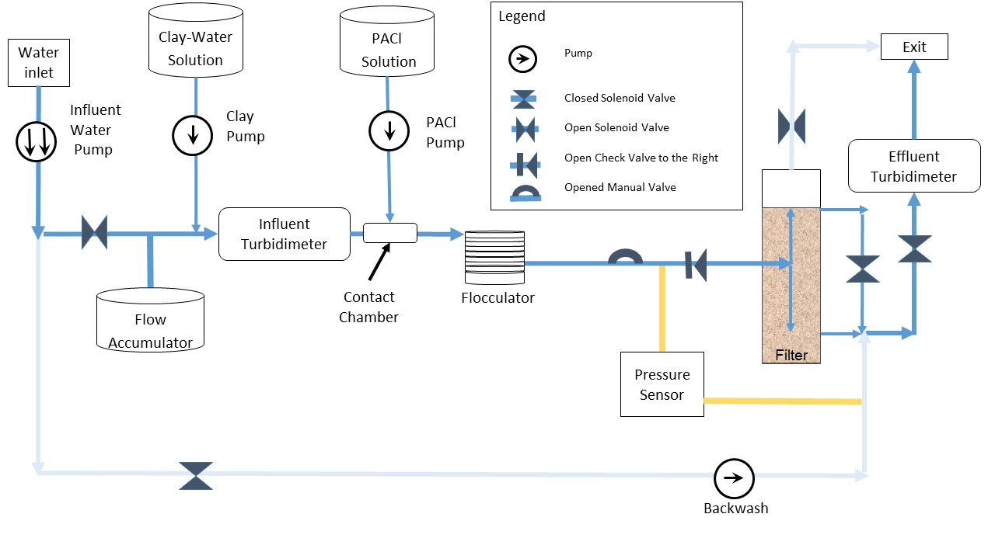
Filter Schematic
StaRS Filter Theory | Research | Final Presentations Fall 2016

Slide 16
Conditions used to test the filter
PACl Dosage (mg/L): 0.2, 0.65, 1.1, 1.55, 2
Influent Turbidity: 5 NTU
  Variable controlled by PID
Flow Rate: 118 mL/minute
Sand Size: Sieved at 30-35
Procedure
  Run Time: 12 hours
  Backwash
StaRS Filter Theory | Research | Final Presentations Fall 2016
Notes:
Procedure and experimental conditions
PID

Slide 17
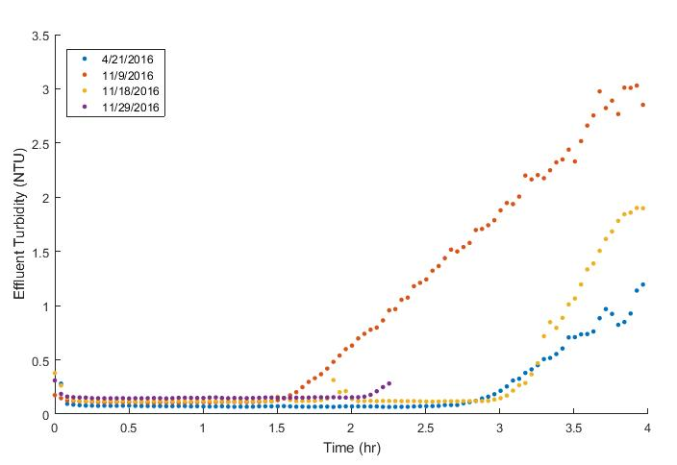
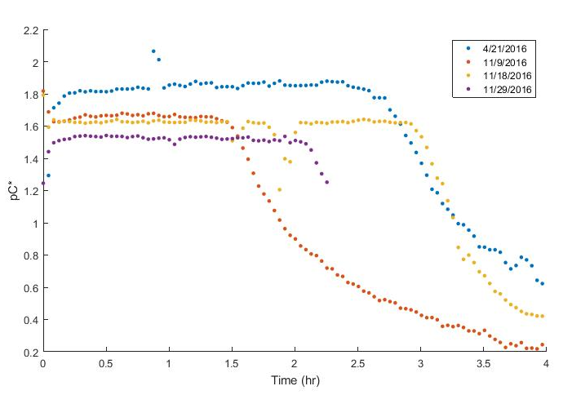
Filter performance is inconsistent
StaRS Filter Theory | Research | Final Presentations Fall 2016
Notes:
Theresa
Influent turbidity at 5 NTU, flow rate at 0.98 mL/s, PACl dosage at 2 mg/L – same experiment over and over, but breakthrough/failure times are different for all of them – ranging from 1.5 hours to 3 hours
Two filter runs have similar failure times of 3 hours – but this result is inconsistent with failure times we expected with other coagulant dosages

Slide 18
Clean Bed Head Loss
StaRS Filter Theory | Research | Final Presentations Fall 2016
Notes:
Clean bed head loss over time during experiment
Each jump up shows an increase in flow rate, thus increasing head loss

Slide 19
Dirty Bed Head Loss
StaRS Filter Theory | Research | Final Presentations Fall 2016
Notes:
Dirty bed head loss over time during experiment
Each jump down shows a decrease in flow rate, decreasing head loss

