Slide 1
Stacked Rapid Sand (StaRS) Filter Theory
Isha Chaknalwar
Theresa Chu
Michelle Lee

Slide 2

Stacked Rapid Sand Filters
Stacked Rapid Sand (StaRS) Filter/Filtration
Invented by AguaClara
Used in newer plants
Water enters the filter through orifices in the pipes
Sand captures colloids
Allows for entirely gravity-powered water filtration
Notes:
Michelle

Slide 3
Purpose
Mathematical model
Build filter apparatus
Assess filter performance
Measure head loss across sand
Measure influent and effluent turbidity
Achieve turbidity breakthrough
Notes:
Michelle

Slide 4
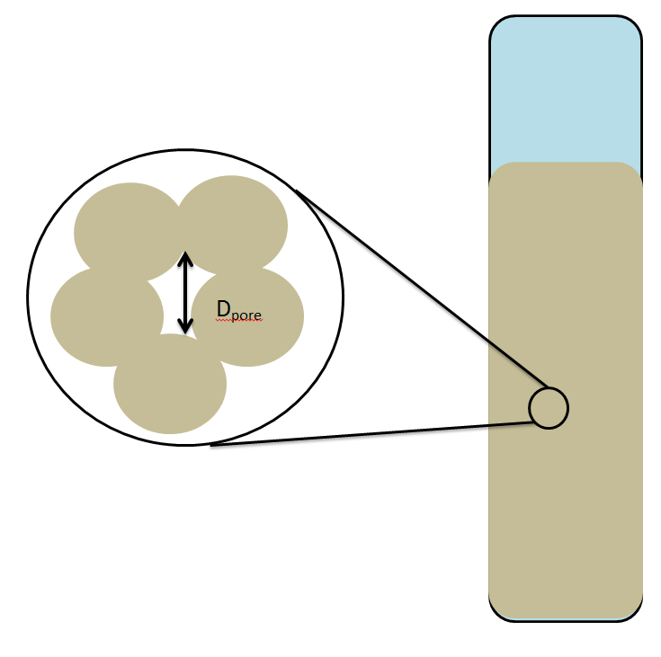
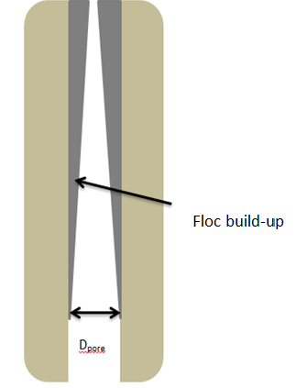
Theory
Flocs build-up in sand pores, causing:
Increase
  Head loss
  Shear force
  Water velocity
Decrease
  Pore diameter
Notes:
Michelle

Slide 5
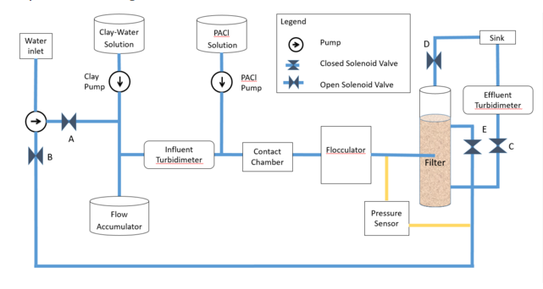
Experimental Apparatus
Notes:
Michelle
Isha – update photo

Slide 6
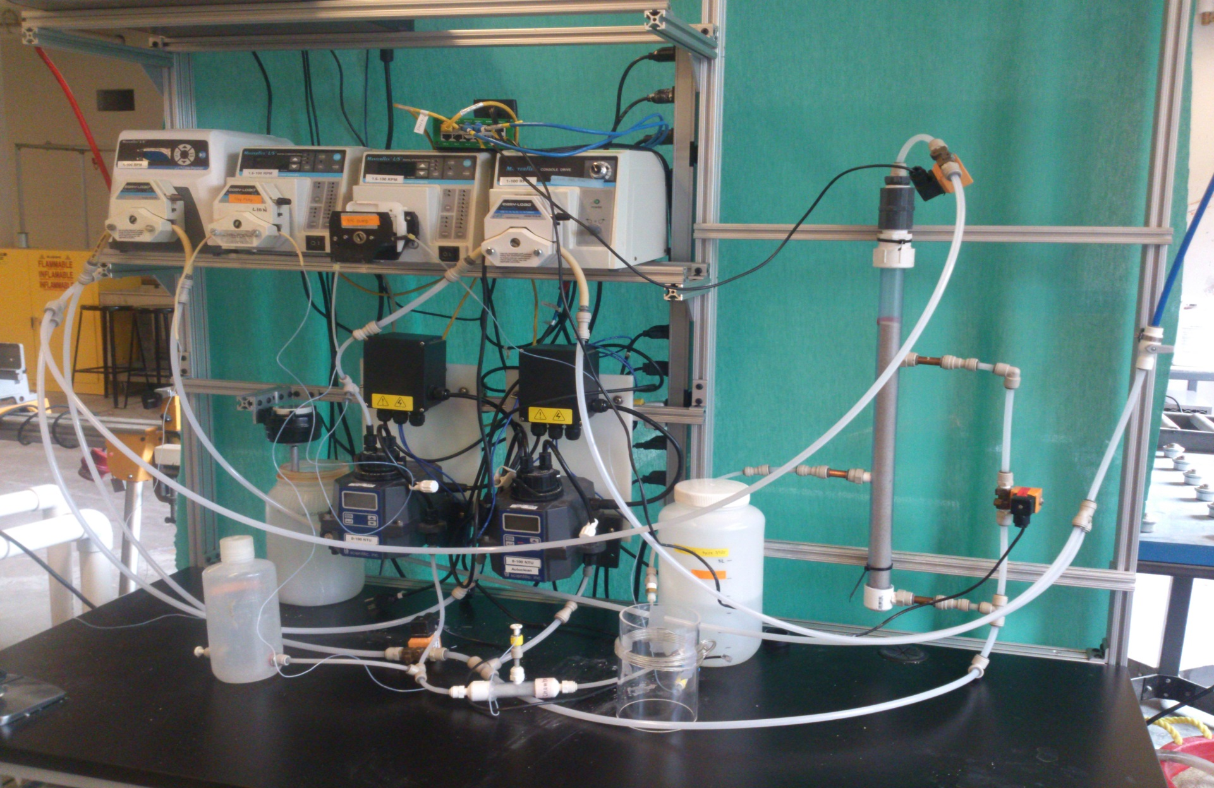
Experimental Apparatus

Slide 7
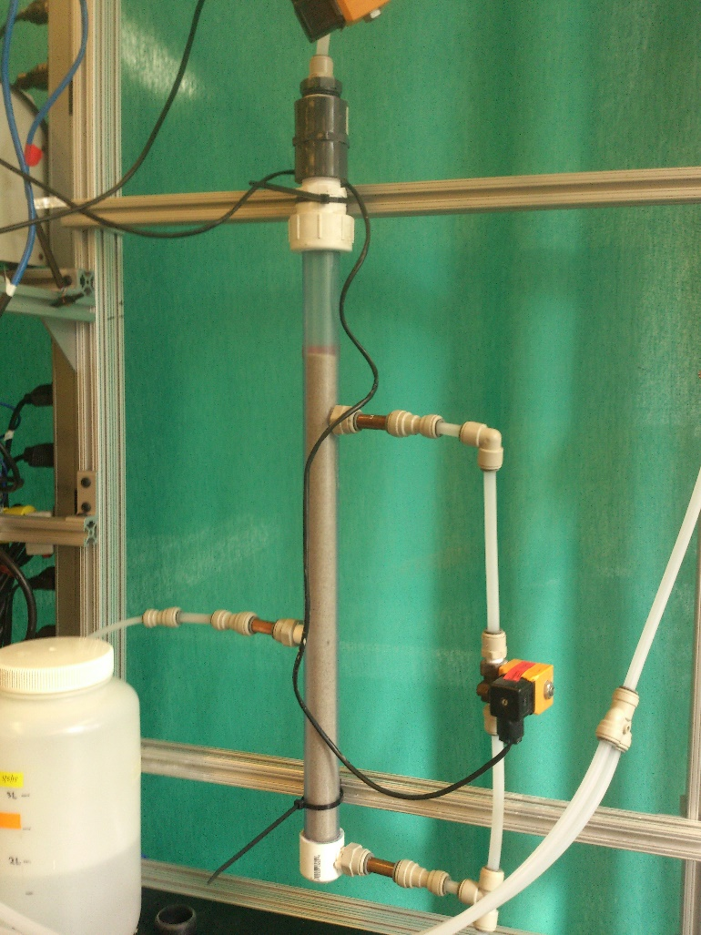
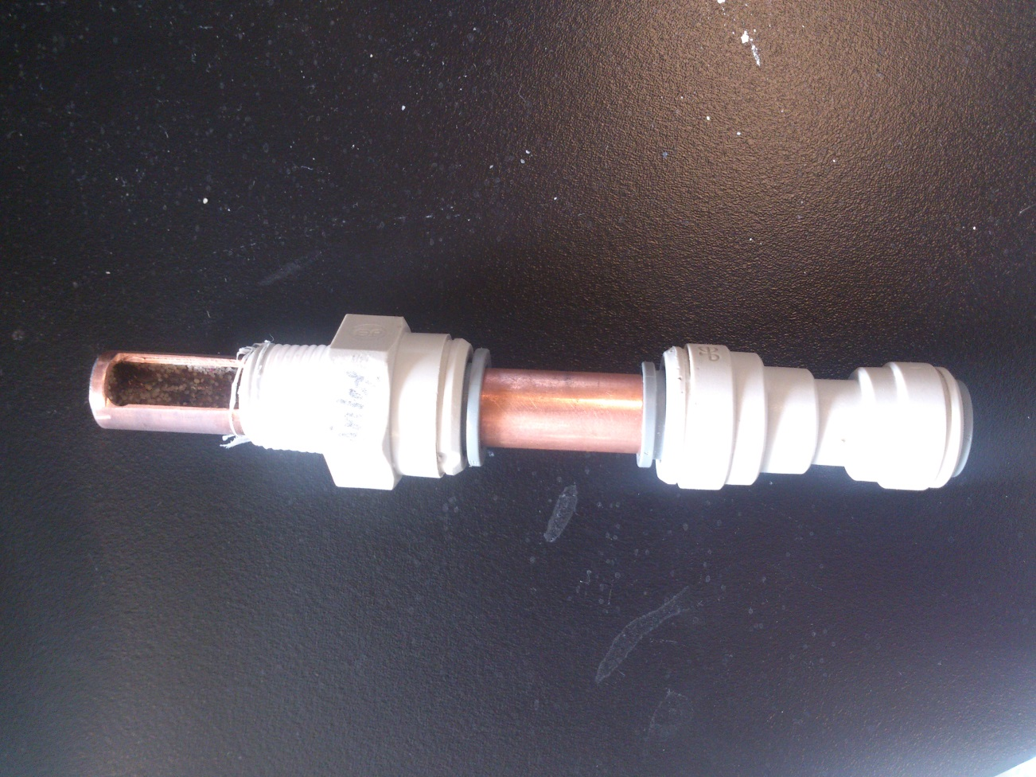
Filter Design
Remove slotted pipes → orifice
Orifice facing downward
New design avoids clogging of the inlet system
Notes:
Michelle
Two Sand Layers: 20 cm each
Velocity: 1.833 mm/s
Flow Rate: 0.984 mL/s

Slide 8
Water Flow in Filter
https://drive.google.com/file/d/0B_IH1uAWiIRwUzBwazZkc3ZNa00/view?usp=sharing

Slide 9
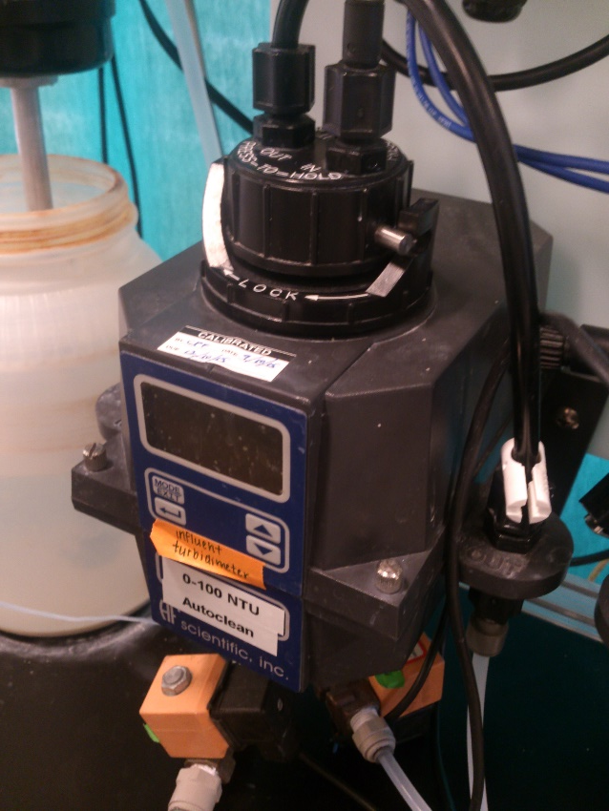
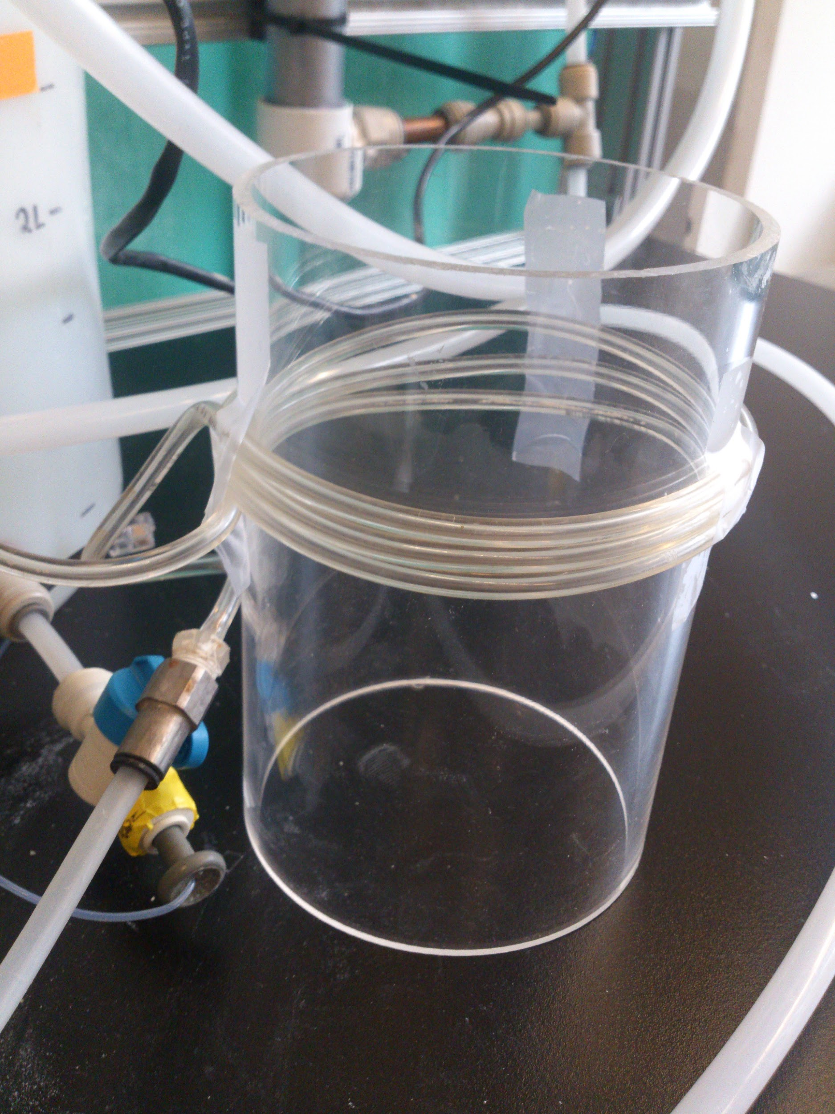
Technical Issues
Inlet system: sand leaves filter column during backwash
Air in system
Flocculator
PID Control
Notes:
The sand kept leaving the filter through the inlet system while backwashing the filter.
The air kept entering the system, each time a tubing was removed for cleaning causing trouble with the filtering. The air was removed by backwashing and hitting the filter with mallet.
We had to bypass the flocculator as the flocculator could not take the high energy dissipation and clay and coagulant started clogging the filter.
PID control was unsuccessful in controlling the influent turbidity.

Slide 10
PID Control
P = 0.7
I = 0.5
Inconsistent influent turbidity
ProCoDA – occasional turbidity reading is -999

Slide 11
Influent Turbidity
PACl Dosage: 2 mg Al/L
Notes:
Theresa

Slide 12
Experimental Conditions
Average Influent Turbidity: 5 NTU
PACl dose: 0.2 mg Al/L
Notes:
Isha

Slide 13
Turbidity
PACl Dosage: 2 mg Al/L
Notes:
Theresa

Slide 14
Effluent Turbidity
PACl Dosage: 2 mg Al/L

Slide 15
Effluent Turbidity
PACl Dosage: 2 mg Al/L

Slide 16
pC*
pC*= -LOG(Effluent/Influent)
PACl Dosage: 2 mg Al/L
Notes:
Theresa

Slide 17
Head Loss
PACl Dosage: 2 mg Al/L
Notes:
Theresa

Slide 18
Conclusions
Head loss: 8 cm/hr
Time till failure: 16 hr
Inlet system control
PID control calibration method
Notes:
Theresa

Slide 19
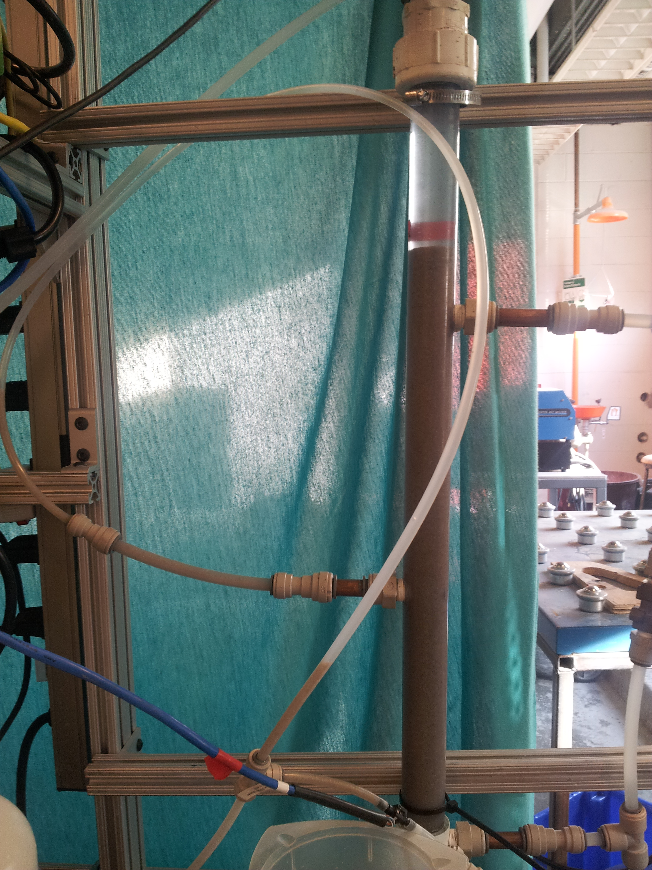
Future Work
PID Control
Inlet system
Run experiments with varying PACl dose
Create mathematical model
Notes:
Isha

Slide 20
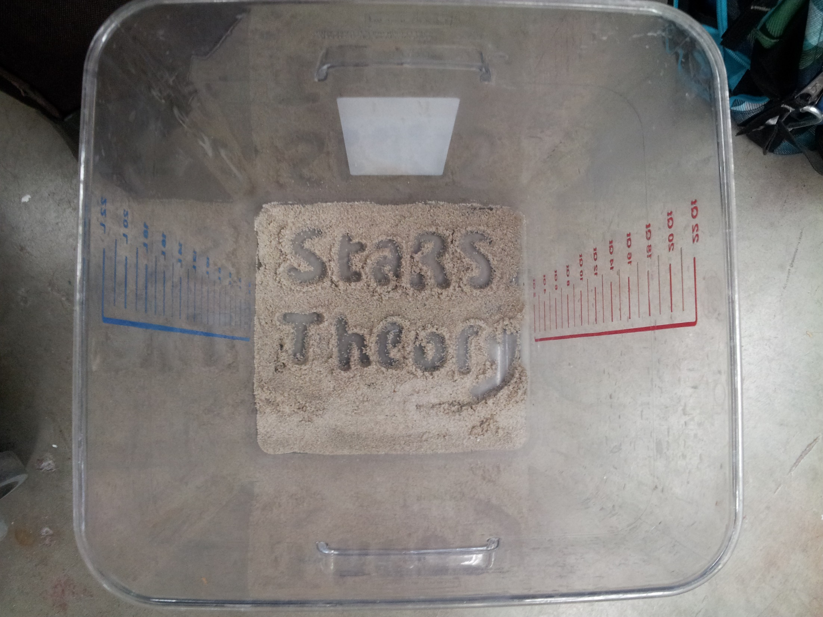
Questions?

