Slide 1

StaRS Filter Theory
Continuing research on the development of a mathematical model to explain the physics of filtration
For more info: StaRS Filter Theory wiki
StaRS Filter Theory | Final Spring 2017
Notes:
Abstract:
Dynamic models of rapid sand filtration have proved elusive in describing for the diminishing pore space and increasing head loss in a filtration run. Empirical data from this study show that head loss increases linearly over time despite filter breakthrough. Dirty filter bed head loss data show that minor losses add to head loss over time. A new model for dynamic filtration is proposed, which models captured particles as embedded rings of flocs in the filter bed. Particle removal through filtration is described with an active filtration zone of empty pores filling up with particles. This zone moves for particles to attach.
Notes: The main goal of our team was to continue research on the development of a mathematical model model to explain the physics behind the filtration. Sand filtration has been in the field of water treatment for more than a century , But a fuller understanding of what happens inside a filter has always remained ambiguous. So our team is trying to find that.

Slide 2
Tasks completed this semester
Invalidated the Washer Model
Completed the paper
StaRS Filter Theory | Final Spring 2017
Notes:
Mythri : So this semester, Our team has been working on two main tasks. One was validating washer model. Past aguaclara team had come up with a model to explain the physics behind the filtration. Through the course of the semester, we found that the washer model does not work Our second task was to organise the ideas, findings and results into a paper for the journal. Since the model does not work, the team tried to conclude the paper explaining a different approach to modelling. And we hope future teams would be able to come up with a reasonable geometry.

Slide 3

Creating a mathematical model for dirty bed is complex
A simpler modelling approach for dirty bed
StaRS Filter Theory | Final Spring 2017
Notes:
Mythri Notes: - This semester, our team did a literature review and also found that the washer model does not work. From the literature review, we found that people all over the world has come up with different filtration models. They are very good at explaining good at explaining at what happens inside a clean bed. But we are concentrating on modelling the dynamic bed , ie when the filter starts getting clogged with the particle. We believe it is very important to know what happens inside a dirty bed as this can give insights on filter performance and filter failure time. Though we found a lot of literature which explains the dynamic bed modelling of filters, but we found that they are complex and do not visualisation or a geometry of the deposition inside the filter. The model which we are proposing is simple and also give a visualisation of flocs deposition in the filters. Our modelling approach is based on the finding of presence of minor losses occurring in a dirty bed and additional major losses occurring in the dirty bed compared to the clean bed. So the two main highlights of our paper are the modelling approach and active zone hypothesis about which you will be hearing in a while.

Slide 4

Constriction model represents the pores as empty chambers
Constrictions
Expansions
StaRS Filter Theory | Final Spring 2017
Notes:
Mythri: Our model is based on the constricted tube model. Past literature also confirms that the constricted tube model is the best model We believe that filter is made up of long tubes which has a series of constrictions and chambers. Constrictions are, the spaces where the sand particles are the closest to one another and the chambers are the volumes of larger pore spaces between tangent sand particles. The space in this picture is the pore volume in one single capillary tube for the constriction model. This is the vertical section of the tube
Source:
A new model for Granular porous media- A.C .Payatakes

Slide 5
Streamline convergence theory validates the constriction model
StaRS Filter Theory | Final Spring 2017
Notes:
Mythri: - Before we get into the model, It is important to know what happens when water flows through the model, water flows through constrictions-streamline converges. When water flows pass through the constrictions, streamlines diverge. We are emphasizing streamline convergence because we hypothesize that interception is the dominant particle deposition mechanism. Interception is a particle deposition mechanism in which the particles follow the streamlines, so when the streamlines come close to the sand wall, the particles have a better chance to attach.

Slide 6
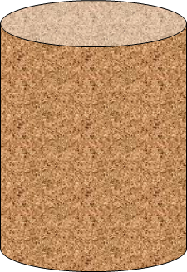
The volume of flocs is much less than the pore volume
A mass balance determined the volume of flocs in the filter
StaRS Filter Theory | Final Spring 2017
Notes:
ROSE: Our goal is to determine the dimensions of the floc buildup in the filter. The first thing we did to determine the geometry was to perform a mass balance on the filter by comparing influent and effluent turbidity. The mass of flocs left in the filter at failure is equal to the mass that entered throughout the test minus the mass that exited. Using an estimated floc density, the mass of flocs in the filter was converted to a volume.
The total volume of available pore space in the filter can be found using the porosity of the sand. Compared to this volume, the volume of flocs is very small.

Slide 7
The floc buildup geometry must be very small
The proposed geometry is a washer
?
StaRS Filter Theory | Final Spring 2017
Notes:
ROSE: Since very little mass actually accumulates in the filter, the volume of whatever geometry forms at the constrictions must be very small. The most intuitive geometry is a simple washer in which flocs accumulate around the edges of the constriction in a ring which builds inward and upward over time. The growth of the washer is limited by shear, since as the inner diameter of the washer contracts, the velocity of water moving through the washer increases.

Slide 8
If washers are forming, minor losses should occur in a dirty bed
StaRS Filter Theory | Final Spring 2017
Notes:
ROSE: The washer geometry would be expected to cause sudden flow expansions, leading to minor head loss in a dirty bed. If something similar to the washer geometry exists, we should see experimentally an appearance of minor losses in a dirty bed.

Slide 9
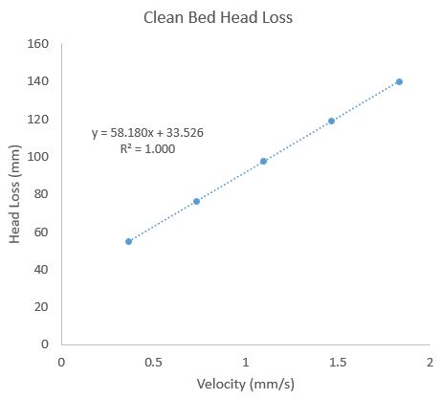
Head loss in a clean bed is linear, since there are only major losses
StaRS Filter Theory | Final Spring 2017
Notes:
ROSE: As a basis for comparison, in a clean bed the losses are only major, since when head loss is plotted versus velocity the plot is linear.

Slide 10
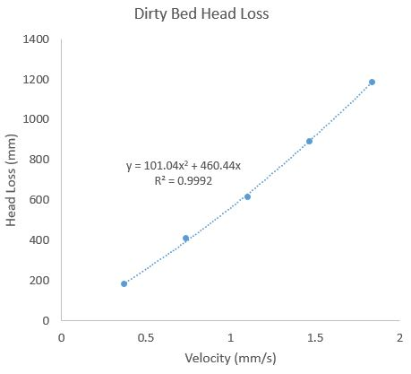
In a dirty bed, head loss is nonlinear, indicating the presence of minor losses
StaRS Filter Theory | Final Spring 2017
Notes:
ROSE: Comparing head loss to velocity in a dirty bed yields a nonlinear relationship, showing that there are minor losses occurring in a dirty bed. This supports the existence of a washer-like geometry. Moreover, major losses also increase and that is important for determining the washer dimensions.

Slide 11

Minor loss component can be used to calculate washer dimensions
Inner diameter
of washer = D.Orifice
D.Pipe = 77 μm
Diameter of
constriction = D.Pipe
D.Orifice = 62 μm
StaRS Filter Theory | Final Spring 2017
Notes:
The minor loss component can then be used to calculate the inner diameter of a washer. Currently, we are using the flow expansion formula to represent the flow contraction through a washer and its expansion into the expansion. However, we assume that there is no vena contracta due to gradual flow expansion in the expansion, so pi VC is 1. Our calculations show that the inner diameter of the washer is about 62 micrometer, which is smaller than the diameter of constriction, 77 micrometer, so it is a reasonable analysis!

Slide 12
There are two ways to calculate the washer height
Shear approach
vs
Volume approach
StaRS Filter Theory | Final Spring 2017
Notes:
To complete the washer model, the washer height was calculated. There are two ways to do so, the shear approach and the volume approach. We can then compare the heights we get using both approaches. If they are the same, then the washer model is validated.

Slide 13
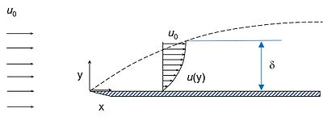


Additional major loss can be used to calculate washer height
P.In
Height
of washer
Shear
P.Out
ΔP = P.Out – P.In
StaRS Filter Theory | Final Spring 2017
Notes:
The shear approach looks at the increase in major loss to calculate washer height. The underlying assumption here is that the flow accumulate additional shear as it passes through the washers. Therefore, we can use a force balance to determine the length through which the flow must pass to create the corresponding pressure drop. The challenge is that the washers are very small and we assume that the flow through the washer will not fully develop into a parabolic velocity profile. Hence, we are considering the flow through the washer to be similar to the flow over a flat plate. So the flat plate is essentially the washer wall. This assumption will give us a flat plate drag coefficient and force equation, which we can use to determine the distance travelled to create that force.
This washer height is the height that the collected data gives us.
Flat plate figure: https://upload.wikimedia.org/wikipedia/commons/thumb/8/85/Wickipedia_Picture_Boundary_Layer_Thickness.jpg/400px-Wickipedia_Picture_Boundary_Layer_Thickness.jpg

Slide 14
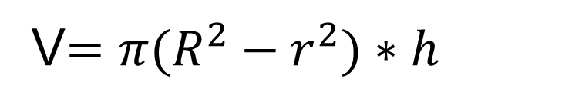
The volume of flocs retained in filter at failure can also be used to calculate the height
Inner diameter of
washer = r
r
V$=π{(R^{2}−r}^{2})∗h$
h
R
Diameter of
constriction = R
StaRS Filter Theory | Final Spring 2017
Notes:
Another way to calculate washer height is using the volume of flocs retailed in the filter and the previously calculated inner diameter of the washer. As mentioned earlier, we did a mass balance of clay and PACl going into and coming out of the filter to find the volume of flocs retained in the filter. Then, following our model, the volume of the floc deposition is the volume of a hollow cylinder where capital R is the diameter of a constriction and r is the inner diameter of washer.
This washer height is the height the model gives us.

Slide 15

The volume height range and the shear height do not match
$$≠$$
Shear Approach
Volume Approach
StaRS Filter Theory | Final Spring 2017
Notes:
When we used the shear approach, the washer height was much too small compared to the height from the volume approach. Therefore, the washer model proposes a particle deposition geometry, the washer, that creates two problems: it creates too much additional major losses and accounts for too little of the volume of retained particles in the filter bed. We need to brainstorm other particle deposition geometries or mechanisms that will limit major losses while accounting for a large volume. But one thing that we can take away from our semester’s analyses is that minor losses are occurring in the filter bed as opposed to the clean bed, so particle deposition must be causing flow contractions and expansions during filtration. This is an approach that previous literature has not taken to understand filter performance, so it is still relevant!
Shear approach: 3.8 micrometer
Volume approach: around 84 micrometer

Slide 16
Future teams will work to better understand rapid sand filters
Brainstorm new geometries of particle deposition at the filter constriction
Create a mathematical model to predict filter performance
Optimizing filter performance during a filtration run using the model
StaRS Filter Theory | Final Spring 2017

Slide 17
Questions
and
Recommendations
Rose Linehan
BS Civil Engineering
rvl24@cornell.edu
Lucinda Li
BS Environmental Engineering
li555@cornell.edu
Mythri K
M Eng, Civil and Environmental Engineering
mk2446@cornell.edu
StaRS Filter Theory | Final Spring 2017

Slide 18
Appendix
Slides
StaRS Filter Theory | Final Spring 2017
Notes:
From this point on, add any slides with figures that will help support your thesis. You might pull these figures from your Final Report.

Slide 19
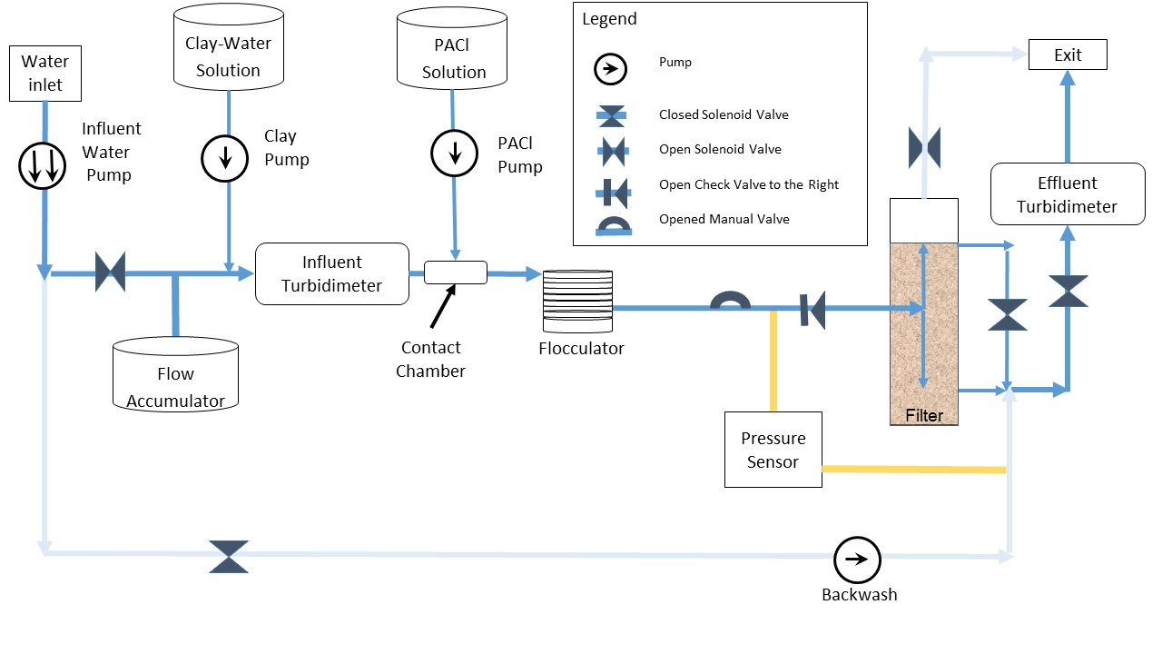
Filter Schematic
StaRS Filter Theory | Final Spring 2017

Slide 20
Conditions used to test the filter
PACl Dosage (mg/L): 0.2, 0.65, 1.1, 1.55, 2
Influent Turbidity: 5 NTU
  Variable controlled by PID
Flow Rate: 118 mL/minute
Sand Size: Sieved at 30-35
Procedure
  Run Time: 12 hours
  Backwash
StaRS Filter Theory | Final Spring 2017
Notes:
Procedure and experimental conditions
PID

Slide 21
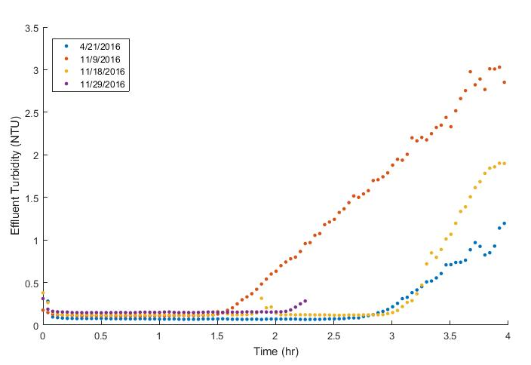
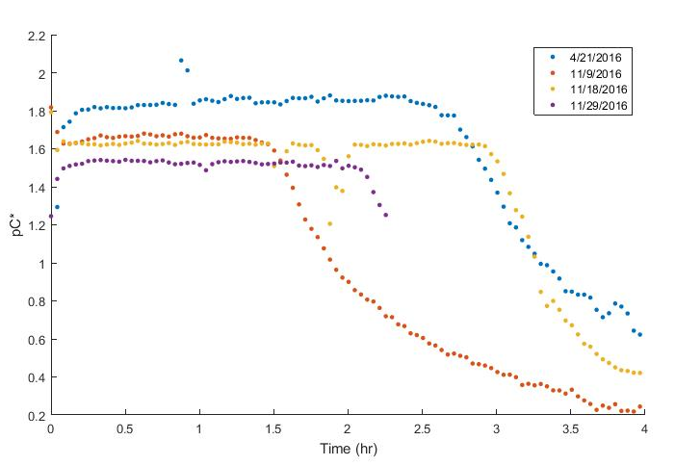
Filter performance is inconsistent
StaRS Filter Theory | Final Spring 2017
Notes:
Influent turbidity at 5 NTU, flow rate at 0.98 mL/s, PACl dosage at 2 mg/L – same experiment over and over, but breakthrough/failure times are different for all of them – ranging from 1.5 hours to 3 hours
Two filter runs have similar failure times of 3 hours – but this result is inconsistent with failure times we expected with other coagulant dosages

Slide 22
Clean Bed Head Loss
StaRS Filter Theory | Final Spring 2017
Notes:
Clean bed head loss over time during experiment
Each jump up shows an increase in flow rate, thus increasing head loss

Slide 23
Dirty Bed Head Loss
StaRS Filter Theory | Final Spring 2017
Notes:
Dirty bed head loss over time during experiment
Each jump down shows a decrease in flow rate, decreasing head loss

Slide 24

Particles are removed in the active filter zone
Dirty Bed
Clean Bed
Active Zone
StaRS Filter Theory | Final Spring 2017
Notes:
Lucinda
After looking at the microscopic deposition at each constriction, we began to hypothesize about the macroscopic process in the filter. Here we will only look at a sand filter layer that has top-down flow and we will visualize the flocs entering from the top. Initially, the sand bed is entirely clean bed; no flocs have attached to the sand grains. As flocs stick to sand particles, washers being to form and the growing washers create the active zone. Therefore we can say that the active zone is where washers are developing. When washers have reached maximum volume, that region of the filter becomes part of the dirty bed. Despite the
.

