Slide 1
SRSF Theory
Michelle Bowen
Theresa Chu
Tanya Peifer

Slide 2

What is SRSF?
Stacked Rapid Sand Filter/Filtration
Invented by AguaClara and used in newer plants
How is it different?
  Water enters the filter through embedded tubes
  Allows for entirely gravity-powered water filtration

Slide 3
Purpose of SRSF Theory Subteam
Create a theoretical understanding of how Stacked Rapid Sand Filters work
Develop a model
  Conduct experiments with varying inputs and monitoring outputs
Help optimize SRSF performance

Slide 4
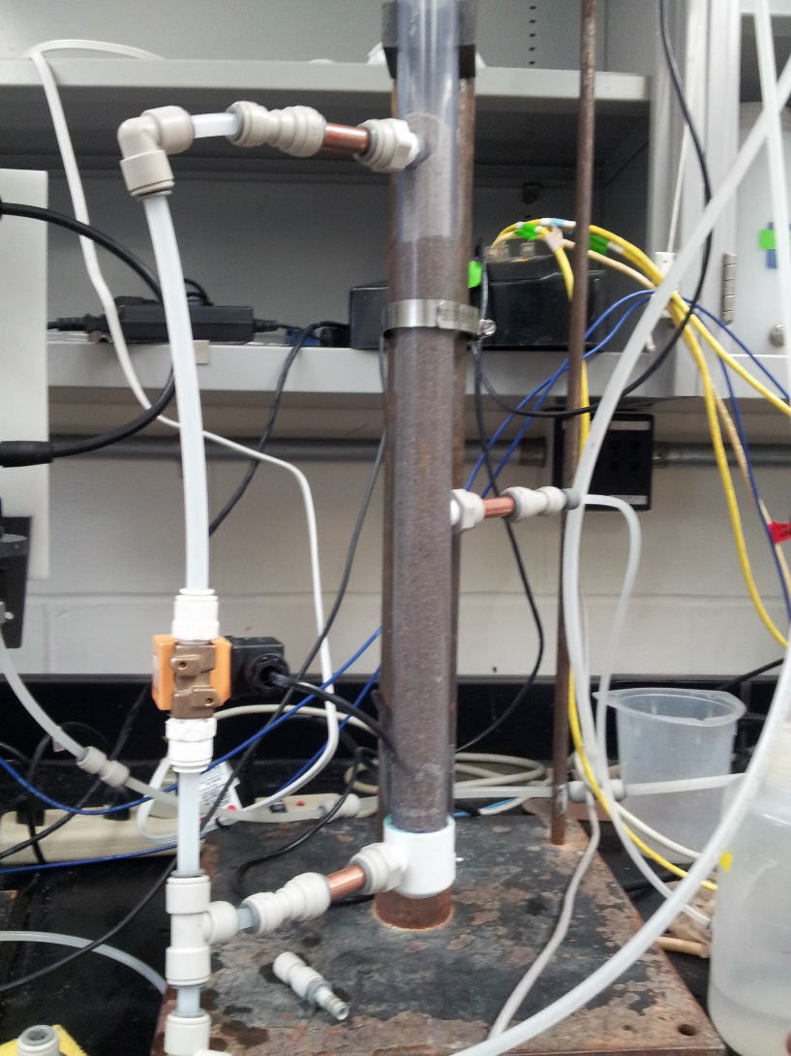
Our Apparatus
Models two layers of an SRSF (which typically has 6 layers)
One inlet, two outlets
Each layer is 20 cm
Total length is 60 cm to allow for backwash
Area ratio of inlet to filter models full scale plants

Slide 5
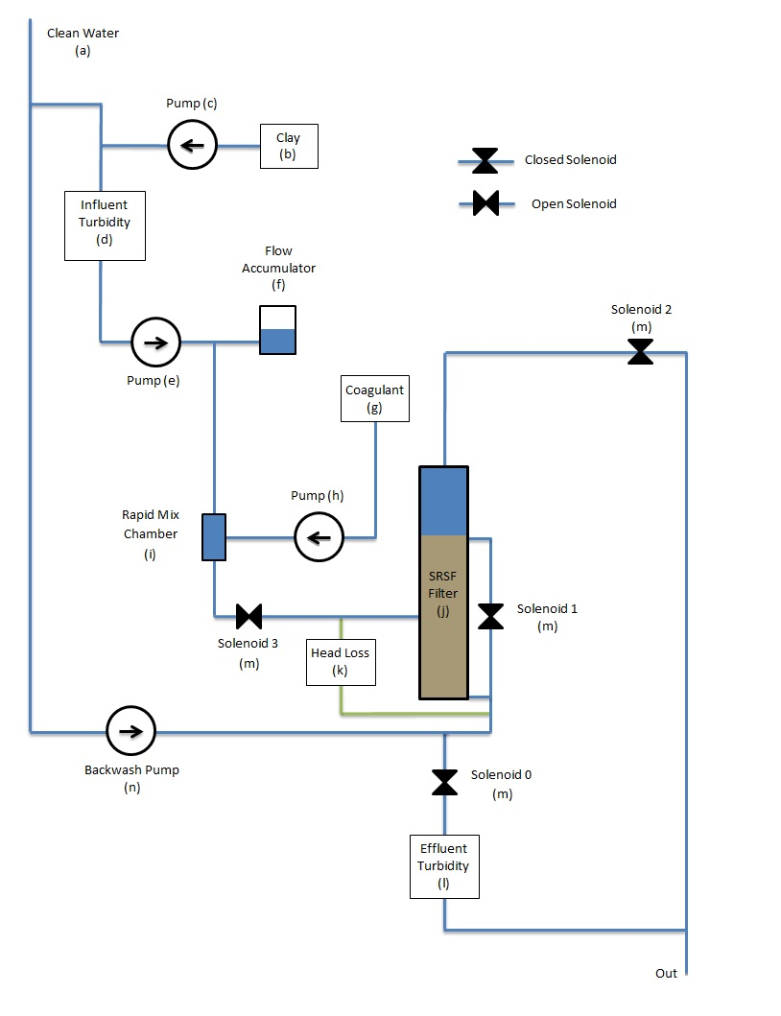
Flow through experimental set-up

Slide 6
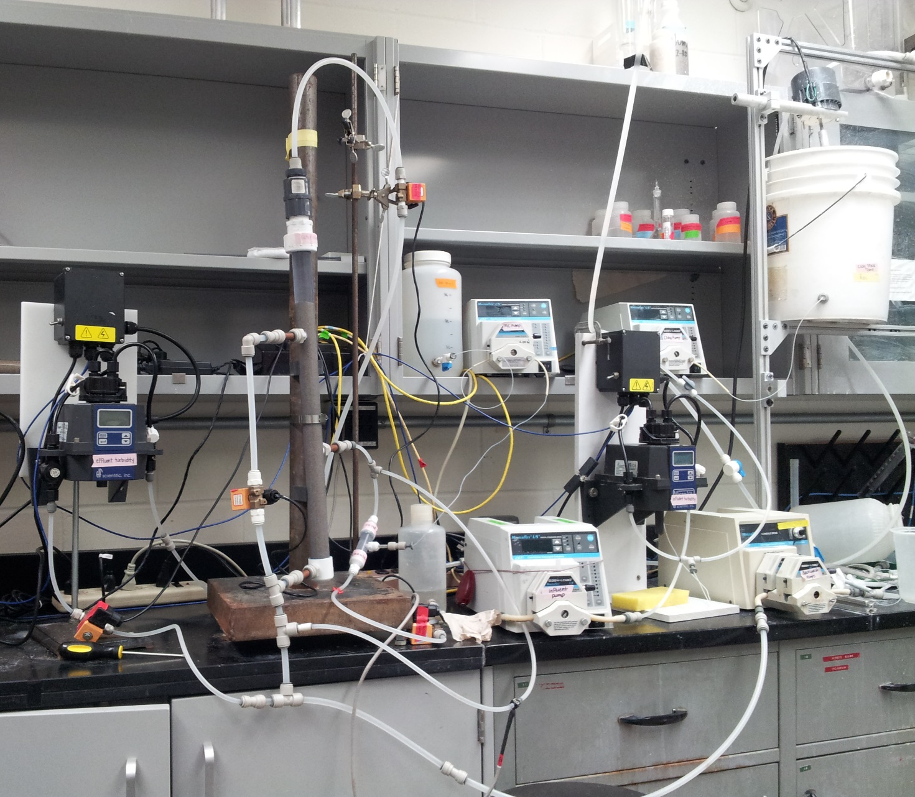
Lab Bench Setup

Slide 7
Experimental Parameters
Constant influent turbidity: 5 ± 0.5 NTU
Constant flow rate: 1.86 mL/s
Coagulant (PAC) dosages:
0.2, 0.65, 1.1, 1.55, and 2 mg/L
Dependent variables:
  Effluent turbidity
  Head loss

Slide 8
PID Control
Proportional Integral Derivative: adjusts clay pump speed in response to measured influent turbidity values
P: proportional to current error
  P was set to 1
I: proportional to magnitude of error over time
  I set to 0.25
D: proportional to rate of change of error
  D set to 0
Notes:
P: we adjust depending on clay stock value, more dilute stocks mean higher P values
I : lower value means fewer previous points from memory used

Slide 9
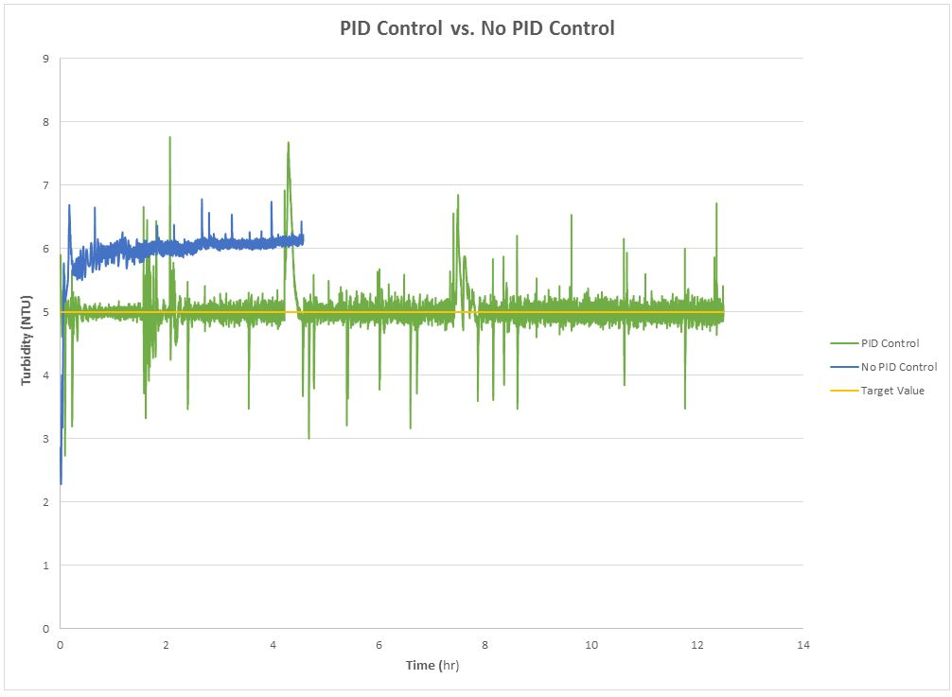
Influent Turbidity with PID

Slide 10
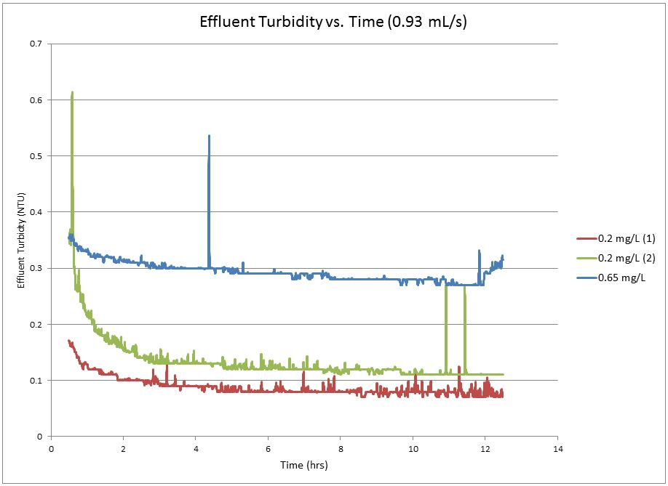
Effluent Turbidity I

Slide 11
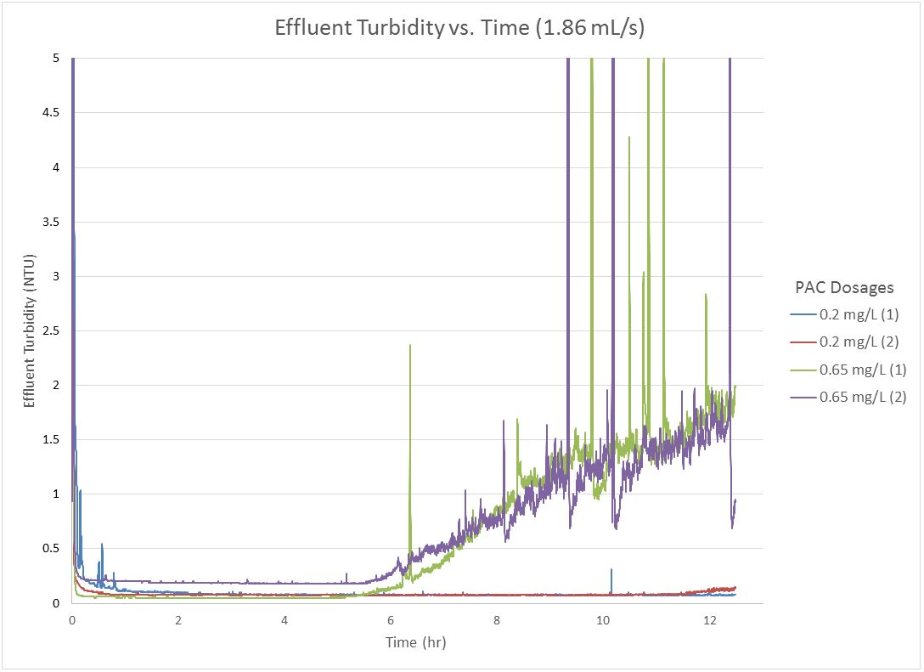
Effluent Turbidity II

Slide 12
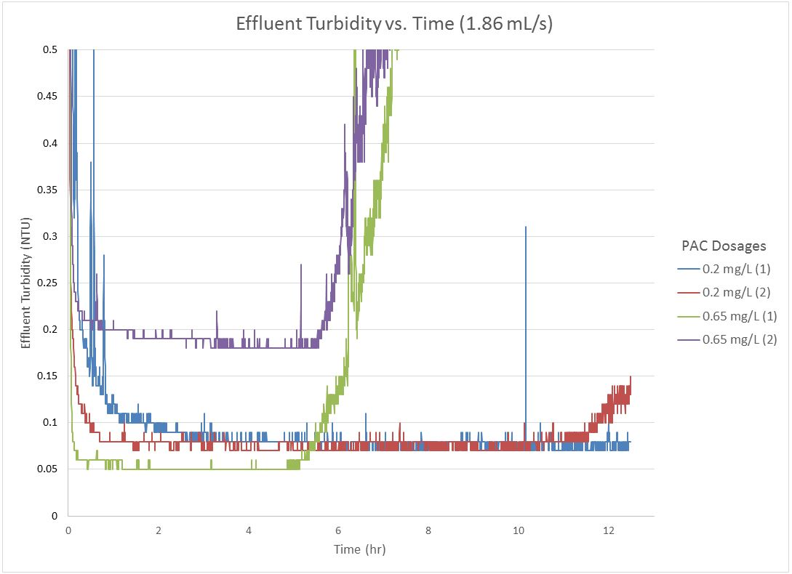
Effluent Turbidity II

Slide 13
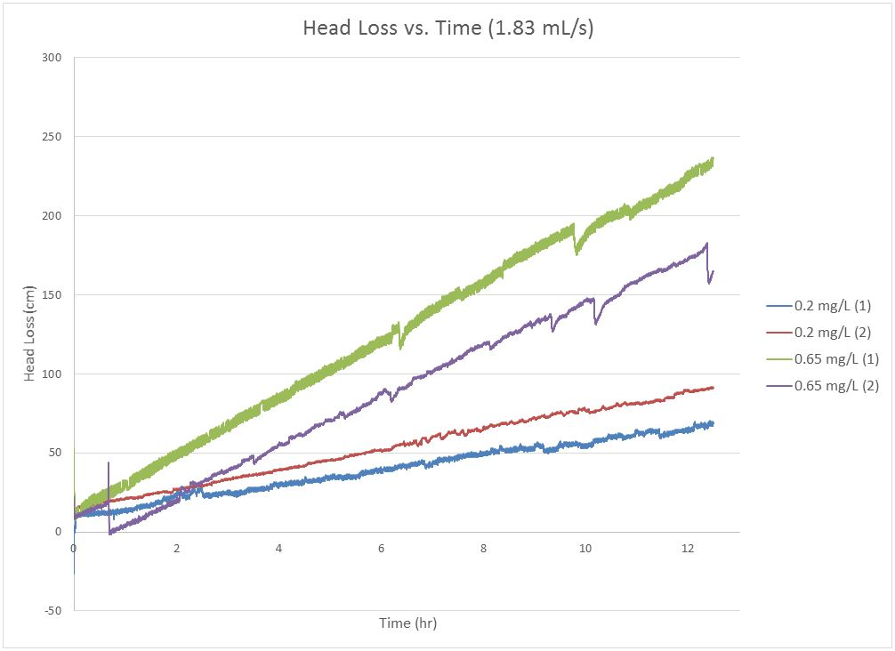
Head Loss

Slide 14
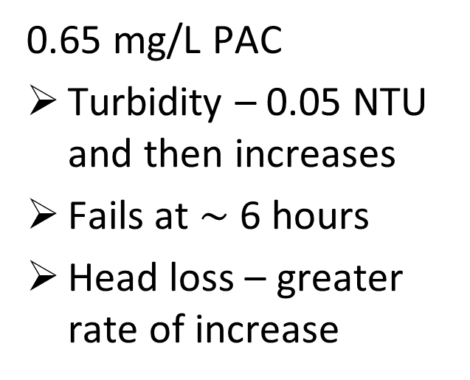
Analysis
Filter successfully reduced the turbidity < 0.5 NTU
Control experiment at 0.0 mg/L of PAC – 1 NTU
Coagulant joins to particles, which are more easily removed by the filter
0.2 mg/L PAC
Turbidity – 0.08 NTU for over 12 hours
Head loss – smaller rate of increase
0.65 mg/L PAC
Turbidity – 0.05 NTU and then increases
Fails at $\sim$ 6 hours
Head loss – greater rate of increase

Slide 15
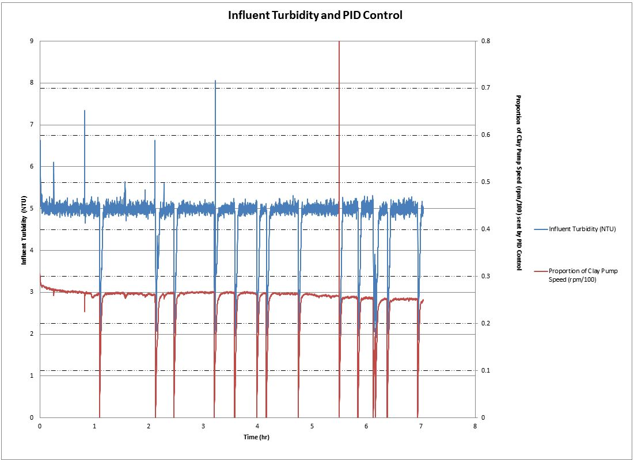
Current Issues
PID control
  Overcorrecting
  Malfunctions
Air in the column after long experiments
  Cause unknown
Head loss values
  Unrealistic
  (over 200 cm)

Slide 16
Conclusions
Higher coagulant doses – effluent turbidity is consistent and then increases over time
  Turbidity breakthrough possible
Lower flow rate – filter performance increases over time
Effluent turbidity lower at 0.2 than 0.65 mg/L overall
0.65 mg/L – performs better for shorter runtime
Current head loss data does not show when clogging occurs
Need to run more experiments to confirm trends
Notes:
Turbidity breakthrough: a crack in the filter bed that allows the passage of flocs through a filter will cause an increase in filter effluent turbidity

Slide 17
Goals for future semesters
Run experiments over range of coagulant doses
Effluent turbidity and head loss:
  Compile data
  Analyze trends
Create a model for SRSF

Slide 18

Questions?

