Slide 1
Depth vs. Surface Sand Filtration
McKenzie Hubert
Hannah Stahl
Michelle Bowen
Eric Grohn

Slide 2
Our Mission
Research what factors determine where particles are captured in the sand bed (depth vs. surface filtration)
Determine significant differences between surface and subsurface water injection (aka Conventional Rapid Sand Filter vs. Stacked RSF)
Maximize efficiency and minimize head loss to enhance filter performance

Slide 3
Depth vs. Surface
Depth
Surface
Particles captured throughout the entire sand bed
Flocs cannot survive in regions of high shear between the pores
Water allowed to easily pass through the bed because no flocs completely block pores
Linear relationship with head loss vs. time
Backwashing (no manual labor)
Particles trapped near the top of the sand bed
Flocs build up in regions between pores which causes a thick layer to form
Exponential relationship with head loss vs. time because of clogging
Surface wash rather than backwash (scrape off top layer)

Slide 4
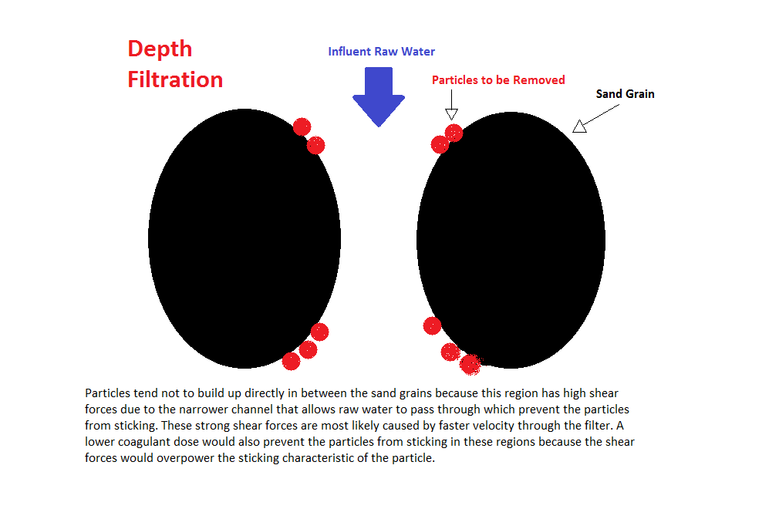
Depth Filtration

Slide 5
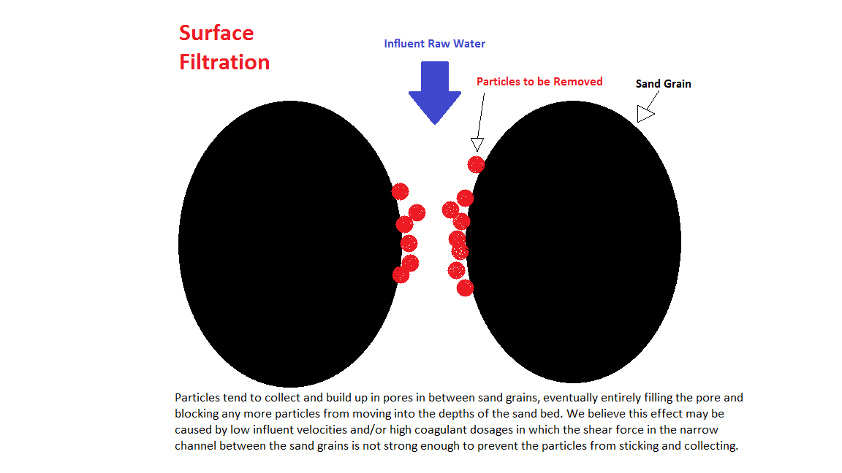
Surface Filtration

Slide 6
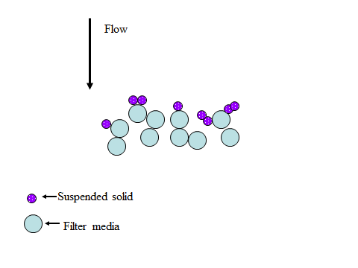
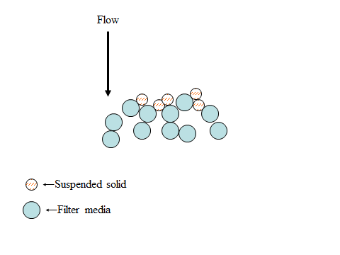
Depth vs. Surface
Depth – pores still allow water to flow freely
Surface – pores blocked and water forced to go around
Notes:
Explain meanings of illustrations; point out where particles collect in relation to gaps in pores; “life of floc”

Slide 7
Surface vs. Subsurface
Surface
Subsurface
Conventional RSF design
Water sits above sand bed
Water enters and exits sand bed in tubes of the same diameter as the filter
SRSF design
Water injected below the surface of the sand bed
Small size of the inlet and outlet tubes = high velocity of water entering and exiting the sand bed

Slide 8
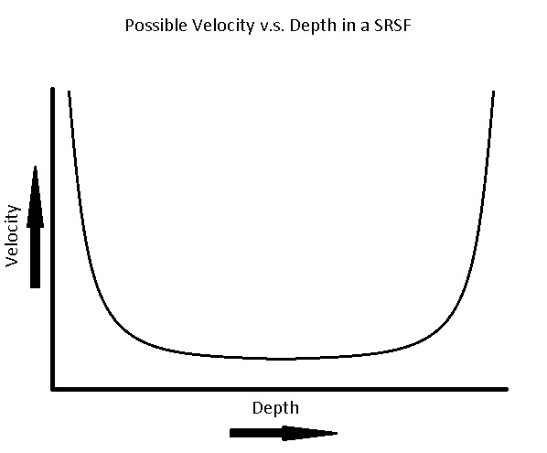
Subsurface Injection vs. Conventional Surface Injection
Velocity vs. Depth
Subsurface Injection
Surface Injection

Slide 9
Our Hypotheses
Factors that affect type of filtration:
  Influent velocity
  Coagulant dosage (size and “stickiness” of flocs)
  Pore sizes
  Relative strength of shear forces between sand grains and binding forces of the particles to the sand grains
Expect high coagulant doses or low velocity will cause surface filtration
Expect subsurface injection will force depth filtration to occur regardless of the initial parameters
Suspect surface filtration is more efficient, but limitations exist due to increases in head loss and shorter run times

Slide 10
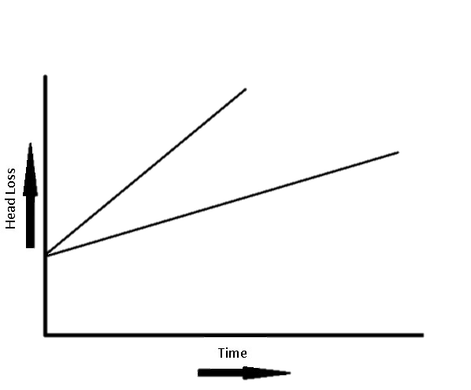
Head Loss Expectations
Head Loss vs. Time
Surface Filtration
Depth Filtration- High Coagulant Dose
Depth Filtration-Low Coagulant Dose

Slide 11
Our Apparatus
Subsurface injection tube in parallel with a conventional downflow rapid sand filter
Constant variables
  Influent turbidities
  Overall flow rate
  Coagulant dosage
  Inner-tube diameter
Measure and compare efficiency and head loss results
Solenoid valves for backwashing purposes
Notes:
Overview of our apparatus; walk through of design and how water flows through it

Slide 12
Future Experiments
Test effects of different flow rates, coagulant dosages
Vary the size of sand grains or filter media
Consider filtering through the bed twice?
Adding a foam filter either before or after?

Slide 13
Questions? Suggestions?
Attaching small inlet tube to filter?
Simplifying the apparatus?
What do you predict our results will be?
Other ideas for research variables or experiments?

