Slide 1

Surface vs. Subsurface Inlet Systems for Sand Filtration
McKenzie Hubert, Eric Grohn, Hannah Stahl, Michelle Bowen

Slide 2
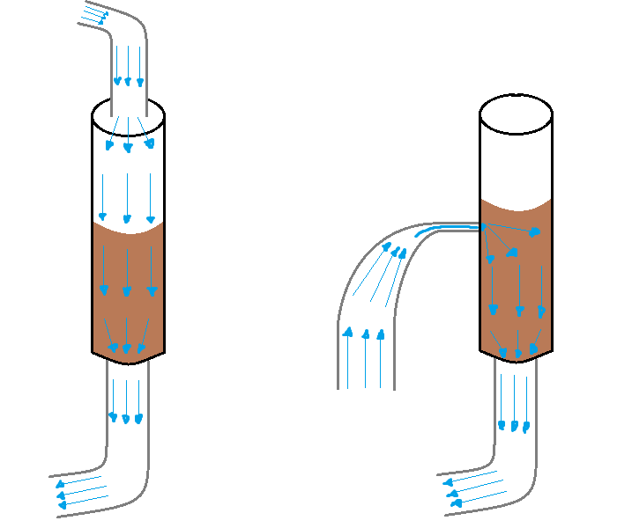
Initial Goals
Compare two different types of sand filtration
Surface Subsurface
Water Injection Water Injection

Slide 3
Experimental Variables
Independent variables
  Influent turbidity
  Influent velocity
  Coagulant dosage
Dependent variables
  Effluent turbidity
  Head loss

Slide 4
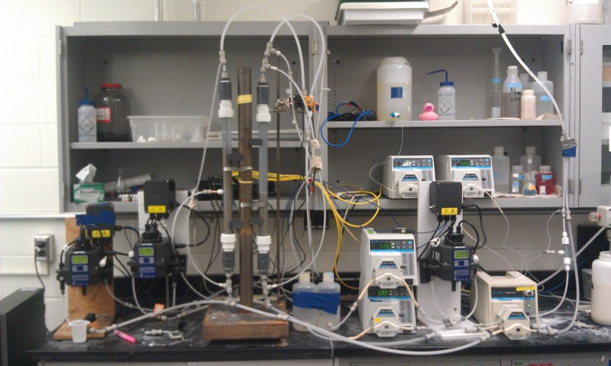
Experimental Apparatus

Slide 5
Changing Influent Turbidity
Independent variable
  Influent turbidity
    Test #1: 90 NTU
    Test #2: 400 NTU
Control variables
  Influent velocity
    2 mm/s
  Coagulant dosage
    5 mg/L

Slide 6
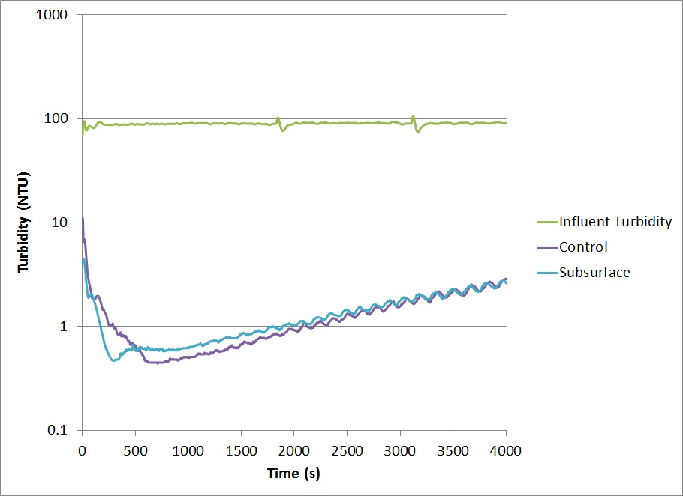
LOW INFLUENT TURBIDITY
Notes:
Test #1 (turbidity: 90 NTU)

Slide 7
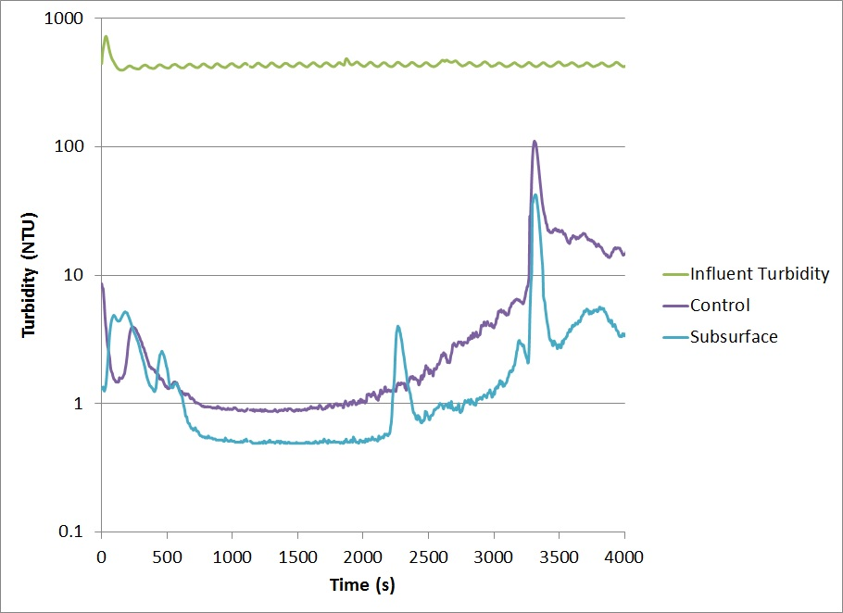
HIGH INFLUENT TURBIDITY
Notes:
Test #2 (turbidity: 400 NTU)

Slide 8
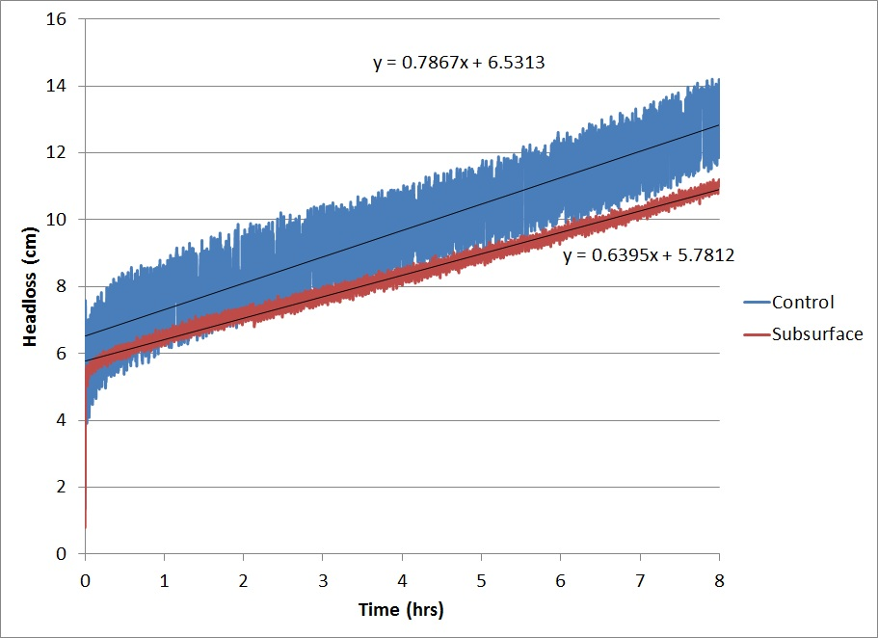
LOW INFLUENT TURBIDITY
Notes:
Test #1 (turbidity: 90 NTU)

Slide 9
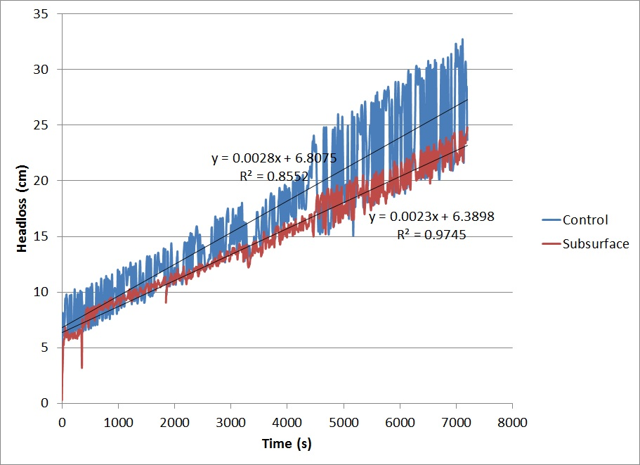
HIGH INFLUENT TURBIDITY
Notes:
Test #2 (turbidity: 400 NTU)

Slide 10
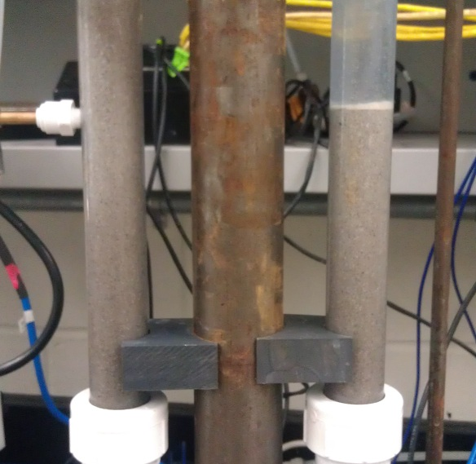

Slide 11
Analysis
Effects on effluent turbidity
    Both increased by a similar amount
Effects on head loss
  Rates in both columns increased by a similar amount
  Control still had faster rate

Slide 12
Changing Influent Velocity
Independent variable
  Influent velocity
    Test #1: 0.5 mm/s
    Test #2: 5 mm/s
Control variables
  Influent turbidity
    240-400 NTU
  Coagulant dosage
    5 mg/L

Slide 13
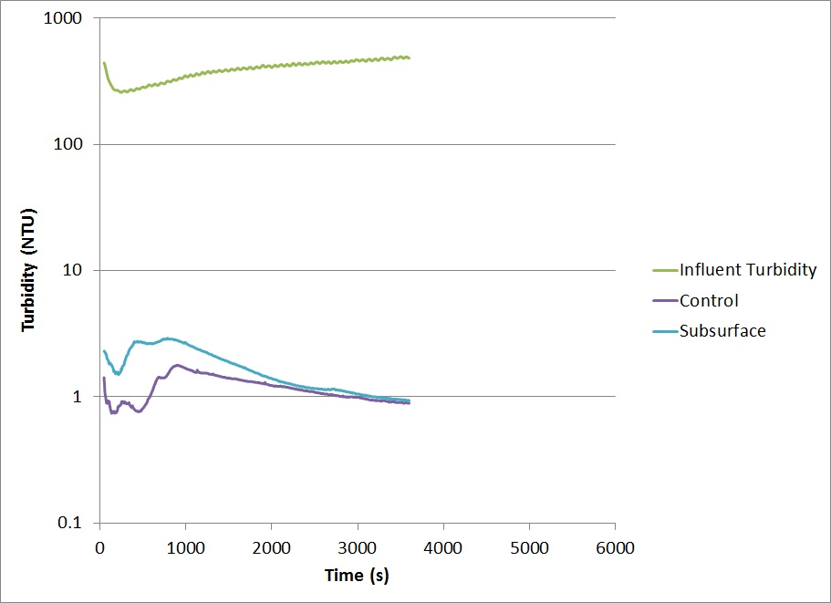
LOW INFLUENT VELOCITY
Notes:
Test #1 (velocity: 0.5 mm/s)

Slide 14
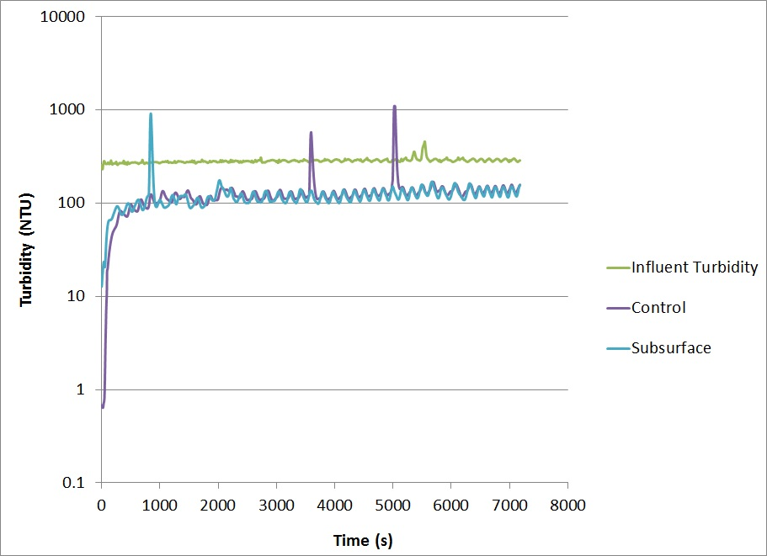
HIGH INFLUENT VELOCITY
Notes:
Test #2 (velocity: 5 mm/s)

Slide 15
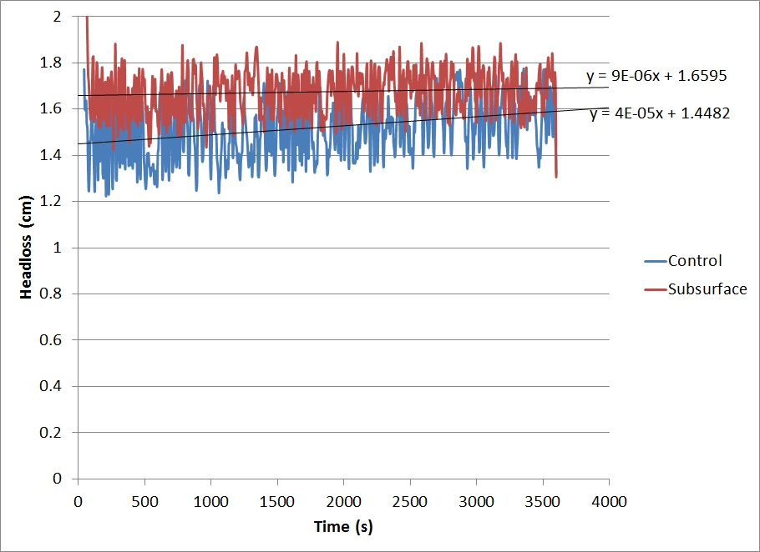
LOW INFLUENT VELOCITY
Notes:
Test #1 (velocity: 0.5 mm/s)

Slide 16
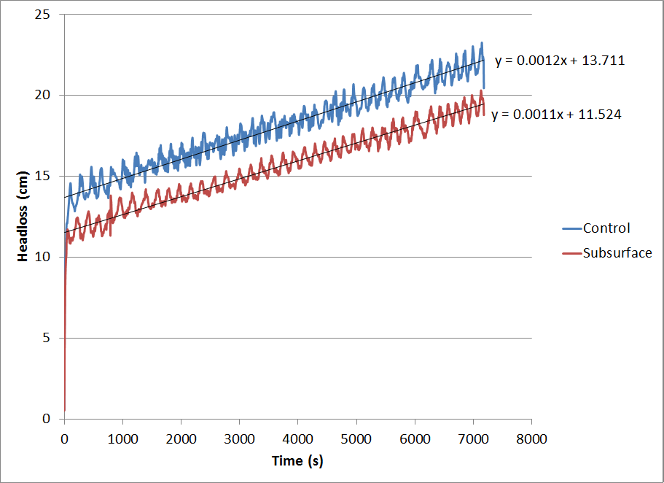
HIGH INFLUENT VELOCITY
Notes:
Test #2 (velocity: 5 mm/s)

Slide 17
Analysis
Effects on effluent turbidity
  Both increased by a similar amount
Effects on head loss
  Rates of both increased, but control increased by less
  Rates were equal

Slide 18
Changing Coagulant Dosage
Independent variable
  Coagulant dosage
    Test #1: 0.5 mg/L
    Test #2: 15 mg/L
Control variables
  Influent turbidity
    165-200 NTU
  Influent velocity
    2 mm/s

Slide 19
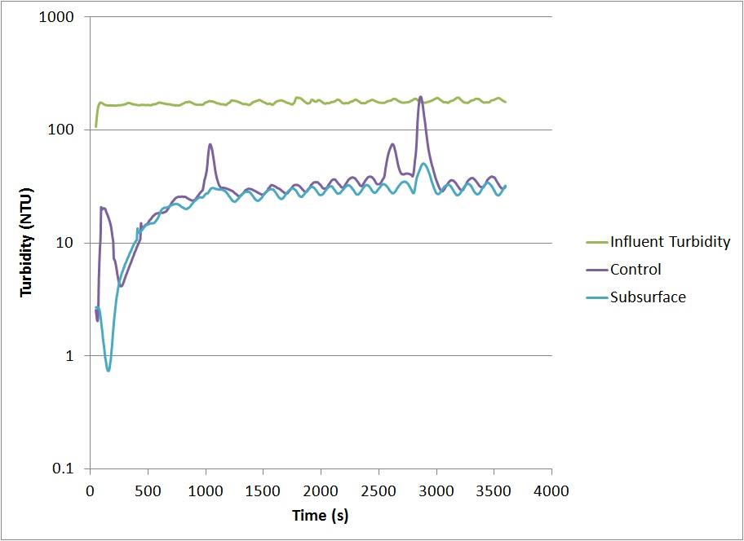
LOW COAGULANT DOSAGE
Notes:
Test #1 (coagulant: 0.5 mg/L)

Slide 20
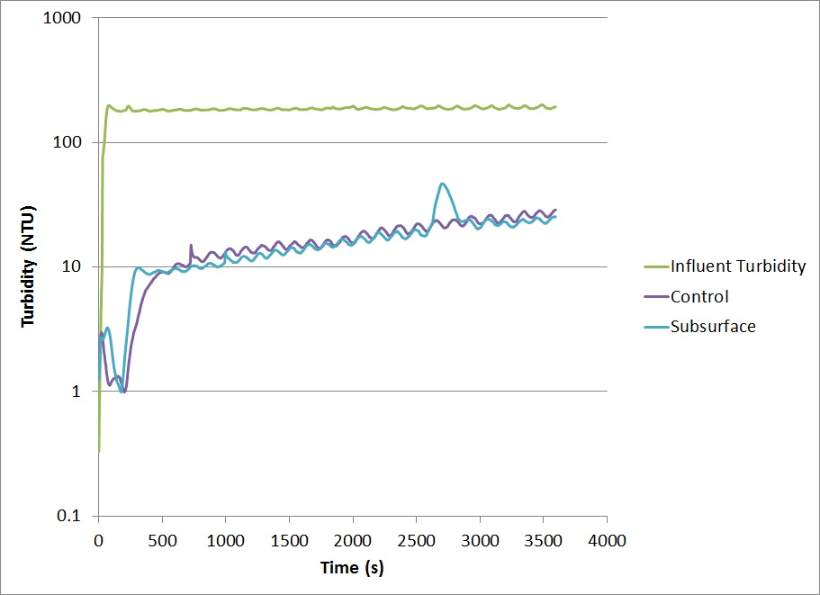
HIGH COAGULANT DOSAGE
Notes:
Test #2 (coagulant: 15 mg/L)

Slide 21
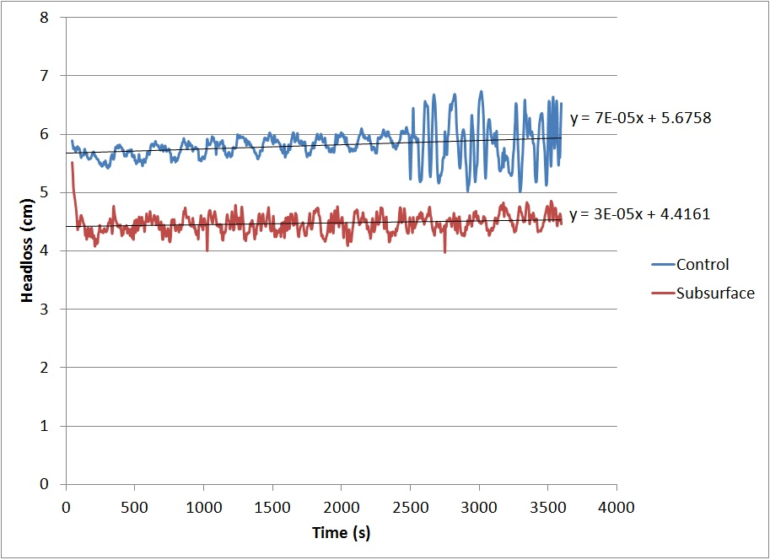
LOW COAGULANT DOSAGE
Notes:
Test #1 (coagulant: 0.5 mg/L)

Slide 22
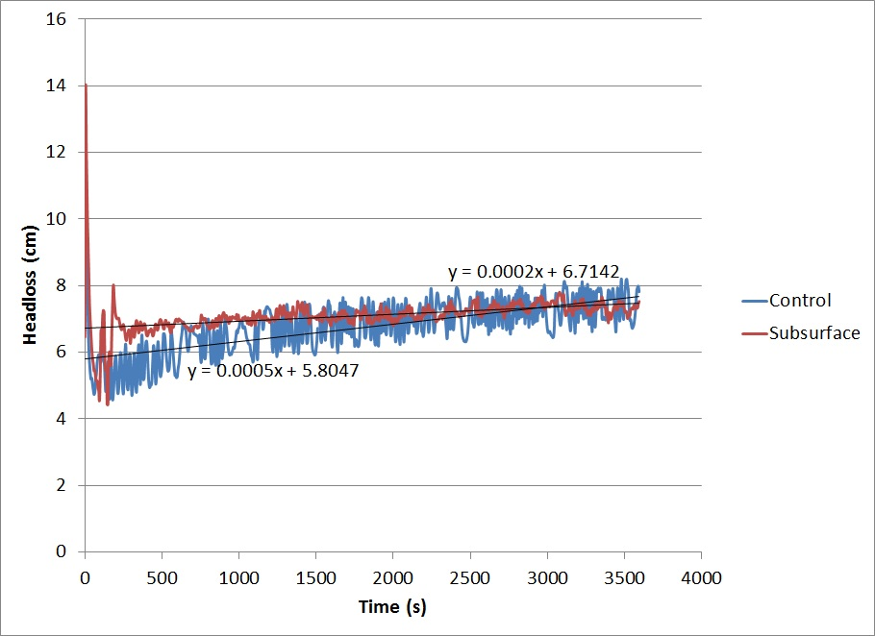
HIGH COAGULANT DOSAGE
Notes:
Test #2 (coagulant: 15 mg/L)

Slide 23
Analysis
Effects on effluent turbidity
  Both increased by a similar amount
Effects on head loss
  Rates of both increased by a similar amount
  Control still had faster rate

Slide 24
Conclusions
Particle-capture efficiency approximately equal for both filtration types
Rate of head loss build-up consistently greater for surface injection
  Exception: high flow rate → equal head loss rates
    Lower rate of head loss build-up in surface injection column when influent velocity was increased
    Likely because flocs break up

Slide 25
Conclusions
    Consistent accumulation of large flocs at surface of surface injection column, especially at low influent velocity → need more frequent backwashing / surface washing
    Never any floc accumulation around subsurface inlet pipe → need less frequent backwashing and no surface washing
    Can conclude that high velocity → low level of floc build-up
    Subsurface therefore better because it always sends water into sand bed with high velocity no matter the set influent velocity, due to tiny inlet pipe/slot

Slide 26
Future Goals
Determine subsurface failure point (where inlet pipe clogs)
Further explore effect of high influent velocity on surface head loss
Improve design/experiments to better mimic AguaClara plant

