Slide 1
Stacked Rapid Sand (StaRS) Filter Theory
Theresa Chu
Nick Coyle
Alex Schwab

Slide 2

Stacked Rapid Sand Filters
Stacked Rapid Sand (StaRS) Filter/Filtration
Invented by AguaClara and used in newer plants
Water enters the filter through slotted pipes
Sand captures colloids
Allows for entirely gravity-powered water filtration

Slide 3
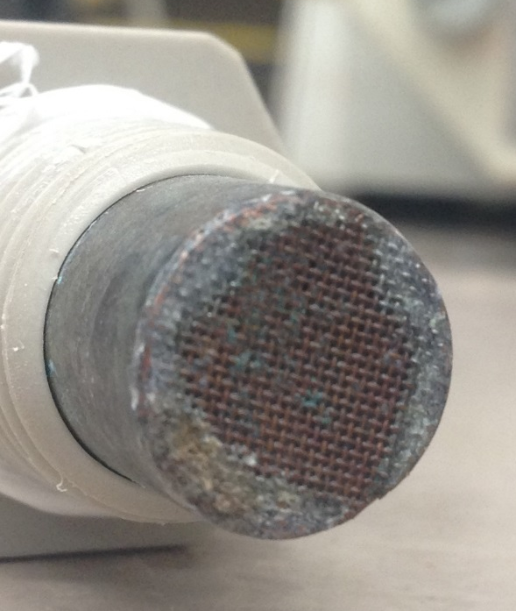
Purpose
StaRS Filter Theory
  Mathematical model
Fall 2014
  Head loss across copper mesh
  Results are inconsistent
Spring 2015
  Head loss across slotted pipes

Slide 4
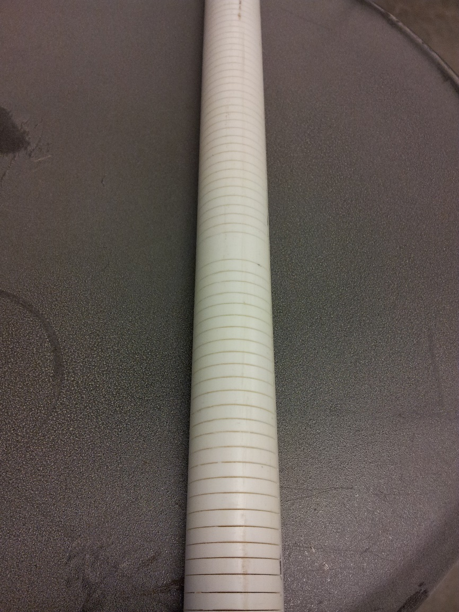
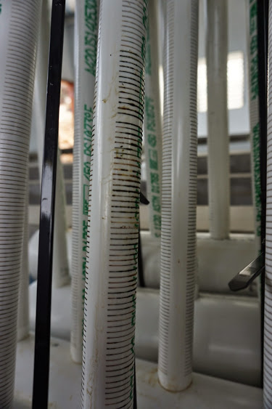
Slotted Pipes
0.2 mm wide
Clogging
  Flocs clog openings
  Sand caught in slots
  Biological growth
Expensive to fabricate

Slide 5
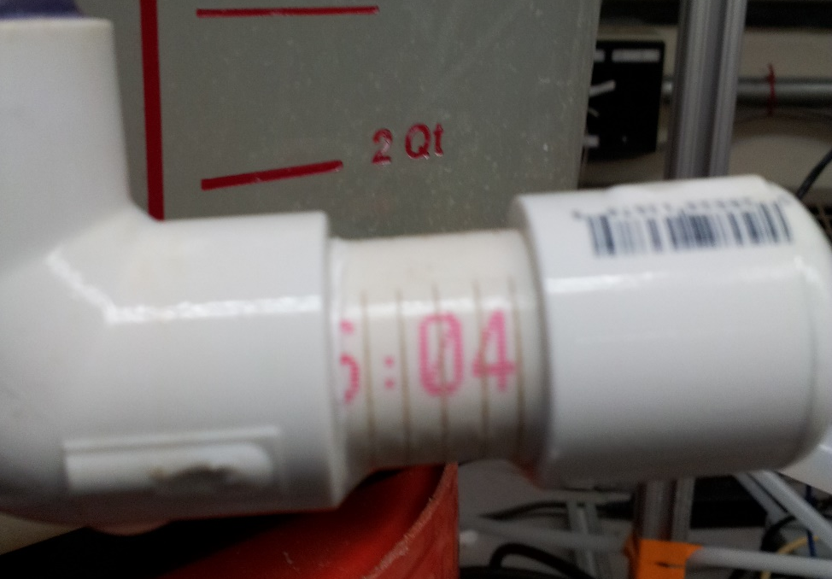
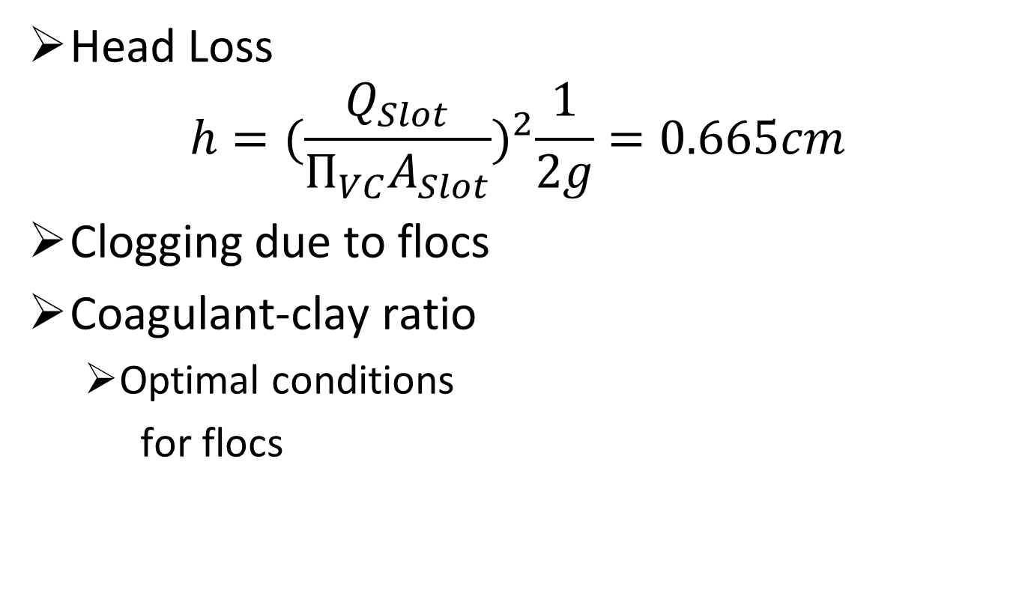
Hypothesis
Head Loss
$$h={(\frac{Q_{Slot}}{П_{VC}A_{Slot}})}^{2}\frac{1}{2g}=0.665cm$$
Clogging due to flocs
Coagulant-clay ratio
  Optimal conditions
  for flocs

Slide 6
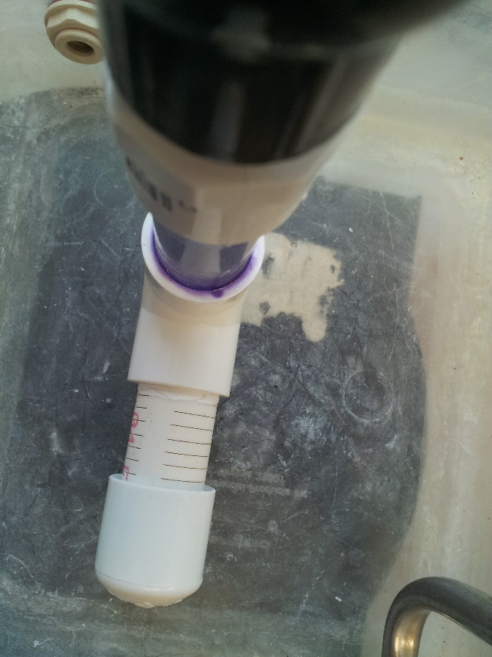
Failure Points and Clogging
Head loss
  StaRS Filters: 50 cm allotted
  Slotted Pipes: 5 cm
Clogging
  Total clogging of pipe not likely
  Shear force of water

Slide 7
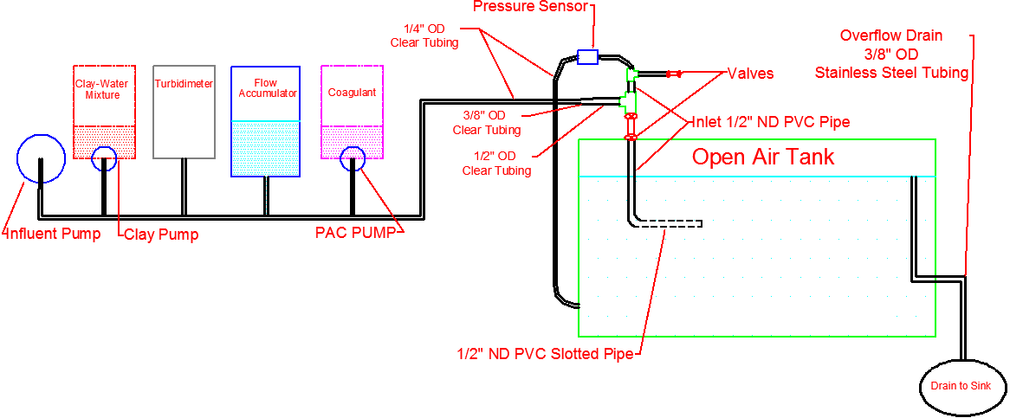
Methods
Experimental Apparatus
PACl Clogging Rapid Mix Pipe

Slide 8
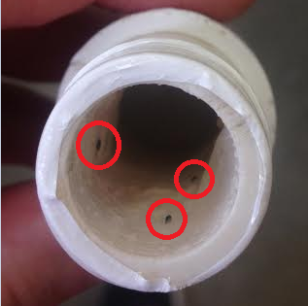
Methods
Biological Growth
Pre-Experiment Cleaning
Rapid Mix Pipe Clogging
Six roller peristaltic pump

Slide 9
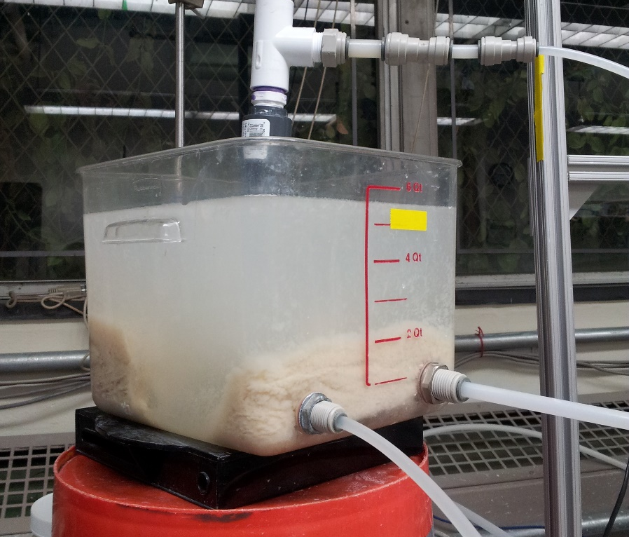
Experiments
Influent Turbidity
  <5 or 500 NTU
PACl
  10.6, 26.5, 60.8 mg/L Al
Runtime: 6 hours
Apparatus Design:
  Filter flow rate: 0.8 L/s
  Flow through slot: 1.1 mL/s
  Flow through apparatus: 6 mL/s

Slide 10
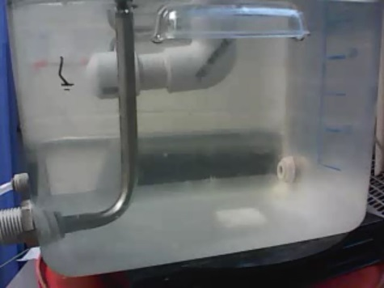
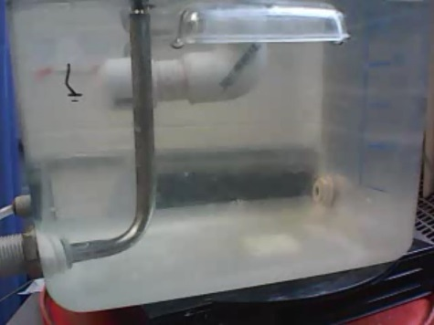
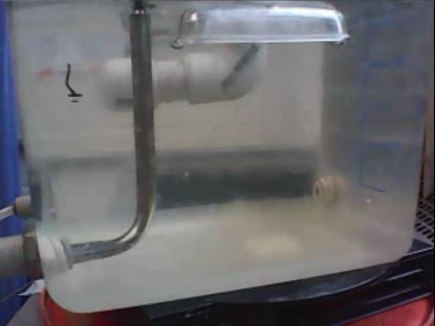
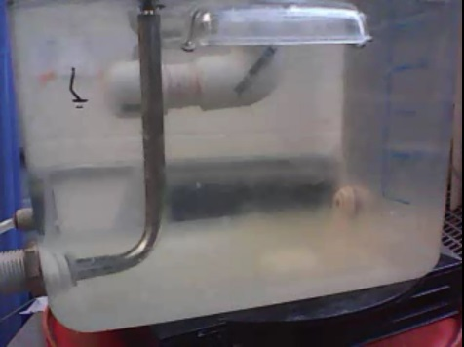
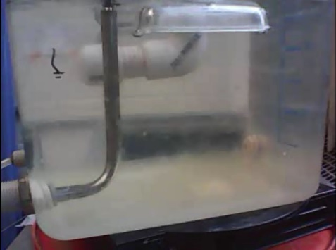
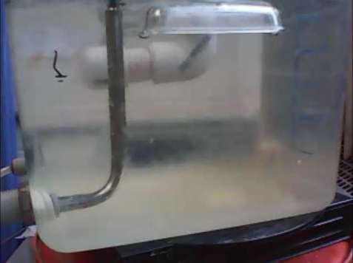

PACl Only
0 hours
1 hour
2 hours
3 hours
4 hours
5 hours
6 hours

Slide 11
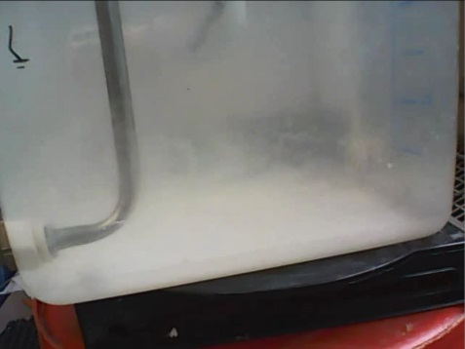

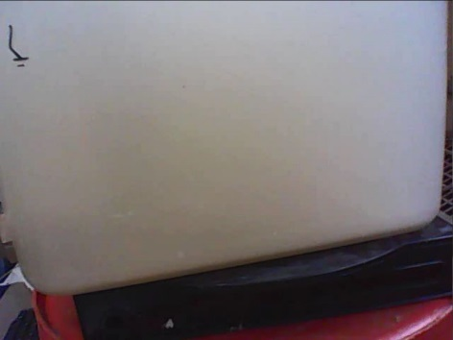
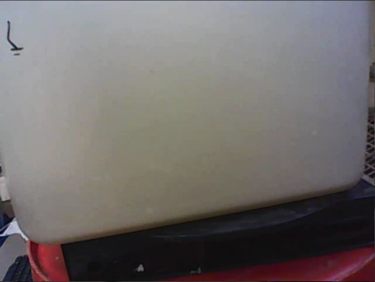


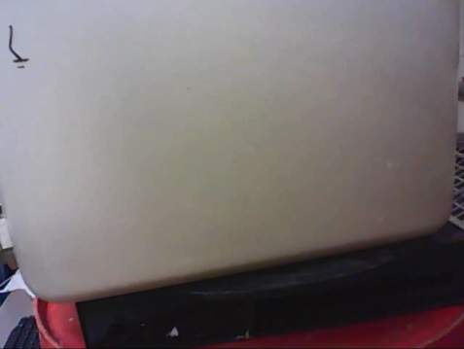
Clay Only
0 hours
1 hour
2 hours
3 hours
4 hours
5 hours
6 hours

Slide 12
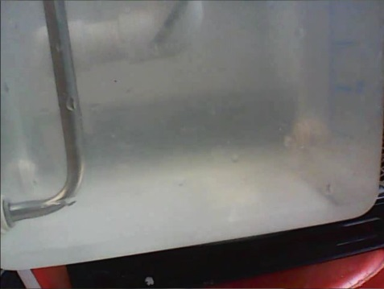


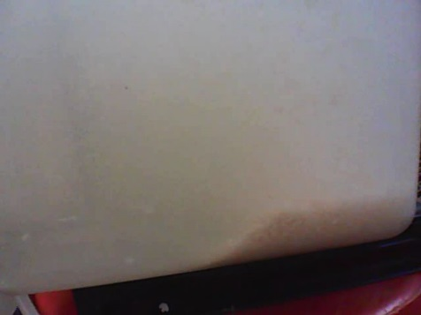


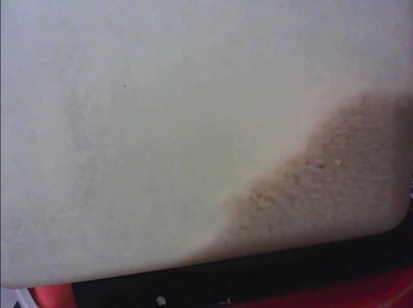
PACl and Clay
0 hours
1 hour
2 hours
3 hours
4 hours
5 hours
6 hours

Slide 13
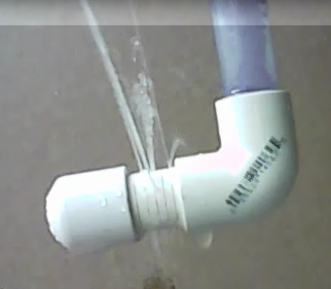
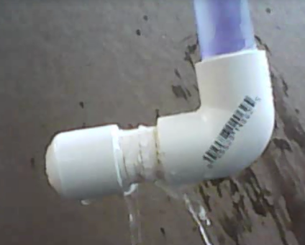
Observations
Clogged: Clay and PACl
Clean

Slide 14
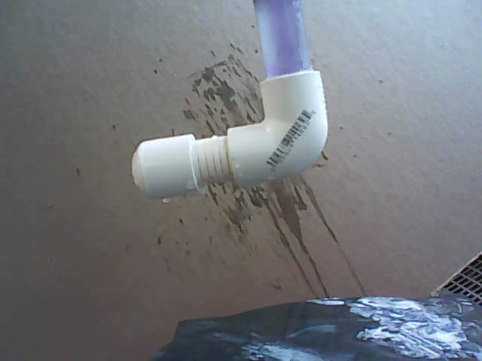
Observations: Unclogged

Slide 15
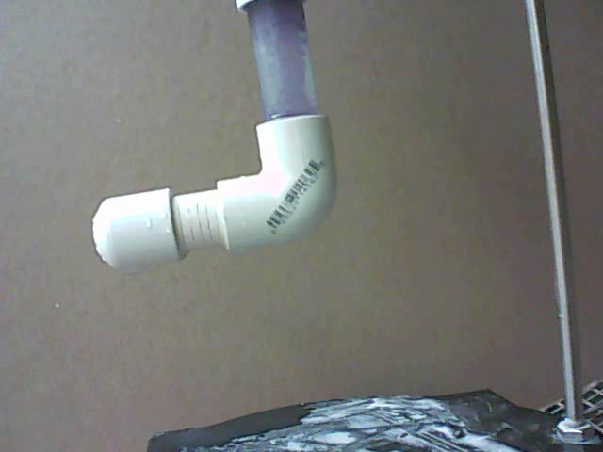
Observations - Clogged

Slide 16
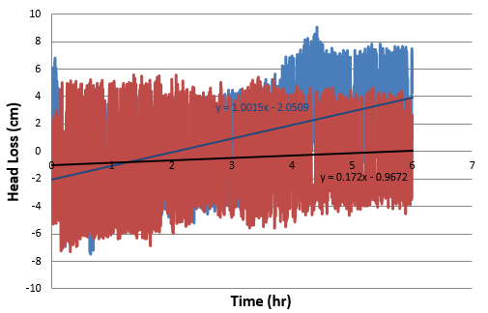
Clay Only
Influent Turbidity: 500 NTU

Slide 17
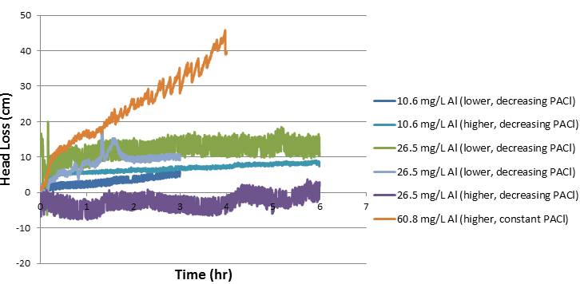
PACl Only

Slide 18
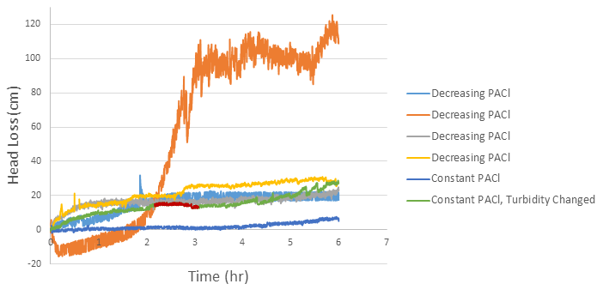
PACl and Clay
PACl: 26.5 mg/L Al
Influent Turbidity: 500 NTU

Slide 19
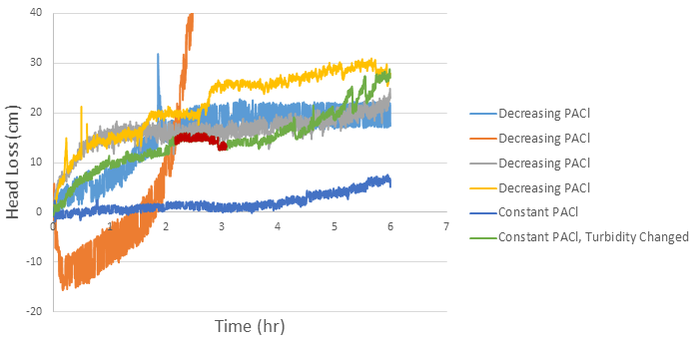
PACl and Clay
PACl: 26.5 mg/L Al
Influent Turbidity: 500 NTU

Slide 20
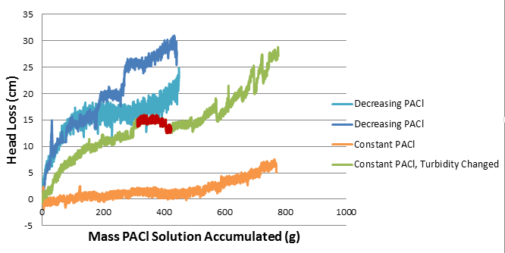
PACl and Clay
PACl: 26.5 mg/L Al
Influent Turbidity: 500 NTU

Slide 21
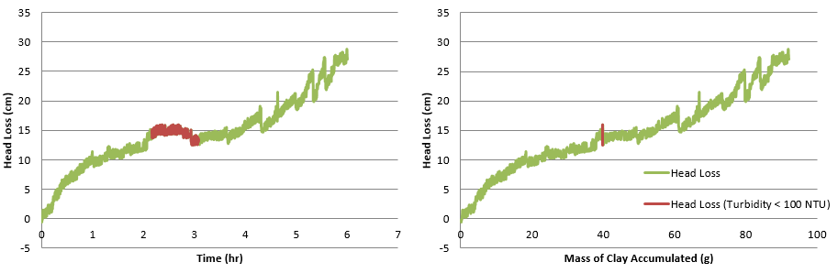
PACl and Clay
PACl: 26.5 mg/L Al
Influent Turbidity: 500 NTU
Need flocs to cause head loss

Slide 22
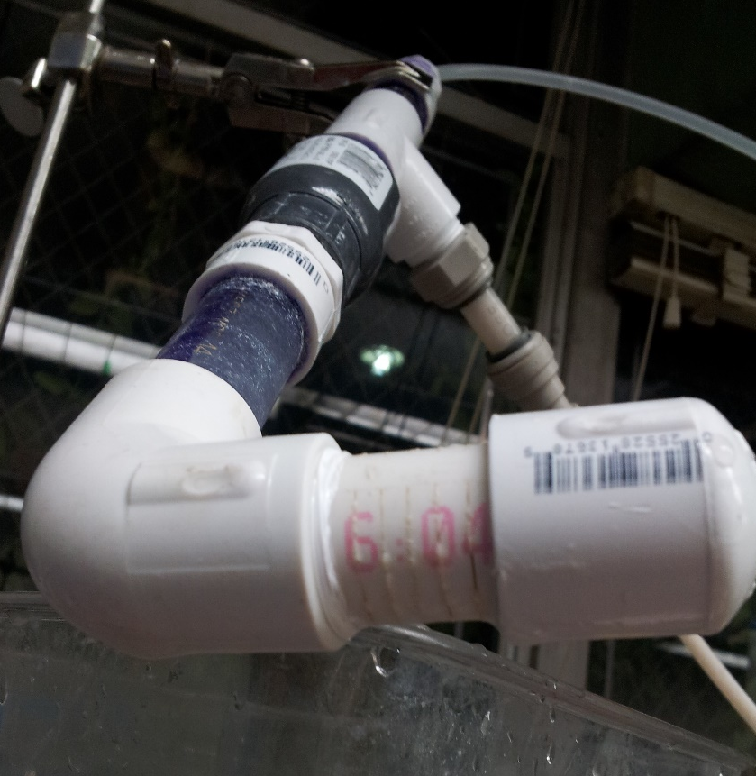
Conclusions
Slotted pipes clog
  Presence of flocs (clay and PACl ratio)
  Amount of coagulant dosage
Head loss
  High PACl dosage (15 cm)
  High PACl dosage and influent turbidity (30 cm)
Replace slotted pipes

Slide 23
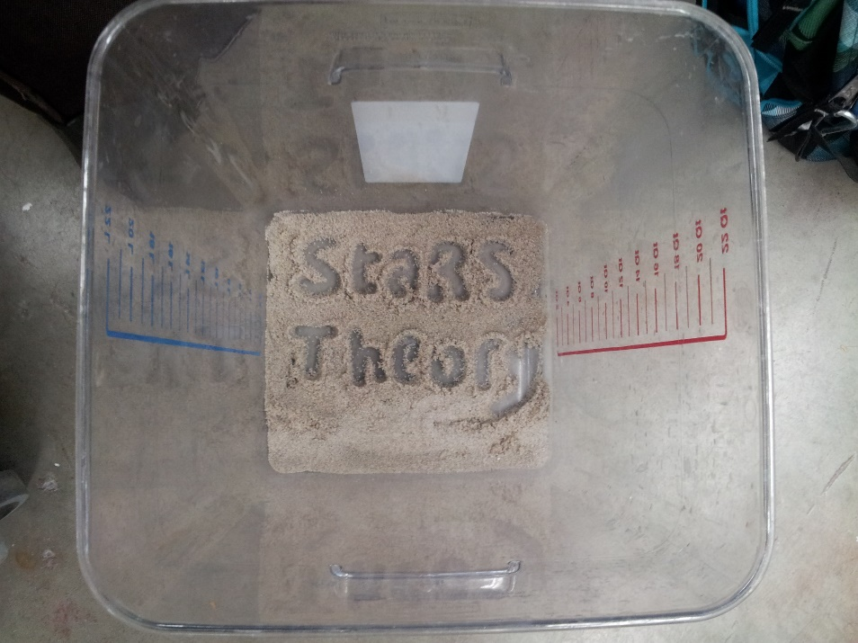
Future Work
Better characterize clogging conditions with consistent PACl dosage
  PACl only
  PACl and Clay only
Design new injection system for StaRS Filters
Create mathematical model of colloid capture in sand

Slide 24

Questions?

