Slide 1
Stacked Rapid Sand (StaRS) Filter Theory
Theresa Chu
Nick Coyle
Alex Schwab

Slide 2

Stacked Rapid Sand Filters
Stacked Rapid Sand (StaRS) Filter/Filtration
Invented by AguaClara and used in newer plants
Water enters the filter through slotted pipes
Sand captures colloids
Allows for entirely gravity-powered water filtration

Slide 3
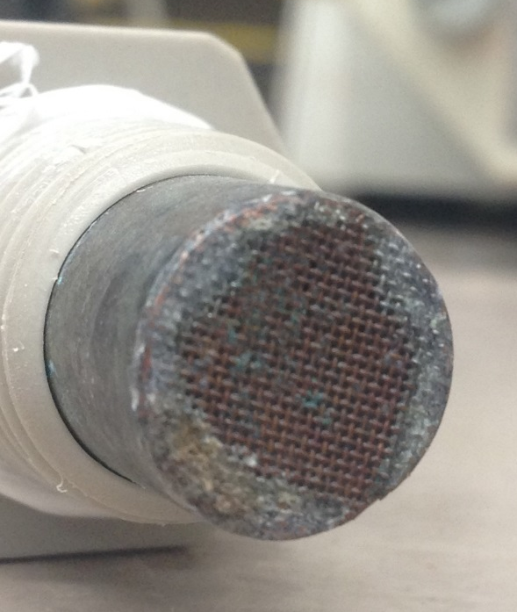
Purpose
StaRS Filter Theory
  Mathematical model
Fall 2014
  Head loss across copper mesh
  Results are inconsistent
Spring 2015
  Head loss across slotted pipes

Slide 4
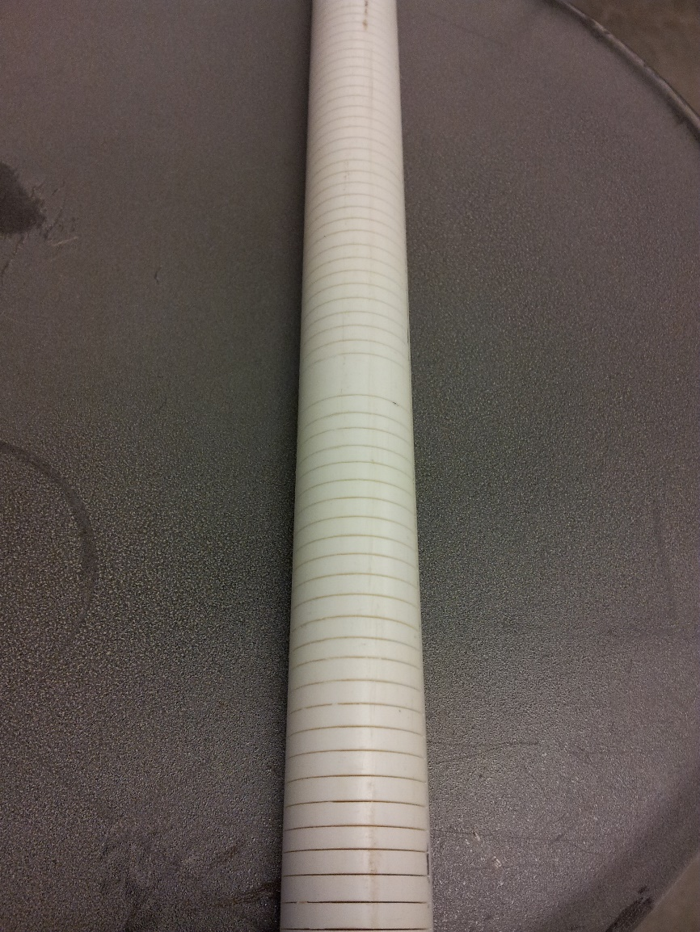
Slotted Pipes
0.2 mm wide
Clogging
  Flocs clog openings
  Sand caught in slots
Expensive to fabricate

Slide 5
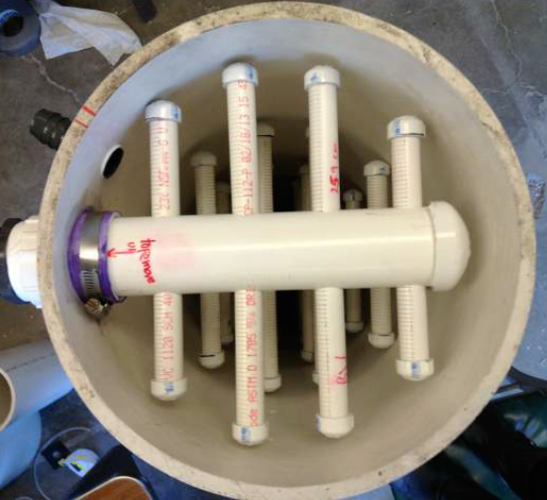
Experimental Conditions
Influent Turbidity: 500 NTU
PACl: 20 mg/L
Runtime: 30 minutes
Apparatus Design:
  Model EStaRS filter
  Filter flow rate: 0.8 L/s
  Flow per length of slotted pipe: 0.36 L/(m*s)
  Flow through slot: 1.1 mL/s
  Flow through apparatus: 6 mL/s

Slide 6
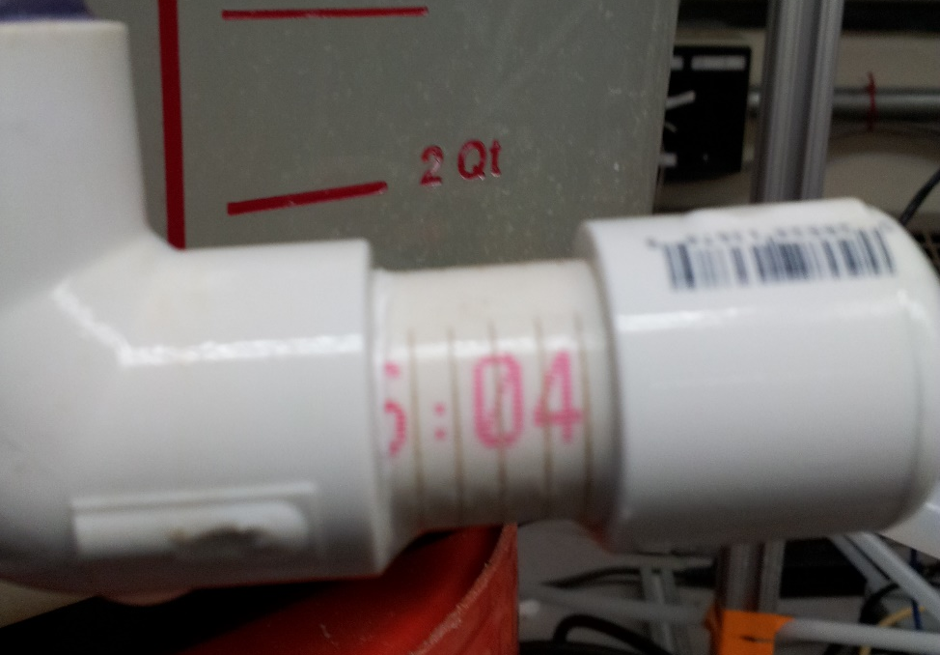
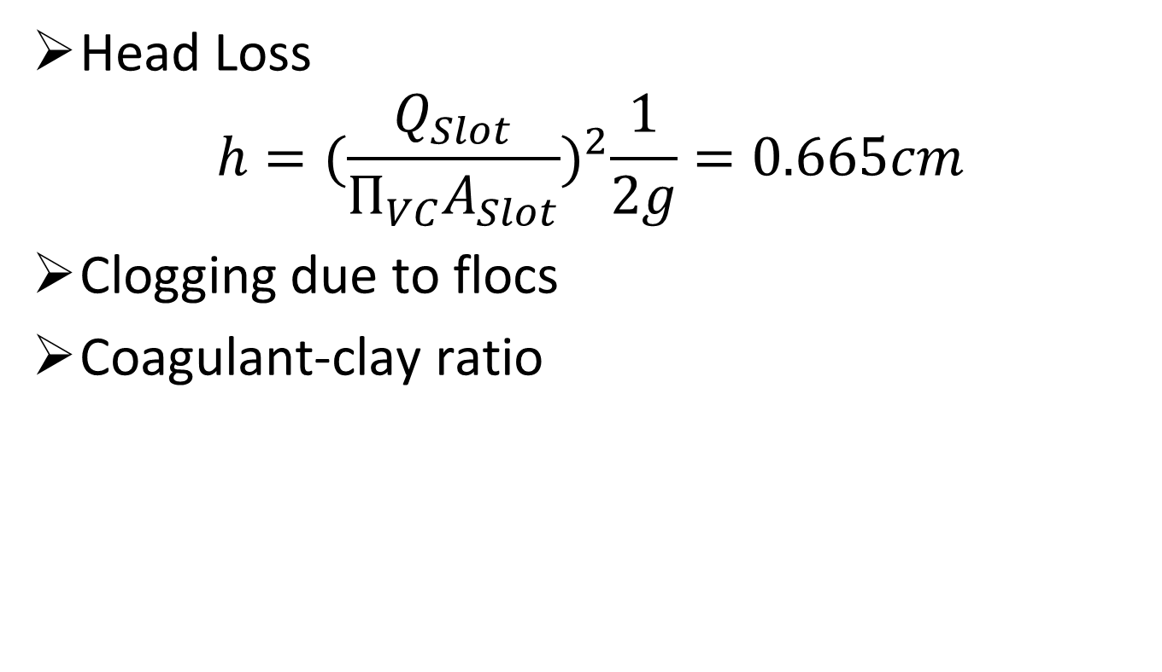
Hypothesis
Head Loss
$$h={(\frac{Q_{Slot}}{П_{VC}A_{Slot}})}^{2}\frac{1}{2g}=0.665cm$$
Clogging due to flocs
Coagulant-clay ratio

Slide 7
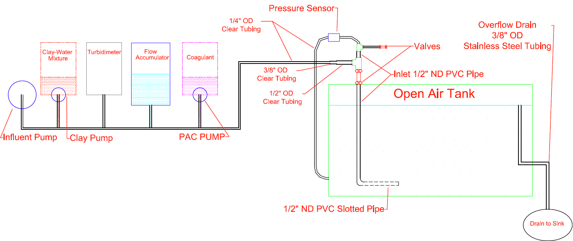
Experimental Apparatus

Slide 8
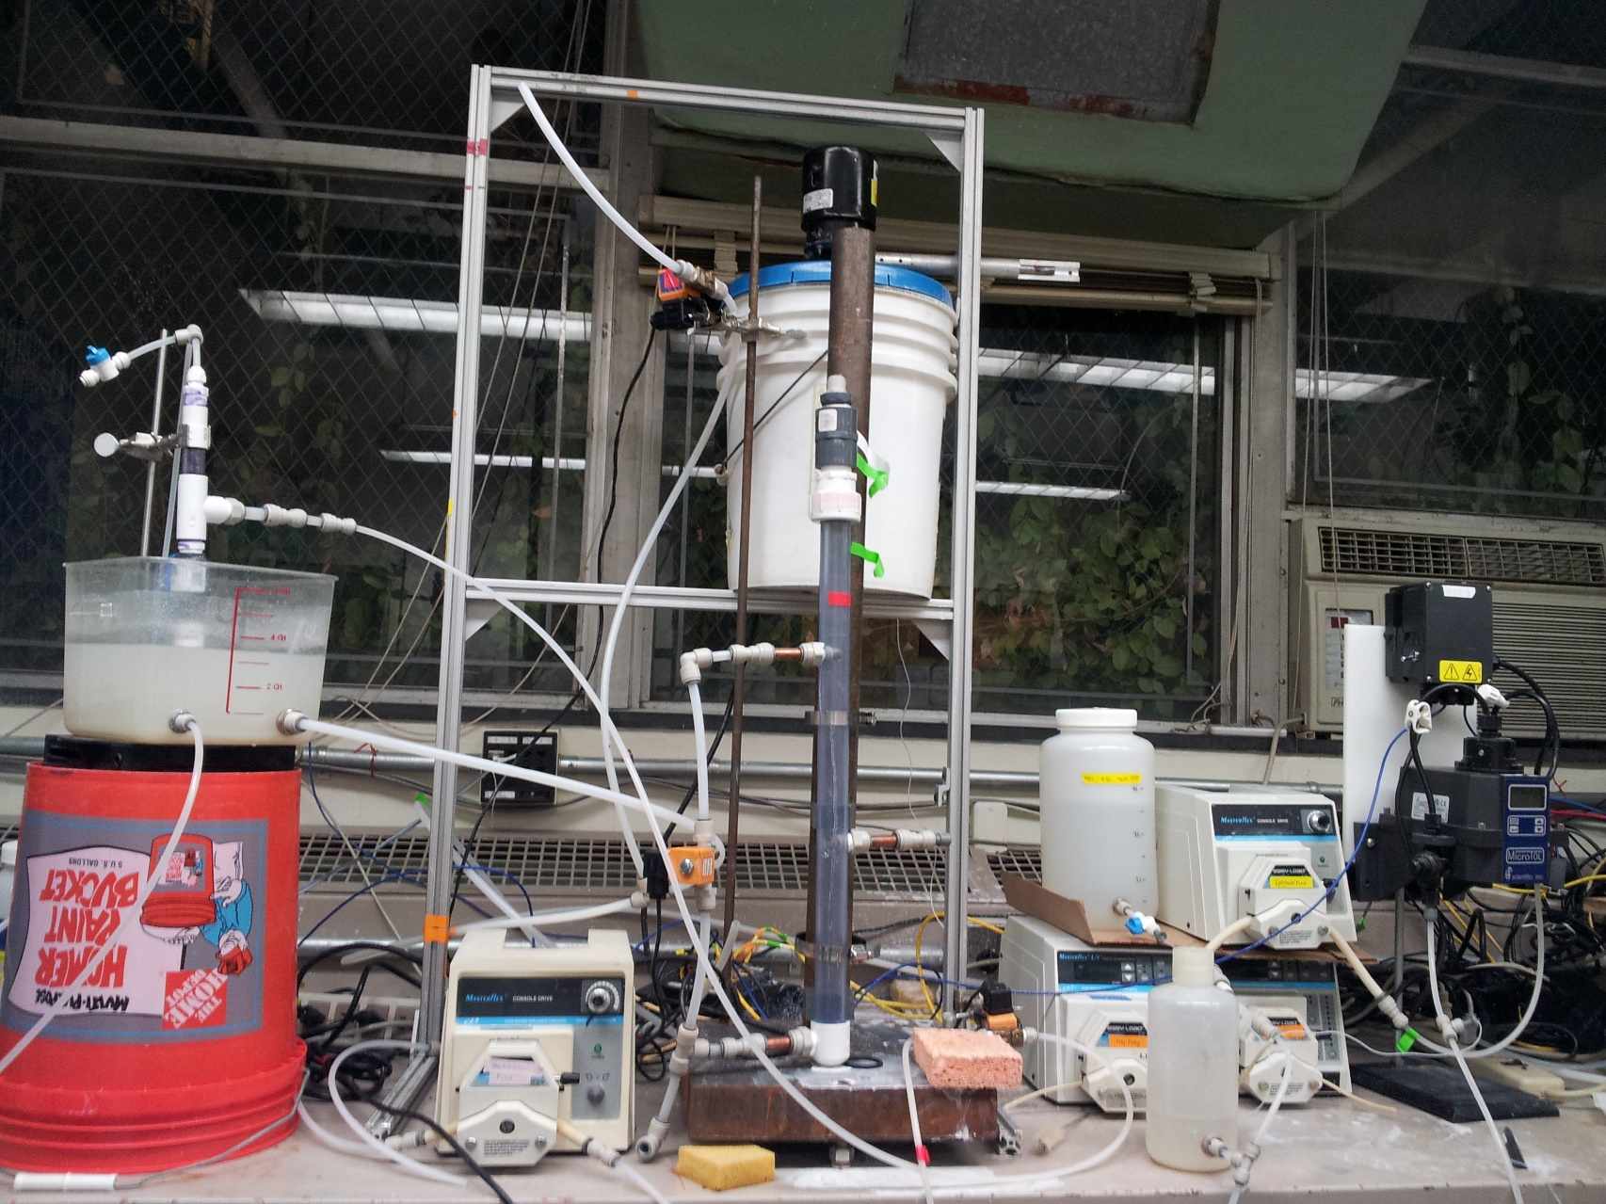
Experimental Apparatus

Slide 9
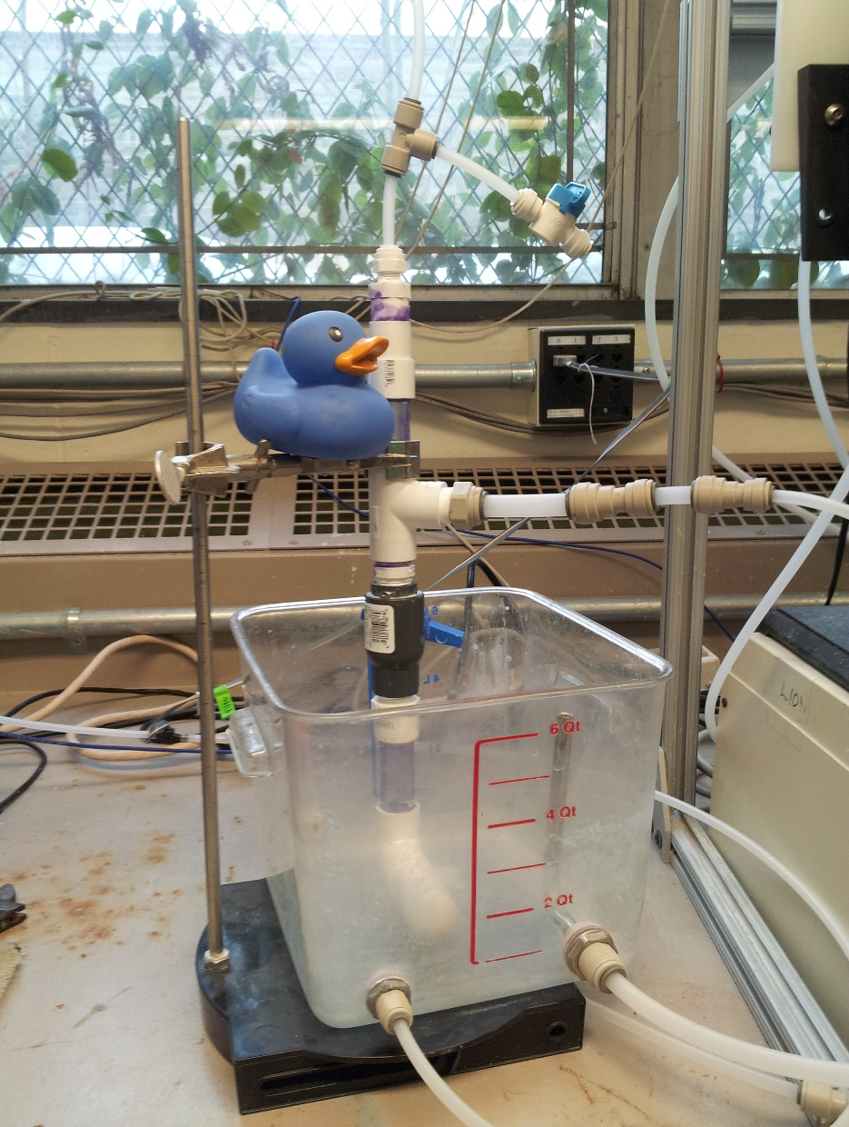
Experimental Apparatus
  Tank/Slotted Pipe Portion

Slide 10
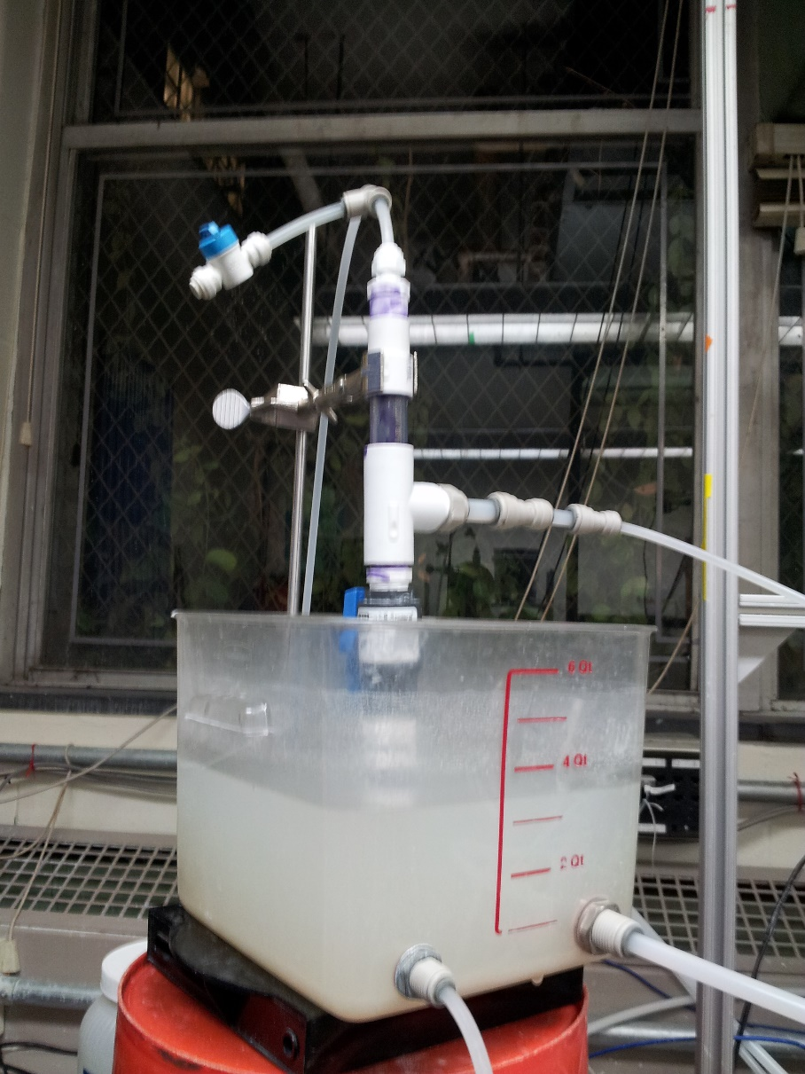
Current Results
Functional apparatus
Pipe has not yet clogged
Equipment complications

Slide 11
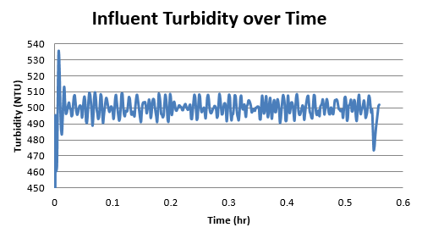
Influent Turbidity

Slide 12
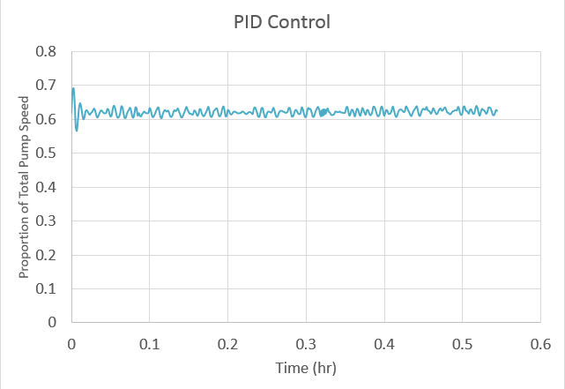
PID Control

Slide 13
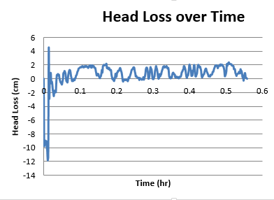
Head Loss

Slide 14
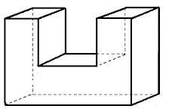
Future Work
Test slotted pipe apparatus
  500 NTU
  20 mg/L PACl
If clogging occurs:
  More reasonable conditions
  Replacement?
http://www.analyzemath.com/Geometry/3D_shapes_problems.html

Slide 15
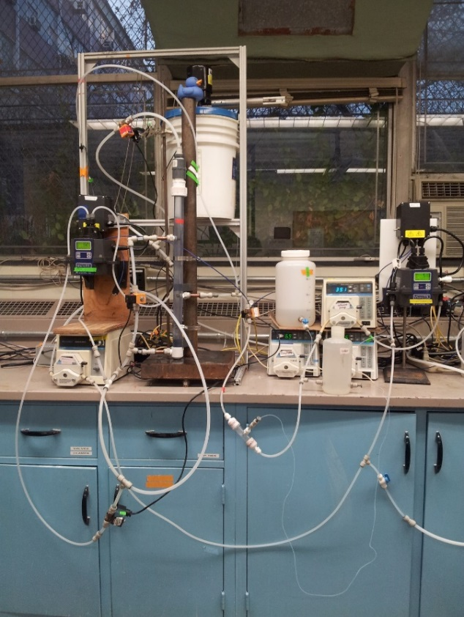
Future Work
Describe sand column performance
Filter vs. Flocculator?
Mathematical Model

Slide 16
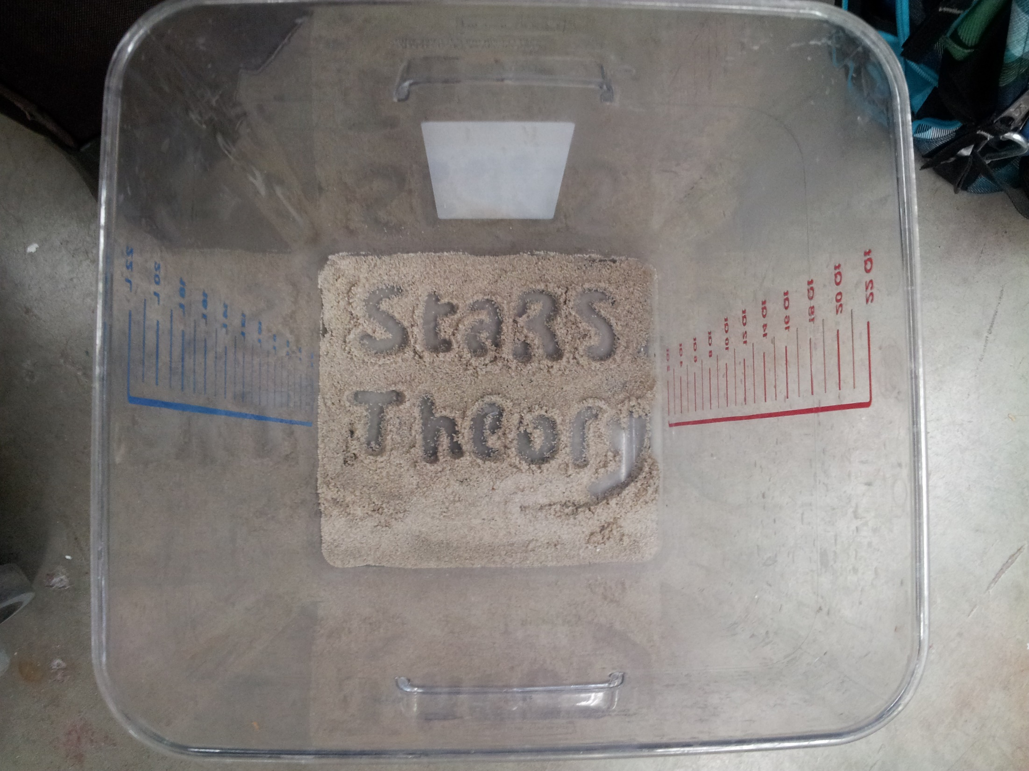
Questions?

