Slide 1
Stacked Rapid Sand (StaRS) Filter Theory
Theresa Chu
Alexandra Schwab
Guillermo Garcia

Slide 2

Stacked Rapid Sand Filters
Stacked Rapid Sand (StaRS) Filter/Filtration
AguaClara invention
Water enters the filter through slotted pipes
Sand captures colloids
Entirely gravity-powered water filtration

Slide 3
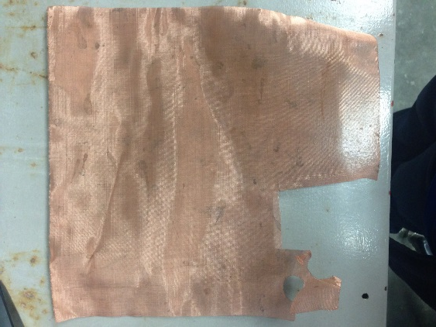
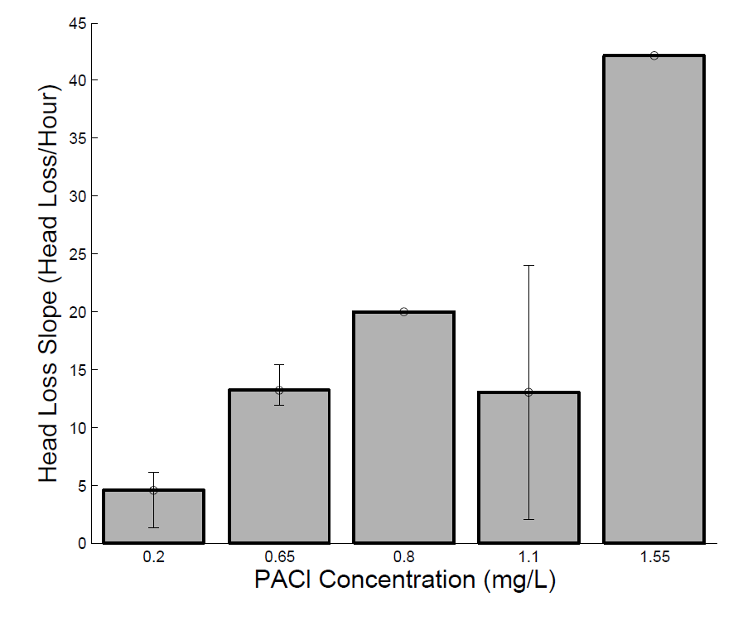
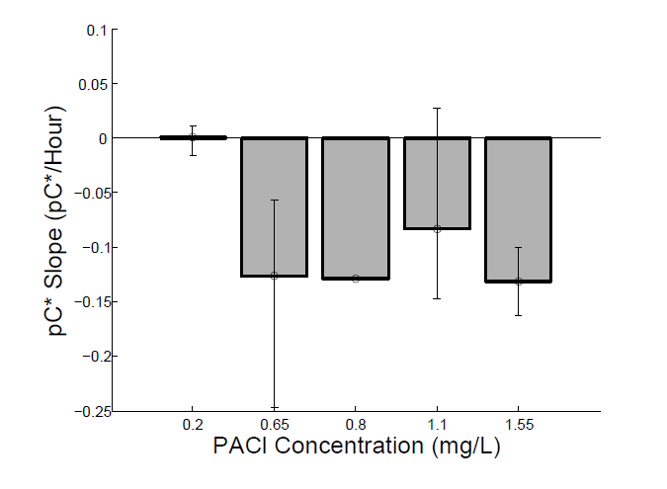
Purpose
Confirm data from Spring 2014
  Very variable
Test head loss across mesh

Slide 4
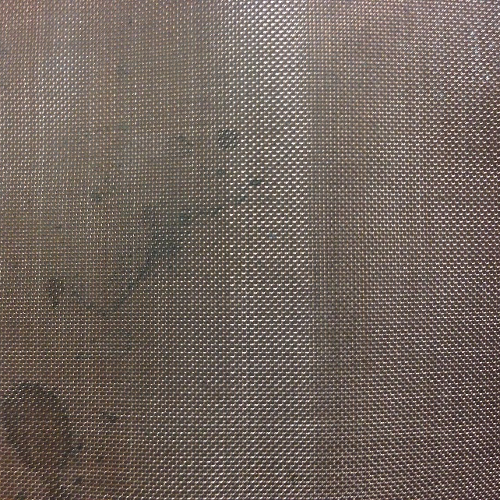
Slotted Pipes
Is there head loss across the copper mesh?
  Openings: 0.23 mm
Slotted pipes
  Openings: 0.2 mm
  Clogging
Hypothesis:
Head loss across copper mesh
Head loss across slotted pipes
͠

Slide 5
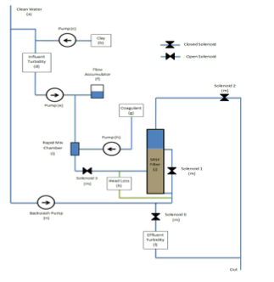
Experimental Apparatus

Slide 6
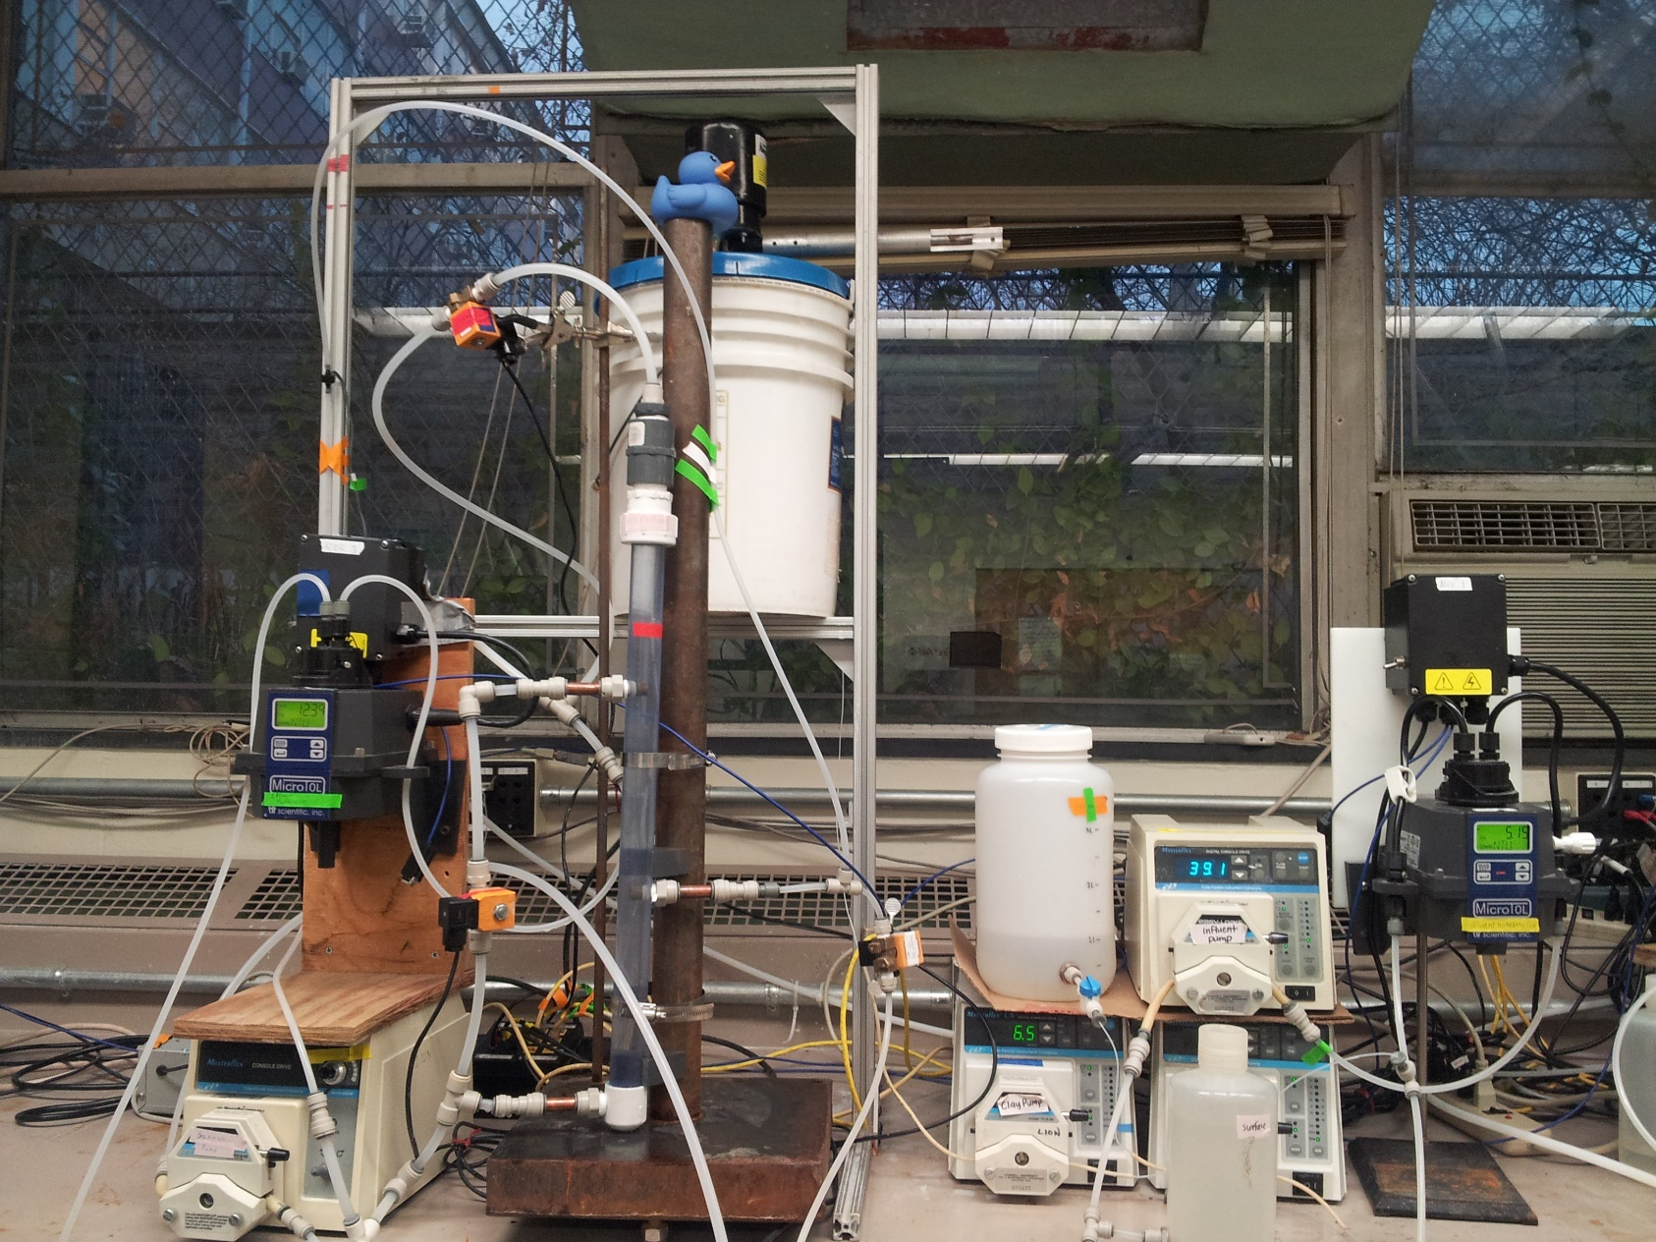
Experimental Apparatus

Slide 7
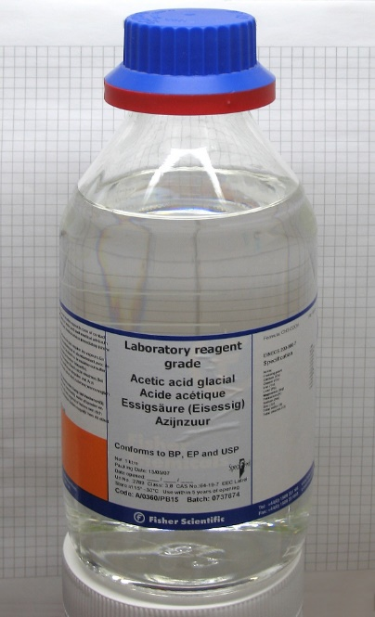
Methods
Conditions:
  Influent Turbidity: 5 NTU
  PACl dosages: 0.2 mg/L; 1.1 mg/L; 2.0 mg/L
  Run time: 12 hours
  Sieve sand between No. 30 and 40 (Factor: 1.5)
Cleaning copper tubing/mesh:
  Physical: scrub mesh
  Chemical: soak in acetic acid

Slide 8
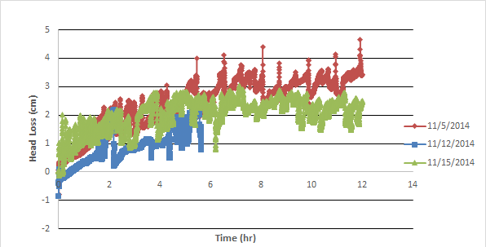
Mesh Only Head Loss
PACl dosage: 2.0 mg/L
Influent Turbidity: variable

Slide 9
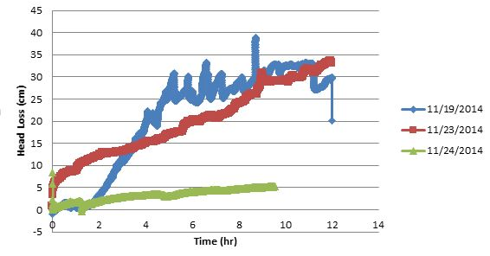
Mesh Only Head Loss
PACl dosage: 2.0mg/L
Influent Turbidity: 5 NTU

Slide 10
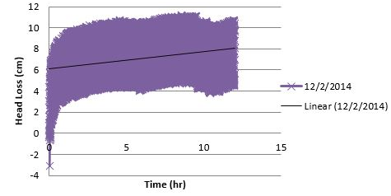
Mesh Only Head Loss
PACl dosage: 1.1 mg/L
Influent Turbidity: 5 NTU

Slide 11
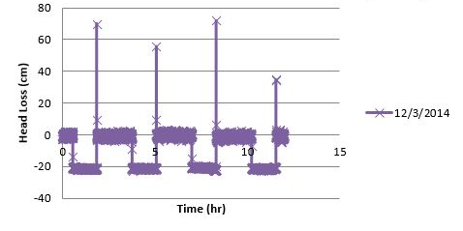
Mesh Only Head Loss
PACl dosage: 0.2 mg/L
Influent Turbidity: 5 NTU

Slide 12
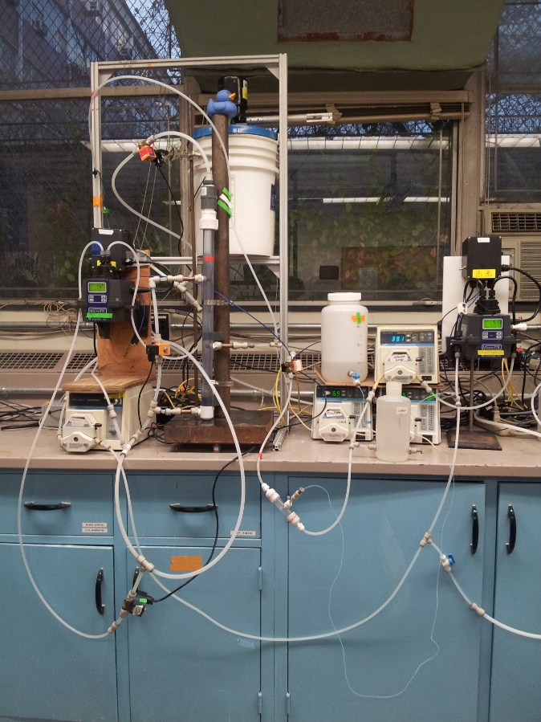
Conclusions
Best performance expected: sand sieved
Head loss increases with coagulant dosage
Head loss on the mesh
  Negligible ( h_{L} < 5 cm)
  Significant (h_{L} > 30 cm)
Slotted pipe/Mesh alternative
Notes:
Mesh head loss ratio: over 1/50

Slide 13
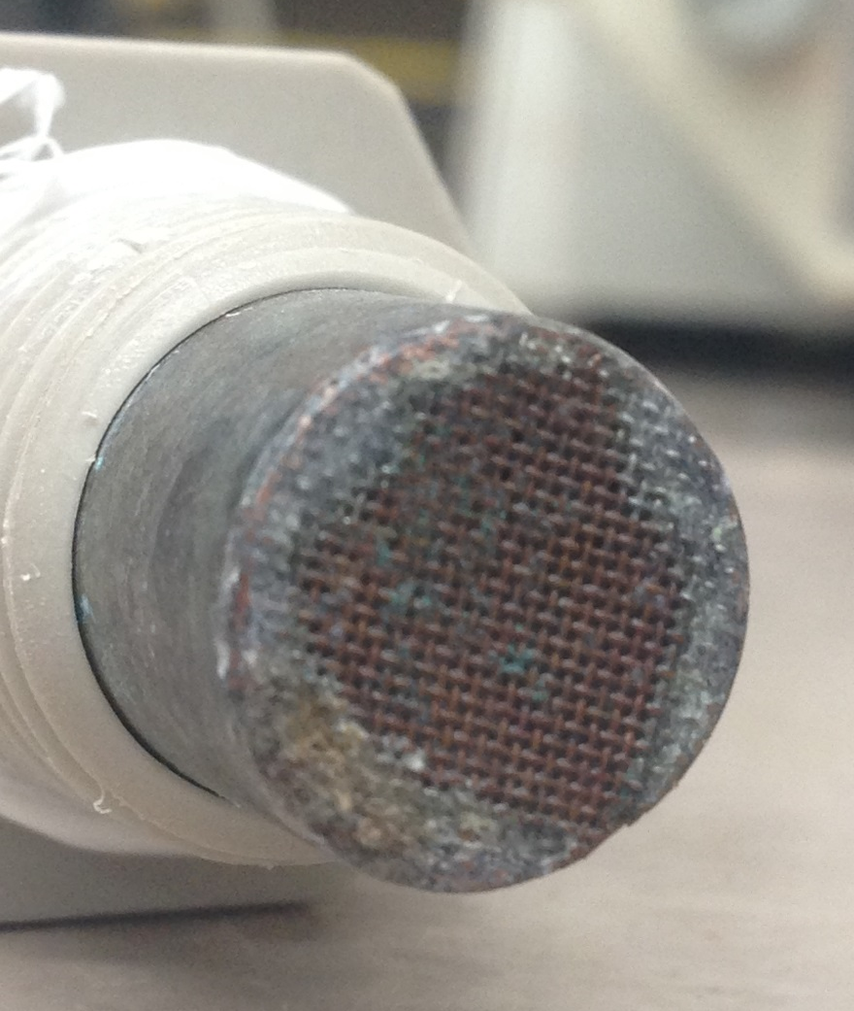
Future Work
Alternative to copper mesh
Larger openings
  Mesh: 0.23 mm
  Sand: 0.400 mm to
  0.595 mm
Non-corrosive metal

Slide 14
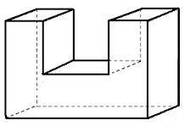
Future Work
Alternative to slotted pipes
  Reduce clogging, head loss
U-design
  Sand does not revert backwards
http://www.analyzemath.com/Geometry/3D_shapes_problems.html

Slide 15
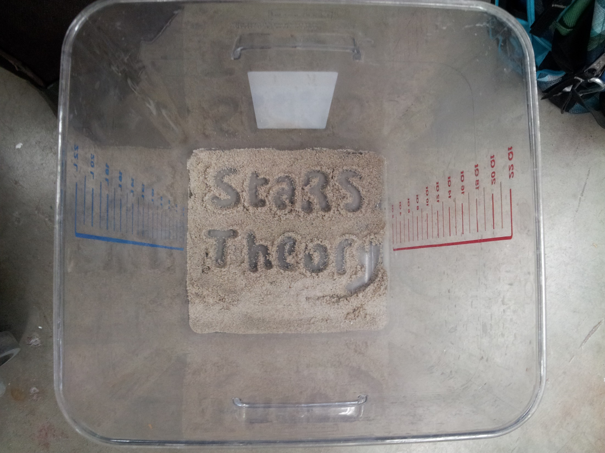
Questions?

