Slide 1
Stacked Rapid Sand (StaRS) Filter Theory
Theresa Chu
Guillermo Garcia
Alex Schwab

Slide 2
Overview
Background
Purpose
Theory
Hypotheses
Previous Data
Experimental Apparatus
Future Modifications
Future Work

Slide 3

Stacked Rapid Sand Filters
Stacked Rapid Sand (StaRS) Filter/Filtration
Invented by AguaClara and used in newer plants
Water enters the filter through slotted pipes
Sand captures colloids
Allows for entirely gravity-powered water filtration

Slide 4
Purpose
Filter performance
  When will the filter clog?
    Effluent Turbidity
    Head Loss
  Search for a mathematical model
  Given:
    Flow rate
    PACl dosage
    Average influent turbidity

Slide 5
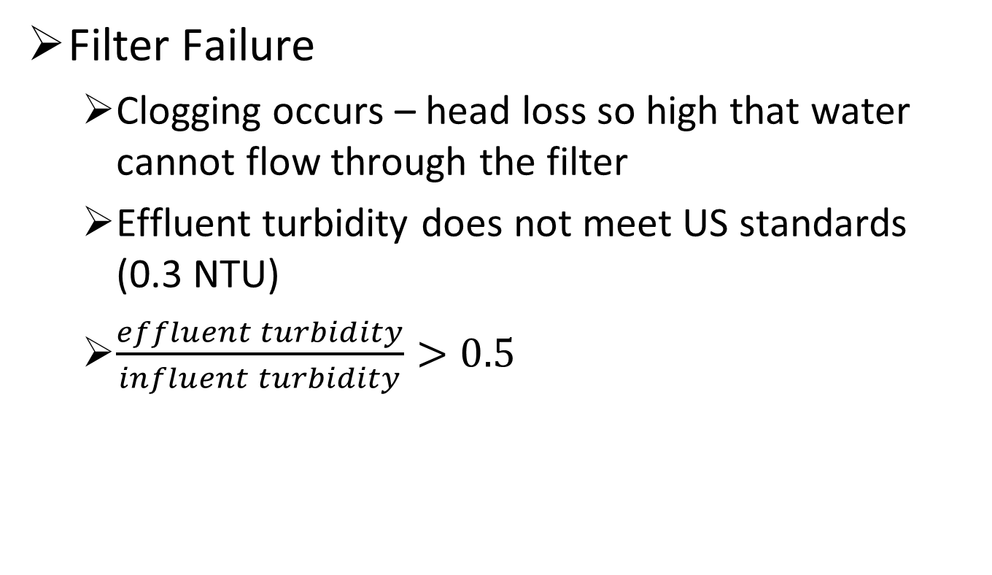
Filter Failure
Filter Failure
  Clogging occurs – head loss so high that water cannot flow through the filter
  Effluent turbidity does not meet US standards (0.3 NTU)
  $\frac{effluent turbidity}{influent turbidity}>0.5$

Slide 6
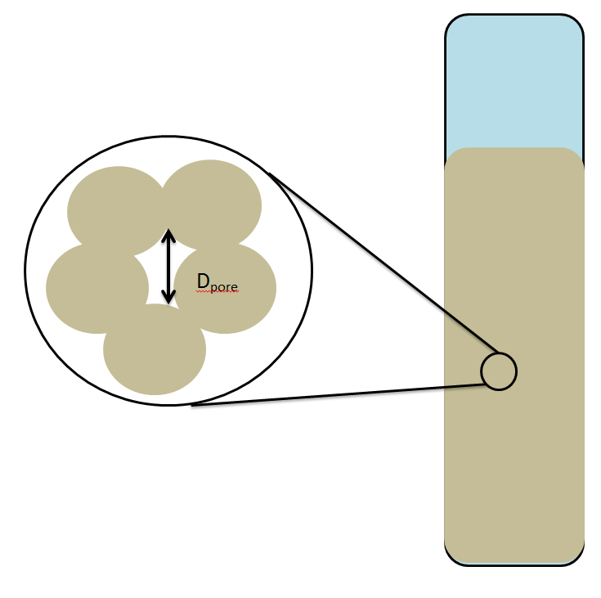
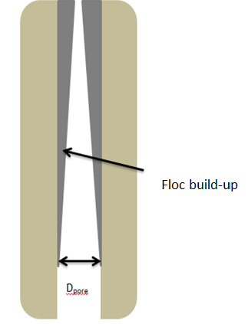
Theory
Flocs build-up in sand pores, causing:
  Increase in
    Head loss
    Shear force
    Water velocity
  Decrease in
    Pore diameter

Slide 7
Hypotheses
Filter Failure Hypothesis
  Head loss levels off after filter failure
Results
  Head loss continues to increase after filter failure

Slide 8
Hypotheses
Coagulant Dosage hypotheses:
Increase coagulant dosage → increase head loss
Why?
Increased bond strength between flocs
More water accumulated
More mass accumulated – smaller pores

Slide 9
Mathematical Model
Performance curves of pC* and head loss for multiple coagulant dosages
  MATLAB, Mathcad
Pore storage volume as function of coagulant dosage
Head loss as function of coagulant dosage and mass of solids accumulated
Filter run times before failure
Goal: Predict when filter will fail

Slide 10
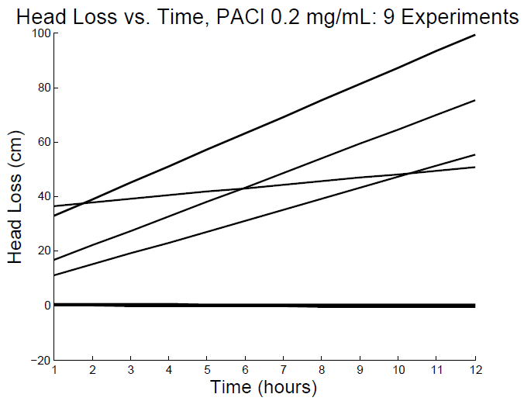
Head Loss
(Replicate Experiments)
Spring 2014 Data

Slide 11
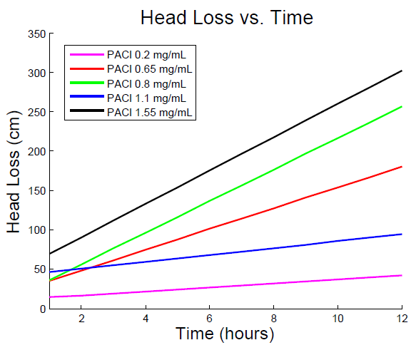
Head Loss
(All PACl Dosages)
Spring 2014 Data

Slide 12
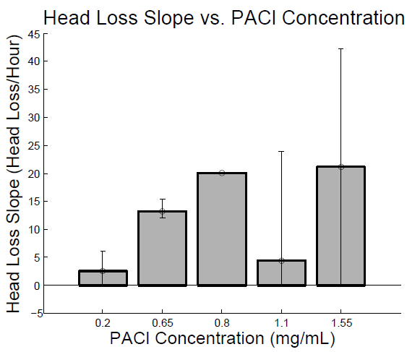
Head Loss Slopes
(All PACl Dosages)
Spring 2014 Data

Slide 13
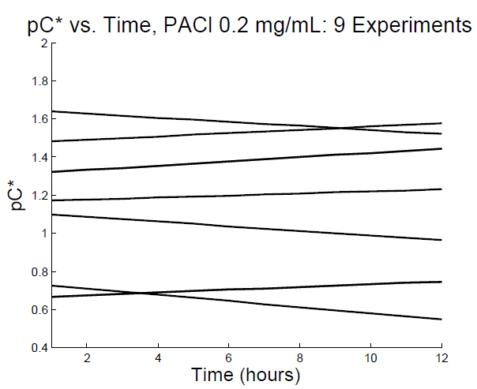
pC*
(Replicate Experiments)
Spring 2014 Data

Slide 14
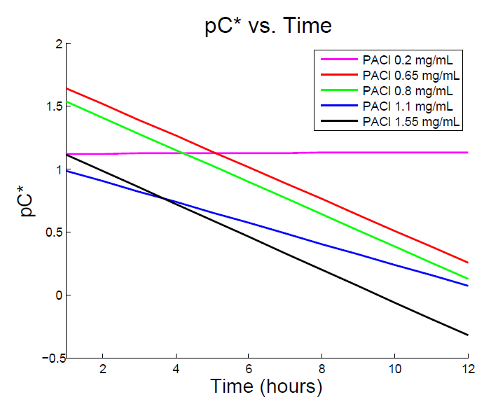
pC*
(All PACl Dosages)
Spring 2014 Data

Slide 15
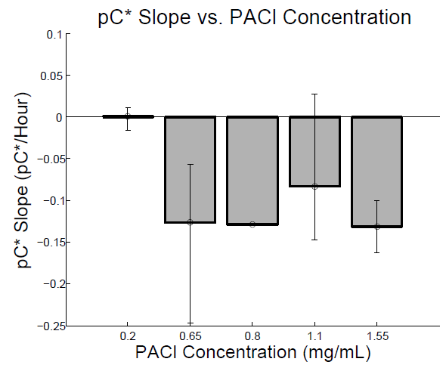
pC* Slopes
(All PACl Dosages)
Spring 2014 Data

Slide 16
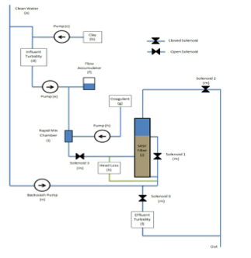
Experimental Apparatus

Slide 17
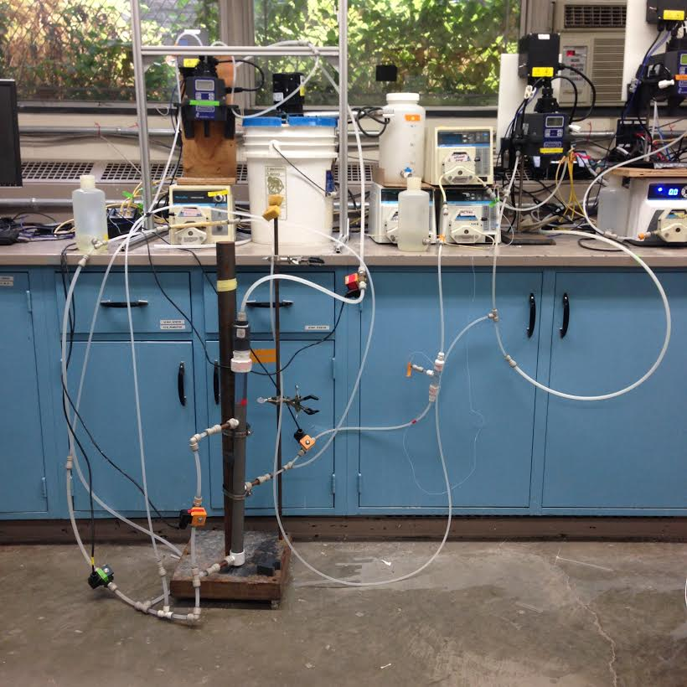
Lab Setup

Slide 18
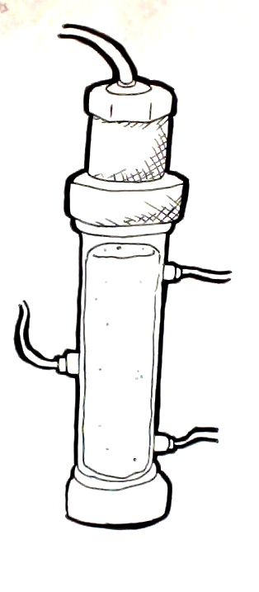
Future Modifications
Alternatives to mesh
Fix sand stratification
Pressure sensors through the filter

Slide 19
Future Work
Explain the continual increase in head loss after filter failure
Relation between amount of PACl and head loss
Distribution of head loss

Slide 20

Questions?

