Slide 1
An Introduction
Spring 2013 AguaClara
Monroe Weber-Shirk

Slide 2
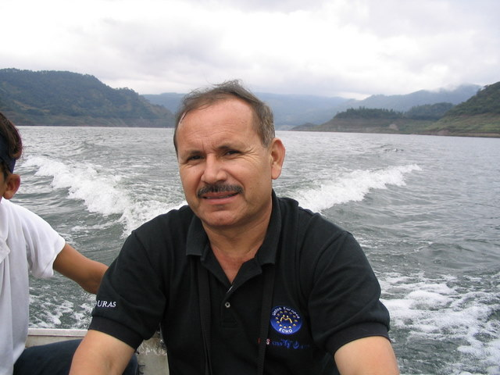
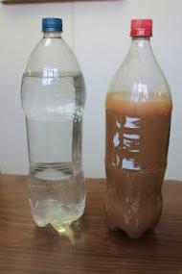
What can we do to treat the dirty water that we are providing to rural communities?
Notes:
What can we do to treat the dirty water that we are providing to rural communities?

Slide 3
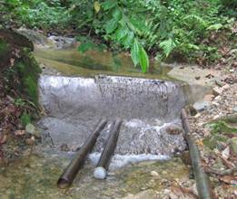
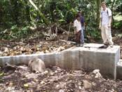
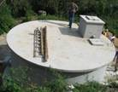
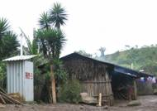
Gravity Water Supply
Drip Chlorinator
Distribution Tank
Spring box or dam

Slide 4
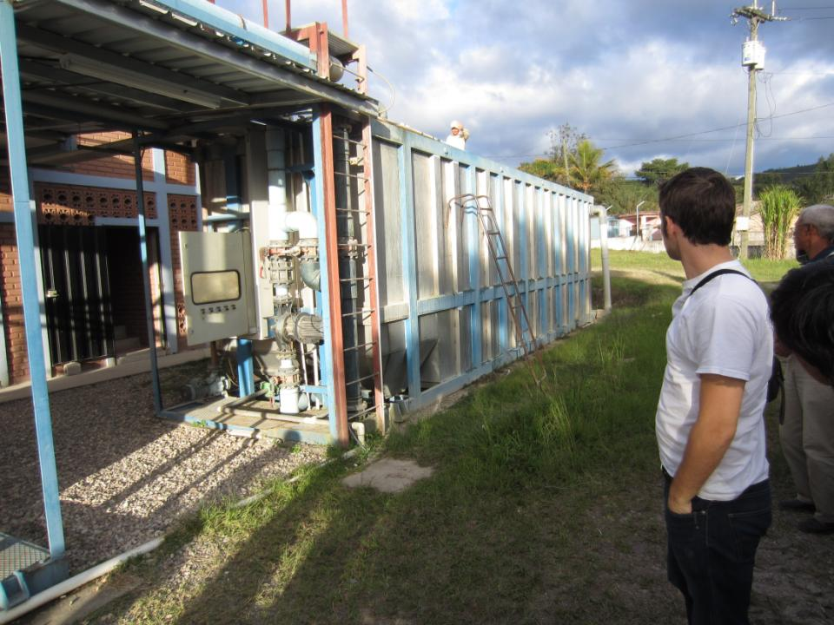
Package Plant

Slide 5
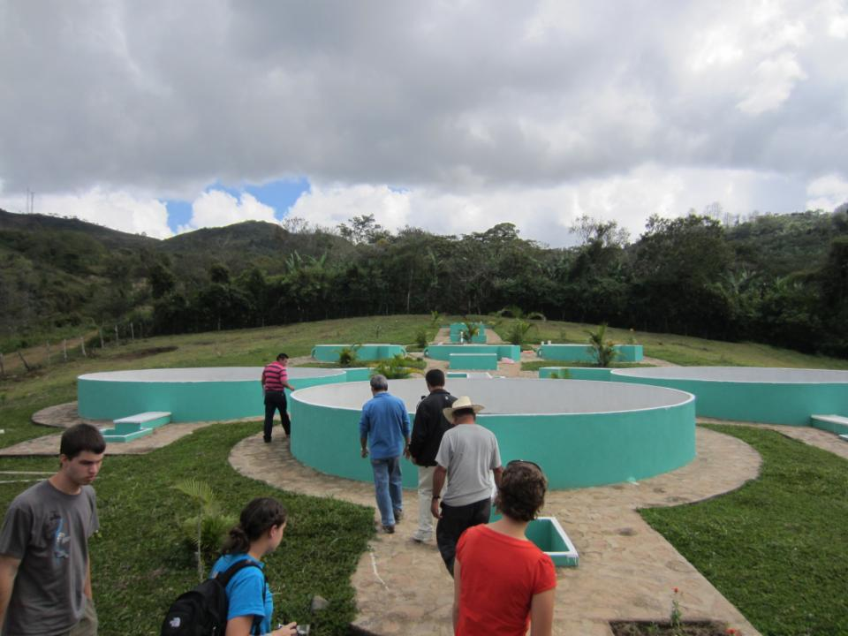
Multiple Stage Filtration Plant (9 L/s)

Slide 6
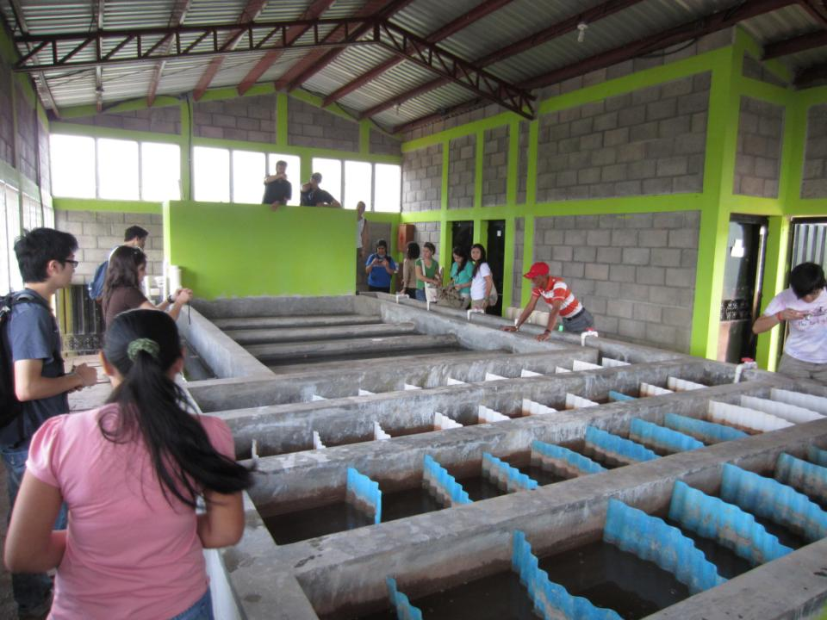
First Female AguaClara Plant Operator: Rosa

Slide 7
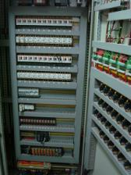
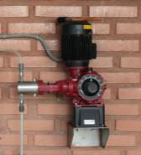
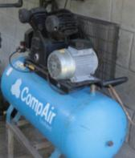
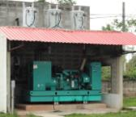
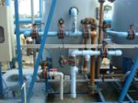
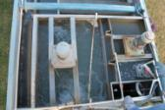
Risk of Failure in a Mechanized Plant
1
1
1
0
1
failure
Role the Dice
The plant can only function if all of the processes are working
The probability of failure is very high when there are several technology platforms with many components

Slide 8
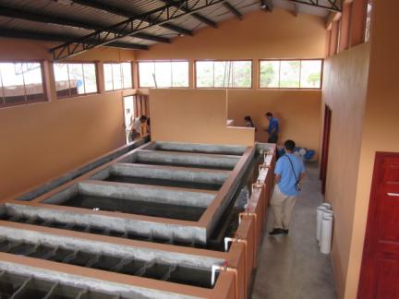
Risk of Failure in an AguaClara Plant
1
success
Role the Dice
There are very few moving parts in an AguaClara plant and thus the risk of failure is very low.

Slide 9
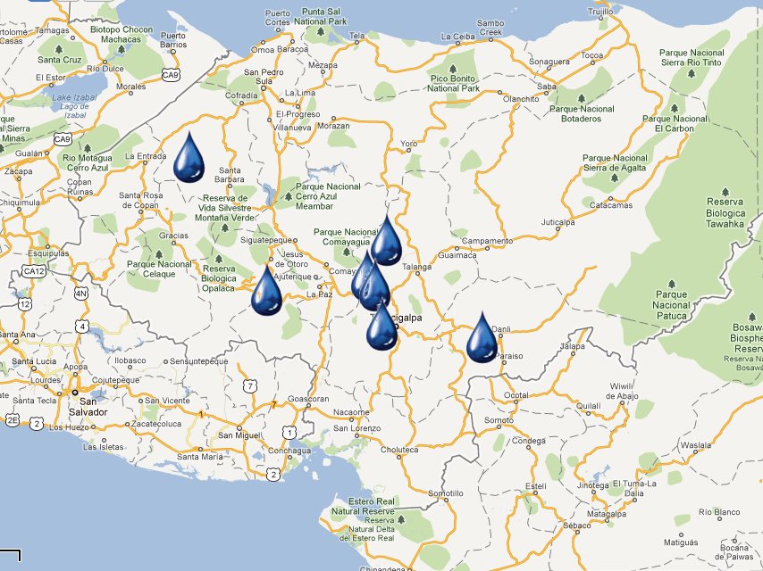



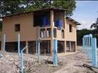



Since 2005:
AguaClara in Honduras
“Cuatro Comunidades” 2009
Atima 2012
Agalteca 2010
Tamara 2008
Marcala 2008/2011
Alauca 2011
Ojojona 2007

Slide 10
AguaClara Network
Investigation, innovation, education, and design
Cornell U
AguaClara R&D
AguaClara LLC
Supervision, quality assurance, consulting services, and technical assistance for the implementation partners.
Implementation Partners
Design/Build/Operate/Train/Transfer
Provide ongoing technical assistance for Water Boards
Water boards
Own, operate, maintain their water system. Monitor and upload performance data.
Community Members
Conserve water, drink safe water, and pay the tariff
Notes:
AguaClara Program at Cornell – R&D, new design and technology development. Note that Agua Clara plans to make their designs open source so cost for their proprietary designs is not an impediment to their adoption.
AguaClara Inc. – Proposed commercial entity which recruits and vets engineering and construction firms local to target communities (Implementation Partners, below), provides oversight and QA services, acts as a “face” to regional/local communities and as a go between with the AguaClara program as needed, and provides feedback to Cornell related to lessons learned and downstream technical requirements. In short, the “glue” between all entities.
Implementation Partners – Engineering and Construction firms in the target regions who will develop bids, sell services and build and deploy the plant and transfer support to local water boards.
Local Water Boards – Municipal entities who will “purchase” the build/deploy services from the Implementation Partner, and get funding from municipal/region/national sources for deployment of the plants.

Slide 11
Sharing understanding, feedback, and innovation
Cornell U
AguaClara R&D
AguaClara LLC
Implementation Partners
Water Boards
Community Members

Slide 12

AguaClara at Cornell
Lecture/Project Based Course
ENGRI 1131: Water Treatment Design
Research, Design, & Admin
Graduate Research
Fundamental physical chemical processes for enhanced drinking water treatment
Capstone Design Course
CEE 4540: Sustainable Municipal Drinking Water Treatment
Project Based Courses
AguaClara: Sustainable Water Supply Project*
CEE 2550
CEE 4550
CEE 5051/5052
Summer Internships at Cornell
Engineering in Context
2 week trip to Honduras during January intersession
Service
Learning
The “service learning” is reversed in this model!
Notes:
This is the “skeleton” of the AC program at Cornell, but not the human story – how this program provides a unique gateway for students into a world of high-stakes tech development an implementation appropriate to the challenges facing the Global South. High stakes because children are dying by the tens millions due to polluted drinking water– and because careful water management is rapidly ascending to the top of the list of critical global development necessities.
As you note, all the way through this Ppt, I am thinking about both the actual details (and organization) of the tasks you represent on the charts (how you would explain them to someone who has no prior knowledge of AC), and the human story that animates them all. We have to be very well prepared to talk about both to serious prospective donors.
---Gail

Slide 13
What is AguaClara?
Teams of 3
Come up with one phrase to complete the sentence
AguaClara is …
Send someone to the white board to write the phrase

Slide 14
AguaClara is…
A philosophy of win/win/win for sustainability
An emphasis on human resources
Smart engineering
Simplicity on the other side of complexity
Sustainable systems
  Highly valued product – willing payment of tariff
  Technical support system
  Feedback loop for continual improvements
A third way

Slide 15
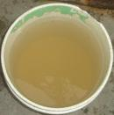
What is it like?
To wash dishes, clothing, children?
To try to keep your children healthy when the water is full of pathogens?

Slide 16
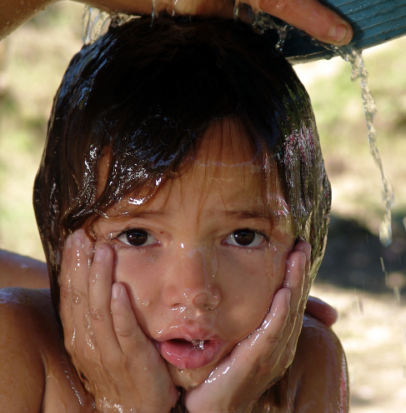
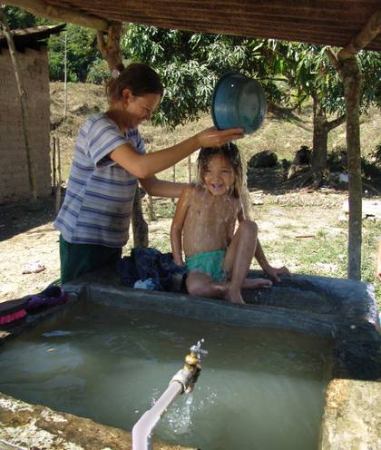
Why we do what we do...
AguaClara: Whenever possible provide local water treatment infrastructure rather than requiring every household to treat their own water

Slide 17
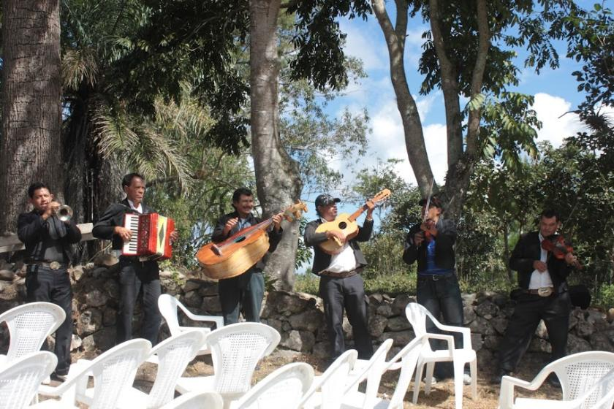
Tamara Stacked Rapid Sand Filter Inauguration

Slide 18
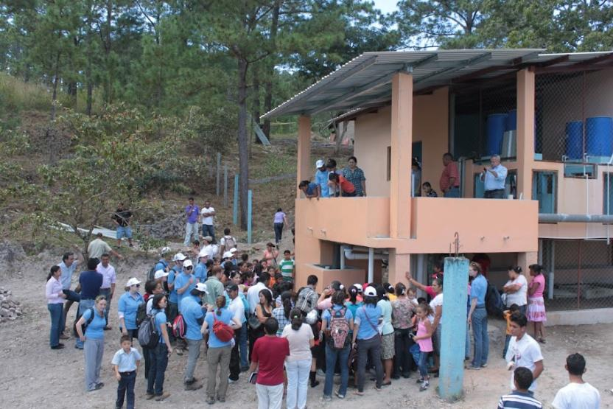
Tamara Inauguration: January 2012

Slide 19

Alauca Inauguration:
Feb. 2012

Slide 20
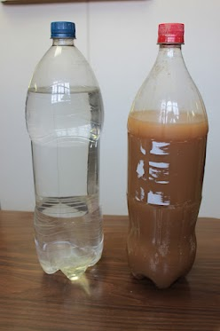
Alauca results

Slide 21
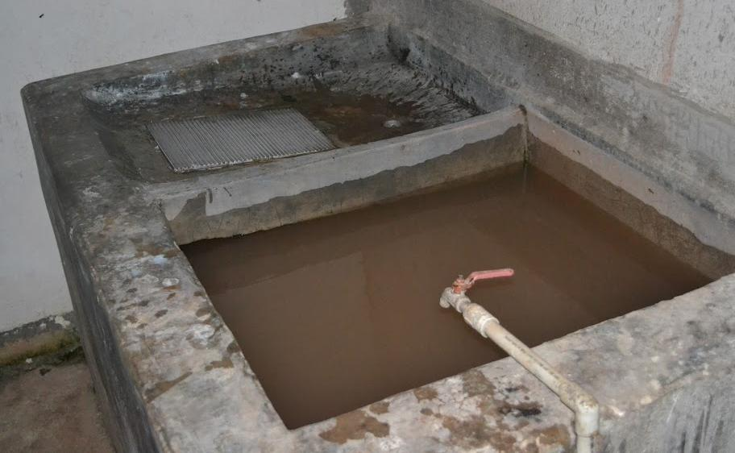
Atima

Slide 22
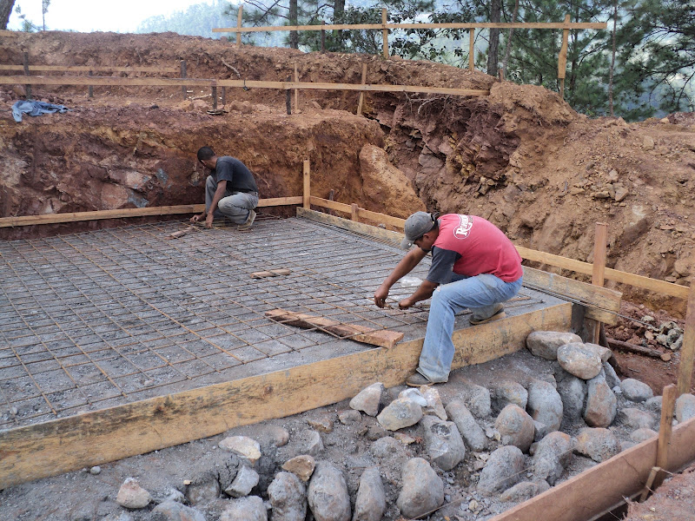

Slide 23
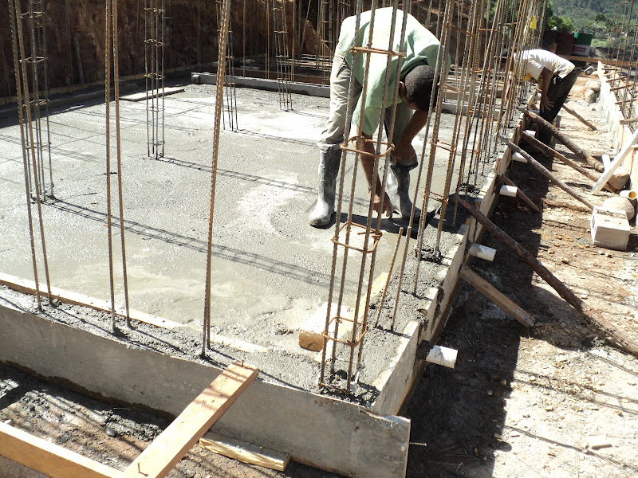

Slide 24
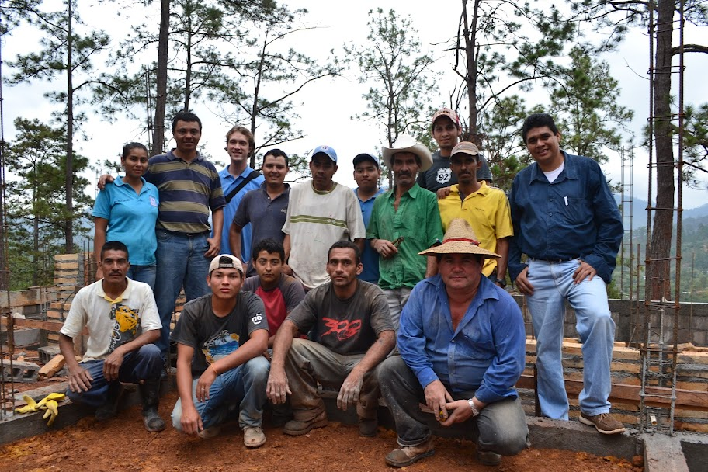

Slide 25
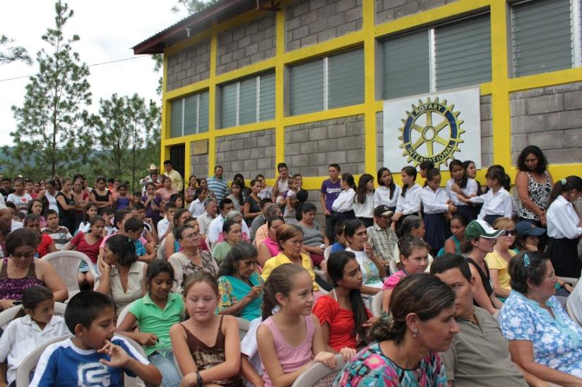
Atima Inauguration:
July 2012

Slide 26
Why has AguaClara succeeded?
Community Friendly
Operator Friendly
Relationships - Trust
Team work – Partnerships
The best technology available
Based on science
A network of win-win!

Slide 27
Guiding Philosophies
Dream Boldly – Create plans to do more tomorrow than what you can do today
Adapt as the program evolves – Develop new systems so that we are ready to go global
Efficiency – Create jigs to move into production mode and to replicate
Distributed intelligence – Collaborate with partners to take advantage of local knowledge
Nested governance, capacity building, and empowerment

Slide 28
Big ideas
The operator!
Simplicity on the other side of complexity
  No electronics required for plant operation!
  No electricity needed!
Local materials
Local Ownership
Local Accountability

Slide 29
If only we had the solution set!
I am calling on you to do something that has never been done before.
This is not a homework assignment where the professor already knows the solution
We are co creators in this global effort to provide safe drinking water for 2+ billion people
You have the capacity to create new solutions
Together we are amazing!

Slide 30
There is no B team…
What you do this spring will not end up in the homework trash can at the end of the semester
This is real. Real people with unsafe water coming out of their taps. And the planet needs you. AguaClara is the only known program working on this problem* on planet earth. There is no B team.
*Municipal drinking water treatment

Slide 31
The challenge of a large range of flow rates
Human settlements range in size from 100 people to 20,000,000 people
The flow rate required is between 0.1 L/s and 80,000 L/s
1,000
10,000
100,000
1
10
100
L/s
Population
100
1,000
10,000
100,000
1,000,000
10,000,000

Slide 32
The challenge of low flow
Flocculator– new geometry required
Sedimentation – easy because it is the largest process
Filter– Difficult to construct in an open container
1,000
10,000
100,000
1
10
100
L/s
Population
100
1,000
10,000
100,000
1,000,000
10,000,000

Slide 33
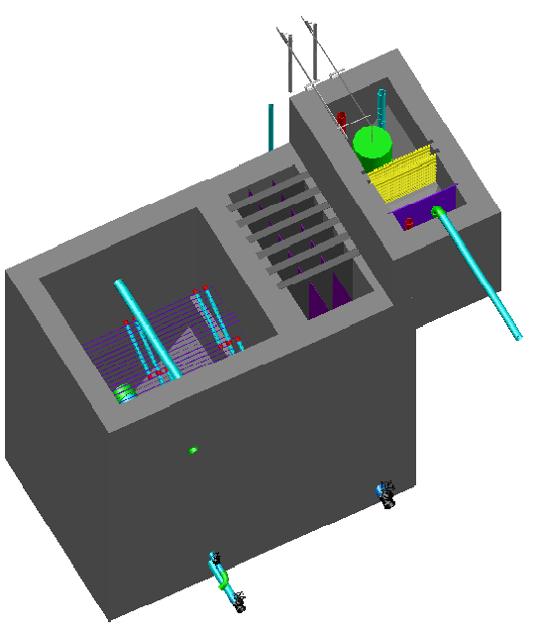
Vista de una planta de 0.8 L/s (sin el filtro)
floculación
Tanque de entrada
sedimentación
2 m
1.9 m

Slide 34
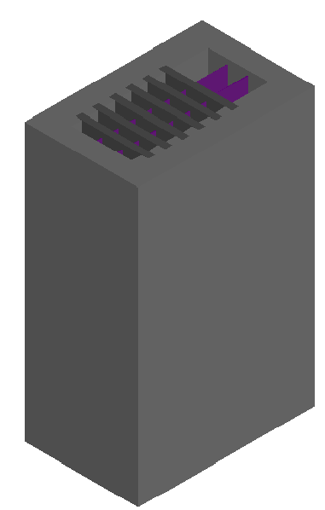
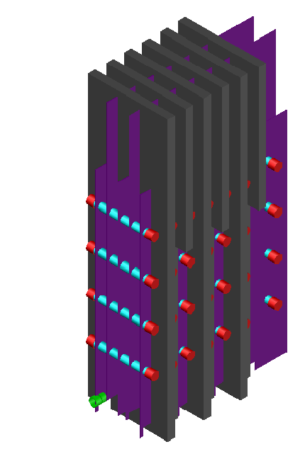
Floculador de 0.8 L/s
1.9 m

Slide 35
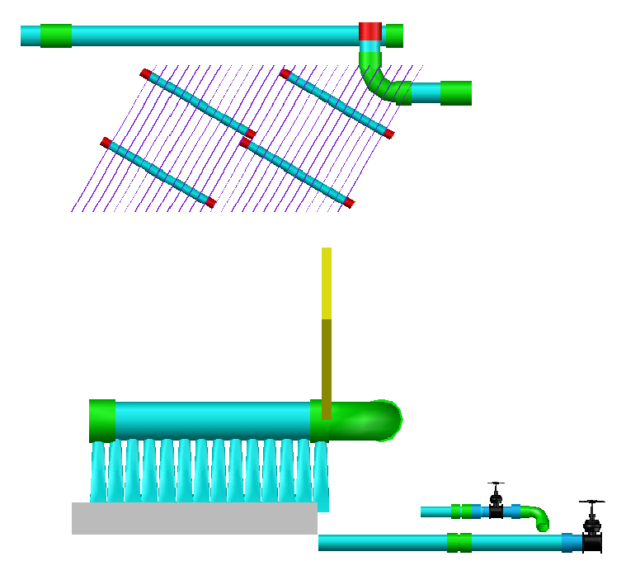
Elevación del tanque de sedimentación

Slide 36
Introduction to Teams

Slide 37
Overview
Public Relations
Design
Invent
  LFSRSF
  Foam Filtration
  Demo Plant
Research
  Ram pump
  Floc/Sed Optimization
  Tube Flocculator
  Tube Flocculator Data Analysis
  Sedimentation Tank Hydraulics
  Depth vs Surface Filtration
  Arsenic
  Calcium Carbonate Scaling
  Turbidimeter
  Coagulant Management

Slide 38
Public Relations
Think Big
Strategize ways to raise funds at the level of $100k to $1M
  Work with College of Engineering
  Gates Foundation, World Bank
Publicize AguaClara – TED talk, National Press, Cornell Press, Blogs

Slide 39

Design Team
Amy Boncelet, Annie Newcomb, Anthony Andrews, Heidi Rausch, Jen Gass, Julia Morris, Kira Gidron, Michael Walsh, and Tori Klug

Slide 40

Automated Design Tool
User Inputs
Plant
Design
LabVIEW
AutoCAD
Mathcad
Calculations
MS Word
Mathcad
Drawing Files

Slide 41
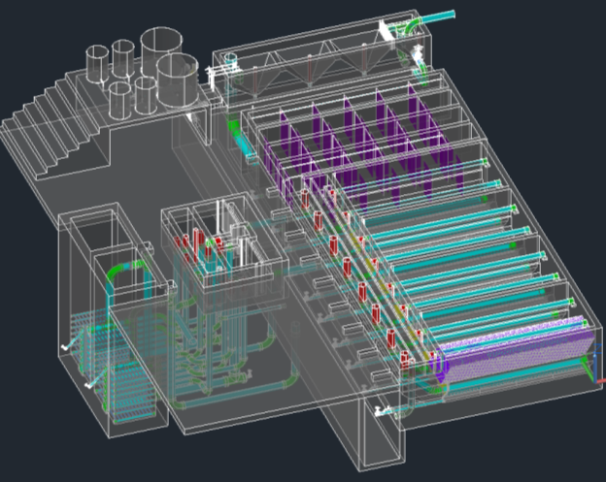
The Drawing

Slide 42
Overall Design Tasks
  Incorporating new research progress into the design
  Designing plants for a greater range of flow rates
  Making our designs more easily understood
  Communicating with the team in Honduras and with new implementation partners to address concerns

Slide 43
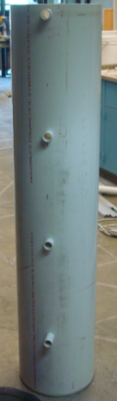
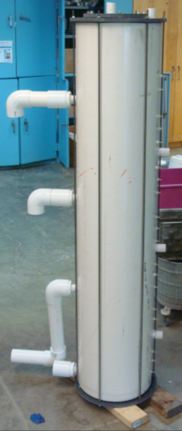
0.8 L/s Stacked Rapid Sand Filter (LFSRSF)

Slide 44
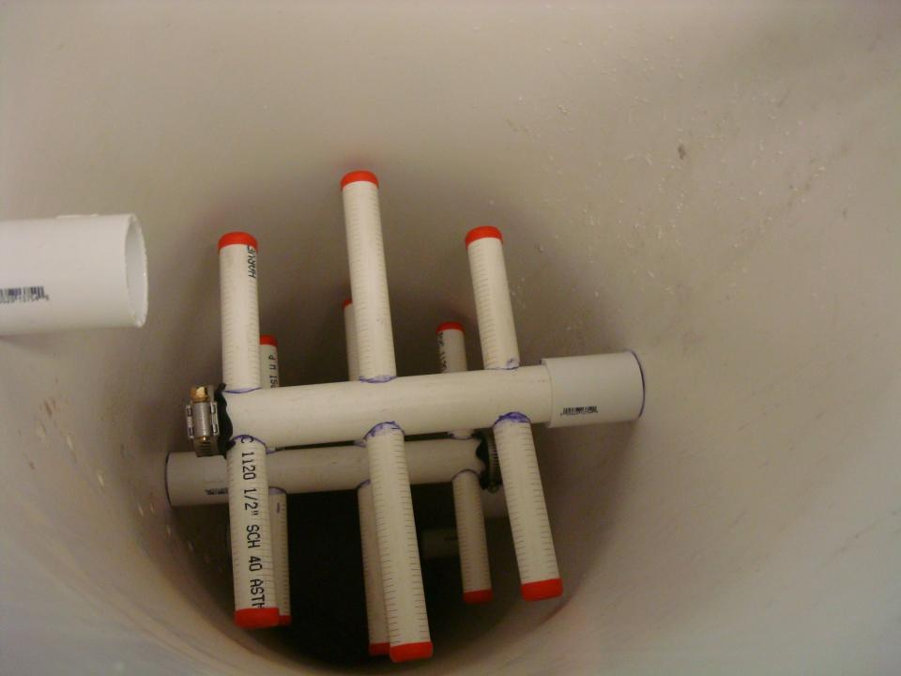

Slide 45
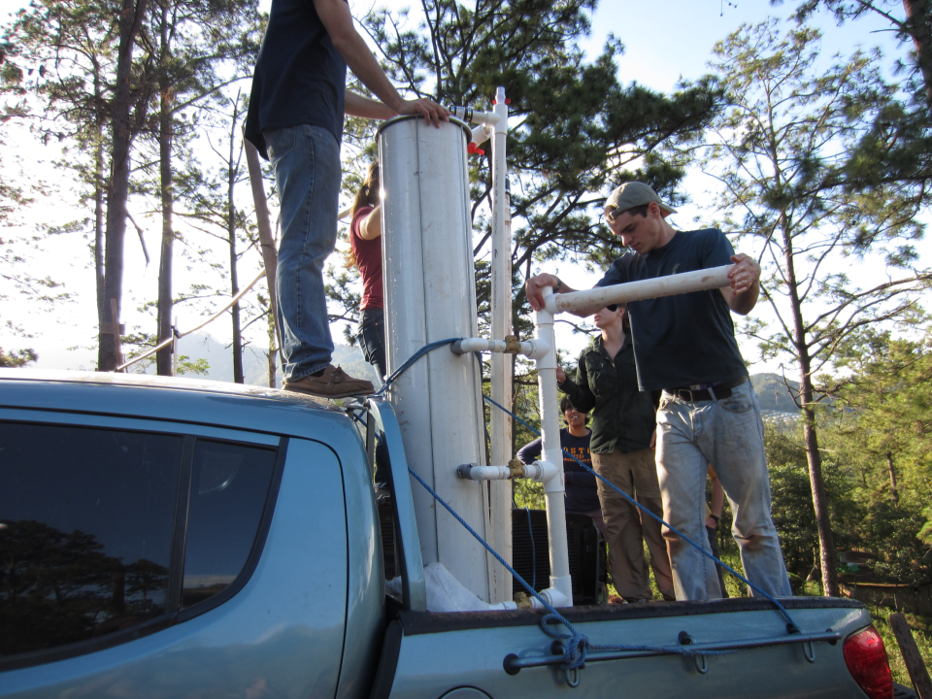

Slide 46
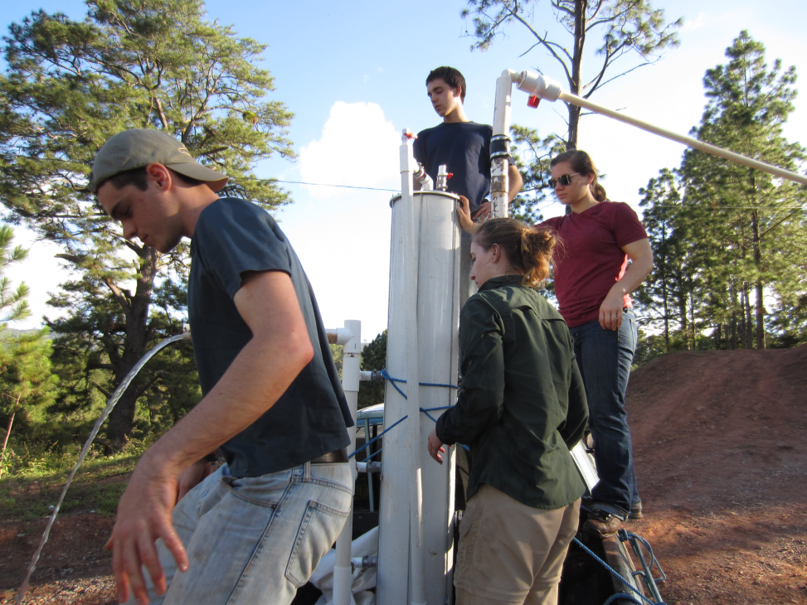

Slide 47
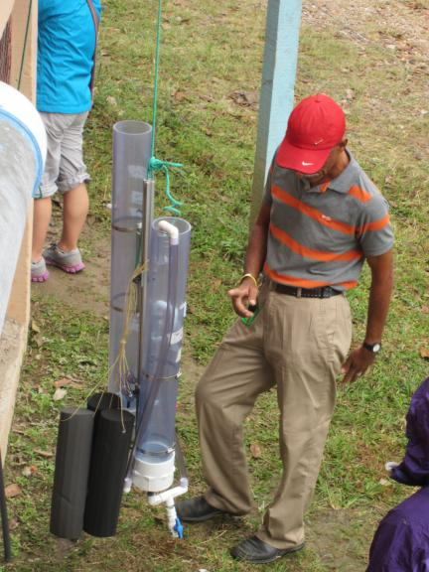
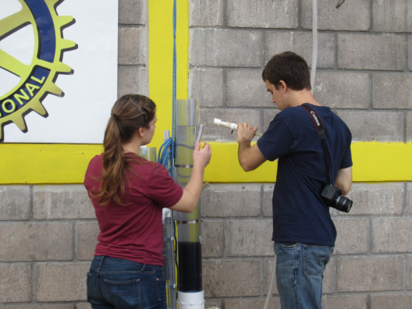
Foam Filtration
Dose Controller, flow meter
Operator Feedback
Work with APP to field test

Slide 48
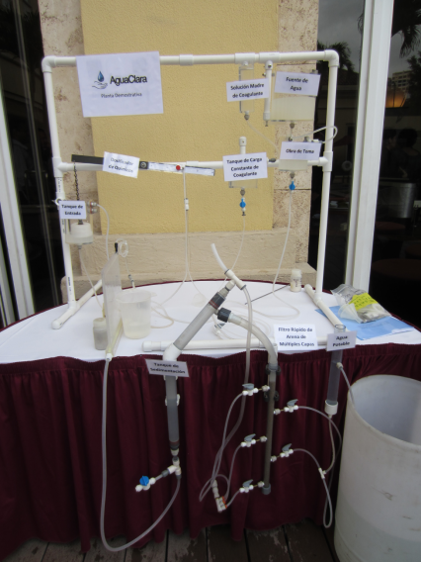
Demo Plant
Correct the hydraulics of the dose controller
Make operation easier
Get setup down to 20 minutes
First plant goes to India on Feb 14

Slide 49
Ram Pump
There is an old technology that used hydraulic transients to lift water from a stream to a higher elevation. The device was called a “Ram Pump”and it made a rhythmic clacking noise.
How did it work?
High pressure pipe
Source pipe
Stream
Ram Pump

Slide 50
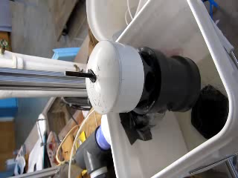
Ram pump
Create a simple, easily repaired pump that can provide water for chemical stock tanks and for the plant bathroom

Slide 51
Floc/Sed Optimization
We know that flocculation of low turbidity water is difficult because the flocs are far apart and thus the time between collisions is long.
Would it improve performance to return flocs from the floc blanket in the sedimentation tank back to the front end of the flocculator?
We need to add imaging capabilities to this apparatus!

Slide 52
Tube Flocculator

Slide 53
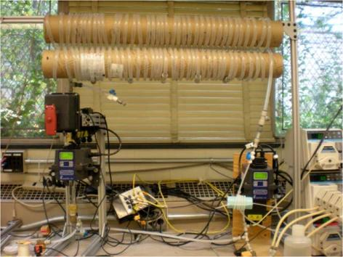
Tube Flocculator
Explore floc break up
Learn all we can with the goal of moving this technology into the field if it proves to be viable.

Slide 54
Tube Flocculator Data Analysis
Data mining from extensive data set
We know floc size is a function of the energy dissipation rate
We hypothesize that floc size is a function of the coagulant dose
Will require coding in Mathcad to extract the data
Connect coagulant dose, flocculator design, and sedimentation tank design – a rational basis for 10 mW/kg???

Slide 55
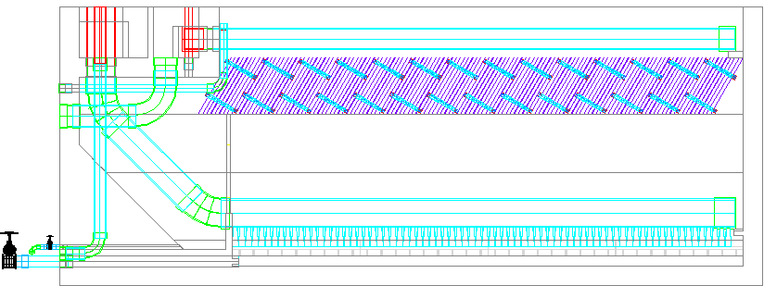
Sedimentation Tank Hydraulics
Entrance Channel
Dump poorly flocculated water channel
Exit Channel
Exit Weir that controls water levels all the way back to the next free fall (LFOM!)
Launder
Plate Settlers
Floc Weir
Floc Hopper
Inlet Manifold
Diffusers
Floc Hopper Drain (to remove sludge)
Sed Tank Drain
Notes:
Exercise: Tell the story of the journey of a large floc, a small floc, a rouge loner clay particle, and of a water molecule as each travels through this sedimentation tank.

Slide 56
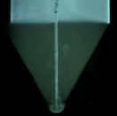
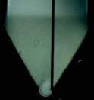
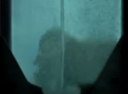
Sedimentation Tank Hydraulics
Centered jet
Offset jet
Flat bottom
Diffuser tube flattened to achieve line source
Floc pickup location
Removable drain cover
Jet reverser
Drain orifice
Drain

Slide 57
Depth vs Surface Filtration
Compare a conventional Stacked Rapid Sand Filter to a Rapid Sand Filter: What are the big differences?
We’d like to know what determines whether depth or surface filtration occurs
We’d like to ensure that the slots in the pipes in the filter bed don’t clog!
We’d like to know the advantages and disadvantages of depth and surface filtration

Slide 58

Begin Filtration cycle
Inlet plumbing head loss
Outlet box
Total filter head loss
What causes water to flow through the filter bed?
____________________________
differences in piezometric head

Slide 59
How does water flow through SRSF?

Slide 60
Arsenic
Expand AguaClara into removal of arsenic from groundwater
Flocculation/Sedimentation/Filtration is an effective method for removing arsenic
The chemistry and physics of the process are poorly understood
Notes:
Learn enough so that we can do it better!

Slide 61
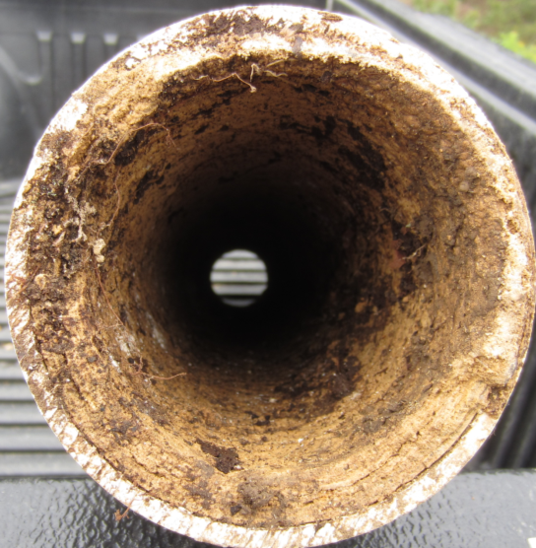
Calcium Carbonate Scaling

Slide 62
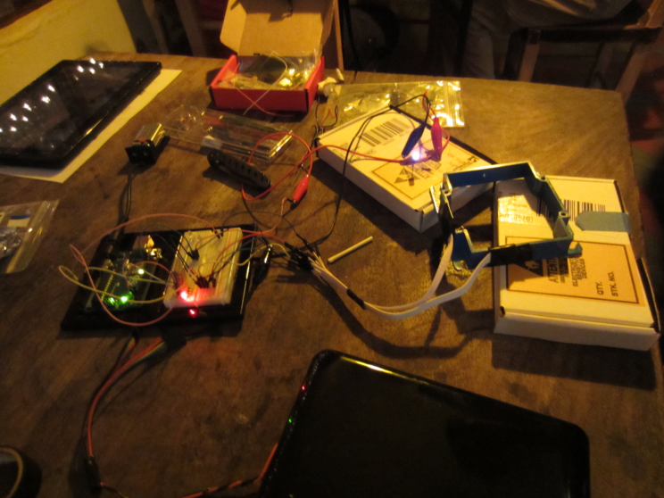
Turbidimeter

Slide 63

Coagulant Management
Chemical concentration in the stock tanks
Mixing of the stock tank chemicals

Slide 64
Next Steps
https://confluence.cornell.edu/display/AGUACLARA/Syllabi

