Slide 1
Technologies
Spring 2013 AguaClara
Monroe Weber-Shirk

Slide 2
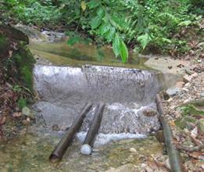
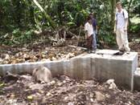
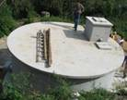
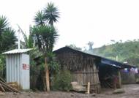
Gravity Water Supply
Drip Chlorinator
Distribution Tank
Spring box or dam

Slide 3
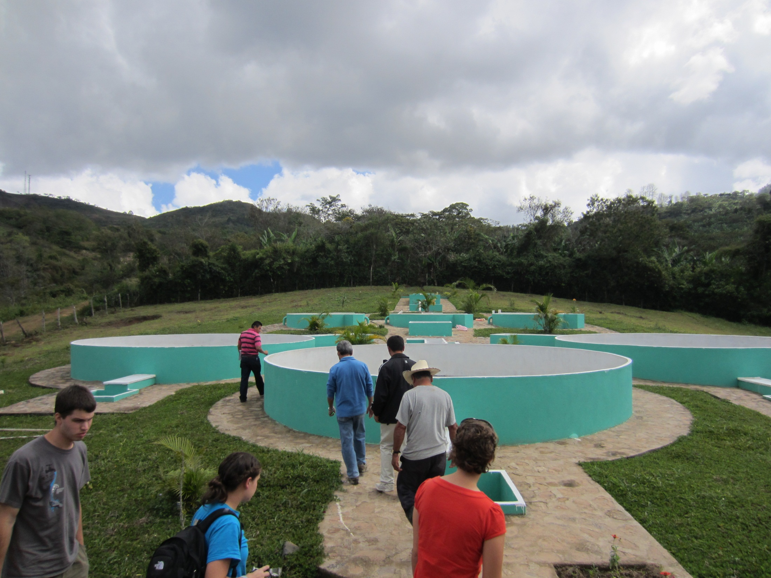
Notes:
Kk1rZBrCIX0
<object width="1280" height="720"><param name="movie" value="http://www.youtube.com/v/Kk1rZBrCIX0?version=3&amp;hl=en_US&amp;rel=0"></param><param name="allowFullScreen" value="true"></param><param name="allowscriptaccess" value="always"></param><embed src="http://www.youtube.com/v/Kk1rZBrCIX0?version=3&amp;hl=en_US&amp;rel=0" type="application/x-shockwave-flash" width="1280" height="720" allowscriptaccess="always" allowfullscreen="true"></embed></object>

Slide 4
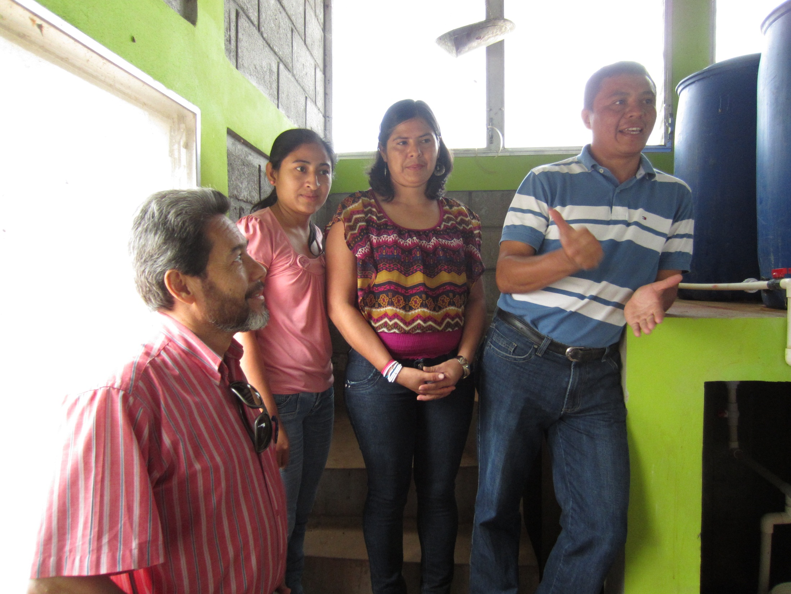
First Female AguaClara Plant Operator: Rosa

Slide 5

Stages of colloid removal
Coagulation
Flocculation
Floc Blanket
Sedimentation
Filtration
Nanoglob deposition
Collisions
More Collisions
Gravity!
Last chance!
What is a colloid?
Notes:
Here are the five stages of colloid or particle removal in hydraulic drinking water treatment plants. The first stage, coagulation, involves the addition of a chemical coagulant to destabilize a suspension of particles. The coagulant precipitates and attaches to the particle surface. Then in flocculation, velocity gradients in the water cause the particles (now coated in precipitated coagulant) to collide and stick to one another forming aggregates. In floc blankets there are many more opportunities for collisions. In sedimentation, fluid flow is very slow and the aggregates settle to the bottom of the tank. Filtration is often used to remove any remaining particles but is not included in the bench-scale setup.

Slide 6

Coagulation Geometry
Notes:
Our smallest aggregates were the control, at 180 nm.

Slide 7
Unit Processes
Entrance Tank (flow measurement, grit removal)
Chemical dosing
Flocculation
Sedimentation
  Floc blanket
  Floc hopper
  Plate Settlers
Stacked Rapid Sand Filters

Slide 8
How Water Flows Through the Plant
Notes:
Images formatted, selected, and animated by Rachel Philipson

Slide 9
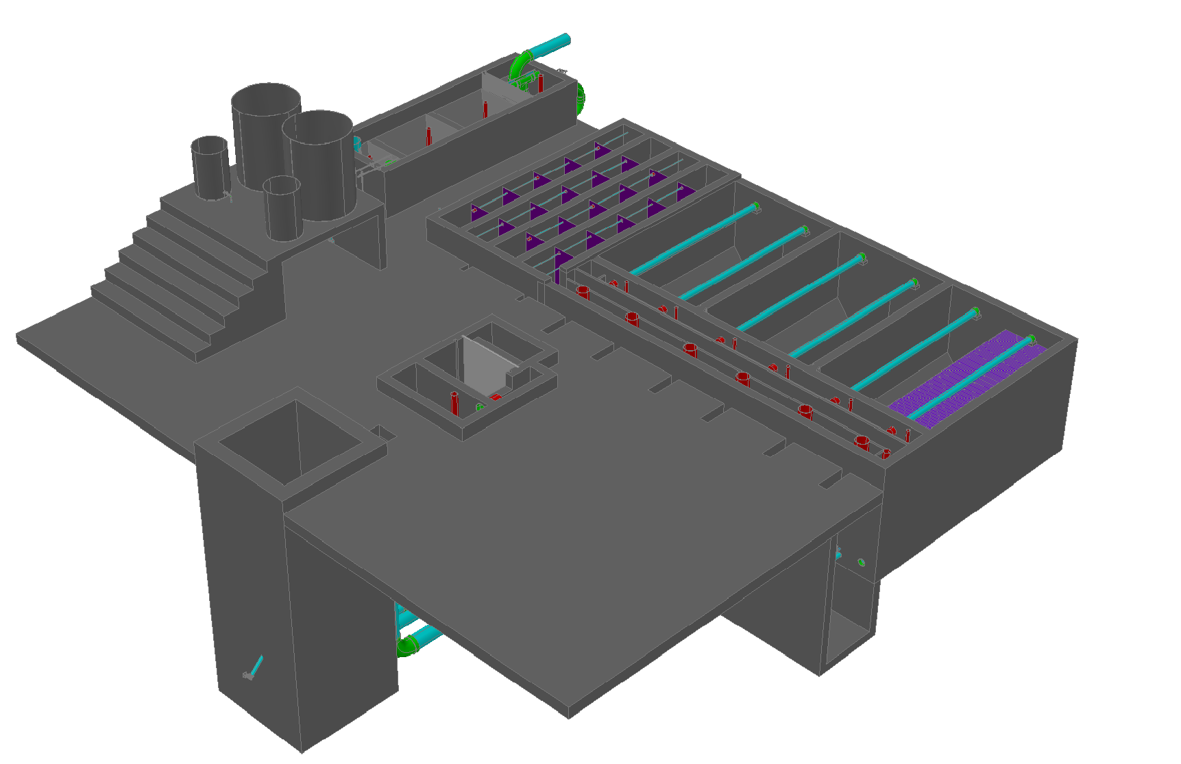
20 L/s AguaClara Plant

Slide 10
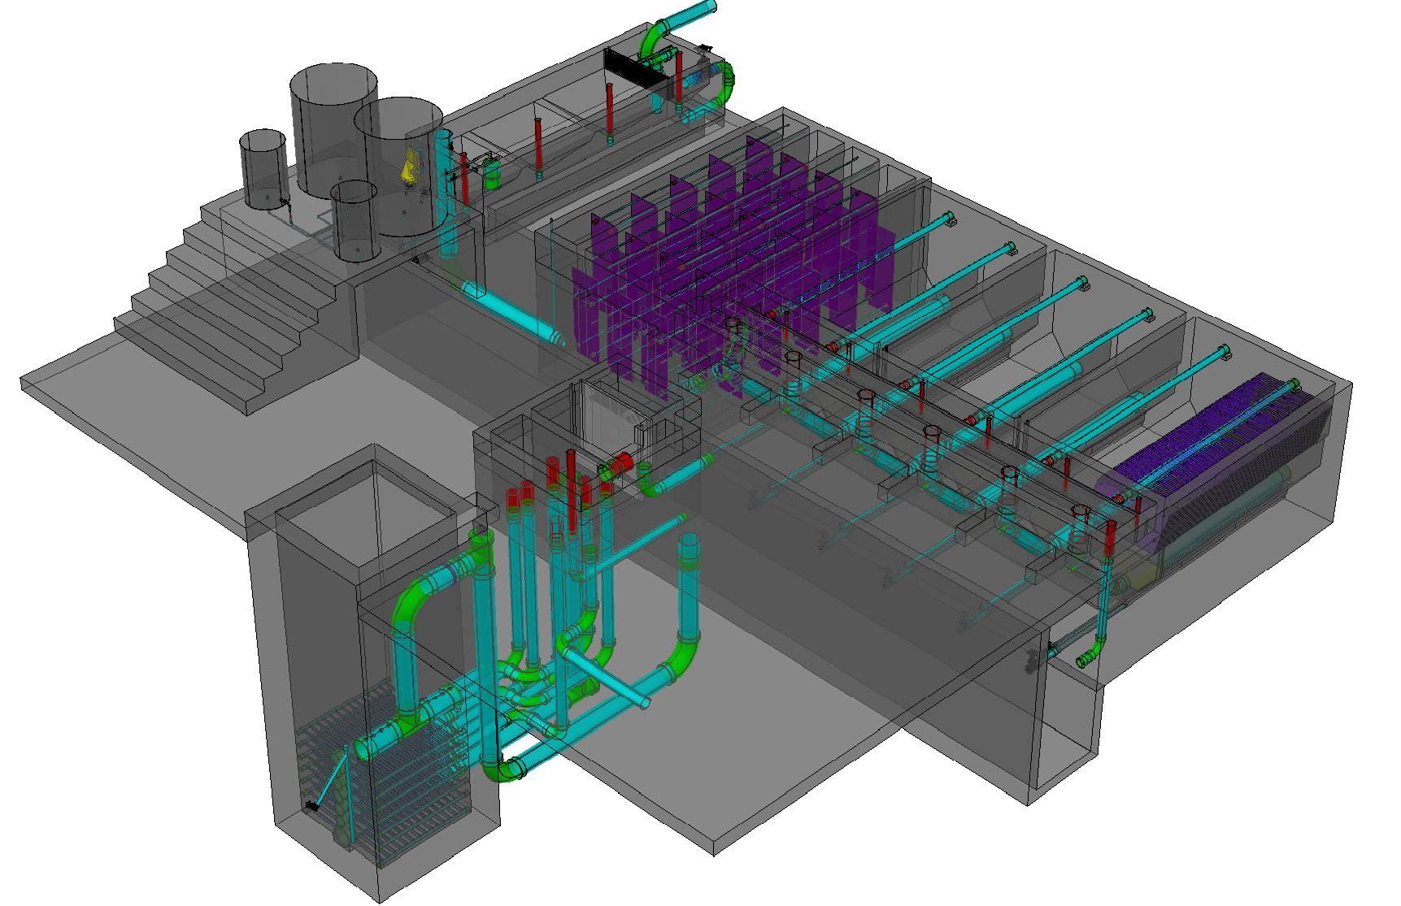
20 L/s AguaClara Plant

Slide 11
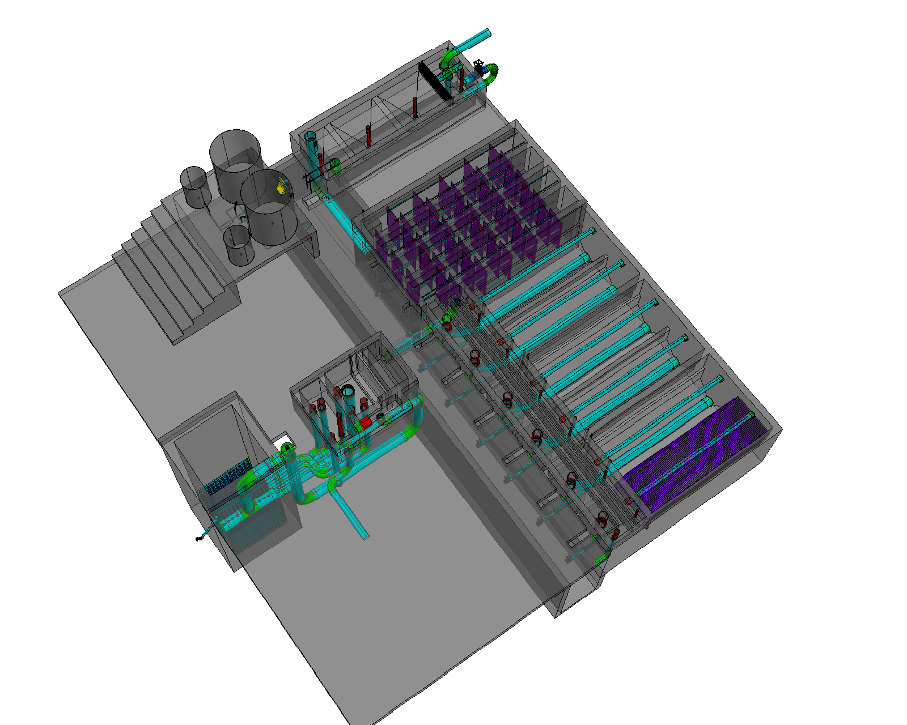
Entrance Tank
Flocculator
Sedimentation
Tanks (3 tanks with 2 bays each)
Stacked Rapid Sand Filter

Slide 12


Slide 13
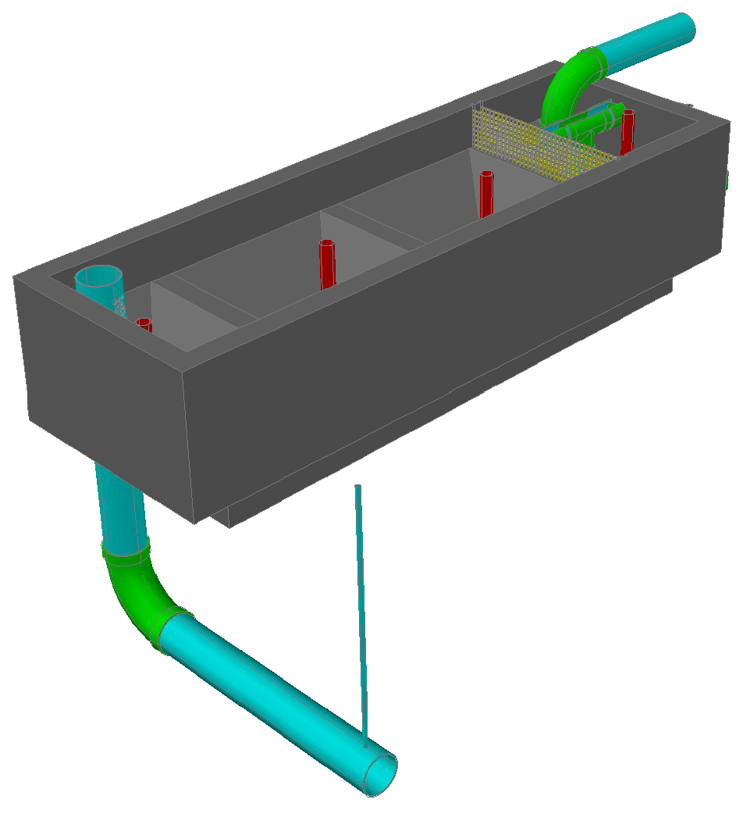
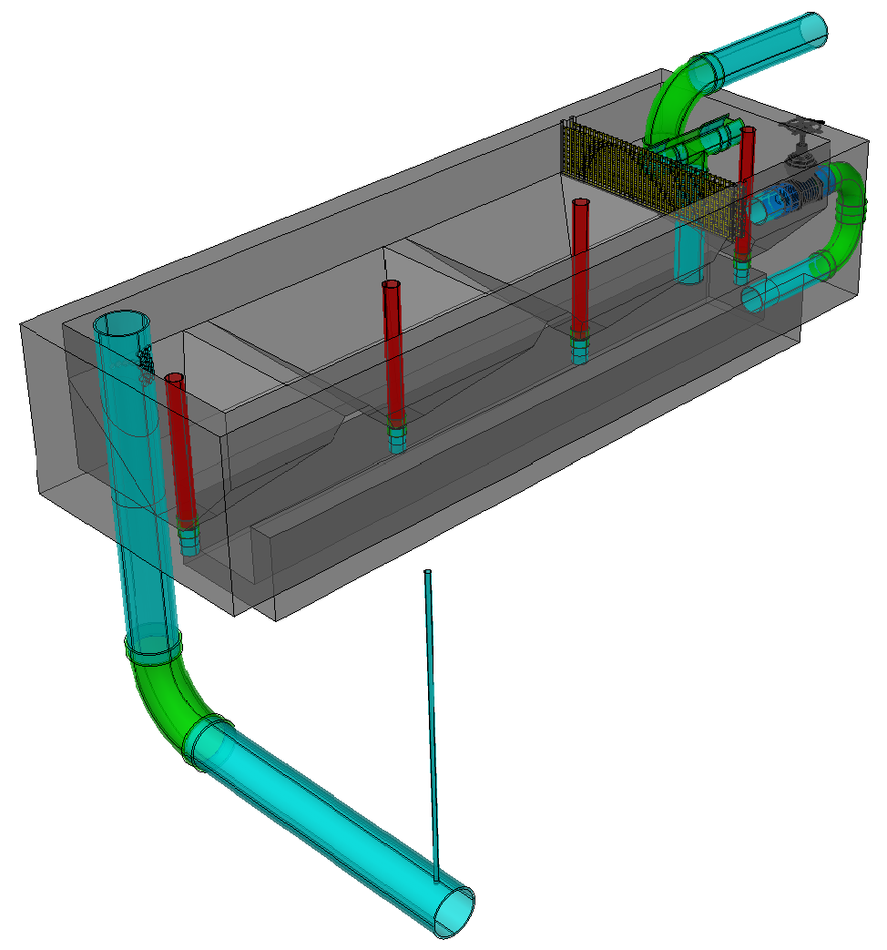
Entrance Tank

Slide 14
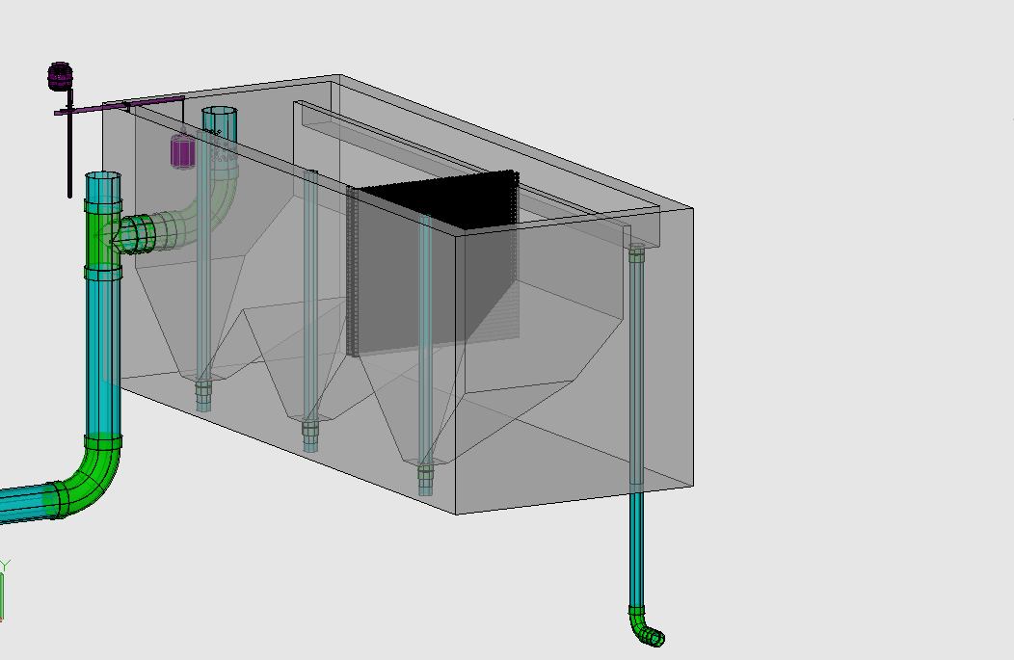
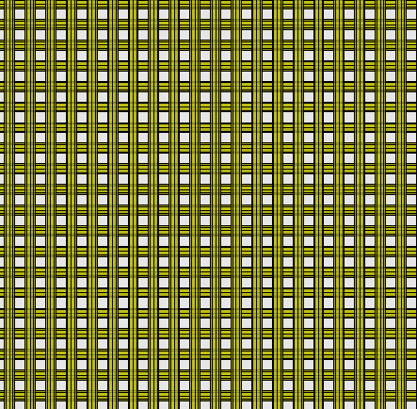
Chemical Dose Controller
Entrance Tank
Overflow Weir
Linear Flow Orifice Meter
Trash Rack
Hopper
Primary Sludge Drain

Slide 15
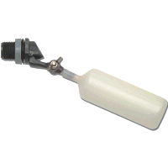
Constant head tank
Stock Tank of coagulant
Lever
Slider
H
Float valve
LFOM
Open channel supercritical flow
Drop tube
Float
Dosing tubes
Purge valves
Notes:
This is a basic schematic of what research and design teams have come up with after many years of work. The stock tank holds a stock chemical solution which is connected to a constant head tank. The constant head tank is regulated by a float valve which keeps the chemical depth constant. A large diameter tube leads from the stock tank to one or more small diameter long straight dosing tubes. A large diameter flexible leads to a drop tube with “open channel super critical flow”, where the chemical flows to be added to the plant’s influent water. The drop tube is connected to a lever via a slider. The plant operator sets the slider at the desired coagulant dose based upon characteristics of the influent water. The float attached to the lever changes position as flow rate into the plant changes, thus changing the elevation of the large diameter tube’s outlet, and maintaining a constant chemical dose.

Slide 16
Decrease dose
H

Slide 17
Increase dose
H

Slide 18
Half flow
H

Slide 19
Plant off

Slide 20
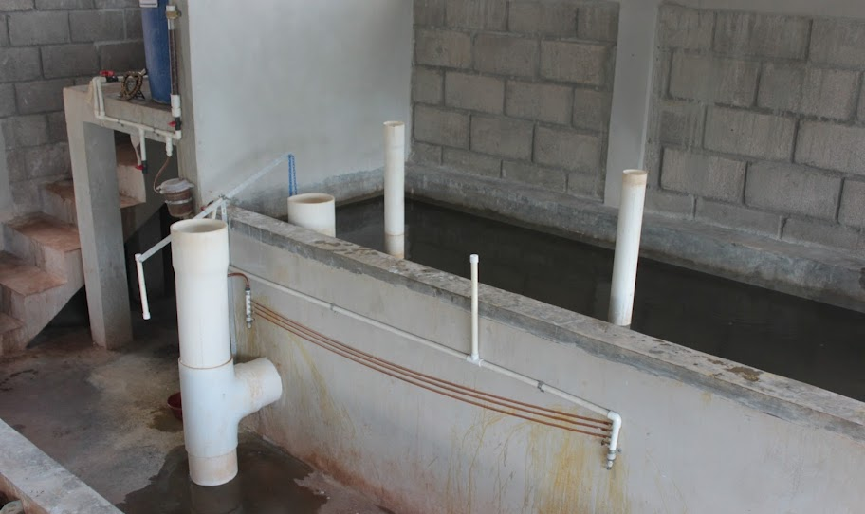
Atima doser: Three 1/8” diameter tubes, 1.93 m long, 187.5 g/L stock solution of PACl, 5 to 48 mg/L dose range.
Coagulant Stock Tank
Flow calibration column
Lever
Constant Head Tank
Linear Flow Orifice Meter
Dosing Tubes
Notes:
Dosificador: 3 mangueras de 1/8" diámetro interno, 1.93m longitud, concentración madre de 187.5 g/L de PAC, dosis máxima 48 mg/L, dosis mínima 5 mg/L.

Slide 21
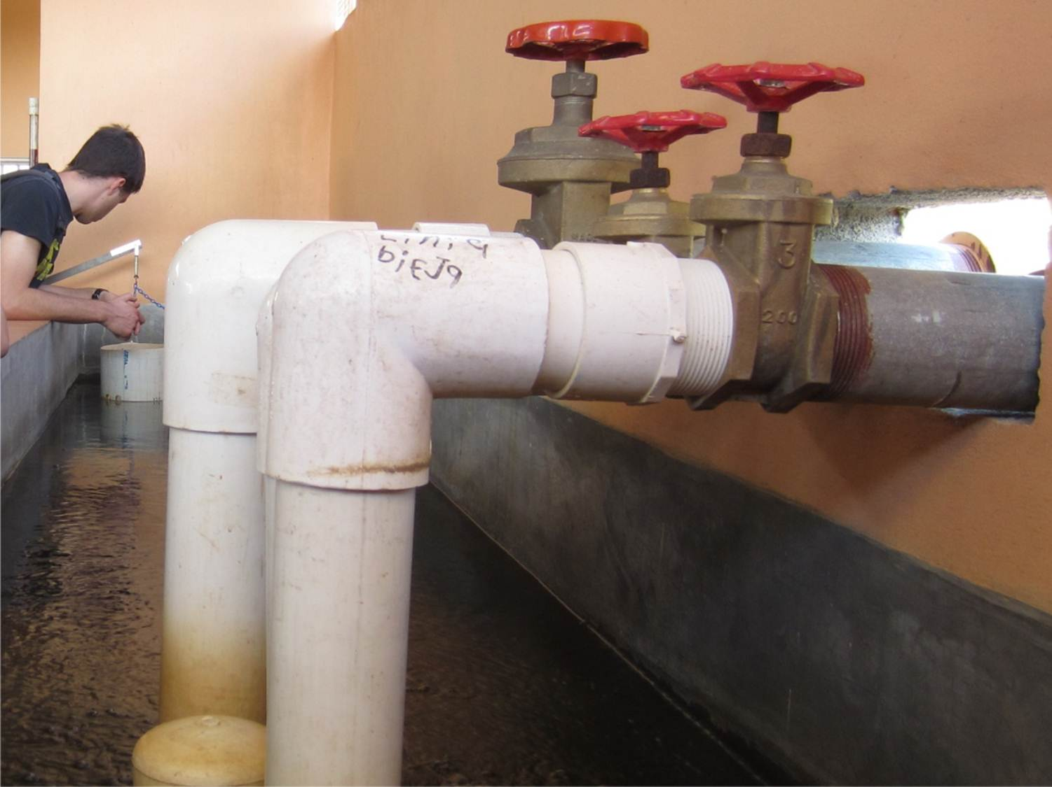

Slide 22
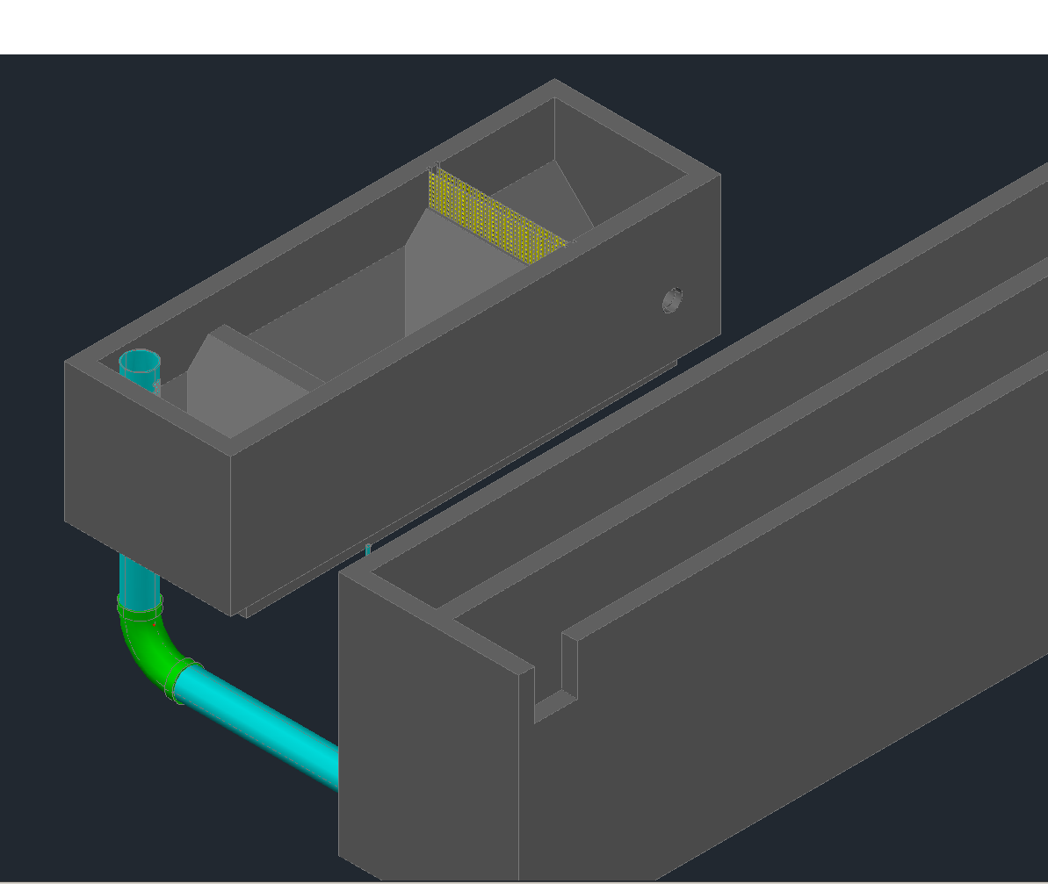
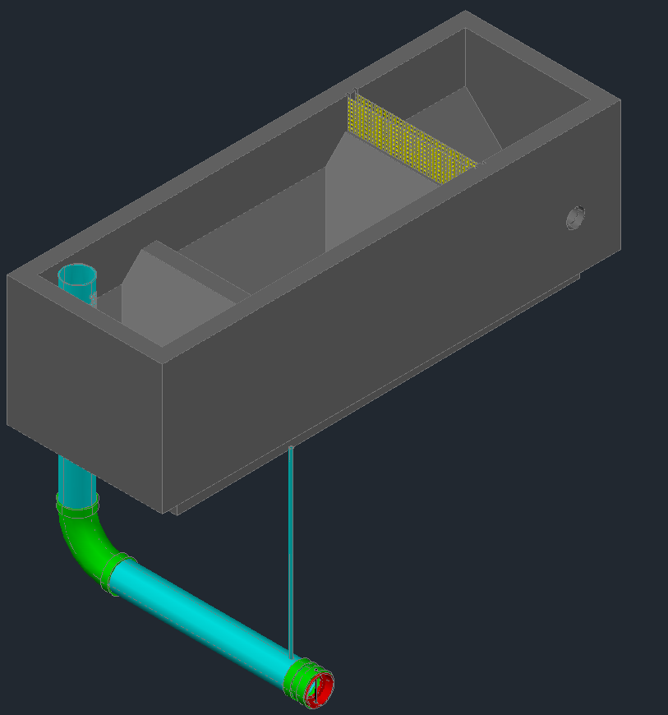
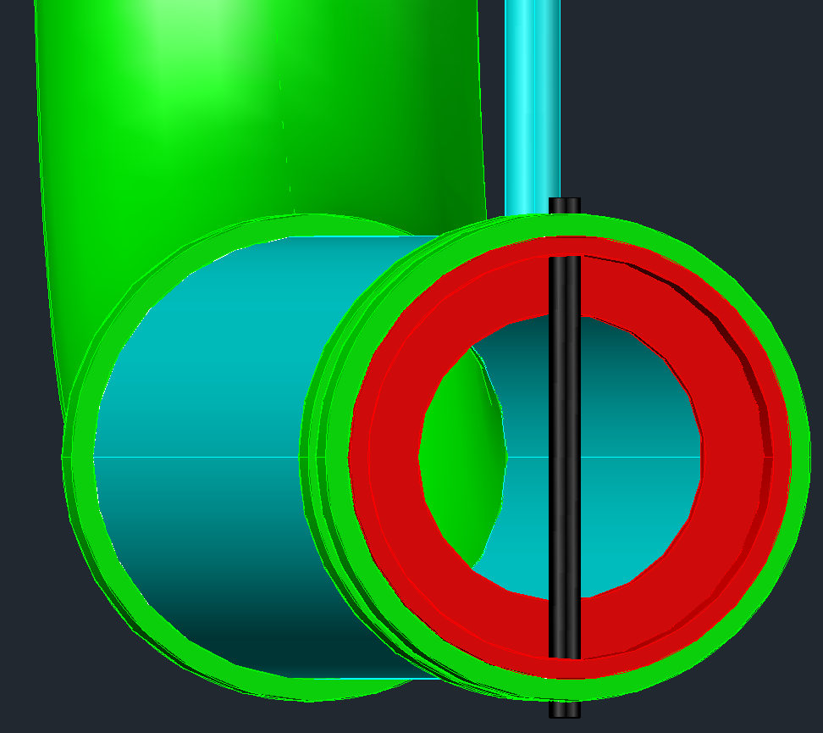
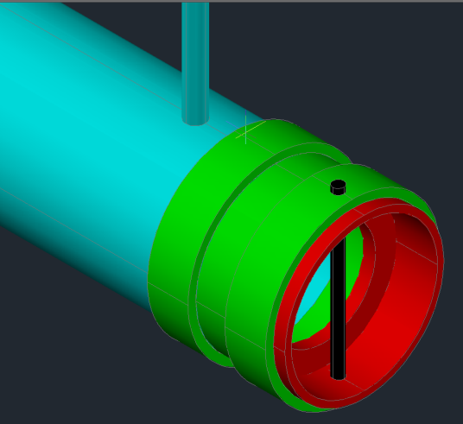
Rapid Mix
Pin to keep plate in place
Access pipe for coagulant delivery tube
Orifice plate
Coagulant delivery tube

Slide 23
How do the flocs grow?

Slide 24
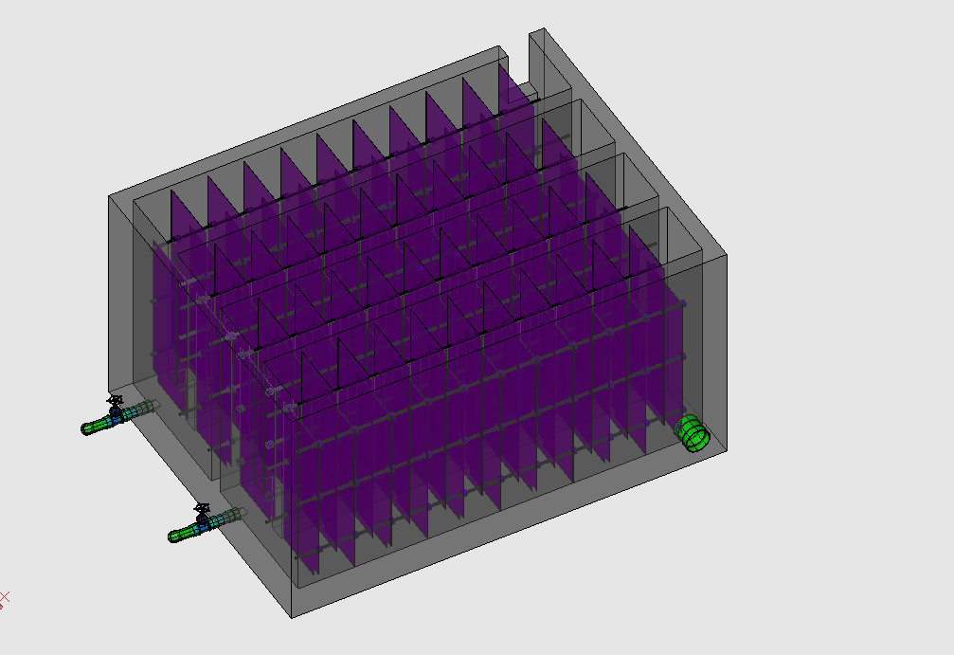
Flocculator
Rapid Mix Pipe

Slide 25
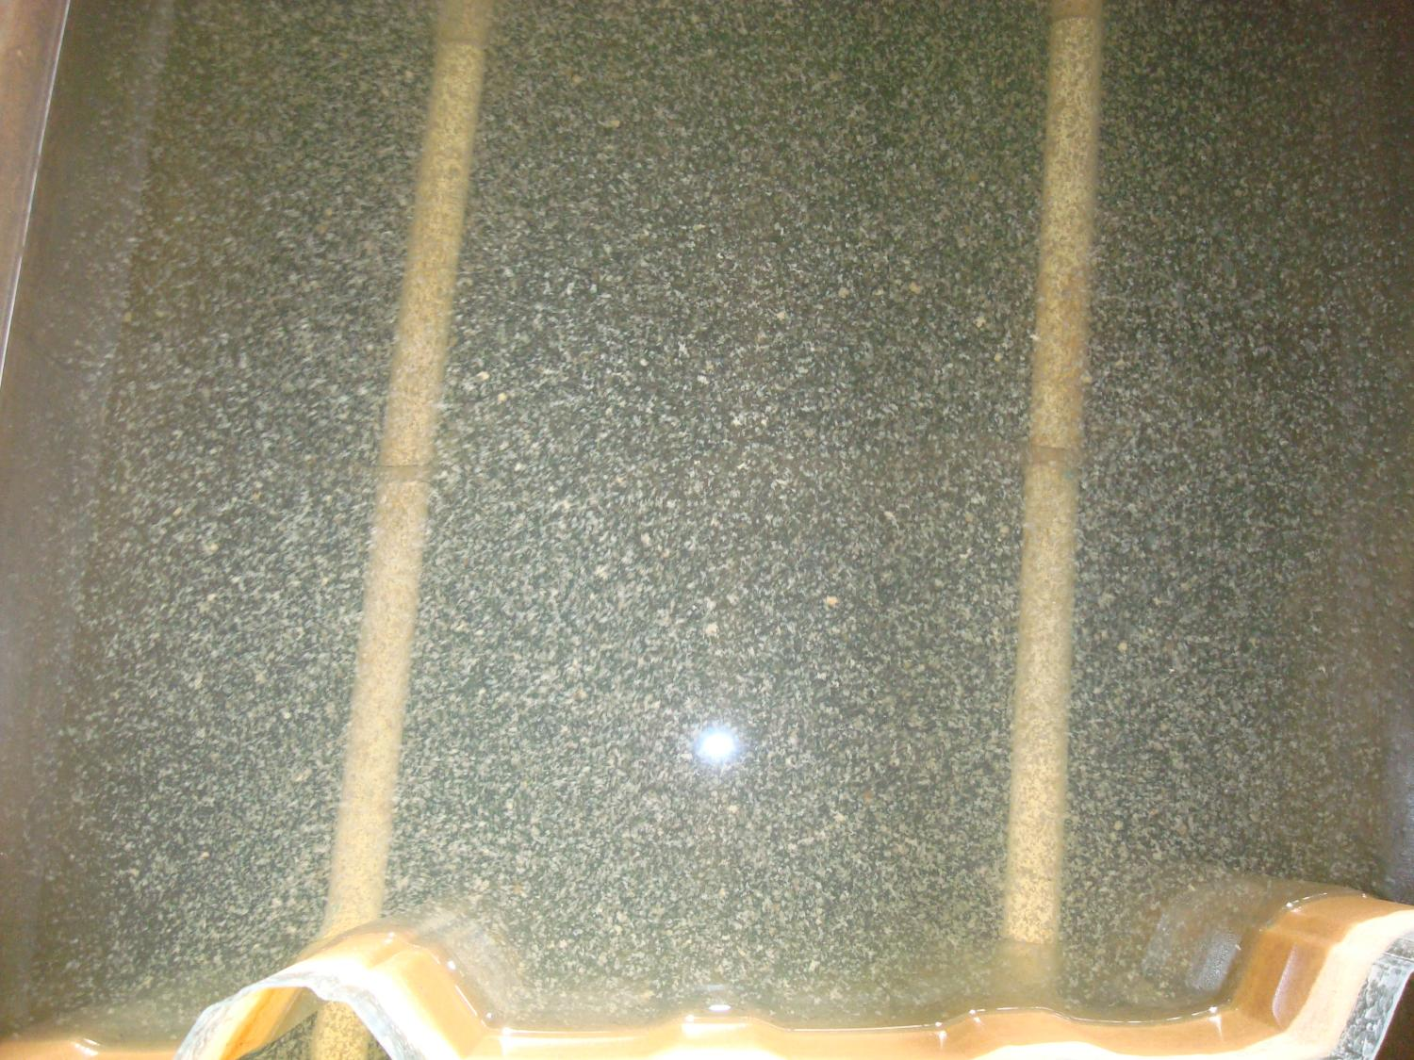

Slide 26
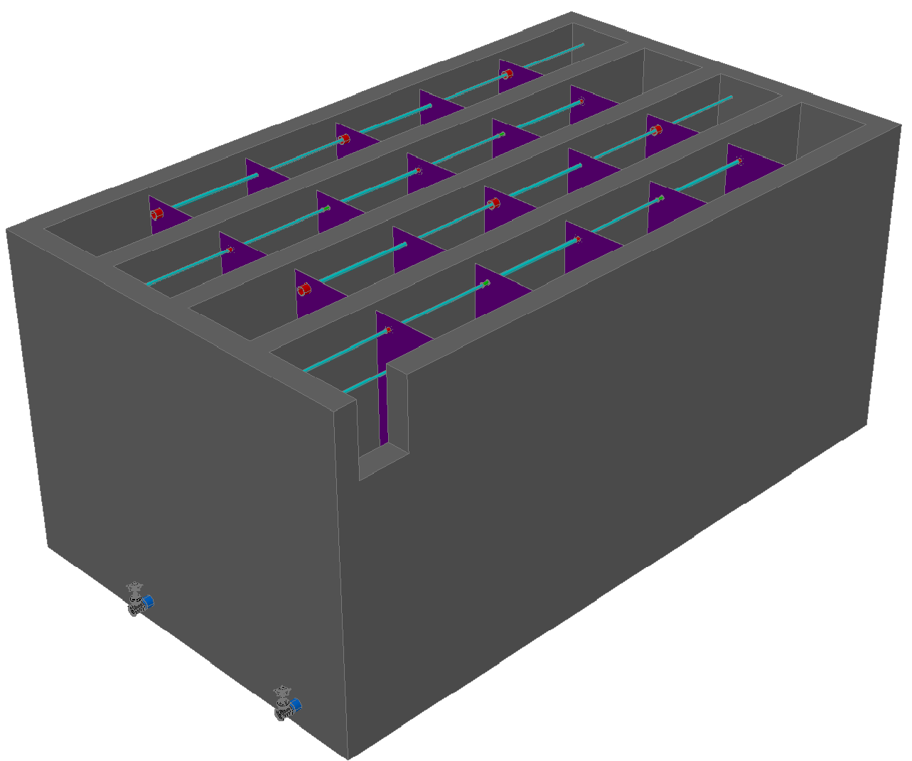
Flocculation

Slide 27
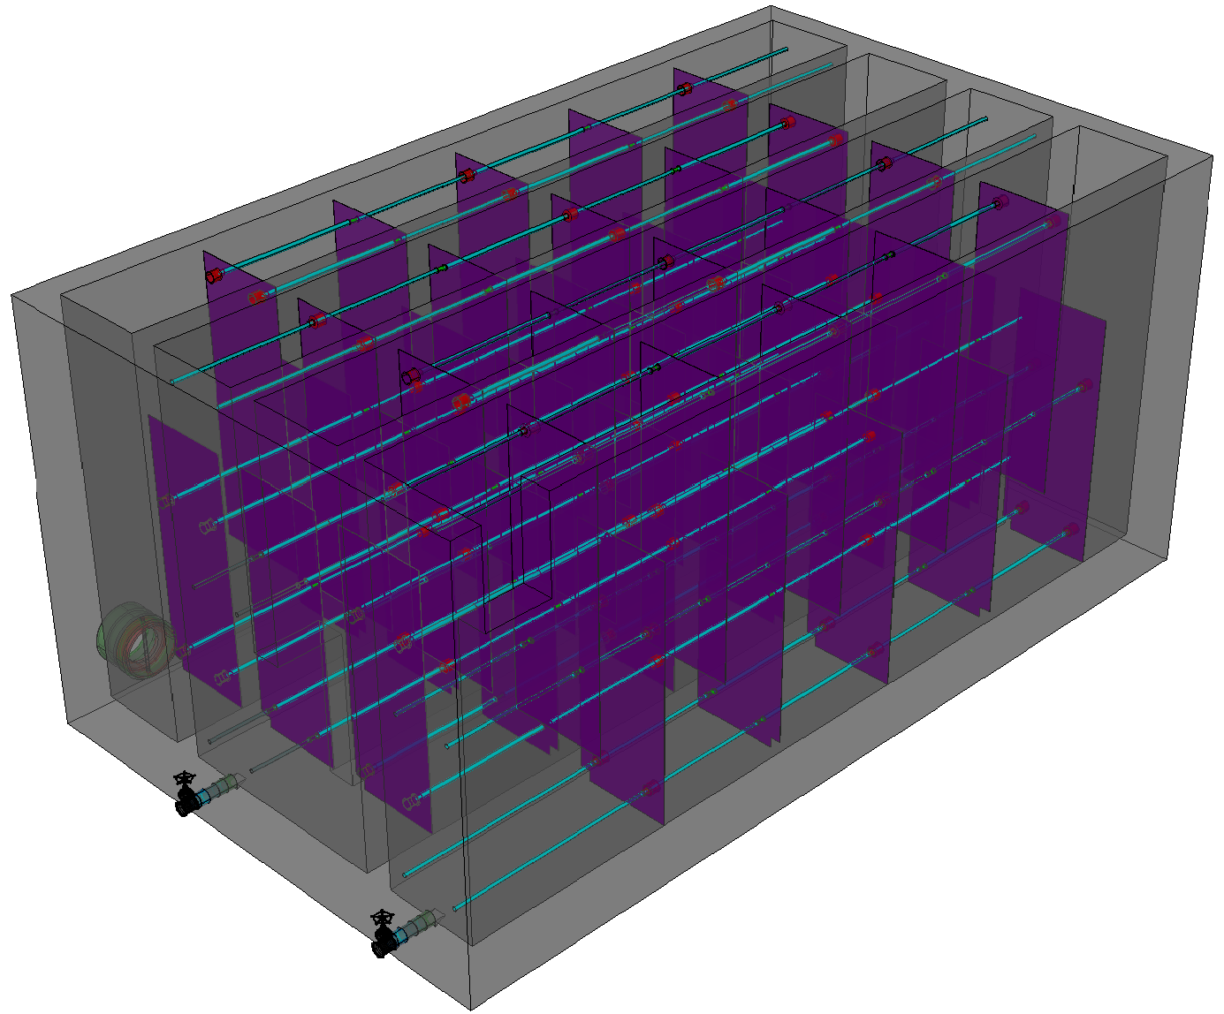
Flocculation

Slide 28
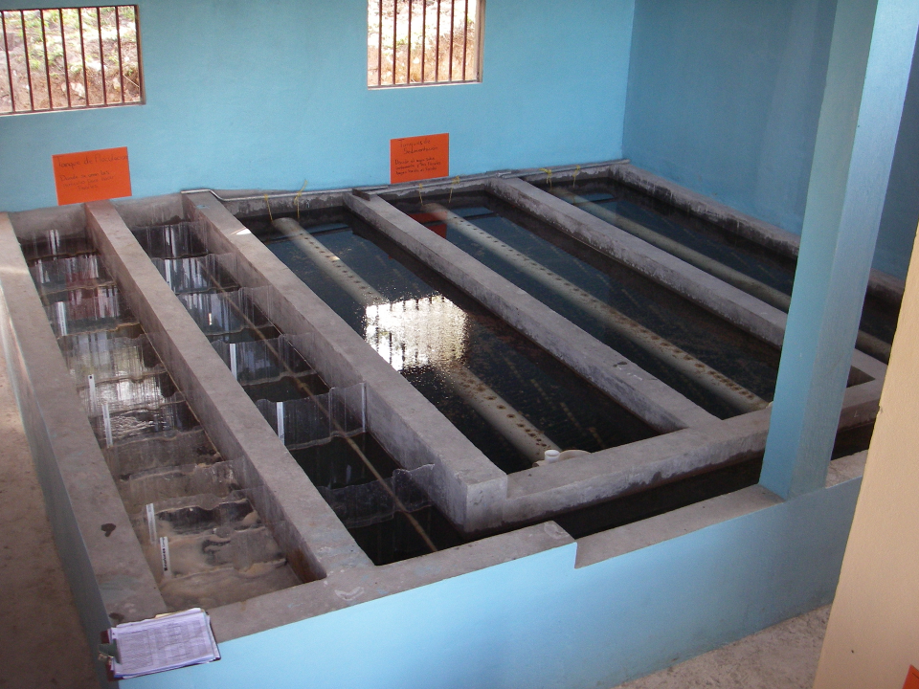
Flocculation - Sedimentation

Slide 29
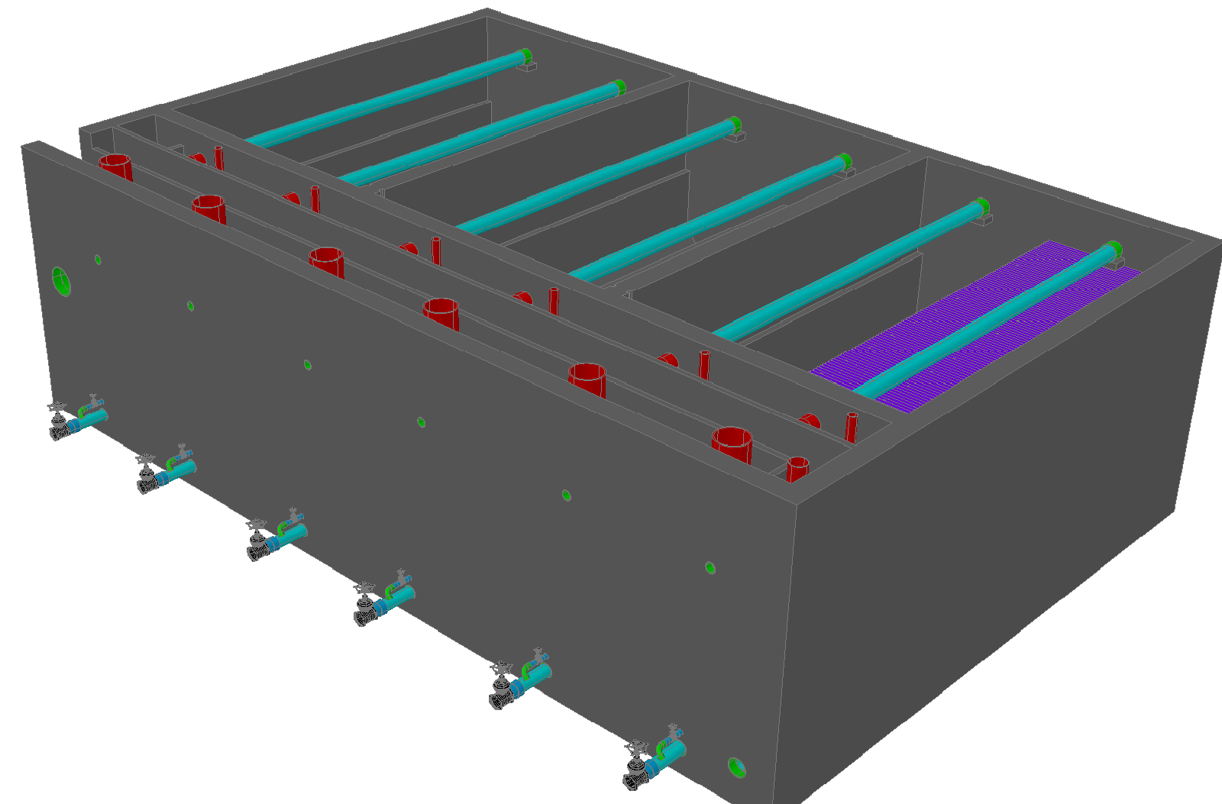
Sedimentation

Slide 30
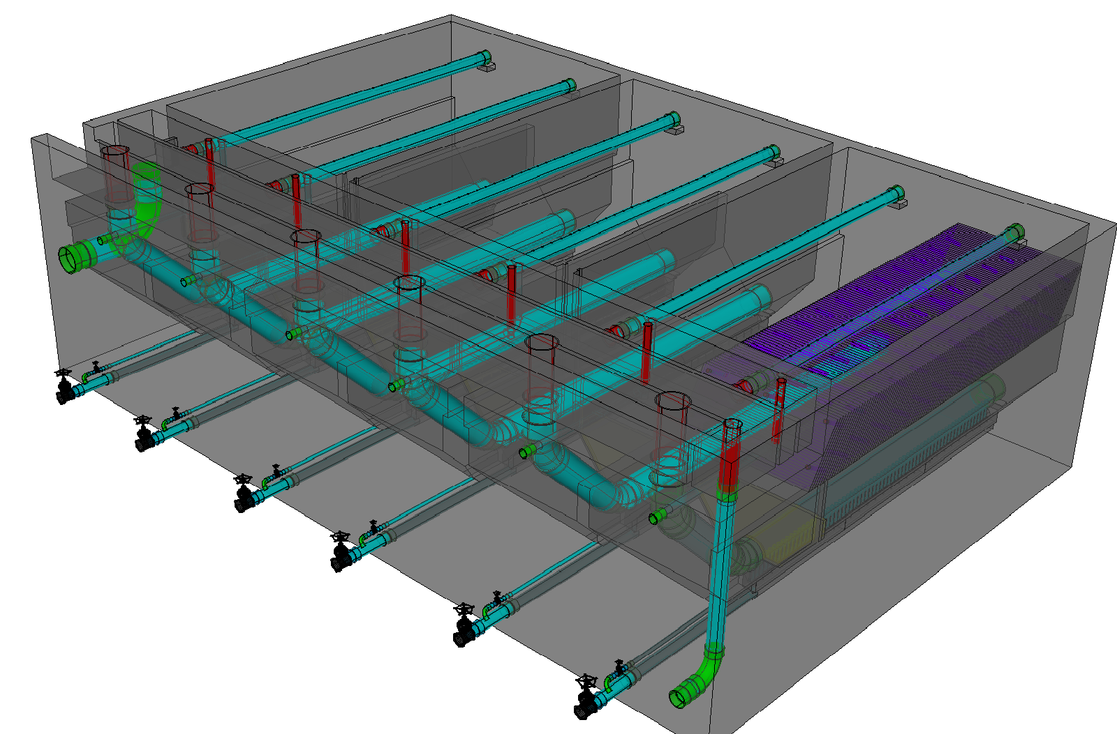
Sedimentation

Slide 31
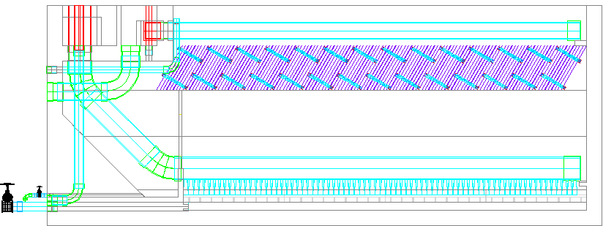
AguaClara Sedimentation Tank
Entrance Channel
Dump poorly flocculated water channel
Exit Channel
Exit Weir that controls water levels all the way back to the next free fall (LFOM!)
Launder
Plate Settlers
Floc Weir
Floc Hopper
Inlet Manifold
Diffusers
Floc Hopper Drain (to remove sludge)
Sed Tank Drain
Notes:
Exercise: Tell the story of the journey of a large floc, a small floc, a rouge loner clay particle, and of a water molecule as each travels through this sedimentation tank.

Slide 32
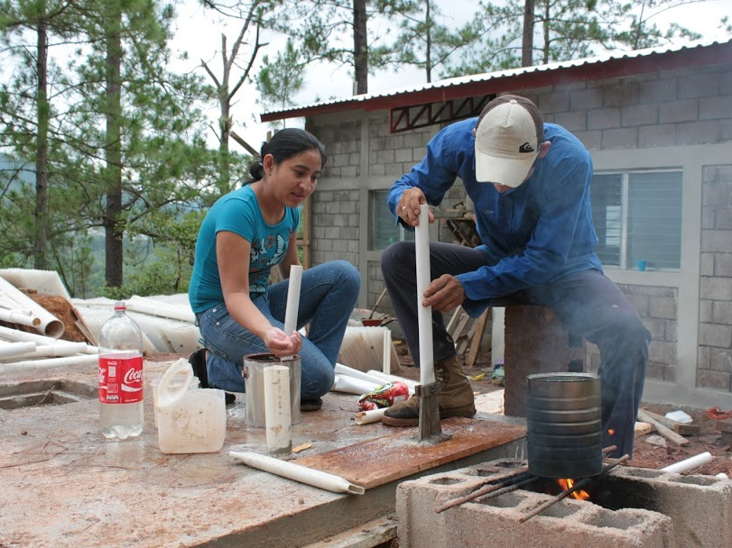
Atima

Slide 33
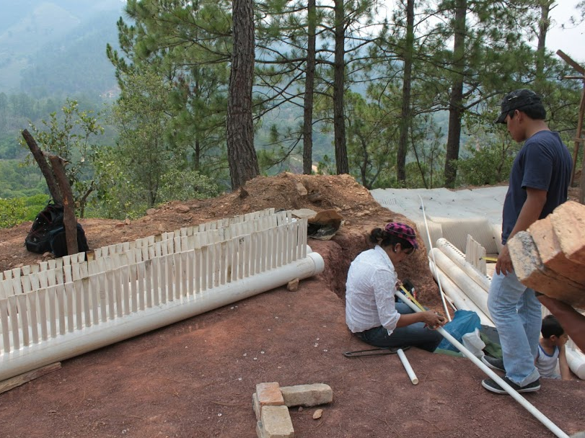

Slide 34
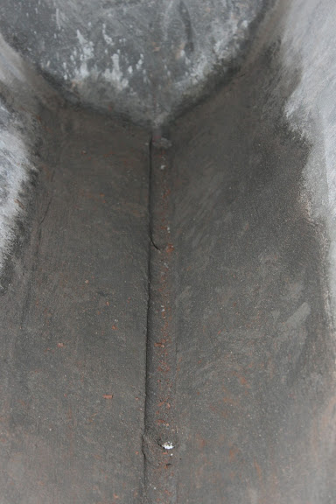
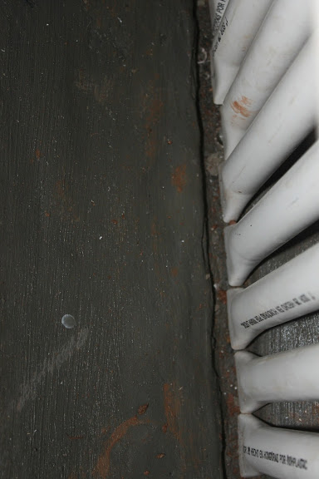

Slide 35
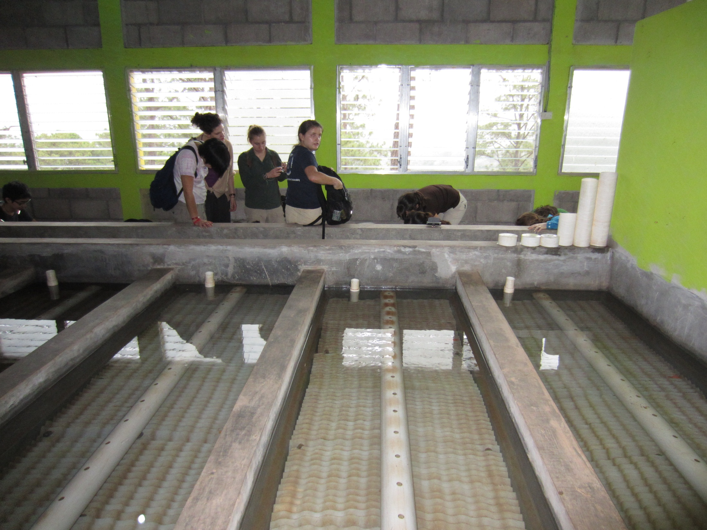
Notes:
http://youtu.be/a8sPdTDIis0
<object width="1280" height="720"><param name="movie" value="http://www.youtube.com/v/a8sPdTDIis0?version=3&amp;hl=en_US&amp;rel=0"></param><param name="allowFullScreen" value="true"></param><param name="allowscriptaccess" value="always"></param><embed src="http://www.youtube.com/v/a8sPdTDIis0?version=3&amp;hl=en_US&amp;rel=0" type="application/x-shockwave-flash" width="1280" height="720" allowscriptaccess="always" allowfullscreen="true"></embed></object>

Slide 36
Floc Blanket Resuspender
Inlet diffuser
drain

Slide 37
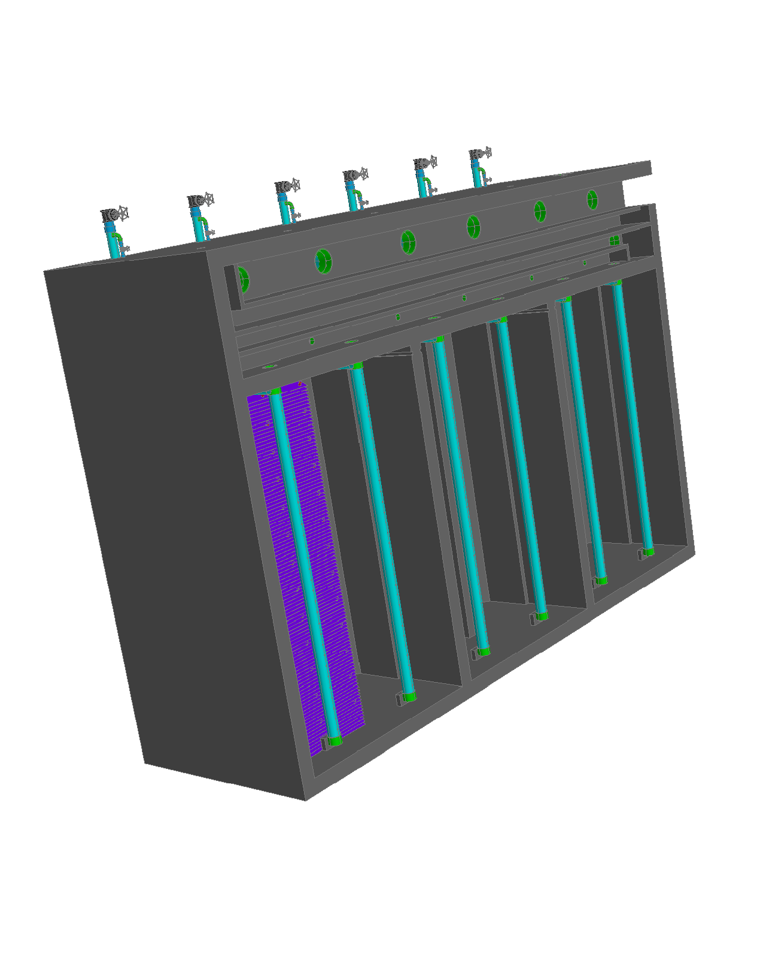
Sedimentation Channels

Slide 38
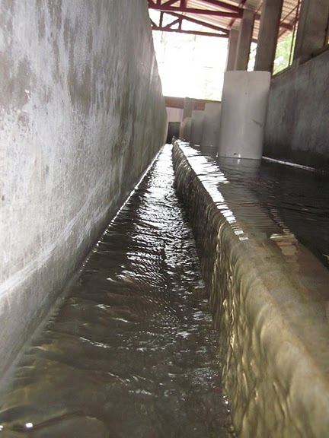
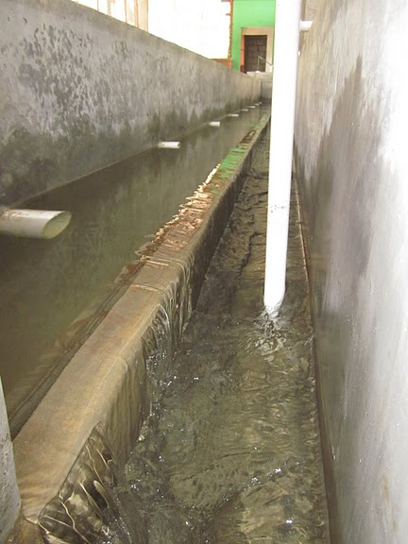
Channels with Weirs
extra
Flocculated Water Channel
Settled Water Channel

Slide 39
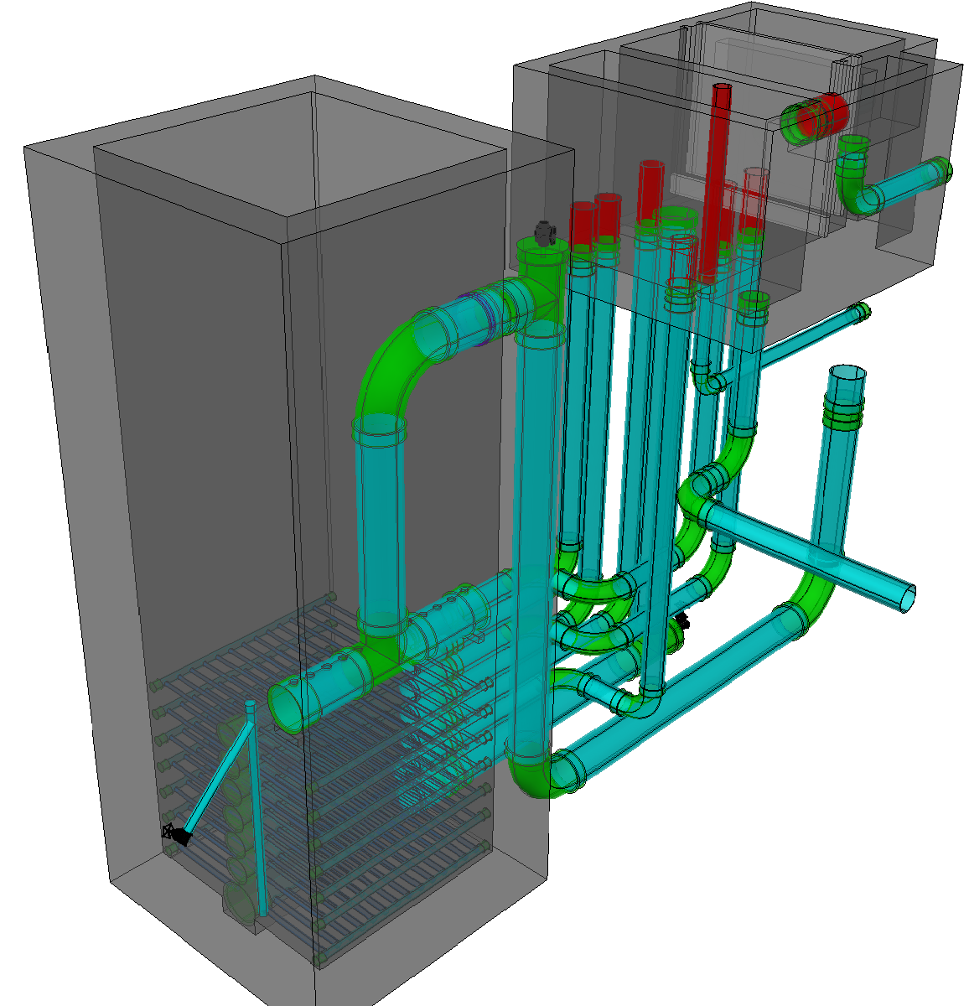
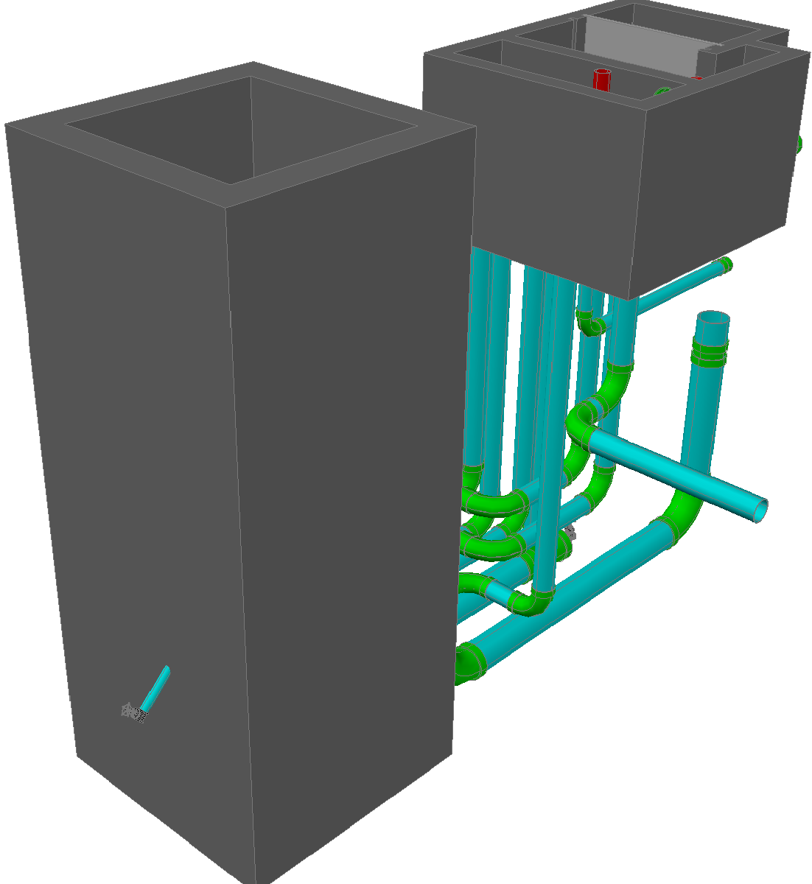
Filter

Slide 40
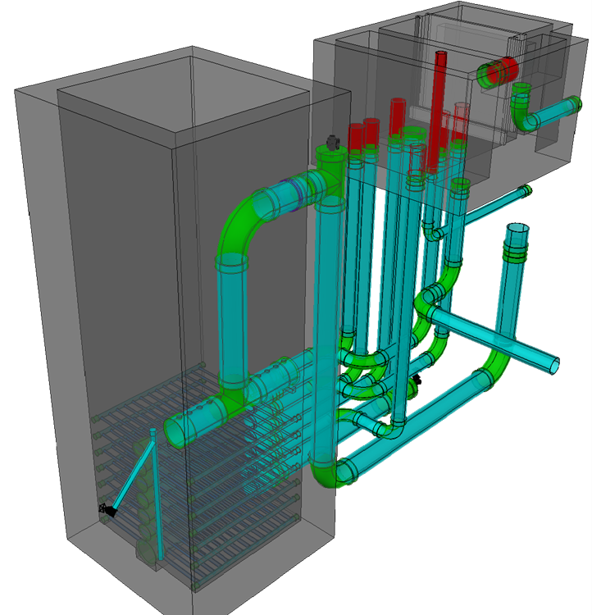

Slide 41
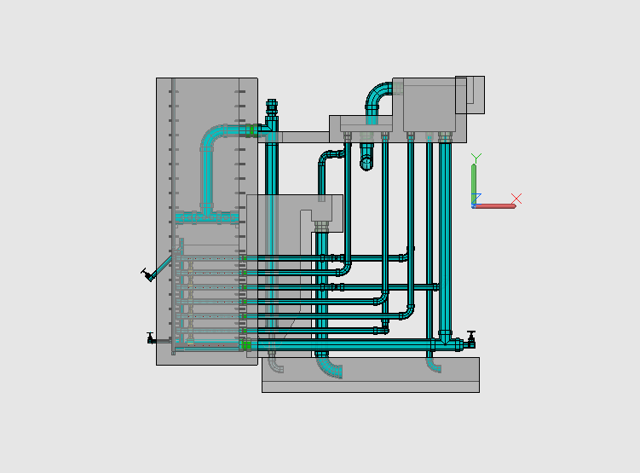
Stacked Rapid Sand Filtration
Filtration Entrance Tank (from Sedimentation Tank)
Exit Tank

Slide 42
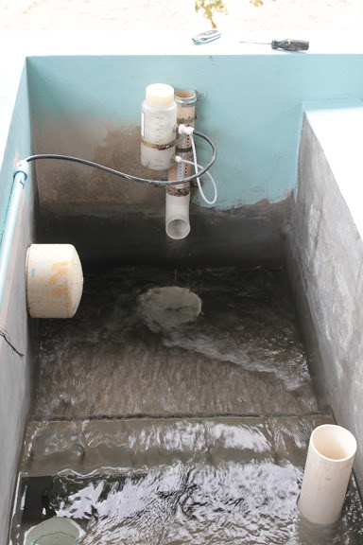
Disinfection
Chlorination using bleach

Slide 43
What does AguaClara do?
Tamara data

Slide 44
Pathogens?
Do AguaClara plants remove pathogens?

Slide 45
More Challenges
1 m deep low flow plant made with stainless steel or plastic tanks
????

