Slide 1
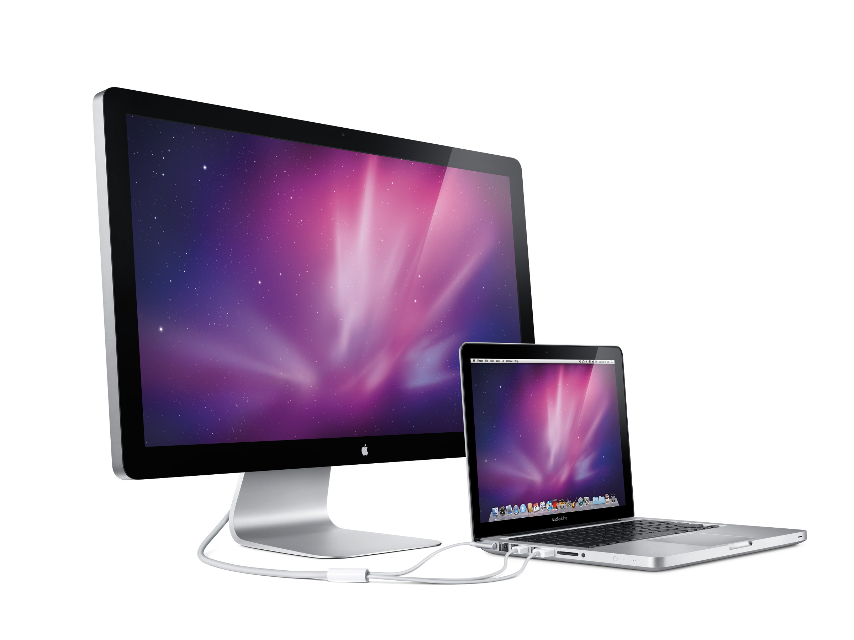
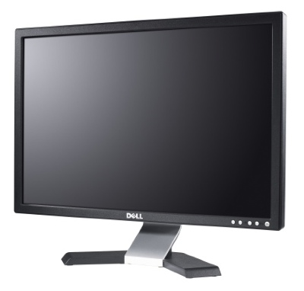
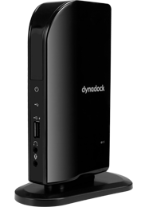

Try one of our NEW
Docking Stations
We purchased two docking stations and would like to know what you think.
Please take time to test them out.
Let us know what you think

