Slide 1

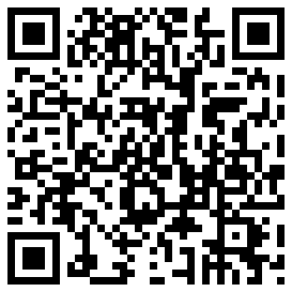
Collaborative Unit 1
Reservable up to 24hrs before group session
Priority given to groups of 2 or more
Integrated Computer with MS Office & Adobe Creative Suite
Reserve this unit or view reservations at:
http://spaces.mannlib.cornell.edu/rooms.php?i=1618

Slide 2
Collaborative Workstation Reservation and Use Policy
Collaborative Workstations are intended for group collaboration. The following policy is to facilitate better use of these spaces for all.
RESERVATIONS HAVE PRIORITY. If you are using an Collaborative Workstation and do not have a valid reservation, you must leave when asked by a group that has a valid reservation. To make a reservation, use the online system at spaces.mannlib.cornell.edu.
Reservations can be made up to 7 days in advance with your Cornell email address.
On any calendar day, you may reserve a maximum of TWO HOURS.
You will have a TEN MINUTE GRACE PERIOD for your reservation. If your group is not present within ten minutes of the start of your reserved time, you will lose the remainder of that hour of your reservation, and another group may use the space for the rest of the hour.
If you leave a Collaborative Workstation unoccupied after the grace period has expired, another group may take the Collaborative Workstation. Any belongings left at an unoccupied Collaborative Workstation will be turned in to the lost and found.
Save your booking confirmation e-mail as it will be used to verify your reservation in the event that two groups claim to have a reservation for the same space and time.
You must make reservations through the online system at spaces.mannlib.cornell.edu. Reservations are not taken over the phone and cannot be made in person.

