Slide 1
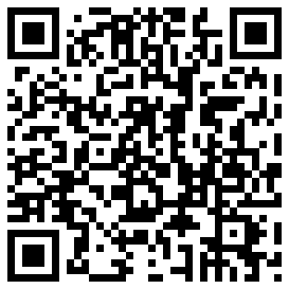

Presentation Room 261
  Room 261 is a reservable presentation space for 2-8 participants
  To reserve this room, go to:
http://spaces.mannlib.cornell.edu/rooms.php?i=1619
or scan
  Space includes:
    50” Lcd screen
    VGA / HDMI connections

Slide 2

About This Room
The room will remaining unlocked during library Hours. No Key Needed.
Reservable up to a week in advance.
To guarantee use of the room, reservations are highly recommended.
If empty, this room may be used until a group with an existing reservation arrives.
RESERVATIONS HAVE PRIORITY. If you are using this room and do not have a reservation, you must leave when asked by a group that has a valid reservation.
Reserve this room at:
http://spaces.mannlib.cornell.edu/rooms.php?i=1619

