Slide 1
Assessing Cataloging
An Administrator’s Perspective
Cross-Institutional Assessment within 2CUL

Slide 2
Assessing “Cataloging”
Acquiring and creating catalog records
Original cataloging
What takes place between receiving and shelf processing
What happens in departments with “cataloging” in the name
What’s done by people called “catalogers.”

Slide 3
Not in Scope (Today)
Serials cataloging
Special collections
“Metadata”

Slide 4
Past Assessment Measures
Processing interval
Productivity
Backlogs
Quality (error rates, user experience)
Professional engagement

Slide 5
“ … a transformative and enduring partnership
… that enables us to pool resources to provide content, expertise, and services that are impossible to accomplish acting alone.”

Slide 6
2CUL: 8 Goals
Improve the quality of collections, services and expertise available to key constituencies
Lay the foundation for a permanent selective integration
Achieve significant integration of operations, services, collections, and resources
Achieve significant cost savings through shared services, joint collections, and elimination of redundancy

Slide 7
2CUL: 8 Goals (cont’d)
Collaborate in generating new resources
Co-invest in critical under-supported areas and innovative new services
Build understanding and support among stakeholders
Share experiences and findings

Slide 8
Phase 1: Laying the Groundwork
Sharing Expertise: Area Specialists
Slavic & East European Studies
Southeast Asian Studies
Latin American & Iberian Studies

Slide 9
Laying the Groundwork (cont’d)
Improving Access
  On-site Borrowing
  Expedited inter-campus delivery
Joint Purchasing, Electronic Resources
  Oxford Bibliographies
  University Press E-Books (2CUL & MaRLI)

Slide 10
Phase 1: Early Successes
Extending Collections:
Slavic: Reduced duplication from 20%-2%
  -- More Bosnian, Latvian, Ukrainian
Latin American:
  More regional, local history

Slide 11
Phase 1: Early Successes
Significant cost savings …
  Share expertise
Columbia savings reinvested in Korean cataloging by Cornell
Co-invest in innovative services:
  Co-development in automating pre-order process
  Chinese purchasing/cataloging plan (reduces cost by ca. 70%)

Slide 12


Phase 2: Getting in Deeper
2CUL Technical Services Integration
TSI
Notes:
We have just finished the final year of a 3 year Mellon grant to explore deep collaboration between Columbia and Cornell. During that time there were some notable accomplishments in technical services. Sarah Elman and others implemented a shared Chinese purchasing/shelf ready plan. POOF which is an enhanced version of our OOF is going live at CU now. Cornell has cataloged Korean and Turkish books for us and we have done some web-archiving for them. We worked with Ex Libris on a design for a shared LMS (library management system) since real efficiencies can only be gained when we work in a shared system.

Slide 13
Why Integrate Technical Services?
Increase scope of language & subject expertise
Eliminate redundant tasks
Many TS tasks can be performed remotely
20% of 2CUL staff works in technical services
Potential for significant reallocation of resources
Model for mainstreaming 2CUL more broadly across both institutions

Slide 14
What technical services?
Acquisitions
Cataloging
E-Resource management
Record Maintenance
Batch loading
___________________________
Shelf processing
Remote storage transfers
Preservation reformatting
ILL/Document delivery

Slide 15
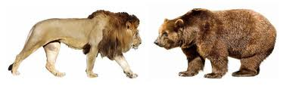
How do we get from here?
Notes:
Harmonizing workflows and changing established cultures won’t be easy. Both libraries have worked long and hard to build efficient workflows and have a lot invested in them. Integration involves compromise and sometimes the lion will win and sometimes it will be the bear. Or the best solution for 2CUL may not seem to be a clear win for either at first. It may also appear to you that there is a kind of standoff where not much is happening. Much of the teams’ work will be theoretical or take place in small pilot projects until we have a shared workspace.

Slide 16
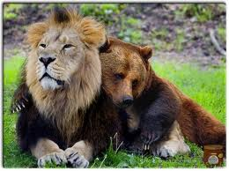
… to here?
Notes:
Our goal will be to be prepared for a shared system and a shared organizational structure as early as 2015. Benefits for both libraries include increased language and subject expertise, the elimination if redundant tasks (especially those that can be done remotely), more clout in negotiating with vendors and most of all, the means to reallocate savings and staff resources into what we can’t do now. For example, the $70,000 Rob Davis saved in de-duping Slavic titles was spent on rare and unique materials neither library could have afforded otherwise.

Slide 17
Towards 2CUL Technical Services:
Thorough review of current policies and practices
Development of best practices for 2CUL
Creation of joint framework for negotiation with vendors and other third parties
Redefinition of job responsibilities
Adoption of new joint organizational structure
Implementation of a shared Library Management System

Slide 18
What We Have in Common
Size
  7-8 million records
  100K+ e-journals
Scope
  Global collections
Consortia
  BorrowDirect, NERL

Slide 19
What’s Different … and Why
Structural differences
  Administrative organization
  Combinations of roles, functions
  Committee structures
  Affiliations
Cultural differences
  Union, non-union
  Decision making
  Locus of power

Slide 20
What’s different – Some Examples
POOF (automated ordering)
Non-Roman scripts
Approach to backlogs
Authority work
Shelf-ready services
Use of students (and resulting outcomes)

Slide 21
What We Say: Core Values
Efficiency
Responsiveness
Quality
Timely access
Collaboration

Slide 22
Selector Role:
Choice of vendor
Standing orders
Shelf-ready
Outsourcing selection (Chinese)
Weighing quality? (of collection)
  vs. efficiency (of processing)

Slide 23
When is a backlog not a backlog?
Make it available (how available?)
Make it discoverable
Do your share (5-year rule)
Weighing responsiveness, efficiency
  vs. quality, collaboration
But, how different are we, really?

Slide 24
What’s good enough?
Evaluating vendor cataloging (Chinese)
Cataloging for others (Korean)
Non-Roman scripts
5-year rule
Authority work:
  Creating new records
  Following up

Slide 25
Do it yourself, or outsource
Authority processing
Shelf-ready services
Cataloging
Budget structures
Use of students

Slide 26
A Matter of Timing
Continual adjustment and lag time
  Effect of backlogs on decisions
Changing realities, uncertain measures
  System capabilities & cost/benefit

Slide 27
No right answer
Size of collection
Strength of programs
User population
Budget structures
Human factors

Slide 28
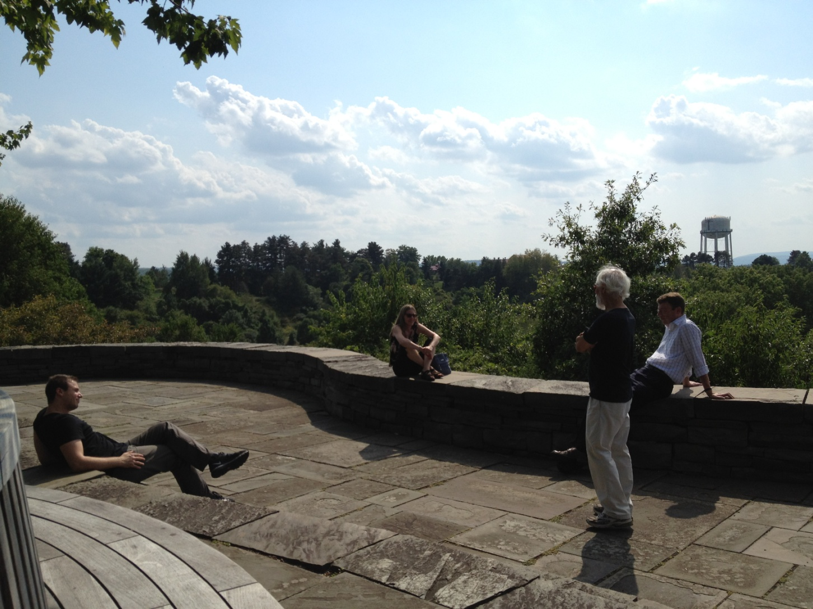
… and then we can relax
Notes:
Breaks and lunch hours are quite different!

