Slide 1
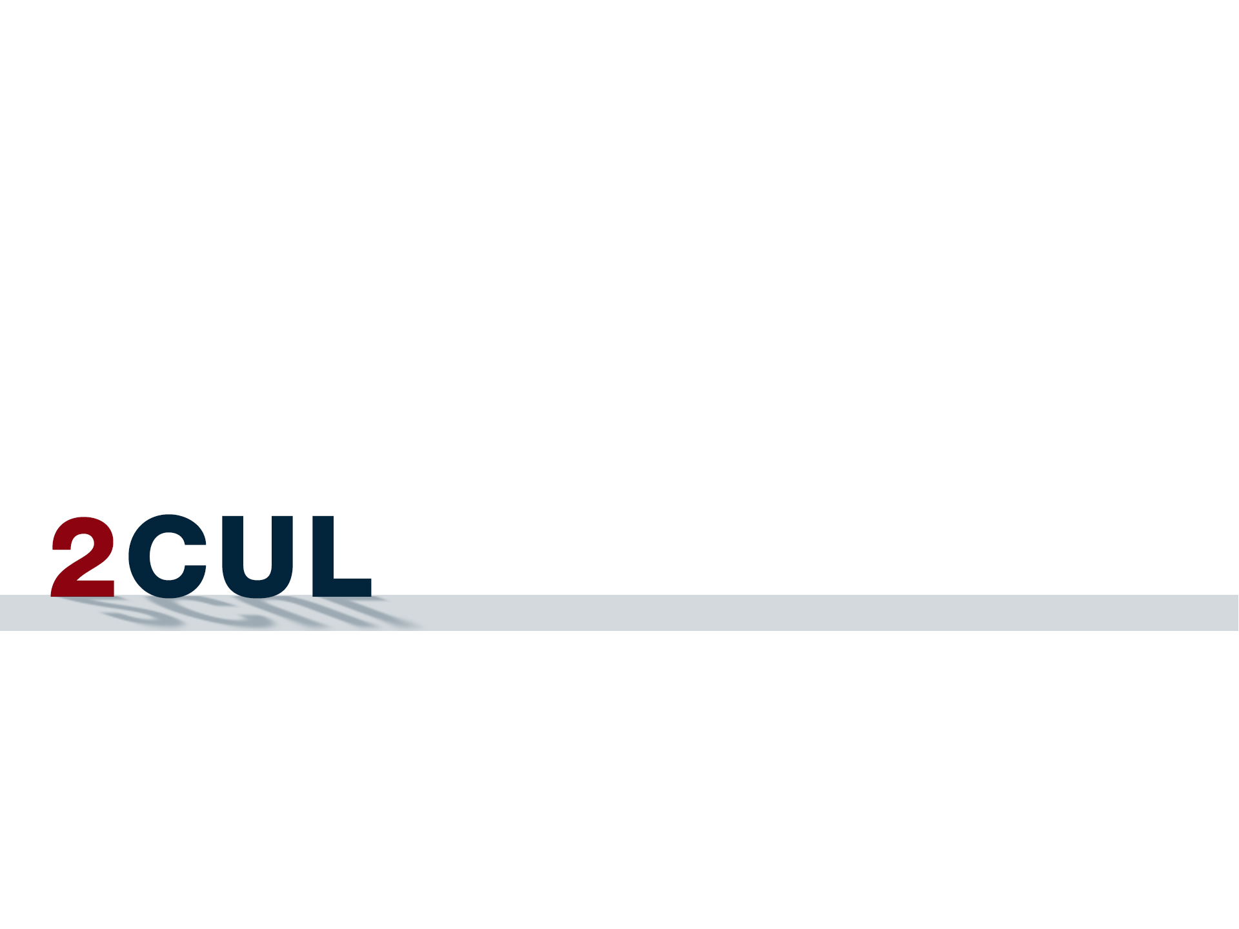
Project Updates
October 22, 2013

Slide 2
Why 2CUL
“ … to pool resources to provide content, expertise, and services that are impossible to accomplish acting alone.”

Slide 3
Phase II Goals
Integration of technical services functions by 2015 (funded by Mellon).
Secure institutional commitment to the 2CUL partnership.
Develop and embrace comprehensive strategies for collection building, resource sharing and discovery, digital preservation, global partnerships, and emerging services.
Select, co-purchase, and implement a joint library management system.
Mainstream 2CUL activities beyond technical services integration.
Ensure support for 2CUL by faculty and students.
Enable budgetary transparency on behalf of 2CUL.
Assess and implement additional partnership arrangements with other institutions on behalf of 2CUL.

Slide 4
Where We Are
Governance (Anne Kenney and Jim Neal)
Collection Development (John Saylor and Damon Jaggars)
Public Services (Damon Jaggars and AUL to be hired)
Digital Preservation (Oya Rieger and Bob Wolven)
Discovery and Access (Dean Krafft and Rob Cartolano)
Alma (Rob Cartolano, Jim LeBlanc, Xin Li, Chris Manly, Bob Wolven)
Opportunities to Take 2CUL Further (Respective AULs)
Technical Services Integration (Jim LeBlanc and Kate Harcourt)

Slide 5
Questions?
Comments?
Suggestions?

Slide 6
TSI Update
October 22, 2013

Slide 7
Why Integrate Technical Services?
To increase significantly the scope of our local skills and expertise
To eliminate redundant tasks and take advantage of evolving changes in staff capacity
Many technical services tasks can be performed remotely
20% of 2CUL staff works in technical services

Slide 8
How to Integrate Technical Services?
Middle-Out Approach
Phase 1: role of functional working groups – information exchange (Spring/Summer 2013)
Phase 2: role of JSMIN – “soft” integration (Fall 2013 – Spring 2015)
Alma implementation?

Slide 9
Examples of Collaboration
Large and small gains
Language expertise
Training
Projects
Grants
New Workflows

Slide 10
For More Information:
TSI Wiki:
https://confluence.cornell.edu/display/2cullts/2CUL+Phase+2+--+Technical+Services+Integration
… or just google “2CUL technical services”

