Slide 1


2CUL Technical Services Integration
TSI
Notes:
We have just finished the final year of a 3 year Mellon grant to explore deep collaboration between Columbia and Cornell. During that time there were some notable accomplishments in technical services. Sarah Elman and others implemented a shared Chinese purchasing/shelf ready plan. POOF which is an enhanced version of our OOF is going live at CU now. Cornell has cataloged Korean and Turkish books for us and we have done some web-archiving for them. We worked with Ex Libris on a design for a shared LMS (library management system) since real efficiencies can only be gained when we work in a shared system.

Slide 2
TSI Steering Committee shall be formed to oversee the process whereby Columbia and Cornell Technical Services unify operations as far as possible while identifying local practices and workflows that must remain institution specific.
Notes:
This summer we began phase 2 of 2CUL which concentrates on technical services integration. When faced with a difficult process, we did what we always do and appointed a steering committee. Our charge reads: We have a Mellon grant in the review process which may help fund this but technical services integration planning is not dependent on grant money or Ex Libris. Our goal is to be prepared for a shared system and a shared organizational structure as early as 2015.

Slide 3
TSI Steering Committee
Kate Harcourt & Jim LeBlanc, Co-Chairs
Adam Chandler
Colleen Major
Boaz Nadav-Manes
Robert Rendall
Notes:
The Steering Committee is formed of equal numbers from Columbia and Cornell and was chosen to represent acqusitions, cataloging and metadata, e-resources and automation. We will be forming task groups and initiating pilot projects to review all existing technical services policies and practices with a view toward reconciling them as much as possible with a lot of help from many of you.

Slide 4
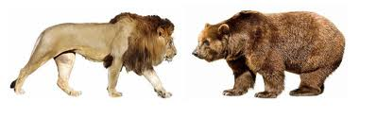
Changing established cultures won’t be easy
Notes:
Harmonizing workflows and changing established cultures won’t be easy. Both libraries have worked long and hard to build efficient workflows and have a lot invested in them. Integration involves compromise and sometimes the lion will win and sometimes it will be the bear. Or the best solution for 2CUL may not seem to be a clear win for either at first. It may also appear to you that there is a kind of standoff where not much is happening. Much of the teams’ work will be theoretical or take place in small pilot projects until we have a shared workspace.

Slide 5
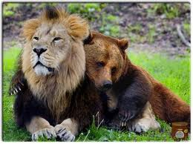
Our goal will be to be prepared for a shared system
Notes:
Our goal will be to be prepared for a shared system and a shared organizational structure as early as 2015. Benefits for both libraries include increased language and subject expertise, the elimination if redundant tasks (especially those that can be done remotely), more clout in negotiating with vendors and most of all, the means to reallocate savings and staff resources into what we can’t do now. For example, the $70,000 Rob Davis saved in de-duping Slavic titles was spent on rare and unique materials neither library could have afforded otherwise.

Slide 6
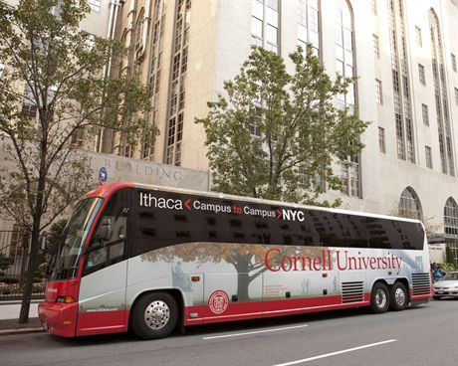
Road Trips!
Notes:
So how will we work? Geography is a challenge and Ithaca is said to be centrally isolated. It is 5 hours by bus from NYC. The team plans many skype and conference calls as well as several face to face visits each year. We just took a 2 day trip to Ithaca and you may see the Cornell folks here in November.

Slide 7
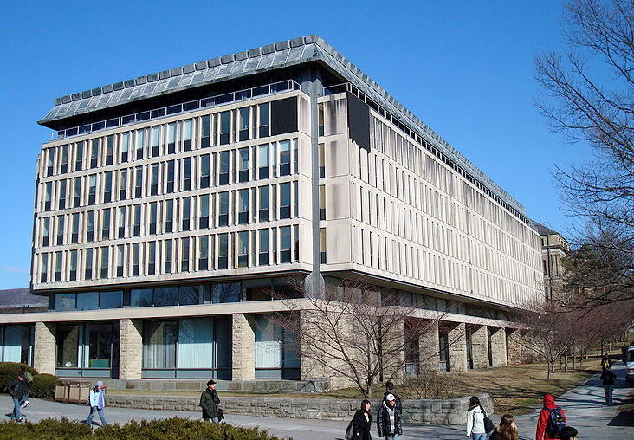
Olin Library which is the main campus library
Notes:
This is a picture of Olin Library which is the main campus library—much newer than Butler!

Slide 8
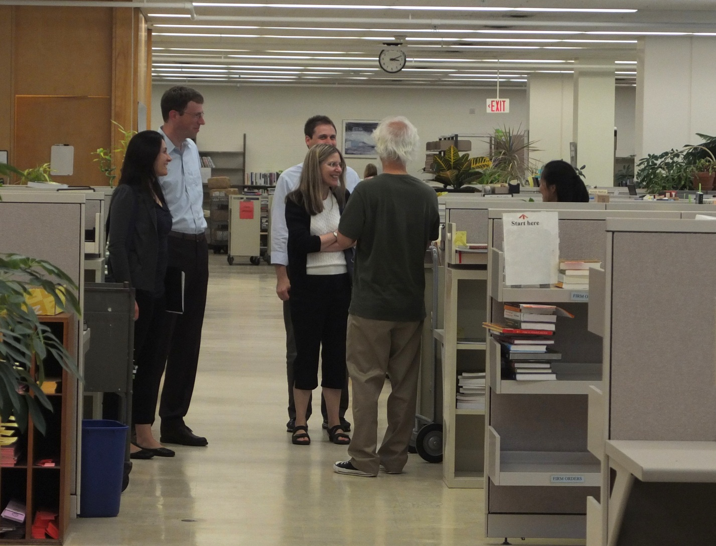
Cornell Technical Services looks very similar.
However out of sight to the right are full length picture windows with views of campus and Cayuga Lake!
Notes:
Technical services looks very similar. However out of sight to the right are full length picture windows with views of campus and Cayuga Lake!

Slide 9
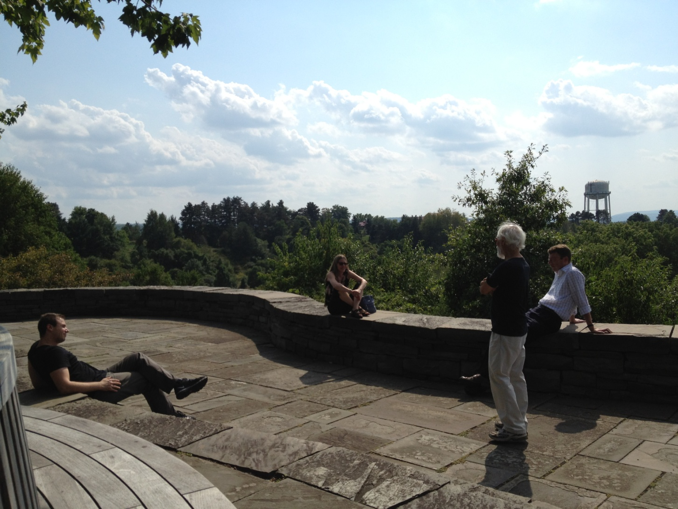
Breaks and lunch hours are quite different!
Notes:
Breaks and lunch hours are quite different!

Slide 10
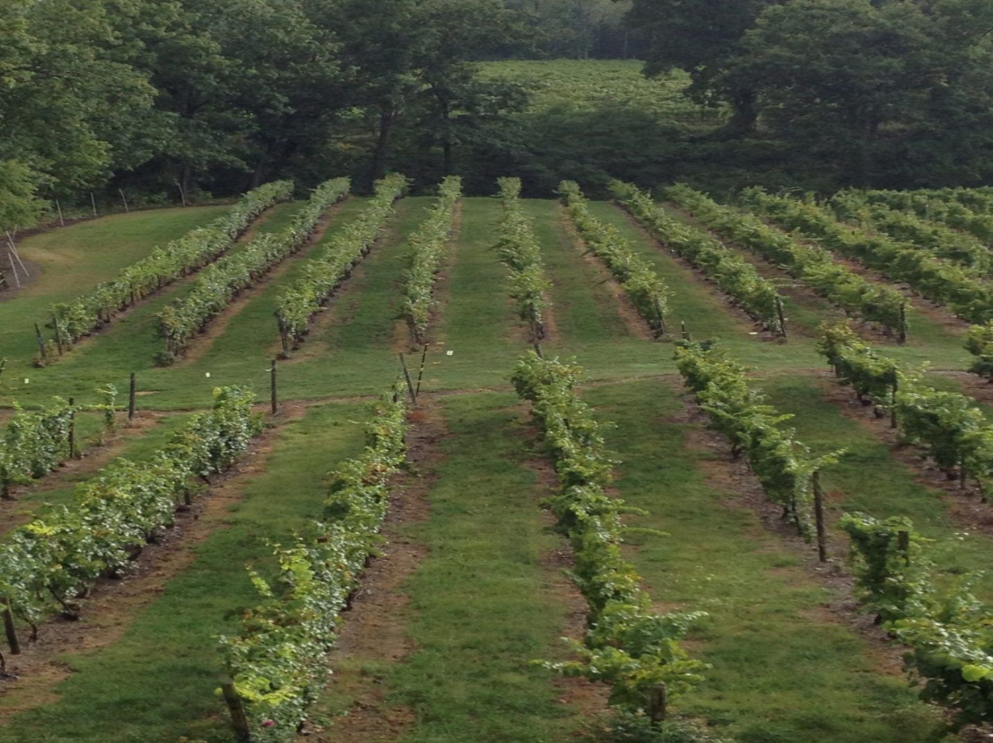
Ithaca is very rural
One doesn’t even need to go off campus to see vineyards and apple orchards.
Notes:
Ithaca is very rural and one doesn’t even need to go off campus to see vineyards and apple orchards.

Slide 11
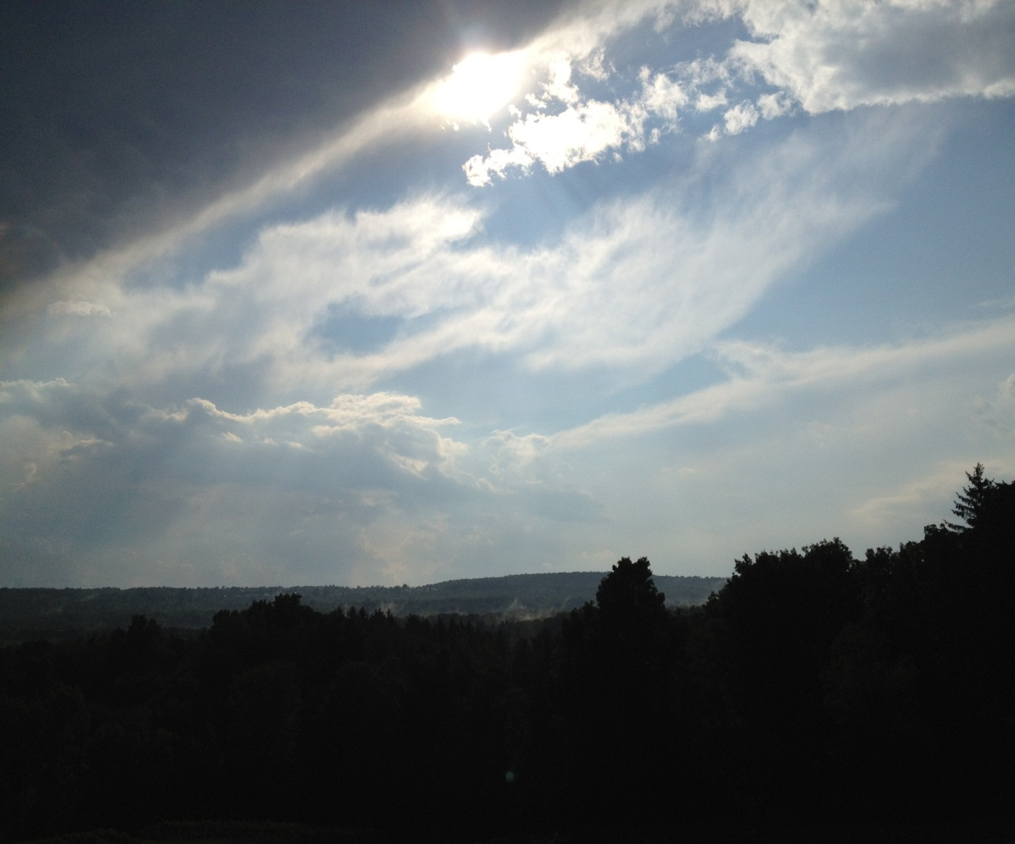
Questions?
Notes:
Questions?

Slide 12
Credits: slides 9, 10, 11 from Colleen Major
Slide 8 from Adam Chandler
Other images from public domain

