Slide 1
Cornell/Columbia Collaboration
Update April 2013

Slide 2
2CUL
“ … a transformative and enduring partnership
… that enables us to pool resources to provide content, expertise, and services that are impossible to accomplish acting alone.”

Slide 3
2CUL: 8 Goals
Improve the quality of collections, services and expertise available to key constituencies
Lay the foundation for a permanent selective integration
Achieve significant integration of operations, services, collections, and resources
Achieve significant cost savings through shared services, joint collections, and elimination of redundancy

Slide 4
2CUL: 8 Goals (cont’d)
Collaborate in generating new resources
Co-invest in critical under-supported areas and innovative new services
Build understanding and support among stakeholders
Share experiences and findings

Slide 5
Phase 1: Laying the Groundwork
Sharing Expertise: Area Specialists
Slavic & East European Studies
Southeast Asian Studies
Latin American & Iberian Studies

Slide 6
Phase 1: Early Successes
Extending Collections:
Slavic: Reduced duplication from 20%-2%
  -- More Bosnian, Latvian, Ukrainian
Latin American:
  More regional, local history

Slide 7
Phase 1: Early Successes
Significant cost savings …
  Share expertise
Columbia savings reinvested in Korean cataloging by Cornell
Co-invest in innovative services:
  Co-development in automating pre-order process
  Chinese purchasing/cataloging plan (reduces cost by ca. 70%)

Slide 8
Laying the Groundwork (cont’d)
Improving Access
  On-site Borrowing
  Expedited inter-campus delivery
Joint Purchasing, Electronic Resources
  Oxford Bibliographies
  University Press E-Books (2CUL & MaRLI)

Slide 9


Phase 2: Getting in Deeper
2CUL Technical Services Integration
TSI
Notes:
We have just finished the final year of a 3 year Mellon grant to explore deep collaboration between Columbia and Cornell. During that time there were some notable accomplishments in technical services. Sarah Elman and others implemented a shared Chinese purchasing/shelf ready plan. POOF which is an enhanced version of our OOF is going live at CU now. Cornell has cataloged Korean and Turkish books for us and we have done some web-archiving for them. We worked with Ex Libris on a design for a shared LMS (library management system) since real efficiencies can only be gained when we work in a shared system.

Slide 10
What technical services?
Acquisitions
Cataloging
E-Resource management
Record Maintenance
Batch loading
___________________________
Shelf processing
Remote storage transfers
Preservation reformatting
ILL/Document delivery

Slide 11
Why Integrate Technical Services?
Increase scope of language & subject expertise
Eliminate redundant tasks
Many TS tasks can be performed remotely
20% of 2CUL staff works in technical services
Potential for significant reallocation of resources
Model for mainstreaming 2CUL more broadly across both institutions

Slide 12
Everybody’s Doing It
Kenyon, Denison colleges (Ohio)
New York Public, Brooklyn Public
University of California System
  … or planning to.

Slide 13
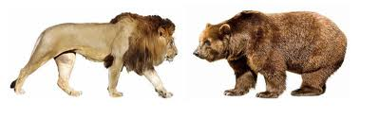
How do we get from here?
Notes:
Harmonizing workflows and changing established cultures won’t be easy. Both libraries have worked long and hard to build efficient workflows and have a lot invested in them. Integration involves compromise and sometimes the lion will win and sometimes it will be the bear. Or the best solution for 2CUL may not seem to be a clear win for either at first. It may also appear to you that there is a kind of standoff where not much is happening. Much of the teams’ work will be theoretical or take place in small pilot projects until we have a shared workspace.

Slide 14
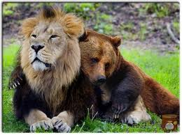
… to here?
Notes:
Our goal will be to be prepared for a shared system and a shared organizational structure as early as 2015. Benefits for both libraries include increased language and subject expertise, the elimination if redundant tasks (especially those that can be done remotely), more clout in negotiating with vendors and most of all, the means to reallocate savings and staff resources into what we can’t do now. For example, the $70,000 Rob Davis saved in de-duping Slavic titles was spent on rare and unique materials neither library could have afforded otherwise.

Slide 15
Towards 2CUL Technical Services:
Thorough review of current policies and practices
Development of best practices for 2CUL
Creation of joint framework for negotiation with vendors and other third parties
Redefinition of job responsibilities
Adoption of new joint organizational structure
Implementation of a shared Library Management System

Slide 16
What gets in the way
Distance
Technical difficulties
Structural differences
Cultural differences
Time

Slide 17
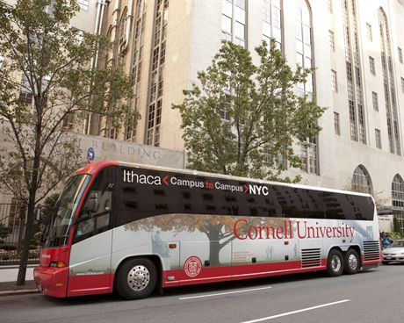
Road Trips!
Notes:
So how will we work? Geography is a challenge and Ithaca is said to be centrally isolated. It is 5 hours by bus from NYC. The team plans many skype and conference calls as well as several face to face visits each year. We just took a 2 day trip to Ithaca and you may see the Cornell folks here in November.

Slide 18
Challenges of Long-Distance Collaboration
230 miles apart, 4-hour bus ride!
conference calls
videoconferencing
  Skype/WebEx
  Polycom
face-to-face meetings

Slide 19
Technical Difficulties
Same technology, separate systems
2011- Virtual Machine environment
Working towards joint system
  2011-2012 Project Scoping Analysis
  2013 Contract development
  2014 Pre-implementation phase
  2015? Implementation

Slide 20
System Integration Challenges
Two distinct financial systems
Two campus IT infrastuctures (e.g., identity management
“Selective integration”
  Columbia zone/database
  Cornell zone
  2CUL zone

Slide 21
Structural differences
  Administrative organization
  Combinations of roles, functions
  Committee structures
  Affiliations
Cultural differences
  Union, non-union
  Decision making
  Locus of power

Slide 22
How we’re getting there
TSI Steering Committee
Working Groups
  Self organizing
  Authority to make changes
Administrative Team
  Budgetary, HR, cross-group issues
Joint Committees
  Collection Development, E-Resources

Slide 23
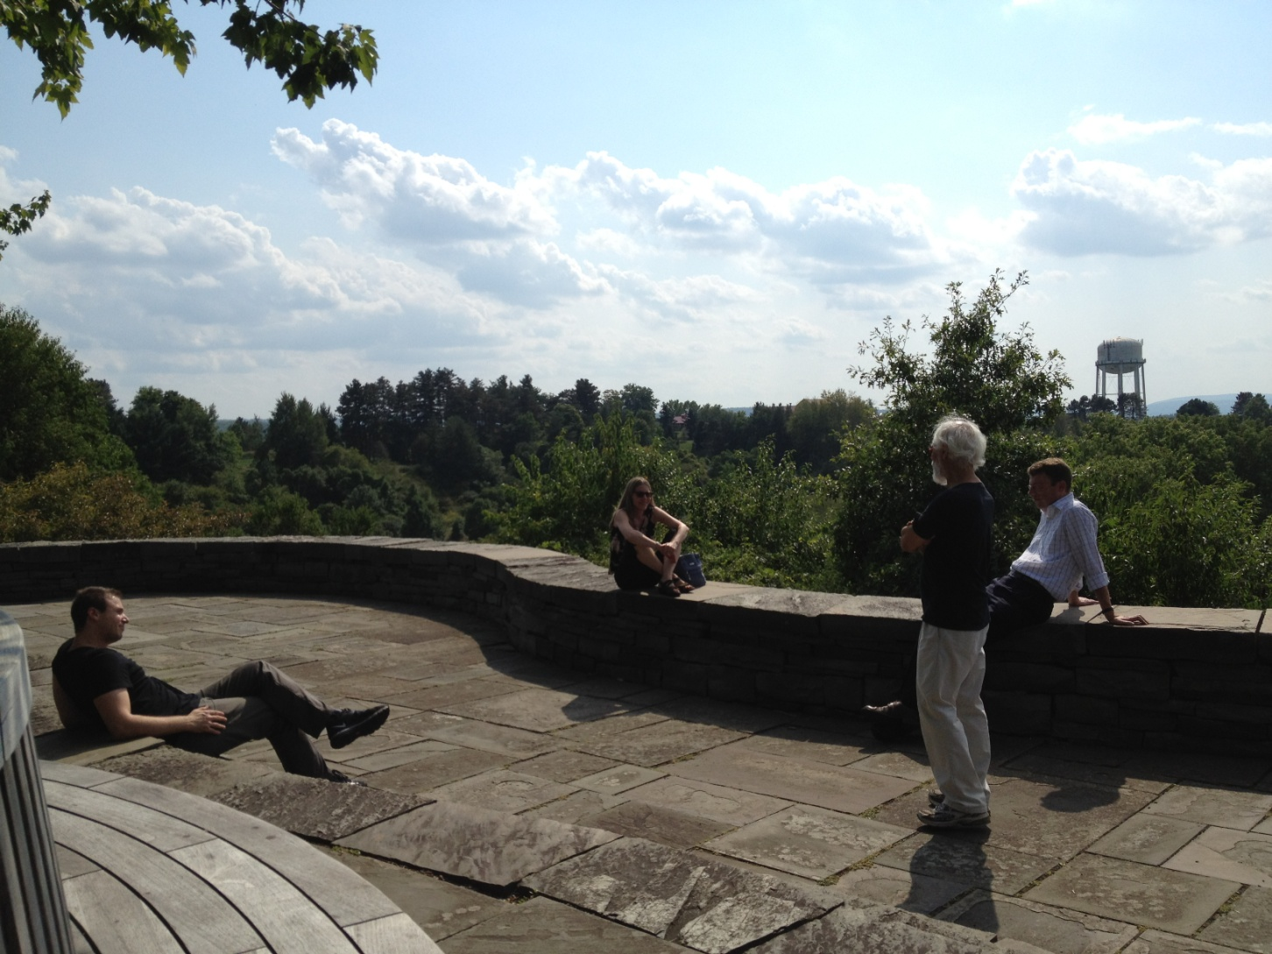
… and then we can relax
Notes:
Breaks and lunch hours are quite different!

