Slide 1
How Water Flows Through the Plant

Slide 2
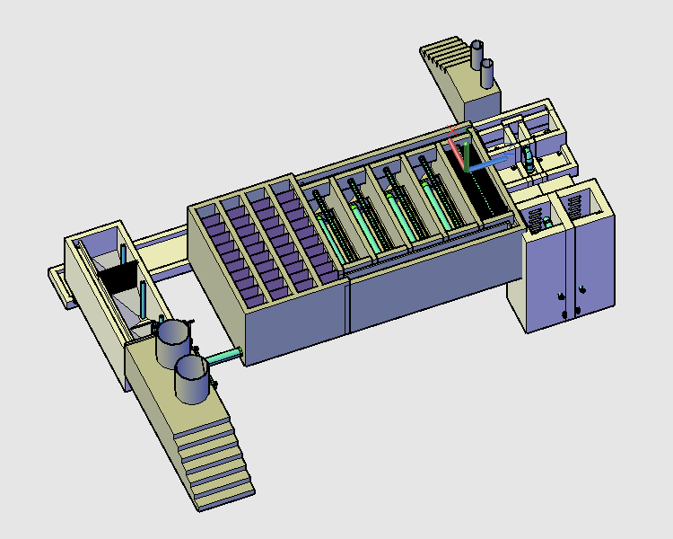
Stacked Rapid Sand Filters
Flocculator
Sedimentation
Tanks
Entrance Tank

Slide 3
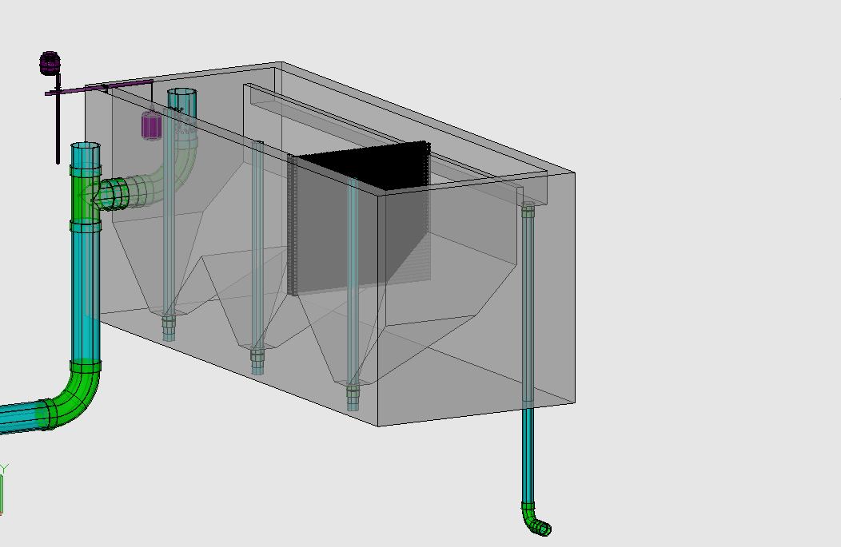
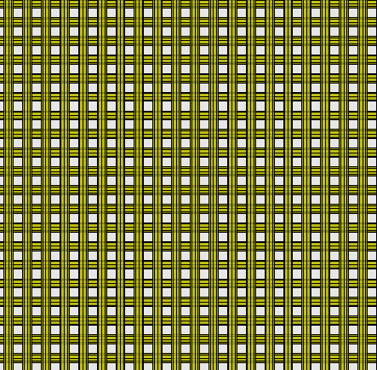
Chemical Dose Controller
Entrance Tank
Overflow Weir
LFOM
Trash Rack
Hopper
Primary Sludge Drain

Slide 4
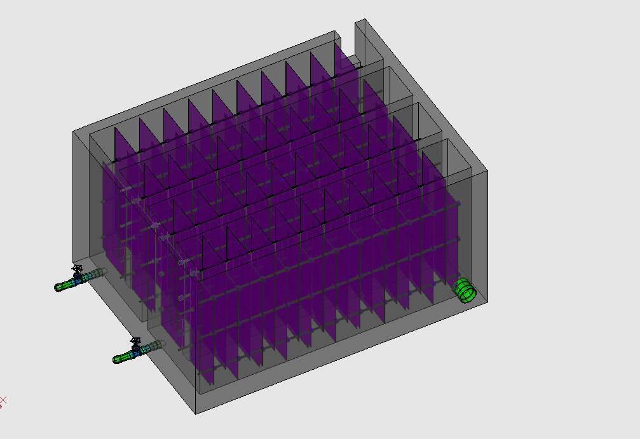
Flocculator
Rapid Mix Pipe

Slide 5
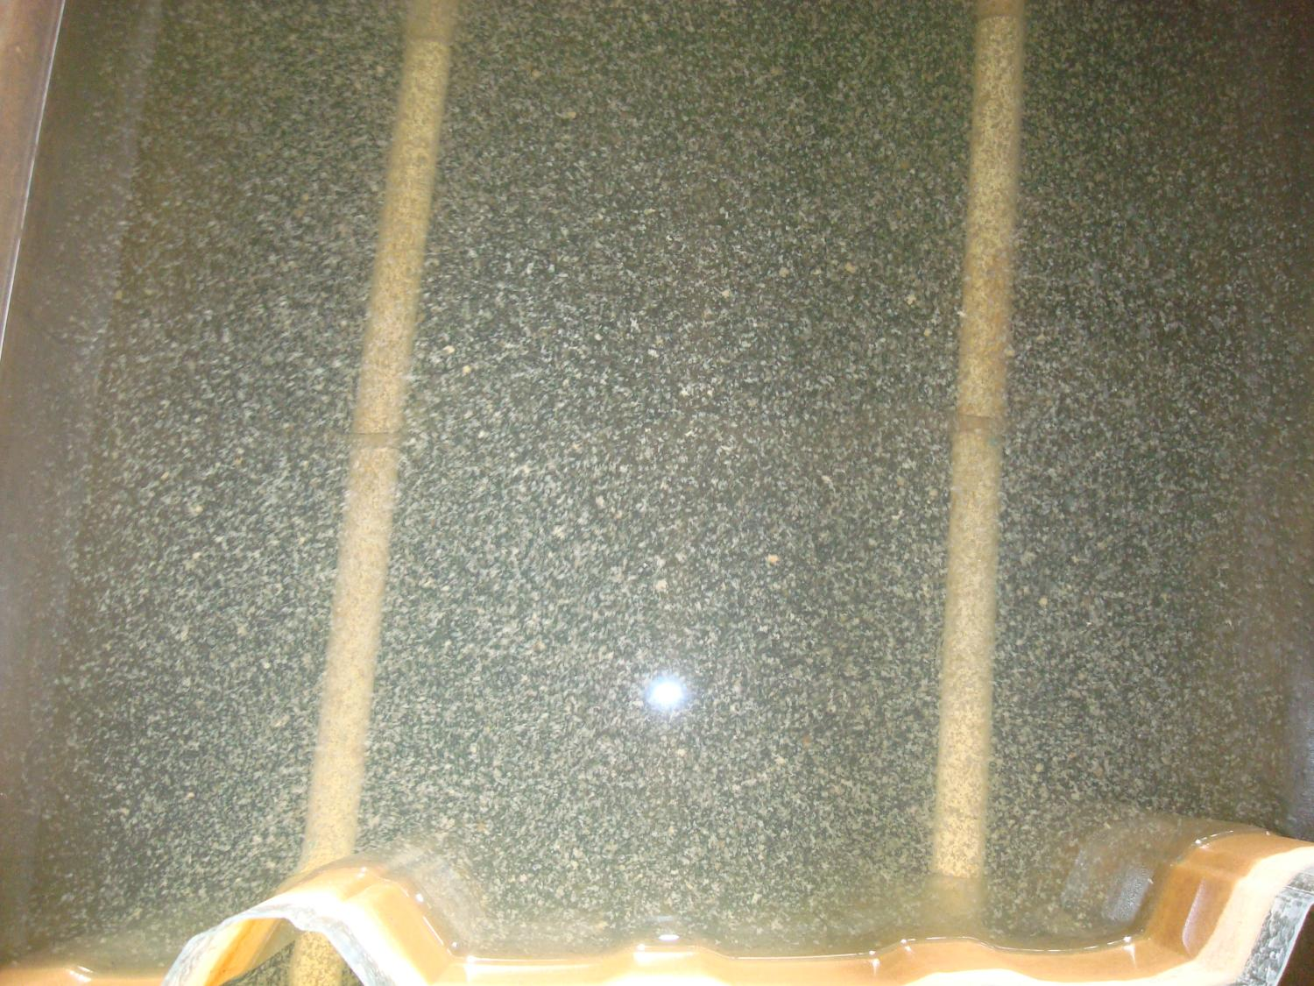

Slide 6
Stacked Rapid Sand Filters
Flocculator
Sedimentation
Tanks
Entrance Tank

Slide 7
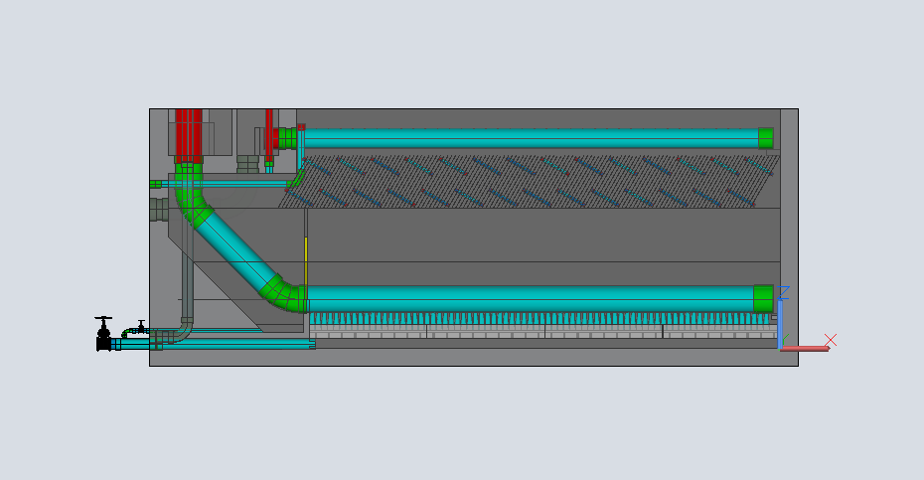
Entrance Channel
Exit Channel
Launder
Plate Settlers
Floc Weir
Inlet Manifold
Diffusers
Sludge Drain
http://www.youtube.com/watch?v=bQgMdkO0qUA

Slide 8
Stacked Rapid Sand Filters
Flocculator
Entrance Tank
Sedimentation
Tanks

Slide 9
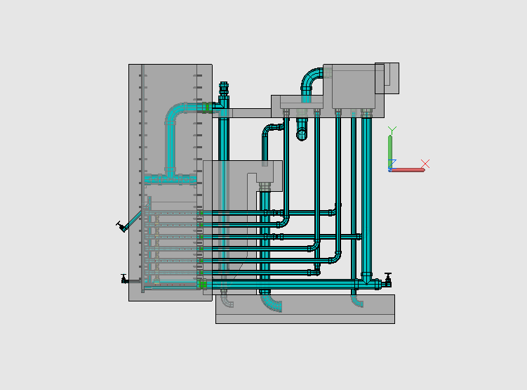
Stacked Rapid Sand Filtration
Filtration Entrance Tank (from Sedimentation Tank)
Exit Tank

